Slide 1
Evaluating the Effects of Surgical Site Infections on Patients with Different Socioeconomic Statuses: A Mixed Method Study
2025 ACHQC Resident & Fellow Research Grant
Nancy Ly MD¹, Megan Melland-Smith MD¹, Courtney Collins MD², Kun Bai MS³, Michael J. Rosen MD¹
¹Northwestern University Feinberg School of Medicine, Chicago, IL
²Ohio State University Wexner Medical Center, Columbus, OH
³Vanderbilt University, Nashville, TN
Notes:
Good morning, my name is Nancy Ly and I’m a resident at Northwestern University. Today, I’ll be presenting our study evaluating the effects of surgical site infections on patients with different socioeconomic statuses.

Slide 2
Disclosures
Dr. Rosen serves as the medical director of the ACHQC and receives salary support, received institutional grants from Medtronic.
Dr. Melland-Smith is supported by a research grant from the American Hernia Society.
The remaining authors have no disclosures to report.
Funding
This work was supported by the Steven J. Stryker, MD, Gastrointestinal Surgery Research and Education Endowment and the ACHQC Resident & Fellow Research Grant.
Notes:
Dr. Rosen and Dr. Melland-Smith have the following disclosures. This work was supported by the Steven J. Stryker Gastrointestinal Surgery Research and Education Endowment and the ACHQC Resident and Fellow Research Grant.

Slide 3
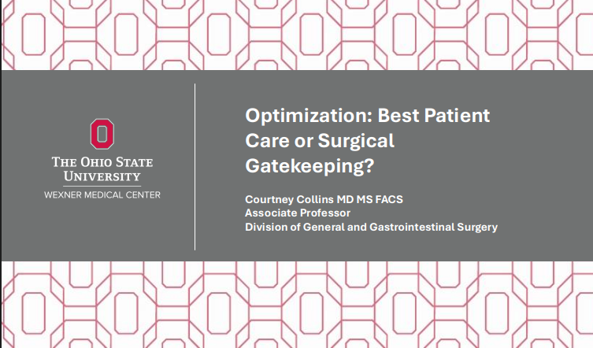
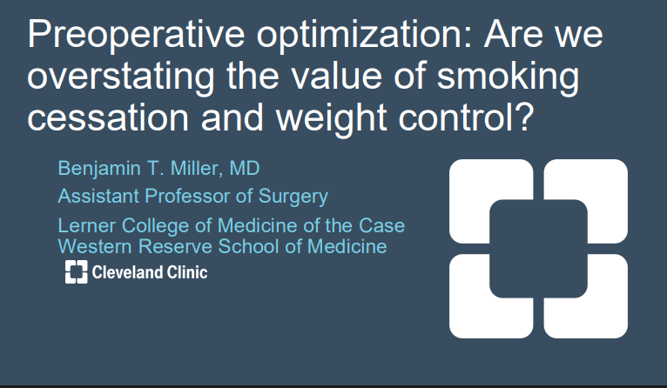
Flashback: ACHQC Summit 2025
Highlights:
Preoperative optimization targets, while well-intentioned, are hard to meet
Access to definitive repair may vary across patient populations
What happens to these patients?
Notes:
At last year’s ACHQC Summit, several presentations highlighted the importance of preoperative optimization — encouraging weight loss, smoking cessation, and better control of comorbidities to reduce complications.
And we know optimization works. It improves outcomes, and it’s become a core part of how many surgeons define readiness for the OR.
But these talks also highlighted something else — that optimization thresholds can be difficult for many patients to meet, and access to definitive repair may vary across patient populations.
This raises an important clinical question.
When patients don’t meet optimization thresholds, surgery is often delayed in good faith — to reduce risk.
But what actually happens to these patients while they wait? What is their clinical trajectory — and what is their lived experience during that time?
To understand this, we wanted to step back and examine how socioeconomic status shapes both surgical outcomes and patient experience.

Slide 4
Background
Preoperative optimization is standard to reduce complications
Many patients struggle to meet optimization thresholds
Barriers to optimization are more common among patients with lower socioeconomic status (SES)
It remains unclear whether current optimization practices may unintentionally contribute to disparities in care and outcomes
Notes:
Preoperative optimization is standard practice in ventral hernia repair and plays an important role in reducing complications.
However, many patients struggle to meet optimization thresholds.
And these barriers are not evenly distributed — patients from lower socioeconomic backgrounds are more likely to face challenges such as smoking cessation, weight loss, and managing comorbidities.
As a result, optimization may unintentionally delay access to definitive repair for some patients.
And importantly, we don’t fully understand the clinical and patient-centered consequences of that delay.

Slide 5
Study Objective
To evaluate how socioeconomic status influences both surgical outcomes and patient experience following ventral hernia repair
Notes:
The objective of this study was to evaluate how socioeconomic status influences both surgical outcomes and patient experience following ventral hernia repair

Slide 6
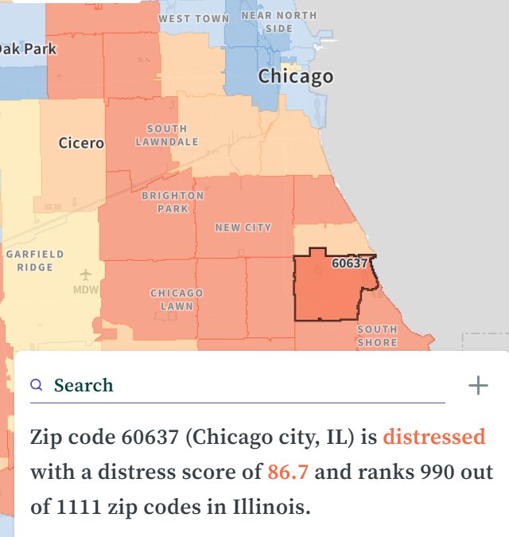
Study Design: Mixed-Methods
Quantitative arm
  Retrospective cohort study using ACHQC (2016–2025)
  Adults undergoing open ventral hernia repair with mesh
  SES measured using Distressed Communities Index (DCI)
  Outcomes including
    Wound morbidity: SSI, SSO, SSOPI
    Healthcare utilization: LOS, readmission, reoperation
    Quality of life: HerQLes, PROMIS 3a
Notes:
We conducted a mixed-methods study consisting of both quantitative and qualitative components.
For the quantitative arm, we performed a retrospective cohort study using the ACHQC registry from 2016 to 2025, including adult patients undergoing open ventral hernia repair with mesh. Socioeconomic status was measured using the Distressed Communities Index.
We evaluated wound morbidity—including SSI, SSO, and SSOPI—as well as healthcare utilization, defined as length of stay, 30-day readmission and 30-day reoperation. And finally, we also looked at patient-reported outcomes to better understand quality of life, using both the HerQLes and Promis 3a survey.
* Distressed Communities Index was established b the Economic Innovation Group in 2015 to investigate the spatial distribution of economic well being. 7 metrics (high school diploma, housing vacancy, unemployment, poverty rate, median income ratio, change in employment, change in establishments), 5 categories

Slide 7

Study Design: Mixed-Methods
Qualitative arm
  Semi-structured patient interviews
  Explored patient experience, barriers to care, and recovery experience
  Purposeful sampling across socioeconomic strata
  Target enrollment: n = 20 or thematic saturation
  Interviews recorded, transcribed, and independently coded
    Transcriptions uploaded onto AI for further thematic analysis then verified
  Ongoing enrollment; findings presented as emerging themes
Notes:
The qualitative arm included semi-structured interviews exploring barriers to care, optimization experiences, and recovery.
We used purposeful sampling across socioeconomic strata, with a target enrollment of 20 patients or until thematic saturation is reached.
Interviews were recorded, transcribed, and coded. The transcripts were then uploaded onto AI for further coding, and then verified.
Enrollment is ongoing, and today I will present emerging themes from our early interviews.

Slide 8
Quantitative Arm: Cohort Selection
ACHQC Cohort
n=61,132
Excluded (n=41,219)
Age < 18y
Outside study period (2016-2025) (n=633)
No primary diagnosis of ventral hernia (n=3666)
Repair without mesh (n=9288)
Non-incisional, parastomal or open Repair (n=20889)
No available case status (n=3)
No available wound status (n=47)
No available zip code (n=1642)
Incomplete 30-day follow-up (n=5045)
No documented presence or absence of SSI (n=6)
Eligible cohort
n=19,913
Excluded middle DCI group
(n=3737)
Final analytic cohort
n=16,176
Low SES
n=6,176
High SES
n=10,000
Notes:
For our quantitative arm, patients were identified from the QC registry and included 61,132 patients undergoing ventral hernia repair.
After applying inclusion/exclusion criteria, including open ventral hernia repair with mesh, available zip code data, and complete 30-day follow-up, 19,913 patients remained eligible.
Patients in the middle DCI groups were excluded to allow comparison of socioeconomic extremes, resulting in a final analytic cohort of 16,176 patients.

Slide 9



Baseline Risk Profile and Operative Complexity by SES
Low SES patients present with higher risk & more complex disease
  Smoking: 11% vs 7% (p<0.001)
  Diabetes: 23% vs 17% (p<0.001)
  BMI >30: 65% vs 56% (p<0.001)
  Contaminated/dirty wounds: 9% vs 5% (p<0.001)
  Hernia width (median) 8 vs 5 cm (p<0.001)
  Worse baseline QOL (p<0.001)
Notes:
Before looking at outcomes, we first examined baseline risk profiles.
What we found was that low SES patients present with a significantly higher optimization burden and more complex operative disease.
They had higher rates of smoking — 11% compared to 7%.
Higher rates of diabetes — 23% versus 17%.
And higher rates of obesity — with 65% having a BMI over 30 compared to 56% in high SES patients.
They also presented with more severe operative context, including nearly double the rate of contaminated or dirty wounds — 9% versus 5% — and significantly larger hernia defects.
But perhaps most importantly, they also reported significantly worse baseline quality of life.
Low SES patients are not just higher risk — they are also suffering more at baseline.
Which means delaying surgery to achieve optimization may disproportionately affect the patients with the greatest need for intervention.

Slide 10
Low SES patients experience higher wound morbidity, driven by risk profile
Unadjusted outcomes:
  30-day SSI: 6% vs 4%
  30-day SSO: 14% vs 10%
Adjusted SSI model
  Low SES vs high SES: OR 1.13 (95% CI 0.97-1.31), p=0.121
  Smoking: OR 1.38 (95% CI 1.07-1.76), p = 0.012
  Diabetes: OR 1.24 (95% 1.04-1.47), p=0.017
  Contaminated vs clean: OR 3.38 (95% CI 2.60-4.41), p <0.001
Notes:
Next, we examined whether these differences in baseline risk translated into differences in wound morbidity.
On unadjusted analysis, low SES patients did experience higher complication rates — with SSI occurring in 6% of low SES patients compared to 4% in high SES patients. Similarly, surgical site occurrences were more common, at 14% versus 10%.
However, when we adjusted for clinical and operative factors, the independent effect of SES itself was no longer statistically significant, with an adjusted odds ratio of 1.13.
Instead, the strongest drivers of SSI were the clinical risk factors we commonly target during optimization.
Smoking increased the odds of SSI by 38%, diabetes by 24%, and contaminated wounds increased the odds more than threefold.
So what this suggests is that SES may not directly cause complications — but rather, SES influences the distribution of these modifiable risk factors and operative severity, which in turn drive wound morbidity

Slide 11
What happens while patients wait and how do they weigh present suffering against future risk?
Notes:
Our quantitative findings show that low SES patients carry a higher burden of risk factors and experience worse disease severity.
But numbers alone can’t capture what it actually feels like to live with a hernia while trying to meet optimization thresholds.
Many of these patients are waiting — often with significant pain, functional limitation, and reduced quality of life — while being asked to modify risk factors that may take months or years to change.
This raised an important question for us:
While patients are waiting, how do they weigh their current suffering against the future risk of complications?
And importantly — how do patients themselves perceive these risks, and how do those perceptions influence their decisions?
To answer this, we proceed to the qualitative arm of this study.

Slide 12
Enrollment ongoing
Target enrollment: n=20
Current enrollment: n=3
  High SES: n=1
  Low SES: n=2
Findings presented as emerging themes
Notes:
At the time of this presentation, enrollment is ongoing. Three interviews have been completed — one high SES and two low SES patients.
While this represents early data, clear patterns have already emerged, which we present here as emerging themes.

Slide 13
High SES Experience: Navigating Optimization and Access
Experienced prolonged delays despite compliance
  “Even though I did the gastric bypass… lost 100 pounds… I still wasn’t qualified…it felt like the surgeon was delaying it”
  “I did everything they asked… but it still felt like I was stuck waiting.”
Actively navigated healthcare system and access specialty care
  “I kept looking until I found someone who would actually help me.”
Ultimately prioritized quality of life improvement despite surgical risk
  “Honestly, I would do it all again…leaving the hospital with my hernia gone, I’d take that any day”
  “Living with the hernia was worse than the surgery.”
Notes:
For the high SES patient, a major theme was prolonged delays despite substantial effort to meet optimization requirements.
One patient described losing over 100 pounds after gastric bypass, yet still being told they weren’t a surgical candidate, saying:
‘Even though I did everything they asked… it still felt like I was stuck waiting.’
Despite these barriers, high SES patients were able to actively navigate the healthcare system. One patient described continuing to seek care until they found a specialized surgeon, stating,
‘I kept looking until I found someone who would actually help me.’
Importantly, even when patients experienced complications, they overwhelmingly felt surgery was worth it. As one patient shared,
‘Honestly, I would do it all again… leaving the hospital with my hernia gone, I’d take that any day.’
This highlights that even among patients with strong access and resources, living with a hernia represented an unacceptable burden — and they were willing to accept surgical risk to regain quality of life.

Slide 14
Low SES Experience: Living with Persistent Burden and Limited Options
Persistent daily pain and profound impairment in quality of life
  “It affects everything. I can’t work like I used to. I can’t live normally with this hernia”
Barriers to surgical care due to surgeon perceived risk
  “They told me the risk was too high… but living like this every day isn’t living.”
Willing to accept substantial complication risk for symptom relief
  “Heck yeah, a 1000x yeah. You can’t win if you don’t roll that dice”
Notes:
“This contrast was even more striking among low SES patients.
Patients described persistent daily pain and profound impairment in their quality of life. One patient shared,
‘It affects everything. I can’t work like I used to. I can’t live normally with this hernia.’
Despite this level of suffering, patients often encountered barriers to surgery due to perceived operative risk. As one patient explained,
‘They told me the risk was too high… but living like this every day isn’t living.’
For many patients, there were no meaningful alternatives. Living with the hernia meant continued pain, functional limitation, and loss of independence.
Importantly, even after experiencing complications, patients remained willing to accept surgical risk in order to regain quality of life.
When asked whether they would still pursue surgery knowing the risks, one patient responded,
‘Heck yeah, a 1000x yeah. You can’t win if you don’t roll that dice.

Slide 15
Emerging Contrast in Patient Experience Across SES Groups
High SES
Able to navigate system + seek specialty care
Persistent advocacy facilitated eventual access
Low SES
Experienced severe symptom burden while awaiting surgery
Willing to accept high complication risk to improve quality of life
Quality of life burden strongly influenced patient willingness to accept surgical risk
Notes:
When we examined these interviews together, an important contrast emerged in how patients across socioeconomic groups experienced and navigated care.
High SES patients were often able to actively navigate the healthcare system. They sought specialty care, advocated for themselves, and were ultimately able to access definitive repair.
In contrast, low SES patients experienced a much heavier symptom burden while awaiting surgery. They faced barriers related to perceived operative risk—many of which were tied to modifiable risk factors like smoking, diabetes, and obesity, which we saw were disproportionately concentrated in this population.
Despite these barriers, low SES patients were not risk-averse. In fact, they were often highly willing to accept substantial surgical risk because their current quality of life was already severely impaired.
And importantly, one theme was consistent across both groups:
Patients were willing to accept surgical risk—not because they didn’t understand the risks—but because their current quality of life was already unacceptable.
This suggests that quality-of-life burden plays a central role in how patients weigh surgical risk, and may not be fully captured in traditional clinical risk assessments

Slide 16
Conclusions
Quantitative Findings
  Low SES patients present with higher burden of modifiable risk factors
  Worse baseline quality of life prior to surgical repair
  Similar adjusted SSI risk despite higher baseline risk profile
Qualitative Findings
  Patients experience profound suffering while awaiting surgery
  Willingness to accept surgical risk driven by quality of life burden
  Optimization requirements may not fully reflect patient priorities
Implication: Optimization thresholds may unintentionally contribute to disparities in surgical access and quality of life
Notes:
In this mixed-methods study, we found that low SES patients present with a significantly higher burden of modifiable risk factors and worse baseline quality of life.
Despite this, adjusted surgical site infection risk was similar between SES groups after accounting for clinical factors.
Our qualitative findings provide important context. Patients described profound suffering while awaiting surgery and expressed a clear willingness to accept surgical risk in order to restore their quality of life.
These findings suggest that while optimization strategies are designed to reduce complications, they may not fully capture the lived burden patients experience while awaiting repair.
This raises an important question for us as surgeons — how do we balance complication risk reduction with equitable access to care and patient-centered outcomes?

Slide 17
Thank You!
Questions?
Notes:
Thank you for listening, we’re happy to take any questions.

