Slide 1

An Interrupted Time Series Analysis of 2023 Hernia CPT Revisions and Differential Effects on Private Practice versus Academic Surgeons
Krishay Sridalla, Nancy Ly, Megan Melland-Smith, Li-Ching Huang, Benjamin K. Poulose, Michael J. Rosen
Notes:
Good afternoon everyone. My name is Krishay Sridalla, and I’m a second year medical student at Northwestern Medicine. I’m excited to present results from an interrupted time series analysis of the 2023 hernia CPT revisions and their differential effects on private practice versus academic surgeons.

Slide 2
Disclosures
No conflicts of interest
Dr. Michael Rosen serves as Principal Investigator on a research grant from Medtronic; grant funding is paid to the institution
Notes:
I have no conflicts of interest. Dr. Rosen serves as principal investigator on a research grant from Medtronic.

Slide 3

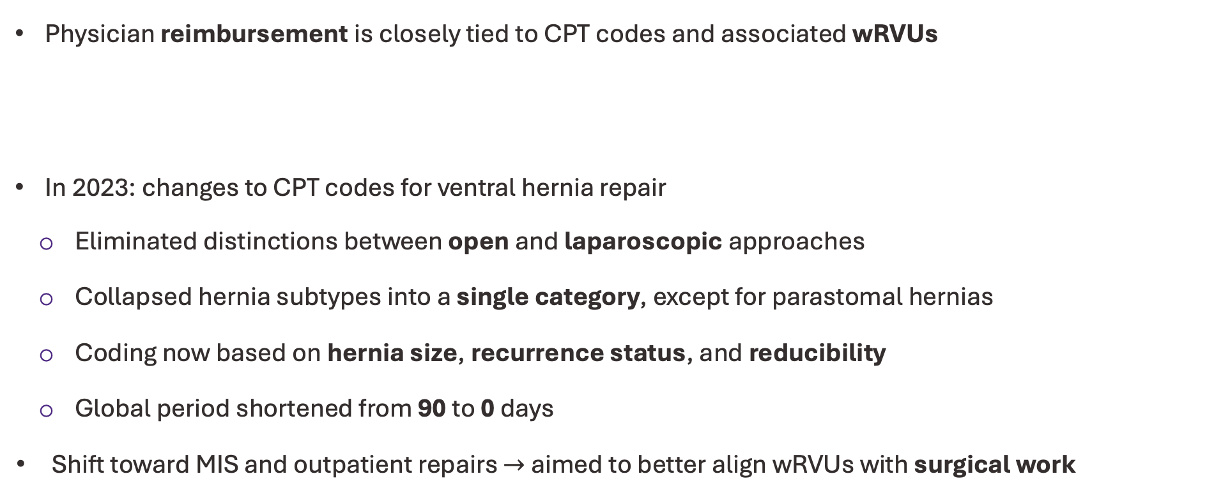
Background
The 2023 Shift in Ventral Hernia Coding and wRVU Alignment
Physician reimbursement is closely tied to CPT codes and associated wRVUs
In 2023: changes to CPT codes for ventral hernia repair
Eliminated distinctions between open and laparoscopic approaches
Collapsed hernia subtypes into a single category, except for parastomal hernias
Coding now based on hernia size, recurrence status, and reducibility
Global period shortened from 90 to 0 days
Shift toward MIS and outpatient repairs $→$ aimed to better align wRVUs with surgical work
Schlosser et al., Ann Surg, 2023
Notes:
As many of you know, physician reimbursement is closely tied to CPT codes, and each CPT code carries a specific number of work relative value units, or wRVUs. 👆
In early 2023, the AMA released new CPT coding changes that had significant implications for ventral hernia repair. These changes were meant to simplify and standardize coding, but they also reshaped how we document and bill these procedures.
There were several major updates: 👆
First, the distinction between open and laparoscopic ventral hernia repairs was eliminated, and surgical approach now no longer factors into coding. 👆
Second, hernia subtypes were collapsed into a single category, with the exception of parastomal hernias, which remain separate. 👆
Third, coding is now determined by more clinically relevant factors, specifically hernia size, whether the hernia is recurrent, and whether it is reducible. 👆
Another big change is that the global period for these procedures was shortened from 90 days to 0 days, fundamentally changing postoperative billing. 👆
Taken together, these changes reflected the broader shift toward minimally invasive and outpatient hernia repairs and aimed to better align wRVUs with contemporary surgical work.

Slide 4

Background
Unintended Consequences?
Reimbursement declined by nearly 60% for incarcerated and reducible hernias at an ambulatory surgery center (Wright et al.)
Large, recurrent, or complex cases may have seen modest increases in wRVUs at an academic center (Al-Mansour et al.)
Academic
$$↑$ or $$↓$
Non-Academic
Wright et al., Am J Surg, 2025
Al-Mansour et al., Surgery, 2024
Notes:
However, these updates may have produced some unintended consequences. 👆
A recent report at an ambulatory surgery center found that reimbursement has declined by nearly 60% for both incarcerated and reducible hernias. 👆
On the other hand, an analysis by Al-Mansour using ACHQC data suggested that larger, recurrent, or more complex hernia repairs may have seen modest increases in wRVUs, though this analysis was limited to cases performed by a single surgeon at an academic center and included a substantial proportion of myofascial releases.
This may mean that the effect of the coding changes on wRVUs may depend on the practice setting. 👆
Academic centers often see higher-complexity cases 👆 while non-academic centers may see less complex ones. 👆 This case mix may play a role in determining whether practice types see an increase or decrease in wRVUs after the coding change.

Slide 5
Aims of This Study
1. Evaluate effects of the coding changes by practice setting
2. Evaluate effects of the coding changes by hernia size
3. Evaluate effects of the coding changes by hernia subtype
Notes:
Given the potential unintended consequences of the coding revisions, our study set out to answer three key questions. 👆
First, we wanted to understand how the coding changes affected wRVUs across different practice settings, namely academic versus non-academic. 👆
Second, we looked at the effect of the coding changes by hernia size. 👆
And third, we evaluated the changes by hernia subtype.

Slide 6
Methods
Retrospective Interrupted Time Series Analysis using the ACHQC
Inclusion criteria
CPT and wRVUs
Concurrent Control
Patients undergoing ventral or inguinal hernia repairs (concurrent control) between 2021-2024
Surgeons contributed ≥15 repairs with 30-day follow-up in pre- and post-code change periods
Hernia CPT codes assigned using clinical variables (e.g. reducibility)
CPT codes assigned for mesh use, myofascial release, inpatient stay, and follow-up
Inguinal hernias not affected by 2023 coding changes
Concurrent control strengthens inferential validity
Notes:
To do this, we performed a retrospective interrupted time series analysis using data from the ACHQC, which gave us a large, contemporary sample spanning both the pre‑ and post‑2023 coding periods. 👆
We included patients undergoing ventral or inguinal hernia repairs between 2021 and 2024.
To ensure reliable estimates, we required that each surgeon had at least 15 repairs with 30‑day follow‑up in both the pre‑ and post‑change periods. 👆
Next, CPT codes were assigned for each case using the relevant clinical variables that determined coding in both the pre‑ and post‑change periods.
We also incorporated additional CPT codes for mesh use, myofascial release, inpatient stay, and follow‑up, as applicable to each period. 👆
Finally, inguinal hernias functioned as the concurrent control group, as they were not affected by the 2023 coding changes. Comparing ventral hernia trends to this stable reference group reduced the impact of broader temporal changes on our model.

Slide 7
Methods
CPT Coding Assumptions
Reducible/Incarcerated
Postoperative Care
ACHQC does not capture hernia reducibility.
Al-Mansour et al.: 26.6% incarceration
DiPaola et al.: 47.5% incarceration
We used a midpoint of 37% incarceration in this study.
Post-2023 procedures billed postoperative care:
Inpatient stays: LOS recorded in ACHQC
Readmissions: LOS based on complexity of diagnosis
Outpatient care: # visits based on hernia size
Notes:
Our analysis required us to make a couple of assumptions: 👆
The ACHQC does not record hernia reducibility, which is important to determine CPT codes. To address this, we used published literature. A study by Al‑Mansour reported an incarceration rate of 26.6%, while a study by DiPaola reported a rate closer to 47.5%. For our analysis, we used a midpoint of 37% incarceration. 👆
We also made assumptions for postoperative care performed after the coding change. For inpatient stays, we used the length of stay recorded in the QC. But since readmission length of stay is not recorded, we assigned it based on the complexity of the readmission diagnosis. And for outpatient care, we estimated the number of visits based on hernia size.

Slide 8
Results
Patient Characteristics
32 (28–36)
BMI
30 (27–34)
5 (2–11)
2 (2–4)
Non-Academic
2,036
Hernias repaired at academic centers are more complex
Academic
4,145
Hernia width (cm)
7 (2–18)
Hernia length (cm)
3 (2–6)
92.2%
Clean wound class
96.9%
29.3%
Recurrent
14.6%
34.1%
Transversus abdominis
5.8%
Notes:
Of over 6,000 total patients, 4,145 were treated at academic centers and 2,036 at non‑academic centers. 👆
Patients treated at academic centers had a slightly higher median BMI compared to those at non‑academic sites. 👆
Median hernia width and hernia length was more than twice as large at academic centers. 👆
Academic centers had a smaller proportion of patients in the clean wound category 👆 and a higher proportion of recurrent hernias. 👆
And importantly, transversus abdominis release, a marker of more complex reconstruction, was performed much more often at academic sites. 👆
Overall, hernias repaired at academic centers were larger, more complex, and more likely to be recurrent.

Slide 9
Aims of This Study
1. Evaluate effects of the coding changes by practice setting
2. Evaluate effects of the coding changes by hernia size
3. Evaluate effects of the coding changes by hernia subtype
Notes:
First, we looked at the effects of the coding changes on practice type.

Slide 10
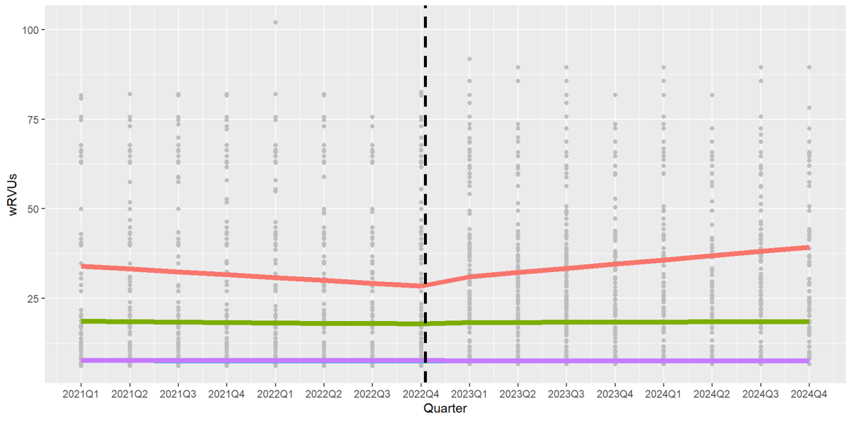
Results
Differential Effects on wRVUs by Practice Type: Academic vs Non-Academic
Pre-2023
Post-2023
Increase in wRVUs at academic centers
Academic - Ventral
Non-Academic - Ventral
Academic - Inguinal
Non-Academic - Inguinal
Notes:
Here we see how wRVUs changed over time for ventral hernia repairs, comparing academic and non‑academic centers before and after the 2023 coding changes.
On the x‑axis is the study period broken down by quarter, with the vertical line marking the implementation of the new CPT codes.
Before the coding change, 👆 wRVUs at academic centers 👆 were slightly declining. 👆 But after the 2023 change, we see a clear upward shift in wRVUs. This suggests that the new coding system better captures the complexity of the cases treated in academic settings. 👆
In contrast, non‑academic centers 👆 experienced no meaningful change in wRVUs after the coding change. This suggests that even though non‑academic centers tend to treat less complex hernias, they were not adversely affected by the coding change. 👆
The inguinal hernia lines at the bottom serve as our concurrent control and, as expected, they remain stable throughout the entire study period. 👆
So overall, the 2023 coding changes may have increased wRVUs at academic centers with no adverse effects for non-academic centers.

Slide 11
Aims of This Study
1. Evaluate effects of the coding changes by practice setting
2. Evaluate effects of the coding changes by hernia size
3. Evaluate effects of the coding changes by hernia subtype
Notes:
Now, I’ll move on to assessing the effects of the coding changes by hernia size, which was defined as the larger of two measured dimensions: width and length.

Slide 12
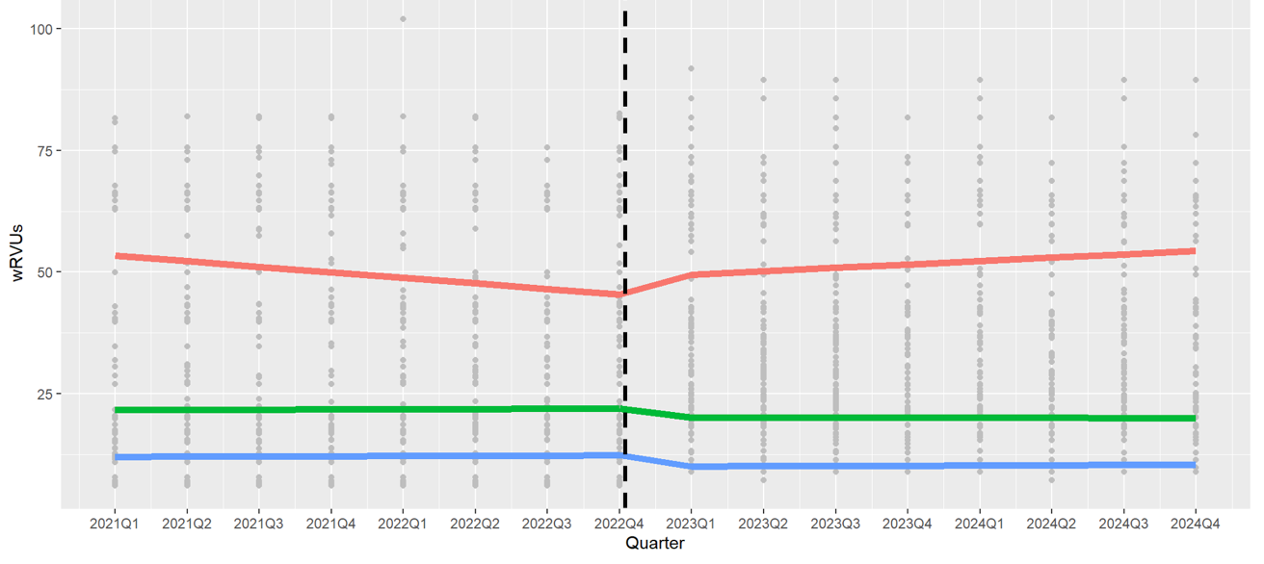
Results
Differential Effects on wRVUs by Hernia Size
Pre-2023
Post-2023
Increase in wRVUs for large hernias
Large (>10 cm)
Medium (3-10 cm)
Small (<3 cm)
Notes:
Prior to 2023, 👆 wRVUs for large hernias, defined as >10 cm, 👆 were slowly declining. 👆 But after the coding change, we see a noticeable upward shift in wRVUs. This aligns with what we would expect, since the new coding structure is designed to better capture the work involved in larger repairs. 👆
In contrast, both medium and small hernias show minimal change in wRVUs. 👆
Overall, this suggests that the coding changes primarily benefited large ventral hernias, while small and medium hernias were essentially unaffected.

Slide 13
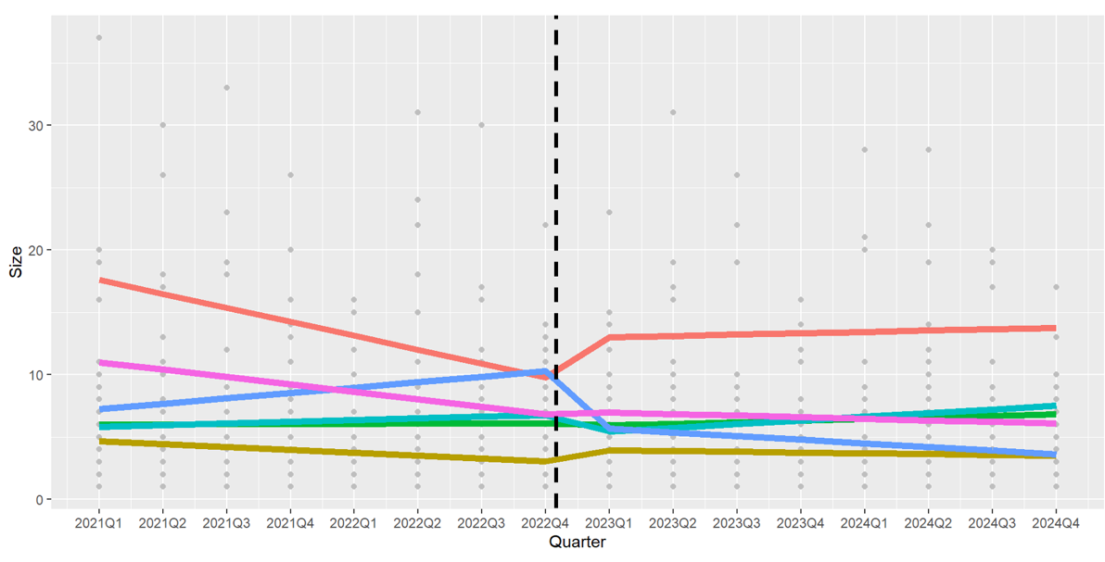
Results
Small
Medium
Medium
Large
Differential Effects on Hernia Sizes Reported
Pre-2023
Post-2023
Potential upstaging of hernias at academic centers
Number of hernias
Large, Academic
Small, Non-Academic
Small, Academic
Medium, Academic
Medium, Non-Academic
Large, Non-Academic
Notes:
Here, we’re examining how reported hernia sizes changed before and after the coding revisions, stratified by practice type and hernia size category. The y‑axis shows the median number of hernias within each category. 👆
Before the coding change, academic centers reported a declining number of large hernias, 👆 a stable number of medium hernias, 👆 and an increasing number of small hernias. But after the transition, we see some notable shifts: 👆
Large hernias at academic centers show a clear increase in number. 👆 Medium hernias remain stable. 👆 And small hernias show a decrease in number.
This divergence raises the possibility of upstaging, where hernias that may previously have been classified as small are now being categorized in a higher size category. Interestingly, this shift seems to bypass medium-sized hernias, which may reflect reclassification of 👆 small hernias as medium 👆 and medium hernias as large. This potential upstaging may reflect either more precise measurement or intentional rounding to achieve higher wRVUs, given that coding is now driven by hernia size.
In contrast, the trends for non‑academic centers are different, 👆 with small hernias being more frequently coded, 👆 but medium and large hernias remaining stable, suggesting that non-academic centers were minimally affected by the coding change.👆
So overall, academic centers appear to have shifted toward reporting larger hernias after 2023, whereas non‑academic centers did not exhibit this pattern, potentially explaining why the increase in wRVUs was restricted to academic centers.

Slide 14
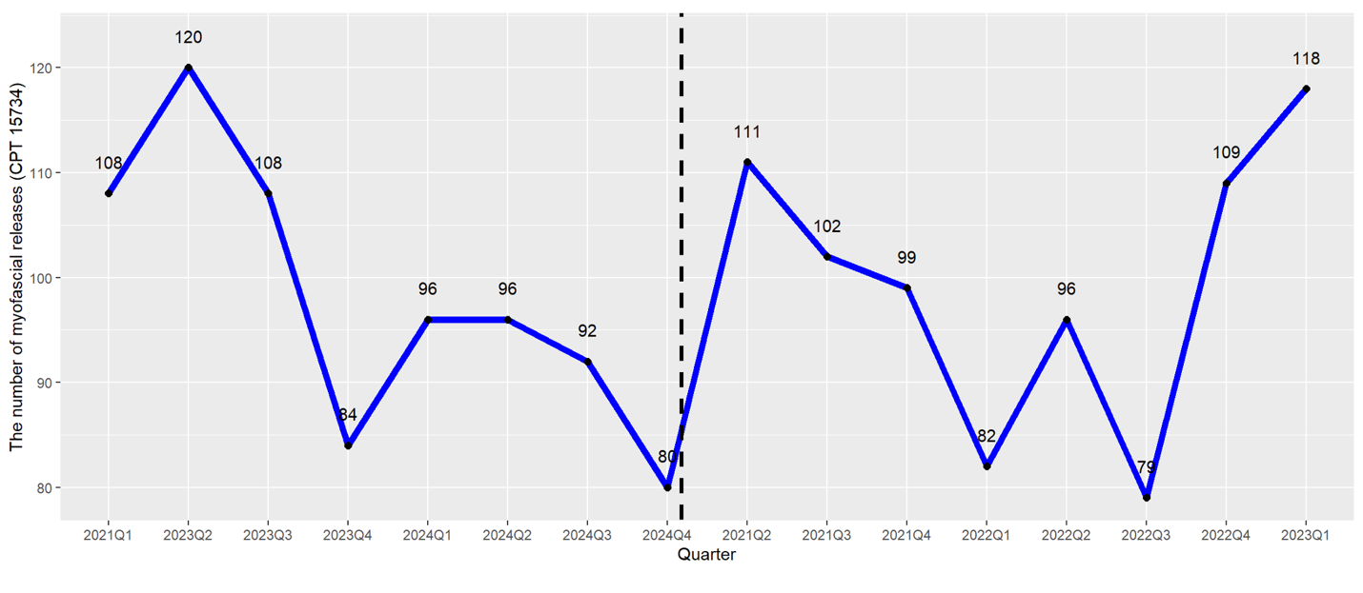
Results
Effect of CPT Changes on Myofascial Releases
Pre-2023
Post-2023
Myofascial releases stable over time
Notes:
Here, we examined the number of myofascial releases performed before and after the coding changes.
Despite some quarter‑to‑quarter variability, the overall frequency of myofascial releases remained quite stable over time, fluctuating between 79 and 120 cases per quarter.👆
This suggests that the wRVU changes we observed earlier are unlikely to be driven by changes in performing myofascial release.

Slide 15
Aims of This Study
1. Evaluate effects of the coding changes by practice setting
2. Evaluate effects of the coding changes by hernia size
3. Evaluate effects of the coding changes by hernia subtype
Notes:
Finally, we evaluated the effects of the coding changes by hernia subtype.

Slide 16
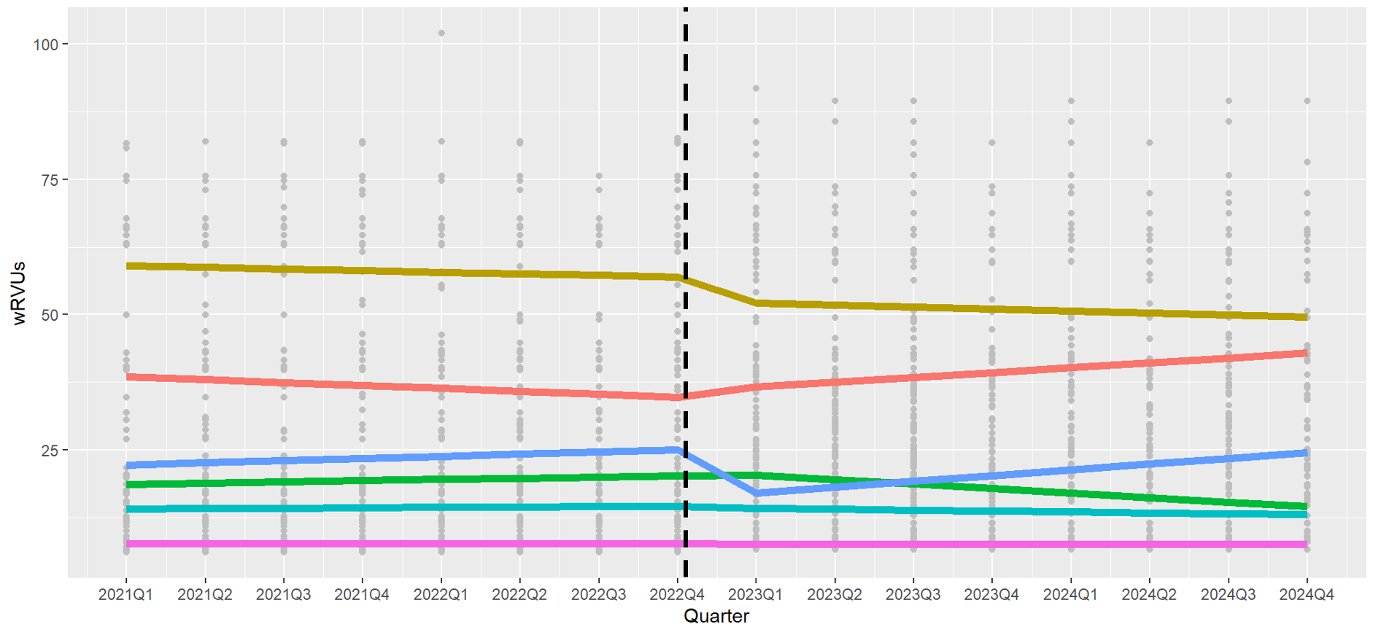
Results
Differential Effects on wRVUs by Hernia Subtype
Pre-2023
Post-2023
Parastomal
Differential effects by subtype
Incisional
Spigelian
Epigastric
Umbilical
Inguinal
Notes:
Incisional hernias 👆demonstrated an increase in wRVUs after the coding change. 👆
Meanwhile, epigastric and umbilical hernias demonstrated a decrease in wRVUs. 👆
Spigelian hernias demonstrated an increase in wRVUs both before and after the coding change, suggesting no net effect. 👆
Parastomal and inguinal hernias showed no change in wRVUs. 👆
Overall, this suggests that the impact of the coding changes varies substantially by hernia subtype.

Slide 17
Conclusions
Academic Centers Benefit, Non-Academic Practices Largely Unaffected
Academic centers see benefits
Non-academic centers unaffected
Treat larger, more complex hernias
Increase in wRVUs
Potential upstaging: large (>10 cm) hernias coded more frequently
No meaningful change in wRVUs
Small (< 3 cm) hernias coded more frequently
Overall, large, complex hernias experienced increased wRVUs and were appropriately awarded at academic centers, while non-academic centers were not adversely affected.
Notes:
In summary, our findings suggest that the 2023 CPT coding changes had different effects on academic and non‑academic practices. 👆
Overall, academic centers seem to benefit from the new coding structure. 👆 They’re treating larger, more complex hernias than non-academic centers, and under the new system, academic centers see higher wRVUs.
However, we also observed potential upstaging, with large hernias being coded more frequently after 2023 and small hernias coded less frequently, which may reflect either improved classification accuracy or intentional rounding to achieve higher wRVUs, given that coding is now driven by hernia size. 👆
In contrast, non‑academic centers were largely unaffected by the coding changes. 👆 Their wRVUs showed no meaningful change, although we saw an increase in the proportion of small (<3 cm) hernias coded. 👆
Overall, the coding revisions appear to have accomplished one of their core goals:
Large, complex ventral hernias now receive increased wRVUs, and those higher values are being appropriately allocated to the centers that perform the most complex repairs, while non-academic centers are not adversely affected

Slide 18
Conclusions
Limitations and Future Directions
Limitations
ACHQC may not reflect general population
CPT codes based on clinical variables
Future directions
Continued monitoring of impact on wRVUs
Effects on patient outcomes
Notes:
Our study has a few limitations. First, our data come from the ACHQC, and this dataset may not fully represent the broader national population. Also, CPT codes were assigned based on documented clinical variables which may not perfectly reflect the codes used in real‑world billing. 👆
In the future, we plan to continue monitoring the impact of the coding changes on wRVUs to determine whether these trends persist or shift over time. We also plan to assess the impact of the coding changes on patient outcomes.

Slide 19
Acknowledgements
Michael Rosen
Krishay Sridalla
Nancy Ly
Megan Melland-Smith
Li-Ching Huang
Benjamin Poulose
Questions?
krishay.sridalla@northwestern.edu
michael.rosen@nm.org
Notes:
I’d like to acknowledge my principal investigator Dr. Rosen as well as our collaborators.

Slide 20
Thank You!
Questions?
Questions?
Notes:
Thank you for listening.
I’d be happy to take any questions.

