Slide 1


Beyond Patient Factors: Neighborhood Vulnerability and Wound Outcomes After Ventral Hernia Repair
Ali Alipouriani, William C. Bennett, Abby R. Gross, Kimberly P. Woo, Jenny H. Chang, David M. Krpata, Ajita S. Prabhu, Lucas R A. Beffa, Clayton C. Petro, Luciano Tastaldi, Sofya Asfaw, Benjamin T. Miller
Department of General Surgery, Digestive Diseases Institute, Cleveland Clinic Foundation

Slide 2
Disclosure
None

Slide 3
A Familiar Scenario
Same patient = Same operation ≠ Different recovery
Patient A
Patient B
58-year-old man
59-year-old man
BMI 31, diabetes (A1c 7.2)
BMI 32, diabetes (A1c 7.1)
Elective open VHR, sublay mesh
Elective open VHR, sublay mesh
Clean wound
Clean wound
Lives in a high-resource neighborhood
Lives in a low-resource neighborhood
Notes:
Lets start with two patients undergoing the exact same ventral hernia repair.
Similar demographics and clinical risk profiles
Same surgeon. Same hospital.
But their recovery looks very different.
One heals without issue.
The other develops a wound complication.

Slide 4
A Familiar Scenario
Same patient = Same operation ≠ Different recovery
Patient A
Patient B
Does Where a Patient Lives Matter ?
Could neighborhood-level disadvantage
influence postoperative outcomes ?
58-year-old man
59-year-old man
BMI 31, diabetes (A1c 7.2)
BMI 32, diabetes (A1c 7.1)
Elective open VHR, sublay mesh
Elective open VHR, sublay mesh
Clean wound
Clean wound
Lives in a high-resource neighborhood
Lives in a low-resource neighborhood
Notes:
So what explains that difference? Is it something biological we missed? Is there any difference in surgical technique?
But what if something outside the operating room matters? Maybe where a patient lives plays a role in how they recover?
“And if it does… how do we measure that?”

Slide 5
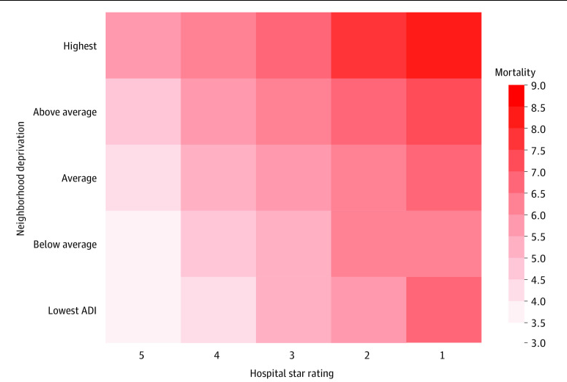
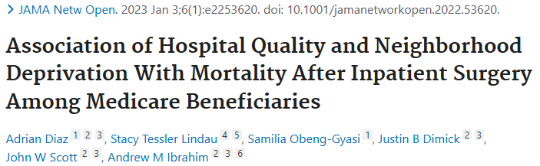
Growing Evidence: Where You Live Affects Surgical Outcomes
Highest mortality: most deprived neighborhoods + lower-quality hospitals
Neighborhood disadvantage linked to higher mortality
Most prior studies used only single measures (income, SVI)
No large hernia-specific study using a multidomain index… until now
Notes:
A recent large study examined outcomes in over a million Medicare patients undergoing inpatient surgery.
You can see on this grid: the darker red boxes mean higher mortality. When patients live in the most deprived neighborhoods and receive care at lower-quality hospitals — that top-right corner — outcomes are the worst.
So neighborhood context clearly matters… but almost every study so far has used just one or two simple measures.
That’s why we decided to use something much more comprehensive in our own ventral hernia patients.

Slide 6



Does Place Matter in Hernia Repair?
Traditional risks (patient factors + operative details)
Hypothesis: Higher neighborhood vulnerability (measured by EJI) → higher wound morbidity after ventral hernia repair
Patient risk
Outcome
Procedure risk
Place-based risk
Notes:
We already know patient factors like BMI, diabetes, smoking, and operative things like approach or defect size explain a lot of wound complications after hernia repair. But they don’t explain everything —there’s still variability we can’t account for in the OR or the patient chart.
That’s where place comes in.
SO we hypothesized, living in a neighborhood with higher vulnerability — measured by the Environmental Justice Index — is independently associated with higher wound morbidity.
So the key question becomes: how do we actually measure ‘place’ in a comprehensive way?”

Slide 7





Environmental Justice Index (EJI): a composite “place-based risk” metric
Created by CDC/ATSDR (2022 base, 2024 update with climate added)
Overall score: 0–1 (higher = greater combined environmental + social + health burden/vulnerability)
Social vulnerability: Socioeconomic status, race/ethnicity, household challenges, housing type
Environmental burden: air toxics, hazardous waste, high-volume roads, lack of parks
Health vulnerability: high prevalence of asthma, diabetes, cancer, poor mental health
Climate burden: extreme heat days wildfire smoke/proximity flooding, drought frequency
Notes:
“To measure place in a robust, national way, we used the Environmental Justice Index — or EJI — created by the CDC and ATSDR.
It ranks every census tract in the U.S. based on over 36 factors that capture cumulative environmental and social burdens affecting health.
The final score runs from 0 to 1 — higher means greater overall vulnerability and burden. It breaks down into four main modules:
First, Social Vulnerability — this captures socioeconomic challenges, racial/ethnic minority status, household factors like disability or age extremes, and housing issues.
Second, Environmental Burden — direct exposures like air pollution, toxic sites, hazardous waste, poor built environment, and transportation infrastructure.
Third, Health Vulnerability — flags for high community prevalence of chronic conditions like asthma, diabetes, cancer, or poor mental health.
And fourth — added in the 2024 update — Climate Burden — risks from extreme heat, wildfires, flooding, , and other climate events.
let’s see what this looks like in our own backyard:

Slide 8

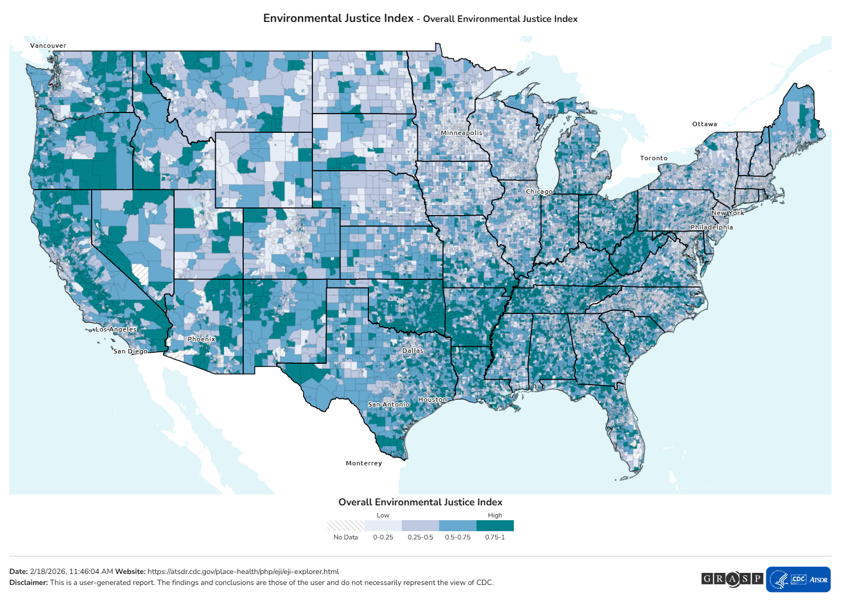
Higher EJI
greater cumulative neighborhood disadvantage
Notes:
Here's the Environmental Justice Index — or EJI —, starting from the whole country
lighter colors mean lower EJI (fewer cumulative burdens), darker greens mean higher EJI (greater combined environmental, social, health, and climate challenges).

Slide 9
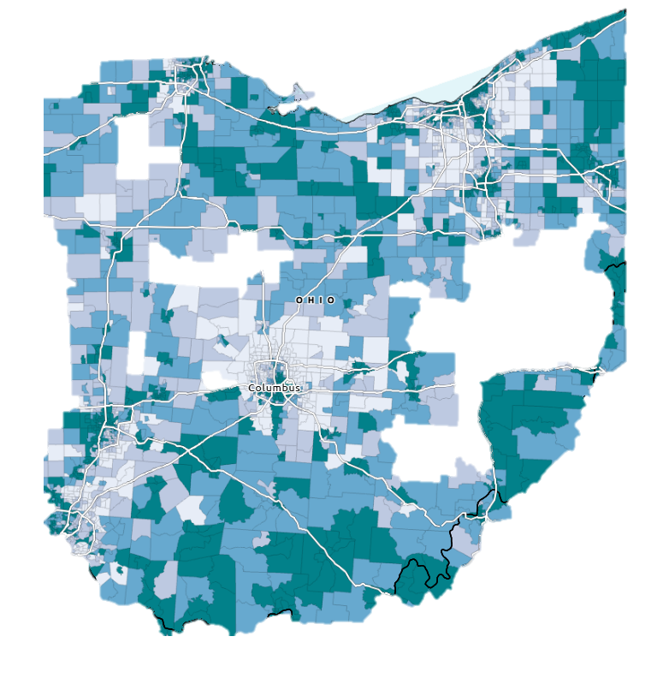
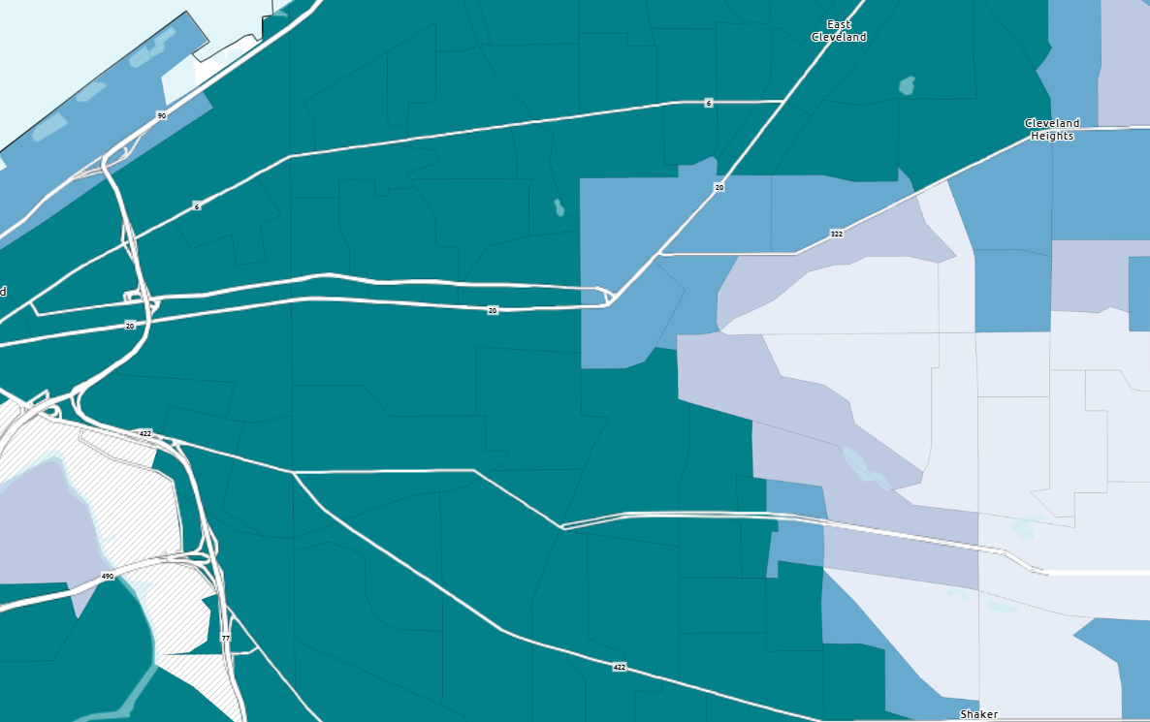


Notes:
Now zoom to Ohio — you can already see variation across the state.
And then we zoom even tighter to the Cleveland metro area, This shows the incredible differences that exist even within our city and suburbs — neighborhoods just miles apart can have very different EJI levels.

Slide 10

Our Study: Quick Overview
• Retrospective ACHQC cohort (N=35,626)
• Ventral hernia repair
• 30-day wound outcomes
Included: VHR ≤18 cm, clean cases, valid ZIP code
Excluded: Parastomal hernia, anterior component separation
Primary outcomes:
SSI
SSO
SSOPI
Notes:
“We conducted a retrospective cohort study using the ACHQC registry. We included adult patients undergoing ventral hernia repair and To maintain comparability, we focused on clean cases with defect size ≤18 cm and excluded parastomal hernia and anterior component separation cases.
Our primary outcomes were 30-day surgical site infection, surgical site occurrence, and SSOPI.

Slide 11
EJI linkage (ZIP → census tract)
ACHQC patient ZIP
HUD ZIP – tract crosswalk
Weighted ZIP-level EJI (primary weighting = TOT_RATIO)
ZIP codes can overlap multiple tracts weighted mean approach
Notes:
In the next level, we wanted to link the EJI data with the ACHQC cases together, and this has been never done before. Since ACHQC contains ZIP code rather than direct census-tract geocoding, we linked patient ZIP codes to tract-level EJI using the U.S. Department of Housing and Urban Development (HUD) ZIP–tract crosswalk. Since a single ZIP can overlap multiple census tracts, we calculated a weighted mean EJI for each ZIP. Our primary weighting used the total address ratio

Slide 12
Outcomes and analysis plan
Analysis:
Multivariable logistic regression: EJI as continuous exposure; adjust for:
  EJI - weighted mean, tot_ratio
  Patient (age, gender, race, BMI, DM, Smoking, immunosuppressants, ASA, COPD)
  Hernia (mesh used, width)
  Operative factors (open / lap / robotic, Myofascial Release)
Domain models run separately (avoid multicollinearity)
Notes:
We modeled EJI as a continuous exposure and used multivariable logistic regression adjusting for standard demographic, clinical, hernia, and operative risk factors. To understand what component of EJI mattered most, we also ran domain-level models—each in a separate model to avoid multicollinearity between domains.

Slide 13
Demographics
Characteristic | N = 35,626
Median Age | 57 (46 - 66)
Gender, male | 19,140 (54%)
Race, white | 29,347 (82%)
Functional Status, independent | 34,603 (97%)
Smoking (current within one month) | 3,374 (9.5%)
Median BMI | 31 (27 - 36)
ASA, class 1-3 | 35,016 (98%)
COPD | 1,779 (5.0%)
Diabetes Mellitus | 5,644 (16%)
Hypertension | 16,054 (45%)
Anti-coagulation medications | 1,968 (5.5%)
Anti-platelet medications | 3,885 (11%)
Immunosuppressants | 1,417 (4.0%)
Notes:
After the adjustments, the cohort included over 35 thousand patients undergoing ventral hernia repair captured in the ACHQC registry. The median age was 57 years old, with a balanced sex distribution. The median BMI was 31 and 16% had diabetes and the vast majority of patients were ASA class I through III.”“

Slide 14
Operative details
Operative details | N = 35,626
Hernia length | 4 (2-11)
Hernia width | 3 (2-6.5)
Stoma present | 91 (0.3%)
Mesh Used | 29,938 (84%)
Ventral Mesh One Location
Inlay | 575 (1.9%)
Onlay | 1,417 (4.7%)
Sublay | 24,936 (93%)
Mesh length (IQR) | 15 (9 - 27)
Mesh Width (IQR) | 13 (8 - 20)
Fascial Closure | 32,966 (93%)
Operative details | N = 35,626
Operative approach
Open | 20,842 (58.9%)
Robotic | 10,497 (29%)
Laparoscopic | 4,286 (13%)
Wound status
Clean | 35,626 (100%)
Elective Case | 34,977 (98%)
Concomitant procedure performed | 3,615 (10%)
Intra-op complications | 335 (0.9%)
History of component separation | 660 (1.9%)
Prior mesh present | 4,980 (14%)
Recurrent | 7,641 (21%)
Notes:
From an operative standpoint, nearly all cases were elective, most repairs were open, mesh was used in over 80% of cases—predominantly in a sublay position—and the median defect width was 3 cm. Overall, this represents a typical ventral hernia population.

Slide 15
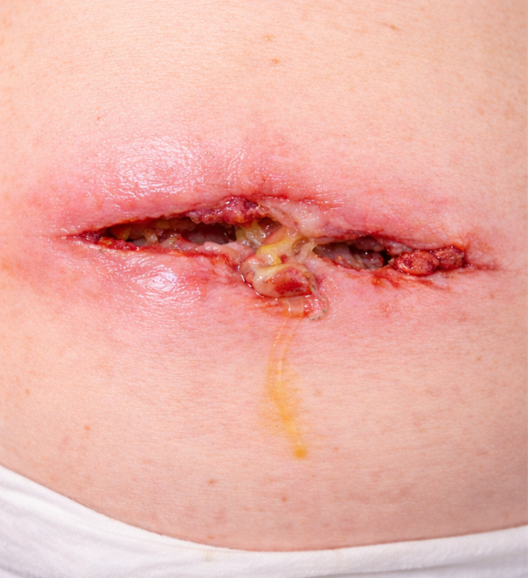
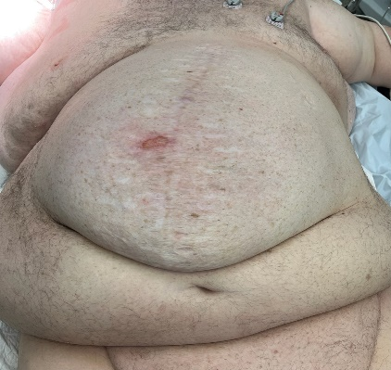
Thirty-day postoperative outcomes
Primary outcomes
SSO: 2,870 (8.1%)
SSI: 660 (1.9%)
SSOPI: 634 (1.8%)
Secondary outcomes
Reoperation: 1.1%
Recurrence: 0.2%
Median LOS: 0 (0-2) days
HerQLes*: 68 (42-88)
PROMIS T-score^: 44 (40-49)
*Hernia-specific quality-of-life instrument scored on a 0–100 scale, with higher scores indicating better abdominal wall–related quality of life.
^National Institutes of Health–developed system of standardized patient-reported outcome measures that assesses physical, mental, and social health domains using T-scores.
Notes:
“At thirty days, surgical site occurrences occurred in 8.1 percent of patients, SSI and SSOPI in 1.9 and1.8 percent respectively”
“Reoperation was uncommon at 1.1 percent, early recurrence was rare at 0.2 percent, with a median length of stay of zero days.”

Slide 16
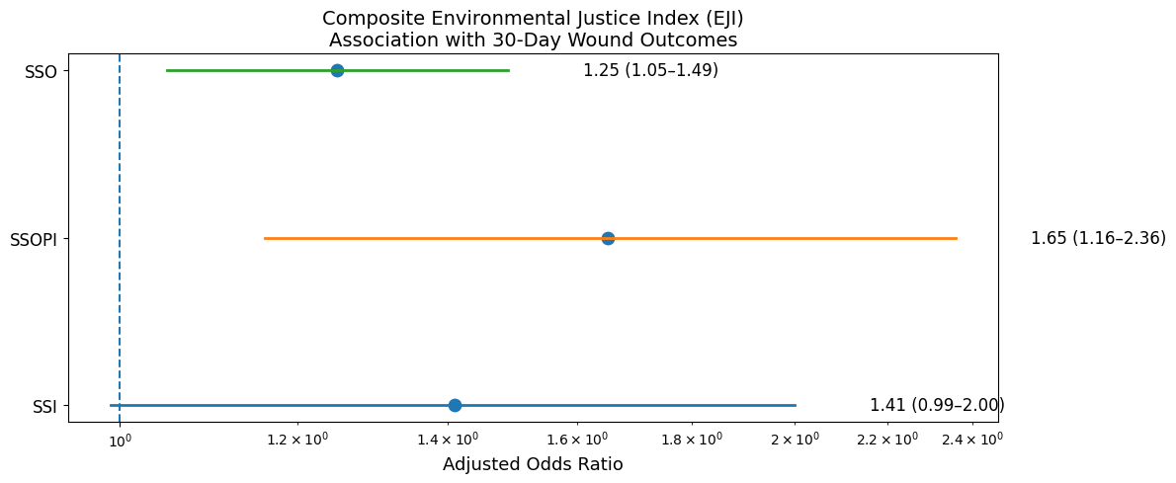
Higher Neighborhood Vulnerability Predicts Worse Wound Outcomes
Surgical Site Occurrences (SSO)
  OR = 1.25 (95% CI 1.05–1.49)
Surgical Site Occurrences Requiring Procedural Intervention (SSOPI)
  OR = 1.65 (95% CI 1.16–2.36)
Surgical Site Infections (SSI)
  Smaller / more variable signal (OR ≈ 1.41, 95% CI: 0.99–2.00)
Adjusted multivariable logistic regression; N=35,626 ACHQC patients
Notes:
After multivariable adjustment for standard risk factors higher neighborhood-level EJI remained independently associated with increased 30-day wound morbidity.
The strongest signals were for surgical site occurrences about a 25% higher odds,
and especially for Surgical Site Occurrences Requiring Procedural Intervention roughly 65% higher odds

Slide 17
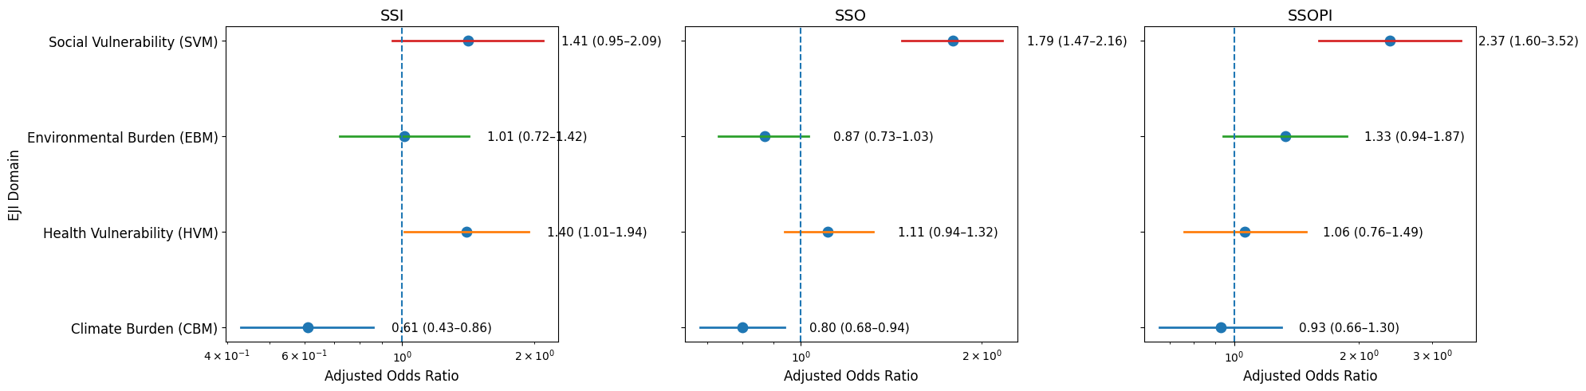
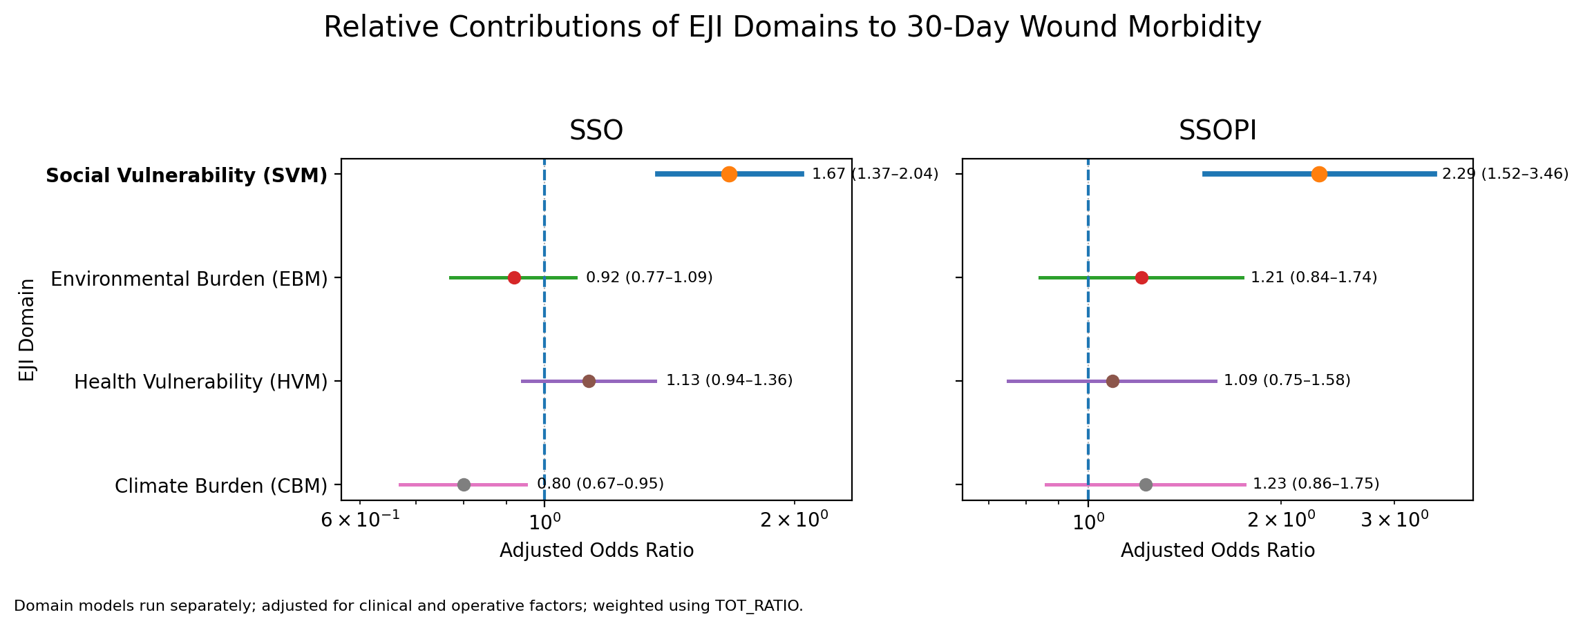
Social Vulnerability Drives Most of the Signal
Social Vulnerability module
  SSO: OR 1.79 (p < 0.001)
  SSOPI: OR 2.37 (p < 0.001)
Environmental / Health / Climate modules: Weaker or inconsistent associations
Notes:
When we broke the EJI down into its four Domains and ran separate models, The Social Vulnerability module showed the strongest and most consistent associations:
about 79% higher odds of SSO
and more than double the odds of SSOPI, both highly significant.
So the dominant driver here is social vulnerability

Slide 18
Why Social Vulnerability Matters After Hernia Repair
Social vulnerability reflects real-life structural barriers — not just individual choices
Harder to attend follow-up visits
Delayed spotting of problems
Wound issues progress before we can intervene
VHR recovery relies heavily on outpatient resources — “place” affects that
Challenges with wound care at home
Notes:
“Why did social vulnerability come through so strongly in our analysis?
And the answer is Because it captures the “real-life structural barriers” that shape what happens after the patient leaves the hospital.
For someone living in a high-EJI neighborhood, everyday challenges add up quickly: They often struggle to make follow-up appointments — maybe because of work schedules or no reliable transportation.
Wound care at home can become surprisingly difficult — limited access to clean supplies, or even basic help from others.
And As a result, small problems tend to be noticed later And once a wound issue begins to progress, it can escalate before we have the chance to step in and manage it.
And its very important is hernia surgery because the recovery depends heavily on consistent outpatient follow-up and good self-care at home — and place of residence plays a direct role in whether those pieces come together.”

Slide 19




Practical Implications
Augment preoperative risk discussions with neighborhood context (e.g., flag high-EJI patients)
Target enhanced postoperative support for patients in high-vulnerability areas
Low-burden interventions to consider :
Early postoperative wound check (in-person or photo)
Proactive follow-up outreach (calls/texts)
Telehealth or photo-based wound review
Clear escalation pathways for early SSO
Notes:
"So the most important question is what can we actually do with this?
First, we can bring neighborhood context into preoperative risk talks — mentioning it alongside BMI or diabetes when counseling high-EJI patients.
And , identify those at higher risk for enhanced postoperative support — and how we follow them.
And some low-burden ideas that could make a difference such as: Early wound checks right after discharge, proactive outreach like calls or texts to check in, telehealth visits or photo uploads for wounds, and very clear instructions on when to escalate if something looks off.
These are practical ways to address the place-based gaps without huge resource lifts."

Slide 20

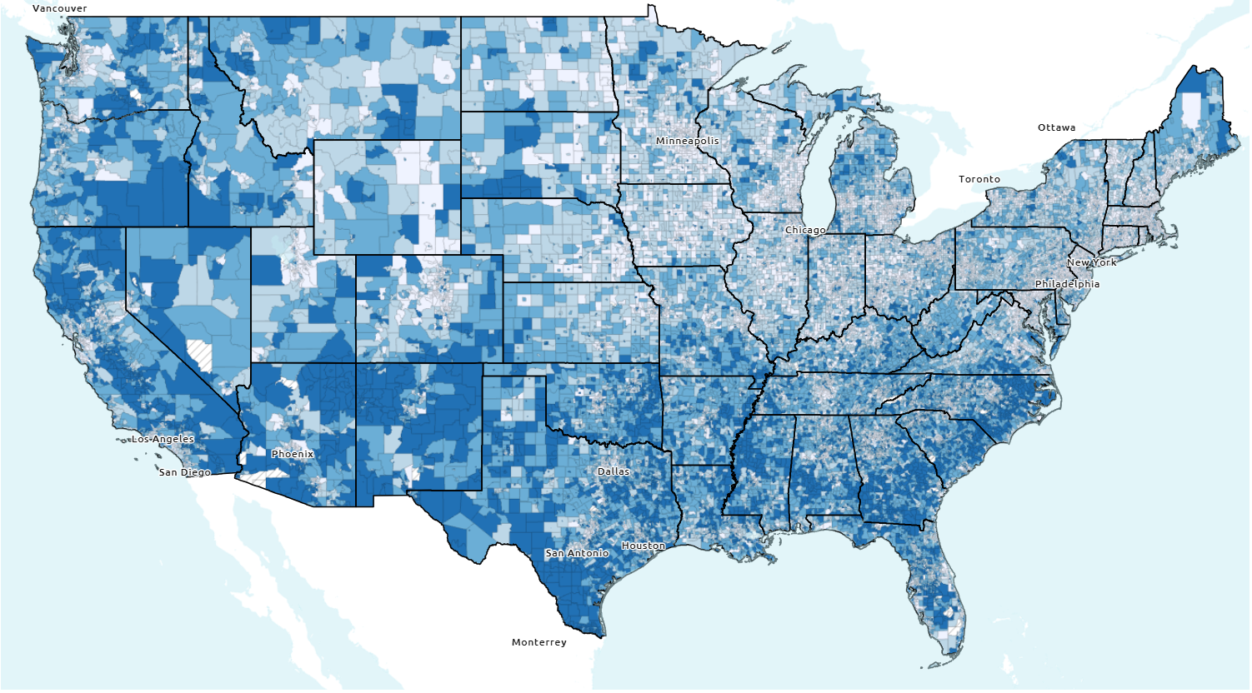

Key Takeaways
Neighborhood-level vulnerability independently predicts wound morbidity after ventral hernia repair, even after adjusting for patient and operative factors.
Social vulnerability is the dominant driver, with the most consistent associations seen for SSO and SSOPI.
Incorporating context may enhance quality improvement efforts by identifying patients who benefit from targeted postoperative support.
Notes:
So in summary
Neighborhood vulnerability, measured by EJI, independently predicts worse wound outcomes after VHR — even after adjusting for all the usual suspects.
And Among four domains, Social vulnerability is the dominant piece driving this, especially for SSO and SSOPI.
and paying attention Bringing “place” into the picture can help us target better postoperative support and work toward more equitable outcomes.

Slide 21

Thank you

Slide 22

QUESTIONS?

Slide 23
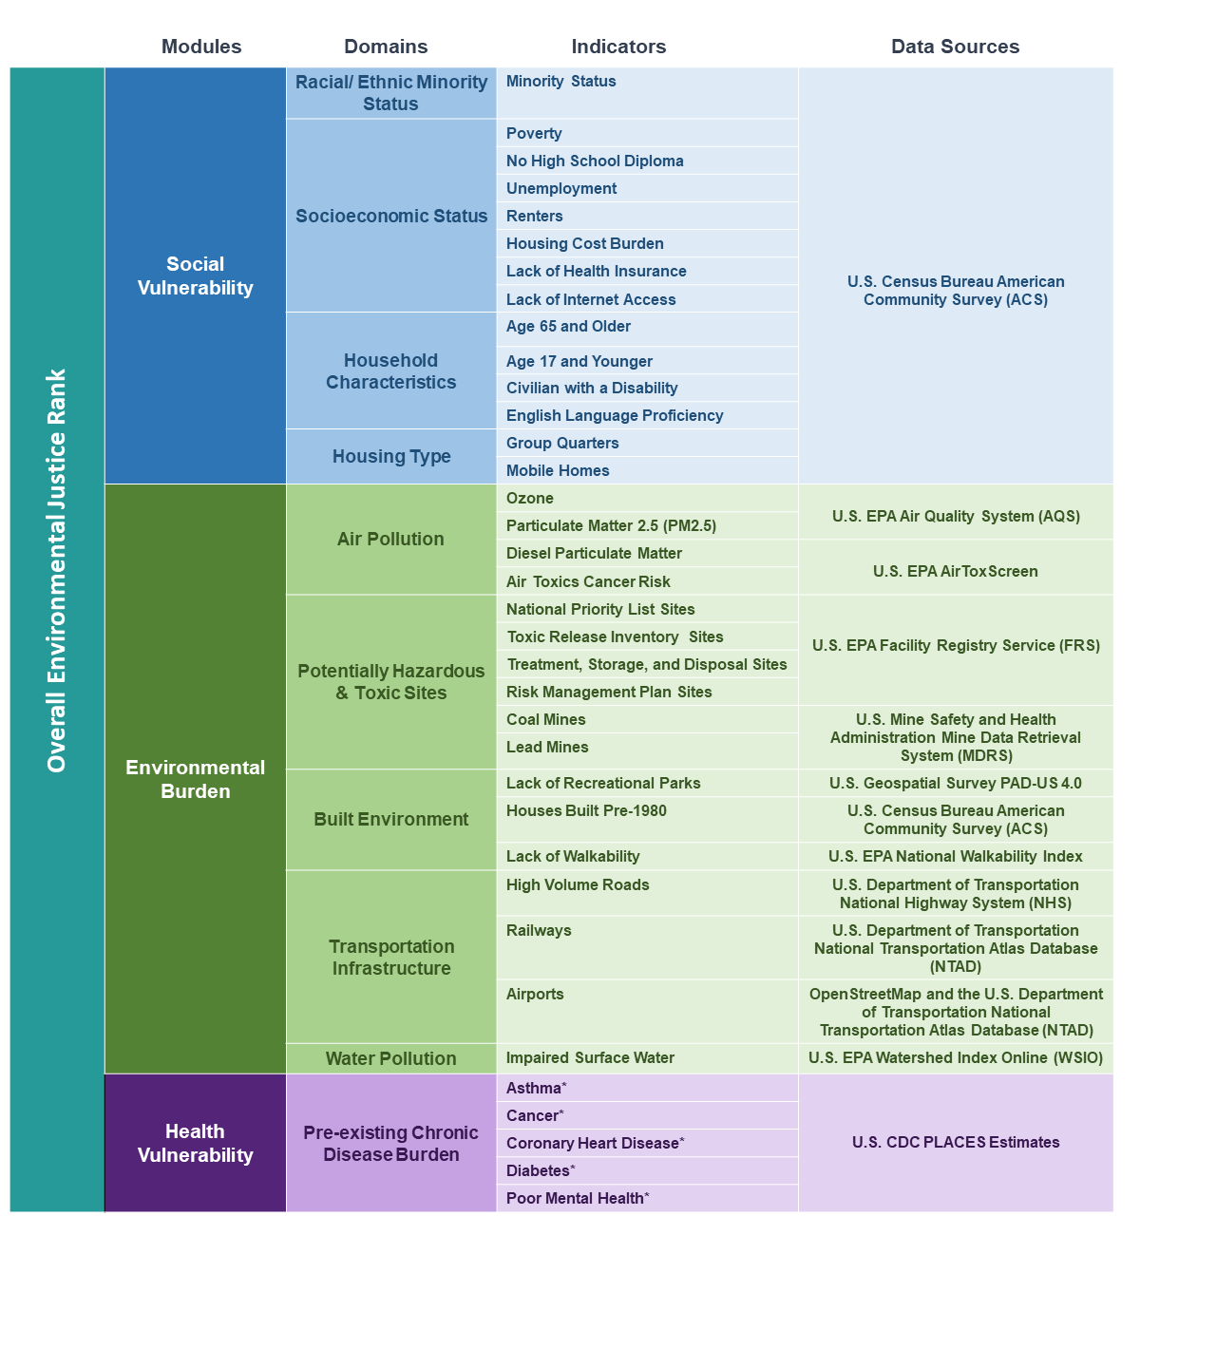
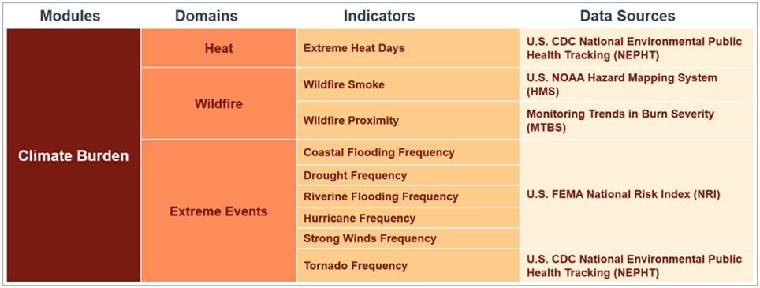
EJI: Detailed Breakdown of the Four Modules

Slide 24
Higher neighborhood-level EJI is independently associated with wound morbidity
logistic regression model: 30-day SSOPI EJI weighted
logistic regression model: 30-day SSO EJI weighted
Characteristic | OR | 95% CI | p-value
EJI - weighted mean, tot_ratio | 1.65 | 1.16, 2.36 | 0.006
BMI Capped 15-60 | 1.04 | 1.03, 1.05 | <0.001
Diabetes Mellitus | 1.34 | 1.10, 1.62 | 0.003
Smoking (current within one month) | 0.88 | 0.68, 1.16 | 0.360
ASA Class, >4 | 1.37 | 0.84, 2.11 | 0.181
Operative approach
Open
Laparoscopic | 0.35 | 0.24, 0.50 | <0.001
MIS convert to open | 1.34 | 0.74, 2.25 | 0.293
Robotic | 0.51 | 0.42, 0.63 | <0.001
Elective Case | 0.54 | 0.36, 0.84 | 0.004
Mesh Used, yes | 2.54 | 1.75, 3.79 | <0.001
Hernia width | 1.10 | 1.08, 1.13 | <0.001
Myofascial Release | 0.92 | 0.74, 1.15 | 0.471
Characteristic | OR | 95% CI | p-value
EJI - weighted mean, tot_ratio | 1.25 | 1.05, 1.49 | 0.013
BMI Capped 15-60 | 1.04 | 1.04, 1.05 | <0.001
Diabetes Mellitus | 1.27 | 1.15, 1.40 | <0.001
Smoking (current within one month) | 0.77 | 0.68, 0.88 | <0.001
ASA Class, >4 | 1.40 | 1.09, 1.78 | 0.006
Operative approach
Open
Laparoscopic | 1.25 | 1.09, 1.42 | <0.001
MIS convert to open | 1.13 | 0.79, 1.57 | 0.493
Robotic | 0.98 | 0.89, 1.08 | 0.704
Elective Case | 0.68 | 0.53, 0.87 | 0.002
Mesh Used | 1.64 | 1.39, 1.95 | <0.001
Hernia width | 1.06 | 1.05, 1.07 | <0.001
Myofascial Release | 1.42 | 1.27, 1.58 | <0.001

