Slide 1
HERnia Surgeons Alliance Advancing Sex Specific Hernia Care
Charlotte Horne MD, FACS
Director, Abdominal Wall Reconstruction
Mayo Clinic Rochester

Slide 2
Disclosures
Consultant: Medtronic, Abbive
Honorarium: BD

Slide 3
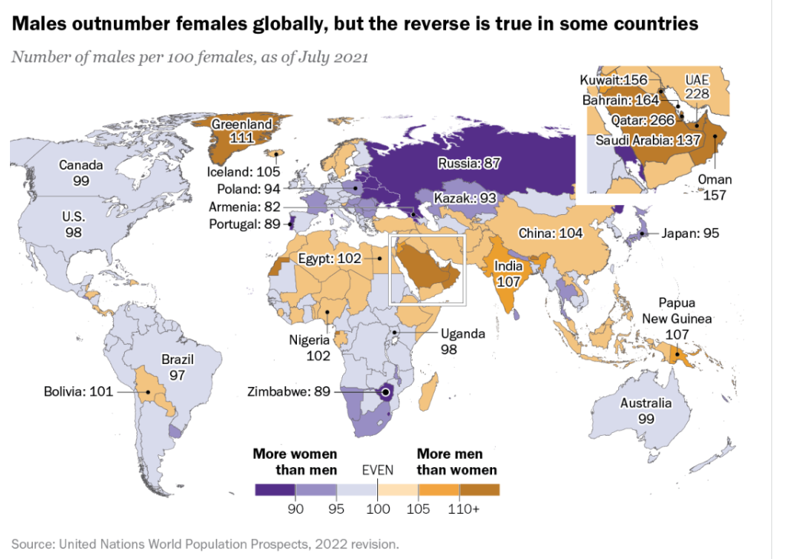
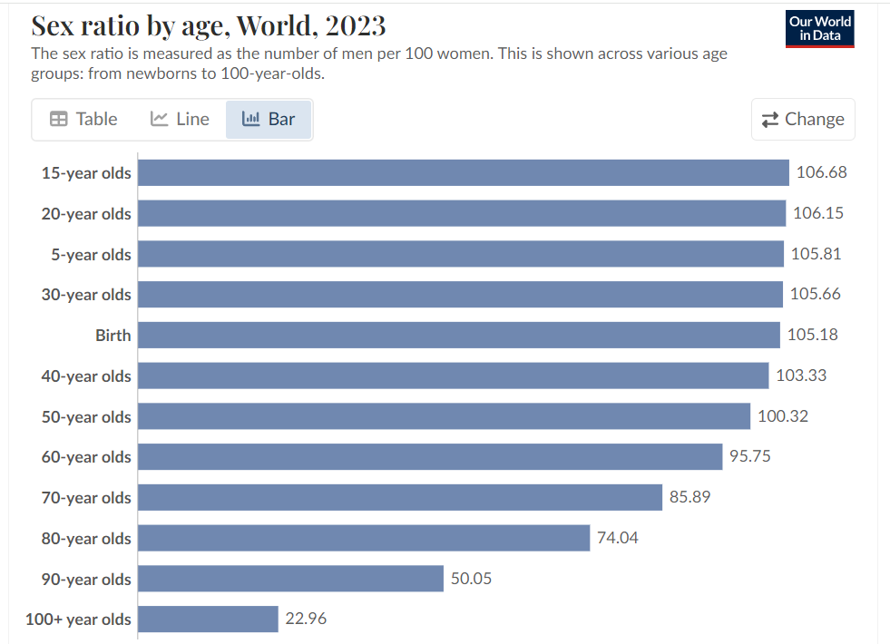
Gender Distribution Worldwide

Slide 4
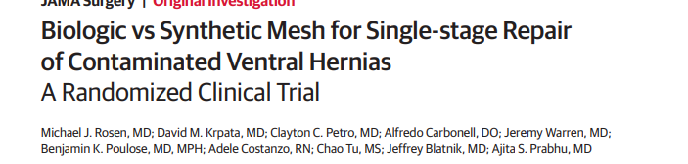
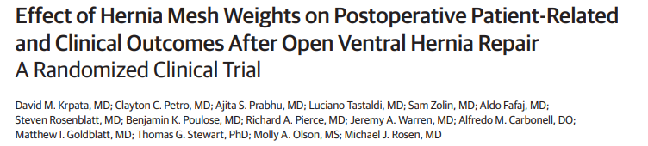
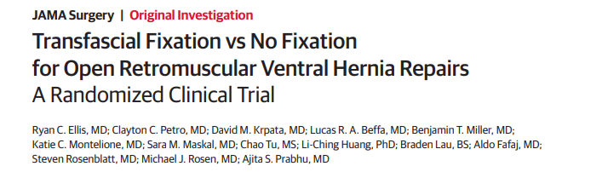
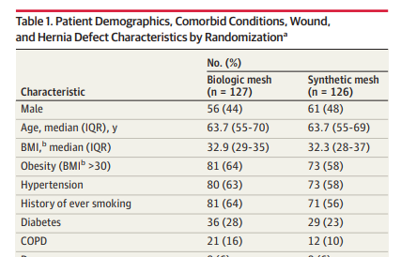
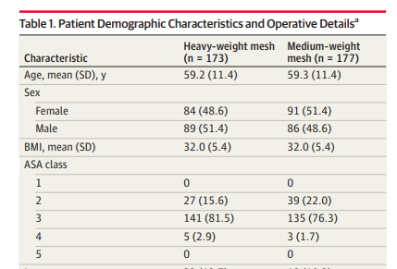
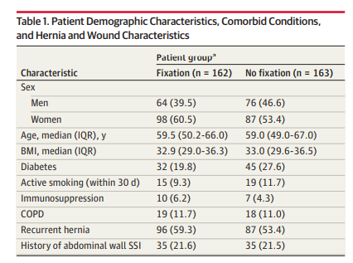
Gender distribution in hernia
Male: 117 pts
Female: 136 pts
Male: 175 pts
Female: 175 pts
Male: 140 pts
Female: 185 pts

Slide 5
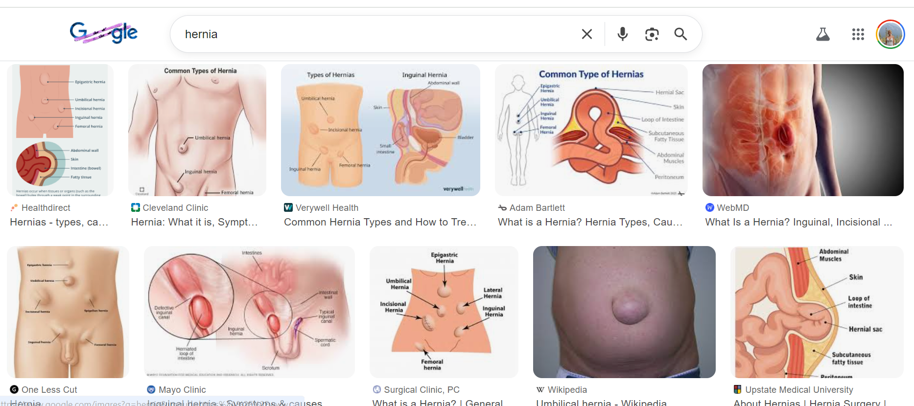
The gender bias

Slide 6
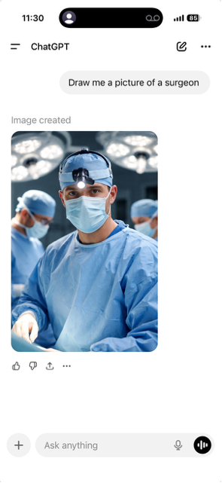

Slide 7

Whiteness and maleness are silent precisely because they do not need to be vocalized. Whiteness and maleness are implicit. They are unquestioned. They are the default. And this reality is inescapable for anyone whose identity does not go without saying, for anyone whose needs and perspective are routinely forgotten
- Caroline Criado Perez

Slide 8

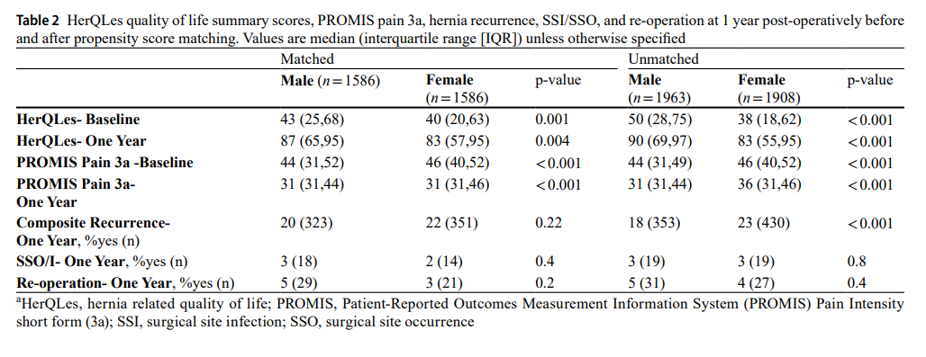
Arhos, Elanna K et al. “Females report worse outcomes than males one year after ventral hernia repair.” Hernia : the journal of hernias and abdominal wall surgery vol. 29,1 16. 16 Nov. 2024

Slide 9
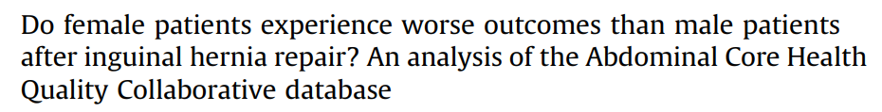
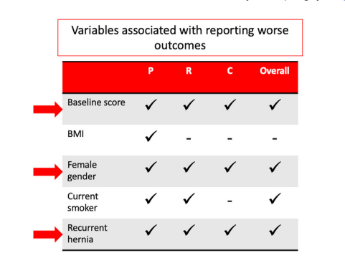
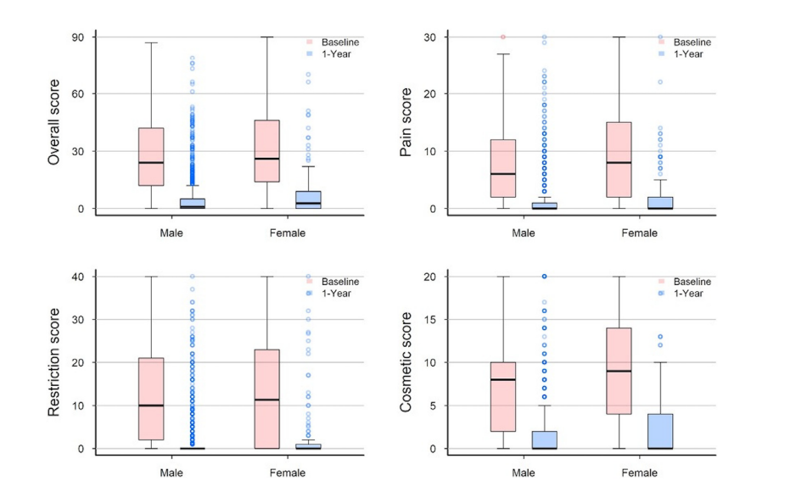


Median baseline EuraHS score
>
Pain/cosmesis
1-year EuraHS score
>
Overall/pain
Iyer, Amrita, et al. "Do female patients experience worse outcomes than male patients after inguinal hernia repair? An analysis of the Abdominal Core Health Quality Collaborative database." Surgery 185 (2025): 109491

Slide 10
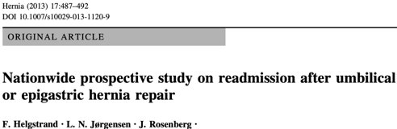
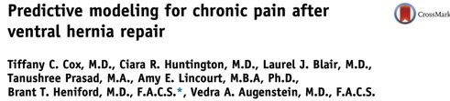
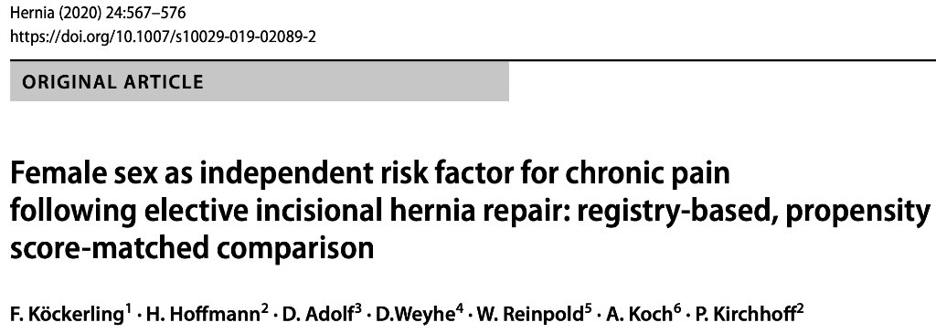
Female sex
- predictive of readmission
Female sex
- higher pain at 1, 6 and 12 months
- Only predictor of readmission
Female sex:
- Higher rates of chronic pain at 1 yr - rest, exertion and requiring treatment

Slide 11
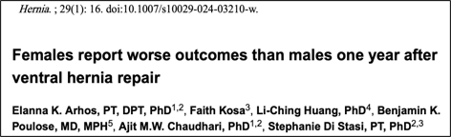
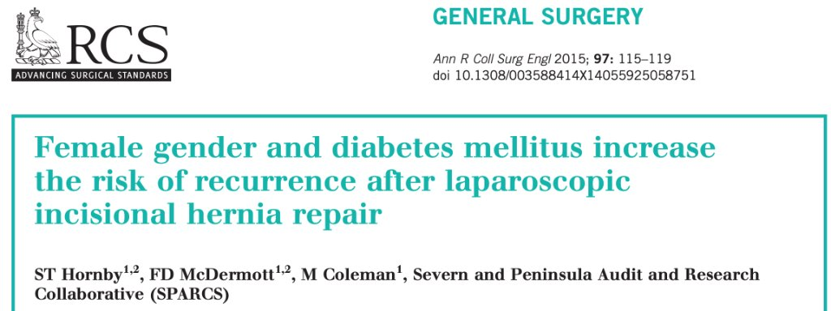
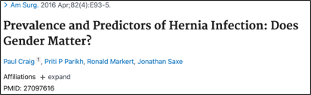
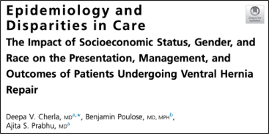
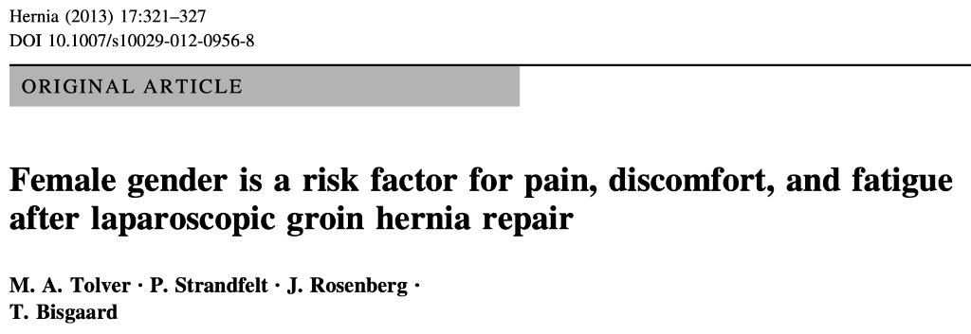

Slide 12
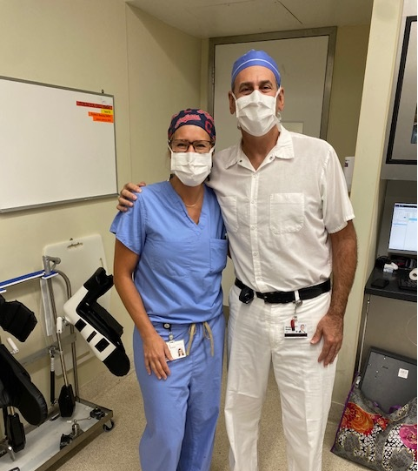
What about other gender differences
What about the impact of these operations on the surgeon based on gender
Ergonomics
Overuse injuries

Slide 13
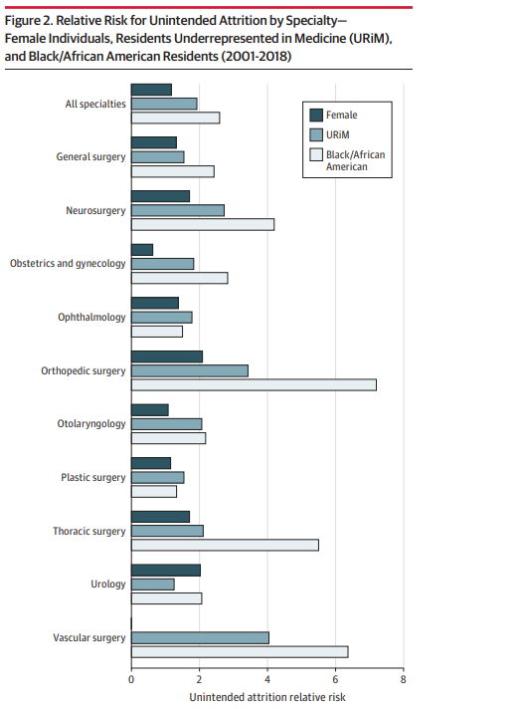
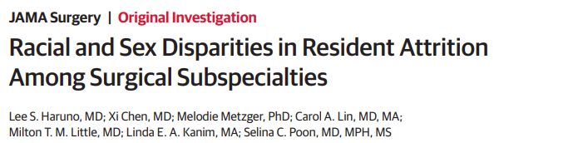
WHAT ABOUT DISPARITIES IN TRAINING & PRACTISE
Why do women leave the field of surgery?
112 205 surgery residents
Male 60%
Female 40%

Slide 14
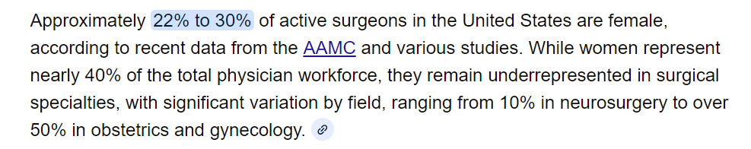
WHAT ABOUT DISPARITIES IN TRAINING & PRACTISE
Why do women leave the field of surgery?
112 205 surgery residents
Male 60%
Female 40%

Slide 15
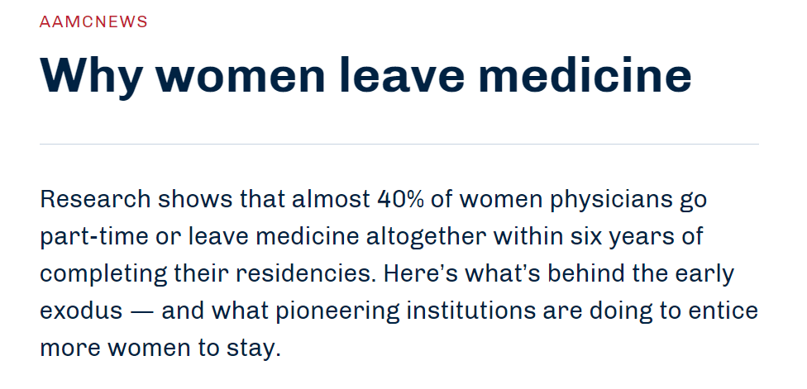
WHAT ABOUT DISPARITIES IN TRAINING & PRACTISE

Slide 16
WE HAVE A DATA GAP
ARE WE EVEN ASKING THE RIGHT QUESTIONS ?

Slide 17

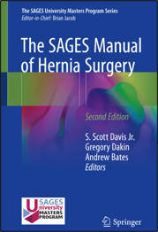
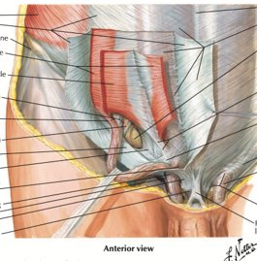
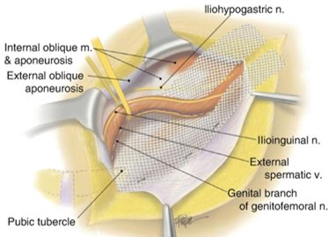

Slide 18
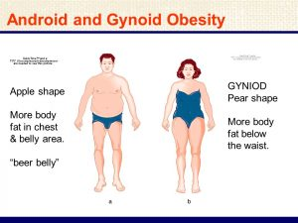
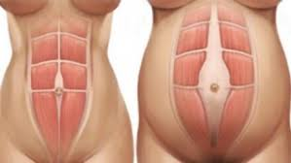
Gender based Abdominal Wall Differences

Slide 19

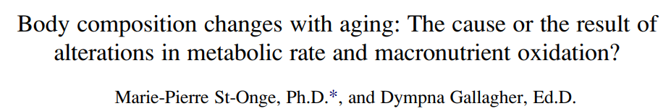
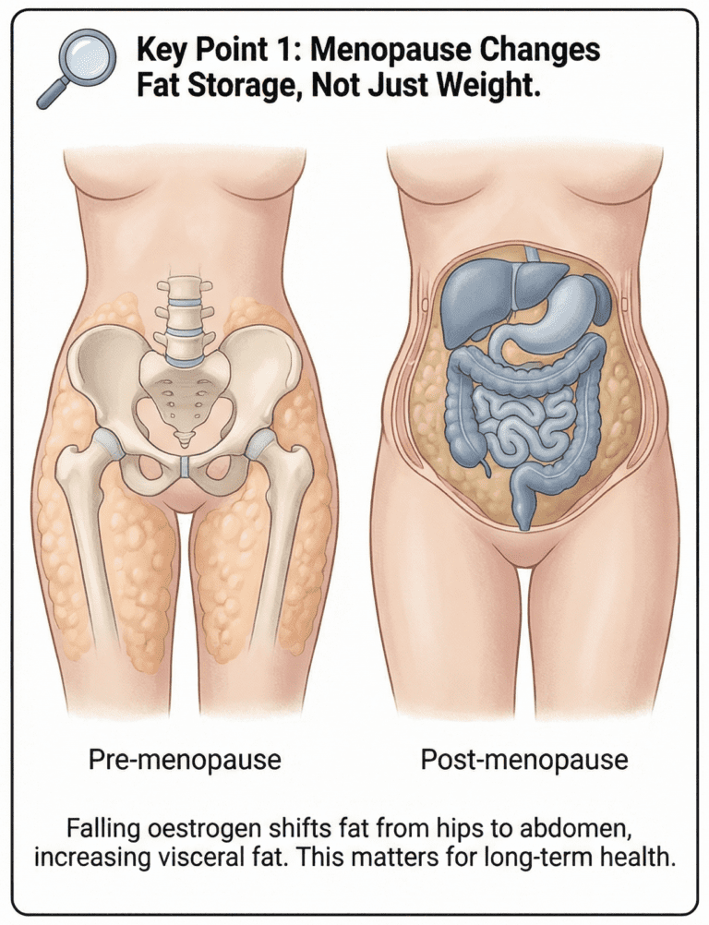
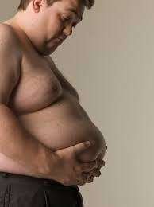
Gender based abdominal wall differences
Hormonal variation in both genders affect fat distribution with age

Slide 20
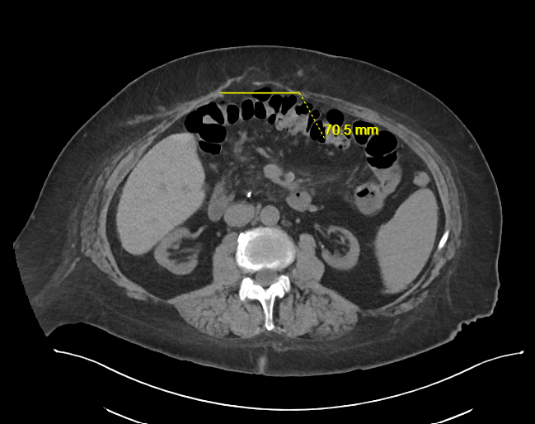
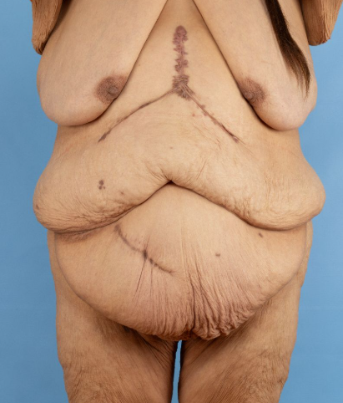
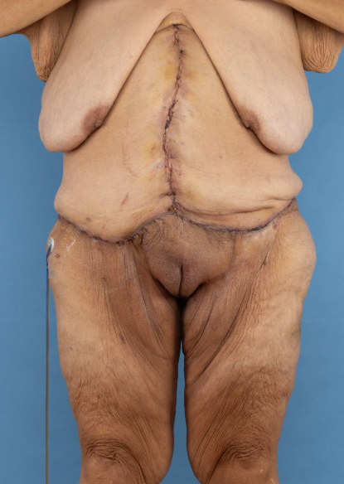
Gender Differences in DESIRED OUTCOMES

Slide 21
“One of the most important things to say about the gender data gap is that it is not generally malicious, or even deliberate. Quite the opposite. It is simply the product of a way of thinking that has been around for millennia and is therefore a kind of not thinking. A double not thinking, even: men go without saying, and women don't get said at all. Because when we say human, on the whole, we mean man.

Slide 22
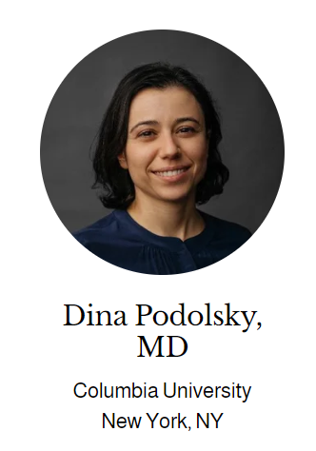
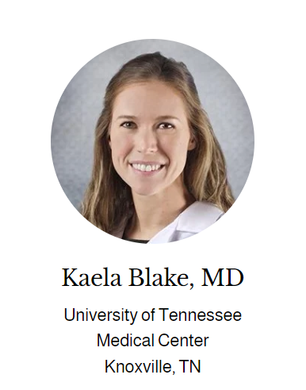
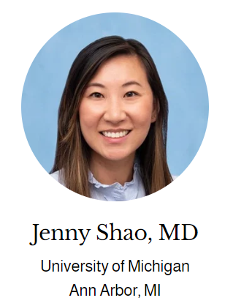
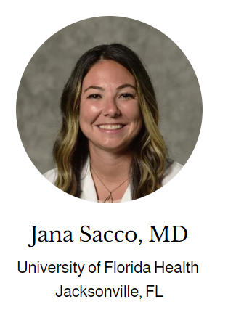
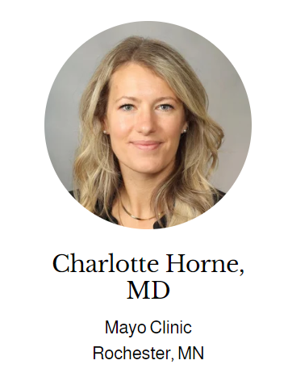
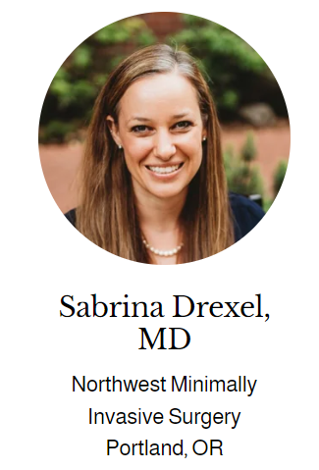
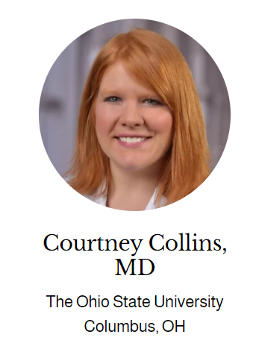

WHO we Are
Multi-Institutional collaborative of female fellowship trained abdominal wall reconstruction/hernia surgeons

Slide 23
OUR MISSION
1. Advance sex-specific hernia research to improve outcomes for women
2. Advocate for and provide excellent gender specific hernia care for our patients
3. Elevate and uplift aspiring female hernia surgeons

Slide 24
Advancing sex-specific hernia research
Evaluating compliance to currently established guidelines for care in females
Evaluating PROs: what matters for which gender
Evaluating the management of rectus diastasis

Slide 25

Advancing sex-specific hernia research
Evaluating the management of rectus diastasis

Slide 26

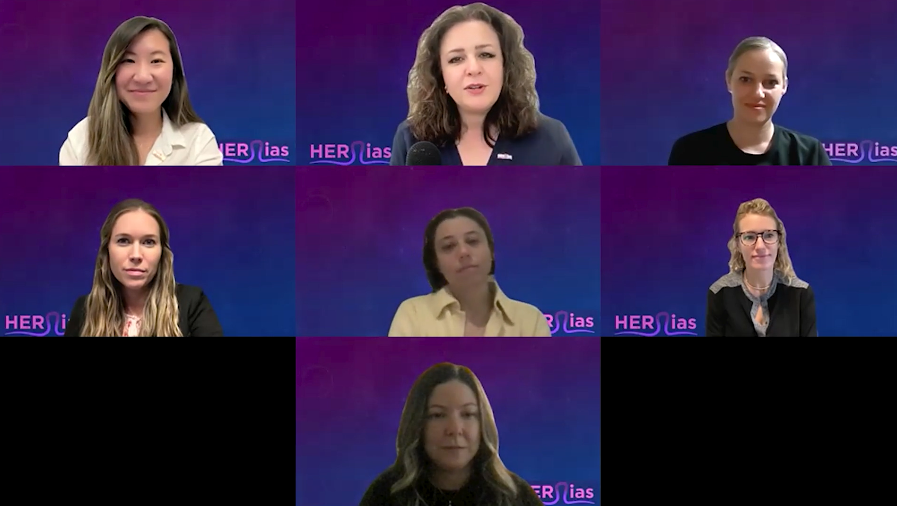

Advocating for and educating our patients

Slide 27
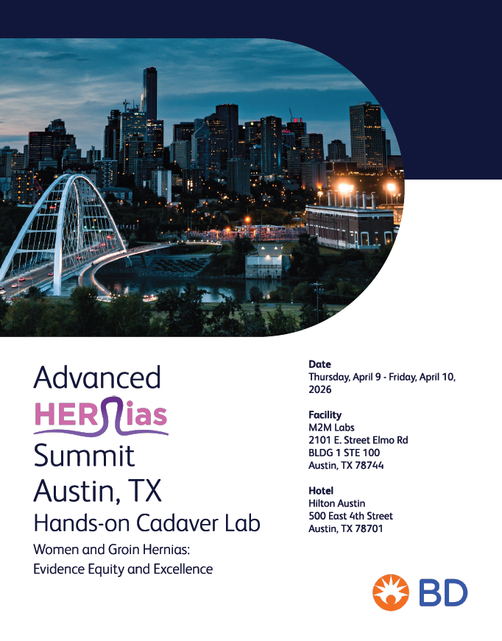
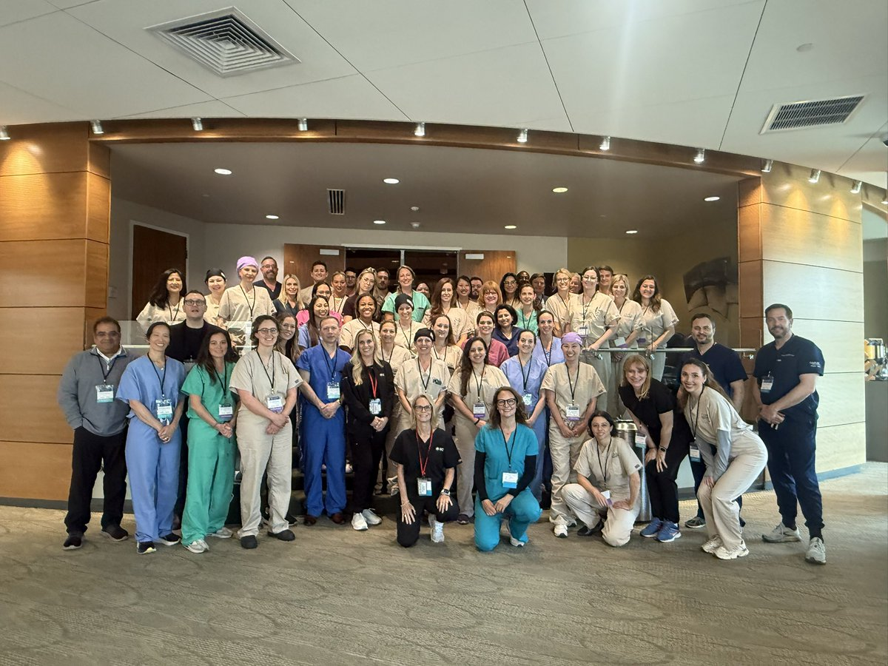
Elevating and uplifting current/aspiring hernia surgeons

Slide 28
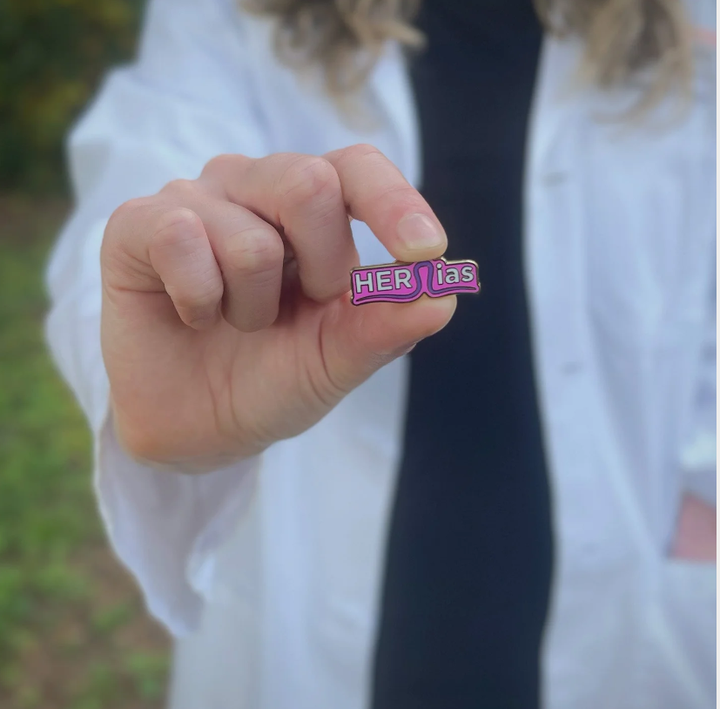
How can you get involved
Collaborate with us
Combined research through the ACHQC
Participate in research in various societies
Join us at a cadaver lab
Few spots left for Austin
Help us get the word out
We are happy to share our mission
Reach out for mentorship opportunities

Slide 29
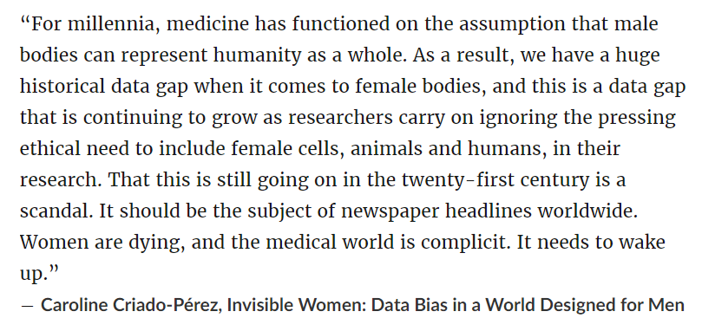

Slide 30


CONTACT US:
www.herniasalliance.com
@HERniasalliance
@HERniaSAlliance

Slide 31



Thank you
@theherniabarbie
@herniabarbie

