Slide 1


Impact of International Guidelines on Inguinal Hernia Management in Women: Are Surgeons Adhering to Best Practices?
Sarah Budney, Charlotte Horne, Sabrina Drexel, Jenny Shao, Dina Podolsky, Courtney Collins, Jana Sacco, Aldo Fafaj, Kaela Blake
University of Tennessee Medical Center
Knoxville, TN

Slide 2
Disclosures
SB:
  Intuitive Foundation – Fellowship Grant
KB:
  BD – speaker, honorarium
  Gore – consultant, honorarium

Slide 3
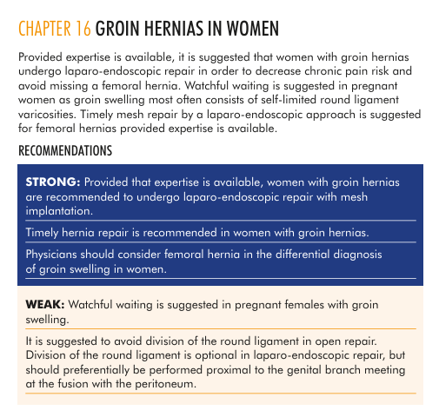
Background
2018 HerniaSurge International Guidelines for Groin Hernia Management
Strong recommendation for women to undergo MIS repair with mesh
Decrease risk of chronic pain and foreign body sensation
Reduce missed femoral hernias
HerniaSurge Group (2018) Hernia. https://doi.org/10.1007/s10029-017-1668-x

Slide 4
Aim
Primary Outcome: Adherence to recommendation for minimally invasive approach for groin hernias in women before and after guideline dissemination

Slide 5
Methods
Retrospective review of the ACHQC Database comparing cases from 2017-2019 to 2020-2025
Inclusion criteria
  Age ≥ 18
  Elective
  Non-recurrent
  Unilateral
  Clean case
  Permanent mesh placed
  30 day follow up
Exclusion Criteria
  Open Preperitoneal Repairs
  Tissue based repairs
  Long-acting resorbable mesh placed
  Hybrid or MIS -> open approach

Slide 6
Methods
  Reviewed demographic data and operative data
  Multivariable logistic regression to evaluate factors associated with an open repair

Slide 7
Results – Demographics
Variable | 2017-2019 (N= 576) | 2020-2025 (N=1028) | p-value
Age | 66 (53-77) | 65 (50-74) | 0.08
BMI | 24 (22-27) | 24 (22-28) | 0.9
ASA |  |  | 0.3
I-II | 411 (71%) | 754 (74%)
III-IV | 165 (29%) | 270 (26%)
Comorbid conditions
Hypertension | 230 (40%) | 336 (33%) | 0.004
Diabetes | 27 (5%) | 57 (6%) | 0.5
COPD | 39 (7%) | 40 (4%) | 0.01
Smoker | 45 (5%) | 79 (8%) | 0.9
Prior pelvic operation | 136 (24%) | 224 (22%) | 0.4
Practice Setting |  |  | 0.005
Academic Affiliation (AA) | 253 (44%) | 521 (51%)
Private Practice (PP) | 220 (38%) | 310 (30%)
PP with AA | 103 (18%) | 190 (19%)
Notes:
** Should we do BMI <30 vs >30 and ASA I-II vs III-IV given this is how the multivariable regression is done?

Slide 8
Results – Operative Details
Variable | 2017-2019 (N= 576) | 2020-2025 (N=1028) | p-value
Approach |  |  | <0.001
Open | 209 (36%) | 289 (28%)
MIS | 367 (64%) | 739 (72%)
Laparoscopic | 224 (39%) | 267 (26%)
Robotic | 143 (25%) | 472 (46%)
Notes:
** also see a transition in TEP -> TAPP
TEP 37% -> 21%
TAPP 63% -> 79%

Slide 9
Results – Operative Details
Variable | 2017-2019 (N= 576) | 2020-2025 (N=1028) | p-value
Hernia type |  |  | 0.67
Direct | 147/574 (26%) | 234/1027 (23%)
Indirect | 411/576 (71%) | 726/1028 (70.6%)
Femoral | 121/572 (21%) | 280/1027 (27%)
Operative Time (minutes) |  |  | 0.3
0-59 | 361 (63%) | 655 (64%)
60-119 | 194 (15%) | 316 (31%)
120-179 | 15 (3%) | 44 (4%)
180-239 | 3 (1%) | 8 (1%)
240+ | 3 (1%) | 3 (0%)

Slide 10
Results – Femoral Hernia Rate
Open 66/495 (13%)
MIS 335/1106 (30%)
p-value <0.00001
Notes:
don’t know indication for surgery
Don’t know what people considered to be a femoral (femoral fat plug vs actual hernia)
* put rate of femoral hernia in men on this slide

Slide 11
Results – Femoral Hernia Rate
  Female
Open 66/498 (13%)
MIS 335/1106 (30%)
p-value <0.00001
  Male
Open 26/5,061 (1%)
MIS 356/10,699 (4%)
p-value <0.01
Notes:
don’t know indication for surgery
Don’t know what people considered to be a femoral (femoral fat plug vs actual hernia)
* put rate of femoral hernia in men on this slide

Slide 12
Odds Ratio for Approach
Private vs Academic (ref)
PP with AA vs Academic (ref)
ASA Class III-IV
BMI >30
Prior pelvic operation
Concomitant procedure
Large hernia
0.39
0.64
1.66
0.76
1.07
1.27
1.47
Favors
MIS
Favors Open

Slide 13
Summary
  Increase in the rate of MIS approach following guideline publication (64% -> 72%)
    Suspect due to adoption of robotic surgery (rather than guidelines)
  Higher rate of femoral hernias identified in MIS approach
    Unclear indication for surgery. Unclear how surgeons defined femoral hernia
    Surgeons doing an open repair should open the floor (guideline issue?)
  Academic affiliation, ASA 3-4, and large hernias are more likely to have open approach
Notes:
There is an increase, which seems mostly driven by the adoption of robotic surgery. This may be enabling surgeons to follow guidelines, but suspect not soley driven by desire to adhere to them
We did also find a higher rate of femoral hernias identified in MIS approach, but again, we don’t know the indication for surgery or how surgeons were defining a femoral hernia. Despite this, for the 30% still doing an open approach, they should consider opening the floor in order to look for a femoral.
Finally, we saw there were a few factors which were associated with an increased rate of open repairs including an AA, higher ASA class, and larger hernias. Interesting as we would think that those in the AA setting would be the ones adhering to guidelines the most. Could argue that they have the more difficult hernias (ie larger hernias, sicker patients), but this association held true in a logistic regression in which those variable as well as BMI, prior pelvic operations, and concomitant procedures were controlled for
Still 30% getting open – issue with surgeon or issue with guidelines?
Definition of femoral hernia
Academic affiliation, ASA 3-4, and large hernias more likely to have open approach

