Slide 1


Do Quality of Life Questionnaires Reflect What Matters to Hernia Patients?
Alice Khomutova, Josephine Fuller, Emme Fitz, Brianna Stadsvold, Charlotte Horne, Melissa Phillips, Aldo Fafaj, Kaela Blake
University of Tennessee- Knoxville

Slide 2
Disclosures
The Complex Hernia and Abdominal Wall Reconstruction Fellowship at the University of Tennessee Medical Center Knoxville is funded by a grant from the Intuitive Foundation. Any research, findings, conclusions, or recommendations expressed in this work are those of the author(s), and not of the Intuitive Foundation
Kaela Blake MD- Bard (speaker, honorarium), Gore (consultant, honorarium)

Slide 3
Background
EuraHS and HerQLes are widely used hernia-specific PROMs
Created by surgeons
How do patients feel about these questions?
Are there gender differences?
Notes:
The EuraHS (European Registry for Abdominal Wall Hernias) and HerQLes (Hernia-Related Quality of Life Survey) are validated patient-reported outcome measures developed by expert consensus without direct patient input.
And, Since these surveys were created by surgeons and not by patients; we don’t have the patients perspective on what they think is important
Additionally, we wanted to evaluate whether there are gender based differences in what men and women want, for example we have biases that females may care more about cosmesis
Given that field of hernia is valuing patient reported outcomes more and more as a measure of hernia repair success, our goal in doing this study was to see how patients felt about these questions
~~
The HerQLes (Hernia-Related Quality-of-Life Survey) summary score is a 12-item survey for patients with hernias, with a scale of 0 to 100, where a higher score indicates a better quality of life. A minimal clinically important difference is a change of +15.6 points signifies a meaningful improvement in quality of life after treatment
Renshaw SM, Gupta A, Poulose BK. Establishing the minimal clinically important difference for the Hernia-Related Quality of Life Survey (HerQLes). Am J Surg. 2022;223(2):245-249.
EuraHS is a 9-item hernia-specific patient-reported outcome measure that evaluates pain, restriction of activities, and cosmetic concerns related to abdominal wall hernias, with higher scores indicating greater symptom burden and worse quality of life. This is measured on a scale of 0-90 and between the several domains of pain, activities and cosmesis. The minimal clinically important diff for EuraHS-QoL is 10. Domain-specific MCIDs are 3 for the pain domain, 5 for the restriction of activities domain, and 2 for the cosmesis domain. Shukla P, et al. Determining the Minimum Clinically Important Difference for the EuraHS-QoL Instrument. J Am Coll Surg. 2023; (details as published).

Slide 4
Notes:
this is an example of a survey filled out by one of our patients

Slide 5
Aim
Assess patient-perceived relevance of EuraHS and HerQLes items and whether relevance differed by sex.
Notes:
This study assessed patient-perceived relevance of HERQLES and EURAHS questionnaire items and whether relevance differed by sex.

Slide 6
Methods
Cross-sectional survey of hernia patients (August- December 2025)
Inclusion criteria
Age ≥ 18
Elective open hernia repair (inguinal and ventral)
Notes:
And the way we did this was we conducted a cross-sectional survey of adult patients who presented for hernia repair in our clinic between August and December 2025.
Participants completed both the EuraHS and HerQLes questionnaires and rated item relevance on a 0–10 scale (0 = least relevant, 10 = most relevant).
~~
Higher ranking= more relevant?
MYMOP next stops
**** insert form with ranking into PPT

Slide 7
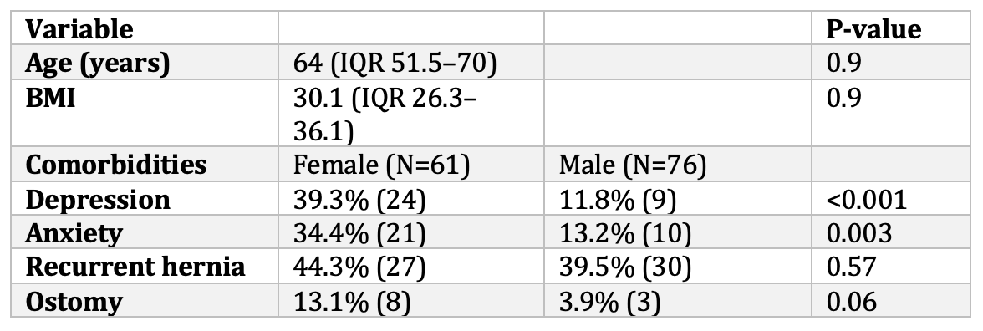
Results - Demographics
Notes:
137 patients (61 female, 76 male) were included in this study
The Median age was 64 (IQR 51.5-70) and median BMI was 30.1 kg/m² (IQR 26.3-36.1).
Females had significantly higher rates of depression (39.3% vs 11.8%, p<0.001) and anxiety (34.4% vs 13.2%, p = 0.003).
There were no differences in hernia recurrence or ostomy prevalence.

Slide 8
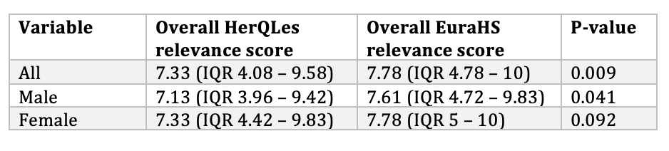
Results – Overall relevance
Notes:
We wanted to compare EURA HS to HERQLES and see which questionnaire is better.
You can see here that for all patients, there is a small but statistically significant difference in the overall relevalcne scores, with 7.33 for HERQLES and 7.78 for EURAhs
in males there is a small difference in the relevance scores as well

Slide 9
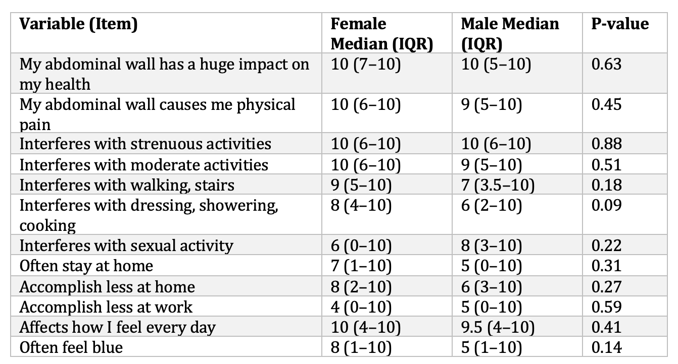
Results – Relevance Scores for HERQLES
Notes:
This is the question by question ranking across twelve HerQLes items.
In general, patients rank the relevance of most questions pretty highly, but in this survey there is no difference between men and women

Slide 10
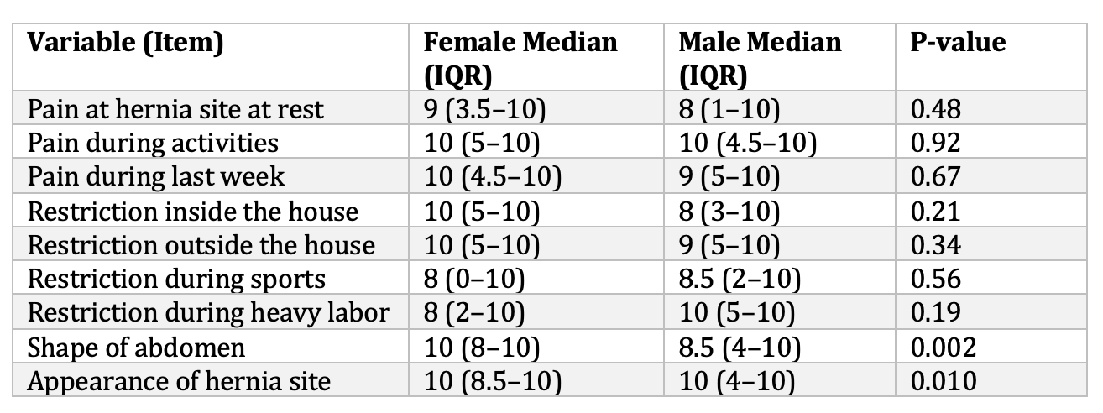
Results – Relevance Scores for EuraHS
Notes:
This is the question by question ranking across 9 EURAHS items
You can see that here, women rated “what is the shape of your abdomen” as more relevant than men [10 (IQR = 8–10) vs 8.50 (IQR = 4–10), p= .002).
And In general, you can see that this survey is ranked as “more relevant”, if you will, than the previous survey.
~~
Assumed female population would care more but males also still care, data doesn’t support bias

Slide 11
Summary
Overall, patients rated the majority of items as relevant
Female patients rated cosmetic outcomes as more relevant than men for EuraHS
No sex-based differences were observed for HerQLes
Notes:
Overall, patient rated the majority items as relevant, with a median of ~7.5/10
Certain items were rated as more important than other items, especially pain
Female patients rated cosmetic outcomes as more relevant than men for EuraHS
No sex-based differences were observed for HerQLes
~~~~~
Discussion:
In General, EuraHS is a survey for inguinals and HERQLES is a survey for ventrals, in our clinic and in thus study we have patients complete both surveys but Since cosmetic outcomes were identified as being important and that is not a component of HerQLES, its worth thinking about including cosmesis in the HERQLES survey as well.
And, as we expand these studies to other centers and address other populations, we may find other differences
Next steps:
Right now there is a new PROM being popularized
in Europe
MYMOP stands for Measure Yourself Medical Outcome Profile.
It is a patient-reported outcome measure (PROM) designed to capture what matters most to an individual patient, rather than relying on standardized symptom lists chosen by clinicians.
Eventually, we predict that based on these relevance rankings, these trend for these surveys will move from what surgeons want to what patients want and what matters to them.
~~
Interquestion variability (**** variability statistics calculation?)
Female cared more about cosmesis, but men cared too
.
Variability in what patients want so we need to find better ways how to identify that and address that for patients
These surveys in general are rated as important to patient centered outcomes.
Next steps:
Eventually re-write the surveys based on these relevance rankings to only include important questions
Similar status but looking for difference in functionatl status, type of hernia repair etc
As we expand these studies to other centers and address other populations, we may find other differences
MYMOP

Slide 12
THANK YOU!
Alice Khomutova, MD
Abdominal Wall Reconstruction Fellow
Dr.Khomutova@gmail.com
(818) 523-6550

