Slide 1

Round Ligament Management in Female Patients Undergoing Inguinal Hernia Repair: Should We Divide or Preserve?
W. Taylor Head MD, Savanna Renshaw MPA MPH, Courney Collins MD MS FACS,
Anand Gupta MBBS MPH, Benjamin Poulose MD MPH FACS, Kelly Haisley MD
ACHQC 8th Annual Quality Improvement Summit
Notes:
Good morning everyone. My name is Taylor Head, and I’m a fourth year general surgery resident presenting on behalf of our team from the Ohio State University. Today I'll be discussing our recently published study on round ligament management in female patients undergoing inguinal hernia repair—specifically addressing the question: should we divide or preserve the round ligament? This work represents a collaborative effort with my co-authors Savanna Renshaw, Dr. Courtney Collins, Dr. Anand Gupta, Dr. Benjamin Poulose, and Dr. Kelly Haisley

Slide 2

Disclosures
W. Taylor Head MD: None
Savanna Renshaw MPA MPH: None
Courney Collins MD MS FACS: National Institute of Health – research support
Anand Gupta MBBS MPH: None
Benjamin Poulose MD MPH FACS:
Abdominal Core Health Quality Collaborative – salary support
BD Interventional – research support
Advanced Medical Devices – research support
Abbvie/Allergan – consulting
EndoEvolve – equity
Kelly Haisley MD: None
Notes:
Here are our team’s relevant disclosures.

Slide 3
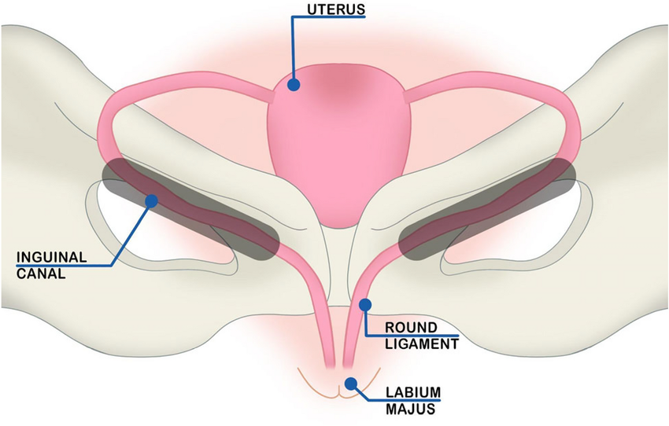
Background
Inguinal hernia repair is common
800,000 performed annually in the US
3% females undergo repair vs 27% males
- Paucity of data on female-specific considerations
Management of the round ligament remains controversial…
Notes:
Let me start with some background. Inguinal hernia repair is an extremely common procedure—we perform approximately 800,000 repairs annually in the United States alone. However, there's a striking sex difference in prevalence. While 27% of males will undergo inguinal hernia repair in their lifetime, only 3% of females will require this operation. This relative rarity of female inguinal hernias has unfortunately contributed to a significant paucity of data on female-specific surgical considerations. One area that has remained particularly controversial is the management of the round ligament during repair.

Slide 4
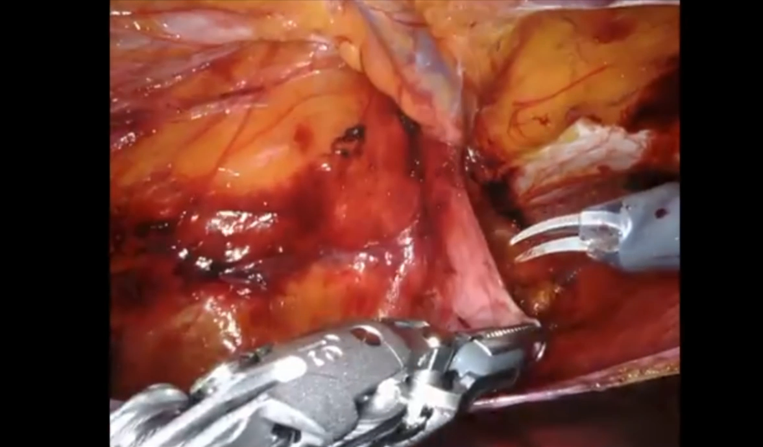
Background
Division is often performed to:
Improve exposure
Facilitate mesh placement
However, potential roles may exist for:
Pelvic support
Uterine positioning
Sexual and reproductive function
Notes:
So why do surgeons divide the round ligament? The most common reasons are to improve surgical exposure and to facilitate mesh placement, particularly during minimally invasive approaches. However, we must consider that the round ligament may play important physiologic roles. It potentially contributes to pelvic support, helps maintain normal uterine positioning, and may have implications for sexual and reproductive function. This creates a clinical dilemma—we're balancing surgical convenience against potentially important anatomic preservation.

Slide 5
Background
International guidelines:
Often recommend preservation in open repair and division may be performed in minimally invasive repair
However, no high-level evidence exists to support this recommendation…
Evidence gap:
No Randomized controlled trials and limited outcomes data is available
Resulting in wide variability in surgeon practice…
Notes:
Looking at the current evidence landscape, international guidelines often recommend preserving the round ligament in open repairs, while division may be performed in minimally invasive approaches. However—and this is critical—there is no high-level evidence to support these recommendations. We have no randomized controlled trials, and very limited outcomes data is available. This evidence gap has resulted in wide variability in surgeon practice patterns. Even among experienced hernia surgeons, there's significant disagreement about optimal management. Some studies have shown that nearly half of surgeons aren't even sure what physiologic role the round ligament plays. This inconsistency and uncertainty is precisely what motivated our study

Slide 6
Objective
Evaluate current practices of round ligament management
in female inguinal hernia repair
Compare outcomes between round ligament division and preservation
Notes:
Our study had two primary objectives: First, to evaluate current practices of round ligament management in female inguinal hernia repair across the United States. And second, to compare clinical and patient-reported outcomes between patients who had round ligament division versus preservation.

Slide 7
Methods
Design: Retrospective cohort study using ACHQC registry data (2013 – 2021)
Population: Adult female patients that underwent inguinal hernia repair
Outcomes:
Clinical: 30-day complications, SSI/SSO, reoperation, recurrence
PROs: EuraHS QoL score (0-90) and EuraHS pain score (0-30) (higher = worse)
Inclusion criteria | 30-day PRO data available
Exclusion criteria | Underwent concomitant procedures
Groupings | Round ligament (1) divided and (2) preserved
Notes:
Let me walk you through our methodology. We performed a retrospective cohort study using ACHQC registry data from 2013 through 2021. Our population included adult female patients who underwent inguinal hernia repair. We looked at multiple outcome categories. For clinical outcomes, we examined 30-day complications, surgical site infections and occurrences, reoperations, and recurrence rates. Importantly, we also captured patient-reported outcomes using the EuraHS Quality of Life instrument, which includes both a comprehensive summary score ranging from 0 to 90, and a pain specific score ranging from 0 to 30. In both scales, higher scores indicate worse outcomes. We included patients who had 30-day patient-reported outcome data available, and we excluded anyone who underwent concomitant procedures to avoid confounding our results. Patients were grouped based on whether their round ligament was divided or preserved during the operation.

Slide 8
Results
Table 1: Demographics and Comorbidities by Division Status
 | Divided (n = 868) | Preserved (n = 497) | Total (n = 1365) | P-value
Age, y, mean (SD) | 62.1 (17.3) | 59.7 (17.1) | 61.2 (17.2) | <0.01
White Race, % | 88.0% | 85.3% | 87.0% | 0.35
BMI, kg/m², mean (SD) | 24.9 (5.1) | 25.2 (5.2) | 25.1 (5.1) | 0.44
ASA Class, % 1 2 3 4 | 18.3% 52.8% 26.9% 2.0% | 18.2% 54.7% 25.9% 1.2% | 18.3% 53.5% 26.5% 1.7% | 0.70
Insurance type, % Private Medicare/Medicaid Other | 48.3% 43.9% 7.7% | 51.9% 39.6% 8.4% | 49.5% 42.5% 8.0% | 0.01
Hypertension, % | 36.6% | 32.0% | 34.9% | 0.08
Diabetes, % | 4.0% | 3.8% | 4.0% | 0.84
COPD, % | 5.8% | 3.8% | 5.1% | 0.84
Notes:
Now let's look at our results. We identified 1,365 female patients meeting our criteria—868 had round ligament division and 497 had preservation. Looking at baseline demographics, the groups were quite similar. The divided group was slightly older with a mean age of 62 versus 60 years—this difference was statistically significant but clinically small. Race, BMI, ASA class, and comorbidities including hypertension, diabetes, and COPD were all similar between groups. One notable difference was insurance type distribution, with the divided group having slightly more Medicare/Medicaid patients, which may perhaps relates to the age difference mentioned earlier.

Slide 9
Results
Table 2: Operative Characteristics by Division Status
 | Divided (n = 868) | Preserved (n = 497) | Total (n = 1365) | P-value
Elective surgery, % | 97.8% | 97.4% | 97.7% | 0.62
Recurrent hernia, % | 5.3% | 6.2% | 5.6% | 0.47
Approach, % Open Laparoscopic Robotic Other | 34.9% 46.8% 27.3% 1.0% | 38.8% 30.6% 29.8% 0.8% | 36.3% 34.5% 28.2% 1.0% | 0.13
Mesh implanted, % | 89.9% | 86.5% | 88.6% | 0.06
Surgeon affiliation, % Academic Private Mixed | 42.2% 42.7% 15.1% | 52.3% 27.2% 20.5% | 45.9% 37.1% 17.1% | <0.01
Notes:
Moving to operative characteristics. There was no significant difference between elective surgery and recurrent surgery. An important point to highlight is that there was no significant difference in surgical approach between the groups. Division occurred in 35% of open cases, 47% of laparoscopic cases, and 27% of robotic cases, while preservation showed similar distribution. This is a key finding because it suggests that the decision to divide or preserve wasn't simply driven by surgical approach, but rather perhaps by individual surgeon preference. We did observe that round ligament preservation was significantly more common among academic surgeons at 52%, compared to 27% in private practice. This may reflect differences in training patterns. Mesh was implanted in about 90% of cases overall, with no significant difference between groups.

Slide 10
Results
Table 3: Operative Outcomes by Division Status
 | Divided (n = 868) | Preserved (n = 497) | Total (n = 1365) | P-value
Length of stay, d, mean (SD) | 0.4 (2.3) | 0.2 (0.9) | 0.3 (1.9) | 0.42
Complications Intra-op Post-op | 0.6% 7.1% | 1.2% 5.2% | 0.8% 6.4% | 0.21 0.17
SSI, % | 0.6% | 0.0% | 0.4% | 0.09
SSO, % | 5.4% | 3.4% | 4.7% | 0.09
ED Visit, % | 2.8% | 2.1% | 2.6% | 0.21
Readmission, % | 1.2% | 1.0% | 1.1% | 0.8
Reoperation, % | 0.5% | 0.2% | 0.4% | 0.044
Recurrence, % | 0.1% | 0.4% | 0.2% | 0.28
Notes:
Now for the clinical outcomes. There were no significant differences in length of stay, intraoperative complications, or postoperative complications between groups. The overall post-op complication rate was 7.1% in the divided group versus 5.2% in the preserved group—this difference did not reach statistical significance. Surgical site infections and occurrences were similarly low and not significantly different. Emergency department visits and readmissions were also comparable. Importantly, reoperation rates were extremely low in both groups— 0.5% for division versus 0.2% for preservation, not statistically significant. And recurrence rates were essentially equivalent—0.1% in the division group versus 0.4% in the preservation group. The take-home message here is that round ligament division does not appear to increase perioperative complications or compromise surgical outcomes in the short term.

Slide 11
Results
Table 4: Patient Reported Outcomes by Division Status
 | Divided (n = 868) | Preserved (n = 497) | Total (n = 1365) | P-value
EuraHS Summary Score, mean (SD)
Baseline | 39.6 (23.2) | 39.8 (22.3) | 39.6 (22.9) | 0.66
30-day | 27.2 (20.7) | 27.8 (20.6) | 27.4 (20.6) | 0.65
6-months | 12.8 (16.2) | 17.1 (19.3) | 14.2 (17.4) | 0.12
EuraHS Pain Score, mean (SD)
Baseline | 11 (8.6) | 11 (8.5) | 11 (8.6) | 0.94
30-day | 6 (6.8) | 5.9 (6.3) | 6 (6.7) | 0.76
6-months | 3 (5.5) | 4.7 (6.5) | 3.5 (5.9) | <0.01
Notes:
Now let's turn to patient-reported outcomes, which tell a more nuanced story. Looking at the EuraHS Summary Scores, which measure overall quality of life, there were no significant differences between groups at baseline, or 30 days, or 6 months. Both groups showed similar improvement trajectories over time. However, when we looked specifically at pain scores, we found something interesting. At baseline and 30 days postoperatively, pain scores were identical between the two groups—around 11 at baseline and 6 at 30 days. But at 6 months, we observed a significant difference. The division group had a mean pain score of 3, compared to 4.7 in the preservation group. This difference was statistically significant with a p-value less than 0.01. To put this in context, both groups experienced substantial pain improvement from baseline, but the division group had better pain outcomes at the 6-month mark.

Slide 12
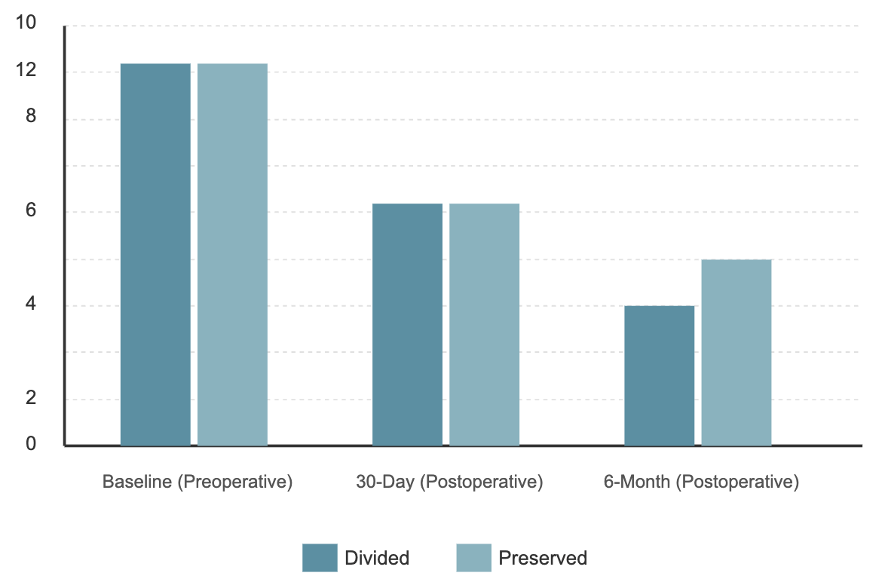

Results
Figure 1: Mean EuraHS Pain Scores based on Division Status
Notes:
This graph illustrates what I just described. You can see both groups start at similar baseline pain levels around 11, drop to similar levels at 30 days around 6, but then diverge at 6 months, with the division group achieving lower pain scores. The red arrow highlights this clinically relevant separation at the 6- month timepoint.

Slide 13
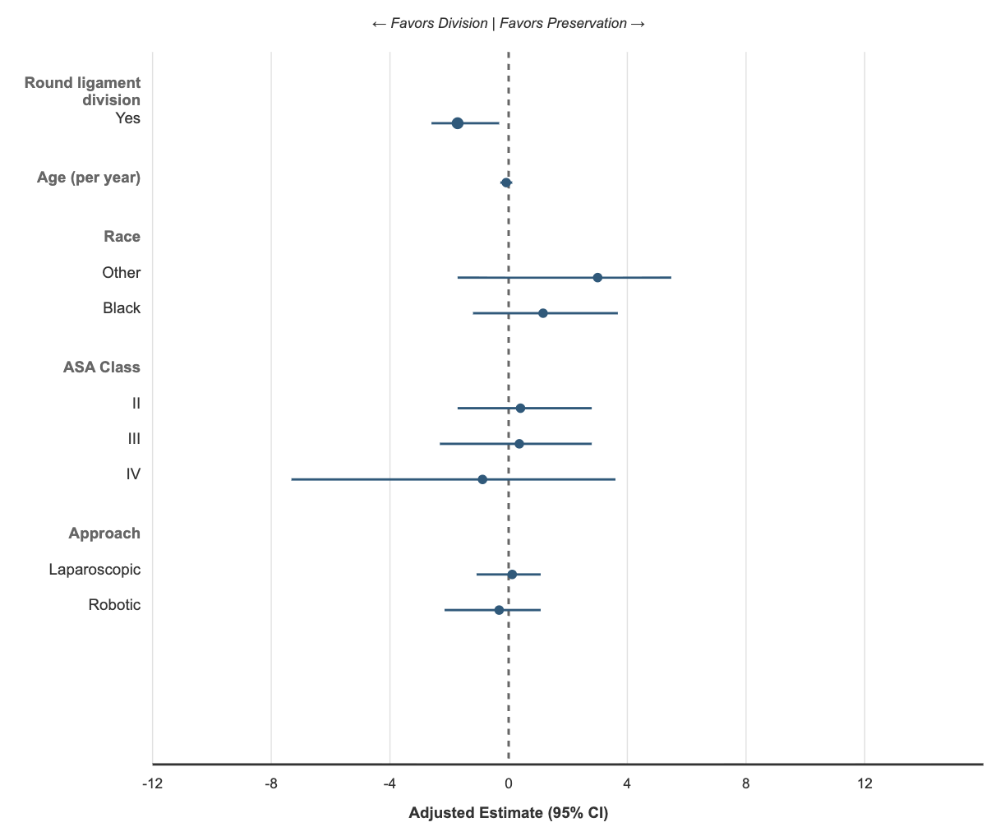

Results
Figure 2: Multivariable Analysis of EuraHS Pain Scores at 6 Months
Notes:
To ensure this finding wasn't confounded by other variables, we performed multivariable analysis adjusting for age, race, ASA class, and surgical approach. As you can see in this forest plot, round ligament division remained significantly associated with lower pain scores at 6 months, with a p-value of 0.02. Importantly, none of the other factors we examined—including age, race, ASA class, or whether the approach was laparoscopic or robotic —were significantly associated with 6-month pain scores. This suggests that the pain benefit we observed with division is independent of these other clinical variables.

Slide 14



Conclusions
Division is associated with
lower 6-month pain
Knowledge gaps limit ability to
offer formal recommendation
Division is common and safe
Notes:
So what can we conclude from this study? First, round ligament division is common—occurring in nearly twothirds of female inguinal hernia repairs—and it appears to be safe. We found no increase in complications, reoperations, or recurrence rates. Second, and perhaps most interestingly, division is associated with lower pain scores at 6 months postoperatively. This finding persisted even after adjusting for potential confounders. However—and this is crucial—significant knowledge gaps limit our ability to offer a firm recommendation. While we found a pain benefit with division, our dataset doesn't capture potentially important outcomes related to pelvic floor function, sexual function, or obstetric outcomes in younger women. The round ligament is a suspensory structure that may contribute to pelvic stability and normal uterine positioning. We simply don't have long-term data on whether division affects these functions

Slide 15


Future Steps
Questions:
Does division affect physical function and obstetric outcomes?
Does effect differ by age, parity, and approach?
Is the statistically significant pain reduction clinically relevant?
Areas of Focus:
Female-specific outcomes: pelvic floor symptoms, dyspareunia, uterine prolapse, pregnancy
Technique-specific analyses: how/where ligament divided and any mesh plane interactions
Which populations should preservation be encouraged
Notes:
This brings me to future research directions, which I believe are critical. We need to answer several important questions: Does round ligament division affect physical function and obstetric outcomes in women of childbearing age? Does the effect differ based on patient age, parity, or surgical approach? And perhaps most importantly, is the statistically significant pain reduction we observed actually clinically meaningful to patients? Our areas of focus moving forward should include female-specific outcomes that weren't captured in our registry—things like pelvic floor symptoms, dyspareunia, uterine prolapse, and pregnancy outcomes. We also need technique-specific analyses to understand how and where the ligament is divided, and whether there are interactions with mesh placement and plane of dissection. Finally, we need to identify which patient populations would benefit most from preservation—for example, younger women planning future pregnancies might be a group where preservation should be strongly considered.

Slide 16

Email: William.Head@OSUMC.edu
Notes:
In summary, our study provides important observational data suggesting that round ligament division is safe and may offer some pain benefits. However, the decision to divide or preserve should be individualized based on patient factors, surgical approach, and surgeon experience. We need prospective studies and longer-term follow-up to truly understand the full implications of this surgical decision. Thank you for your attention, and I'm happy to take any questions. My email is on the screen if anyone would like to discuss this further
If you are to transect it do it as distal as possible; theoretically the genital branch of genitofemoral nerve can take off earlier.
If doing MIS, can preserve it
50% of women it is part of peritoneum and can’t mobilize it but 50% can mobilize it
If in first part, incise peritoneum and then suture close that hole that typically starts near
Shouldice take it every single time
Women may experience pain with sitting up to 1 year but often goes away but goes away bc bag genitofemoral nerve

