Slide 1
Measuring What Matters
Courtney Collins MD MS
ACHQC Summit
Feb 2026

Slide 2

A Case Report
Plaintiff: USW
Complaint: Non-payment after laryngectomy
Testimony: Patient voluntarily consented to laryngectomy. Unable to find provider willing to take on case due to complexity and social issues until seen by USW. USW provided charity care with expectation of payment in timeline explicitly outlined in the consent/contract. Procedure went well with expected all goals achieved but patient now refusing to adhere to outlined repayment plan due to dissatisfaction.

Slide 3
Defendant: AM
Testimony: While laryngectomy performed without issue, post operative course was more complicated than was outlined and she is not satisfied with the overall outcome. Unable to participate in activities to the extent which she expected. Quality of life poor after surgery largely due to actions of USW. Felt she agreed to pay only in the event of successful surgical course which did not happen.

Slide 4

The Sad Ending
During confrontation about continued non-payment, USW attacked by partner of AM
USW died immediately of stab wound to the torso/abdomen
No legal action against AM or husband.

Slide 5


USW’s side
Procedure performed without issue
AM got exactly what she requested
Risks clearly explained (it was a whole song)
Why not just write?

Slide 6

AM’s side
Didn’t understand how hard life would be without a voice.
Thought she’d get kissed faster (been there. . .)
Um, I’m 16?

Slide 7

Was this procedure successful?
Pain free
Outcome achieved
No real “complications”
But. . .

Slide 8

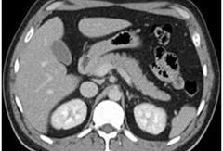
The Hernia Outcome Paradox
The CT is amazing!!
The patient is miserable

Slide 9
Why Does Hernia Surgery Happen?
Patients
Surgeons
Pain
Cosmesis
Anxiety
What the literature says
Feasibility
Prevent complications
Patient symptoms (mostly pain)

Slide 10
Why Does Hernia Surgery Happen?
Patients
Surgeons
Pain
Cosmesis
Anxiety
What the literature says
Feasibility
Prevent complications
Patient symptoms (mostly pain)

Slide 11

Why We’re Special
We exist in “the grey"
Quality of life operation
Decreased health literacy around hernia disease
Differing views of success
Tons of procedures now!

Slide 12
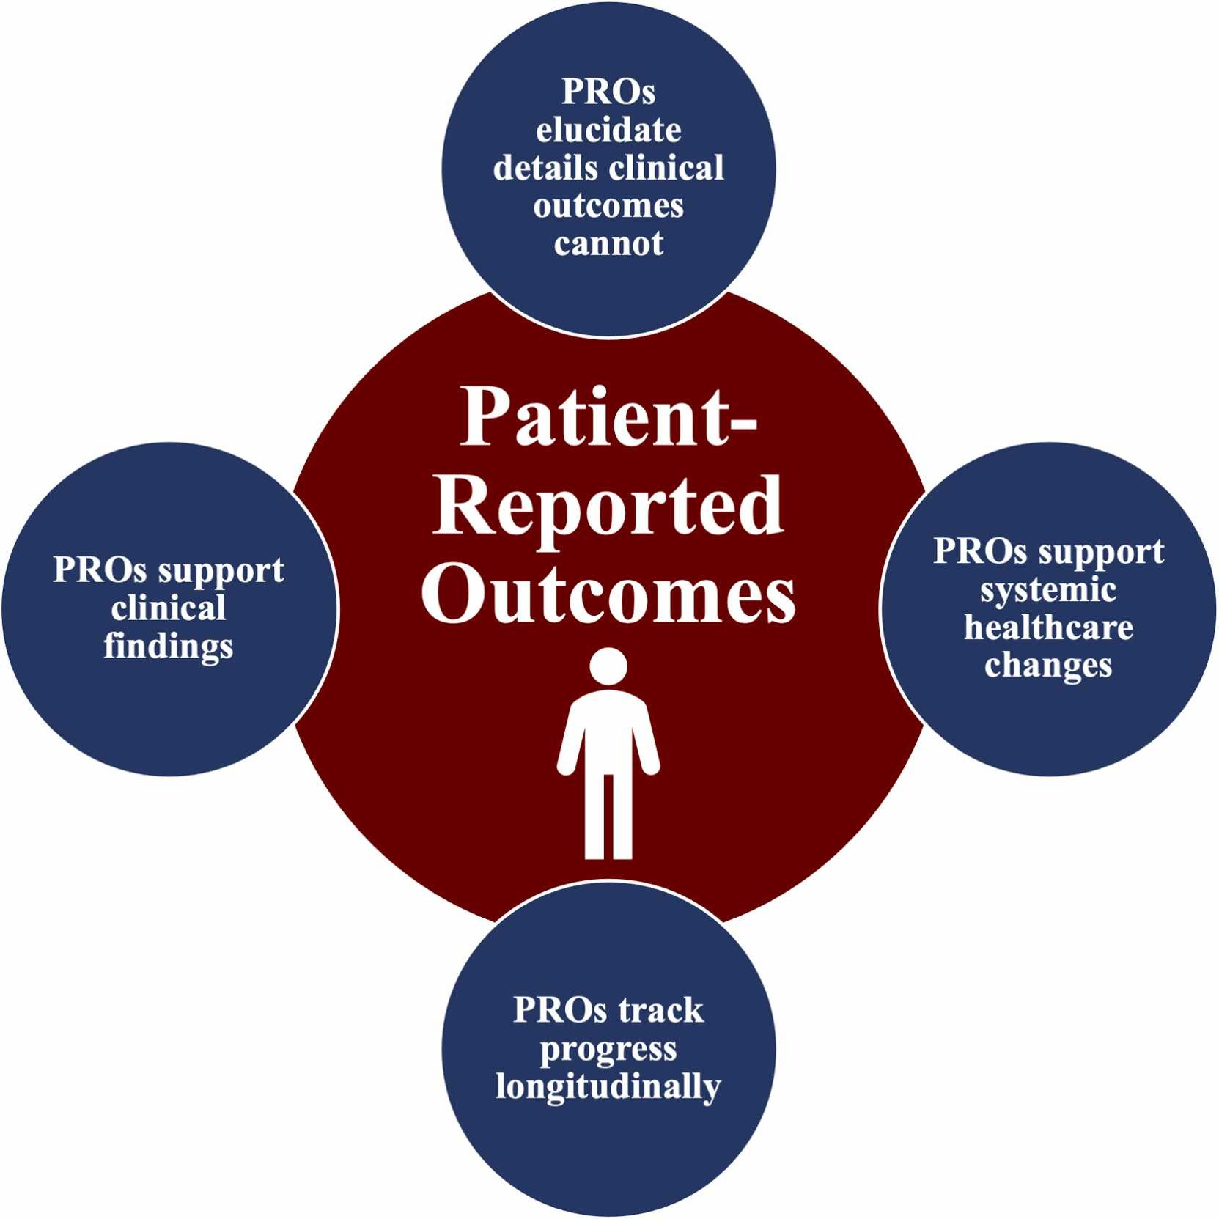
What Patient Reported Outcomes Offer
They measure what patients feel
They identify “hidden failure”
Can help spot early complications
Improves shared decision making
Governing bodies are starting to care

Slide 13
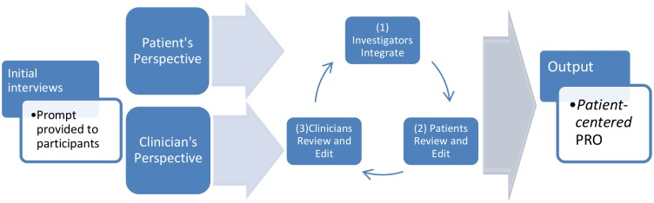
How to Make a Patient Reported Outcome Measure (PROM)

Slide 14

Conceptual Framework-Finding the Path

Slide 15

What is Your Question?
Overall health vs. condition specific?
Altering existing scale vs. creating new one?
General understanding vs. specific questions?
How are you going to use it?

Slide 16

Why Patients Matter. . .From a Data Perspective

Slide 17

This next slide is messy
Black bars: patient derived items
Grey bars: physician derived items (tie goes to the physician)
Height: How “good” the item was found to be
It’s a bladder procedure of some kind, no questions please

Slide 18
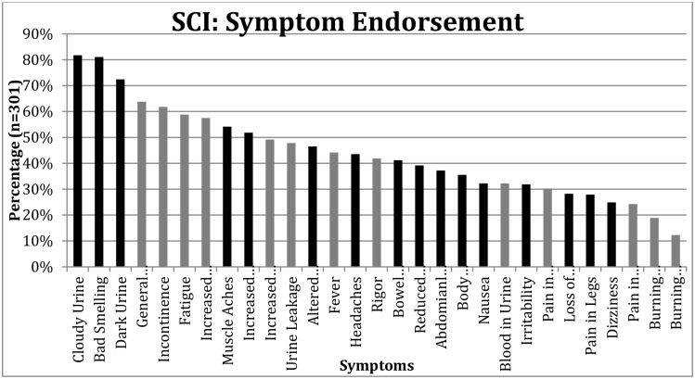

Slide 19
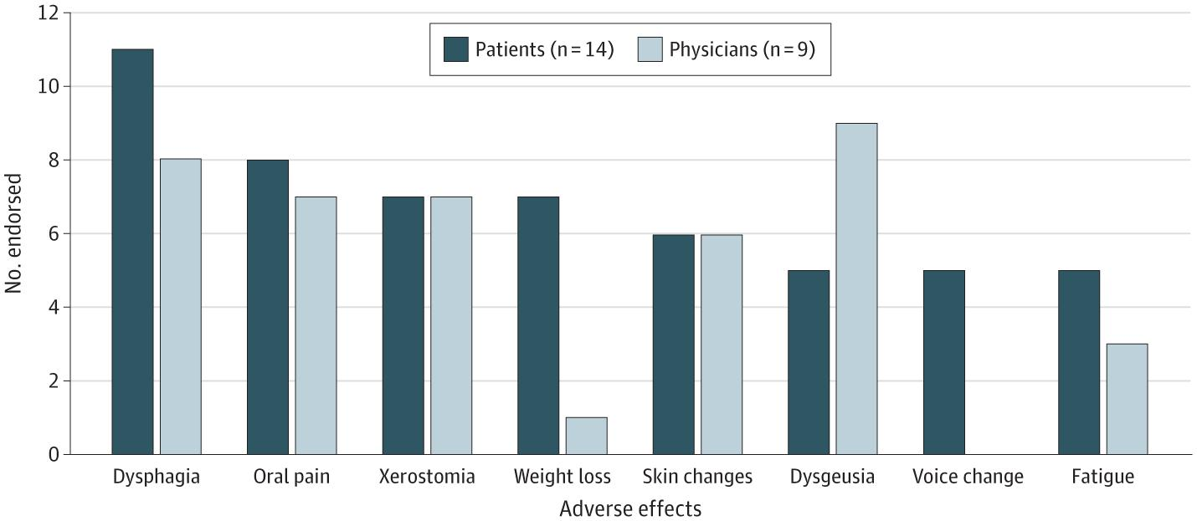
Figure

Slide 20
In General
Physicians value
Clear endpoints
Things they’ve read about
Things that make sense to them
Things they think they can fix
Patients value
Experience
Psychosocial aspects
Treatment burden
Quality of life concerns

Slide 21

Don’t Be Sad We Still Matter!
Identify things that are actionable
Identify shared goals
Refine questions to best identify improvements

Slide 22
What Makes a Good Item?
Specific
Scaleable
Measures one concept at a time
Avoids ”topping” or “bottoming” out
Actionable
Statistically valid
Bad question “Does your hernia cause you problems with things like bending or lifting heavy items”
Medium question ”How much does your hernia affect your ability to lift?”
Better question “In the past 7 days how often has your hernia prevented you from lifting something?”

Slide 23
Other things to think about
Population-will this be valid for everyone?
Men, women, age, surgical approach
Is it written so everyone understands it?
Language, reading level (6th grade or lower)
Is it feasible?
Short, fast.
Does EVERY question matter?
If you aren’t going to do anything with it don’t ask

Slide 24


Slide 25
My Two Cents
Hernia PROMs are good. . but can probably be improved
AHQ only looked at open procedures, young patients
HerQLes not designed with patients (also probably due for an update)
General PROMs not found to be very useful
Several hernia domains don’t have good PROs at all (inguinal, parastomals, etc).

Slide 26
More of my cents
Validate HerQles (and AHQ) in different populations/approaches
New PROs?
Use findings to generate discussion guides/shared decision making tools.

Slide 27

Thank You!
Courtney.collins@osumc.edu
253 651 1539

