Slide 1
Integrating Wearable Technology into Hernia Quality Outcome Measures
Jeremy Warren, MD FACS
University of South Carolina School of Medicine Greenville
Prisma Health Upstate

Slide 2
Disclosures
Johnson & Johnson: consultant

Slide 3
What do you tell your patients about postop recovery?
AWR (open RM+TAR) in 50 y/o male with 15x20cm hernia.
Restrictions
Expected return to “normal”
Reference

Slide 4
What do you tell your patients about postop recovery?
AWR (open RM+TAR) in 70 y/o female with 12x15cm hernia.
Restrictions
Expected return to “normal”
Reference

Slide 5
What do you tell your patients about postop recovery?
Unilateral lap inguinal hernia in 40 y/o healthy male.
Restrictions
Expected return to “normal”
Reference

Slide 6

What do we really know about post-op recovery?
Not that much …

Slide 7
Targeted Prehabilitation & Outcome Tracking in Ventral Hernia Repair
Next steps?
Control
>65
Frail
Study
>65
Frail
Prescribed Physical Activity
Observational
Any patient
Target N=40
Current enrollment 5
Target N=40+
Current enrollment 11
Barriers: elderly patients & technology

Slide 8

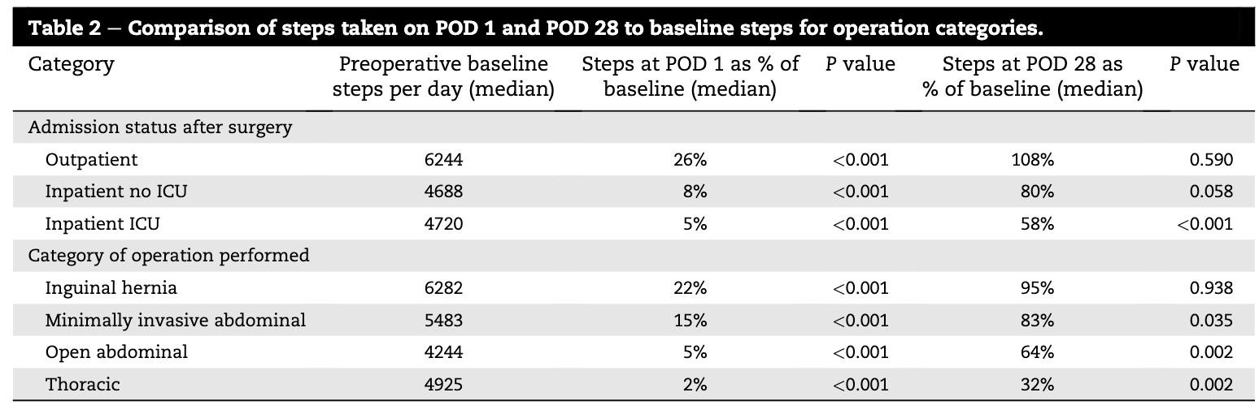
What do we really know about post-op recovery?
143 with preop and at least 2 weeks postop data
Carmichael H, et al. J Surg Rsrch 2019:244;368-373

Slide 9

What do we really know about post-op recovery?
Post-hoc analysis of prior study analyzing 84 outpatient surgery (various; 79% inguinal)
61% of patients <65y/o returned to preop step-count by POD 7
35% of patients >65y/o returned to preop step-count by POD 7
In patients <65y/o that failed to return to baseline, there was a 6x increase in return to the ED
Abbitt D, et al. Surg Endosc 2024;38:999-1004

Slide 10

What do we really know about post-op recovery?
87 patients measured with Oura ring to moderate and vigorous intensity measure metabolic-equivalent minutes (MAVI-MET) and step count.
Endpoints: 30-day complication, postop goal (>70% of baseline), and return to baseline (2-6 week postop follow-up)
Wang CC, et al. Gyn Onc 2024;186:137-143

Slide 11
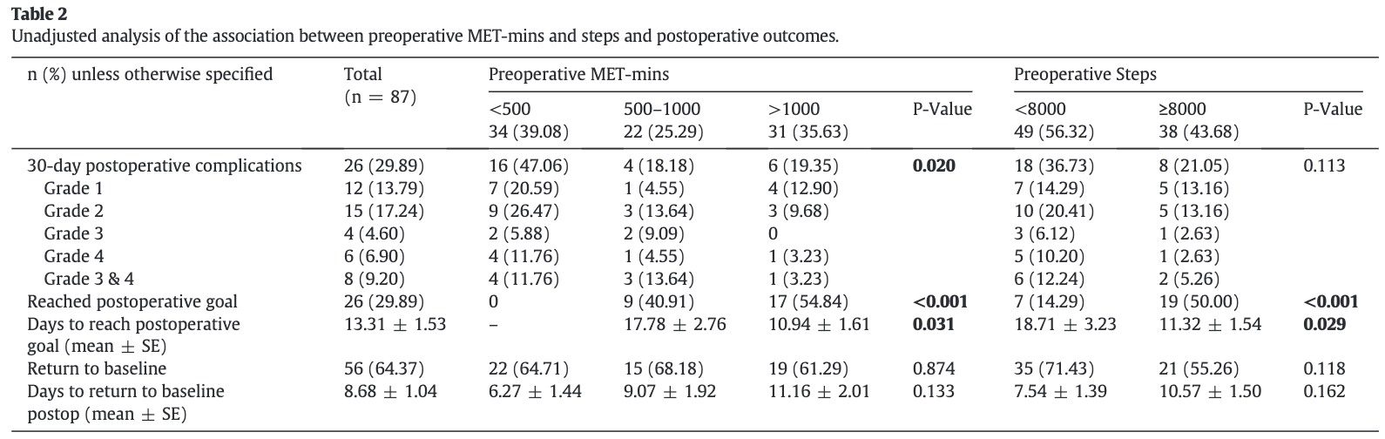
What do we really know about post-op recovery?
Wang CC, et al. Gyn Onc 2024;186:137-143

Slide 12
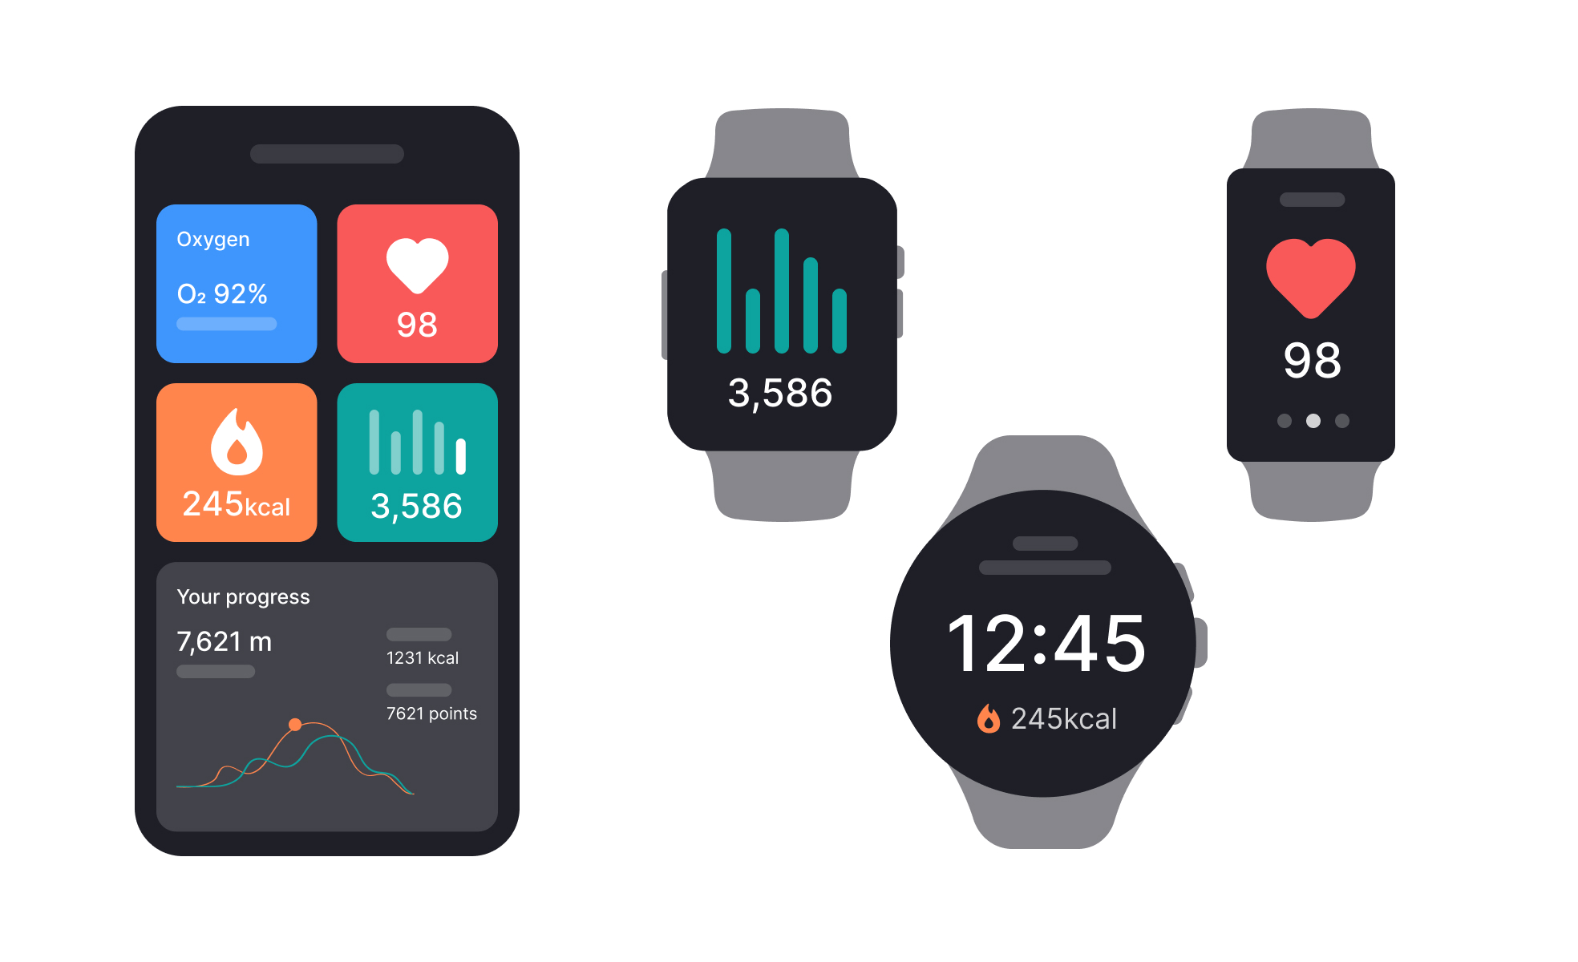

What can OBERD do for you?
Wearable technology to monitor perioperative patient activity

Slide 13
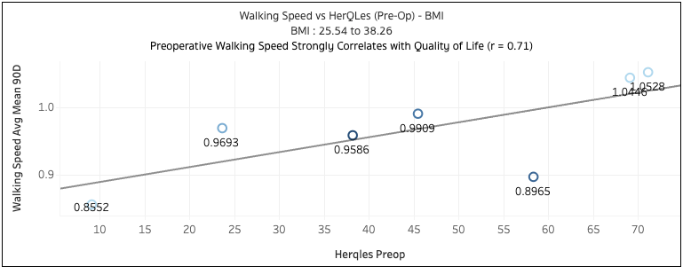
Preoperative Gait Speed Mirrors Patient-Reported Functional Status
What can OBERD do for you?
Reference

Slide 14
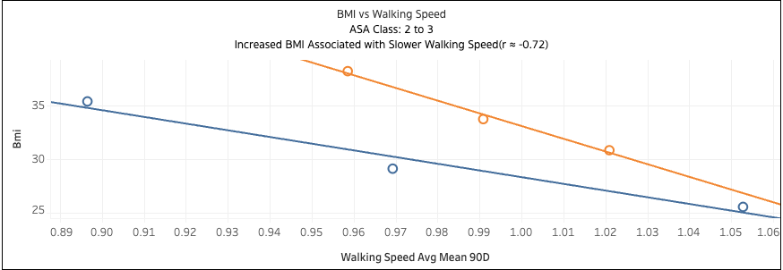
Higher BMI Associated with Reduced Digital Mobility
What can OBERD do for you?

Slide 15
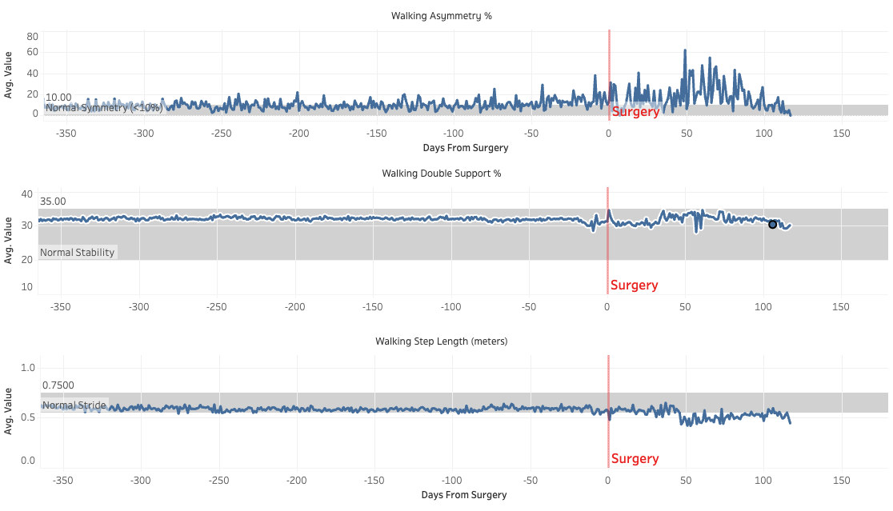
Gait Stability Trajectory Following Surgery
What can OBERD do for you?

Slide 16
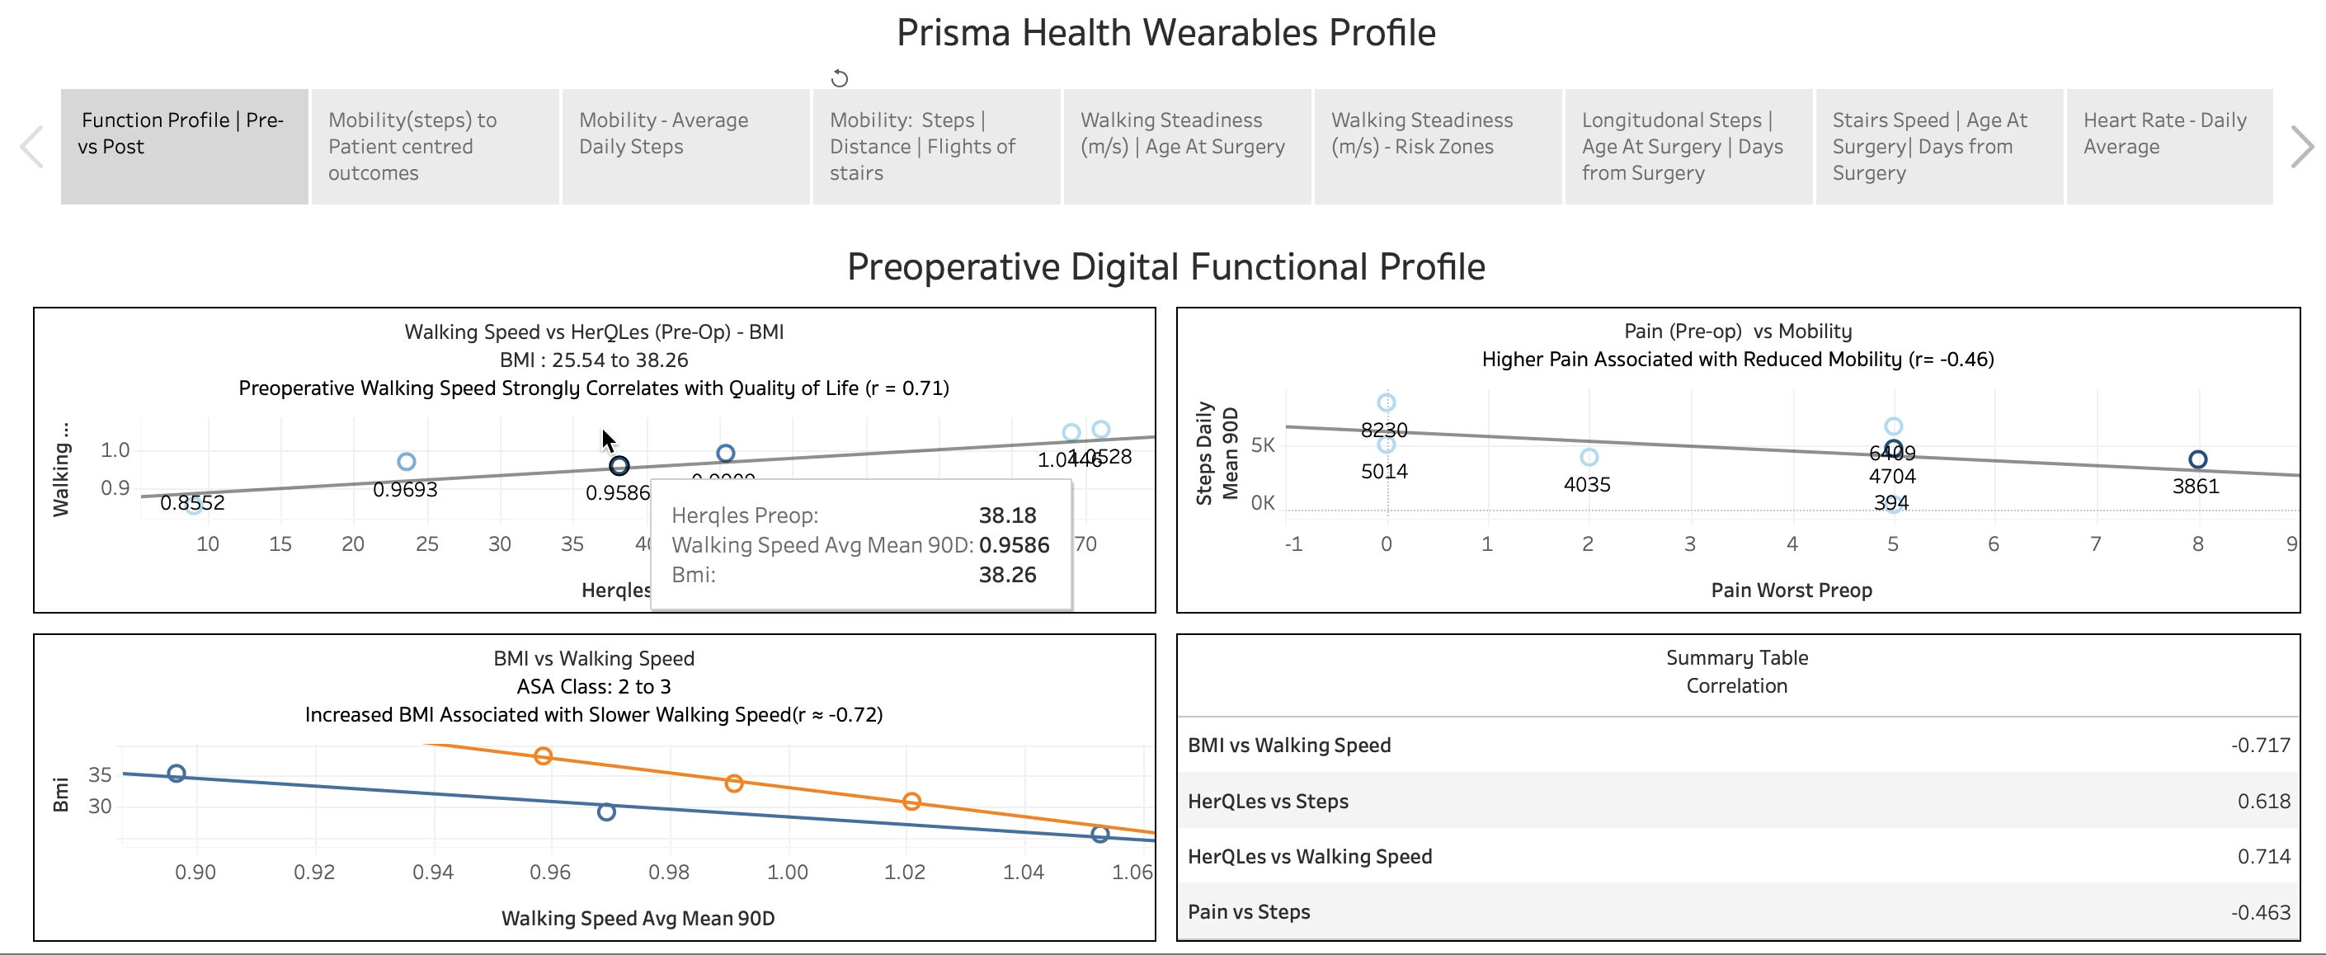
What can OBERD do for you?

Slide 17
Targeted Prehabilitation & Outcome Tracking in Ventral Hernia Repair
Next steps?
Control
>65
Frail
Study
>65
Frail
Prescribed Physical Activity
Observational
Any patient
Target N=40
Current enrollment 5
Target N=40+
Current enrollment 11

Slide 18
Next steps?
Barriers:
elderly patients & technology
IT, DUA, etc
Opportunities:
Multicenter through QC
More universal enrollment
PT vs self-directed / guided

Slide 19


