Slide 1

Long Term Outcomes after Shouldice Inguinal Hernia Repair
Marguerite Mainprize, PhD (Dr rer med candidate) MSc BSc(Hons) CCRP
Notes:
12 min presentation

Slide 2
What is the Shouldice Repair at the Shouldice Hospital?

Slide 3
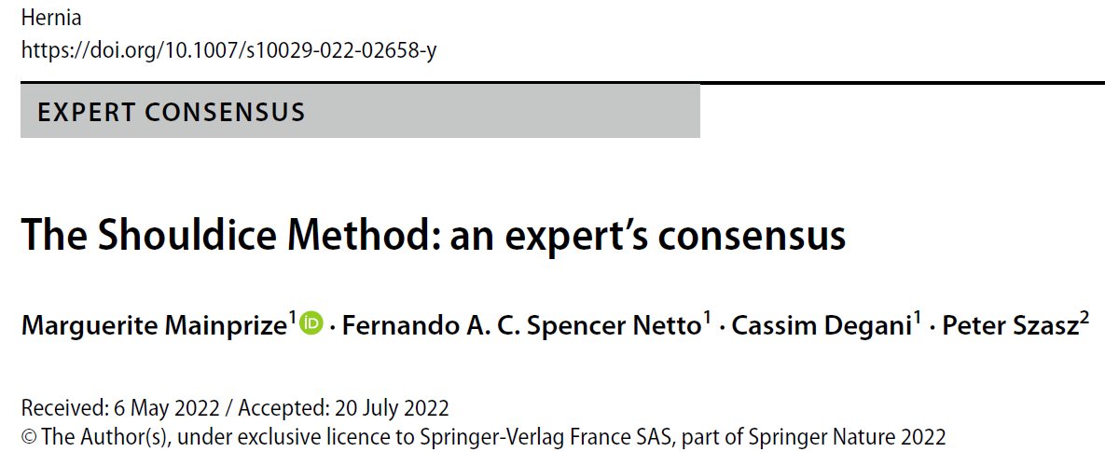
Preoperative Preparation
Clinical diagnosis, prehab, weight control, & setting expectations
2. Conscious sedation and Local anesthesia
3. Oblique inguinal incision, nerve identification, and femoral check

Slide 4
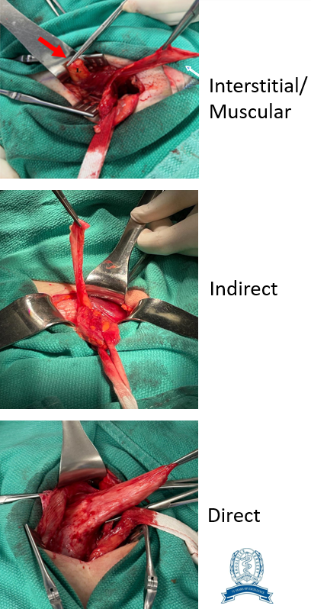
4. Splitting of Cremasteric Muscles
Resection of medial & posterior
5. Hernia identification and treatment
6. Posterior wall reconstruction
4 lines with permanent monofilament
7. Postoperative Management
Early ambulation, opioid sparing, & patient as teachers
Photo credit: Dr. Yilbas, Dr. Henao, Dr. Spencer-Netto, and Dr. Alnumay
Notes:
The identification, isolation, and dissection beyond the internal ring to fully mobilize and deal with indirect hernia sacs
The indirect sac should be reduced or excised
Identification, dissection, and reduction of a peritoneal protrusion, medial to the vas deferens at the level of the internal ring, to rule out the presence of a small or occult indirect hernia
It is important to identify possible interstitial hernias, surrounding the internal ring or in other locations where they can be commonly found
First line: transversalis fascia and the medial abdominal wall muscles and incorporate the proximal cremasteric stump
Second line: medial flap (transversus abdominus, internal oblique arch, and rectus) down to the shelving edge of the inguinal ligament
Third line: more superficial layers of the medial flap down to the shelving edge of the inguinal ligament
Fourth line: anterior wall medial muscles and more superficial portion of the shelving edge of the inguinal ligament/ external oblique fascia. Caliber of the internal ring is checked (to ensure enough space for the spermatic cord +/- nerves to pass through)

Slide 5
High volume centre (~7000 ops/year)
Experts (up to 700+ ops/year)
<430,000 operations to date
Notes:
High volume=large internal registry

Slide 6
Recurrence Rates

Slide 7

Patient Dinners

Slide 8

Beryl’s Table → ALL HERNIAS
2023: 0.71% (47/6660)
Cumulative Rate 1952-2023: 1.19%

Slide 9
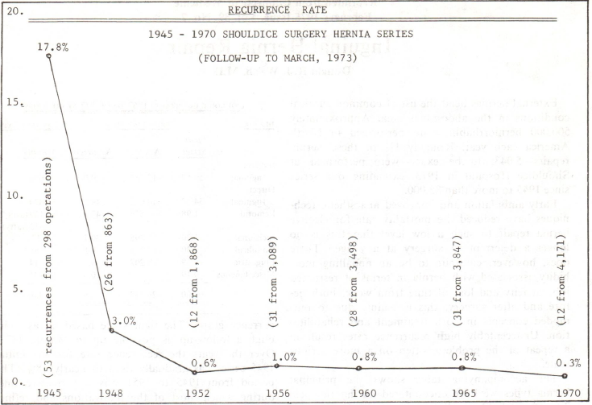
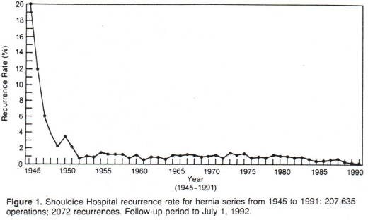
Previous Publications (1975 & 1990s)
Current Research on Inguinal Hernias: 0.23%
Notes:
PROMS- recent data, only inguinal hernias, n=1290

Slide 10
Chronic Postsurgical Pain

Slide 11
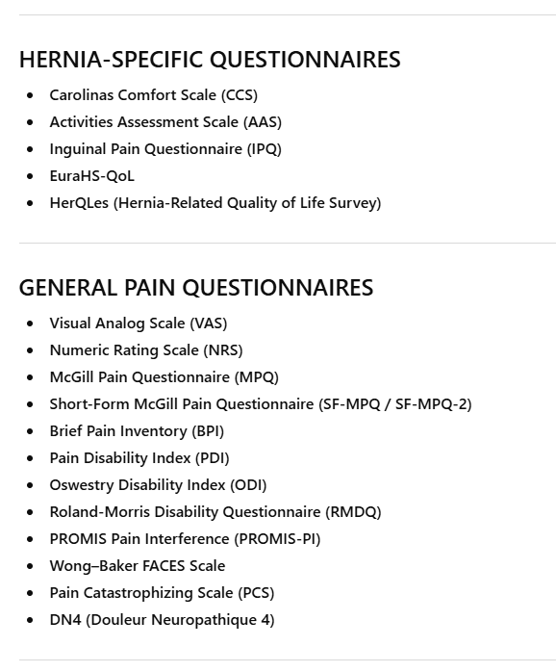
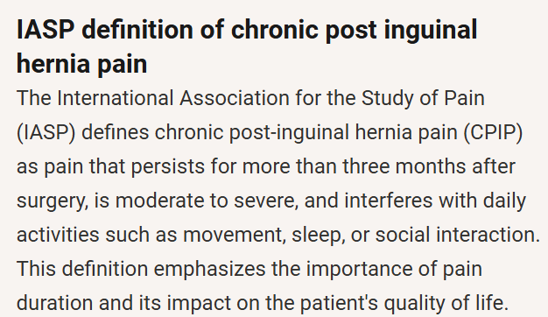

Slide 13
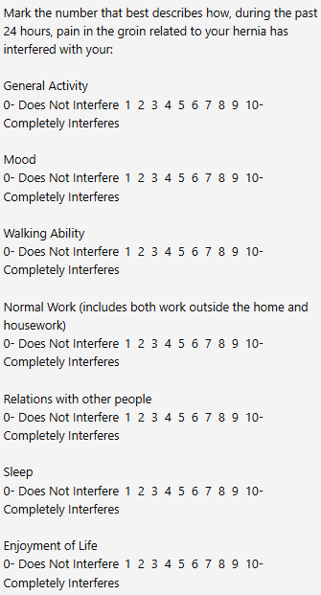
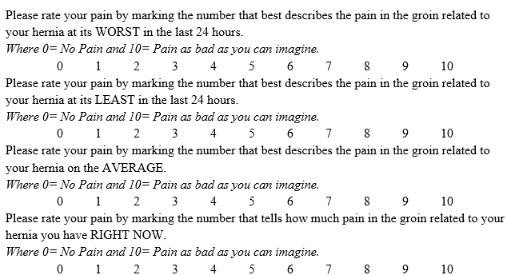
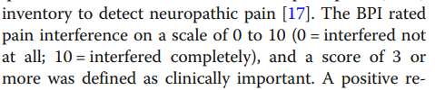
Brief Pain Inventory- Short Form: Pain Intensity & Interference
Bande et al, 2020

Slide 14
Who developed pain 1 year after surgery?
None to Mild
Preoperative Pain
85.5%
Moderate to Severe
1-Year Postoperative Pain
2.3%
Non-Clinically Significant
Preoperative Pain Interference
83.1%
Clinically Significant
1-Year Postoperative Pain Interference
0.8%
Notes:
N=1100

Slide 15
Return to Normal Activities

Slide 16

Pain Study, n=1100, inguinal hernias
98.5% reported returning to normal activities 1 year after surgery

Slide 17
Repair Satisfaction

Slide 18
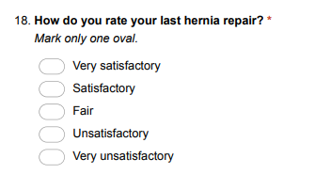


PROMs Study , n=1738, all hernias
95.7% of patients reported being satisfied or very satisfied with their Shouldice Repair 1-year after surgery
HERQL
Notes:
Hernia specific quality of life assessment instrument
Overall patient satisfaction with experience and care is HIGH- patients love the piano, grounds, food

Slide 19
Quality of Life

Slide 20
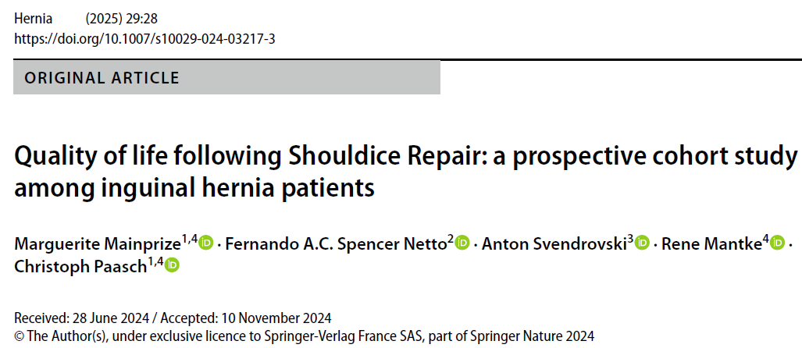

EQ-5D-3L (index & VAS)
Preop 6 months Postop
0.83 & 79.5 → 0.95 & 85.25 (p<0.001)
Notes:
Significant improvement in QOL
N=532, 6 months 189

Slide 21
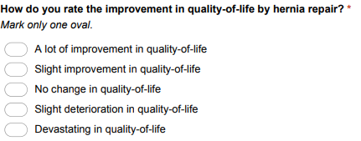
PROMs Study, n=1855, all hernias
85.4% of patients at 1 year after surgery reported an improvement in quality-of-life (slight or a lot) after undergoing hernia repair
HERQL
Notes:
Hernia specific quality of life assessment instrument

Slide 22
Comparison

Slide 23
Satisfaction
Shouldice
Lichtenstein
Laparoscopic
66.7% [Ahmadinejad et al, 2024]
95.7% [Shouldice Hospital PROMs Study, 2023-2025]
66.7% [Ahmadinejad et al, 2024]
95.8% [Romain et al, 2018]
88.7% [Tanphiphat et al, 1998]
97% [Romain et al, 2018]
Notes:
Ahmadinejad I, Jalali A, Ahmadinejad M, Soltanian A, Ahamdinejad Y, Shirzadi A, Chaghamirzayi P. Inguinal hernia: Lichtenstein VS Shouldice technique repair: A randomized controlled trial. Surg Open Sci. 2024 Jan 15;17:70-74. doi: 10.1016/j.sopen.2024.01.001. PMID: 38298435; PMCID: PMC10828570.
Laparoscopic vs open inguinal hernia repair. A randomized, controlled trial. Tanphiphat C, Tanprayoon T, Sangsubhan C, Chatamra K. Surg Endosc. 1998;12:846–851. doi: 10.1007/s004649900727.
Bowling K, El-Badawy S, Massri E, Rait J, Atkinson J, Leong S, Stuart A, Srinivas G. Laparoscopic and open inguinal hernia repair: Patient reported outcomes in the elderly from a single centre - A prospective cohort study. Ann Med Surg (Lond). 2017 Aug 29;22:12-15. doi: 10.1016/j.amsu.2017.08.013. PMID: 28878892; PMCID: PMC5577406.
Romain B, Gillion JF, Ortega-Deballon P, Meyer N; Club Hernie. Patient's satisfaction at 2 years after groin hernia repair: any difference according to the technique? Hernia. 2018 Oct;22(5):801-812. doi: 10.1007/s10029-018-1796-y. Epub 2018 Jul 3. PMID: 29971566.

Slide 24
Return to Normal
Shouldice
Lichtenstein
Laparoscopic
21 days [Shouldice Hospital Pain Study, 2019-2023]
19.8 days (SD:4.6) [Shah et al, 2022]
24.48 (SD:9.43) [Pereira and Varghese, 2022]
86.33 days (SD:8.5) [Varshney et al, 2024]
13.6 days (SD:6.8) [Shah et al, 2022]
80.71 days (SD:10.51) [Varshney et al, 2024]
Notes:
Shah, Mohammed Yunus MS^{a,*}; Raut, Pratik MS^{b}; Wilkinson, T.R.V. MS^{c}; Agrawal, Vijay MS^{b}. Surgical outcomes of laparoscopic total extraperitoneal (TEP) inguinal hernia repair compared with Lichtenstein tension-free open mesh inguinal hernia repair: A prospective randomized study. Medicine 101(26):p e29746, July 1, 2022. | DOI: 10.1097/MD.0000000000029746
Varshney A, Kawatra V, Watal U, Abraham NT, Avinash M, Pugalendhi AS, Rana S. Comparing Laparoscopic Total Extraperitoneal and Lichtenstein Mesh Repair for Inguinal Hernias: A Focus on Patient Outcomes. Cureus. 2024 Apr 1;16(4):e57373. doi: 10.7759/cureus.57373. PMID: 38694654; PMCID: PMC11061776.
Pereira C, Varghese B. Desarda Non-mesh Technique Versus Lichtenstein Technique for the Treatment of Primary Inguinal Hernias: A Systematic Review and Meta-Analysis. Cureus. 2022 Nov 18;14(11):e31630. doi: 10.7759/cureus.31630. PMID: 36540427; PMCID: PMC9759756.

Slide 25
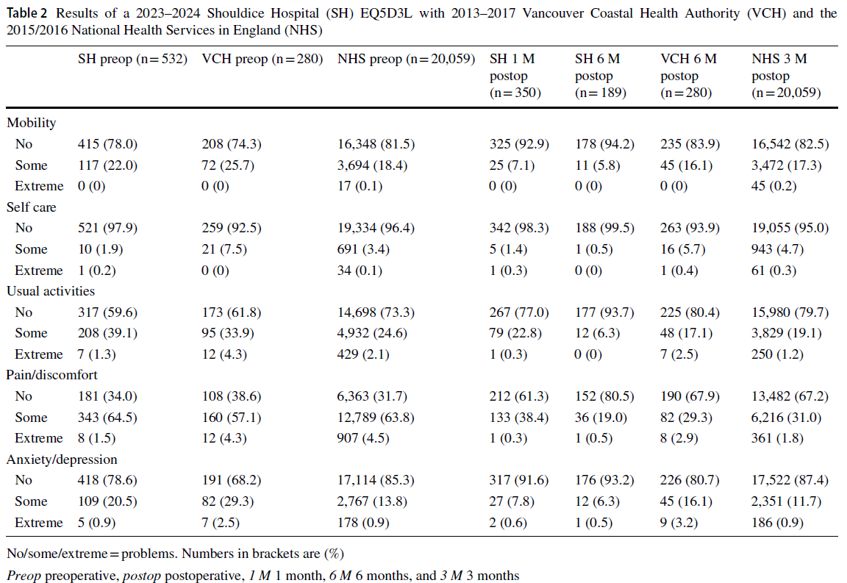
Quality of Life

Slide 26
CPIP
Shouldice
Lichtenstein
Laparoscopic
0.8-2.3% [Shouldice Hospital Pain Study, 2019-2023]
2.2% [Ahmadinejad et al, 2024]
6.5% [Pompeu et al, 2024]
4.6% [Ahmadinejad et al, 2024]
6.5% [Pompeu et al, 2024]
10.4% [Romero-Silva et al, 2025]
3-20% [Budney et al, 2025]
2.9% [TEP, Sunamak et al, 2018]
3.4% [TEP, Shah et al, 2022]
2.4-10.6% [TAPP, Mateska and Kunst, 2024]
Notes:
Romero-Silva MA, Caballero-Alvarado J, Zavaleta-Corvera C. Efficacy of totally extraperitoneal endoscopic hernioplasty (TEP) versus Lichtenstein hernioplasty: a systematic review and meta-analysis. Hernia. 2025 Apr 1;29(1):130. doi: 10.1007/s10029-025-03322-x. PMID: 40167793.
Sunamak O, Donmez T, Yildirim D, Hut A, Erdem VM, Erdem DA, Ozata IH, Cakir M, Uzman S. Open mesh and laparoscopic total extraperitoneal inguinal hernia repair under spinal and general anesthesia. Ther Clin Risk Manag. 2018 Oct 1;14:1839-1845. doi: 10.2147/TCRM.S175314. PMID: 30319265; PMCID: PMC6171754.
Chronic Pain after Laparoscopic Transabdominal Preperitoneal I...
Chronic groin pain after Lichtenstein inguinal hernia repair: partially absorbable light-weight mesh versus conventional light-weight versus heavy-weight mesh | Hernia

Slide 27
Recurrences
Shouldice
Lichtenstein
Laparoscopic
0.23-0.71% [Shouldice Hospital research & stats, 2023-2024]
3.3% [Bux et al, 2022]
7.1% [Ahmadinejad et al, 2024]
0.83% [Kockerling et al, 2015]
1.6% [Shah et al, 2022]
2.4% [Kamani et al, 2024]
3% [Ahmadinejad et al, 2024]
0.94% [TEP, Bux et al, 2022]
1% [TAPP, Niebuhr et al, 2017]
2.2% [TEP, Shah et al, 2022]

Slide 28
Summary

Slide 29
Retrospective data collection recurrence rate: 0.23-0.71%
Prospective cohort data CPIP: 0.8%-2.3%
Prospective cohort data quality of life: significant improvements from preoperative values

Slide 30
Future Work

Slide 31
Ongoing patient education and inclusion in research
Quality initiatives to continue to improve short- and long-term complications
Ongoing research!!
RCTs, collaborative work, etc.
Notes:
Ongoing collaborations with researchers and surgeons around the world
18 publications in the last 5 years, more under peer review and being written up
Ongoing short and long term follow up program that has collected data from over 7400 patients in the past 2 years

Slide 32

Thank you!
mmainprize@shouldice.com
905-889-1125, 297

