Slide 1
When the Hernia is Fixed But The Patient is Not
Courtney Collins MD MS FACS
Ohio State University
ACHQC Summit 2026

Slide 2


Is This A Good Idea?
Derrick- Brand new to boarding. . and the world
Kelly –ACC Champion Snowboarder
“Could I do that?

Slide 3
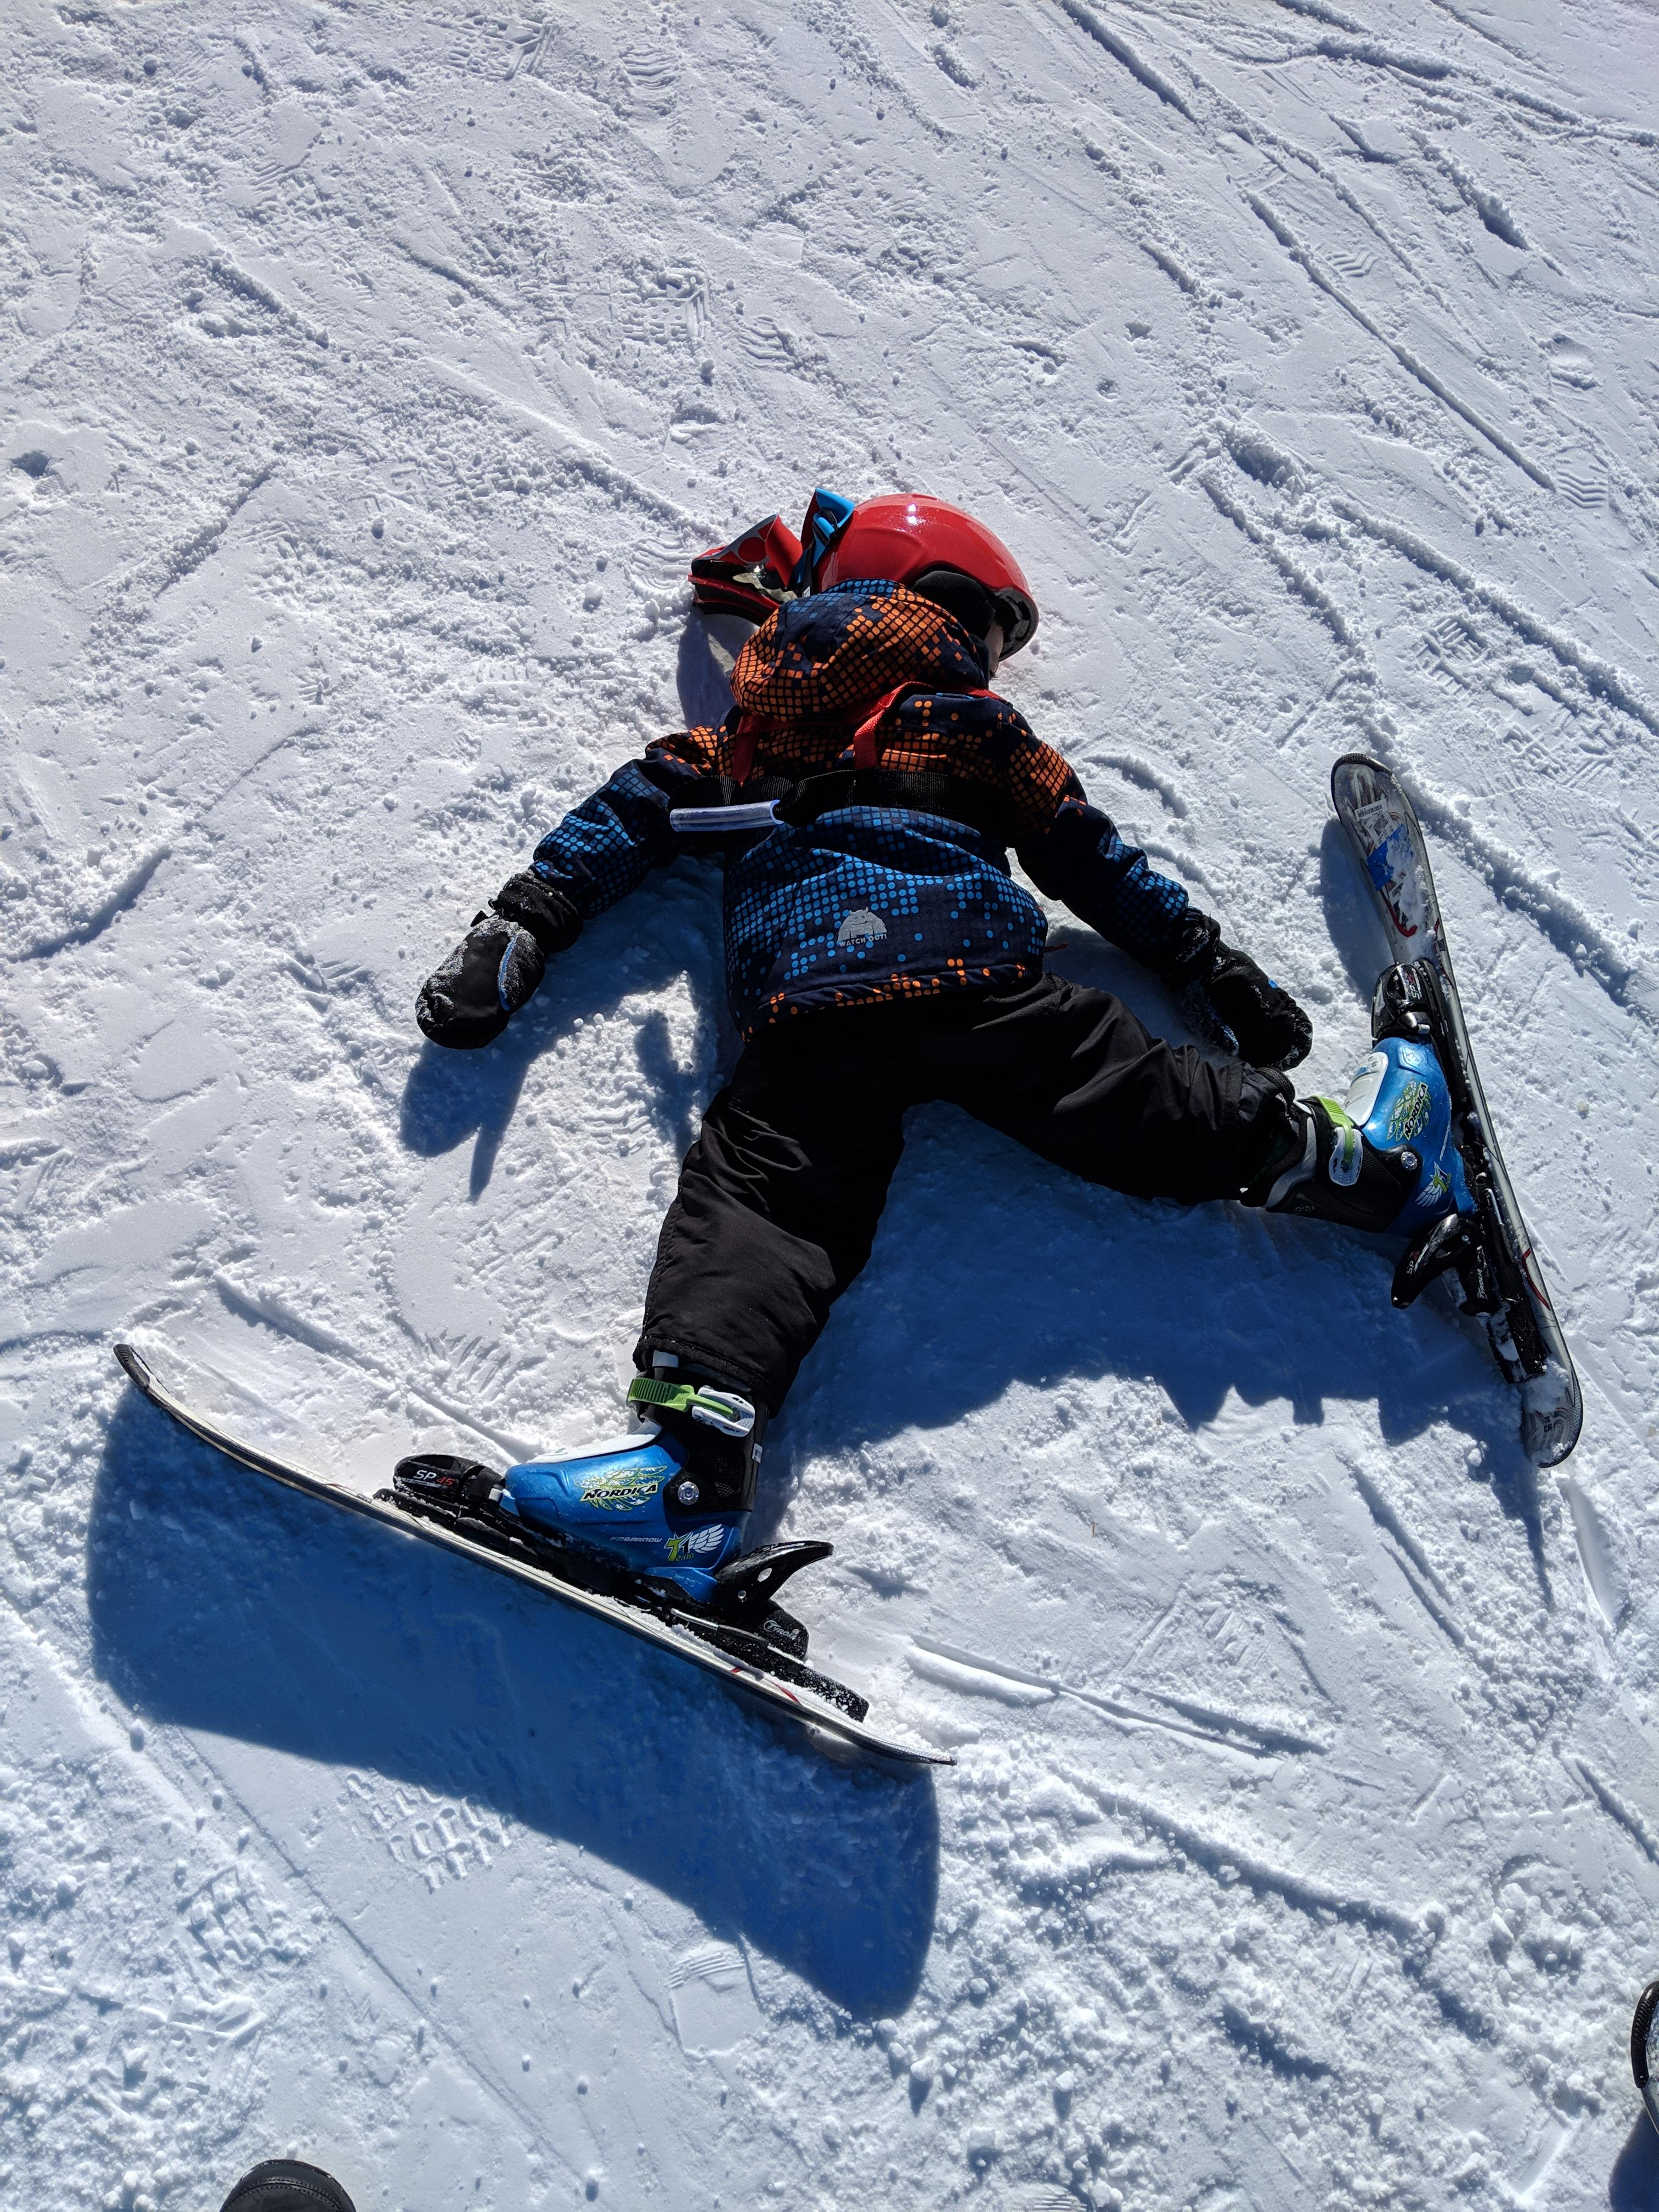



Slide 4








Who Regrets Surgery- A Journey
ASA/comorbidities: 0
Age: 0-1.5x
Function: 1-2x
Female: 0-3x
Complications: 2-4x
Severe pain: 2x
Depression: 2-5x
Expectation mismatch: 5-7x

Slide 5
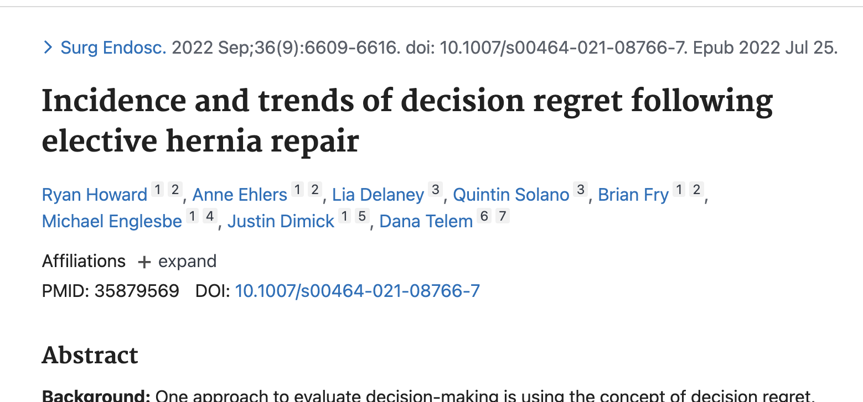
What About in Hernia Repair
Ventral Hernias-11% Regret
Inguinals-9% Regret
Most predictive:
  Low SES (OR 1.5)
  Laparoscopic approach (OR 2.1)
  Complications (2.33 OR)
  Readmission (2.7)
Not predictive
  Age
  Sex
  Race
  Comorbidities
  Robotic approach
Most predictive:
  ED visit (OR 2.0)
  Female (OR 1.4)
  Readmission (OR 4.2)
  Smoker (OR 1.4)
Not predictive
  Age
  Race
  SES
  Robotic approach
  Complication

Slide 6
Are Quality of Life and Decisional Regret the Same?
Maybe?
Post op QoL is associated with regret in multiple specialties (head and neck, cardiac, colorectal)
BUT so is decreased pre-op QoL
Is the difference what matters?

Slide 7
Who Isn’t Benefitting from Hernia Repair?

Slide 8
The Analysis
Adult QC Patients
Elective Ventral hernias
All approaches, all sizes, all techniques
HerQLes scores at least at 30 days
Outcome: HerQLes score improvement (meeting MCID)
Secondary: Temporal trends in HerQLes improvement, predictors of QoL trends

Slide 9
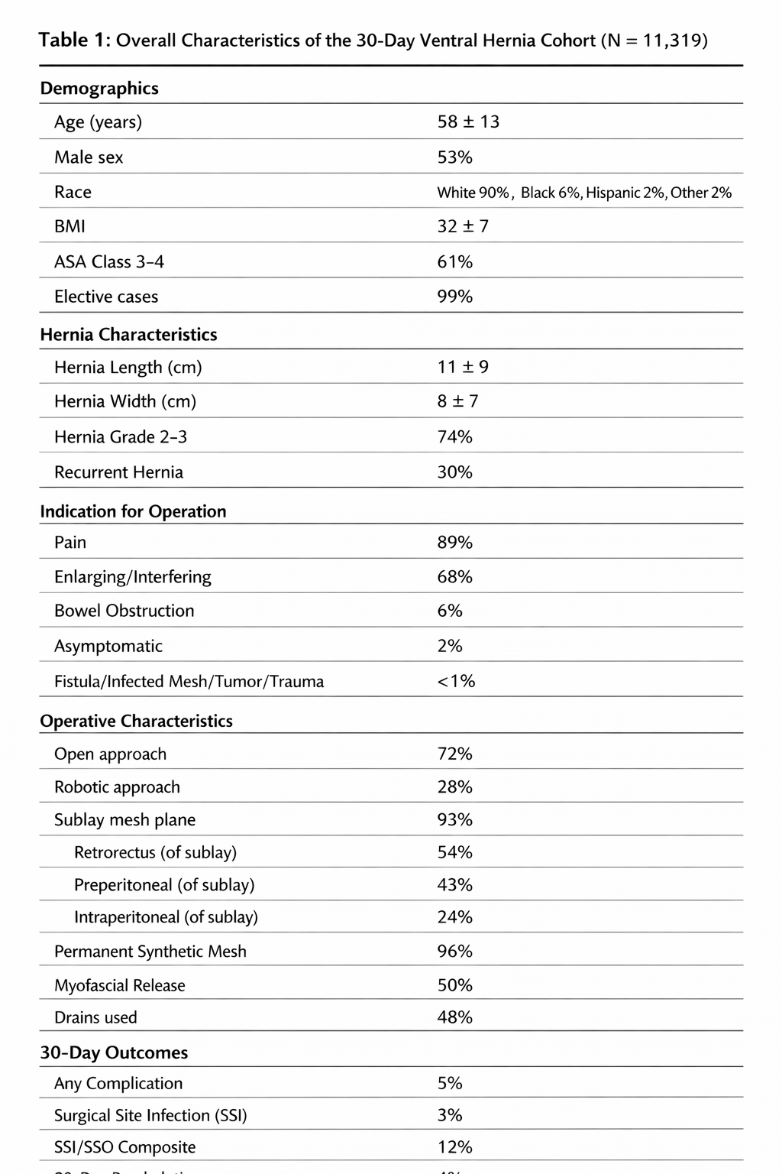
Population

Slide 10
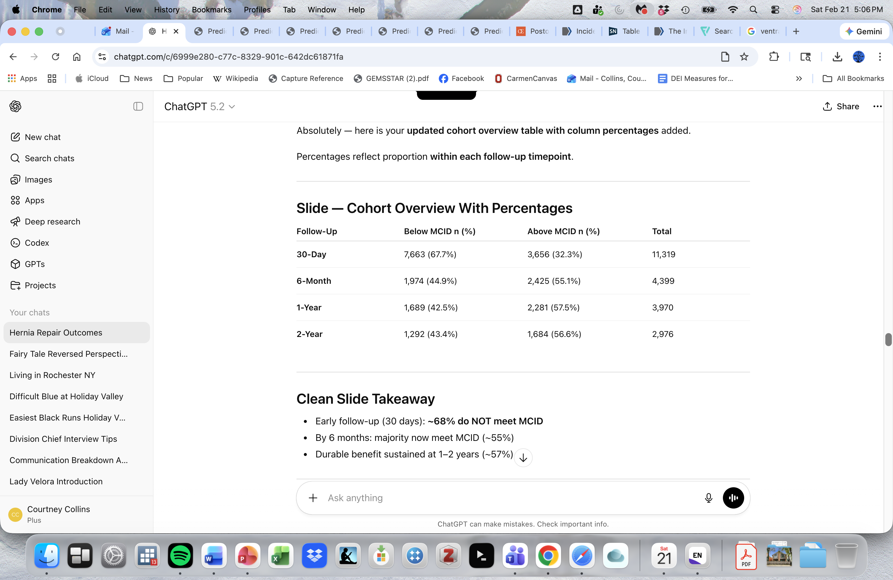
QoL Trends
Gains are small in the first 30 days
Significant jump at 6 months
Then a plateau
Only 60% achieve MCID?

Slide 11


Slide 12
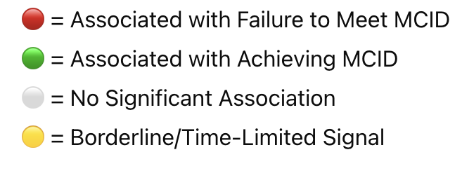

Slide 13
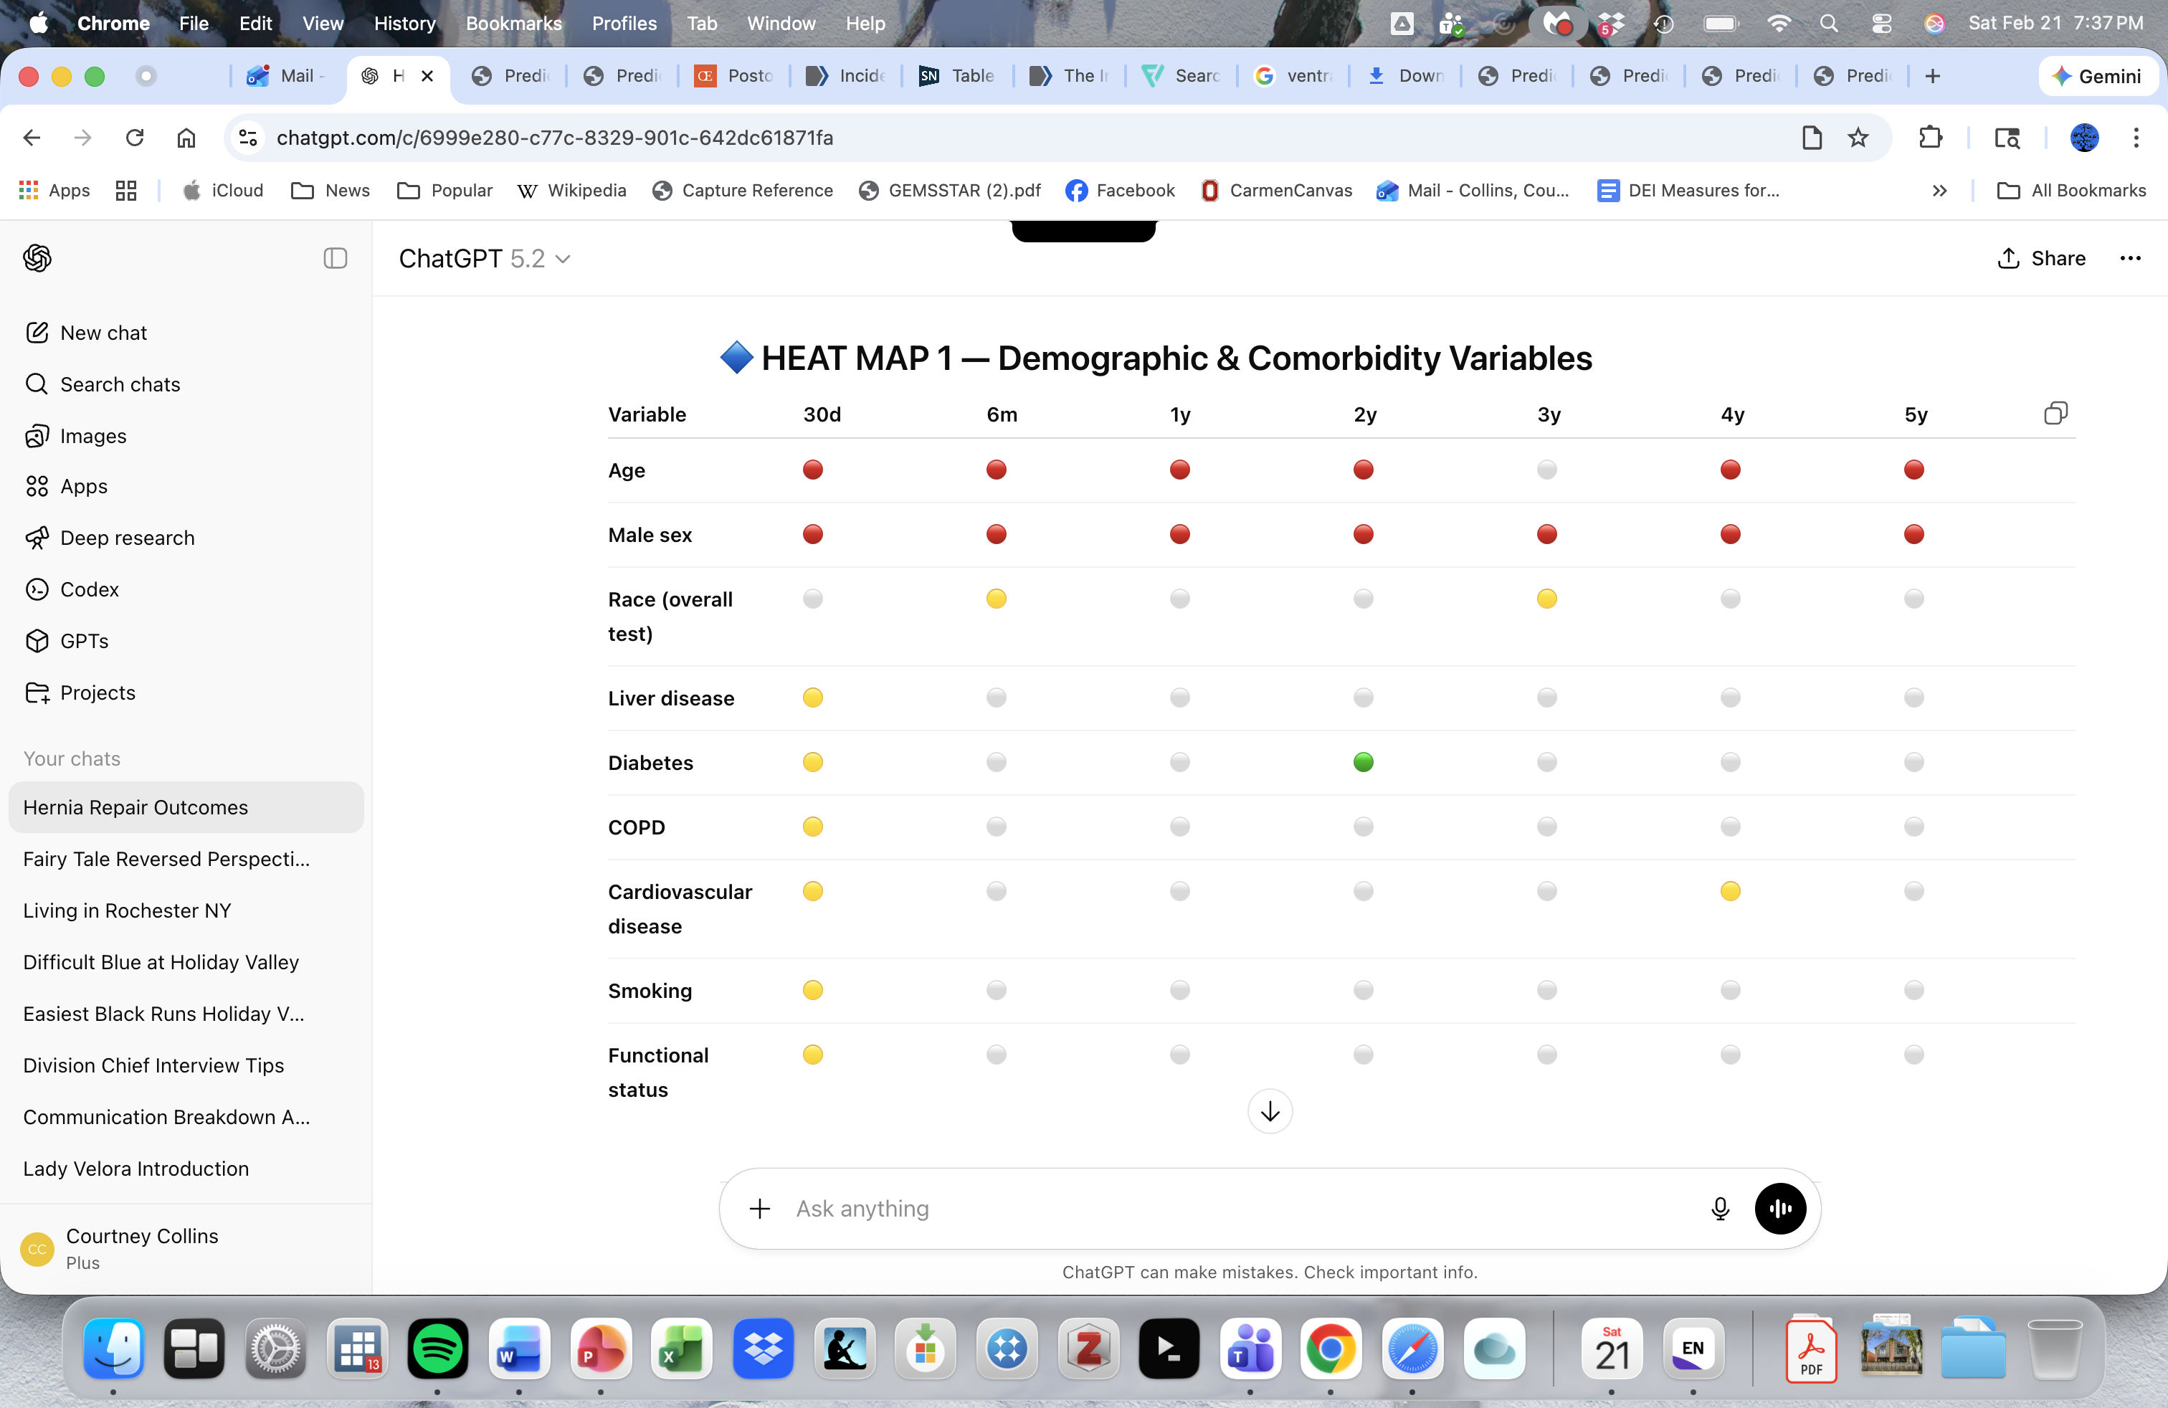
Demographics

Slide 14

Comorbidities

Slide 15
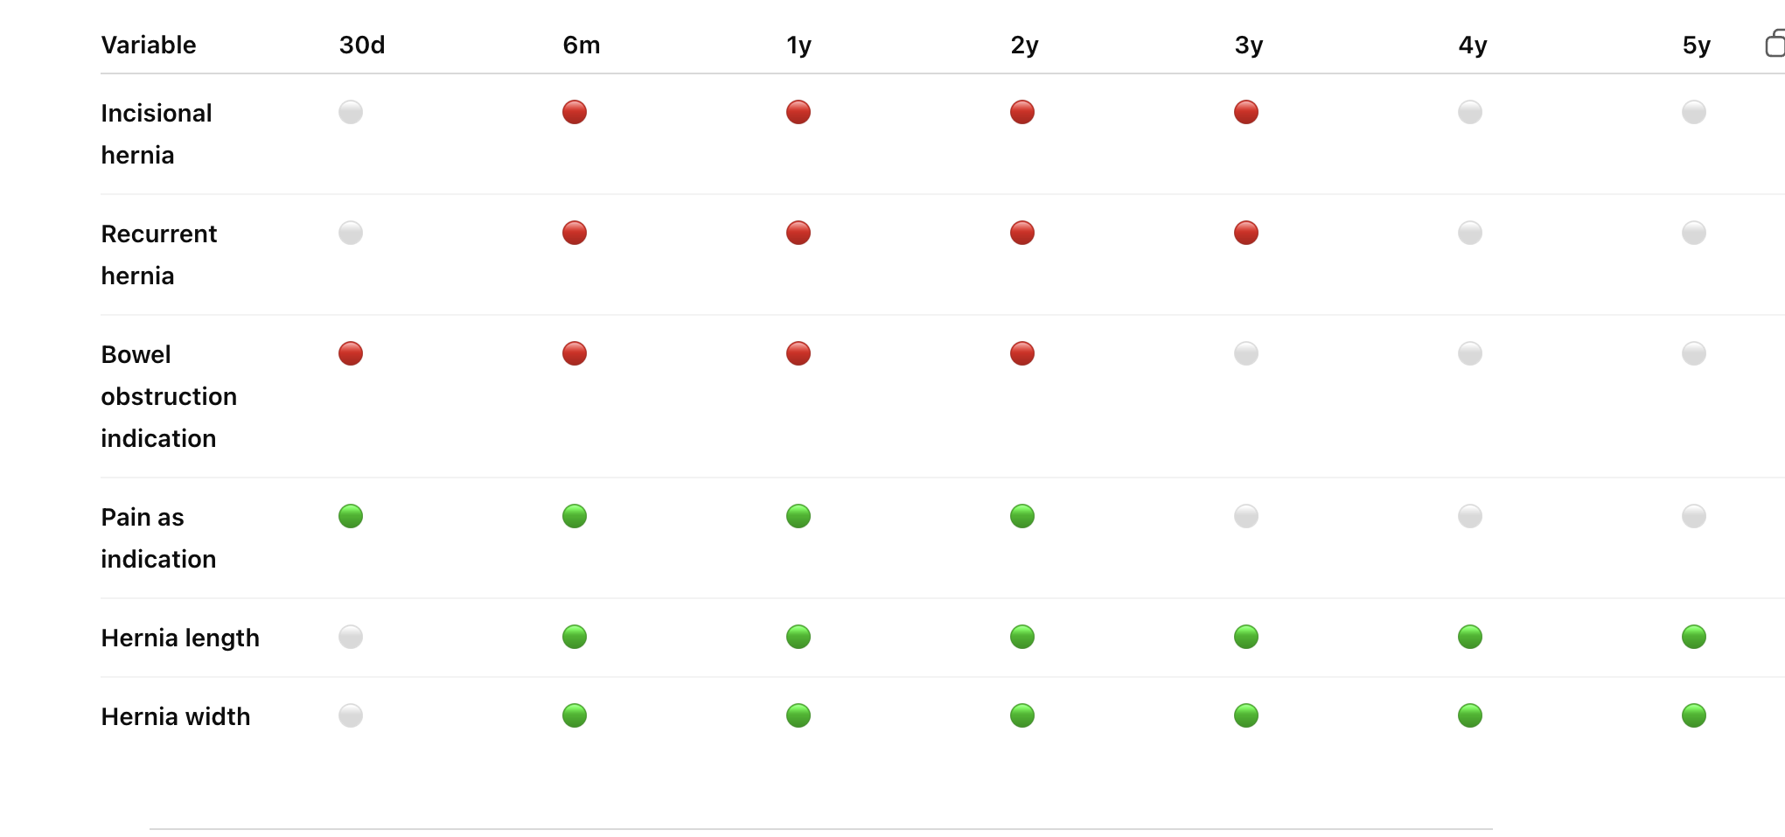
Indication and Hernia Biology

Slide 16
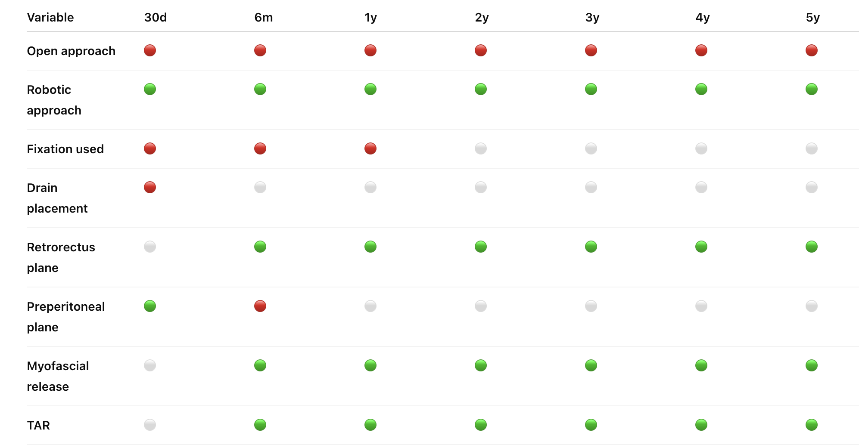
Operative Approach

Slide 17
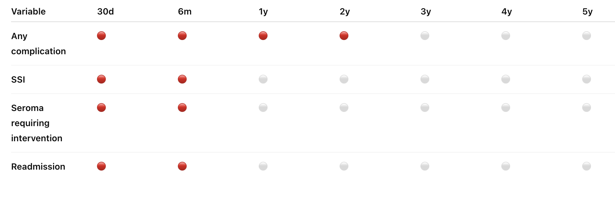
Complications

Slide 18


Slide 19
Big Picture
Predictors of MCID Failure
Predictors of MCID Success
Male
Older Age
Open approach
Early complications
Bowel Obstruction
Incisional/recurrent hernias
Retrorectus repair/TAR
Large hernia size
Pain indication

Slide 20

Temporal Trends
Early
  Biology dominates
  Complications, indication matter
  Size does not matter
Mid way
  Hernia biology starts to play a role
  Complex hernias plateau
Long term
  Indication, complication effects vanish
  Structure and size persist
  Demographic effects persist

Slide 21
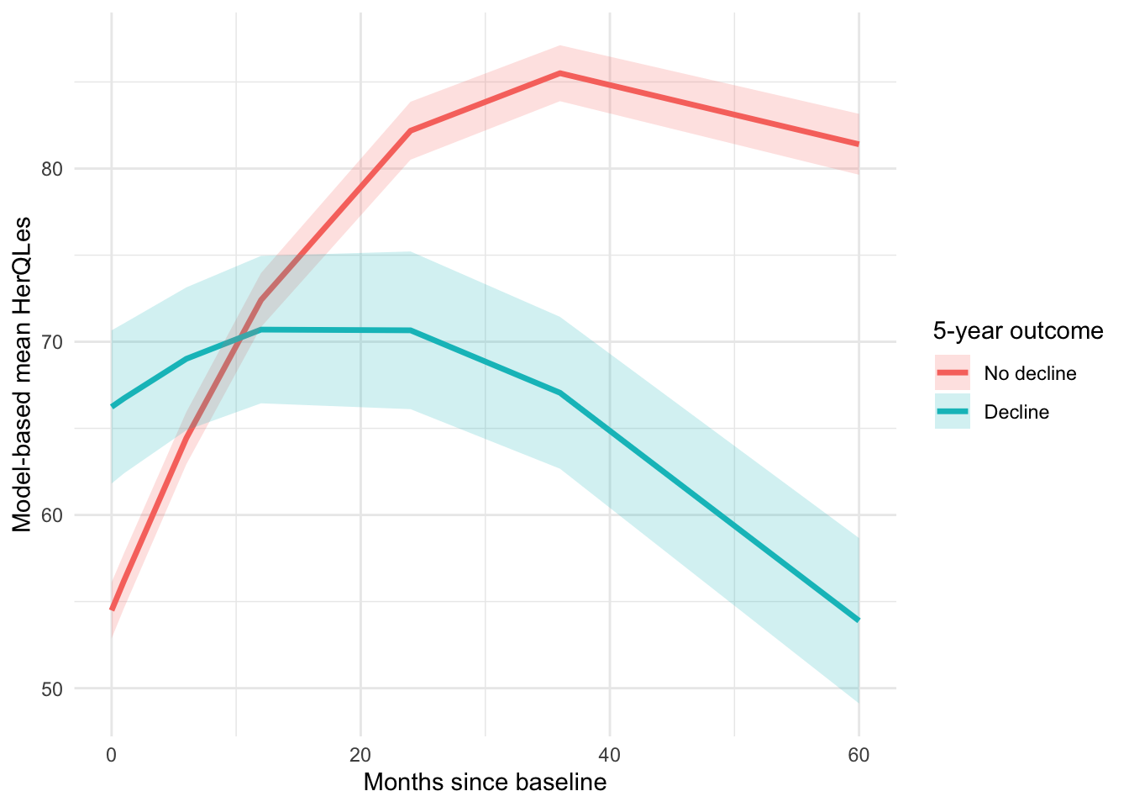
Are Some People Worse Off After Surgery?
Yup!
12% of people report a decrease in QoL compared to pre op.
Still analyzing this group-but overall similar trends

Slide 22

Parting Thoughts
I need to do a lot more math.
Certain groups do appear to benefit less from ventral hernia repair
Early and late QoL trends are different
What about small hernias?
Could we use HerQLes better?
How will QoL and decisional regret interact?

Slide 23

Thank you!
Courtney.collins@osumc.edu
253-651-1539

