Slide 1
Anatomical vs Flat Mesh for Minimally-Invasive Inguinal Hernia Repair: An ACHQC Analysis
Ayesha Siddiq MD, Nicolette Winder MD, Xinyan Zheng MS, Joshua Lyons MD FACS, Jeffrey Marks MD FACS, Samuel Zolin MD.
Notes:
• Good morning. My name is Ayesha Siddiq, and I am a research associate at University Hospitals Cleveland.
• Today I will be presenting our study comparing anatomical versus flat mesh for minimally invasive inguinal hernia repair.

Slide 2
Disclosures
Dr. Jeffrey Marks - Consulting Fees for Boston Scientific and Steris Endoscopy.
Dr. Joshua Lyons - Consulting fees for Steris Endoscopy.
Study data obtained from the ACHQC registry. No endorsement of any commercial products is implied.
Notes:
• here are our disclosures

Slide 3
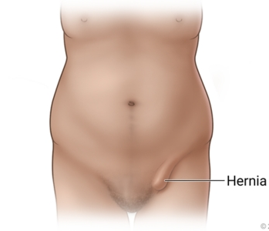

Background
Inguinal hernia repair (IHR) is one of the most frequently performed general surgical procedures worldwide
About 800,000 IHR performed annually in the United States.
Direct hospital cost per inguinal hernia repair: ≈ $3,000–$5,000
Estimated national annual expenditure - up to $48 billion
Notes:
Inguinal hernia repair (IHR) is one of the most frequently performed general surgical procedures worldwide

Slide 4


Current Guidelines
Stabilini C, van Veenendaal N, Aasvang E, Agresta F, Aufenacker T, Berrevoet F, Burgmans I, Chen D, de Beaux A, East B, Garcia-Alamino J. Update of the international HerniaSurge guidelines for groin hernia management. BJS open. 2023 Oct;7(5):zrad080.
Notes:
Minimally invasive inguinal hernia repair is now the recommended first line approach for primary inguinal hernias according to the most recent HerniaSurge guidelines, due to lower risk of postoperative pain

Slide 5
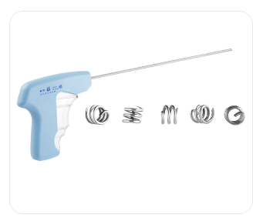
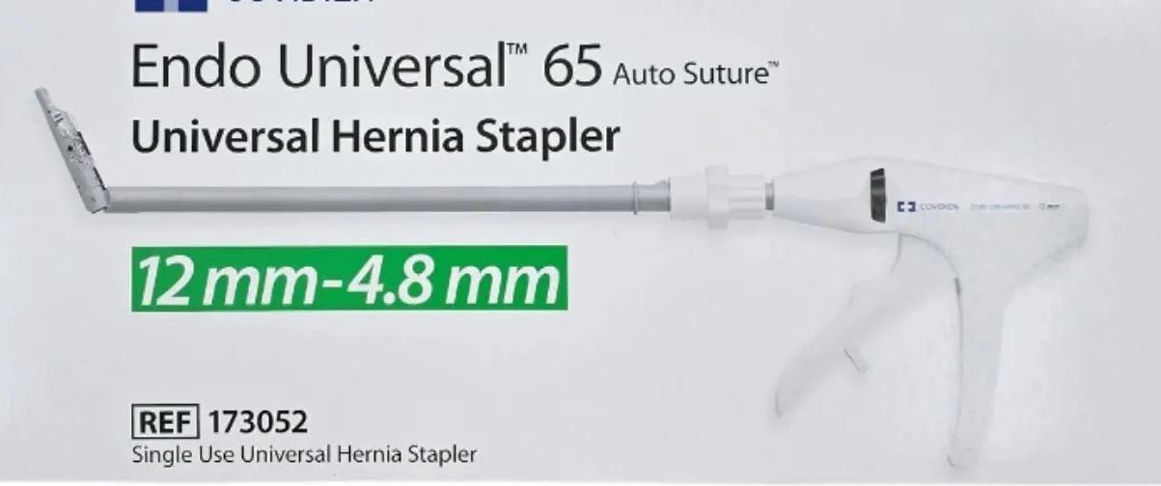
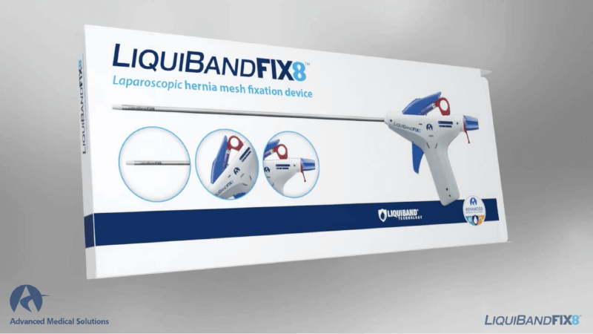
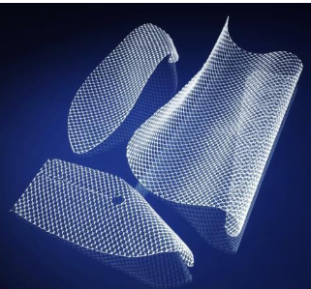
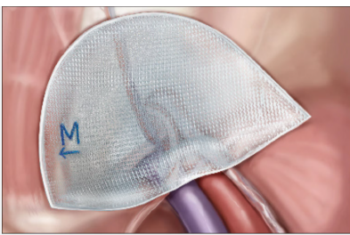
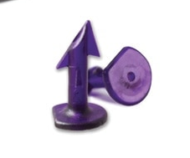


Technical Aspects of MIS Inguinal Hernia Repair
Notes:
There are a number of technical factors that may influence postoperative outcomes after minimally invasive inguinal hernia repair. Mesh fixation methods and mesh weight have been studied extensively, however the effect of mesh configuration, has not been explored.

Slide 6
Specific Aim
Evaluate the clinical outcomes of anatomical vs flat mesh in MIS IHR.
Hypothesis: Patients undergoing repair with anatomical mesh will have decreased 30-day pain compared to patients undergoing repair with flat mesh.
Notes:
• Our objective was to evaluate clinical outcomes of anatomical versus flat mesh in MIS IHR repair using data from the ACHQC.
• We hypothesize that Patients undergoing repair with anatomical mesh will have decreased 30-day pain compared to patients undergoing repair with flat mesh.

Slide 7
Study Design and Methods
Retrospective analysis of prospectively collected data from the ACHQC
Inclusion
Adults (≥18 years)
Elective repair
Clean wound class (CDC 1)
Primary hernia - unilateral or bilateral
MIS approach (laparoscopic or robotic)
TAPP or TEP
Any fixation technique, including no fixation
30-day follow-up with patient-reported outcomes
Exclusion
Repair of a recurrent inguinal hernia
Barrier-coated mesh use
Bilateral repair with flat mesh on one side and anatomical mesh on the other side
Concomitant procedure
Notes:
• We performed a retrospective analysis of prospectively collected ACHQC registry data.
• We included adult patients who underwent elective clean primary inguinal hernia repair Via a minimally invasive approach either laparoscopic or robotic,
• Both TAPP and TEP approaches were eligible.
• Any fixation technique was included, including cases with no fixation.
• and cases with available 30-day follow-up with patient-reported outcomes included
• We excluded cases involving recurrent inguinal hernia repair, use of barrier-coated mesh
• also excluded bilateral repairs in which flat mesh was used on one side and anatomical mesh on the other.

Slide 8
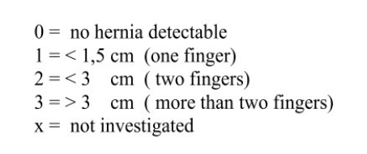
Study Design and Methods
Propensity Score Matching (PSM)
Age
Gender
BMI
ASA classification
Smoking status
Prior pelvic surgery
Indication for surgery
Unilateral or bilateral - exact matching
Laparoscopic or Robotic
TAPP or TEP
Perioperative pain control (TAP block, local infiltration)
Defect closure (yes/no)
Nerve identification
Mesh fixation method
Hernia size based on EHS classification
Notes:
Matching included key demographic, hernia characteristic, and operative variables, listed here.
Of note, we matched exactly on whether hernias were unilateral or bilateral, so that unilateral cases were compared with other unilateral cases and bilateral with bilateral.
EHS classification was included in this matching, and patients were classified based on the largest component of their hernia. (For instance, a patient with a class 1 indirect hernia and a class 2 direct hernia would be considered a class 2.)

Slide 9
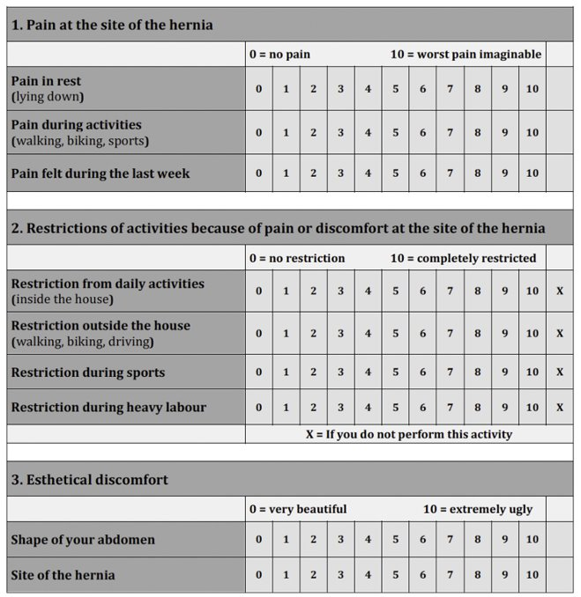

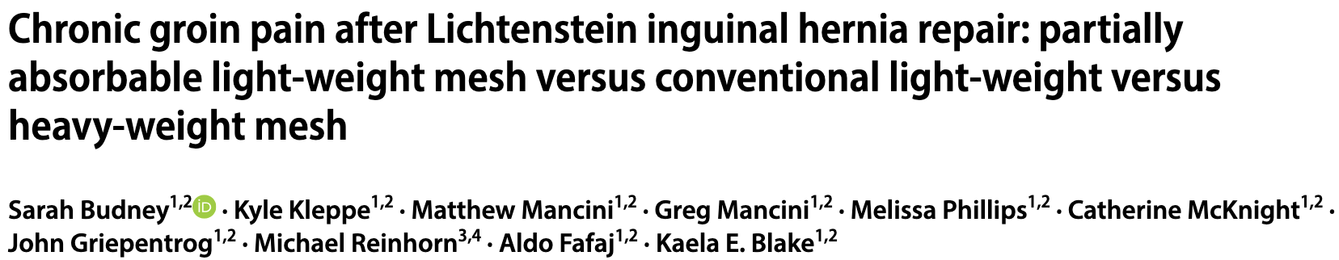
Study Design and Methods
Primary outcome - Postoperative pain at 30 days measured by EuraHS-QoL pain sub-domain.
Overall EuraHS scores range from 0 to 90
Higher = worse
Minimal Clinically Important Difference (MCID) Pain – 3 Activity Restrictions – 5 Cosmesis – 2 Overall Score – 10
Chronic Postoperative Inguinal Pain (CPIP) EuraHS pain domain score ≥3 at 6+ months
Notes:
Our primary outcome was postoperative pain at 30 days, measured using the EuraHS- QoL pain subdomain.
"The EuraHS is a validated quality of life instrument for groin hernia repair.
Shown here, it consists of 3 sub-domains which include pain, activity restrictions, and cosmesis.
It is scored overall on a scale from 0 to 90. Higher scores indicate worse outcomes.
Prior work from the ACHQC has determined that the minimal clinically important difference, or MCID, is 3 for the pain domain, 5 for activity restrictions, and 2 for cosmesis, with 10 being the MCID for the overall instrument.
A secondary outcome was chronic postoperative inguinal pain, which has previously been defined in publications from this registry as a EuraHS pain domain score of 3 or greater at 6 month or more follow-up."

Slide 10
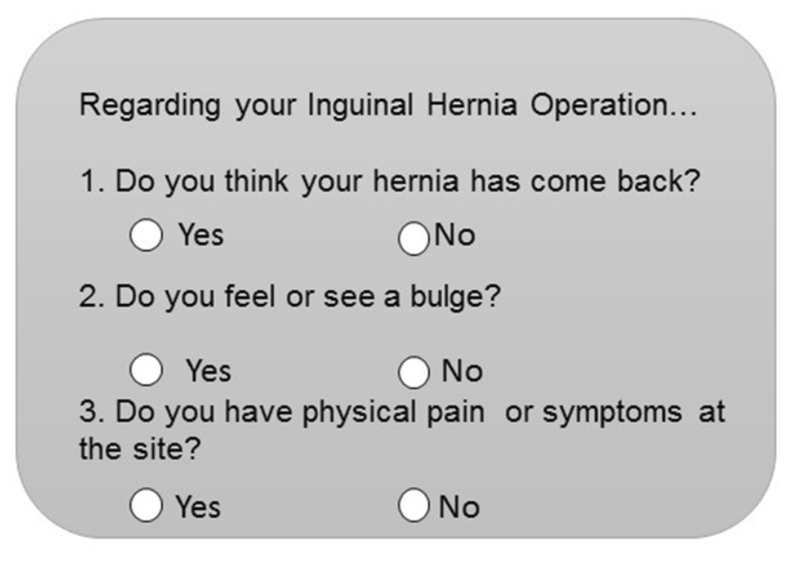
Recurrence Definitions
Patient-reported recurrence – Positive response to the Hernia Recurrence Inventory
Surgeon-reported recurrence – Surgeon-reported recurrence based on clinical exam or imaging
Notes:
• We used 3 different definitions of hernia recurrence in this study.
• Patient-reported recurrence was defined as a positive response to either of the first two questions of the Hernia Recurrence Inventory
• Surgeon-reported recurrence was defined as a surgeon-documented hernia recurrence based on clinical exam or imaging

Slide 11
Pragmatic Recurrence
Recurrence based on available elements of patient-reported and surgeon-reported recurrence at a given time point.
 | Patient-Reported Recurrence | Surgeon-Reported Recurrence | Pragmatic Recurrence
Patient A | - | - | -
Patient B | + | + | +
Patient C | + | - | -
Patient D | + | ? | +
Notes:
Finally, pragmatic recurrence integrates available elements of patient-reported recurrence and surgeon-reported recurrence at a given time point.
To go over some of the most common scenarios:
-If both are negative – no recurrence
- if both are positive – recurrence
If pt reported but negative on clinical evaluation – no recurrence
But pt reported w/o f/u – yes recurrence

Slide 12
Secondary Outcomes
 | Baseline | Immediate | 30 days | 6 months | 1 year | 2+ years
Operative Time |  | x
SSO, SSI, SSOPI |  |  | x
Readmission, Reoperation |  |  | x
EuraHS | x |  | x | x | x | x
CPIP |  |  |  | x | x
Recurrence |  |  | x | x | x | x
Notes:
secondary outcomes included Perioperative outcomes such as operative time and early postoperative complications such as surgical site occurrences and infections, readmissions and reoperations
EuraHS qol score from baseline through long-term follow-up.
CPIP, was evaluated at 6m and 1yr to assess persistent pain.
Recurrence was assessed at each follow-up interval (30d, 6m,1yr

Slide 13
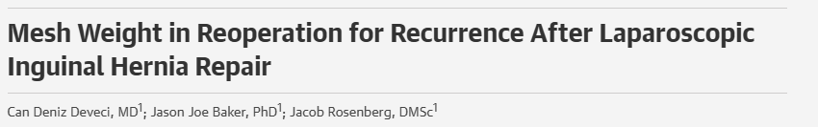
Definitions
Mesh weight
Heavy weight mesh (HWM) >65 g/m²
Medium weight mesh (MWM) 45 to 65g/m²
Light weight (LWM) <45g/m²
Notes:
mesh weight was classified based on prior published literature
If a patient undergoing bilateral repair had two different weights of mesh used, they were classified based on the heaviest of the meshes used.

Slide 14
Statistical Analysis
Medians and Interquartile Ranges (IQRs) were used to summarize continuous variables
Matched cohorts were then analyzed using
Chi-squared tests for categorical variables
Wilcoxon rank-sum testing for continuous variables
Multivariable logistic regression adjusted for mesh weight & self-gripping mesh (SGM) due to post-match imbalance
p-value of <0.05 was considered statistically significant
Notes:
• For statistical analysis, standard method utilised.... sig diff noted bw mesh weight and sgm utliisation so we prfomerd mvlr to acc for these diff
• After matching we performed a multivariate logistic regression to adjust for differences

Slide 15
Adults
N = 145,842
ACHQC dataset
N = 148,517
Elective inguinal, no concomitant procedure, CDC 1
N = 40,084
Final eligible
N = 7,566
MIS repair with mesh (unilateral or bilateral)
N = 23,455
EuraHS pain score at 30 days available
N = 8,737
30-day surgeon-reported outcomes available
N = 17,918
Eligible mesh & valid approach (TAPP or TEP)
N = 8,102
Notes:
Here is a flow diagram of how patients were ultimately included in this study based on inclusion and exclusion. After applying all of these criteria, about 7500 patients remained

Slide 16
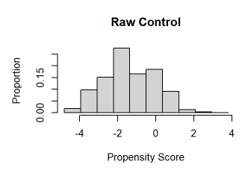
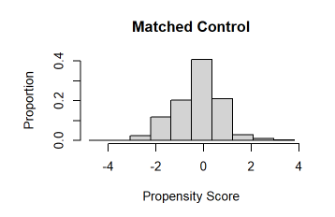
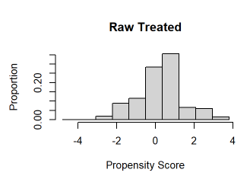
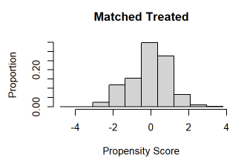
PSM
PSM
Flat = 2090
Anatomical Mesh= 2090
Flat Mesh = 2788
Anatomical Mesh= 4778
Notes:
After performing propensity score matching, 2090 patients remained in each group. There was significant improvement in covariate balance.

Slide 17
Demographics median (IQR) or n (%) | Anatomical Mesh N = 2,090 | Flat Mesh N = 2,090 | p-value
Age, years | 62 (49 - 70) | 61 (48 - 69) | 0.007
Male sex | 1,898 (91.0%) | 1,888 (90.0%) | 0.597
BMI, kg/m² | 26.2 (23.8 - 28.9) | 26.3 (23.9 - 29.0) | 0.301
Diabetes mellitus | 153 (7.3%) | 150 (7.2%) | 0.858
COPD | 46 (2.2%) | 41 (2.0%) | 0.590
Smoking | 202 (9.7%) | 213 (10.0%) | 0.569
Immunosuppression | 34 (1.6%) | 37 (1.8%) | 0.720
ASA class III | 542 (25.6%) | 535 (25.6%) | 0.683
Notes:
Moving to baseline demographics after matching:
• patients receiving anatomic mesh were slightly older
• the remainder of the variables were comparable between groups.

Slide 18
Operative Details n (%) | Anatomical Mesh N = 2090 | Flat Mesh N = 2090 | p-value
Hernia laterality |  |  | >0.999
Bilateral | 628 (30%) | 628 (30%)
Unilateral | 1,462 (70%) | 1,462 (70%)
Operative approach |  |  | 0.770
Laparoscopic | 732 (35%) | 723 (35%)
Robotic | 1,358 (65%) | 1,367 (65%)
Peritoneal access |  |  | 0.533
TAPP | 1,751 (84%) | 1,736 (83%)
TEP | 339 (16%) | 354 (17%)
Notes:
• Next, operative characteristics:
• No significant diff in between groups
• Hernia laterality was identical after matching, with 30 percent bilateral and 70 percent unilateral repairs in both groups.
• Operative approach was comparable, with roughly one-third laparoscopic and two-thirds robotic cases in each arm.
• Peritoneal access was also similar, with the majority performed via TAPP and a smaller proportion via TEP.

Slide 19
Operative Details n (%) | Anatomical Mesh N = 2090 | Flat Mesh N = 2090 | p-value
Direct hernia |  |  | 0.238
I (<1.5cm) | 206 (9.9%) | 190 (9.1%)
II (1.5-3cm) | 424 (20%) | 414 (20%)
III (>3cm) | 182 (8.7%) | 219 (10%)
Notes:
for direct hernias the distribution of small, medium, and large defects is comparable between groups, with most in the 1.5 to 3 cm range.

Slide 20
Operative Details n (%) | Anatomical Mesh N = 2090 | Flat Mesh N = 2090 | p-value
Indirect hernia |  |  | 0.017
I (<1.5cm) | 308 (15%) | 323 (15%)
II (1.5-3cm) | 871 (42%) | 802 (38%)
III (>3cm) | 452 (22%) | 531 (25%)
Notes:
for indirect hernias, anatomical mesh cohort has more medium-sized defects, whereas the flat mesh cohort demonstrates a greater proportion of large indirect hernias over 3 cm.

Slide 21
Operative Details n (%) | Anatomical Mesh N = 2090 | Flat Mesh N = 2090 | p-value
Femoral hernia |  |  | 0.025
I (<1.5cm) | 122 (5.8%) | 120 (5.7%)
II (1.5-3cm) | 38 (1.8%) | 66 (3.2%)
III (>3cm) | 3 (0.1%) | 7 (0.3%)
Notes:
Looking at femoral defects, these are overall uncommon in our cohort.
flat mesh group has a relatively higher proportion of medium and large femoral hernias.

Slide 22
Mesh Characteristics median (IQR) or n (%) | Anatomical Mesh N = 2090 | Flat Mesh N = 2090 | p-value
Mesh size
Mesh length (cm) | 12.0 (10.0 - 15.0) | 15.0 (12.0 - 15.0) | <0.001
Mesh width (cm) | 15.0 (10.0 - 15.0) | 12.0 (10.0 - 15.0) | 0.133
Mesh weight |  |  | <0.001
HWM | 1,382 (66%) | 708 (34%)
MWM | 539 (26%) | 1,151 (55%)
LWM | 169 (8.1%) | 231 (11%)
Notes:
• Looking at mesh characteristics:
• anatomical mesh had a shorter median length, while flat mesh tended to be longer.
• Mesh width was similar between groups.
• We also observed differences in mesh weight distribution. Anatomical mesh was more frequently heavy-weight, whereas flat mesh more commonly utilized medium-weight and lightweight options.

Slide 23
Mesh Fixation n (%) | Anatomical Mesh N = 2090 | Flat Mesh N = 2090 | p-value
Suture | 870 (42%) | 858 (41%) | 0.706
Tacks | 609 (29%) | 559 (27%) | 0.085
SGM | 545 (26%) | 674 (32%) | <0.001
No fixation | 98 (4.7%) | 79 (3.8%) | 0.144
Adhesives | 12 (0.6%) | 34 (1.6%) | 0.001
Staples | 14 (0.7%) | 28 (1.3%) | 0.030
Notes:
Finally, fixation methods:
Most fixation strategies were similarly distributed between groups.
There were small differences in the use of staples and adhesives, which were slightly more common in the flat mesh group.
Self-gripping mesh was used more frequently in the flat mesh cohort
Put suture, tacks, sgm, no fixa, adhesives, staples,

Slide 24
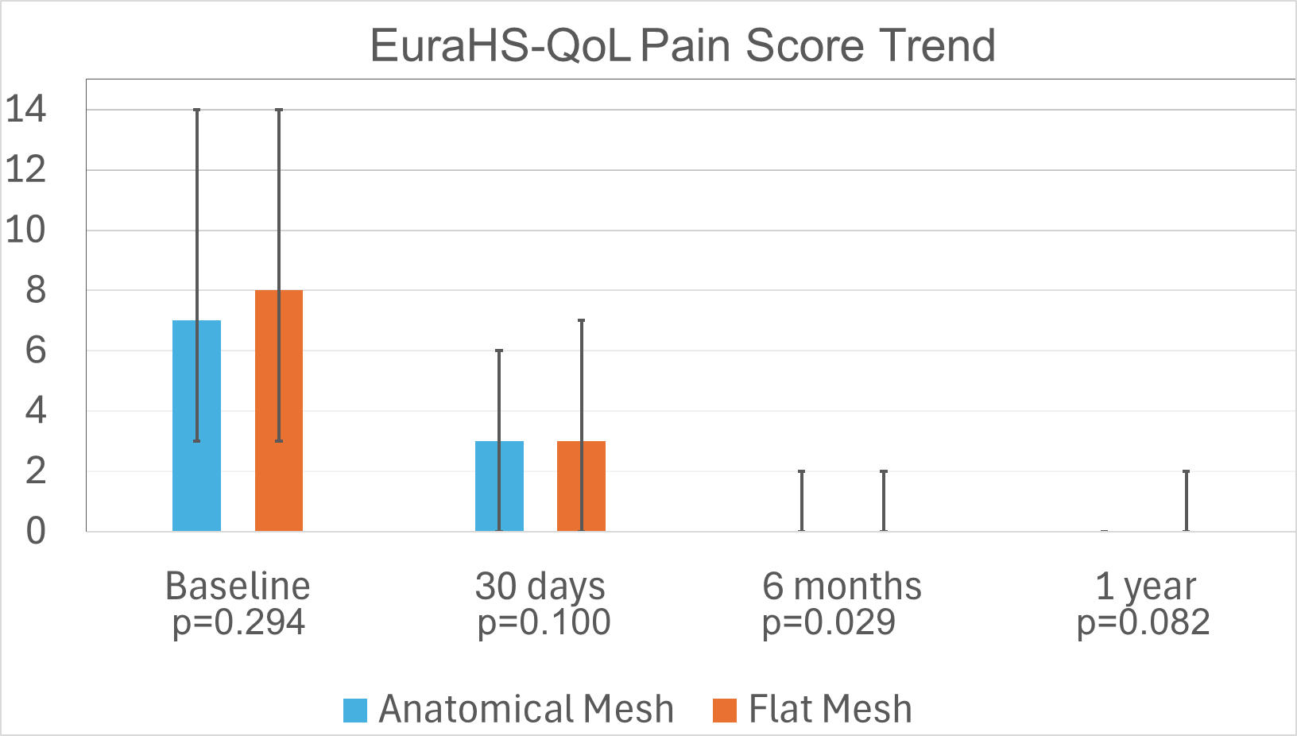
Notes:
We first examined patient-reported pain over time using the EuraHS quality-of-life pain domain.
Both groups demonstrated a similar trajectory, with pain scores decreasing substantially from baseline to 30 days and continuing to improve through 6 months and 1 year

Slide 25
Notes:
• Next, we evaluated chronic postoperative inguinal pain, or CPIP.
• At both 6 months and 1 year, CPIP rates were similar between groups.

Slide 26
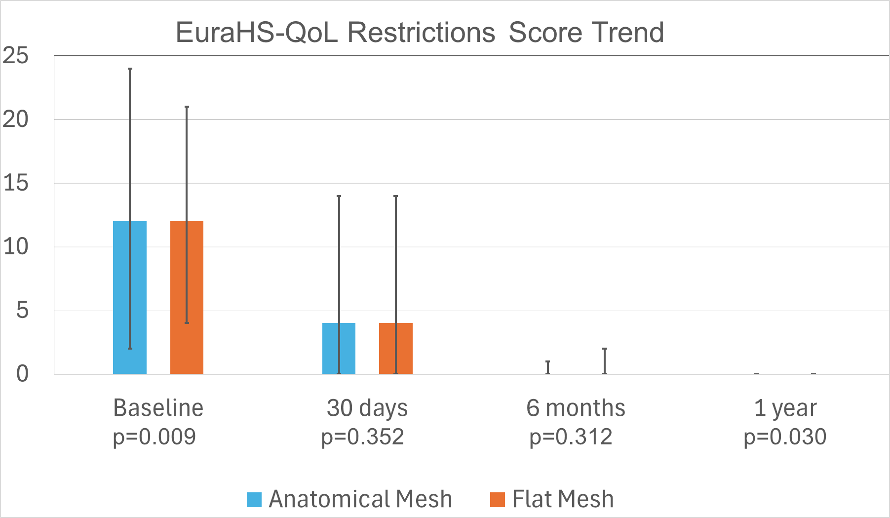
Notes:
QoL outcomes followed the same pattern across all Eura-HS domains --- marked improvement from baseline with early recovery by six months and stable results at one year.

Slide 27
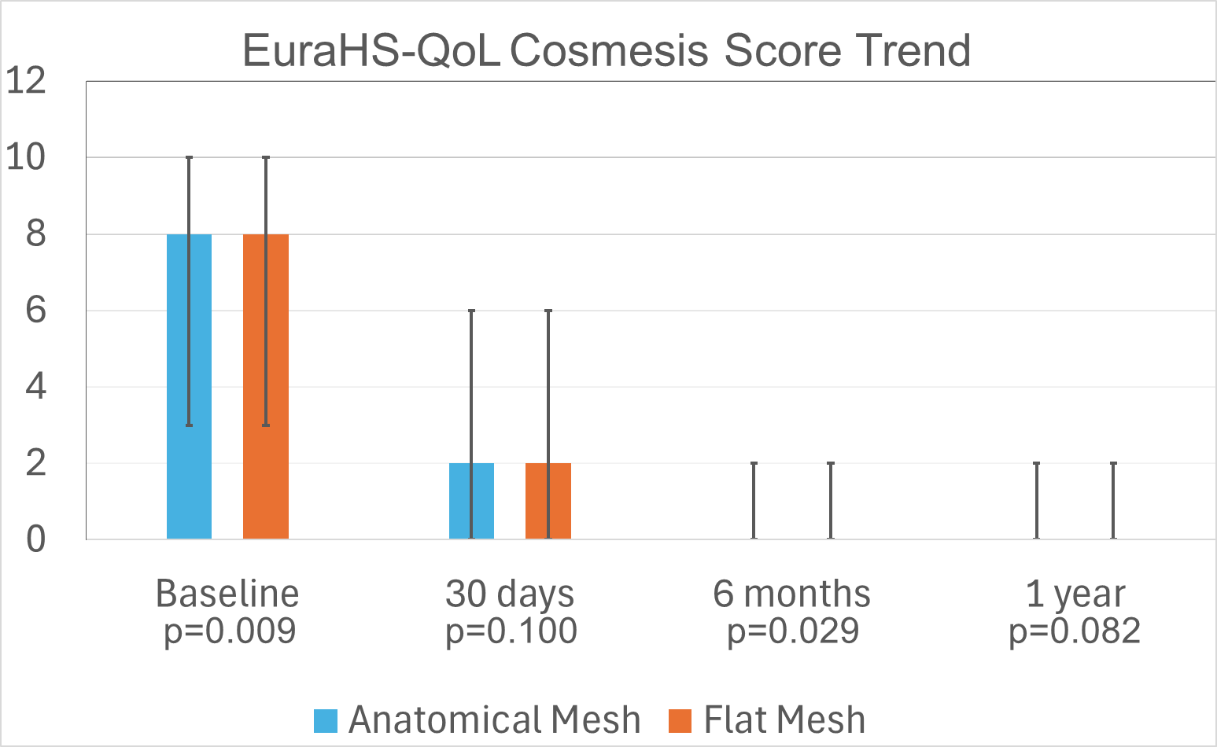

Slide 28
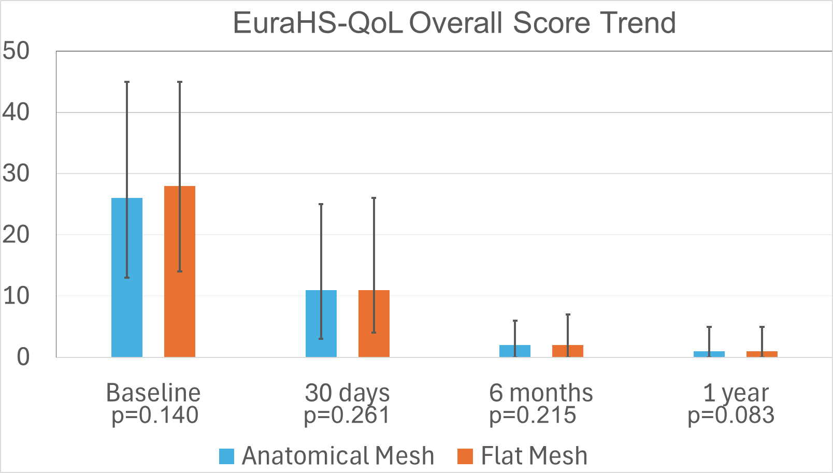

Slide 29
Notes:
• We next looked at operative time.
• Anatomical mesh cases were more frequently completed in under one hour,
• whereas flat mesh cases more often fell in the one- to two-hour range.
• However, the overall distribution suggests only a modest difference, and there is not a clear directionality to the overall trend.

Slide 30
Notes:
Rates of short-term postoperative outcomes at 30 days were all low and comparable between the two groups.

Slide 31
Notes:
Higher pt reported at 30days but not later time points

Slide 32
Notes:
Interestingly, there was a statistically sig higher rate of early surg recu w flat mesh at 30days, but no stas sig dff at subseq time pts

Slide 33
Notes:
• Pragmatic recurrence at one year was 7.1 percent in the anatomical mesh group compared with 4.2 percent in the flat mesh group

Slide 34
Multivariable Logistic Regression
EuraHS-Qol pain score at 30-days | Beta | 95% CI | p-value
Flat vs anatomical | 0.21 | -0.13 - 0.54 | 0.224
LWM vs HWM | -0.05 | -0.60 - 0.49 | 0.851
MWM vs HWM | 0.09 | -0.44 - 0.63 | 0.730
SGM vs non-SGM | -0.39 | -0.92 - 0.15 | 0.156
EuraHS-Qol pain score at 1 year | Beta | 95% CI | p-value
Flat vs anatomical | 0.07 | -0.40 - 0.55 | 0.766
LWM vs HWM | 0.40 | -0.56 - 1.40 | 0.415
MWM vs HWM | -0.14 | -0.89 - 0.60 | 0.708
SGM vs non-SGM | 0.14 | -0.58 - 0.87 | 0.697
Notes:
• We next performed multivariable regression and saw that no mesh characteristics independently predicted outcomes after adjusting for confounders.
• We evaluated EuraH-QOL pain subdomain as well as the overall score at 30 days and 1 year, CPIP at 6m and 1y, and pragmatic recurrence at 1 year.
30d - Early postoperative pain was not independently associated with mesh classification, mesh weight, or fixation method.
1 y - EuraHS pain scores not independently associated with mesh classification, mesh weight, or fixation method

Slide 35
EuraHS-Qol overall score at 30d | Beta | 95% CI | p-value
Flat vs anatomic | 0.23 | -0.87 - 1.30 | 0.684
LWM vs HWM | -0.23 | -2.0 - 1.60 | 0.800
MWM vs HWM | 0.42 | -1.3 - 2.2 | 0.634
SGM vs non-SGM | -1.80 | -3.5 - 0.00 | 0.050
EuraHS-Qol overall score at 1y | Beta | 95% CI | p-value
Flat vs anatomic | 0.73 | -0.58 - 2.00 | 0.275
LWM vs HWM | 0.46 | -2.2 - 3.10 | 0.734
MWM vs HWM | -0.94 | -3.0 - 1.10 | 0.375
SGM vs non-SGM | 0.54 | -1.5 - 2.50 | 0.596
Notes:
(((((((((30d - no mesh characteristic independently predicted EuraHS overall score.
Appears to be statistically sig, it does not meet MCID – confirm number – for sgm vs nonsgm
1y - no mesh characteristic independently predicted EuraHS overall score.))))))))

Slide 36
CPIP at 6m | OR | 95% CI | p-value
Flat vs anatomic | 0.97 | 0.72 - 1.29 | 0.815
LWM vs HWM | 1.30 | 0.78 - 2.09 | 0.295
MWM vs HWM | 1.54 | 0.99 - 2.37 | 0.055
SGM vs non-SGM | 0.81 | 0.54 - 1.24 | 0.335
CPIP at 1y | OR | 95% CI | p-value
Flat vs anatomic | 1.20 | 0.82 - 1.76 | 0.333
LWM vs HWM | 0.91 | 0.38 - 1.91 | 0.809
MWM vs HWM | 0.93 | 0.51 - 1.66 | 0.812
SGM vs non-SGM | 1.04 | 0.59 - 1.86 | 0.898
Notes:
(((((((((((((6 m - no mesh characteristic was independently associated with CPIP. MWM demonstrated a borderline trend toward higher odds of CPIP compared HWM but did not reach statistical significance.
1 yr - no association between mesh characteristics and CPIP. ))))))))))))))

Slide 37
Pragmatic Recurrence at 1y | OR | 95% CI | p-value
Flat vs anatomic | 0.55 | 0.30 - 0.99 | 0.054
LWM vs HWM | 0.98 | 0.23 - 2.89 | 0.977
MWM vs HWM | 1.00 | 0.33 - 2.72 | 0.995
SGM vs non-SGM | 1.24 | 0.47 - 3.66 | 0.674
Notes:
((((((No variable was independently associated with prag recurrence at 1y . Flat mesh showed a borderline trend toward lower recurrence compared with anatomic mesh but did not reach statistical significance. )))))))))))

Slide 38
Summary of Findings
No difference in EuraHS-QoL scores
No difference in CPIP rate
Higher rate of early postoperative patient-reported recurrence with anatomical mesh
Higher 1-year pragmatic recurrence with anatomical mesh
On multivariable regression no mesh characteristic independently associated with outcomes.
Notes:
• To summarize our findings:
• We observed no meaningful differences in EuraHS quality-of-life scores or CPIP rates between mesh configurations.
• There was a higher rate of early patient-reported bulging with anatomical mesh and a higher pragmatic one-year recurrence signal in unadjusted analyses.
• However, these differences were modest and did not persist in multivariable models.

Slide 39
Limitations
Retrospective analysis
Non-randomized design
Surgeon-entered data
Incomplete longer-term clinical follow-up
Notes:
• This study has several characteristic limitations a retrospective study has
• however a reasonable proportion of patients had available data at the 1-year time point, allowing for meaningful short- to intermediate-term outcome assessment

Slide 40
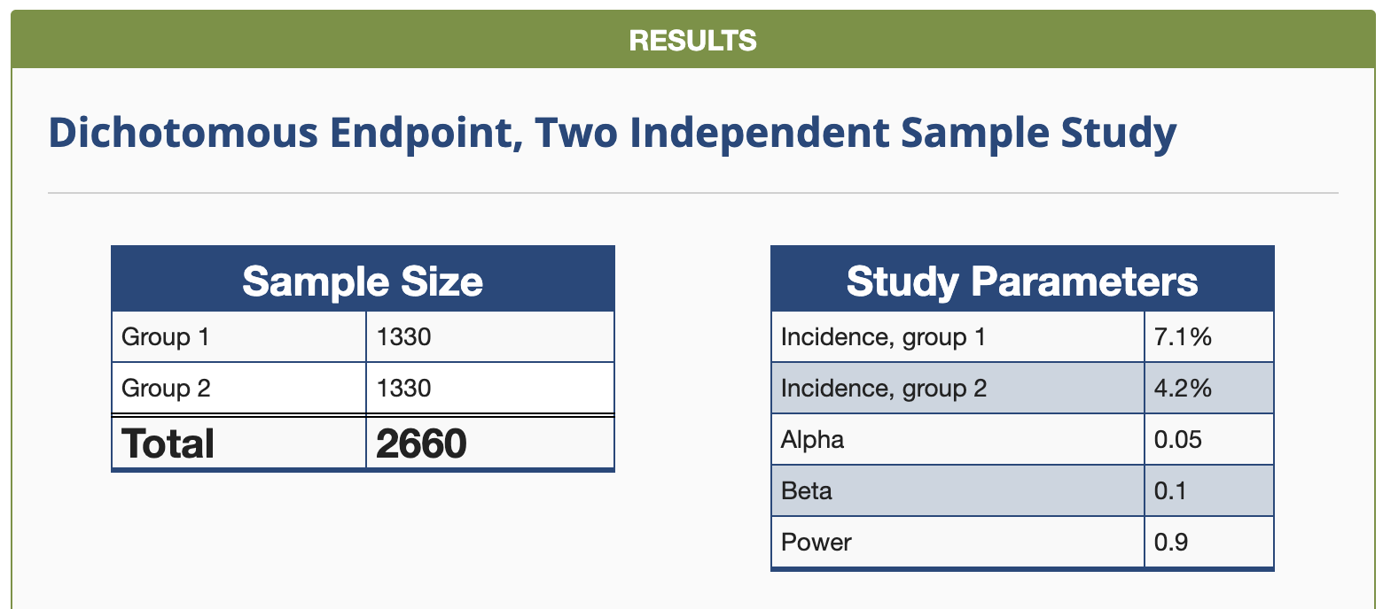
How do we use these results?
Notes:
• To power a trial based on the diff in prag recurr in this study, we would need 2,600 to 3,000 total patients which would be a major undertaking.
• this emphasizes the importance and value of registries such as this in terms of collecting long-term observational data.

Slide 41
Conclusions
Anatomical and flat mesh demonstrate comparable outcomes in MIS IHR when adjusted for characteristics such as mesh weight and SGM
Mesh configuration alone is unlikely to be the primary driver of patient outcomes.
Careful surgical technique, appropriate mesh coverage, and individualized decision-making remain the most important factors in optimizing results.
Notes:
In summary, anatomical and flat mesh demonstrate comparable outcomes in minimally invasive inguinal hernia repair, with no clinically meaningful differences in short- to intermediate-term pain or recurrence.
Overall, these findings suggest that mesh configuration alone is unlikely to be the primary driver of patient outcomes. Instead, careful surgical technique, appropriate mesh coverage, and individualized decision-making remain the most important factors in optimizing results.

Slide 42
Thank you!

