Slide 1
Patient Optimization and Equitable Care - Finding Common Ground
Megan Melland-Smith, Nancy Ly, Michael Rosen

Slide 2
Disclosures
American Hernia Society Disparities in Hernia Care Grant recipient

Slide 3
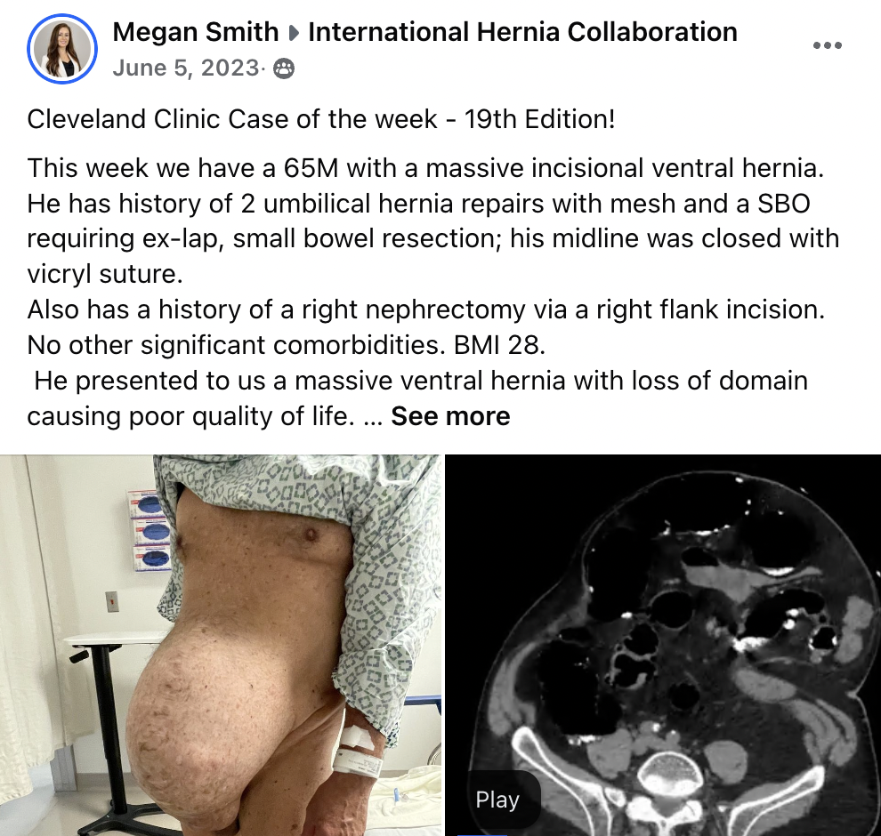

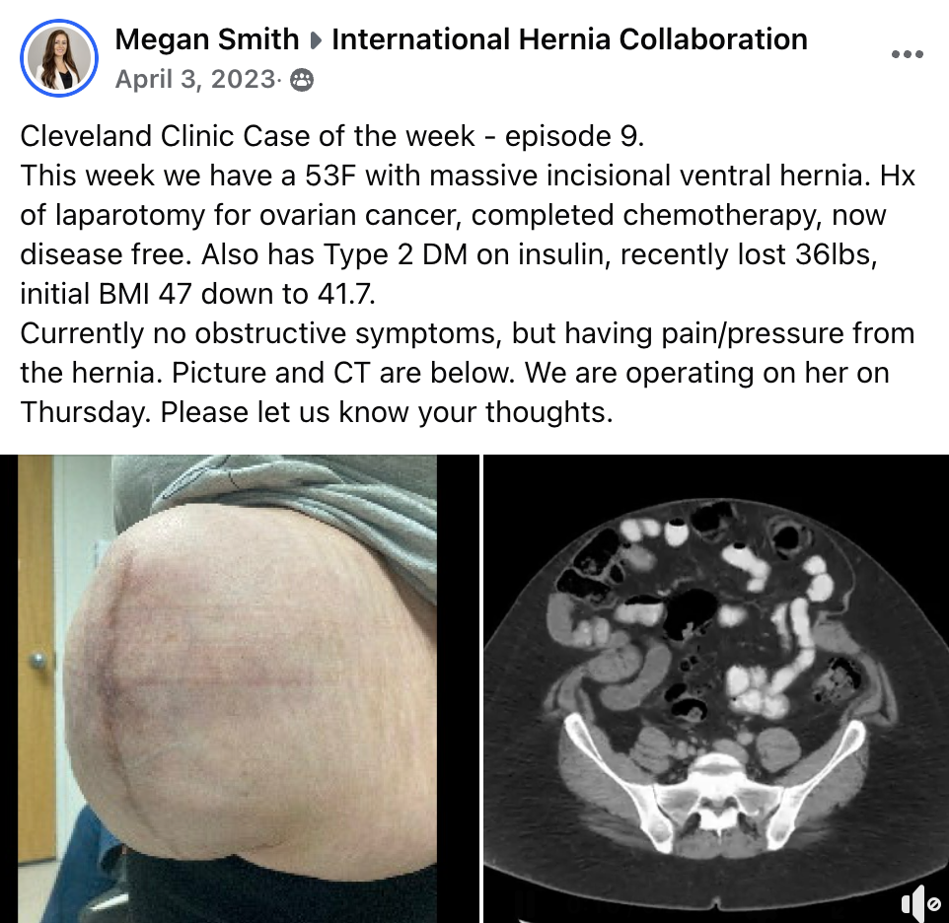
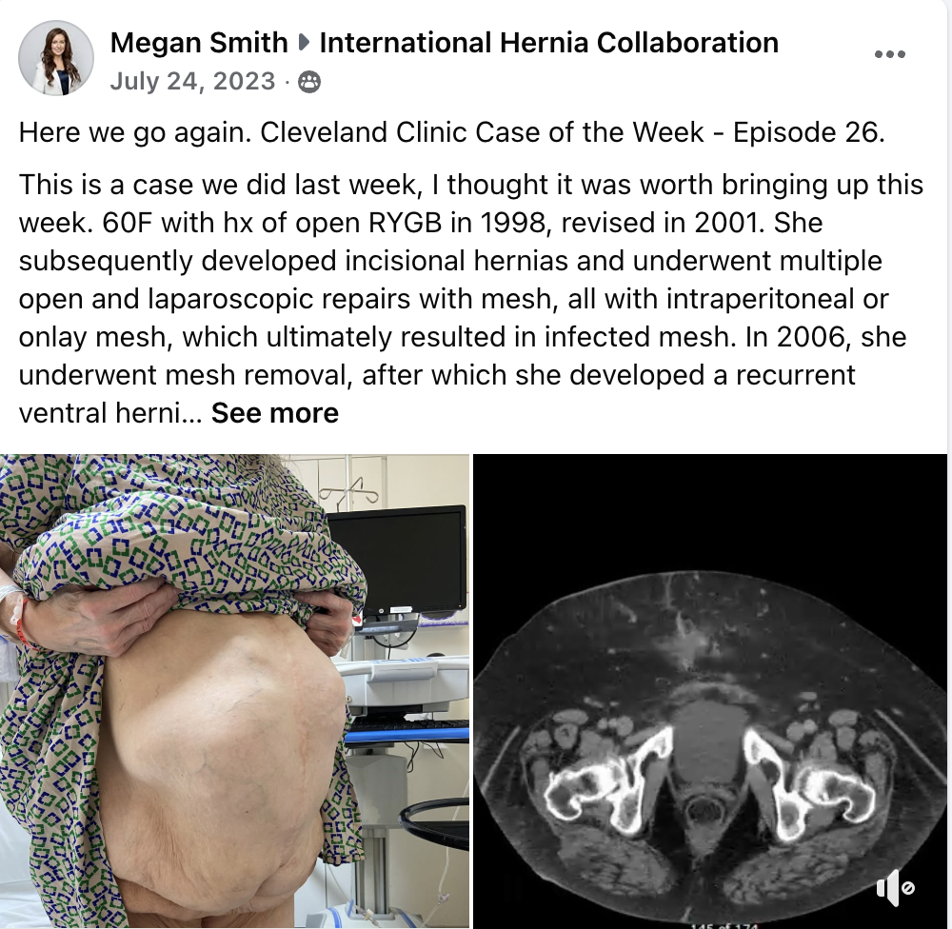
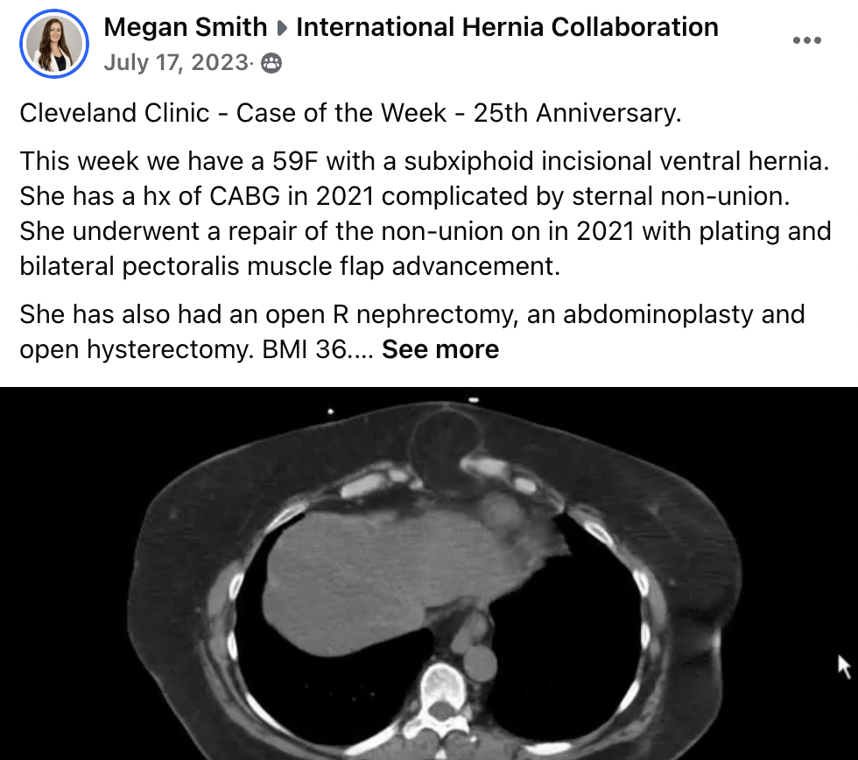

Cleveland Clinic Case of the Week
Notes:
I’m going to bring you back to my fellowship days. For 27 weeks in a row I posted a complex case that we were operating on that week and asked for opinions and advice form the 13,000 surgeons on the IHC.

Slide 4


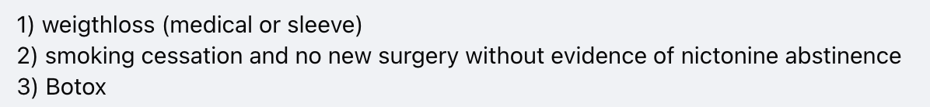

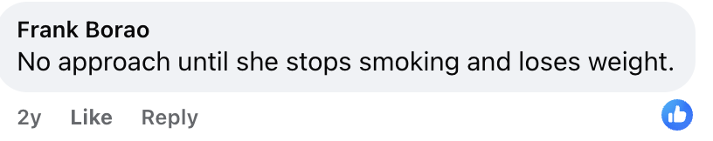
Cleveland Clinic Case of the Week
Notes:
Every single week, we repeatedly would get answers like this….. It was striking how many surgeons couldn’t get past the optimization piece and wouldn’t even offer a surgical approach.
There was a huge disconnect between who we felt were optimized at the Cleveland clinic compared to who the rest of the world felt were optimized.

Slide 5

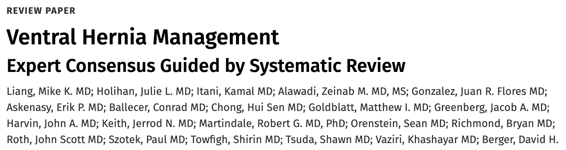
Abdominal Wall Reconstruction
Upfront Surgery
Preoperative Optimization
Ann Surg, 2017
Notes:
How did this happen, how did the pendulum swing so far away from upfront surgery
Well part of the reason is old data, and these expert consensus guidelines written by strong voices on the IHC that tell you you shouldn’t operate on the unoptimized patient because complications are higher.

Slide 6


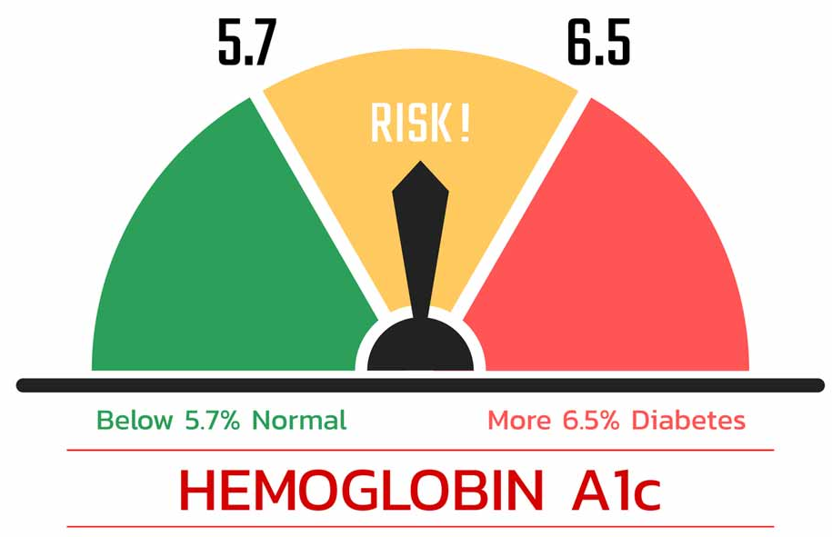

Preoperative Optimization
Generally accepted cut-offs: BMI 35kg/m², HbA1C <8, abstinence
Notes:
Today we’re going to discuss the 3 main optimization factors that most surgeons get hung up on.

Slide 7
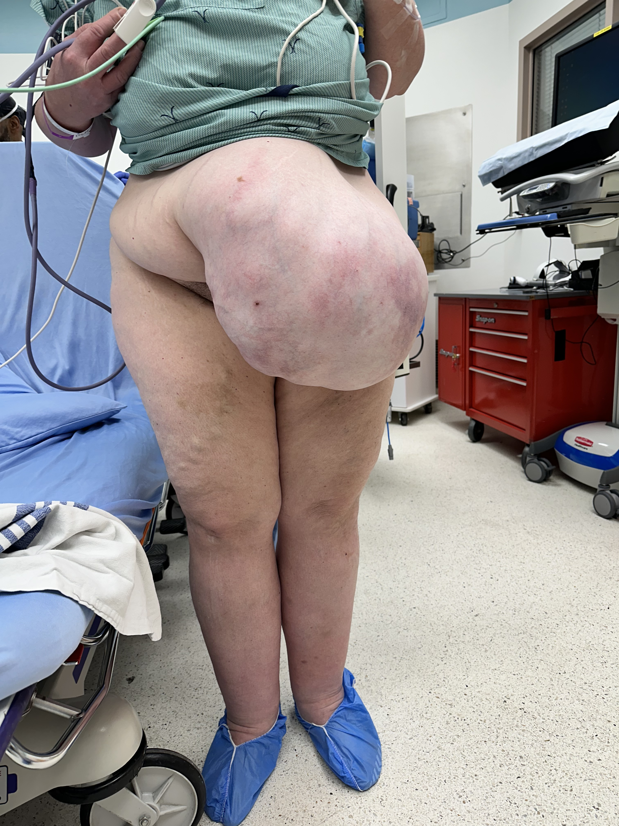
Full recovery
Do well, Appropriate LOS
Delayed complication
Upfront surgery
TAR
Readmission
Postoperative Complications → Prolonged Inpatient Stay
Full recovery
Home care, wound care
Rehab, LTC
Successful ~ 25%
Unoptimized
Prehabilitation/Optimization
Lower Socioeconomic Status
Surgery
Not
Hernia-related emergency ~5%
Drop Out
Liang et al. 2022
Notes:
Even if the complication rate is 50%, that means 50% of the patients will follow this path.
The other half will experience the post-op storm associated with operating on the unoptimized
But lets bring one more piece into the algorithm. Its no surprise that the obese diabetic smokers, the ones being denied care, also happen to the be those patients who come from lower SES

Slide 8
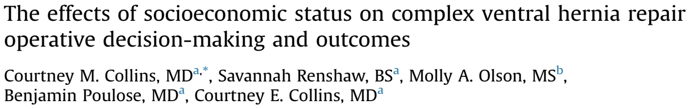

How Does SES Effect Presentation?
Surgery, 2024
65+ yrs, 4,172 patients elective complex ventral hernia repair
Prosperous vs distressed
Distressed communities:
↑ BMI
↑ COPD, Diabetes, heart failure
↑ Nicotine use within 1 year
↑ ASA
↑ Age
↑ Hernia size
Increased 30-day Complications
BUT No Difference in Hernia Recurrence
Notes:
Read paper

Slide 9


Does preoptimization really matter?
OR
Are we just WORSENING health inequalities?

Slide 10
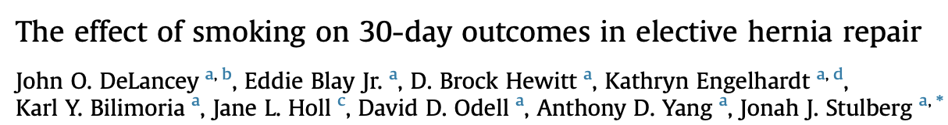
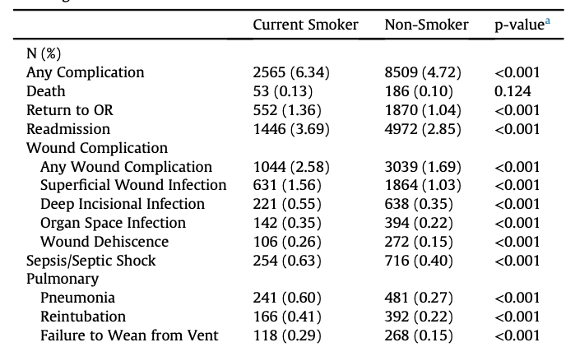
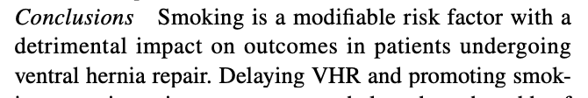
Does Smoking Really Matter?
AJS, 2018
NSQIP – 220,629 patients
All hernias – Current smokers vs Non-smokers
30-day Complications

Slide 12
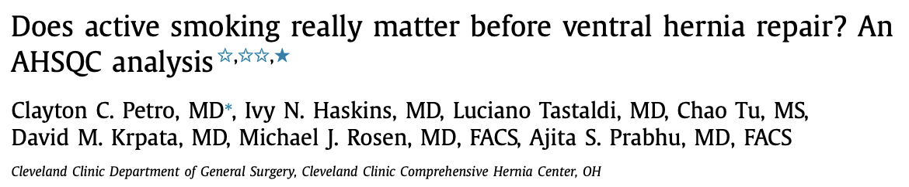
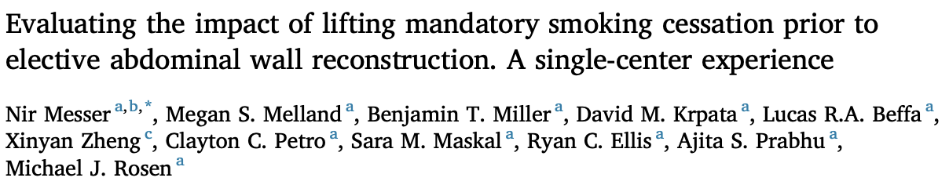
Does Smoking Really Matter?
Surgery, 2019
Active smokers vs never smokers → Open VHR
↑ SSO (12.0% vs 7.4%, P = .03) → Cellulitis, seroma
No difference SSI, SSOPI, re-operation at 30 days
No mesh infections
AJS, 2024
Active smokers vs never smokers → Open TAR
SSI (12.2% vs 6.9%, P = 0.13)
SSO (21.7% cs 13.2%, P = 0.052)
↑ pneumonia (5% vs 0.7%, P=0.005)
No mesh infections

Slide 13
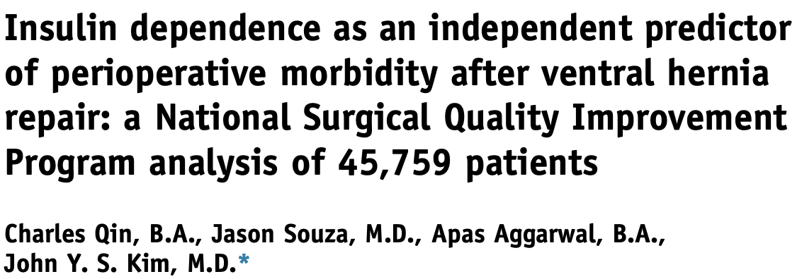
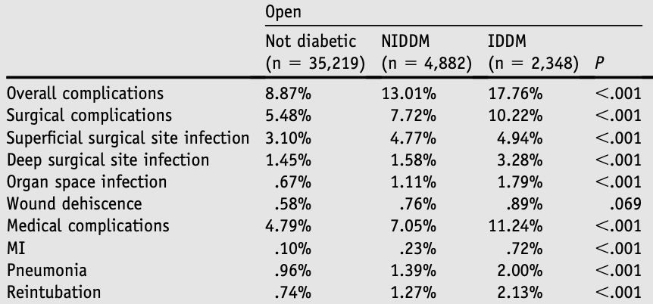
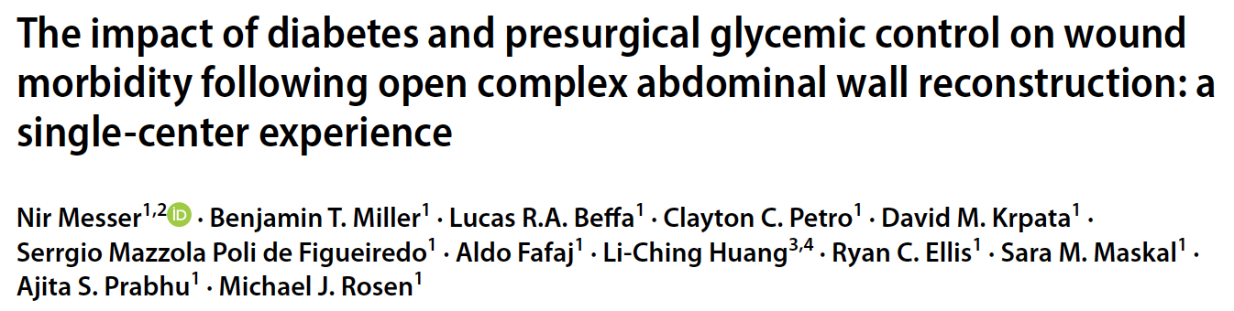
Does Diabetes Really Matter?
AJS, 2016
NSQIP – 45,000 patients
All Ventral Hernias
30-day Complications
HbA1c < 7 vs HbA1c 7-8.4 vs HbA1c > 8.5
Open, Clean, TAR
No differences in 30-day postoperative complications between the three groups
Hernia, 2024
No mesh infections
Notes:
Ready Nir’s paper

Slide 14
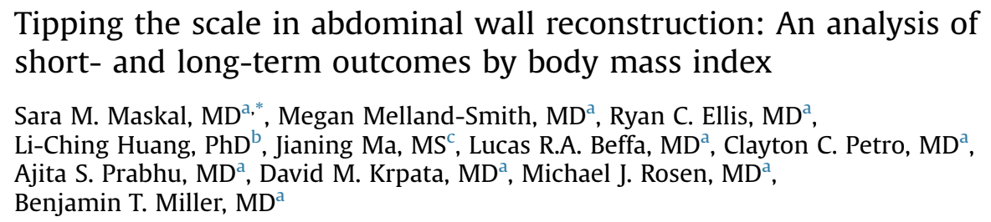
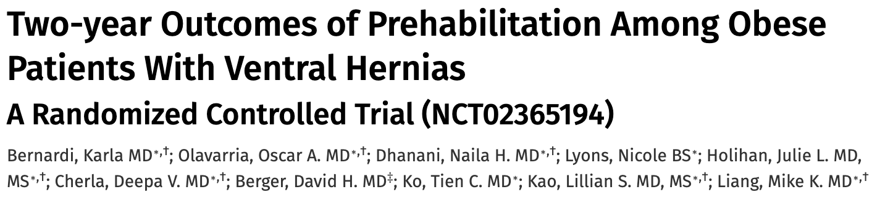
Does Obesity Really Matter?
Surgery, 2024
Hernia recurrence rate at 1 year was lower for BMI ≥35 kg/m² group (7% vs 12%; P = .02)
↑ SSI, SSO in BMI ≥35 kg/m²
Greater ↑ QOL
Annals, 2022
Prehabilitation vs standard counseling
BMI similar
Non-significant ↓ post-op complications
No difference in recurrence or complications at 2 years
ON-GOING→ RCT – Preoperative Weight Loss for Open AWR

Slide 15
Obese, Diabetic, Smoker
Wound Infection
Re-do Hernia Repair
Mesh Infection
Hernia Recurrence
Mesh Excision

Slide 16
Obese, Diabetic, Smoker
↑ Complications/Wound Infections
Wound Packing
Multiple Follow-ups
Lower Socioeconomic status
Family member or Home Care Support
Extended Time-off Work
Resolution
Improved Quality of Life

Slide 17
What is the impact of being denied care and prolonged recovery in patients with low SES?
Increased Healthcare Resource Utilization?
Lower Quality of Life?
What are the challenges faced to accessing care for SSIs/complications?
What are the barriers to accessing care/recovery?

Slide 18
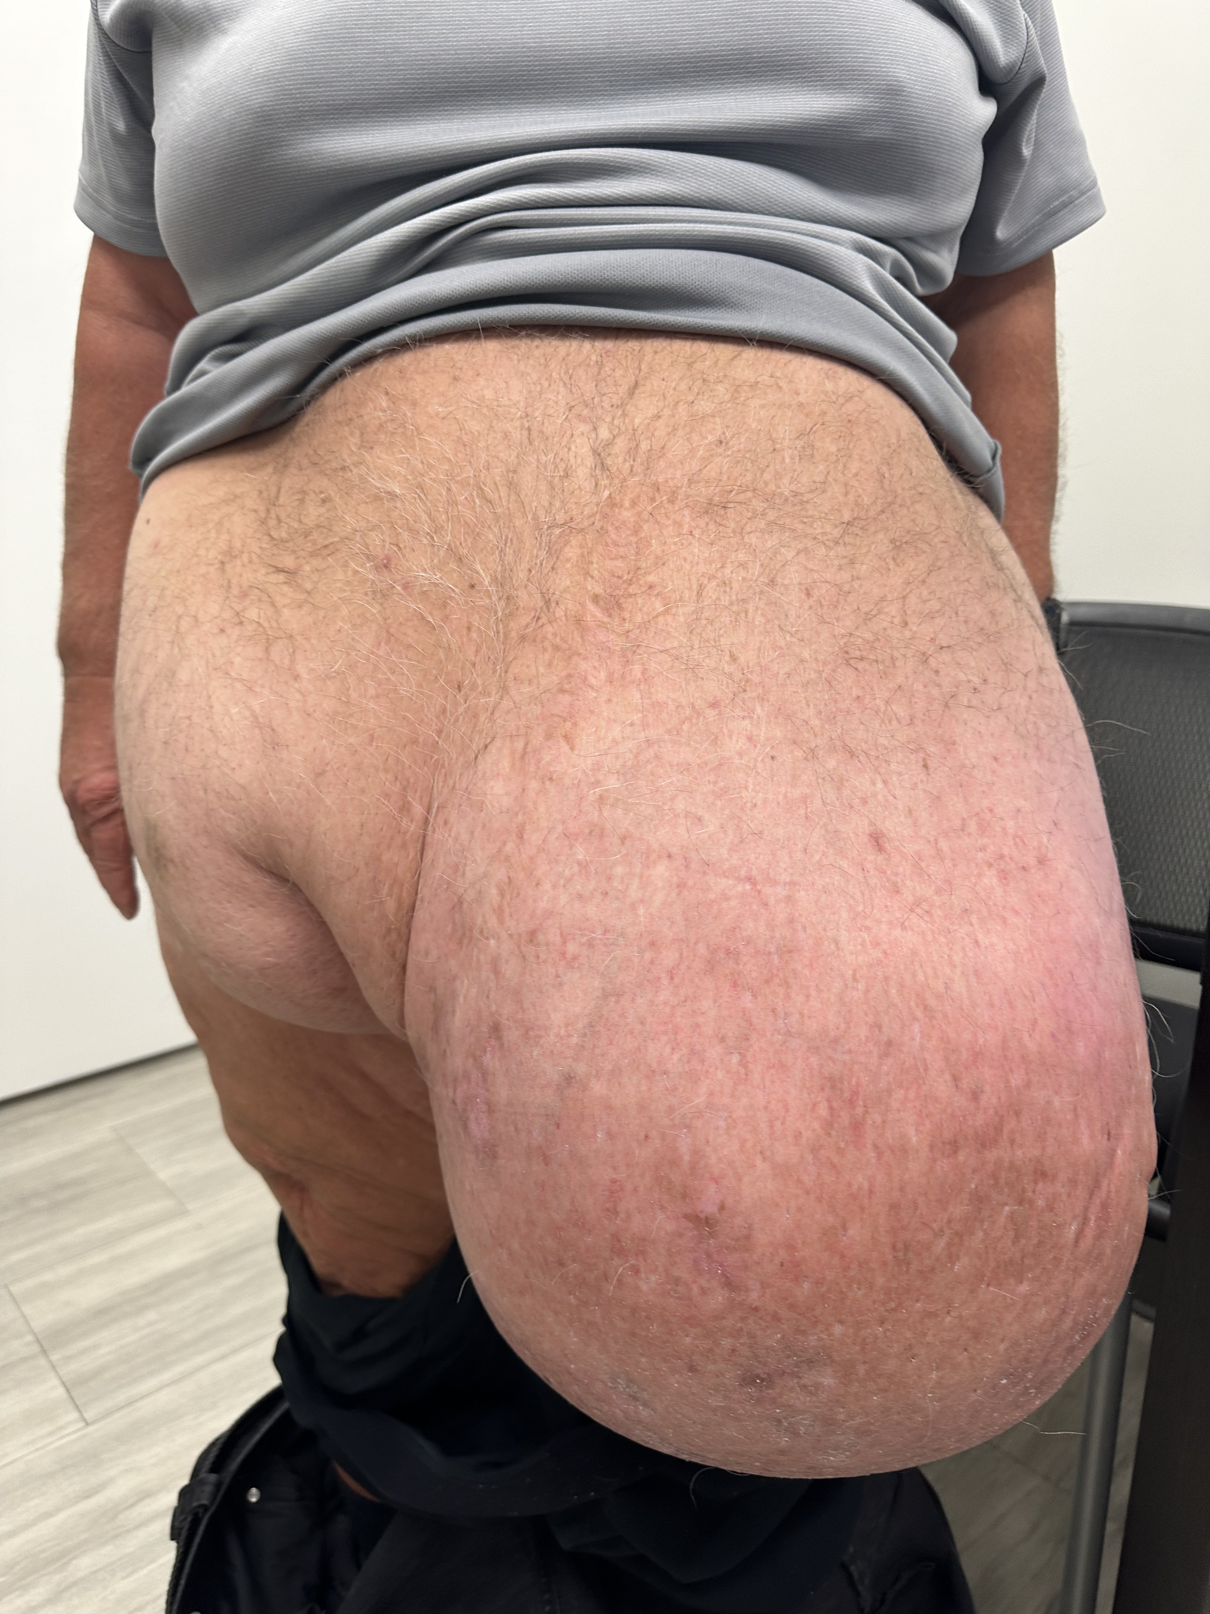
Where Optimization Does Matter

Slide 19
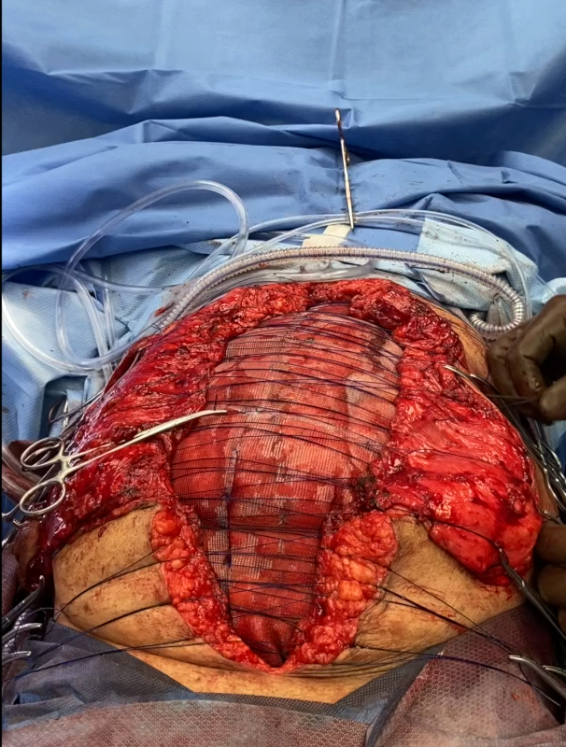
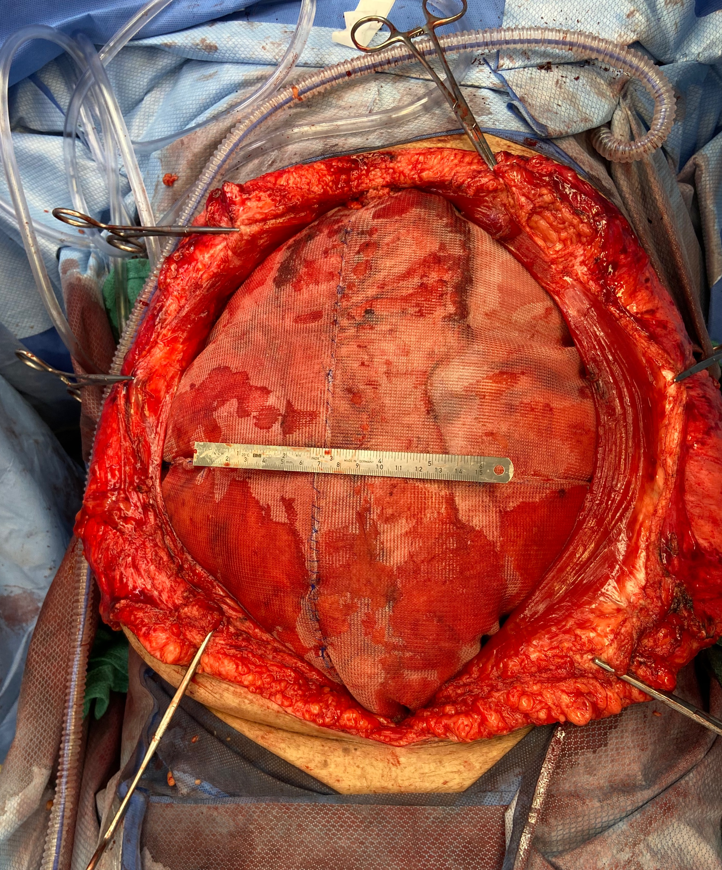
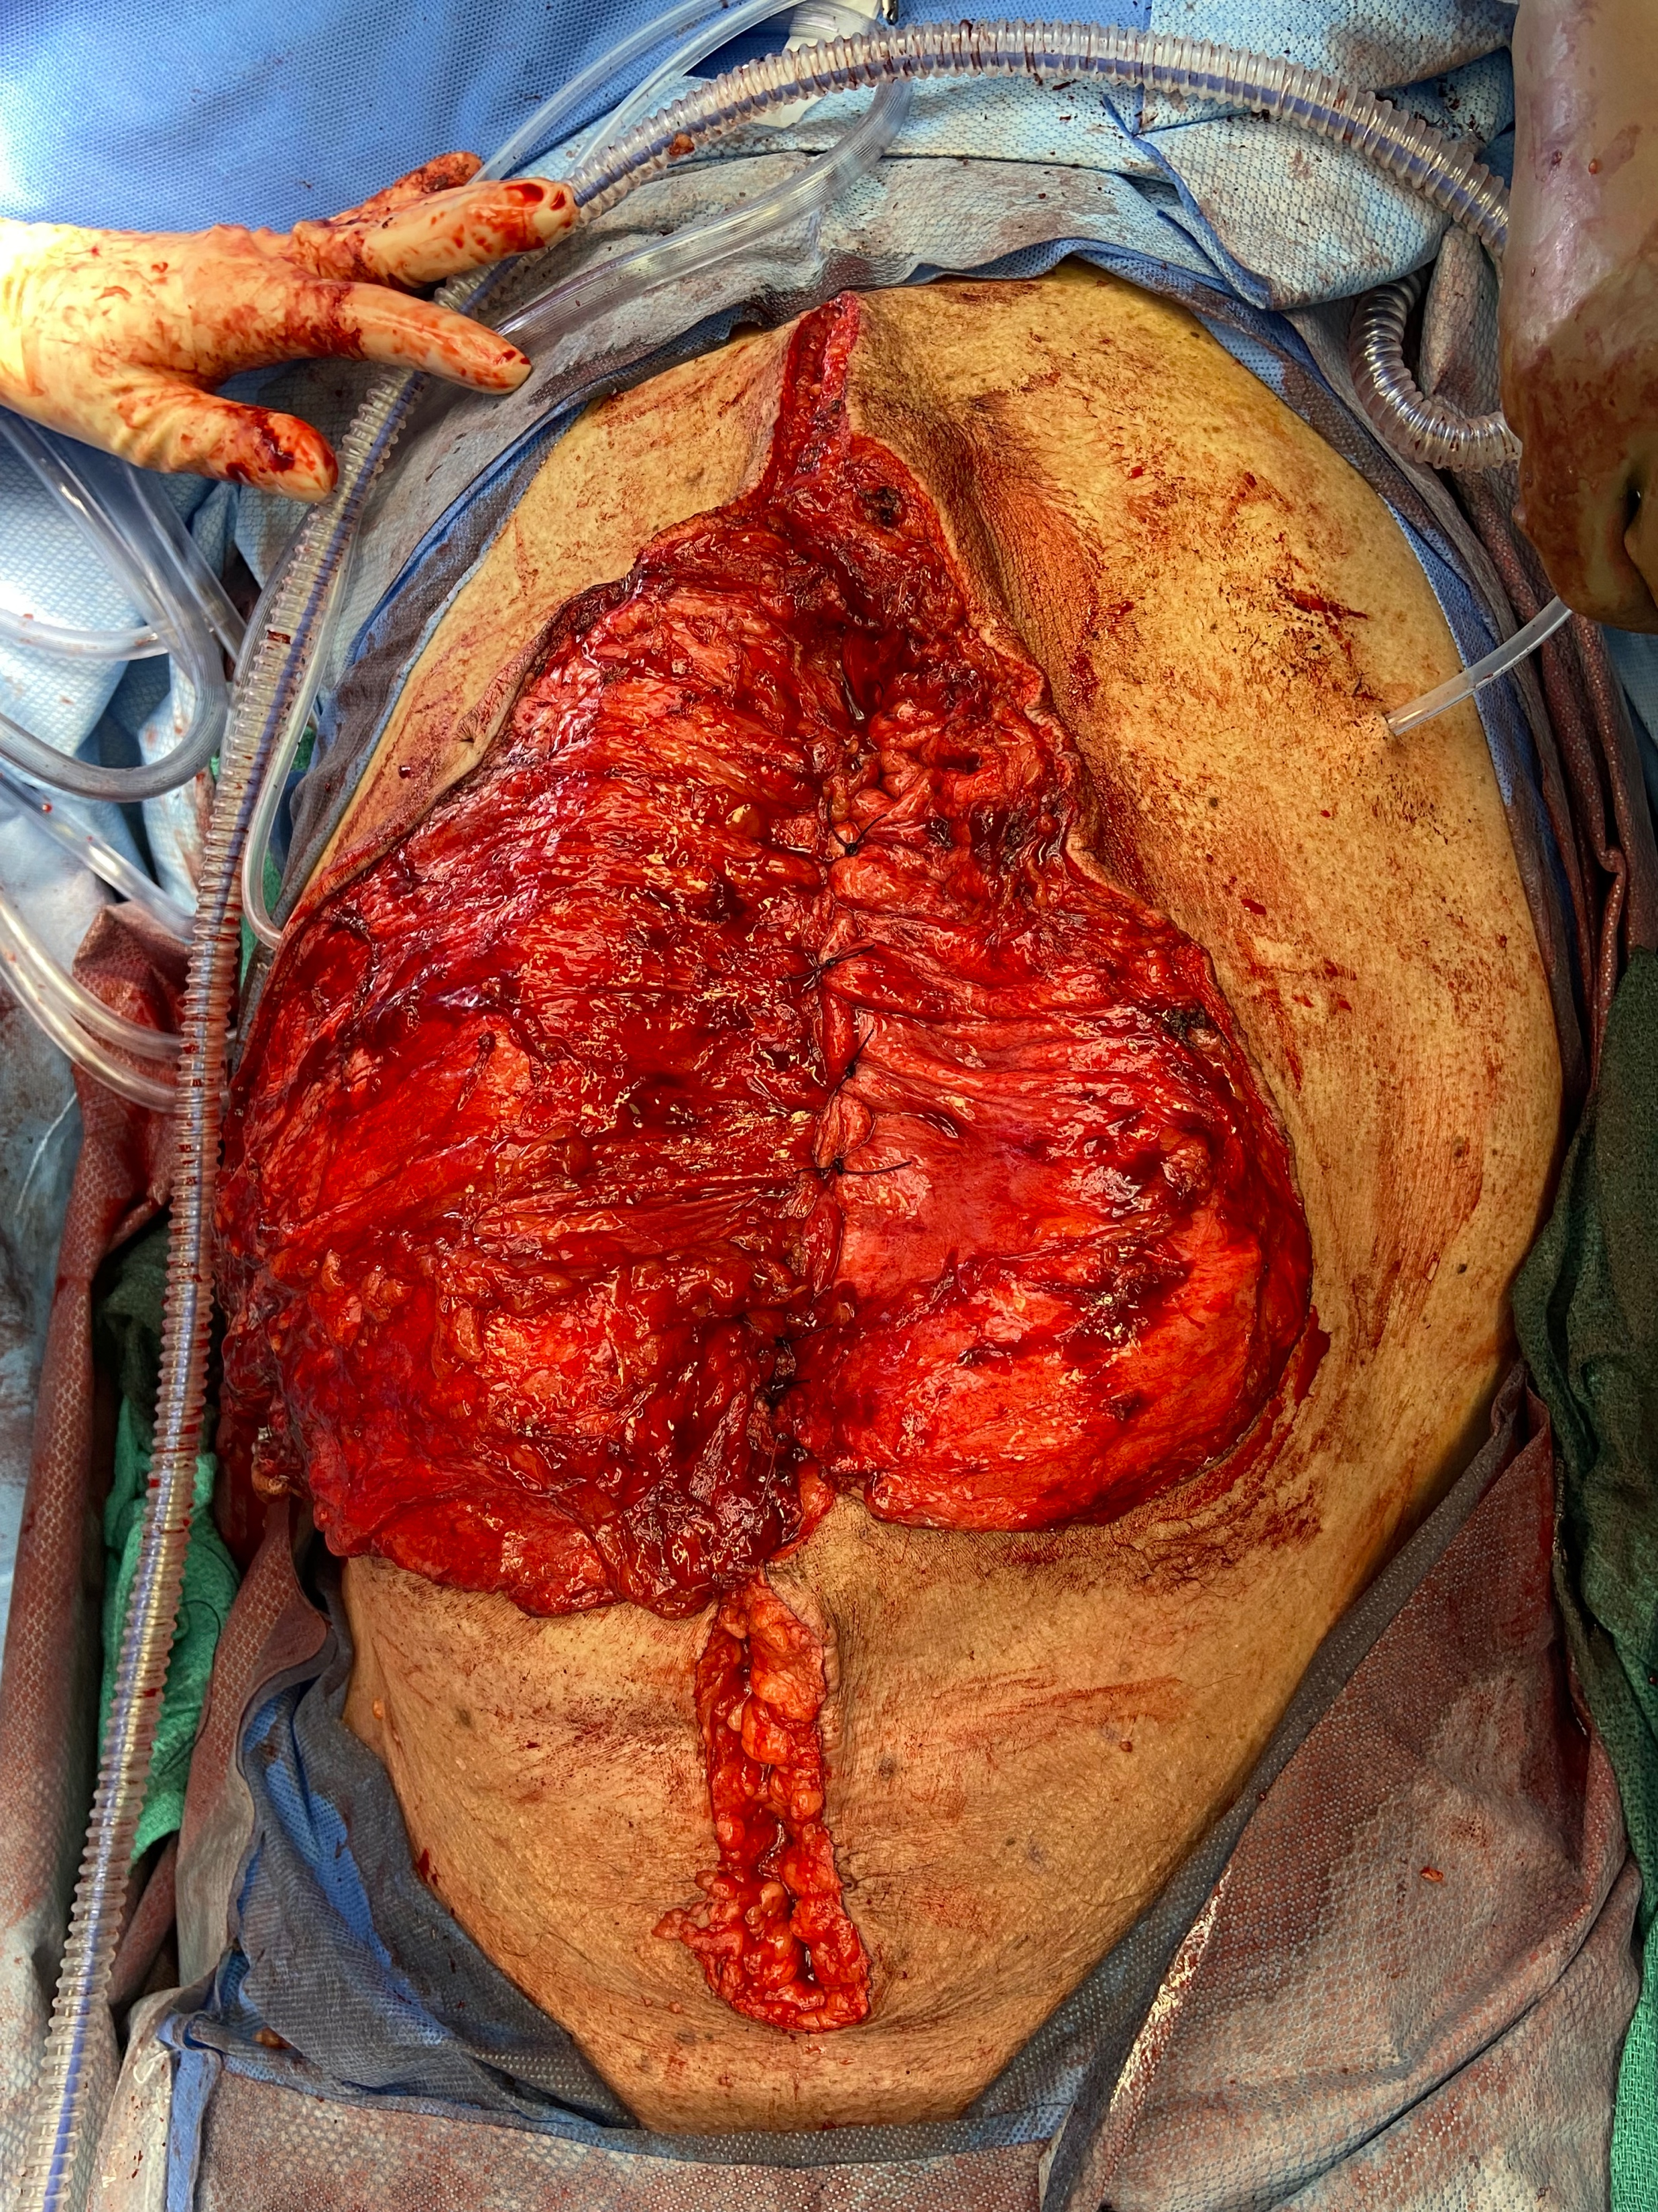
Loss of Domain → A Tight Closure
Iatrogenic Abdominal Compartment Syndrome

Slide 20
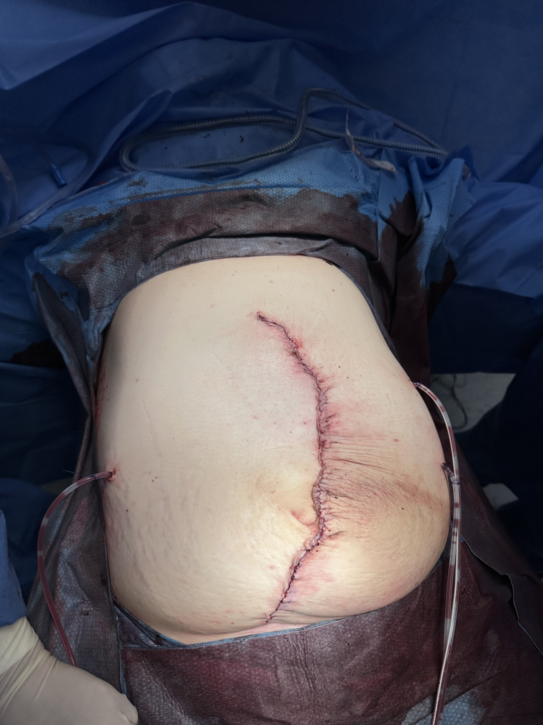
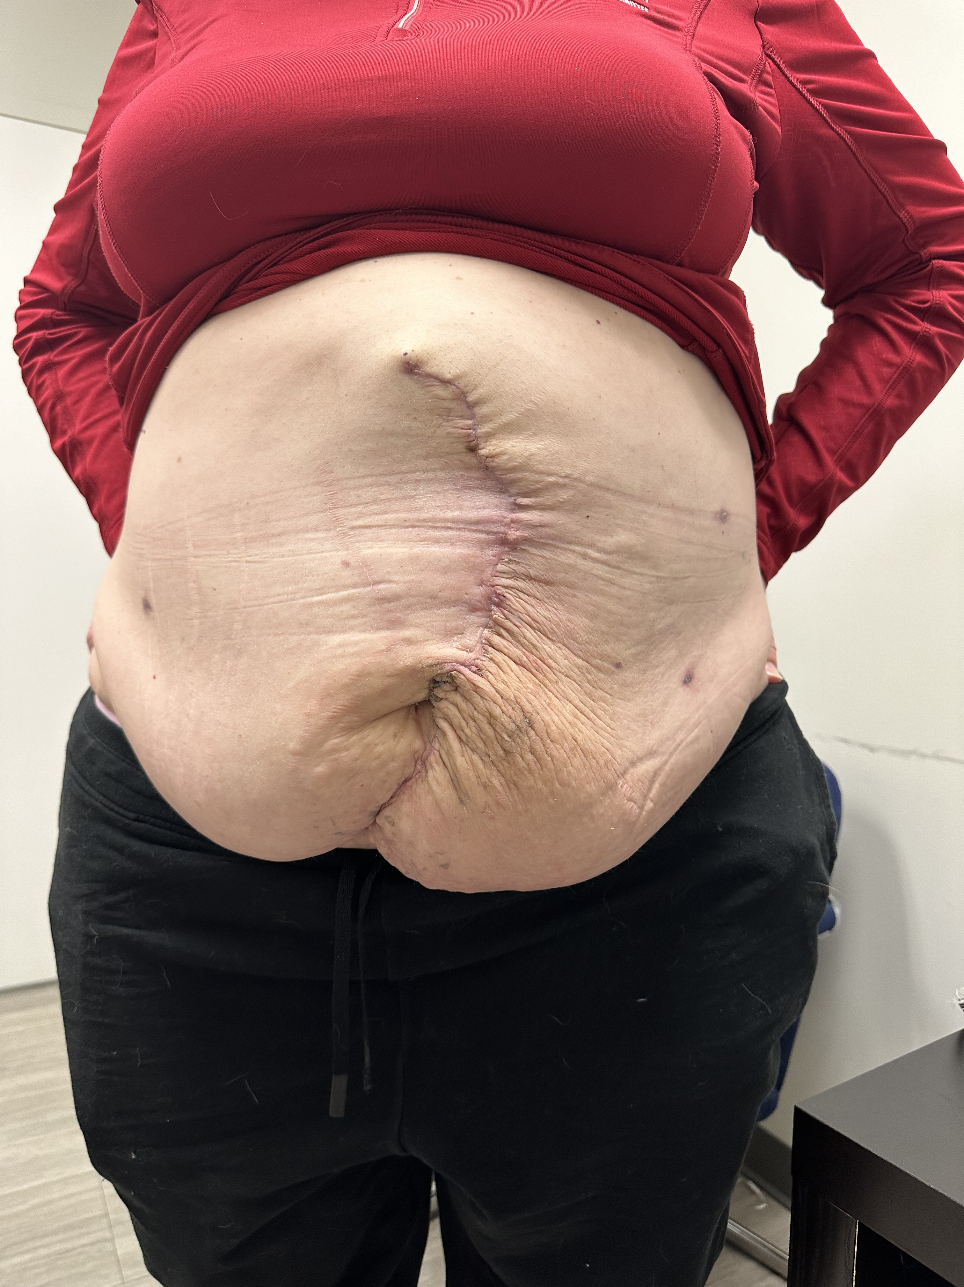
Before/After (52F)
BMI 40, diabetes
19cm x 22cm hernia
Vent: 3 days, extubated to HighFlow
Creatinine: 1.31 (from 0.59)
D/C POD 12

Slide 21
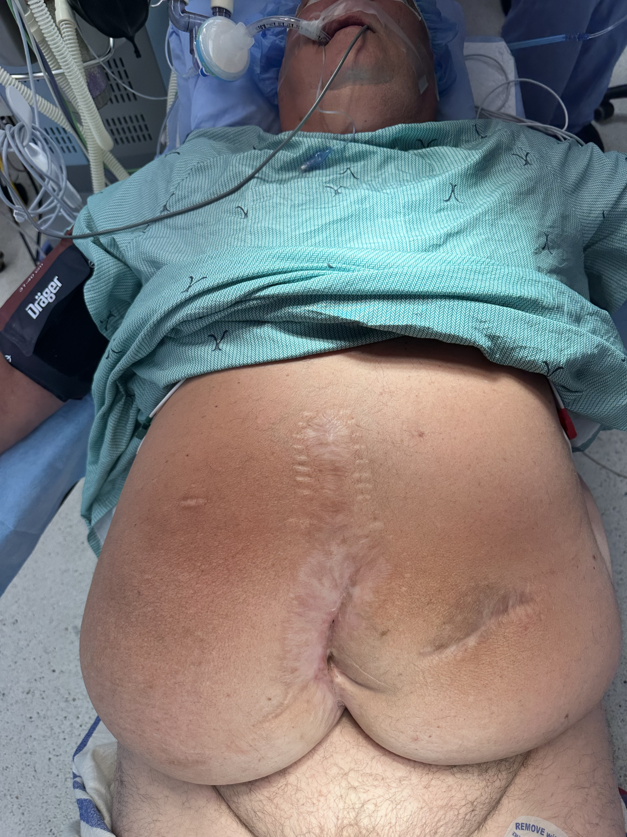
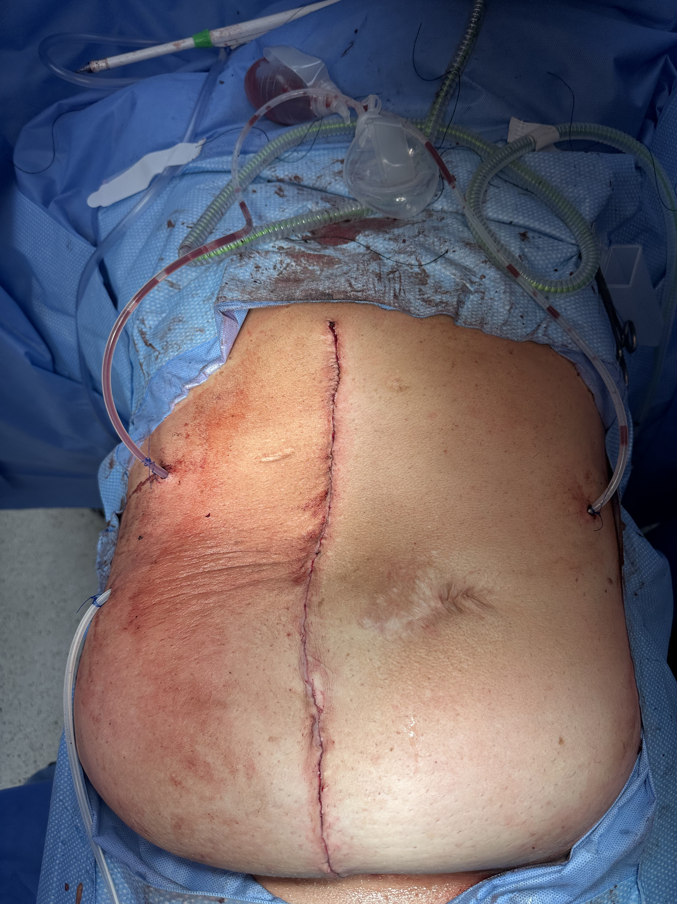
Before/After (69M)
BMI 47, Diabetes
23cm x 23cm hernia
Vent: 27 days, VAP, ARDS, now tracheostomy
Creatinine: 1.91, dialysis 3 weeks
Discharged POD 45 to a vent weaning center

Slide 22
The Bottom Line
Symptomatic ventral hernia patients should not be denied surgery based on smoking status, BMI or HbA1C
SES should be considered when operating on un-optimized patients
Warn them of the postoperative storm
Healthcare resources to help manage potential complications should be discussed in advance
Be cautious in massive LOD hernias in the un-optimized

Slide 23


Slide 24
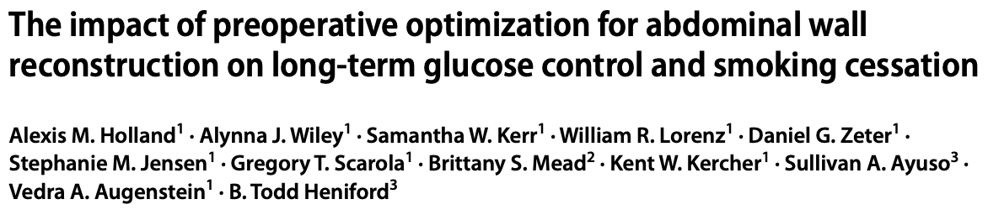
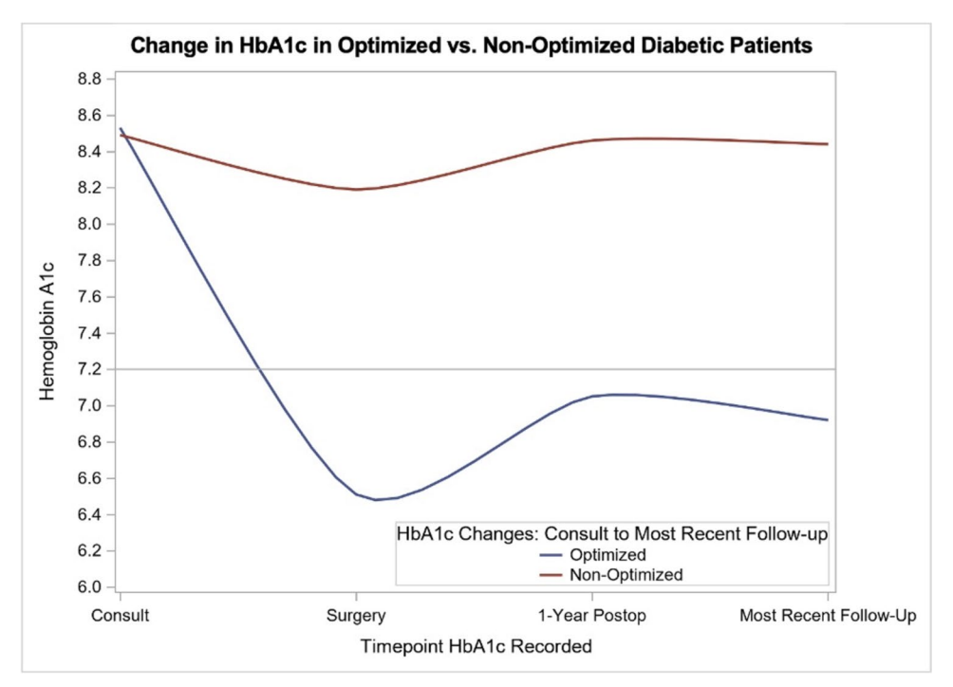
Optimized patients (HbA1c <7.2, smoking abstinence) vs unoptimized patients
63.2% maintained HbA1c ≤ 7.2
58.6% maintained smoking cessation with long-term follow-up
“Patients’ and surgeons’ efforts last well beyond the operation and positively impact patients’ overall health long-term”

Slide 25
Thank You!
Questions?

Slide 26
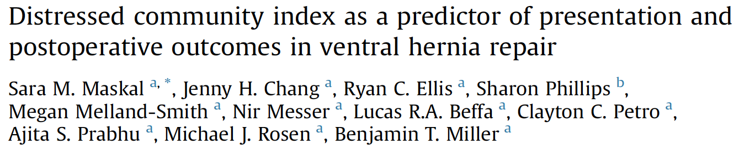
How Does SES Effect Outcomes?
AJS, 2023
32,000 patients → Ventral hernia repair – any approach
Distressed communities:
↑ BMI, diabetes, smoking
↑ Readmission → related to wound complications
↑ Reoperation
↑ SSO, SSI, SSOPI
No difference in 1-year recurrence (8% Prosperous vs 10% distressed)
↑ QOL in all patients
Despite ↑ 30-day Complications
Repair is safe in low SES/distressed communities

Slide 27
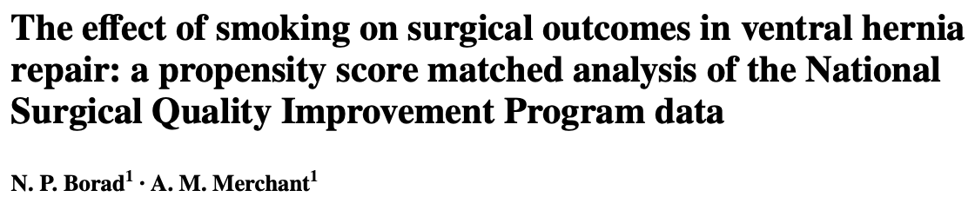
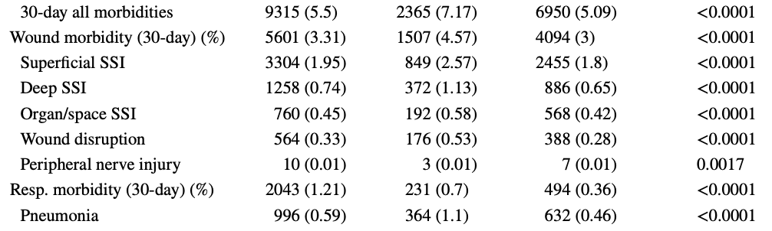
Hernia, 2018
NSQIP – All ventral hernias
169,000 patients
30-day Complications

Slide 28
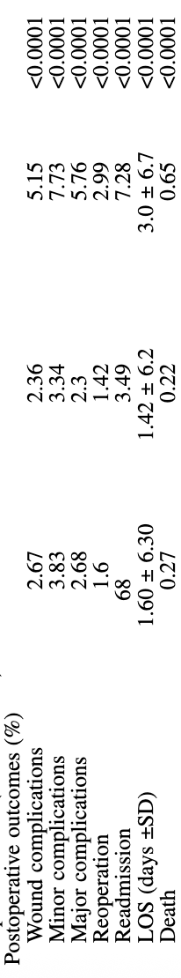
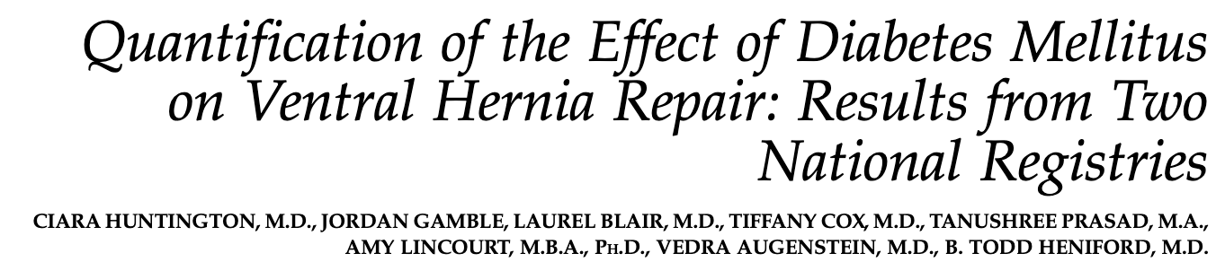
Does Diabetes Really Matter?
Am Surg, 2016
NSQIP – 219,000 patients
All Ventral Hernias
30-day Complications
All
Non-Diabetic
Diabetic
HbA1c < 7 vs HbA1c 7-8.4 vs HbA1c > 8.5
Open, Clean, TAR
No differences in 30-day postoperative complications between the three groups
Hernia, 2024
Notes:
Ready Nir’s paper

