Slide 1

ACHQC: From AWR Fellowship to Practice
Aldo Fafaj, MD

Slide 2
Disclosures
None

Slide 3


Introduction

Slide 4

Fellowship Experience

Slide 5
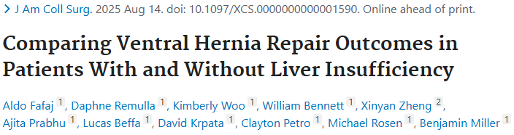
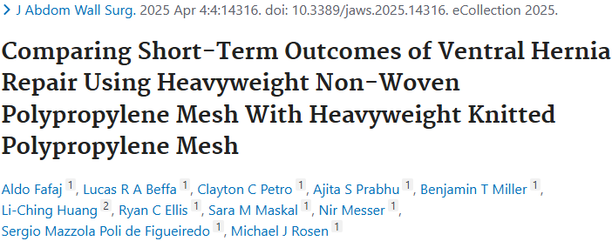
Fellowship Experience

Slide 6
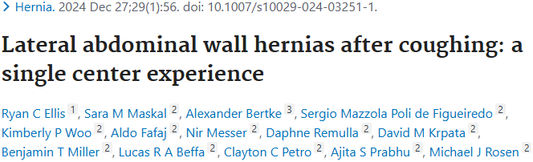
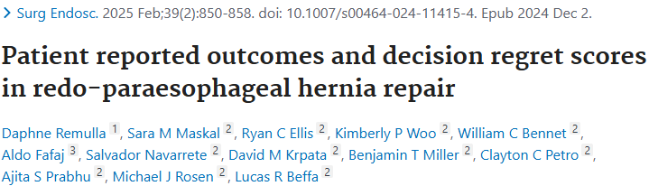
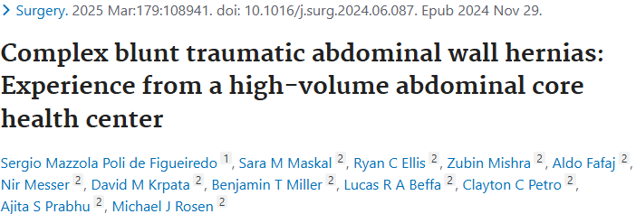
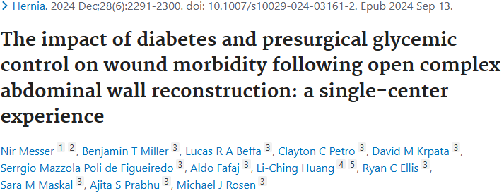
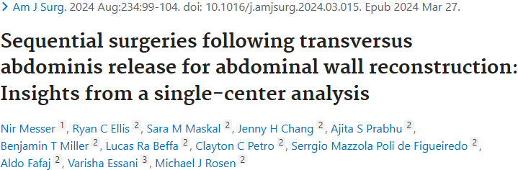
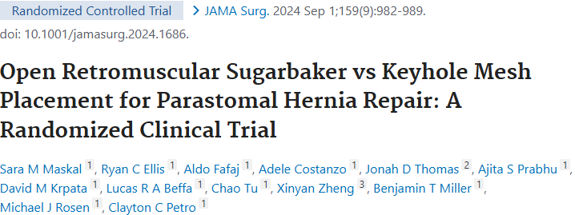
Fellowship Experience

Slide 7
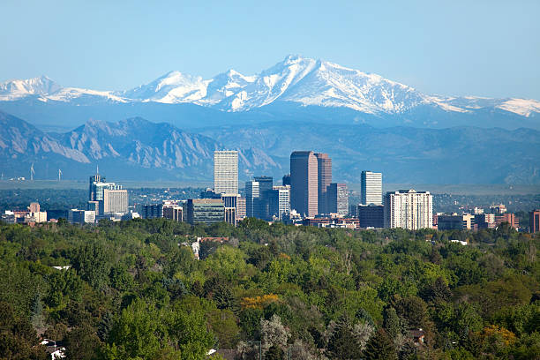
Fellowship Experience
Resident and fellow ACHQC committee
Increase attendance at annual meetings
Educational program
Data access – research grant

Slide 8
Fellowship Experience
Research fellow for two years
Worked with ACHQC daily

Slide 9

Fellowship Experience

Slide 10
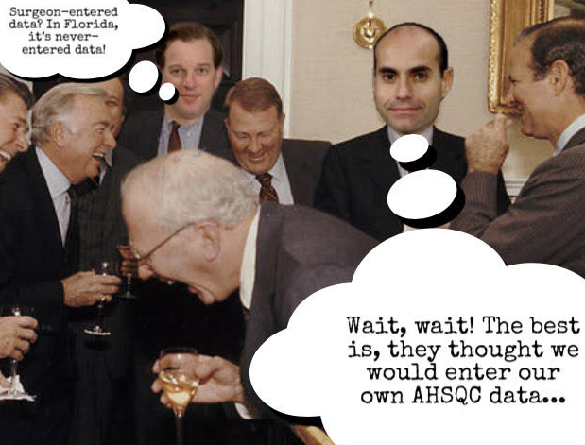


Slide 11

Transition to Practice

Slide 12

Transition to Practice

Slide 13
Practice Experience
Patients getting the wrong form/not getting it
Confusion in the office
No patient record on the ACHQC
Nurse change

Slide 14


Slide 15





Practice Experience

Slide 16


Slide 17


Slide 18

Office Presentation

Slide 19
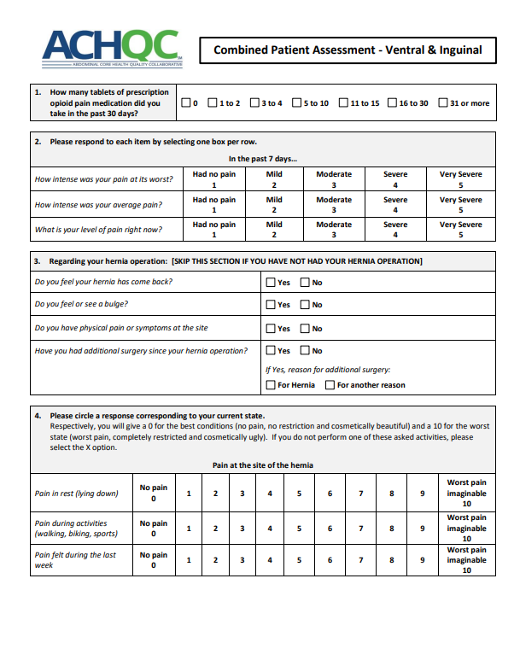
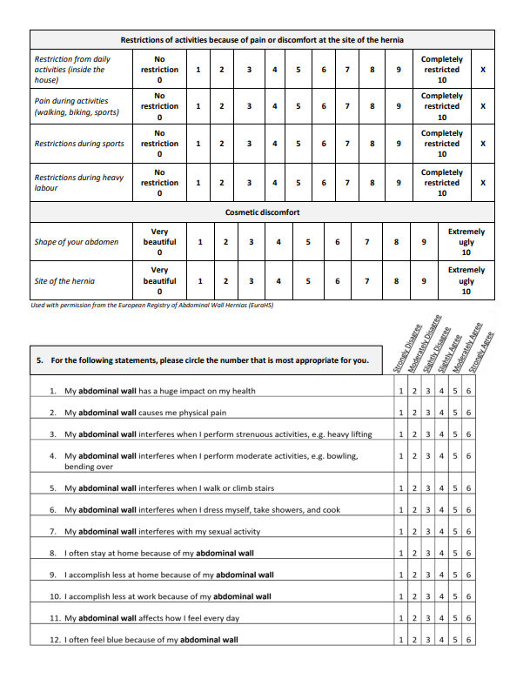
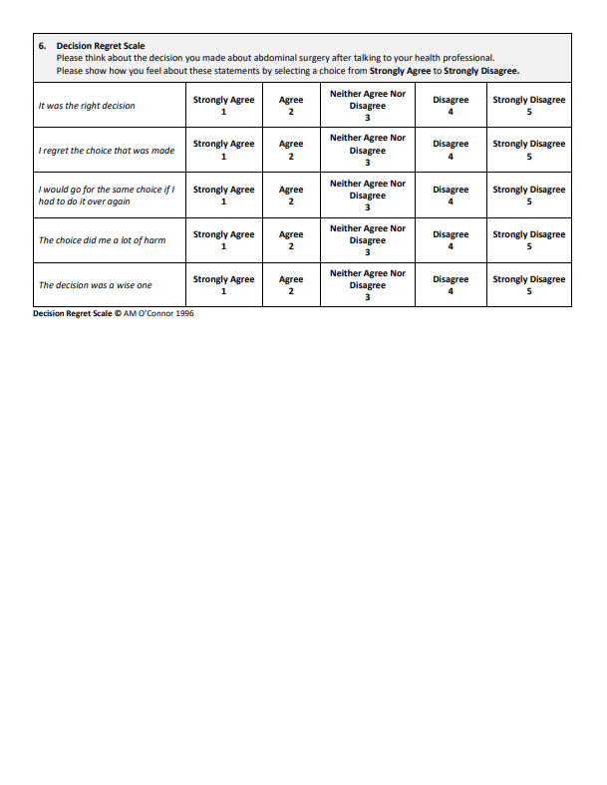

Slide 20
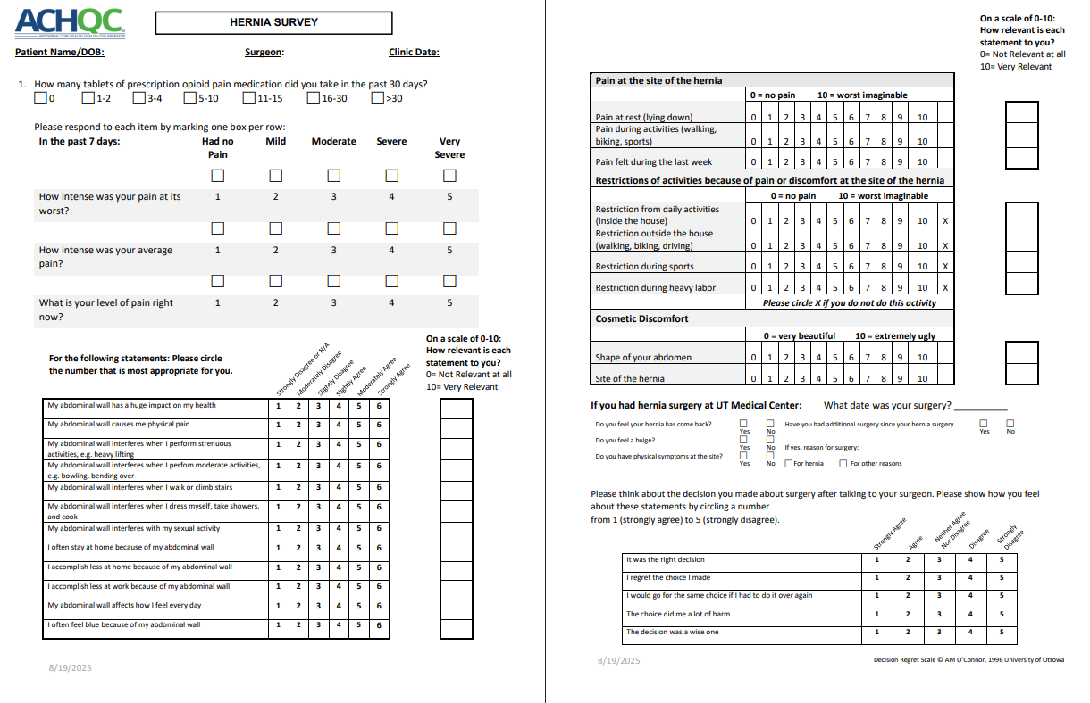
Best Solution – Pre Op

Slide 21
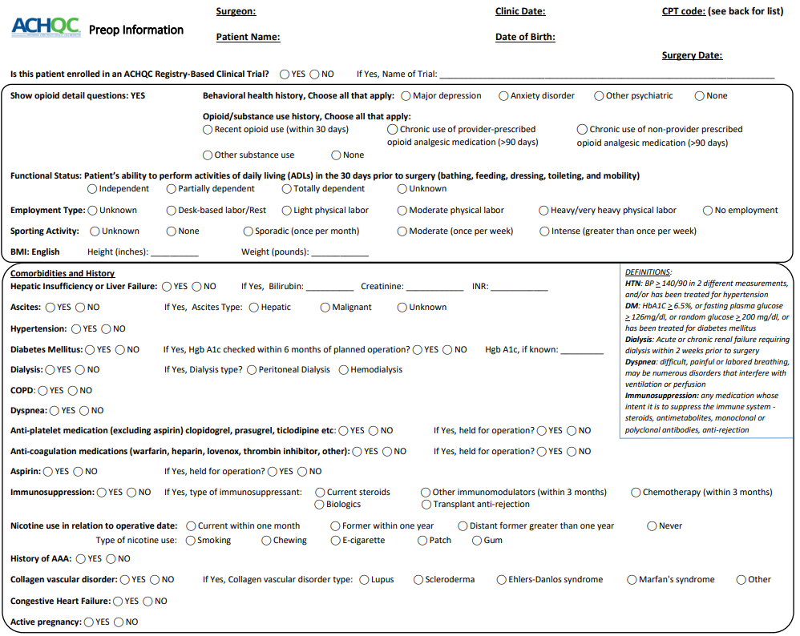

Slide 22
Best Solution – Post Op

Slide 23
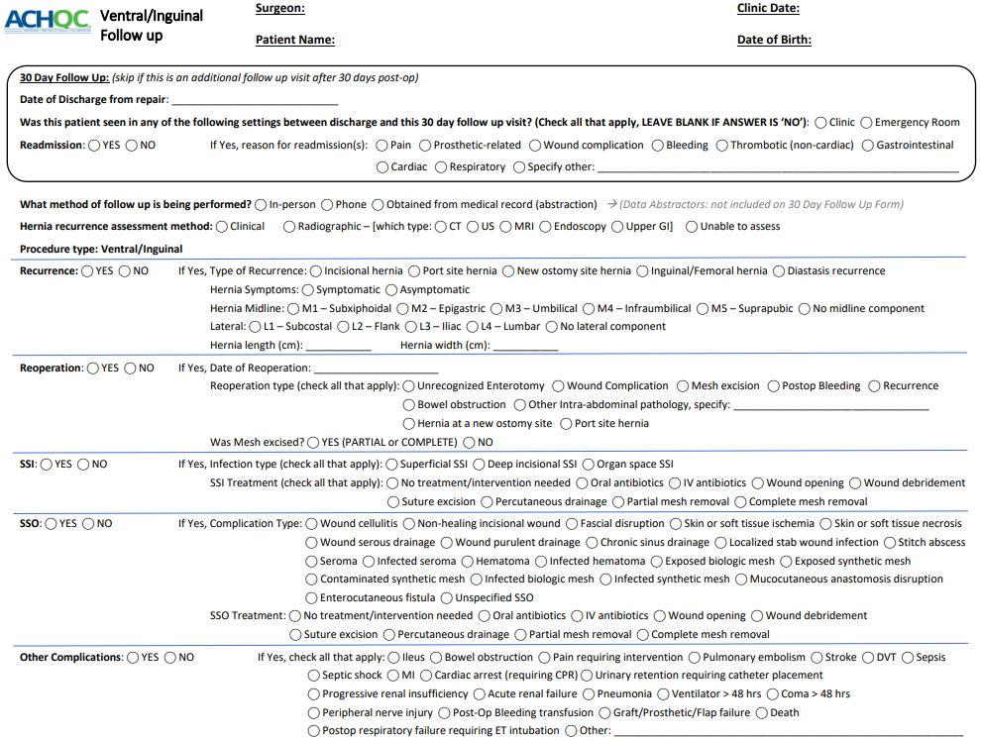

Slide 24
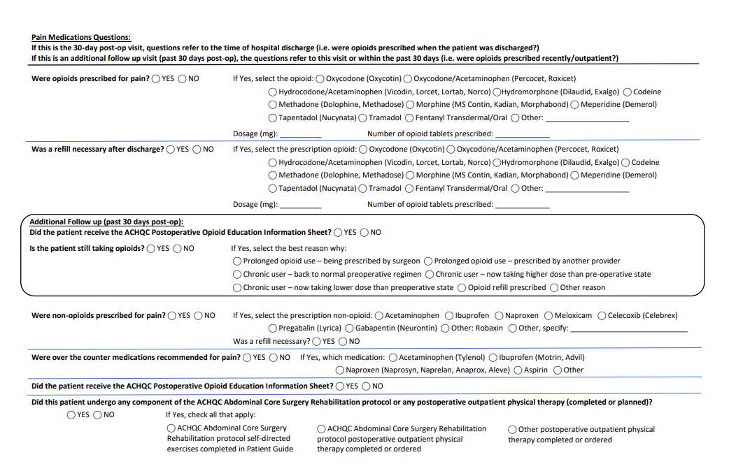

Slide 25


Slide 26




Slide 27


Slide 28
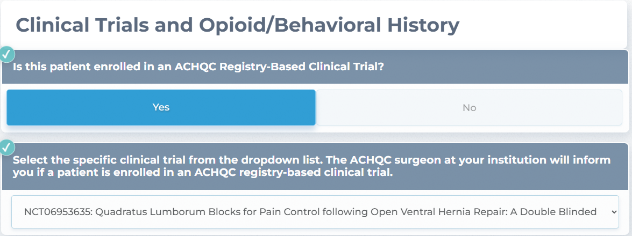

Slide 29
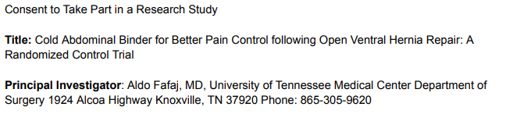
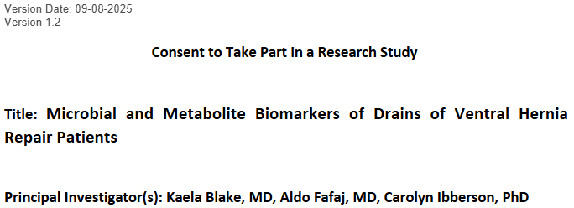

Slide 30
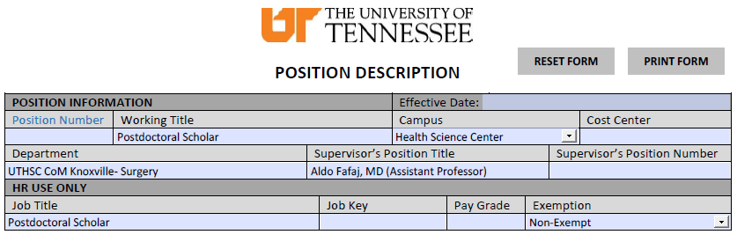
Funded research fellow position
$100K/year

Slide 31
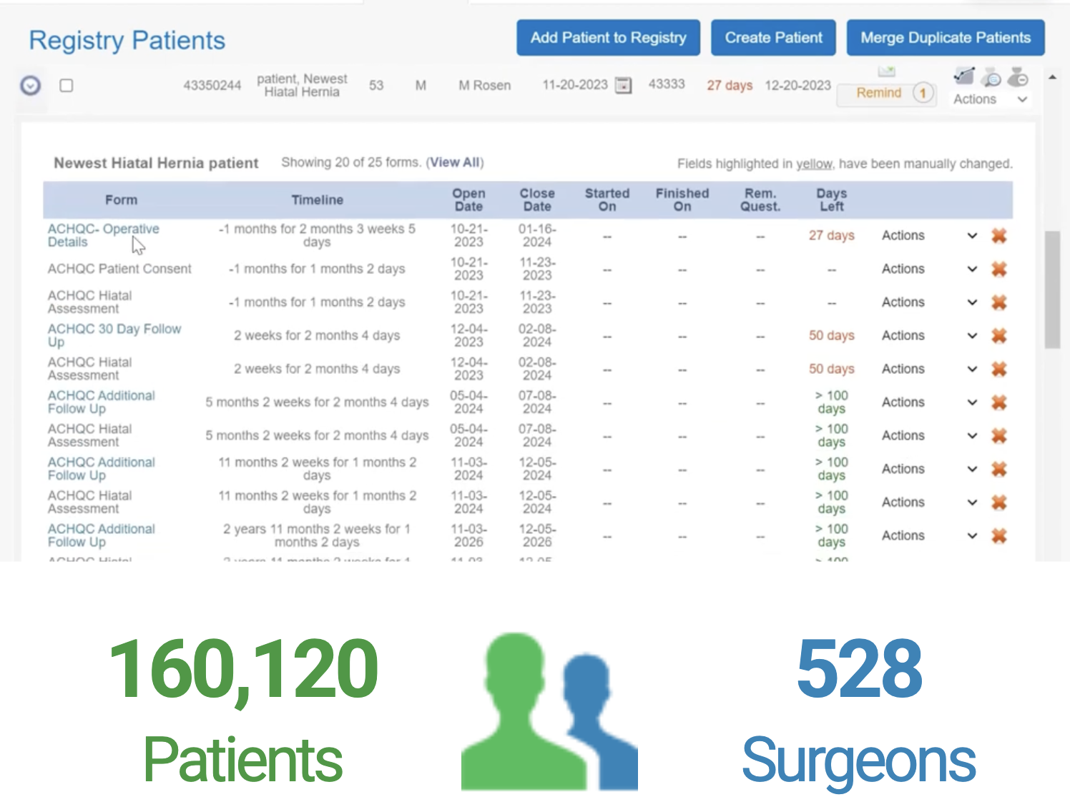
Abdominal Core Health Quality Collaborative

Slide 32



Slide 33
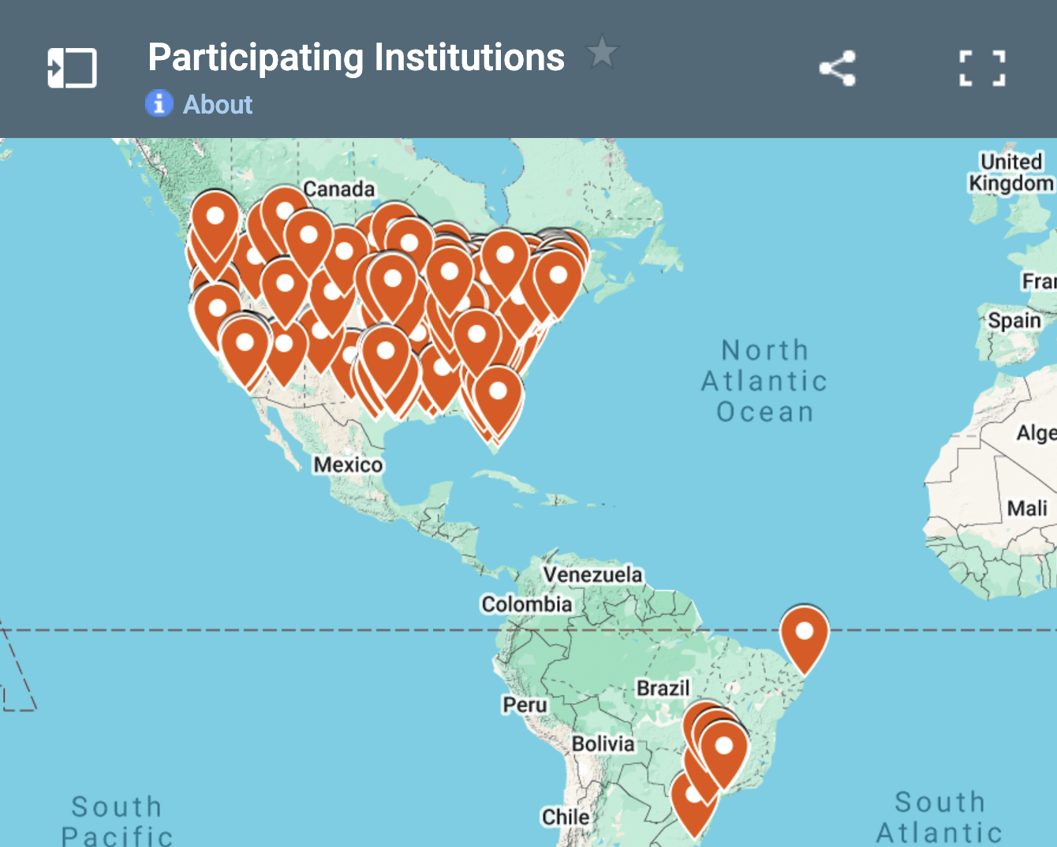

Slide 34
Thank you! Aldo Fafaj afafaj@utmck.edu

