Slide 1

No Opioids vs. Minimal Opioids Following Inguinal Hernia Repair
Noah X. Tocci MD
Kimberly P. Woo MD
Center for Abdominal Core Health, Cleveland Clinic Foundation Cleveland, OH

Slide 2
Participating Surgeons
ACHQC Nopioids Collaborative
Surgeons:
Ajita Prabhu MD
Aldo Fafaj MD
Alfredo Carbonell MD
Amitabh Goel MD
Ana Pena MD
Benjamin Miller MD
Christian Massier MD
Clayton Petro MD
David Krpata MD
Diya Alaedeen MD
Emanuele Lo Menzo MD
Jeremy Warren MD
Joshua Lyons MD
Kaela Blake MD
Kevin Baier MD
Lucas Beffa MD
Luciano Tastaldi MD
Matthew Goldblatt MD
Megan Melland-Smith MD
Michael Rosen MD
Rana Higgins MD
Roy Mayank MD
Samuel Szomstein MD
Todd Harris
Wes Love MD

Slide 3
Disclosures
No relevant disclosures to report

Slide 4

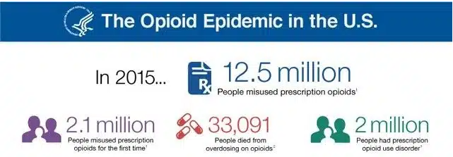


Background
Notes:
https://www.cdc.gov/nchs/nvss/vsrr/drug-overdose-data.htm

Slide 5
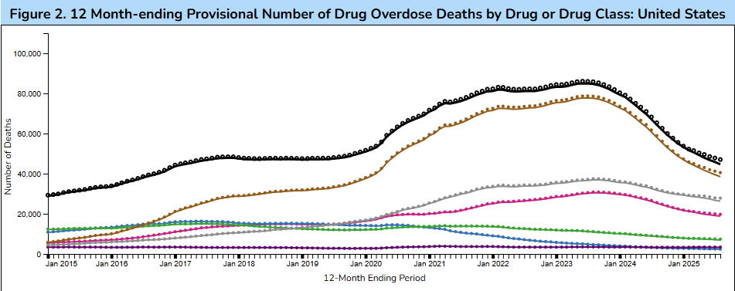

Background
Notes:
https://www.cdc.gov/nchs/nvss/vsrr/drug-overdose-data.htm

Slide 6
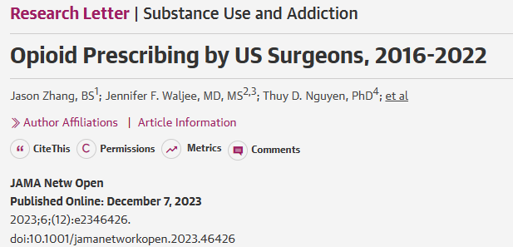
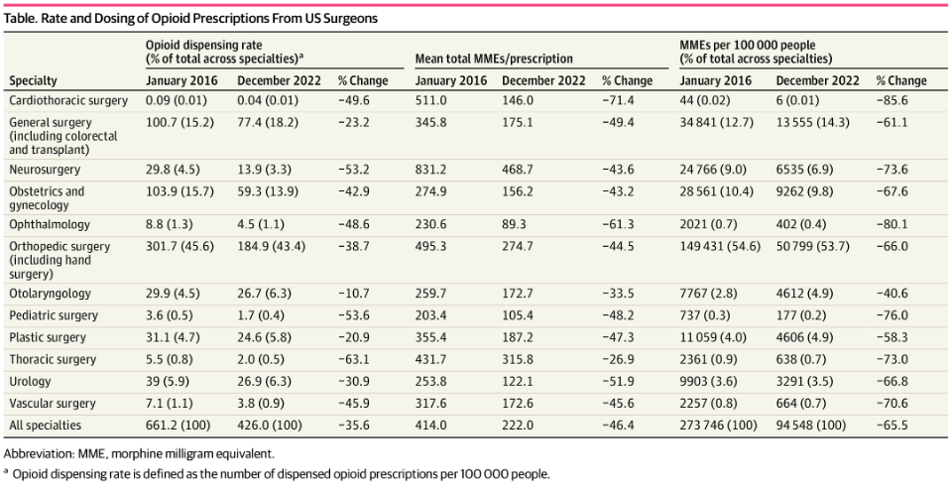
Background
Notes:
Michigan group
- Shows that while prescribing decreased over this time frame, general surgeons are still one of the highest prescribers in dispense rate and MMEs

Slide 7
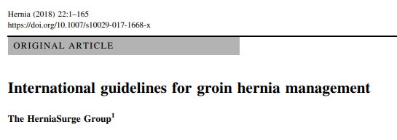
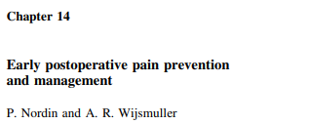
Background
“Non-opioid and non-steroidal anti-inflammatory medications should be used for postoperative pain management [..] Opioids are recommended in limited circumstances”
[…]
“weakness in the review presented in this chapter stems from the variation in quality of the available randomized trials.”
Notes:
- 2018 HerniaSurg group
HerniaSurge Group. International guidelines for groin hernia management. Hernia. 2018;22(1):1-165. doi:10.1007/s10029-017-1668-x

Slide 8
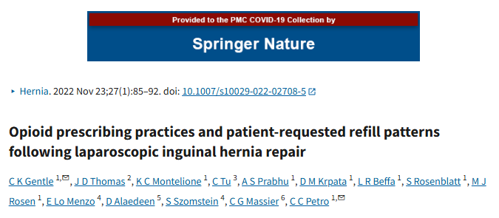
Background
Retrospective review of LIHR
67% used ≤ 4 tablets opioids.
4% of patients required refill
For every 1 tablet of oxycodone, 12% increase in the odds of refill
Notes:
Gentle CK, Thomas JD, Montelione KC, et al. Opioid prescribing practices and patient-requested refill patterns following laparoscopic inguinal hernia repair. Hernia. 2023;27(1):85-92. doi:10.1007/s10029-022-02708-5
Millard JL, Moraney R, Childs JC, et al. Opioid Use After Inguinal and Ventral Hernia Repair. Am Surg. 2020;86(8):965-970. doi:10.1177/0003134820942179

Slide 9
Primary Aim
Determine if no opioid prescription was non-inferior compared to opioid prescription for patient refill requests following inguinal hernia repair

Slide 10
Design
Multicenter, prospective randomized controlled trial
Patients undergoing elective IHR
Arm 1: 5 tablets, 5mg Oxycodone (or equivalent)
Arm 2: Acetaminophen / Ibuprofen

Slide 11









Participating Sites

Slide 12



Outcomes
Primary outcome:
30-day opioid rescue requests
Secondary outcomes:
Patient satisfaction with pain regiment
Patient QOL (EuraHS)
Clinical visits related to postoperative pain

Slide 13





Methods
Inclusion:
≥18 years old
Elective inguinal hernia (open or MIS) repair with mesh
Exclusion:
Chronic opioid use
Inability to take opioids/NSAID
Extensive dissection-at surgeon discretion
Opioid: 5 tablets, 5mg Oxycodone
No Opioid: Acetaminophen, Ibuprofen

Slide 14
Results
1080 Patients Consented
Enrollment start:
July 2023
Enrollment close:
October 2025
904 Patients Randomized
9 Patients withdrew after randomization
5 Patients with insufficient data
890 Patients for primary analysis
448 Opioids
442 No opioids

Slide 15
Results: Patient Characteristics
 | Opioid (n=453) | No Opioid (n=451)
Age, median [IQR] | 64.0 [53-71] | 64.0 [53-71]
Gender
Female | 26 (5.7%) | 28 (6.2%)
Male | 427 (94.3%) | 422 (93.8%)
BMI
<=29.9 | 378 (85.1%) | 366 (83.9%)
>=40 | 2 (0.5%) | 1 (0.2%)
30-34.9 | 50 (11.3%) | 58 (13.3%)
35-39.9 | 14 (3.2%) | 11 (2.5%)
Hypertension | 186 (41.4%) | 179 (40.0%)
Diabetes | 49 (10.8%) | 34 (7.6%)
No | 403 (89.2%) | 416 (92.4%)
Yes | 49 (10.8%) | 34 (7.6%)
COPD | 10 (2.21%) | 13 (2.89%)
Active smoking | 32 (7.6%) | 35 (7.8%)
Baseline EuraHS QOL | 25.8 [14.0-44.0] | 26.0 [12.0-41.0]
Pain domain, median [IQR] | 7.3 [3.0-13.0] | 7.0 [3.0-12.0]
Restriction domain, median [IQR] | 10.8 [2.7-23.0] | 10.0 [2.0-21.3]
Notes:
Mostly male (94%)
Median age 64
ASA II-III (~60%)
BMI< 29 (~80%)

Slide 16
Results: Hernia / Operative Characteristics
 | Opioid (n=453) | No Opioid (n=451) | p value
ASA Class |  |  | 0.4
1 | 70 (15.5%) | 67 (15.0%)
2 | 198 (43.7%) | 205 (45.9%)
3 | 178 (39.3%) | 173 (38.7%)
4 | 7 (1.6%) | 2 (0.5%)
Recurrent Repair | 23 (5.1%) | 21 (4.8%) | 1.0
Scrotal component | 38 (15.0%) | 21 (8.71%) | 0.04
Hernia defect >3cm or >2 fingers breath | 49 (17.0%) | 47 (17.8%) | 0.8
Laterality |  |  | 0.6
Unilateral | 345 (76.2%) | 353 (78.8%)
Bilateral | 108 (23.8%) | 95 (21.2%)
Surgical approach |  |  | 0.7
Open | 93 (20.5%) | 87 (19.4%)
MIS | 360 (79.5%) | 331 (80.5%)
TAPP | 144 (100%) | 126 (100%) | .
TEP | 215 (100%) | 232 (100%) | .
Local infiltration or nerve block | 350 (77.3%) | 346 (77.2%) | .
Neurectomy performed | 32 (7.0%) | 34 (7.6%) | 0.7
Concomitant procedure performed | 23 (5.1%) | 25 (5.6%) | 0.9
OpTime, N (%): |  |  | 0.06
0-59 minutes | 248 (55.1%) | 237 (53.4%)
60-119 minutes | 169 (37.6%) | 186 (41.9%)
120-179 minutes | 32 (7.1%) | 17 (3.8%)
180-239 minutes | 1 (0.2%) | 4 (0.9%)
Notes:
Operative:
Primarily non recurrent repairs (~95%)
~20% bilateral
Open (~20%)
MIS
TEP (~50%)
TAPP (~50%)
Nerve blocks (~75%)
Neurectomy (~45%)

Slide 17
Results: Primary Outcome
 | n | Opioid (n=448) | No Opioid (n=442) | p value
Opioid rescue | 890 | 15 (3.4%) | 35 (7.9%) | 0.005
Rescue MME, median [IQR] | 50 | 37.5 [37.5-73.1] | 37.5 [37.5-75.0] | 0.7
Notes:
Patients who are prescribed opioids post operatively had an opioid rescue rate of 3.4% compared to 7.9% in the non opioids. This finding was notably significant, thus indicating that no opioid prescription after IHR was indeed not non-inferior. The absolute risk reduction afforded by prescribing opioids postoperatively is 4.5 %
Of note, for those patients who did receive a rescue dose of opioids, there was no difference in the dose prescribed to either group

Slide 18
Results: Primary Outcome
442 No opioids
35 (7.9%) Opioids
407 (92.1%) No opioids
26 (74.3%) requested on day of discharge
Median days for delayed prescribing was on POD2 [2-3]
No patients required an additional script within 30 days
Notes:
These numbers in context:
92% of patients who are not prescribed opioids do not require a prescription to be filled
So in practice over 22 patients (NNT 22.2) would need to be prescribed Opioids post operatively to prevent one additional patient calling.
Depending on surgeon’s practices, you would need to complete over 260 inguinal hernias a year to receive one less phone call per month for a script fill

Slide 19
Results: Primary Outcome*
Adding nuance: When taking away the patients prescribed on POD 0 (26):
 | n | Opioid (n=448) | No Opioid (n=442) | p value
Opioid rescue | 890 | 15 (3.4%) | 38 (8.6%) | 0.005
VS
 | n | Opioid (n=448) | No Opioid (n=442) | p value
Opioid rescue after POD 0 | 890 | 15 (3.4%) | 9 (2.0%) | 0.16
Notes:
- Excludes patients who received on POD0– trying to get at those who otherwise ***

Slide 20
Results: Primary Outcome*
Adding nuance: 3 patients with self reports of home opioid use.
 | n | Opioid (n=448) | No Opioid (n=442) | p value
Opioid rescue | 890 | 15 (3.4%) | 41 (9.3%) | 0.002
VS
 | n | Opioid (n=448) | No Opioid (n=442) | p value
Opioid rescue after POD 0 | 890 | 15 (3.4%) | 12 (2.7%) | 0.36
Notes:
- Excludes patients who received on POD0– trying to get at those who otherwise ***

Slide 21
Primary Aim
Determine if no opioid prescription was non-inferior compared to opioid prescription for patient rescue requests following inguinal hernia repair

Slide 22
Results: Primary Outcome*
Should these 3 patients count as requiring a rescue?
3 patients with self reports of home opioid use.
Notes:
- Excludes patients who received on POD0– trying to get at those who otherwise ***

Slide 23
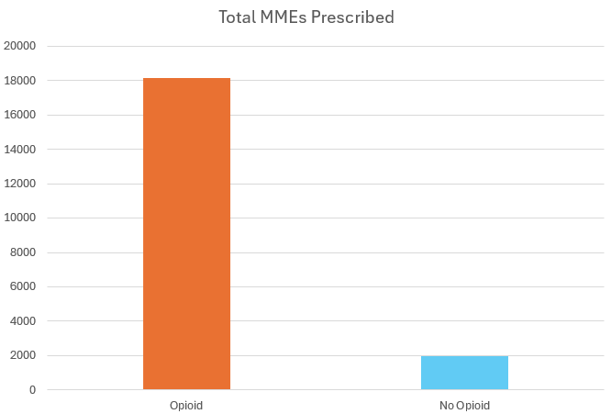
Results: Total MME Distributed
18163
1945

Slide 24
Results: Visits and QOL
 | n | Minimal Opioid (n=448) | No Opioid (n=442) | p value
Clinical visits for pain
ED | 806 | 7 (1.7%) | 5 (1.2%) | 0.8
Clinic | 532 | 2 (0.8%) | 5 (1.9%) | 0.5
Pain regiment satisfaction | 674 |  |  | 0.4
Dissatisfied |  | 10 (2.9%) | 9 (2.8%)
Neutral |  | 27 (7.8%) | 35 (10.7%)
Satisfied |  | 310 (89.3%) | 283 (86.5%)
Postop EuraHS QOL scores | 666 | 10.0 [4.0-23.7] | 10.0 [3.0-20.0] | 0.3
Pain domain, median [IQR] | 667 | 2.0 [0.0-6.0] | 2.0 [0.0-5.0] | 0.08
Restriction of activity domain, median [IQR] | 678 | 3.0 [0.0-12.0] | 2.0 [0.0-10.0] | 0.3

Slide 25
Results: Patient Reported Usage
Of those in the Opioid cohort, with reported 30-day opioid use (n= 351, 78%):
0 tablets | 1-2 tablets | 3-4 tablets | 5-10 tablets | 11- 15 tablets | 16-30 tablets
217 (62%) | 56 (16%) | 28 (8%) | 44 (13%) | 2 (0.6%) | 4 (1.1%)

Slide 26
Results: Patient Reported Usage
Of those in the Opioid cohort, with reported 30-day opioid use (n= 351, 78%):
0 tablets | 1-2 tablets | 3-4 tablets | 5-10 tablets | 11- 15 tablets | 16-30 tablets
217 (62%) | 56 (16%) | 28 (8%) | 44 (13%) | 2 (0.6%) | 4 (1.1%)
301 (86%)

Slide 27
Future Directions
Multivariate and sensitivity analysis
Patient: age, smoking, bilaterality, scrotal component
Local anesthetic/ block
Muscle relaxants
1-year follow up to assess continued narcotic pain medication use

Slide 28
Conclusion
Prescribing 5 tablets of 5mg oxycodone reduces the need for recue prescriptions by 4.5%
Patients and surgeons should use this information to have an informed discussion regarding the need for an opioid prescription following IHR

Slide 29
Acknowledgments
ACHQC Nopioids Collaborative
Participating Sites:
California Hernia Specialist
Cleveland Clinic Foundation- Florida
Cleveland Clinic Foundation- Ohio
Medical College of Wisconsin
North York General Hospital
Prisma Health
University Hospital
University of Tennessee College of Medicine – Knoxville

Slide 30
Acknowledgments
ACHQC Nopioids Collaborative
Surgeons:
Ajita Prabhu MD
Aldo Fafaj MD
Alfredo Carbonell MD
Amitabh Goel MD
Ana Pena MD
Benjamin Miller MD
Christian Massier MD
Clayton Petro MD
David Krpata MD
Diya Alaedeen MD
Emanuele Lo Menzo MD
Jeremy Warren MD
Joshua Lyons MD
Kaela Blake MD
Kevin Baier MD
Lucas Beffa MD
Luciano Tastaldi MD
Matthew Goldblatt MD
Megan Melland-Smith MD
Michael Rosen MD
Rana Higgins MD
Roy Mayank MD
Samuel Szomstein MD
Todd Harris
Wes Love MD

Slide 31
Acknowledgments
ACHQC Nopioids Collaborative
Statistical Staff:
Chao Tu
Li-Ching Huang
Li Tang

Slide 32
Acknowledgments
ACHQC Nopioids Collaborative
Support Staff:
Abby Birrell
Aileen Beckler
Alvaro Carvalho
Ana Paula Lacombe
Ayanna Cooper
Elizabeth LaFontaine
Erika Schmidt
Jalen Plaster
Kimberly Miles
Mauricio Sarmiento Cobos
Mahamad Mohamad
William Bennett

Slide 35
Who called:
 | No call n=839 | Call N= 50 | p value
Recurrent Repair | 60 (7.3%) | 5 (10.0%) | 0.3
Scrotal component | 55 (12.0%) | 4 (12.9%) | 0.8
Hernia size >3 cm or > 2 finger | 96 (17.5%) | 5 (14.7%) | 0.9
Bilateral repair | 185 (22.1%) | 16 (32%) | 0.3
Surgical Approach |  |  | 0.9
Open | 166 (19.8%) | 8 (16.0%)
Laparoscopic | 609 (72.7%) | 39 (78.0%)
Robotic | 62 (7.4%) | 3 (6.0%)
Neurectomy | 64 (47.4%) | 1 (14.3%) | 0.1
Concomitant UHR | 45 (5.4%) | 3 (6.1%) | 1.0
Operative Time |  |  | 0.006
0-59 minutes | 460 (55.3%) | 16 (32.7%)
60-119 minutes | 322 (38.7%) | 31 (63.3%)
120-179 minutes | 45 (5.4%) | 2 (4.0%)
180-239 minutes | 5 (0.6%) | 0 (0%)
Tablets taken |  |  | <0.001
0 | 498 (77.6%) | 7 (18.9%)
1-2 | 66 (10.3%) | 8 (21.6%)
3-4 | 33 (5.1%) | 4 (10.8%)
5-10 | 41 (6.4%) | 15 (40.5%)
11-15 | 0 (0%) | 4 (10.8%)
16-30 | 4 (0.6%) | 1 (2.7%)
Patient:
Male
Median age 60
ASA II-III
BMI< 29

