Slide 1

Post-Operative Pathways and Physical Rehabilitation
W. Taylor Head MD
ACHQC 8th Annual Quality Improvement Summit
Notes:
Good morning, everyone. My name is Taylor Head, and I'm a fourth-year general surgery resident at The Ohio State University. Today I'll be talking about post-operative pathways and physical rehabilitation in abdominal core health—how we can move from arbitrary restrictions to evidence-based recovery protocols that actually restore patient function.

Slide 2

Disclosures
W. Taylor Head MD: None
Notes:
I have no relevant financial disclosures to report.

Slide 3

The Clinical Problem
The “Rule of 10s”: Historical reliance on arbitrary 10-lb lifting restrictions for 6-8 weeks
Impact:
Physiological : Contribute to muscle atrophy and core dysfunction
Psychological: “Kinesiophobia” generates anxiety and poor engagement
Quality Gap: Significant variability in post-op advice
Notes:
Let's start with a problem we all recognize: the "Rule of 10s." For decades, we've told patients not to lift more than 10 pounds for 6 to 8 weeks after hernia repair. But let's be honest—that number is arbitrary. It's rooted in tradition, not biomechanics.
This creates two major problems. Physiologically, we contribute to muscle atrophy and "neurological silencing" of the very muscles we just reconstructed. Psychologically, we instill kinesiophobia—a clinical fear of movement—where patients become so afraid of "popping a stitch" that they stop moving naturally.
There's a major quality gap here. The ACHQC gives us a platform to move from anecdotes to data-driven recovery. We need to stop asking patients to "do less" and start teaching them how to move correctly.

Slide 4
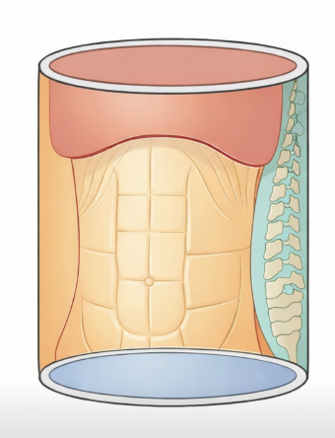
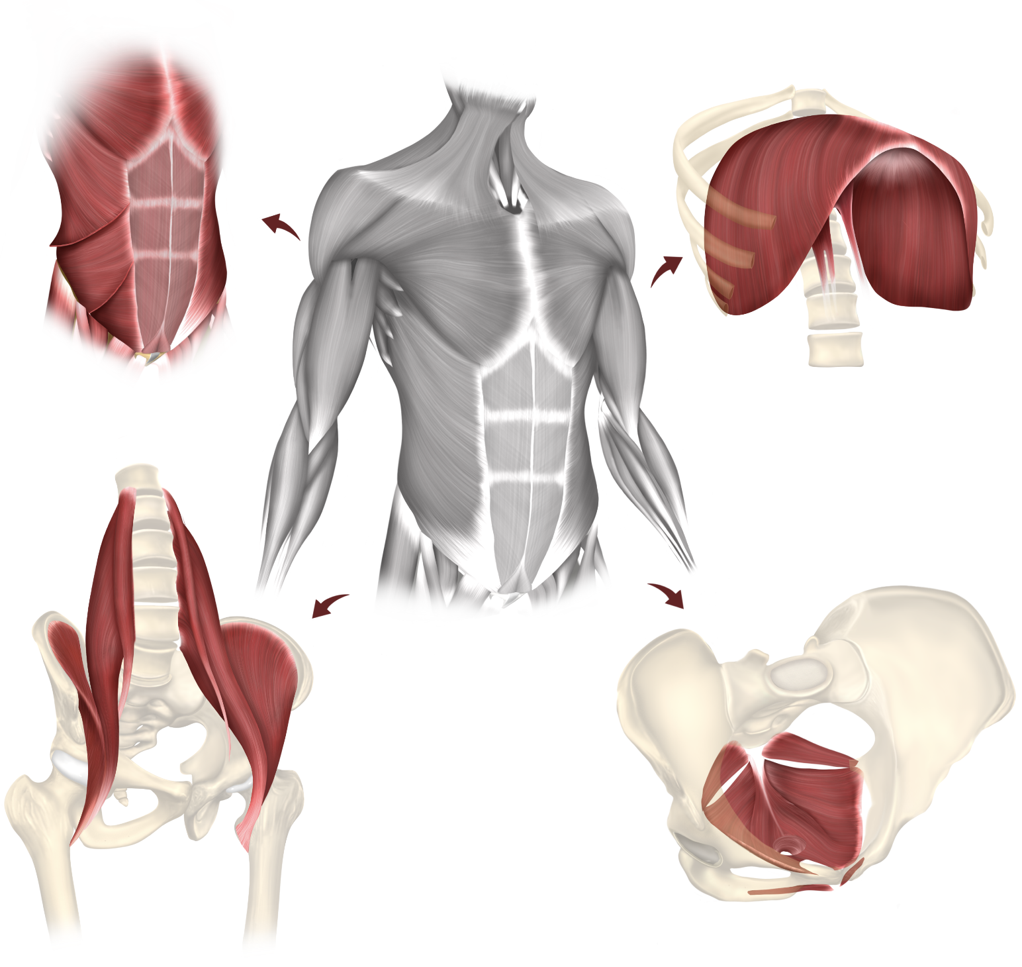
Defining the Abdominal Core
Not isolated, separate components
The Functional Cylinder: A dynamic pressure-chamber system
Both hernias and hernia repairs are a Disruption: Break in the functional cylinder
Goals of Rehab: Restoration of form and function
Notes:
To optimize recovery, we need to understand the abdominal core as a functional unit. Historically, we've viewed the abdominal wall, diaphragm, and pelvic floor as separate structures. But physical therapists and movement specialists recognize these as a single integrated system—a functional cylinder where the diaphragm is the top, the pelvic floor is the base, and the abdominal wall provides dynamic support.
A hernia acts as a "pressure leak" in this cylinder, often leading to compensatory patterns. When we perform a repair, we're restoring anatomy, but we're also temporarily disrupting the neuromuscular coordination of this entire system.
Our rehab goal isn't just "strengthening a repair"—it's recalibrating the entire system so it manages intra-abdominal pressure effectively, ensuring the repair heals in a balanced, low-stress environment.

Slide 5

The Role of the ACHQC in Rehab
The Registry Advantage: Utilizing longitudinal data to track both objective AND subjective recovery
The Data Gap: Moving from "Is the incision healed?" to "Can the patient function?”
Patient-Centered Information: Providing standardized "Information for Patients" to align expectations for post-op care.
Standardizing the "Rehab Dose": Guides to ensure consistent care for all
Notes:
How does the ACHQC drive quality improvement in rehab? It provides infrastructure to look beyond immediate surgical results.
First, the Registry Advantage: we track both objective clinical markers and subjective patient-reported outcomes longitudinally—not just at 30 days, but across the entire recovery trajectory.
This addresses the Data Gap—moving from "Is the incision healed?" to "How is the patient actually functioning?" This functional focus defines true abdominal core health.
The ACHQC offers standardized "Information for Patients" sheets to align expectations and provides Rehabilitation Guides to bridge the gap between surgeon and physical therapist. Our goal is to standardize the "rehab dose" so every patient gets consistent, evidence-based care.

Slide 6
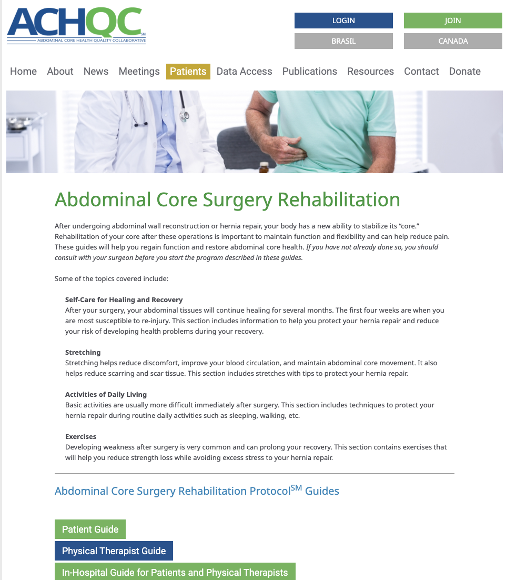
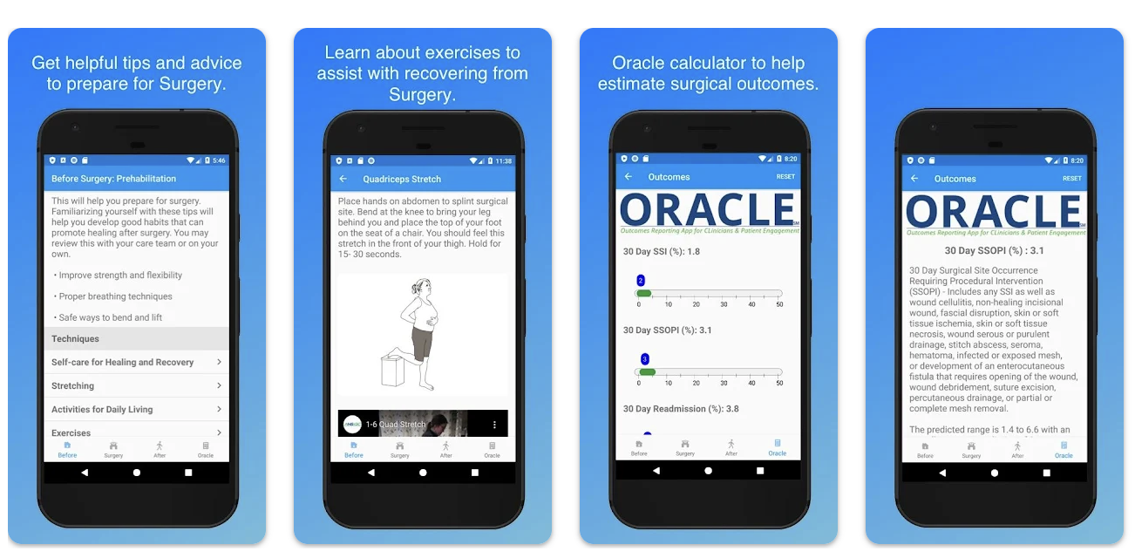
ACHQC’s Abdominal Core Surgery Rehab Protocol
Tiered Resource Suite: patient, in-hospital, PT guides
Integrated Surgical Continuum:
4 weeks pre-op → 16 weeks post-op
Multidisciplinary Alignment: Bridging the "Communication Gap” to ensure consistency
Notes:
The ACHQC provides a structured suite of resources: tiered guides for patients, in-hospital staff, and physical therapists. This creates an Integrated Surgical Continuum—rehab starts 4 weeks before surgery and extends 16 weeks after.
This multidisciplinary alignment bridges the traditional communication gap between the surgeon's office and the outpatient therapist. These protocols are available on the ACHQC website under Patient Resources.

Slide 7

Prehabilitation: The Head Start
Pre-op
Surgery
Post-op
Traditional Risk Modification: Address smoking, BMI, and glycemic control
Functional Preparation: Teach breathing, core control, movement strategies at baseline
Neuromuscular Mastery: Learning exercises and skills at functional baseline
Surgical Resilience: Shorter LOS, fewer complications, faster recovery
Notes:
Optimization begins well before surgery. Traditional risk modification—smoking cessation, BMI management, glycemic control—remains essential. But we're adding functional prehabilitation.
We use the preoperative window to teach diaphragmatic breathing, gentle core engagement, and movement strategies like log-rolling while patients are still at their functional baseline and pain-free. This gives patients a neuromuscular head start—they're learning skills before pain and fear show up, so on post-op Day 1 they're repeating something familiar instead of learning something brand new.
When we combine medical risk modification with functional prehab, we're not just clearing patients for surgery—we're building physiological resilience, which translates to shorter length of stay, fewer complications, and smoother recovery.

Slide 8
The ERAS Framework
Pre-op
Surgery
Post-op
Multimodal analgesia: Reduce opioid use → restore gut motility faster
Early mobilization: Dangle and ambulate Day 0 (prevent VTE, ileus)
Diaphragmatic breathing: Prevent atelectasis, reduce IAP-spiking bracing patterns
In-hospital PT: Teach log-rolling, sit-to-stand, assess mobility
Notes:
Enhanced Recovery principles form our early post-op foundation. We use multimodal analgesia to minimize opioids and restore gut motility faster. We mobilize patients early—dangling and walking on Day 0—to prevent VTE and ileus.
We prioritize diaphragmatic breathing from Day 1 to prevent atelectasis and reduce the bracing patterns that spike intra-abdominal pressure. Many centers include in-hospital PT to teach log-rolling, safe transfers, and assess mobility before discharge. This early engagement sets the tone for the entire pathway.

Slide 9





Post-Operative Rehabilitation Timeline
Pre-op
Surgery
Post-op
Week 0-2
PROTECTION
Self-directed
Week 2-4
ACTIVATION
PT 1x/week
Week 4-8
LOADING
PT 1x/week
Week 8-12
Week 12-16
STRENGTH
PT 2x/week
MAINTENANCE
Home program
Notes:
The ACHQC protocol structures post-op rehab as a continuum. Weeks 0-2 are self-directed, emphasizing protection and breathing. Formal PT begins at week 2 with once-weekly visits. From weeks 4-8, we continue weekly PT but shift to progressive loading. Then weeks 8-12, we ramp up to twice-weekly sessions for maximum strength gains.
Progression is symptom-guided: pain shouldn't increase more than 2 points, we monitor for swelling and fatigue, and we watch for doming or coning at the incision.

Slide 10
Early Post-Op – Protection & Activation
GOALS: Tissue protection + Prevent complications + Re-establish neuromuscular control
Week 0-2:
Self-directed at home
Walking 5 min × 3-6/day
Diaphragmatic breathing
Lift <10 lbs, wear binder
Week 2-4:
Begin PT 1×/week
Activate transverse abdominis
Pelvic floor coordination
Walk → 30 min by week 4
Week 0-2
PROTECTION
Self-directed
Week 2-4
ACTIVATION
PT 1x/week
Week 4-8
LOADING
PT 1x/week
Week 8-12
Week 12-16
STRENGTH
PT 2x/week
MAINTENANCE
Home program
Notes:
The first month divides into two phases. Weeks 0-2 focus on protection: patients walk 5 minutes multiple times daily, practice diaphragmatic breathing, and follow strict lifting precautions—less than 10 pounds—while wearing an abdominal binder.
At week 2, we begin neuromuscular activation with supervised PT once weekly. We focus on "waking up" the transverse abdominis and introducing pelvic floor coordination—these deep stabilizers manage intra-abdominal pressure during real-world activity.
By week 4, patients should walk 30 consecutive minutes and demonstrate proper core engagement with basic movements. Our goals are tissue protection, preventing complications, and re-establishing neuromuscular control.

Slide 11
Late Post-Op – Loading & Return to Function
Shift from weight restrictions → movement education: HOW you lift > WHAT you lift
Week 4-8:
PT 1×/week continues
Add resistance exercises (1-3 lbs)
Teach proper lifting mechanics
Lift 10-15+ lbs with form
Week 8-12+:
PT 2×/week (max strength phase)
Planks, push-ups, loaded exercises
Symptom-limited lifting
Return to work/recreation
Week 0-2
PROTECTION
Self-directed
Week 2-4
ACTIVATION
PT 1x/week
Week 4-8
LOADING
PT 1x/week
Week 8-12
Week 12-16
STRENGTH
PT 2x/week
MAINTENANCE
Home program
Notes:
From weeks 4-12, we progress through loading and functional return. Weeks 4-8 introduce progressive loading—adding resistance exercises with light weights and teaching proper lifting mechanics. We emphasize squatting over bending, exhaling with exertion, avoiding breath-holding. Lifting liberalizes to 10-15 pounds and beyond, but always with proper form.
Weeks 8-12 is the return-to-function phase—twice-weekly PT with demanding exercises: planks, push-ups, loaded functional movements. Lifting becomes symptom-limited rather than weight-limited.
The critical shift here is from arbitrary weight restrictions to movement education. How you lift—your mechanics, breathing, core engagement—matters far more than what you lift. This is education-based care replacing restriction-based care.

Slide 12
Emerging Evidence: Rehabilitation and Hernia Repair
Postoperative Rehabilitation Reduces Readmissions: 122,952 groin hernia repairs → 44% reduction in 30-day readmissions (OR 0.56) (Mercier et al., Sci Rep 2018)
Prehabilitation Matters: Higher pre-op exercise frequency associated with fewer complications and lower readmission rates (Baltodano et al., Surgery 2021)
Exercise Improves Quality of Life: Systematic review of 2,409 patients shows exercise improve QoL between pre- and post-op assessments (Syst Rev Meta-analysis 2024)
Structured Protocols Work: Formal rehabilitation pathways after lap hernia repair enhance recovery metrics and patient satisfaction (Hernia 2026; Front Surg 2025)
Notes:
While large-scale trials are emerging, we already have compelling evidence that structured rehabilitation makes a measurable difference.
A 2018 French national study by Mercier and colleagues analyzed over 122,000 groin hernia repairs and found that postoperative rehabilitation reduced 30-day readmissions by 44%—an odds ratio of 0.56, which is both statistically and clinically significant.
Prehabilitation data published by Baltodano in 2021 studied nearly 3,000 ventral hernia patients and showed that higher preoperative exercise frequency was associated with significantly fewer complications and lower readmission rates. Building physiological reserve before surgery pays real dividends afterward.
A 2024 systematic review of over 2,400 abdominal wall hernia patients demonstrated that exercise interventions consistently improved quality of life between pre- and postoperative assessments.
And most recently, studies on structured rehabilitation pathways after laparoscopic hernia repair have shown enhanced recovery metrics and improved patient satisfaction.
The evidence is building: the question isn't "does rehab work?" but "how do we implement it for every patient?"

Slide 13
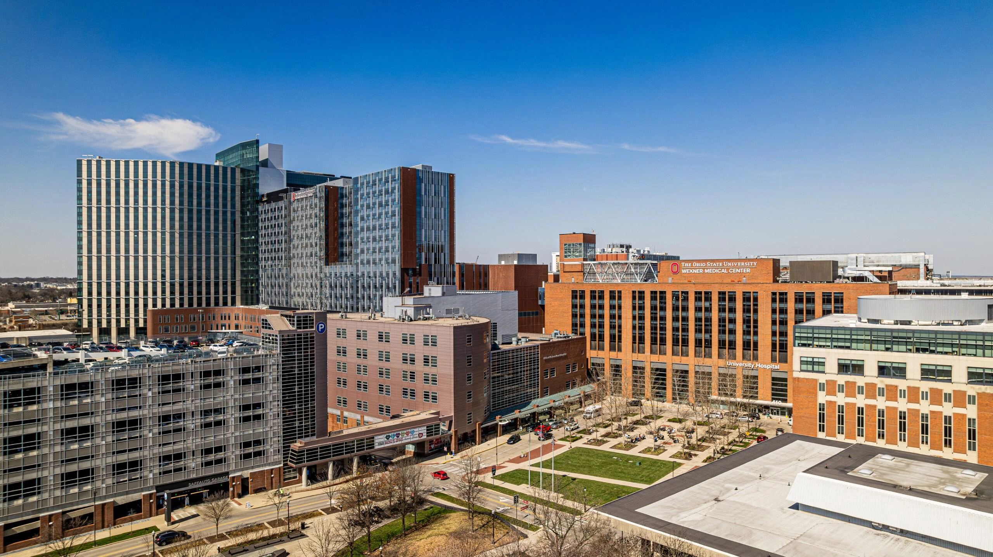

ABVENTURE-P: THE Ohio State's Rehabilitation Trial
RCT: structured PT vs standard care after VHR
Intervention: 12-week supervised rehabilitation protocol (2-3x/week)
Preliminary findings:
1. Hernia Size does NOT predict pre-op but does influence post-op function
2. Functional impairment is multifactorial
3. Recovery ceilings may exist; can PT raise these?
Notes:
Now I want to share insights from our center's work—the ABVENTURE-P trial: Pilot Trial of Abdominal Core Rehabilitation To Improve Outcomes After Ventral Hernia Repair.
This randomized controlled trial compares structured physical therapy versus standard-of-care restrictions after ventral hernia repair. The intervention is a 12-week supervised protocol, two to three times per week, following the phased progression we discussed.
We're tracking patients with objective measures—Five Times Sit-to-Stand and Timed Up-and-Go tests—plus patient-reported outcomes at baseline, 4 weeks, 10 weeks, 6 months, and 1 year.
Three preliminary findings are striking:
First, hernia size does NOT predict preoperative function. Patients with small hernias can have significant impairment, and patients with large hernias can perform well at baseline. However, hernia size DOES influence postoperative trajectories—larger defects show worse initial decline.
Second, functional impairment is multifactorial. It's not just about the hole size. Age, BMI, comorbidities, compensatory patterns, kinesiophobia—they all play roles.
Third, recovery ceilings may exist. Our data show progressive improvement through 6 months, then plateau at one year. This raises our key question: can structured PT raise that ceiling? Can we push past natural recovery limits?

Slide 14
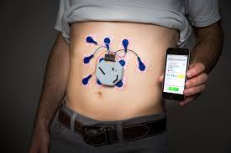

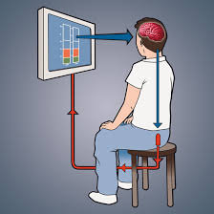


Future Directions: Technology to Advance Rehab Science
Wearables: Objective activity monitoring (steps, activity volume, movement pattern)
Tele-rehab: Extend access to PT in rural/underserved areas
Biofeedback: sEMG for core activation, pressure sensors for IAP monitoring
ACHQC tools: Mobile apps for patient-reported outcomes, adherence tracking
AI/ML integration: Predict which benefit most from intensive rehab protocols
Notes:
Looking forward, technology offers tremendous opportunity. Wearable sensors can provide objective activity data, replacing subjective recall with real metrics. Tele-rehabilitation can extend PT access to rural and underserved areas with video-guided sessions mapped onto ACHQC protocols.
Real-time biofeedback—surface EMG for core activation, pressure sensors for IAP monitoring—can teach patients proper technique. The ACHQC currently has a mobile app that could be used to capitalize and extrapolate data captured in apple and android health.
Looking further ahead, AI and machine learning could predict which patients benefit most from intensive protocols versus those who'll do well with minimal intervention, allowing us to personalize care.
The combination of rigorous trials, robust registry data, and emerging technologies positions us to transform post-op care from guesswork to precision medicine.

Slide 15
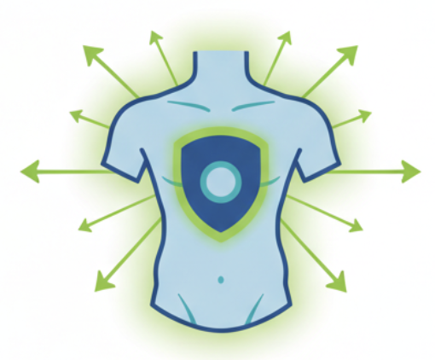
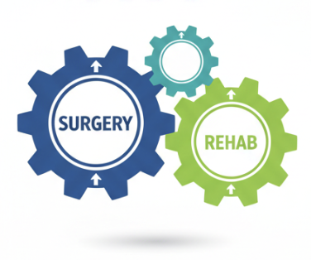
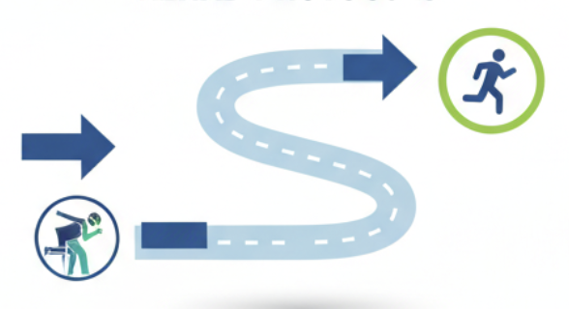
Conclusion & Call to Action
Integrate standardized rehab protocols
Rehab is not an "optional extra”
Fix not just the hole, but also the function
Notes:
To wrap up, three takeaways:
First, rehab is not an "optional extra." It's a core part of the surgical dose. Just as we wouldn't skip a step in the OR, we shouldn't skip structured recovery. Surgery and rehab work together—like these gears—to drive patient outcomes.
Second, use standardized protocols. We have ACHQC Rehabilitation Guides to move away from arbitrary restrictions. By using shared resources, we provide consistent, evidence-based roadmaps.
Third, fix the function, not just the hole. Our goal is restoring the entire core cylinder. Surgery fixes the anatomical defect, but rehab restores the patient's ability to manage pressure and return to daily life safely.
Our patients should be fully functional, not just "repaired."

Slide 16
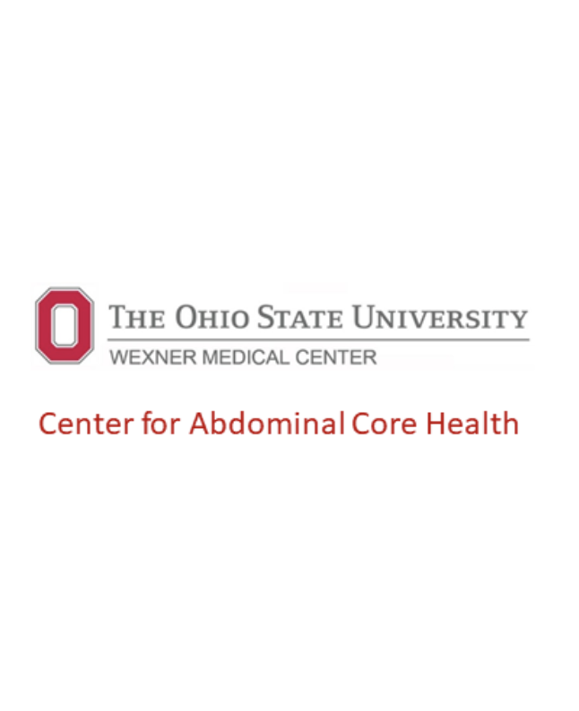


Email: William.Head@OSUMC.edu
Notes:
Thank you for your time. I've placed a QR code linking to the ACHQC Rehabilitation Protocols. Feel free to reach out at the email posted. Happy to take questions now.
All this is based out of the tendon repair literature from PT (why would this even be a thing; translating)
Shows early rehab significantly improves tendon function which is of course collagen
Refuting 10lb rule – heneford study putting foley in college students and did exercise and 2 things that impacted IAP was coughing and sneezing

