Slide 1
Ventral Hernia Prehabilitation
Randal Zhou MD
Assistant Professor of Surgery
Division of Bariatric and MIS

Slide 2
Disclosures
None
Notes:
This work has been ongoing by other hernia giants it the room today.
The concept is also not new; in fact, started as early at 1940s when the british army established prehab centers to boost recruits’ physical and mental capacity, showing significant improvements.
This concept then re-emerged in sports medicine, and eventually to surgical oncology, proving it reduces complications and length of recovery.
Prehab in hernia surgery recently gained significant traction in the last decade and is an interest of mine.

Slide 3
Goals and Objectives
Why prehabilitation matters
Significance of exercise

Slide 4

Problems We Face
Obesity, poor fitness, and modifiable risk factors are prevalent
Significantly increase postoperative complications
Traditional approaches address complications reactively, rather than proactively

Slide 5
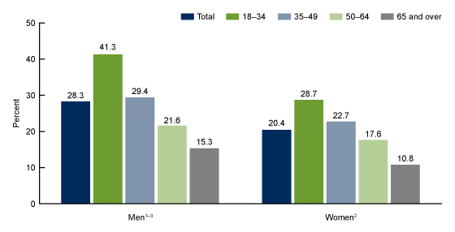
Exercise Adherence
SOURCE: National Center for Health Statistics, National Health Interview Survey, 2020.
Notes:
Aerobic guidelines for adults recommend at least 150 to 300 minutes a week of moderate-intensity, or 75 to 150 minutes a week of vigorous-intensity, or an equivalent combination of moderate- and vigorous-intensity aerobic activity. Muscle-strengthening guidelines for adults recommend activities of moderate or greater intensity involving all major muscle groups on 2 days a week or more.

Slide 6
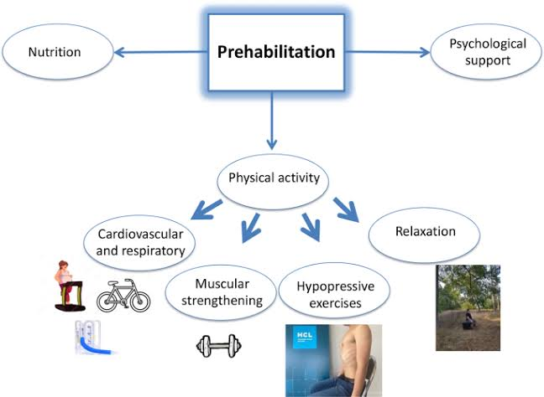
3 Main Domains of Multimodal Prehabilitation
Exercise
  Aerobic
  Inspiratory muscle training (IMT)
  Resistance
Nutrition
  Weight loss
  Malnutrition correction
  Personalized nutrition plans
Psychosocial
  Mindfulness
  Smoking cessation
  ETOH
Notes:
2.Opportunities and Challenges for the Next Phase of Enhanced Recovery After Surgery: A Review.
JAMA Surgery. 2021. Ljungqvist O, de Boer HD, Balfour A, et al.
3. Joliat, GR., Krouk, S., Cotte, E. et al. Implementation of a prehabilitation program before abdominal wall surgery: a pilot and feasibility study. Hernia 29, 138 (2025). https://doi.org/10.1007/s10029-025-03325-8
This list is not exhaustive and medical optimization is a given and should be done concurrently.

Slide 7
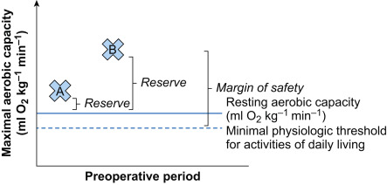
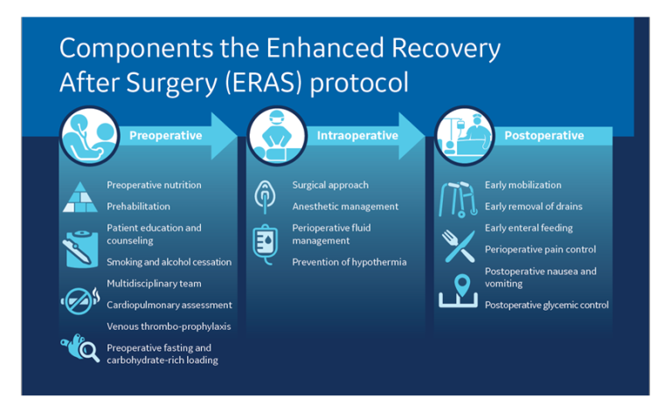
Why Prehabilitation Matters
Strengthens physiologic reserve and enhances functional capacity before surgery [1]
Preoperative period presents a teachable moment when patients are particularly receptive to health optimization [2]
ERAS synergy
  Recovery is not a passive process – it begins preoperatively [1]
Notes:
1.Prehabilitation, Enhanced Recovery After Surgery, or Both? A narrative Review.
British Journal of Anaesthesia. 2022. Gillis C, Ljungqvist O, Carli F.
2.Opportunities and Challenges for the Next Phase of Enhanced Recovery After Surgery: A Review.
JAMA Surgery. 2021. Ljungqvist O, de Boer HD, Balfour A, et al.
Patient A exhibits poor exercise capacity, has little cardiorespiratory reserve, and is perilously close to the minimal physiological threshold required for functional independence. For this patient, a decompensating event as simple as bed rest after surgery could threaten functional independence. Patient B has excellent exercise capacity and cardiorespiratory reserve, contributing to a margin of safety that would likely permit this patient to withstand surgical stress without compromising functional independence.
Ideally, patient A would improve their cardiorespiratory status before surgery, similar to patient B, and thus higher likelihood to experience an uneventful postoperative course.
Better preoperative functional status tolerate ERAS protocols more effectively and achieve faster recovery

Slide 8

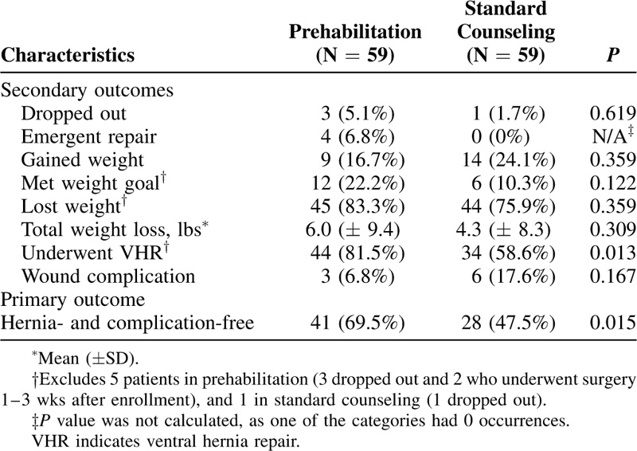
Evidence for Complication Reduction
Overall complications
  Reduces overall morbidity (RR 0.879, p=0.034)
Hernia-free and complication-free
  Liang et al. RCT Annals of Surgery, 2018
Notes:
4.The Role and Effect of Multimodal Prehabilitation Before Major Abdominal Surgery: A Systemic Review and Meta-Analysis.
World Journal of Surgery. 2022. Jain SR, Kandarpa VL, Yaow CYL, et al.
5.Preoperative Exercise and Outcomes After Ventral Hernia Repair: Making the Case for Prehabilitation in Ventral Hernia Patients.
Surgery. 2021. Renshaw SM, Poulose BK, Gupta A, et al.
6.Modifying Risks in Ventral Hernia Patients With Prehabilitation: A Randomized Controlled Trial.
Annals of Surgery. 2018. Liang MK, Bernardi K, Holihan JL, et al.
Multi discip consultation, nutritionist, PT, hernia navigator. Weekly group meetings, daily goal check in, peer support system, monthly assessment.

Slide 9
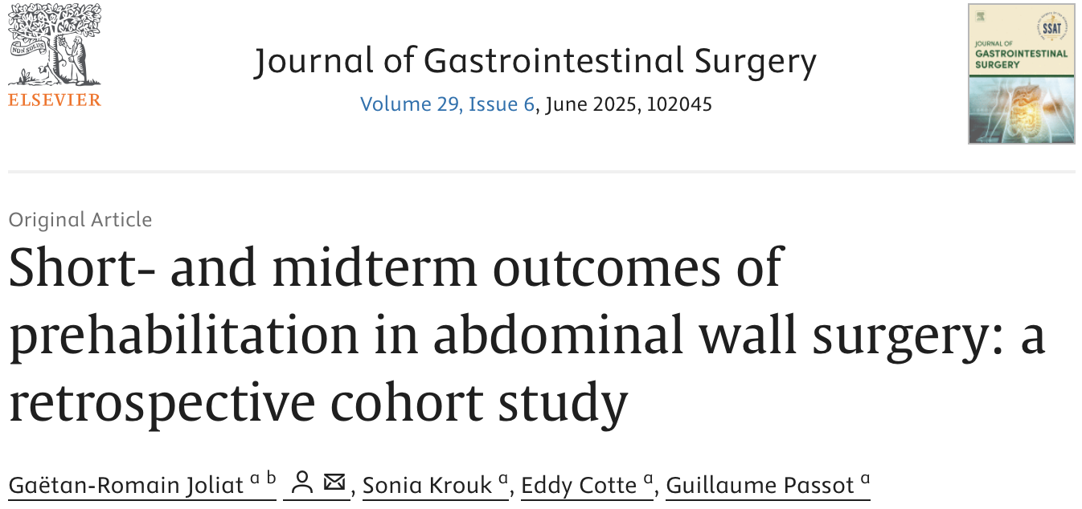
Longer-term Benefits
Sustained benefits beyond immediate post operative period:
  Recurrence – lower midterm recurrence rates
    2/114 vs. 14/201, p=0.043 at median 16-month follow up
Notes:
10.Short- And Midterm Outcomes of Prehabilitation in Abdominal Wall Surgery: A Retrospective Cohort Study.
Journal of Gastrointestinal Surgery : Official Journal of the Society for Surgery of the Alimentary Tract. 2025. Joliat GR, Krouk S, Cotte E, Passot G.

Slide 10
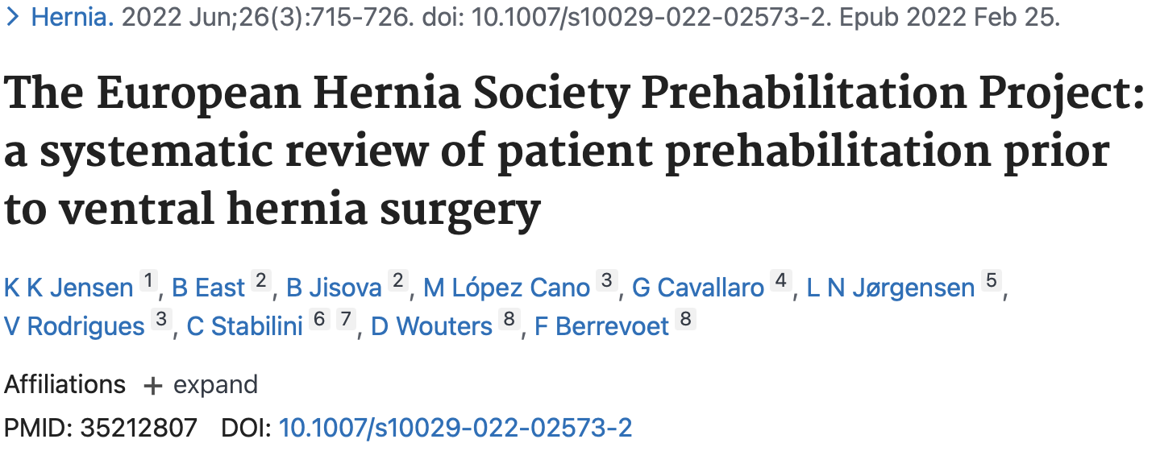
Limited well-conducted studies evaluating prehabilitation
Weight loss and smoking cessation strongest evidence
  Reduced complications after abdominal wall reconstruction
Fewer studies on exercise
Notes:
7.Effectiveness of Prehabilitation for Patients Undergoing Complex Abdominal Wall Surgery.
Surgical Endoscopy. 2025. Cattaneo M, Jastaniah A, Ghezeljeh TN, et al.New
“Prehabilitation positively impacted modifiable risk factors in hernia patients, aiding in their eligibility for complex abdominal wall surgery. Patients participating in the program experienced enhanced functional capacity, indicating the potential benefits of prehabilitation in optimizing surgical outcomes.”
8.The European Hernia Society Prehabilitation Project: A Systematic Review of Patient Prehabilitation Prior to Ventral Hernia Surgery.
Hernia : The Journal of Hernias and Abdominal Wall Surgery. 2022. Jensen KK, East B, Jisova B, et al.
“A limited amount of well-conducted research studies evaluating prehabilitation prior to ventral hernia surgery was found. The primary findings showed that smoking cessation and weight loss led to reduced risks of complications after abdominal wall reconstruction.”

Slide 11
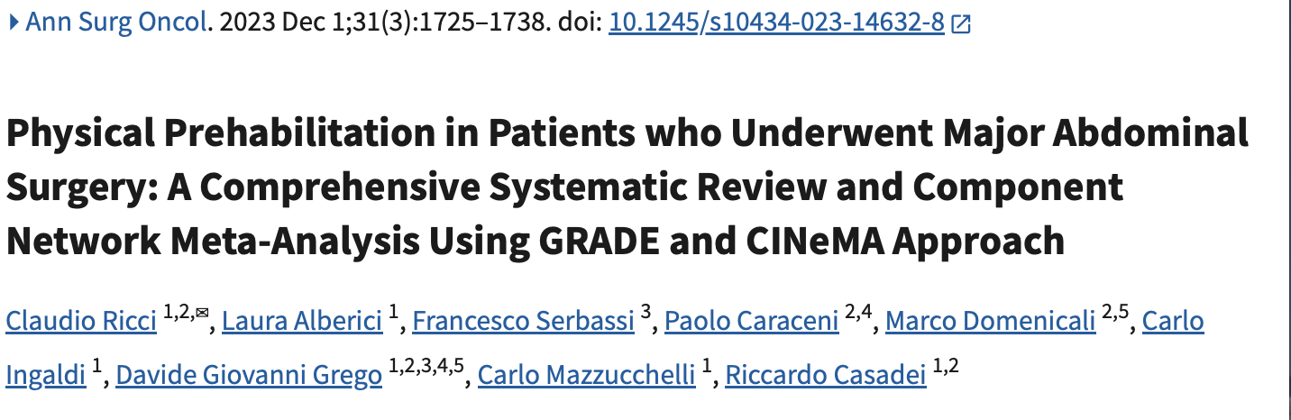
Exercise
25 studies, underwent major oncologic resections
  Resistance, Aerobic, and IMT
Aerobic exercise combined with inspiratory muscle training (AE + IMT) provides greatest benefit
  Pneumonia prevention
    AE + IMT: OR 0.21
    AE alone: OR 0.52
  Overall mortality
    AE + IMT: OR 0.66
    AE: OR 0.61
  Length of stay
    AE +IMT reduced LOS by 1.7 days
Notes:
9.Physical Prehabilitation in Patients Who Underwent Major Abdominal Surgery: A Comprehensive Systematic Review and Component Network Meta-Analysis Using GRADE and CINeMA Approach.
Annals of Surgical Oncology. 2024. Ricci C, Alberici L, Serbassi F, et al.
Take the time now to highlight the benefits of exercise which I believe it huge.
Included 25 studies,

Slide 12
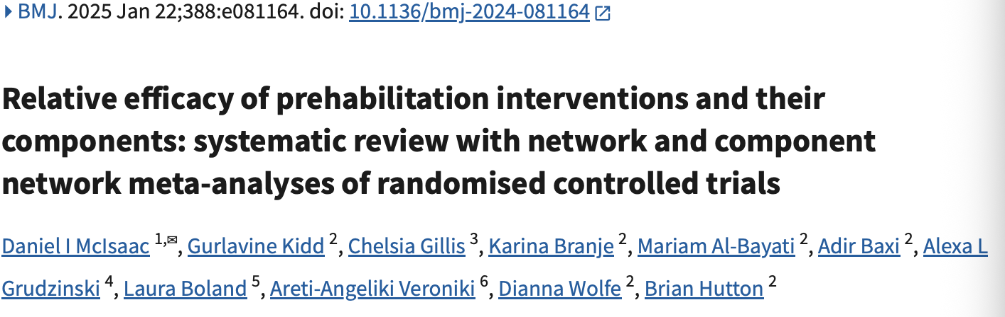
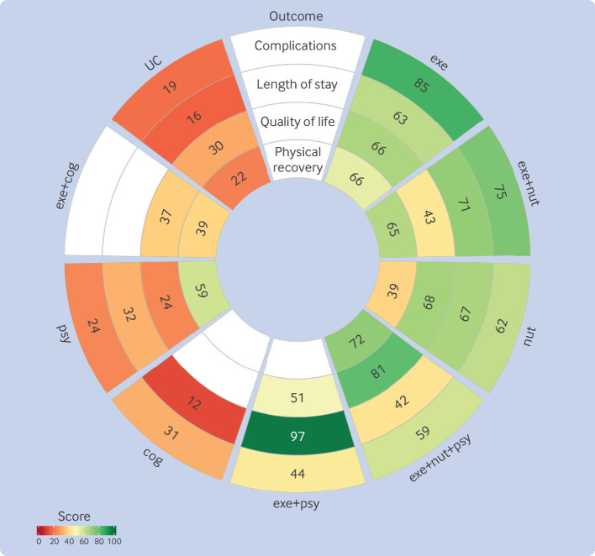
Notes:
The most robust evidence is from a network meta-analysis of 186 trials with 15,684 participants that found isolated exercise prehabilitation reduced complications (OR 0.50, 95% CI 0.39-0.64) and decreased length of stay by approximately 0.93 days. When comparing individual components using component network meta-analysis, exercise and nutrition were the components most likely to improve all critical outcomes.[1]
The rank heat plot presents a summary of P scores (range 0-100) for each intervention across outcomes, where darker shades of green represent more benefit and darker shades of red represent less benefit. cog=cognitive; exe=exercise; nut=nutrition; psy=psychosocial; UC=usual care
However data specific to ventral hernia patients is limited.

Slide 13
Our Study ACHQC Analysis
Ventral hernia repair (open and MIS), adults with at least 30 day follow up
With smoking (current and quit within 1 year) and sporting data (none, sporadic, moderate, intense), ASA 1-4
Excluded current infection, ASA5, never and former smokers (>1 year)
1718 in sporting analysis and 6528 in smoking analysis
30-day readmission, SSI, SSO, SSOPI, and LOS
Quit within 1 year (Prehab) vs. current smoker
Sporting levels (Prehab) vs. none

Slide 14
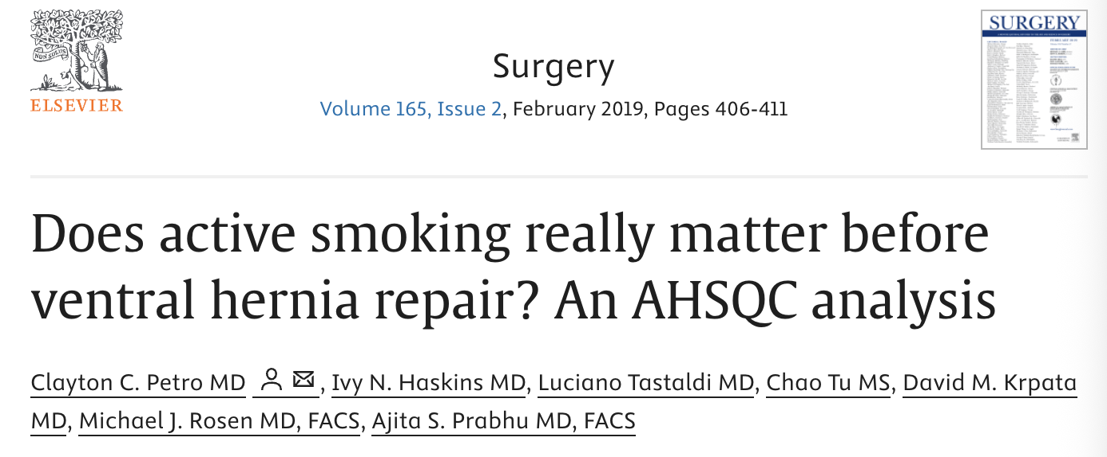
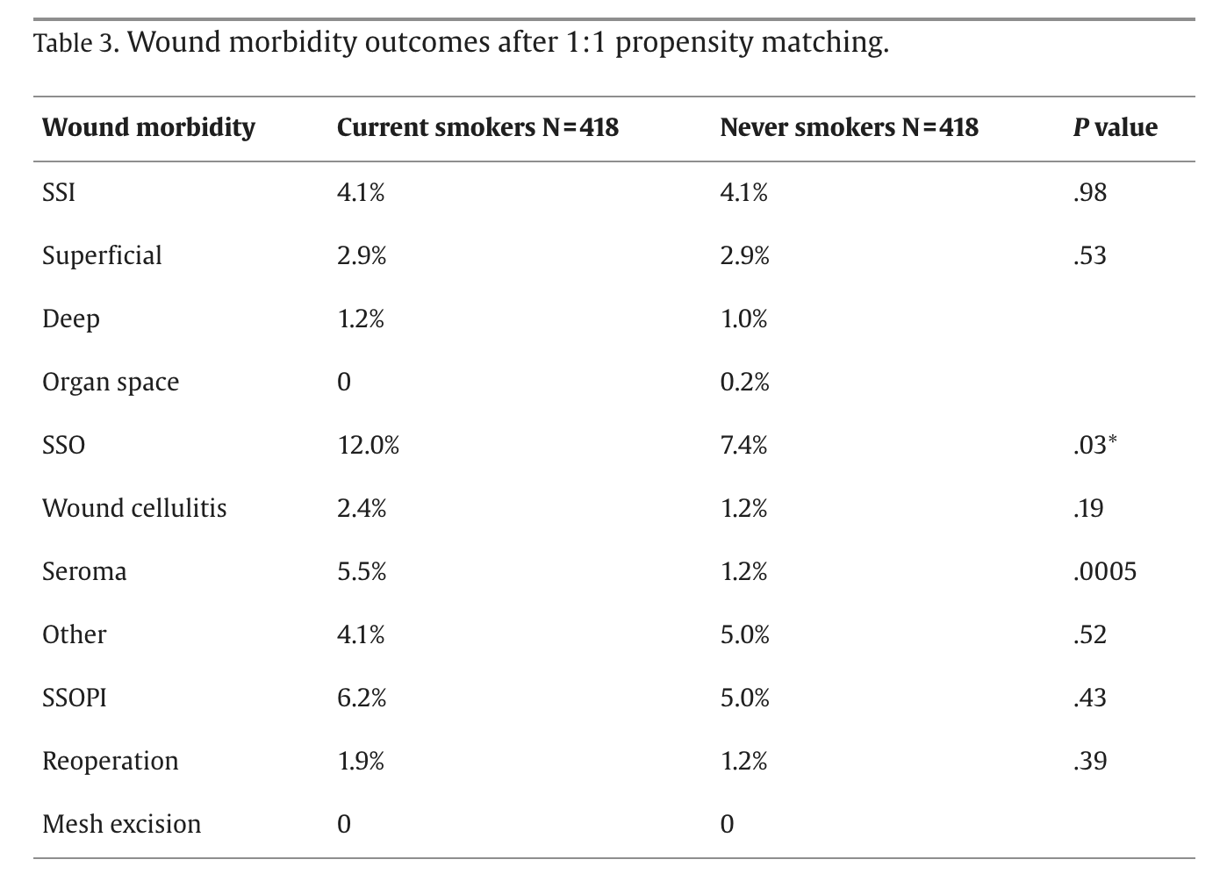
Smoking
Active smoking vs. quit within 1 year (ASA 1-4)
  30-day readmission – no difference p=0.15
  SSI – no difference p=0.92
  SSO – no difference p=0.38
  SSOPI - no difference p=0.41
  LOS – no difference p=0
Myofascial release
  No difference in those who had smoking prehabilitation
Notes:
Open ventral in clean wounds.
Matched 418 current smokers to 418 who had never smoked.
Rates of SSO were greater in active smokers (12.0% vs 7.4%, P = .03) driven by increased rates of cellulitis (2.4% vs 1.2%) and seroma (5.5% vs 1.2%); however, rates of SSI (4.1 vs 4.1, P = .98), SSOPI (6.2% vs 5.0%, P = .43), reoperation (1.9% vs 1.2%, P = .39), and all 30-day morbidity (7.5 vs 6.6, P = .60) were not significantly increased in active smokers.
Our data adds to the body of evidence that perhaps smoking cessation may not affect hernia outcomes as much as previously thought, at least in the short term.
This does not negate the myriad of other reasons why we should still recommend smoking cessation.

Slide 15
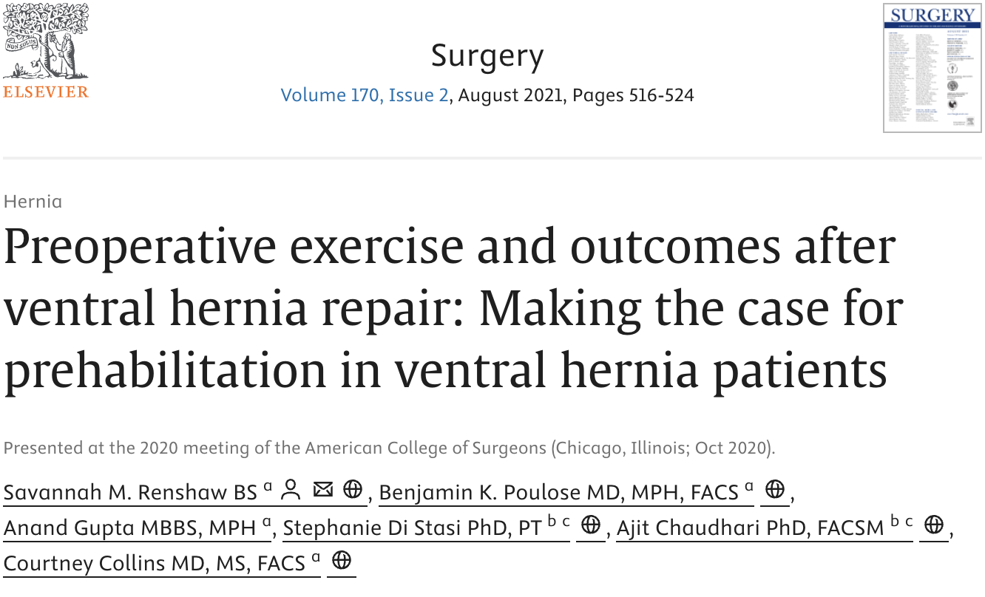
Sporting
Exercise frequency matters
  Greater preoperative frequency decreased risk of complications and readmission after VHR
  First to demonstrate benefit may be dose dependent
    Sporadic: OR 0.70 (p=0.008)
    Moderate: OR 0.62 (p=0.006)
    Intense: OR 0.767 (p=0.04)
Notes:
Any exercise, even just sporadic, is better than none.

Slide 16
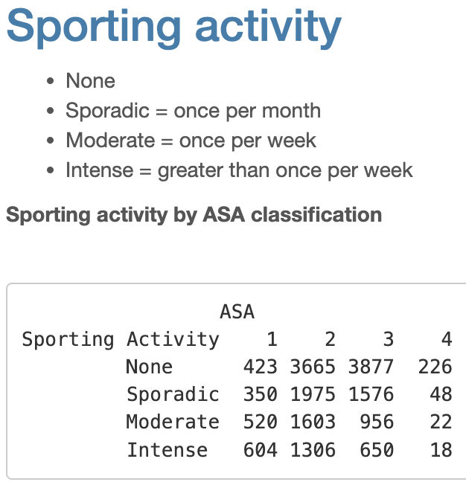
Sporting
Notes:
We wanted to see whether exercise benefited those who are more ”sick.”

Slide 17
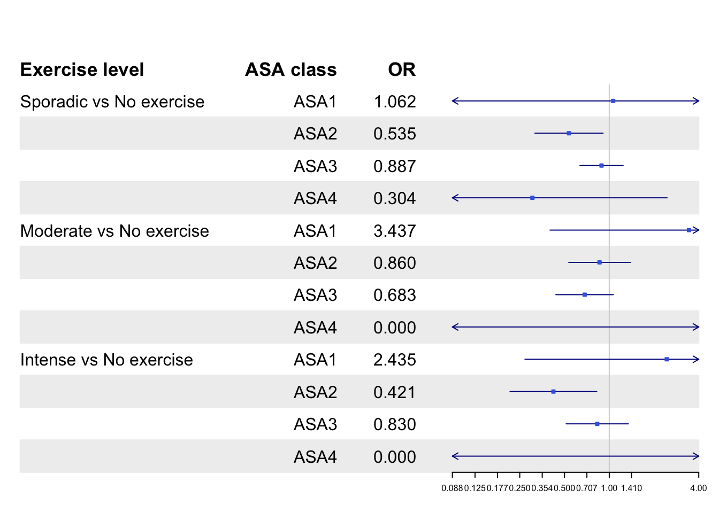
30-Day Readmission
Notes:
ASA2 with sporadic vs none, OR 0.535
ASA2 with intense vs none, OR 0.421

Slide 18
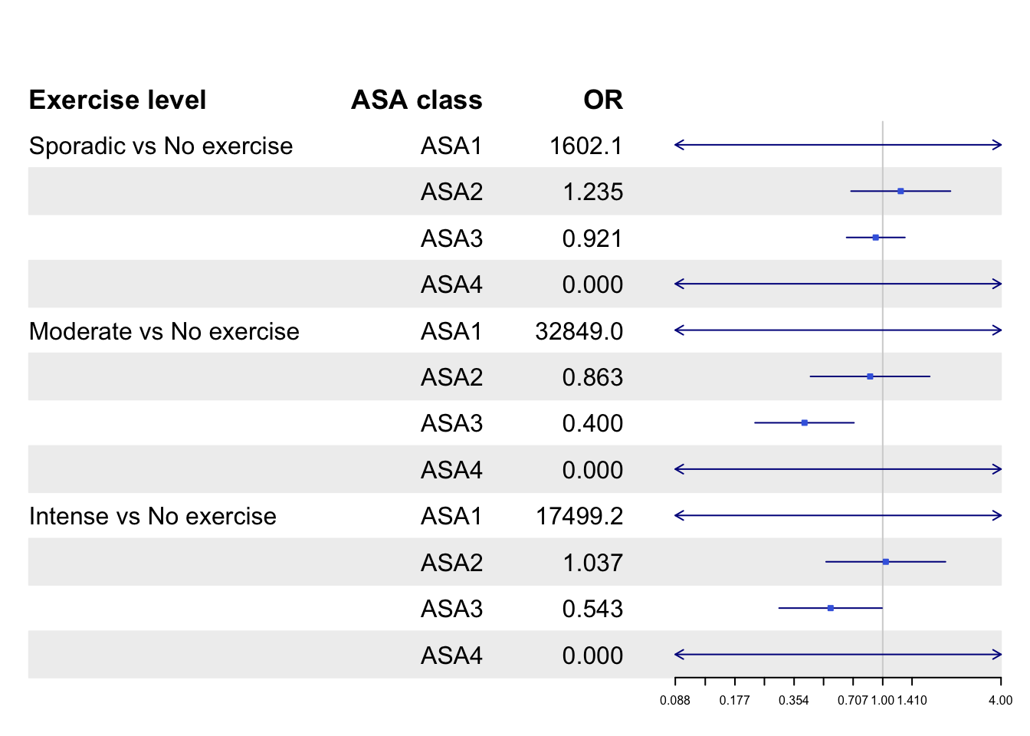
30-day SSI
Notes:
ASA3 moderate vs none, OR 0.40
ASA3 intense vs none OR 0.543

Slide 19
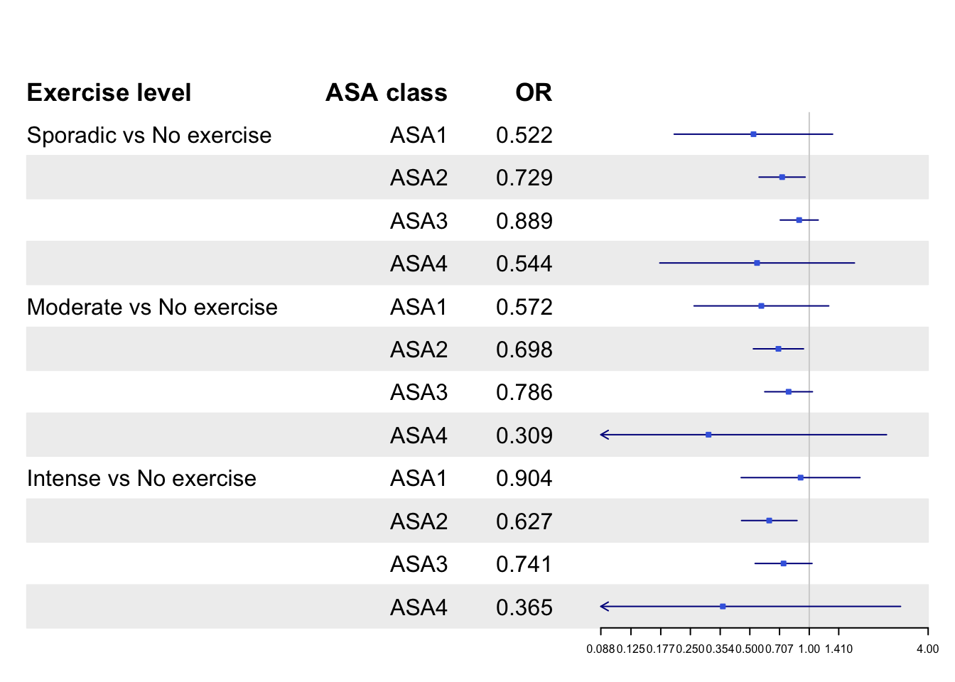
30-day SSO
Notes:
ASA2 and 3 moderate exercise, OR 0.698, OR 0.786
ASA2 and 3 intense exercise, OR 0.627, OR 0.741

Slide 20
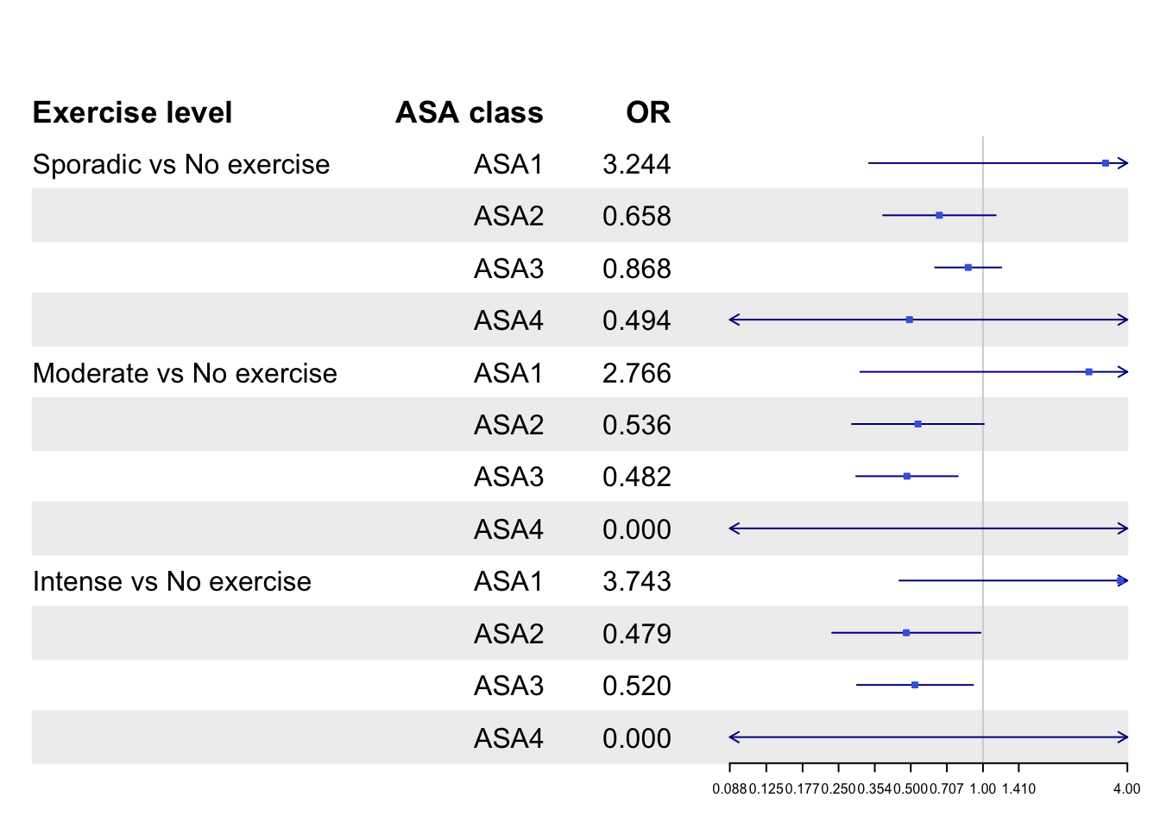
30-day SSO/I-PI
Notes:
ASA2 and 3 with intense exercise vs none, OR 0.479, OR 0.520

Slide 21
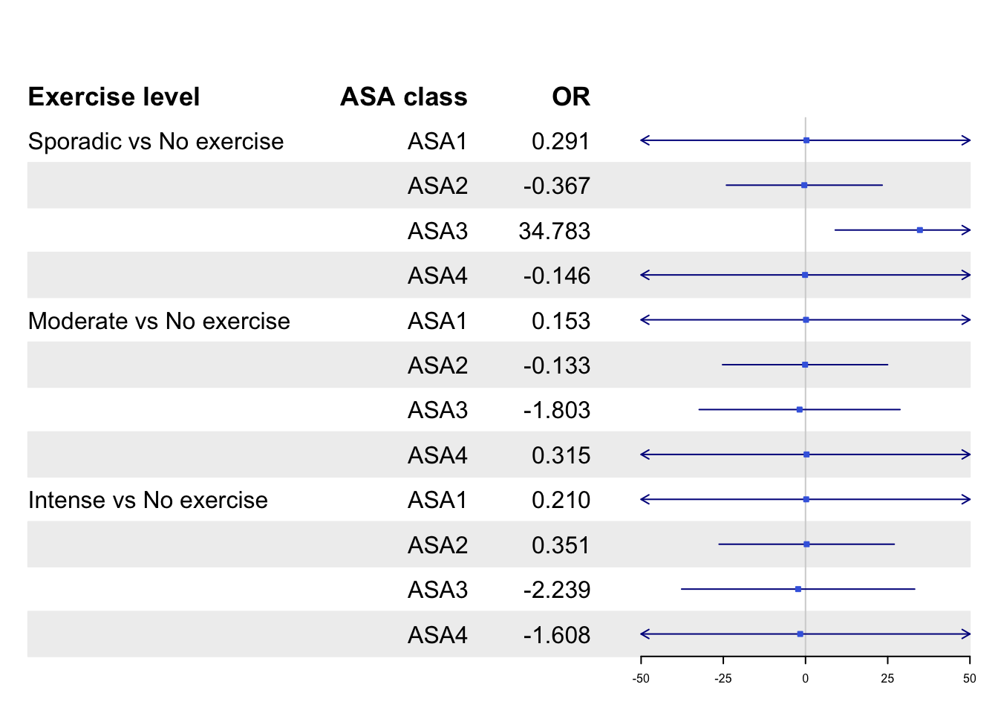
LOS
Notes:
LOS failed to reach any evidence of difference, likely due to low N.

Slide 22
Takeaways and Future Directions
Positive trend in exercise, even just sporadic may improve short term outcomes, in ASA2 and 3
  More data needed for ASA1 and 4
  Open approach similar trend in ASA2 and 3
Smoking cessation may not be as important for short term results
Exercise is under-studied and a significant component of prehabilitation
Evidence is growing, awaiting RCTs

Slide 23
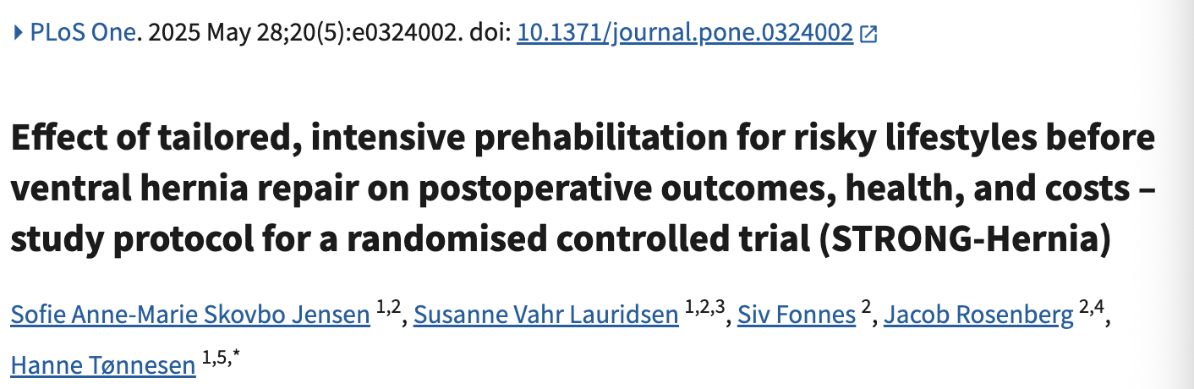
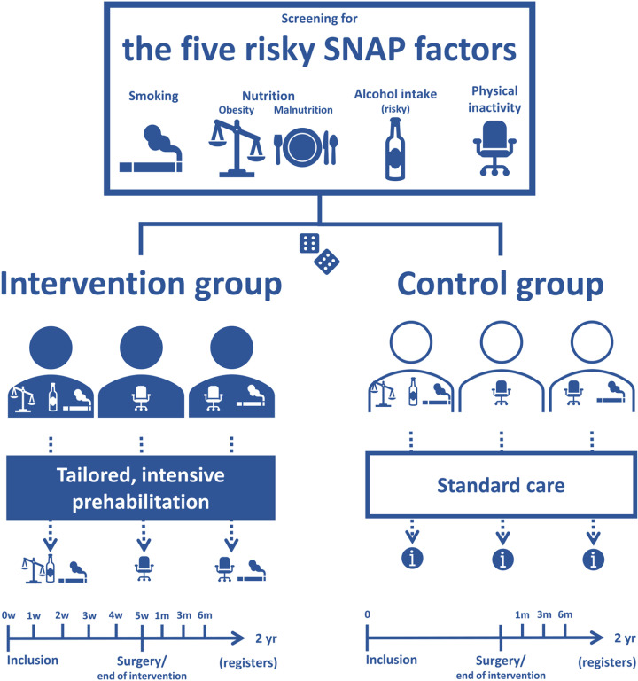
Notes:
Recruitment began March 4, 2024, and is ongoing. Participant recruitment is expected to be completed in 2.5 years. Data collection will be completed 6 months after last participant has been recruited, i.e., around March 2027. Results are expected to be analyzed within six months after last participant follow-up, thus September 2027.

Slide 24
Thank you!

