Slide 1
Long-Term Outcomes of Heavy-weight Mesh vs Medium-weight Mesh in Open Ventral Hernia Repair
Feb 22, 2026
William Bennett, Ji Woo Han, Sara Maskal, Ouen Mali, Ava Moe, Li-Ching Huang, Benjamin Miller, Lucas Beffa, Ajita Prabhu, Clayton Petro, Michael Rosen, David Krpata
Division of Abdominal Wall Reconstruction and Hernia Surgery; Cleveland Clinic
Lerner College of Medicine at the Case Western School of Medicine

Slide 2
Disclosures
Dr. Petro serves as a consultant for Advanced Medical Solutions, TelaBio, Medtronic, Bard-Davol, and has received an institutional research grant from Merck.​​
Dr. Prabhu is on the advisory board (received consulting fees) for DistalMotion, and CMR Surgical.​​
Dr. Miller is a consultant for Boston Scientific, received a research grant from the American Hernia Society and research funding from Integra.
Dr. Beffa is a consultant for Gore and Abbvie. ​​
The remaining authors have no disclosures to report.​
Notes:
We have no disclosures

Slide 3
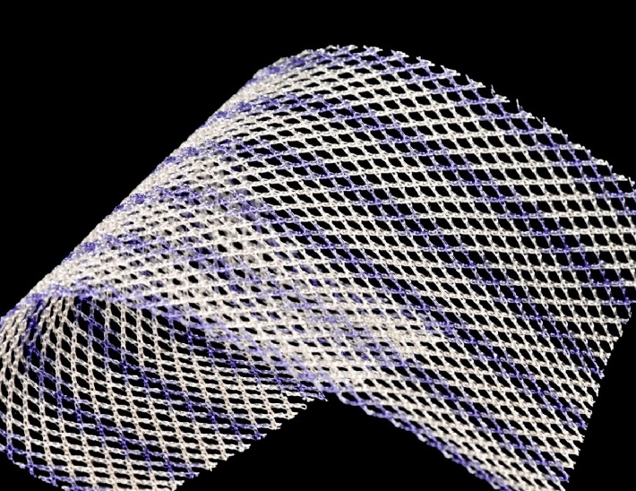
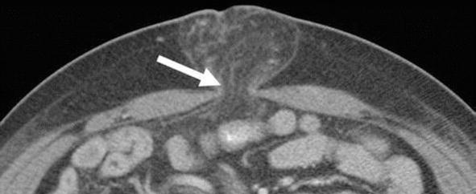
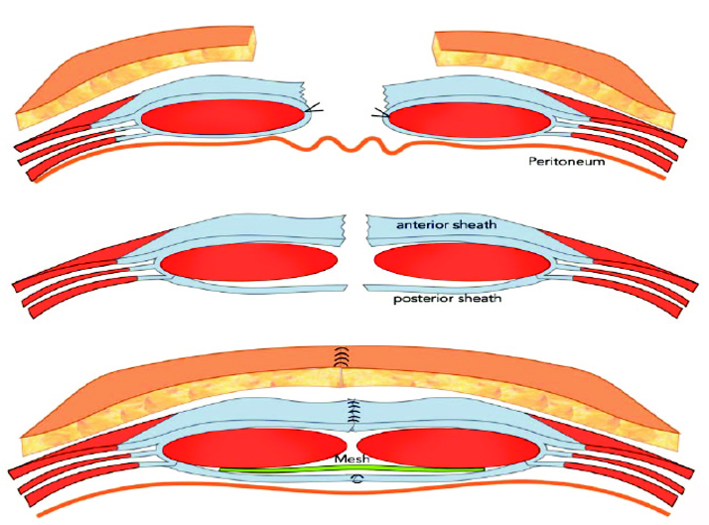
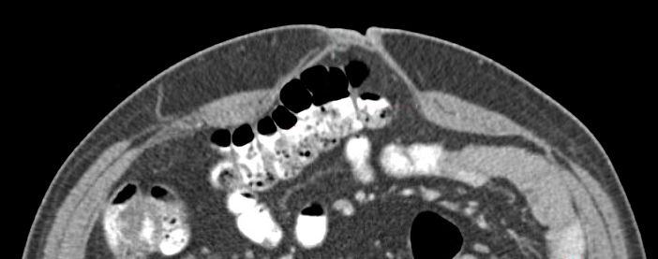
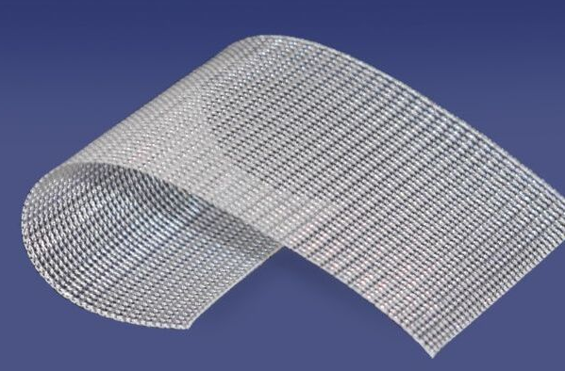
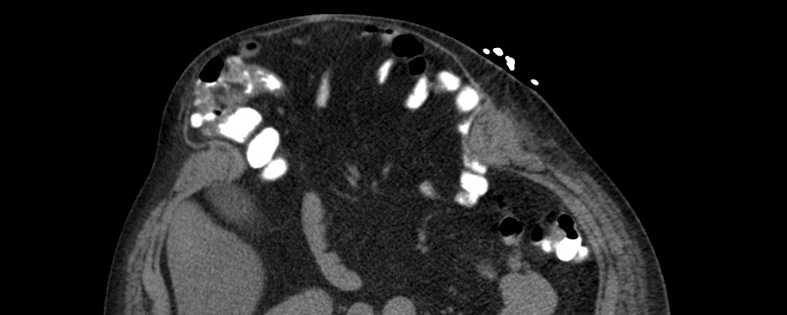
Contemporary Ventral Hernia Repair
?

Slide 4
Theoretical Mesh Weight Considerations
40–70 g/m²
>75 g/m²
Heavier Weights greater structural integrity
Decreased risk of mesh fracture/failure
Lower Weights
fewer mesh complications
Less sensation, chronic pain
Lower infection risk

Slide 5
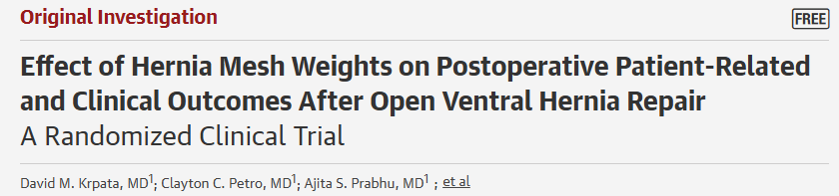
Clean, open retromuscular ventral hernia repair
95% TAR
5% RS
All received polypropylene, randomized to mesh weight
Polypropylene
MW: 40-70 g/m²
HW: >75 g/m²
Primary Aim
Difference in Pain at 1 year
Via NIH PROMIS 3a survey

Slide 6
No 30-day or 1-year differences in
SSO, SSI, SSOPI
Patient discomfort/quality of life
Recurrence
Mesh sensation
If no difference, what should be used?

Slide 7
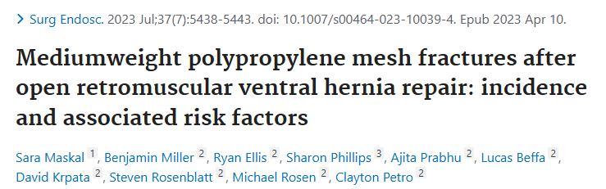
Use Medium
If no benefit to HW, why risk theoretical chances of:
- long-term discomfort/pain
- future infectious/wound complications
Use Heavy
If no downside to HW, why use less reinforcement:
- risk of mesh fracture = risk of recurrence
No 30-day or 1-year differences in
SSO, SSI, SSOPI
Patient discomfort/quality of life
Recurrence
Mesh sensation
If no difference, what should be used?

Slide 8
No 30-day or 1-year differences in
SSO, SSI, SSOPI
Patient discomfort/quality of life
Recurrence
Mesh sensation
If no difference, what should be used?
Long-term outcomes are necessary to inform mesh weight selection.

Slide 9
Study Questions
Beyond 1 year, is mesh weight associated with differences in:
Patient Quality of Life?
Mesh Complications?
Hernia Recurrence?

Slide 10

Methods
1. Long-Term follow-up of registry-embedded RCT
<20 cm defect
Clean cases
350 participants from March 2017 – April 2019
2. Data capture effort for all participants at our institution 5- and 6-year marks.
Patient-surveys captured once
Medical records captured multiple times
All results tracked in ACHQC
Longer term follow-up (if available) was also captured

Slide 11
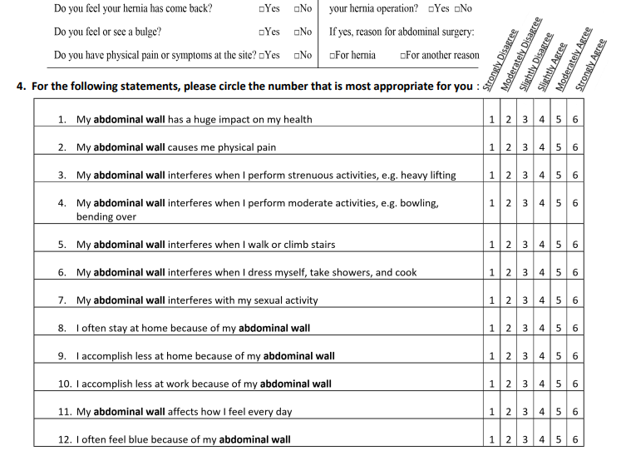
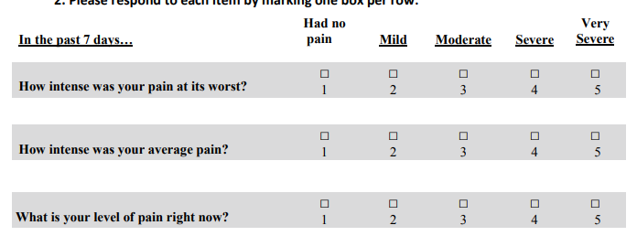
Methods: Patient Reported Outcomes
HerQLes
Hernia-related Quality of Life Survey
Range 0-100
Higher Score = Better QoL
NIH PROMIS 3a
Short-Form Pain Intensity (v1)
Range 30.7-71.8
Higher Score = More Pain

Slide 12






Long-Term Follow-Up Collection
PROs
Hernia QoL (HerQLes)
Pain (PROMIS 3a)
Recurrence/Bulge
Reoperation
(4.5 – 6.5 years)
Clinical
Outcomes
Recurrence (exam)
Recurrence (image)
Reoperation
SSO, SSI, etc.

Slide 13


Long-Term Follow-Up Collection
PROs
Hernia QoL (HerQLes)
Pain (PROMIS 3a)
Recurrence/Bulge
Reoperation
(4.5 – 6.5 years)
Clinical
Outcomes
Recurrence (exam)
Recurrence (image)
Reoperation
SSO, SSI, etc.

Slide 14

Long-Term Follow-Up Collection
PROs
Hernia QoL (HerQLes)
Pain (PROMIS 3a)
Recurrence/Bulge
Reoperation
(4.5 – 6.5 years)
Clinical
Outcomes
Recurrence (exam)
Recurrence (image)
Reoperation
SSO, SSI, etc.

Slide 15
Methods: Data Analysis
Time-stratified PRO summary scores
HerQLes
PROMIS 3a
Cumulative wound morbidity
SSO
SSI
SSOPI
Reoperations
Time-to-event recurrence-free survival analysis
Recurrence via reoperation, radiograph, or exam
Unrelated reoperations censored

Slide 16
Results: Patient Capture
324 randomized at CCF
Long-term outcomes captured for 278 participants (80.8%)
Medium:
N=142
Heavy:
N=136

Slide 17
Results: Demographics
Original Cohort
5-6 Year Cohort
 | MW (n=164) | HW (n=160) | P |  | MW (n=142) | HW (n=136) | P
Age, years | 61 [52-69] | 60 [53-69] | 0.6 |  | 61 [52-69] | 60 [52-67] | 0.5
Gender, female | 86 (52%) | 78 (49%) | 0.5 |  | 73 (51%) | 72 (53%) | 0.8
DM | 41 (25%) | 40 (25%) | 0.9 |  | 38 (27%) | 35 (26%) | 0.8
COPD | 11 (7%) | 16 (10%) | 0.3 |  | 8 (6%) | 14 (10%) | 0.1
Smoking | 8 (5%) | 2 (1%) | 0.06 |  | 6 (4%) | 2 (1%) | 0.2
Recurrent, yes | 84 (51%) | 85 (53%) | 0.7 |  | 75 (53%) | 75 (53%) | 0.9
Prior Repairs
1 | 38 (45%) | 43 (51%) | 0.7 |  | 35 (47%) | 34 (47%) | 0.7
2 | 22 (26%) | 24 (28%) |  |  | 19 (25%) | 21 (29%)
3 | 8 (10%) | 5 (6%) |  |  | 5 (7%) | 5 (7%)
4 | 7 (8%) | 8 (9%) |  |  | 7 (9%) | 8 (11%)
5+ | 9 (11%) | 5 (6%) |  |  | 9 (12%) | 4 (6%)
Hernia Width, cm | 15 [12-17] | 15 [12-16] | 0.2 |  | 15 [12-17] | 15 [12-16] | 0.5
Hernia Length, cm | 23 [20-25] | 22 [19-25] | 0.5 |  | 23 [19-25] | 23 [19-25] | 0.7
- Minimal demographic shifts
- Follow-up cohort remains representative of index cohort

Slide 18
Aim 1: Patient-Reported Outcomes

Slide 19
Results: HerQLes
Range 0-100
Higher Score = Better QoL
No difference at any timepoint
P=.8 @ 5 years

Slide 20
Results: HerQLes – Non-recurrent Only
Range 0-100
Higher Score = Better QoL
No difference at any timepoint
P=.5 @ 5 years

Slide 21
Results: PROMIS 3a (Pain)
Range 30.7-71.8
Higher Score = More Pain
No difference at any timepoint
P=.8 @ 5 years

Slide 22
Results: PROMIS 3a – Non-recurrent only
Range 30.7-71.8
Higher Score = More Pain
No difference at any timepoint
P=.1 @ 5 years

Slide 23
Aim 2: Wound Morbidity
SSO
SSI
SSO/I PI
Reoperation

Slide 24
Results: SSO – Cumulative
n=21
13%
Events after 1 Year
n=28
18%
Events at/before 1 Year
p=.3
Notes:
Pre 1 year, post- 1 year

Slide 25
Results: SSI – Cumulative
n=11
7%
n=7
4%
p=.4
Notes:
Pre 1 year, post- 1 year

Slide 26
Results: SSO/I PIs – Cumulative
n=13
8%
n=13
8%
p=.9
Notes:
Pre 1 year, post- 1 year

Slide 27
Results: Reoperations
MW (n=17)
HW (n=18)
8
Related
9
Unrelated
5
Related
12
Unrelated
4
Recurrence
4
Major wound complications
1
Recurrence
4
Major wound complications
2
Mesh excisions
1 Postoperative bleed
1
Debridement
2
Mesh excisions
1 Postoperative bleed
1 Debridement

Slide 28
Aim 3: Recurrence

Slide 29
Results: Recurrence
n=13
8%
Notes:
Pre 1 year, post- 1 year

Slide 30
Results: Recurrence
n=13
8%
n=4
2.5%
Notes:
Pre 1 year, post- 1 year

Slide 31
Results: Medium-weight Recurrences
Central mesh failure (n=10)
One s/p 6-month debridement w/ mesh excision, then recurred at 1 year
~2 / year
Insufficient overlap (n=3)
One subcostal, two lateral
2 years (n=2)
6 years (n=1)
Notes:
Pre 1 year, post- 1 year

Slide 32
Results: Heavy-weight Recurrences
Posterior sheath breakdown (n=1)
POD1
Immediate reoperation, no subsequent recurrence
Central mesh failure (n=1)
Ex lap 4 months later at OSH for cecal perforation
Insufficient overlap (n=2)
Both lateral recurrences overlap
1 year and 5 years
Notes:
Pre 1 year, post- 1 year

Slide 33
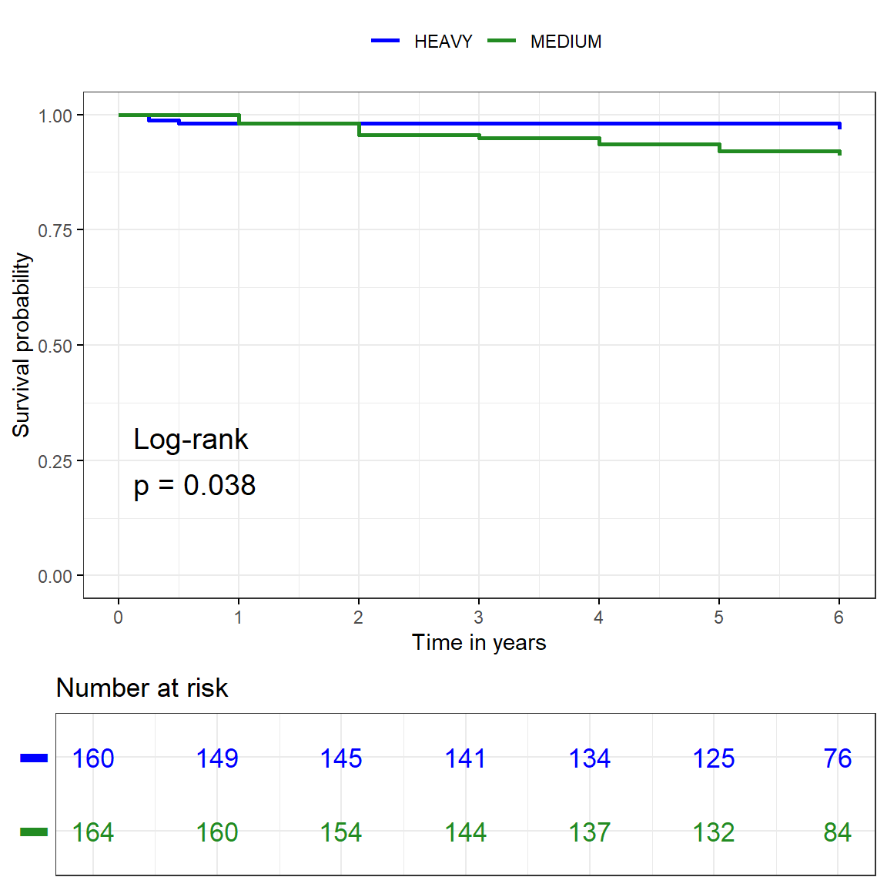


Time-to-Event: Clinical Recurrence
>
>
HW 3.2% (0.0, 6.5)
MW 9.0% (4.1, 13.6)
p=0.038

Slide 34
Results: Reoperations
HW (n=18)
5
Related
1
Recurrence
4
Major wound complications
2 mesh excisions
1 postoperative bleed
12
Unrelated
1 Debridement
MW (n=17)
8
Related
4
Recurrence
4
Major wound complications
2
Mesh excisions
1 Postoperative bleed
9
Unrelated
1
Debridement

Slide 35
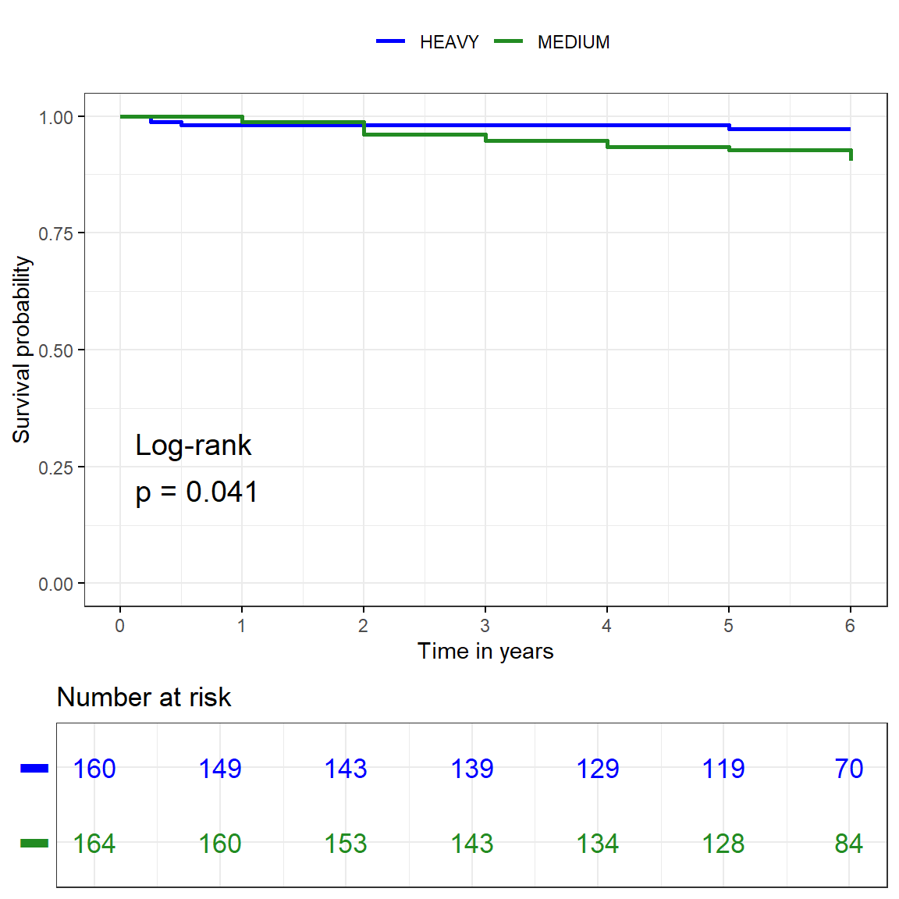
Time-to-Event: Clinical Recurrence, Censored
Censored from time-to-event analysis after unrelated violation of mesh
>
>
HW 2.8% (0.0, 5.4)
MW 9.5% (4.3, 14.5)
p=0.041

Slide 36
Study Questions
Beyond 1 year, is mesh weight associated with differences in:
Patient Quality of Life?
Mesh Complications?
Hernia Recurrence?

Slide 37
Conclusions
Patient quality of life is no different between HW and MW at 5 years
No differences in mesh complication, infection, or reoperation by 6th year
Recurrence
HW mesh is associated with lower 6-year recurrence
HW appears protective against mesh fracture
Both weights vulnerable to lateral recurrence

Slide 38
Acknowledgements
Sara Maskal, MD
Ouen Mali
Ava Moe
Jay Han
Li-Ching Huang, PhD
ACHQC
HWvMW Trial Surgeons
CCF Abdominal Wall Group

Slide 39
Questions?

