Slide 1

Long-Term Urostomy-Specific Outcomes After Retromuscular Hernia Repair: Comparative Analysis from a High-Volume Abdominal Wall Center
Joseph Edwards, MD
Center for Abdominal Core Health
Cleveland Clinic Foundation, OH
Notes:
Hello my name is Joe Edwards. I am a clinical associate at the Cleveland Clinic. I am excited to be here and I am grateful for the opportunity to present today on what I think is a somewhat overlooked topic. Long-term urostomy-specific outcomes after retromuscular hernia repair

Slide 2
Disclosures
No relevant disclosures

Slide 3
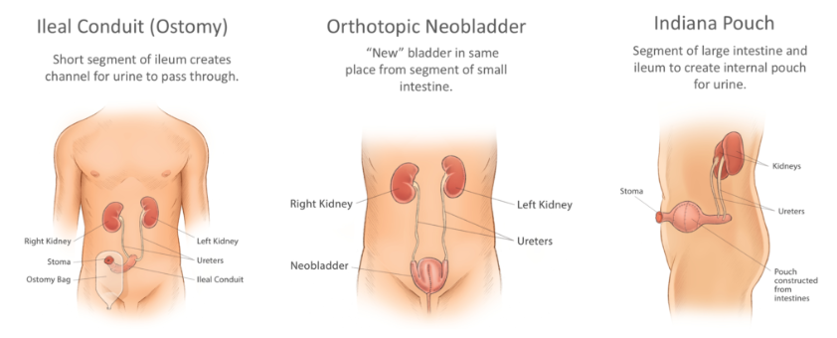
Urinary Diversion: Brief Overview
[1]
Notes:
Urinary diversion: so when a patient undergoes cystectomy, multiple ways of performing urinary diversion exist. Ileal conduits are the most common – a segment of ileum is isolated from GI continuity, ureters are implanted, and an ostomy is then matured. The orthotopic neobladder is a procedure where a new bladder is formed and the urine is then routed via the native urethra – not requiring a stoma. An Indiana pouch is a conduit formed from colon that is used to make a pouch and ultimately a tubularized segment is brought out of the abdominal wall – thus requiring a stoma as well. For our discussion today, we will be talking bout urinary diversion requiring a stoma – thus the Indiana Pouch and the ileal conduit.

Slide 4
Scope
~85,000 patients diagnosed with bladder cancer in 2025 in USA²
10,000 patients per year undergo radical cystectomy with urinary diversion²
Parastomal hernias are common
6%-68%, ~ 1/3 will undergo operative repair^{3,4,5}
General concerns: pain, GI obstruction, pouching
Urostoma-specific: renal function, need for urologic procedure
Recurrence of parastomal hernias – up to 50%⁶
Notes:
So you may be asking- what is the scope of this problem? Well, 85k patients in USA diagnosed with bladder cancer in 2025 - ~ 10k will undergo radical cystectomy with diversion – the vast majority of those undergoing ileal conduit creation. And in this population, this is a permanent ostomy – up to 2/3 of these patients will develop a parastomal hernia and 1/3 of those will undergo repair. Breaking down reasons for repair – general concerns like all parastomals – pain, issues with pouching, and GI obstruction. But unique to urostomies, urinary drainage is dependent upon a patent, nonobstructed stoma so hernias and subsequent repairs can impact renal function and as such, repair can help restore patency for these patients.
When we look at patients who undergo parastomal hernia repair, we see that the recurrence rates for these parastomal hernias are up to 50%. So then the question is – how are we repairing these hernias that results in such a high recurrence rate?

Slide 5
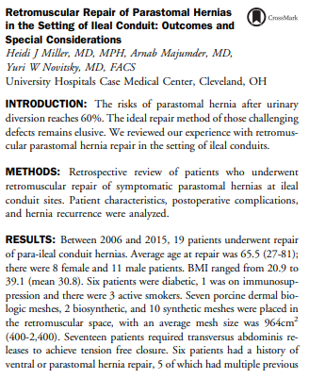
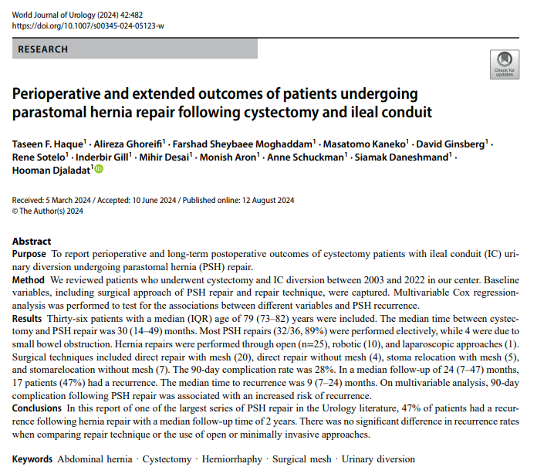
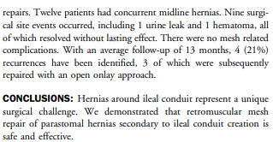
Contemporary Management
1. Paucity of data
2. Small studies
3. Heterogeneity in terms of repair
4. Minimal data on urologic outcomes after repair
Notes:
Parastomal in this setting are a recognized problem. There have been numerous approaches for repair of these hernias.
First study –retrospective series of patients at 6 French academic institutions. ~ 50 patients, mostly open repairs, but there was large heterogeneity in terms of the technique of repair. Ultimately there were high recurrence rates. And so the conclusion was that novel approaches need to be explored.
Second study – 35 patients, less heterogeneity in repair. 32 patients with laparoscopic repairs, 3 converted to open, 8% rate of recurrence. This shows in terms of recurrence, that this approach is feasible in smaller defects
Third study: touted as one of the largest series of patients undergoing parastomal hernia repair in the urology literature – 36 patients- all with different types of repair in terms of technique, mesh use, as well as relocation. They reported a recurrence rate of 47%.
But what about retromuscular repair? I found a poster about this from 2016 ACS clinical congress – 19 patients who underwent this technique, had a 21% recurrence rate at 13 month median follow up. So maybe a retromuscular repair is a viable option for patients in which a laparoscopic repair is less feasible?
Still missing from the data was the implications on renal function. None of these studies reported renal function parameters and whether they needed to undergo urologic procedures for decompression.

Slide 6
Aims
Exploratory, retrospective study
Characterize renal functional parameters and need for urinary decompression after retromuscular repair
Characterize rates of recurrence and reoperation in this patient cohort
Notes:
Goals of current study:
Characterize renal function parameters and need forurologic procedure after RM repair.
Characterize rates of recurrence and reoperation afterrepair.

Slide 7
Methods
Retrospective case series: ACHQC data, EMR review
Patients:
Urinary diversion conduit
Ventral and/or parastomal hernia repair requiring mesh coverage of stoma utilizing posterior component separation with TAR
Fascia able to be closed primarily
Variables of interest:
Demographic
Operative
Outcomes:
Urologic – change in creatinine; change in hydronephrosis, need for urologic procedure
General – recurrence, reoperation for any reason
Analysis:
Combined
By mesh type
By repair type
Notes:
Creatinine – looked at change from preop to dc as well as preop to 2y.
Hydronephrosis – we looked at baseline, which was described on CT scan as mild, moderate, or severe. Based on this, we looked a 2y imaging and compared the grade to determine if there was worsening, stable, or improved hydronephrosis.
Need for urologic procedure – this was defined as any procedure performed, including reoperation, due to need for urologic decompression, including IR drain for collections, stents, percutaneous nephrostomy tube placement. We scoured the chart to assess who underwent procedure.
In terms of general outcomes – recurrence was defined as the presence of ventral hernia or parastomal hernia defined as Moreno-Matias class II or III – hernia containing omentum or bowel not including the ostomy or reoperation for recurrence. Reoperation – any reason within the 2 year period.
Given the relatively small number of patients, we then analyzed this series in 3 ways – combined to get a general idea of the impact of these repairs, by mesh type – whether a biologic vs synthetic and by repair type – Sugarbaker vs keyhole.

Slide 8
Combined Analysis:
49 patients
Imaging Follow Up
Laboratory Follow Up
44 patients with imaging at 2 years
Hernia recurrence
Status of hydronephrosis
Need for urological procedure
38 patients with labs at 2 years
Change in creatinine
Notes:
We identified 49 patients at our institution between 2015-2022.
All 49 patients had preoperative creatinine data as well as creatinine values at discharge.
Imaging – had 44 patients with imaging at 2 years

Slide 9
Combined Results
Operative Characteristics
Prior mesh repair | 21/49 (43%)
Stoma type:
Ileal conduit | 43/49 (88%)
Indiana pouch | 6/49 (12%)
Hernia type:
Ventral only | 5/49 (10%)
Parastomal only | 8/49 (16%)
Parastomal and Ventral | 36/49 (73%)
Revision:
Ostomy only | 36/49 (73%)
Ureteral anastomoses | 7/49 (14%)
Median Hernia Width, cm (IQR) | 15 (12, 16)
Demographic Characteristics
Gender:
Male | 28/49 (57%)
Female | 21/49 (43%)
Median Age (IQR) | 70.5 (62, 78)
ASA Class (IQR) | 3 (2, 3)
BMI (IQR) | 30 (27.9, 35.1)
Comorbid Condition
Hypertension | 33/49 (67%)
Diabetes | 8/49 (16%)
COPD | 8/49 (16%)
Active tobacco use | 0/49 (0%)
Preoperative use of steroids | 3/49 (6%)
Worsening hydronephrosis: 3 patients
2 mild and stable, no intervention needed
1 more severe, patient refused intervention
Need for urologic procedure: 6 patients
3 with urolithiasis
1 pt needed perc neph tube at index hospitalization – removed 6m later
1 pt developed urinoma causing ureteral obstruction – IR drain placed
1 pt required reoperation due to tight mesh aperture causing urinary obstruction
Reoperation:
2 mesh-related complications
2 bowel obstructions
2 isolated recurrences
Clinical Variable
Creatinine
Median Δ Op Creatinine (IQR) | -0.16 (-0.25, -0.02)
Median Δ 2y Creatinine (IQR) | 0.02 (-0.11, 0.3)
Hydronephrosis at 2 years
Worsened | 3/44 (7%)
Stable | 34/44 (77%)
Improved | 7/44 (16%)
Need for urologic procedure at 2y (decompression) | 6/44 (14%)
Procedural Outcomes
Reoperation at 2 years | 6/44 (14%)
Recurrence at 2 years | 12/44 (27%)
Notes:
Demographics – Median age was ~ 70, BMI 30, Most patients had hypertension, none with active tobacco use, only 6% with perioperative use of steroids
Operative characteristics – vast majority with ileal conduit and majority had concomitant parastomal and ventral. Revision was defined as if the mucocutaneous junction was disrupted – most of the ostomies were revised but only 14% of the ureters were revised. Median width, as measured according to EHS guidelines was 15 cm.
Outcomes:
Change in Op creatinine was the change in creatinine at baseline to the index hospitalization discharge. The median was -0.16. The median change in creatinine at 2 years was 0.02. So when looking at the impact of these repairs on renal function, it does not appear that the creatinine changes all that much from baseline. So retromuscular repair appears safe from a renal function standpoint.
Hydronephrosis – overall 7% had worsening hydronephrosis at 2 years. 2/3 had mild hyronephrosis that did not require procedure. 1 patient had more significant hydronephrosis but was refusing procedure and ultimately did not get a procedure at 2 years for this. But overall, 93% of patients either had stable or improved hydronephrosis at 2 years.
Need for urogic procedure:
6 total patients – 3 due to development of stones. ~10% of patients with urinary conduits develop urolithiasis as part of the natural history of this disease process. Thus, these procedures really may not have been due to hernia repair itself. One patient developed a urinoma causing ureteral compression requiring IR drain. One underwent percutaneous nephrostomy tube at index hospitalization – may have been due to edema as this patient was able to have this removed about 6 months after the case without subsequent worsening in hydronephrosis. One patient required revisional surgery due to mesh strangulation of the conduit.
Reoperation rates were 6/44 – the one patient with the mesh strangulation I just mentioned. Another patient had a deep space infection requiring removal of the mesh about 3 weeks after the index case. Two patients required reoperation for bowel obstruction.

Slide 10
Analysis: Mesh Type
49 patients
Biologic:
12 patients
Synthetic:
37 patients
Imaging:
10 patients
Labs:
10 patients
Imaging:
34 patients
Labs:
28 patients

Slide 11
Results: Mesh Type
Demographic Characteristics
 | Biologic | Synthetic
Gender:
Male | 6/12 (50%) | 22/37 (59%)
Female | 6/12 (50%) | 15/37 (41%)
Median Age (IQR) | 68.7 (61, 80) | 71 (62, 78)
ASA Class (IQR) | 2 (2, 3) | 3 (2, 3)
BMI (IQR) | 30.4 (26.5, 34.7) | 30 (27.9, 35.4)
Comorbid Condition
Hypertension | 8/12 (67%) | 25/37 (68%)
Diabetes | 3/12 (25%) | 5/37 (14%)
COPD | 2/12 (17%) | 6/37 (16%)
Active tobacco use | 0/12 (0%) | 0/37 (0%)
Preoperative use of steroids | 0/12 (0%) | 3/37 (8%)
Urologic Outcomes
 | Biologic |  | Synthetic
Creatinine
Median Δ Op Creatinine (IQR) | -0.15 (-0.27, 0.06) |  | -0.16 (-0.24, -0.04)
Median Δ 2y Creatinine (IQR) | 0.01 (-0.09, 0.39) |  | 0.04 (-0.12, 0.25)
Hydronephrosis at 2 years
Worsened | 0/10 (0%) |  | 3/34 (9%)
Stable | 8/10 (80%) |  | 26/34 (76%)
Improved | 2/10 (20%) |  | 5/34 (15%)
Need for urologic procedure at 2y (decompression) | 0/10 (0%) |  | 6/34 (18%)
Procedural Outcomes
Reoperation at 2 years | 2/10 (20%) |  | 4/34 (12%)
Recurrence at 2 years | 6/10 (60%) |  | 6/34 (18%)
Operative Characteristics
 | Biologic | Synthetic
Prior mesh repair | 5/12 (42%) | 16/37 (43%)
Stoma type:
Ileal conduit | 10/12 (83%) | 33/37 (89%)
Indiana pouch | 2/12 (17%) | 4/37 (11%)
Hernia type:
Ventral only | 1/12 (8%) | 4/37 (11%)
Parastomal only | 2/12 (17%) | 6/37 (16%)
Parastomal and Ventral | 9/12 (75%) | 27/37 (73%)
Revision:
Ostomy only | 11/12 (92%) | 25/37 (68%)
Ureteral anastomoses | 1/12 (8%) | 6/37 (32%)
Median Hernia Width, cm (IQR) | 11 (10, 13) | 15 (12, 17.5)
Notes:
No difference in demographic conditions
Operative characteristics – no difference
Outcomes: no differences in change in creatinine, need for urologic procedure, or reoperation. However, there was a significant difference in the rate of recurrence as 6/10 patients had recurrence at 2 years who underwent repair with biologic mesh.

Slide 12
Analysis: Repair Type
49 patients
Sugarbaker:
20 patients
Keyhole:
29 patients
Imaging:
20 patients
Labs:
16 patients
Imaging:
24 patients
Labs:
22 patients

Slide 13
Results: Repair Type
Operative Characteristics
 | SB | KH
Prior mesh repair | 12/20 (60%) | 9/29 (31%)
Stoma type:
Ileal conduit | 19/20 (95%) | 24/29 (83%)
Indiana pouch | 1/20 (5%) | 5/29 (17%)
Hernia type:
Ventral only | 1/20 (5%) | 4/29 (14%)
Parastomal only | 1/20 (5%) | 7/29 (24%)
Parastomal and Ventral | 18/20 (90%) | 18/29 (62%)
Revision:
Ostomy only | 7/20 (35%) | 29/29 (100%)
Ureteral anastomoses | 4/20 (20%) | 3/29 (10%)
Median Hernia Width, cm (IQR) | 15 (12.5, 17.8) | 13 (11, 15)
Demographic Characteristics
 | SB | KH
Gender:
Male | 13/20 (65%) | 15/29 (52%)
Female | 7/20 (35%) | 14/29 (48%)
Median Age (IQR) | 74 (67, 79) | 67.4 (60.3, 76.8)
ASA Class (IQR) | 3 (2, 3) | 3 (2, 3)
BMI (IQR) | 30.1 (28, 35.6) | 30 (27.7, 34.6)
Comorbid Condition
Hypertension | 14/20 (70%) | 19/29 (66%)
Diabetes | 3/20 (15%) | 5/29 (17%)
COPD | 5/20 (20%) | 3/29 (10%)
Active tobacco use | 0/20 (0%) | 0/29 (0%)
Preoperative use of steroids | 1/20 (5%) | 2/29 (7%)
Type of Repair
 | Sugarbaker | Keyhole
Creatinine
Median Δ Op Creatinine (IQR) | -0.22 (-0.25, -0.01) | -0.14 (-0.26, 0)
Median Δ 2y Creatinine (IQR) | 0.05 (-0.12, 0.33) | 0.01 (-0.1, 0.21)
Hydronephrosis at 2 years
Worsened | 2/20 (10%) | 1/24 (4%)
Stable | 14/20 (70%) | 20/24 (83%)
Improved | 4/20 (20%) | 3/24 (13%)
Need for urologic procedure at 2y (decompression) | 3/20 (15%) | 3/24 (13%)
Procedural Outcomes
Reoperation at 2 years | 2/20 (10%) | 4/24 (17%)
Recurrence at 2 years | 3/20 (15%) | 9/24 (37.5%)
Notes:
Those in SB were more likely to have both a parastomal and ventral rather than one type of hernia in isolation. Additionally, KH patients were more likely to have the ostomy revised at the time of surgery. There were no other significant differences between these patients in terms of demographic or operative characteristics. In terms of clinical outcomes, there were no significant differences that were seen in terms of change in creatinine, need for urologic procedure, change in hydronephrosis, reoperation, or recurrence.

Slide 14
Discussion Points:
27% rate of recurrence at 2 years:
Synthetic mesh: 6/34 (18%) at 2 years
Synthetic SB: 3/19 (16%)
Synthetic KH: 3/15 (20%)
Suggests that biologic mesh may have higher rates of recurrence – consistent with our data in press
Urologic procedures 14%:
3/6 due to stones
2/6 associated with ureteral revision
1/6 due to technical error with keyhole mesh
7% rate of hydronephrosis
2.3% appeared to be clinically significant, without urolithiasis

Slide 15
Conclusions
Retromuscular TAR repair in setting of urinary diversion conduits does not have harmful effect on renal function
Use of biologic mesh may be associated with higher rates of recurrence
Mesh-related complications are uncommon

Slide 16
References:
[1] https://bladdercancercanada.org/en/urinary-diversion-options-after-bladder-removal/
[2] Lin-Brande M, Nazemi A, Pearce SM, Thompson ER, Ashrafi AN, Djaladat H, Schuckman A, Daneshmand S. Assessing trends in urinary diversion after radical cystectomy for bladder cancer in the United States. Urol Oncol. 2019;37(3):180.e1-180.e9. doi:10.1016/j.urolonc.2018.11.003
[3] Donahue, T. F., & Bochner, B. H. (2016). Parastomal hernias after radical cystectomy and ileal conduit diversion. Investigative and clinical urology, 57(4), 240–248. https://doi.org/10.4111/icu.2016.57.4.240
[4] Narang, S. K., Alam, N. N., Campain, N. J., Pathak, S., McGrath, J. S., Daniels, I. R., & Smart, N. J. (2017). Parastomal hernia following cystectomy and ileal conduit urinary diversion: a systematic review. Hernia : the journal of hernias and abdominal wall surgery, 21(2), 163–175. https://doi.org/10.1007/s10029-016-1561-z
[5] Rezaee, M. E., Goldwag, J. L., Goddard, B., Bihrle Iii, W., Viazmenski, A., Wilson, M. Z., & Seigne, J. D. (2020). Parastomal hernia development after cystectomy and ileal conduit for bladder cancer: results from the Dartmouth ileal conduit enhancement (DICE) project. The Canadian journal of urology, 27(5), 10369–10377.
[6] Haque, T. F., Ghoreifi, A., Sheybaee Moghaddam, F., Kaneko, M., Ginsberg, D., Sotelo, R., Gill, I., Desai, M., Aron, M., Schuckman, A., Daneshmand, S., & Djaladat, H. (2024). Perioperative and extended outcomes of patients undergoing parastomal hernia repair following cystectomy and ileal conduit. World journal of urology, 42(1), 482. https://doi.org/10.1007/s00345-024-05123-w

Slide 18
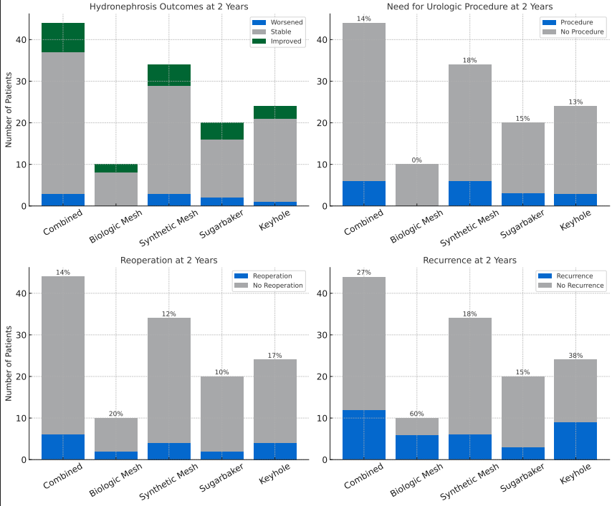

Slide 19
Combined Results
Demographic Characteristics
Gender:
Male | 28/49 (57%)
Female | 21/49 (43%)
Median Age (IQR) | 70.5 (62, 78)
ASA Class (IQR) | 3 (2, 3)
BMI (IQR) | 30 (27.9, 35.1)
Comorbid Condition
Hypertension | 33/49 (67%)
Diabetes | 8/49 (16%)
COPD | 8/49 (16%)
Active tobacco use | 0/49 (0%)
Preoperative use of steroids | 3/49 (6%)
Operative Characteristics
Prior mesh repair | 21/49 (43%)
Stoma type:
Ileal conduit | 43/49 (88%)
Indiana pouch | 6/49 (12%)
Hernia type:
Ventral only | 5/49 (10%)
Parastomal only | 8/49 (16%)
Parastomal and Ventral | 36/49 (73%)
Revision:
Ostomy only | 36/49 (73%)
Ureteral anastomoses | 7/49 (39%)
Median Hernia Width, cm (IQR) | 15 (12, 16)
Clinical Variable
Creatinine
Median Δ Op Creatinine (IQR) | -0.16 (-0.25, -0.02)
Median Δ 2y Creatinine (IQR) | 0.02 (-0.11, 0.3)
Hydronephrosis at 2 years
Worsened | 3/44 (7%)
Stable | 34/44 (77%)
Improved | 7/44 (16%)
Need for urologic procedure at 2y (decompression) | 6/44 (14%)
Procedural Outcomes
Reoperation at 2 years | 6/44 (14%)
Recurrence at 2 years | 12/44 (27%)

