Slide 1
Comparative Outcomes of Barrier-coated and Uncoated Mesh in CDC Class II-III Ventral Hernia Repairs
Nancy Ly MD¹, Krishay Sridalla¹, Megan Melland-Smith MD¹, Cassie Hennessy MS², Michael J. Rosen MD¹
¹Northwestern University Feinberg School of Medicine, Chicago, IL
²Vanderbilt University, Nashville, TN
Notes:
Good morning, again. My name is Nancy Ly & I’m a resident from Northwestern University.
Today I’ll be presenting our analysis comparing barrier-coated versus uncoated mesh in CDC class II and III ventral hernia repairs

Slide 2
Disclosures
Dr. Rosen serves as the medical director of the ACHQC and receives salary support, received institutional grants from Medtronic.
Dr. Melland-Smith is supported by a research grant from the American Hernia Society.
The remaining authors have no disclosures to report.
Notes:
Here are our disclosures

Slide 3
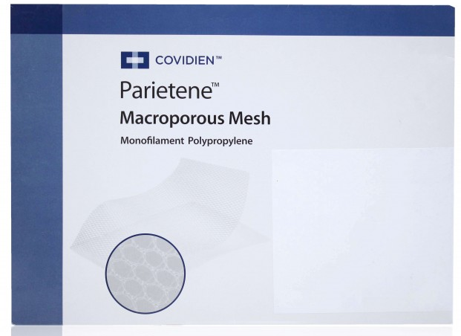
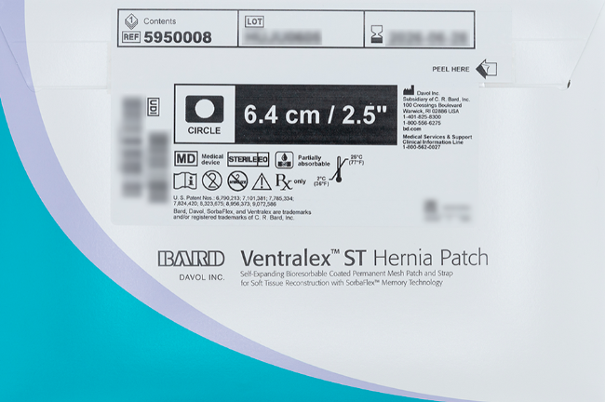
The Clinical Problem
Synthetic mesh is increasingly used in CDC II-III ventral hernia repair
RCTs showed lower recurrence vs biologic mesh
Extraperitoneal placement of uncoated mesh may be technically challenging, particularly in contaminated fields
Barrier coating alter the mesh-tissue interface and bacterial interaction
Clinical impact of coating in contaminated settings remain unclear
Notes:
Synthetic mesh is increasingly used in clean-contaminated and contaminated ventral hernia repair, particularly after randomized trials demonstrated lower recurrence compared with biologic mesh.
However, extraperitoneal placement of uncoated mesh can be technically challenging, especially in contaminated settings where tissue planes may be less favorable.
Barrier coatings may improve handling and reduce visceral adhesions, but they also alter tissue incorporation and bacterial interaction.
As a result, the independent clinical impact of barrier coating in contaminated ventral hernia repair remains unclear.

Slide 4
Study Question
Among patients undergoing CDC II–III ventral hernia repair, how do wound morbidity outcomes compare between barrier-coated and uncoated synthetic mesh?
Primary outcome
30-day wound morbidity: SSI, SSO, SSOPI
Secondary outcomes
Mesh-related complications: infections, removal
Healthcare utilization: LOS, 30-day readmission and reoperation
Patient-reported outcomes: HerQLes, PROMIS 3a
Notes:
So then we sought to compare wound morbidity outcomes between barrier-coated and uncoated synthetic mesh in CDC class II and III ventral hernia repair.
Our primary outcome was 30-day wound morbidity, including SSI, SSO, and SSOPI.
Secondary outcomes included healthcare utilization, such as length of stay, readmission, and reoperation, as well as patient-reported outcomes measured using HerQLes and PROMIS scores

Slide 5
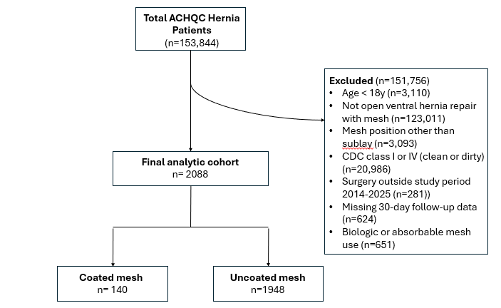
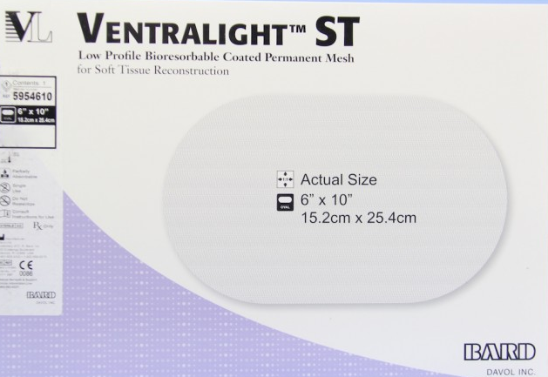
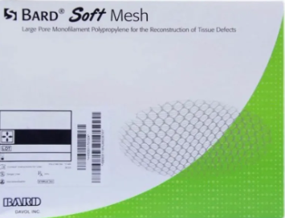
Methods – Retrospective Cohort
Notes:
We performed a retrospective cohort study using the ACHQC registry from 2014 through 2025.
We included adult patients undergoing open ventral hernia repair with permanent synthetic mesh placed in the sublay position in CDC class II or III wounds.
We excluded minimally invasive repairs, clean or dirty wounds, non-sublay mesh placement, biologic or absorbable mesh, and cases without 30-day follow-up.
From over 153,000 registry patients, 2,088 met inclusion criteria.
Of these, 140 patients received barrier-coated mesh and 1,948 received uncoated permanent synthetic mesh.

Slide 6
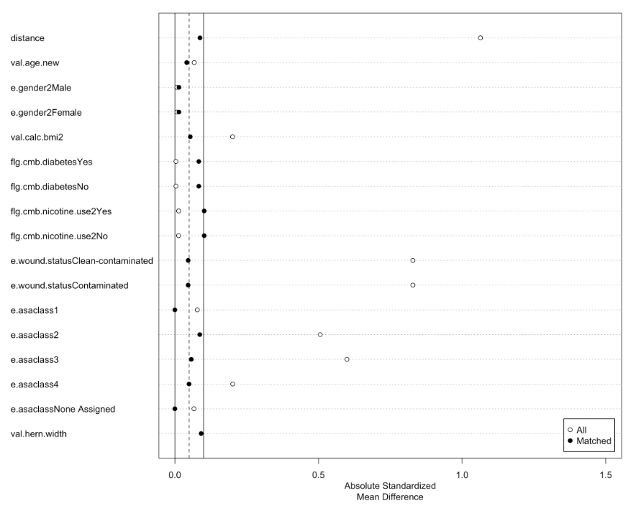
Methods – Propensity Score Matching
Pre-match cohort:
Coated: 140 (6.7%)
Uncoated: 1,948 (93.3%)
Matched cohort:
Covariates: age, BMI, smoking, ASA class, hernia width
Coated: 140
Uncoated: 140
All SMD <0.1
Notes:
Because this was an observational study, there were important baseline differences between patients receiving coated and uncoated mesh.
To address this, we performed 1-to-1 propensity score matching using clinically relevant covariates, including age, BMI, smoking status, diabetes, ASA class, hernia width, and operative factors.
Before matching, the cohort included 140 coated repairs and 1,948 uncoated repairs.
After matching, we obtained a balanced cohort of 140 coated and 140 uncoated patients, for a total of 280 patients.
As shown in the Love plot, all standardized mean differences were reduced to below 0.10, indicating excellent covariate balance between groups.
We therefore used the matched cohort for all subsequent outcome analyses

Slide 7

Baseline Characteristics
Matched cohort: 140 coated vs 140 uncoated
Age: 61 vs 63 (p=0.7)
BMI: 33 vs 34 kg/m² (p=0.4)
Diabetes: 24% vs 28% (p=0.5)
Smoking: 8.6% vs 11% (p=0.4)
Hypertension: 54% vs 54% (p>0.9)
Well-balanced comorbidity and risk profiles between groups
Notes:
After propensity score matching, baseline characteristics were well balanced between groups.
Mean age was similar at 61 years in the coated group and 63 years in the uncoated group.
BMI was also comparable at 33 versus 34 kilograms per meter squared.
Major comorbidities including diabetes, smoking, and hypertension were similar between groups.
Overall, the matched cohort represents a well-balanced population appropriate for outcome comparison.

Slide 8

Operative Details
Wound class & defect size were similar between groups (coated vs uncoated)
CDC Class 2: 89% vs 91, Class 3: 11% vs 9.3% (p=0.8)
Hernia width: 5 vs 5 cm (p=0.1)
Operative duration differed significantly
OR time >2 hours: 58% vs 90% (p<0.001)
Mesh position differed between groups
No uncoated mesh placed intraperitoneal
Retrorectus/retromuscular: 29% vs 86% (p<0.001)
Preperitoneal: 28% vs 30% (p=0.7)
Notes:
Operative characteristics were largely similar between groups in terms of wound class and hernia size.
The majority of repairs were CDC class II in both groups, and median hernia width was similar at approximately 5 centimeters.
However, operative duration differed significantly. Operative time exceeding two hours occurred in 90% of uncoated repairs compared with 58% of coated repairs.
Mesh position also differed between groups. Uncoated mesh was more frequently placed in the retromuscular plane, while coated mesh was more commonly used in preperitoneal positions.
Importantly, no uncoated mesh was placed intraperitoneally, reflecting differences in mesh selection based on anatomic considerations.
Despite these operative differences, postoperative wound morbidity remained similar between groups.

Slide 9
Primary Outcomes (SSI/SSO/SSOPI)
No difference in 30-day wound morbidity
Outcome | Coated | Uncoated | p-value
SSI | 7.1% | 5.7% | 0.60
SSO | 13% | 18% | 0.20
SSOPI | 12% | 7.9% | 0.20
Notes:
In the matched cohort, there was no significant difference in 30-day wound morbidity between coated and uncoated mesh.
Surgical site infection occurred in 7.1% of coated repairs compared to 5.7% of uncoated repairs, which was not statistically different.
Similarly, overall surgical site occurrence rates were comparable at 13% in the coated group and 18% in the uncoated group.
Surgical site occurrence requiring procedural intervention occurred in 12% of coated repairs and 7.9% of uncoated repairs, which was also not significantly different.
Overall, barrier coating was not associated with increased wound morbidity.

Slide 10

Secondary outcomes: Mesh-related complications
Mesh infection was rare
Coated: 1/140(5.6%)
Uncoated: 0 cases
p=0.4
Mesh removal was also rare
Partial removals: 0 cases in either groups
Complete removal:
Coated: 1/140 (0.7%)
Uncoated: 0/140
p=0.4
Notes:
Mesh-related complications were rare. Only one mesh infection occurred in the coated group, and none occurred in the uncoated group.
Similarly, mesh removal was uncommon. No partial mesh removals occurred, and only one complete mesh removal occurred in the coated group.
Overall, mesh infection and removal rates were very low and did not differ between groups.

Slide 11
Secondary outcomes: HCU & PROs
Healthcare utilization (coated vs uncoated)
LOS: 4 days vs 4 days (IQR 1-6 vs IQR 3-6.5), p=0.014
Readmission: 12% vs 8.6% (p=0.3)
Reoperation: 2.1% vs 3.6% (p=0.7)
Patient-reported outcomes
HerQLes scores similar at 30 days and 1 year
PROMIS scores similar between groups
No significant difference in quality of life or pain
Notes:
Healthcare utilization outcomes were largely similar between groups.
Median length of stay was four days in both groups. Although the interquartile range differed slightly, resulting in a statistically significant p-value, the absolute difference was small and unlikely to be clinically meaningful.
Readmission and reoperation rates were also similar between groups.
Patient-reported outcomes, including HerQLes quality-of-life scores and PROMIS pain scores, were comparable at both short- and longer-term follow-up.
Overall, barrier coating was not associated with increased healthcare utilization or worse patient-reported outcomes.

Slide 12
Interpretations
Barrier coating was not associated with increased wound morbidity
Healthcare utilization and patient-reported outcomes were similar between groups
Barrier coating alone does not appear to independently increase risk in CDC II-III repair
Notes:
In this propensity-matched analysis of CDC class II and III ventral hernia repair, barrier-coated mesh was not associated with increased wound morbidity compared with uncoated mesh.
Mesh-related complications, healthcare utilization and patient-reported outcomes were also similar between groups.
These findings suggest that barrier coating alone does not independently increase risk when permanent synthetic mesh is used in CDC II-III ventral hernia repair.
Mesh selection decisions may therefore be guided by other factors, such as operative technique and surgeon preference, rather than concern for coating-related infection risk.

Slide 13
Strengths & Limitations
Strengths
Limitations
National, prospectively collected registry
Surgeon-entered technical data
Matched design
Small coated cohort
Retrospective
Coated mesh was placed across multiple extraperitoneal planes, which may influence outcomes independent of coating
Notes:
This study has several important strengths.
We used a large national registry with prospectively collected, surgeon-entered technical operative data, allowing detailed characterization of operative variables.
Additionally, propensity score matching achieved excellent covariate balance, improving the validity of comparisons between groups.
However, several limitations should be acknowledged.
The coated mesh cohort was relatively small, which may limit power to detect rare outcomes.
Additionally, this was a retrospective observational study and remains subject to residual confounding despite matching.
Finally, coated mesh was placed across multiple extraperitoneal planes, and differences in operative plane selection may independently influence outcomes apart from mesh coating itself.

Slide 14
Take-Home Messages
In CDC II-III sublay repair, barrier-coating was not associated with increased wound morbidity
Healthcare utilization, recurrence, and patient-reported outcomes were similar between groups
Coating alone should not preclude use in appropriately selected contaminated repairs
Notes:
In summary, in CDC class II and III sublay ventral hernia repair, barrier-coated mesh was not associated with increased wound morbidity compared with uncoated synthetic mesh.
Healthcare utilization, recurrence, and patient-reported outcomes were also similar between groups.
These findings suggest that barrier coating alone should not preclude use of permanent synthetic mesh in appropriately selected contaminated ventral hernia repairs.
Thank you.

Slide 15
Thank You!
Questions?

