Slide 1
Predictors of Poor Outcomes In Ventral Hernia Repair (Why your patient will be back)
Randal Zhou MD
Assistant Professor of Surgery
Division of Bariatric and MIS

Slide 2
Disclosures
Nothing to disclose

Slide 3
Objectives
Magnitude of poor outcomes after ventral hernia repair
Known risk factors
Current predictor models
Directions for the future
Notes:
Tremendous financial, emotional, and physical strains on patients and the healthcare system.
Developing a good model for prediction will be huge benefit to patients
Hope this talk will spark ideas and conversation about our next steps.

Slide 4
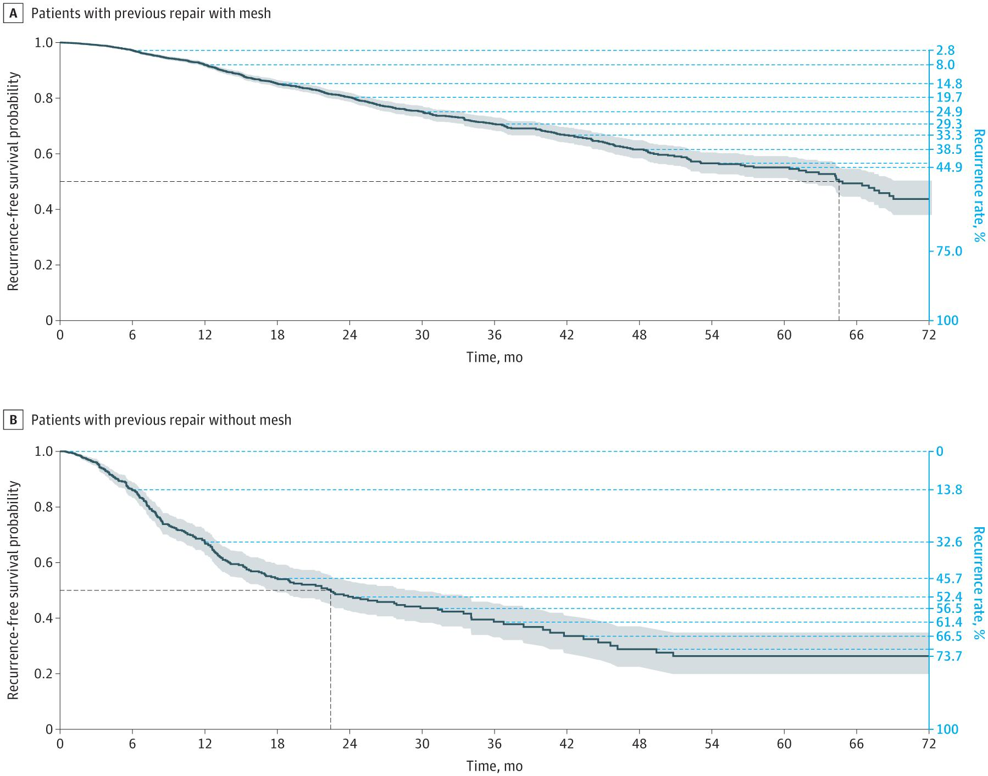
Magnitude of the Problem
30-day complications 4-20%
SSI 3-10%
Readmission 4-12%
Reoperation 2-11% [1-5]
Long-term recurrence:
5-yr rates ranging from 40-45% with mesh
70-75% without mesh
At 10-yrs recurrence rates approximate 47-65%
1% reduction in hernia recurrence would save US healthcare $32 million according to a 2012 study [8]
Figure 1. Recurrence Rates Over Time Following Ventral Hernia Repair in Patients With and Without Mesh
Year-Over-Year Ventral Hernia Recurrence Rates and Risk Factors. JAMA Surg. May 31, 2024.
Notes:
1. The Association of Hernia-Specific and Procedural Risk Factors With Early Complications in Ventral Hernia Repair: ACHQC Analysis.
American Journal of Surgery. 2024. Al-Mansour MR, Ding DD, Yergin CG, Tamer R, Huang LC.
2. Risk Factors for Surgical Complications in Ventral Hernia Repair.
World Journal of Surgery. 2018. Lindmark M, Strigård K, Löwenmark T, Dahlstrand U, Gunnarsson U.
3. Adverse Events After Ventral Hernia Repair: The Vicious Cycle of Complications.
Journal of the American College of Surgeons. 2015. Holihan JL, Alawadi Z, Martindale RG, et al.
4.Risk Factors for Surgical Site Infection in the Undeserved Population After Ventral Hernia Repair: A 3936 Patient Single-Center Study Using National Surgical Quality Improvement Project.
Journal of Laparoendoscopic & Advanced Surgical Techniques. Part A. 2022. Romero-Velez G, Lima DL, Pereira X, et al.
5.Development and Validation of a Scoring System to Predict Surgical Site Infection After Ventral Hernia Repair: A Michigan Surgical Quality Collaborative Study.
World Journal of Surgery. 2017. Karamanos E, Kandagatla P, Watson J, Schmoekel N, Siddiqui A.
6. Risk Factors for Postoperative Wound Infections and Prolonged Hospitalization After Ventral/­Incisional Hernia Repair.
Hernia : The Journal of Hernias and Abdominal Wall Surgery. 2015. Kaoutzanis C, Leichtle SW, Mouawad NJ, et al.
7. Identification of Risk Factors for 30-Day Postoperative Complications in Patients Undergoing Primary Ventral Hernia Repair: A Prospective Cohort Study of 2,374 Patients.
Surgery. 2018. Kroese LF, Gillion JF, Jeekel J, Lange JF, Kleinrensink GJ.
8. Poulose BK, Shelton J, Phillips S, et al. Epidemiology and cost of ventral hernia repair: making the case for hernia research. Hernia. 2012;16(2):179-183.

Slide 5
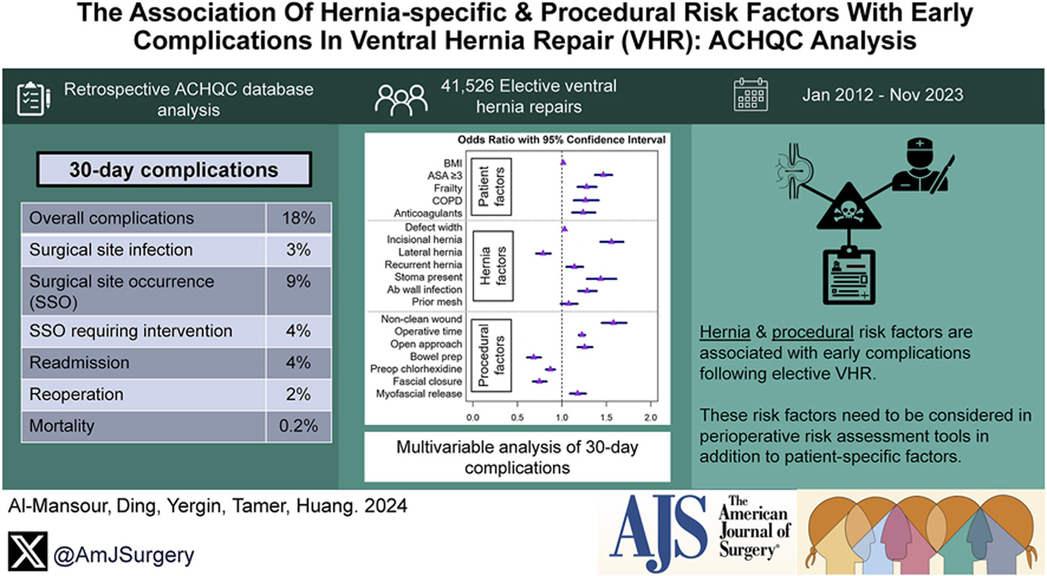
What Causes Poor Outcomes?
Current risk models may be incomplete
3 main factors: Patient, Hernia, Procedure
Notes:
What causes poor outcomes? This remains a heavily studied topic.
Our current risk models often offer incomplete risk assessment.
Earlier models emphasize heavily on patient factors.
As more data emerges, we start to understand there are more factors at play.
This study utilizes the QC data to recognize relevant risk factors that are beyond just the patient, ie hernia and procedural derived.
Important study that calls for risk assessment models to incorporate all 3 factors.

Slide 6
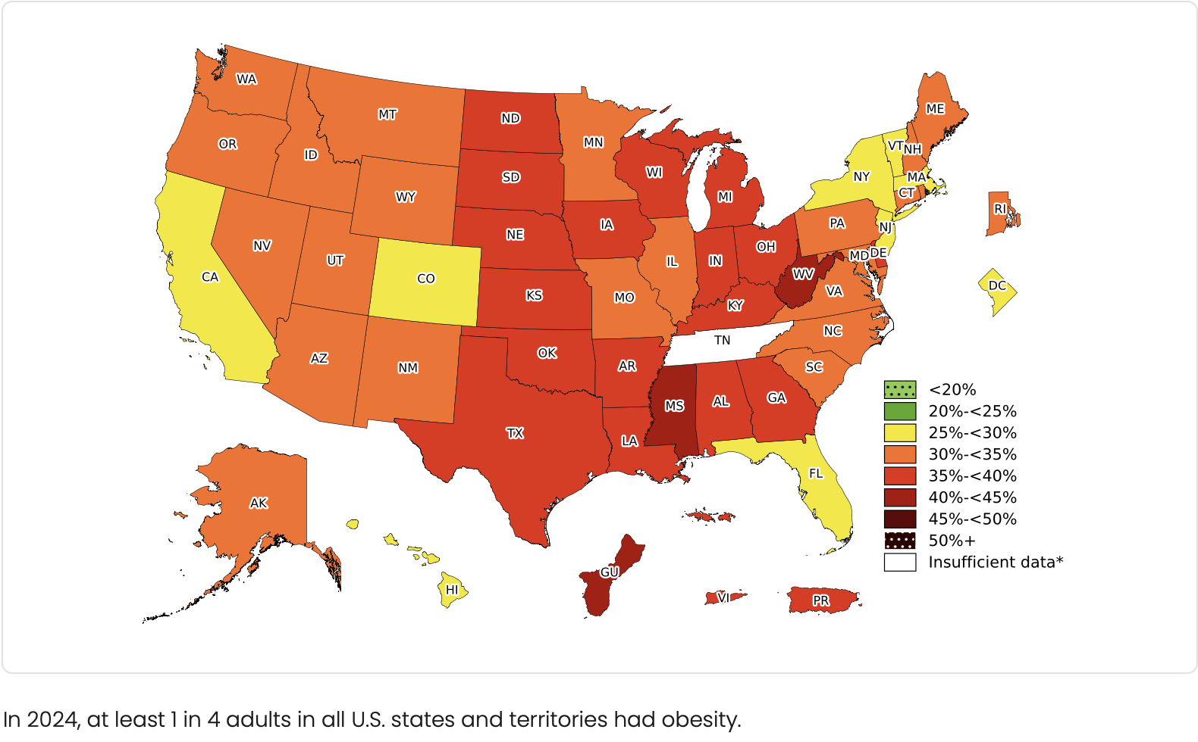
Patient Risk Factors
Obesity [1-4]
BMI >30 is an independent predictor of SSI (OR 1.01-1.66)[1][6]
BMI>35 increases SSI (aOR 2.38) and is also linked to higher wound complications, prolonged hospitalization, and cardiopulmonary complications.
Diabetes[1,2,5]
Increases SSI (aOR 2.36), delayed wound healing, any complications (aOR 1.34) and serious complications (aOR 1.51)
Smoking [1,3,6]
Increase SSI (aOR 1.32) and overall complications, though its impact may be mitigated by patient selection and favoring MIS.
https://www.cdc.gov/obesity/data-and-statistics/adult-obesity-prevalence-maps.html
Notes:
What do we know about ventral hernia risk factors in 2026?
1.Costs Associated With Modifiable Risk Factors in Ventral and Incisional Hernia Repair.
JAMA Network Open. 2019. Howard R, Thompson M, Fan Z, et al.
2.Risk Factors for Surgical Site Infection in the Undeserved Population After Ventral Hernia Repair: A 3936 Patient Single-Center Study Using National Surgical Quality Improvement Project.
Journal of Laparoendoscopic & Advanced Surgical Techniques. Part A. 2022. Romero-Velez G, Lima DL, Pereira X, et al.
3.Risk Factors for Postoperative Wound Infections and Prolonged Hospitalization After Ventral/­Incisional Hernia Repair.
Hernia : The Journal of Hernias and Abdominal Wall Surgery. 2015. Kaoutzanis C, Leichtle SW, Mouawad NJ, et al.
4.Risk Factors Associated With Adverse Outcomes After Ventral Hernia Repair With Component Separation.
The Journal of Surgical Research. 2021. Ferguson DH, Smith CG, Olufajo OA, Zeineddin
5. Effect of Patient and Hospital Characteristics on Outcomes of Elective Ventral Hernia Repair in the United States.
Hernia : The Journal of Hernias and Abdominal Wall Surgery. 2013. Novitsky YW, Orenstein SB.
6.
Correlation Between Inguinal and Ventral Hernia Repair Outcomes and Pre-Existing Comorbidity Clusters: ACS-NSQIP Study.
Hernia : The Journal of Hernias and Abdominal Wall Surgery. 2025. Wang W, Haq J, Long-Mills E, Tumin D, Chumakova-Orin M.New
7. Association of body mass index with morbidity following elective ventral hernia repair
Author: Russyan Mark Mabeza,Nam Yong Cho,Amulya Vadlakonda,Sara Sakowitz,Shayan Ebrahimian,Ashkan Moazzez,Peyman Benharash
Publication:
Surgery Open Science
Publisher:
Elsevier
Date:
August 2023

Slide 7
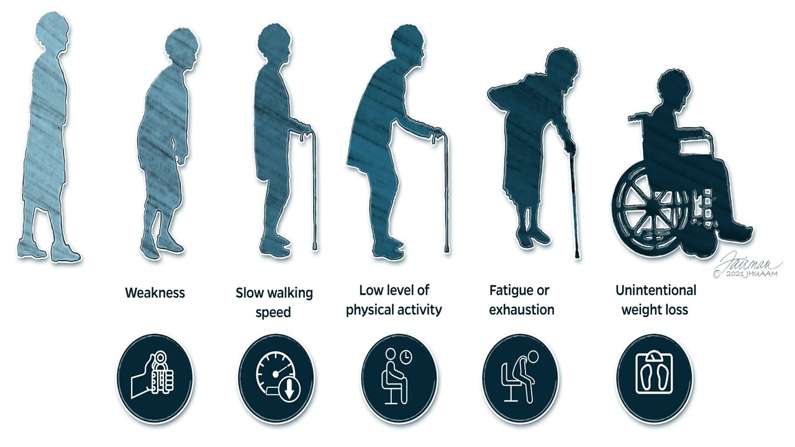
Patient Risk Factors
COPD [3, 4]
Substantial increase in overall complication (aOR 2.02)
Higher ASA 3 or 4 [1,3]
Any complication (aOR 3.47 for ASA 4) and serious complication (aOR 3.15 for ASA 4)
CHF or bleeding disorder (aOR 1.68), hx of DVT (aOR 1.95)
Older age, African American, alcohol abuse, low prealbumin, and poor functional status – increase length of stay [3,5]
Frailty diagnosis: 3 out of 5 clinical features
Credit: Hopkins Medicine; Jennifer Fairman
Notes:
With an aging population, frailty is an increasingly important diagnosis to recognize.

Slide 8
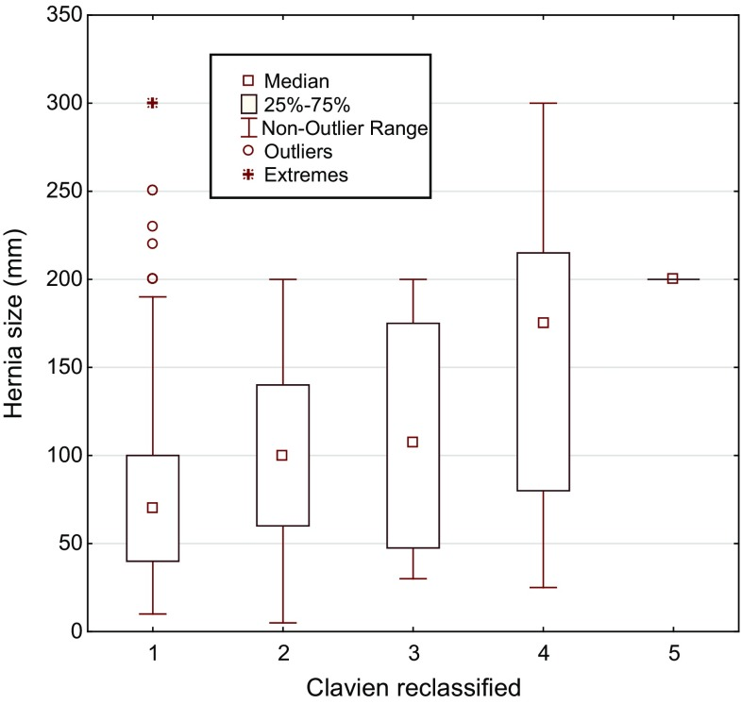
Hernia Risk Factors
Size [1-2]
Width >6cm (aOR 3.15)
Larger size proportional relationship with Clavien outcome class severity (p<0.001)
Type [3-5]
Incisional or recurrent
Complication (aOR 1.44)
Recurrence (aOR 4.9 in early cohorts and aOR 2.1 in recent)
Prior ventral repair linked to SSI (p=0.0010 and SSO (p=0.012)
Correlation between hernia size aperture and complication graded by modified Clavien score.
Patients where hernia size was recorded (N = 356). p < 0.001.
1 = no complication, 2 = Clavien 1–3a, 3 = Clavien 3b, 4 = Clavien 4, 5 = Clavien 5
Notes:
1.
Variation in Surgical Approach and Postoperative Complication Among Older Adults Undergoing Ventral Hernia Repair.
Surgical Endoscopy. 2024. Reynolds CW, Hallway A, Sinamo JK, et al.
2.
Risk Factors for Surgical Complications in Ventral Hernia Repair.
World Journal of Surgery. 2018. Lindmark M, Strigård K, Löwenmark T, Dahlstrand U, Gunnarsson U.
3.
The Association of Hernia-Specific and Procedural Risk Factors With Early Complications in Ventral Hernia Repair: ACHQC Analysis.
American Journal of Surgery. 2024. Al-Mansour MR, Ding DD, Yergin CG, Tamer R, Huang LC.
4.
Open Preperitoneal Ventral Hernia Repair: Prospective Observational Study of Quality Improvement Outcomes Over 18 Years and 1,842 Patients.
Surgery. 2023. Katzen MM, Kercher KW, Sacco JM, et al.
5.
Abdominal Wall Reconstruction in Ventral Hernia Repair: Do Current Models Predict Surgical Site Risk?.
Hernia : The Journal of Hernias and Abdominal Wall Surgery. 2025. Gala Z, Lemdani MS, Crystal D, et al.New

Slide 9
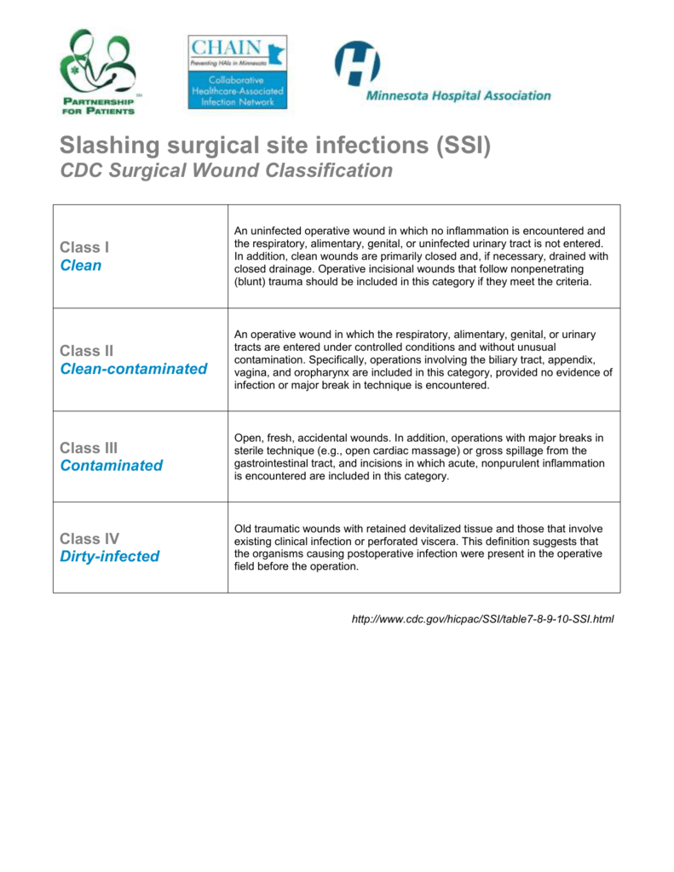
Hernia Factors
Prior mesh
increases 30-day complication and prior mesh infection increases SSI (p=0.004) [3,5]
Prior non-VHR abdominal surgery
increases SSI and SSO (p<0.001) [5]
Wound class 3 or 4 independently associated with complications (aOR 2.1 in early cohorts and aOR 1.8 in recent) [3-4]

Slide 10
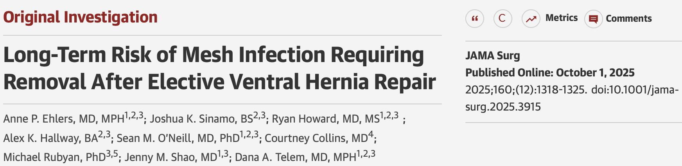
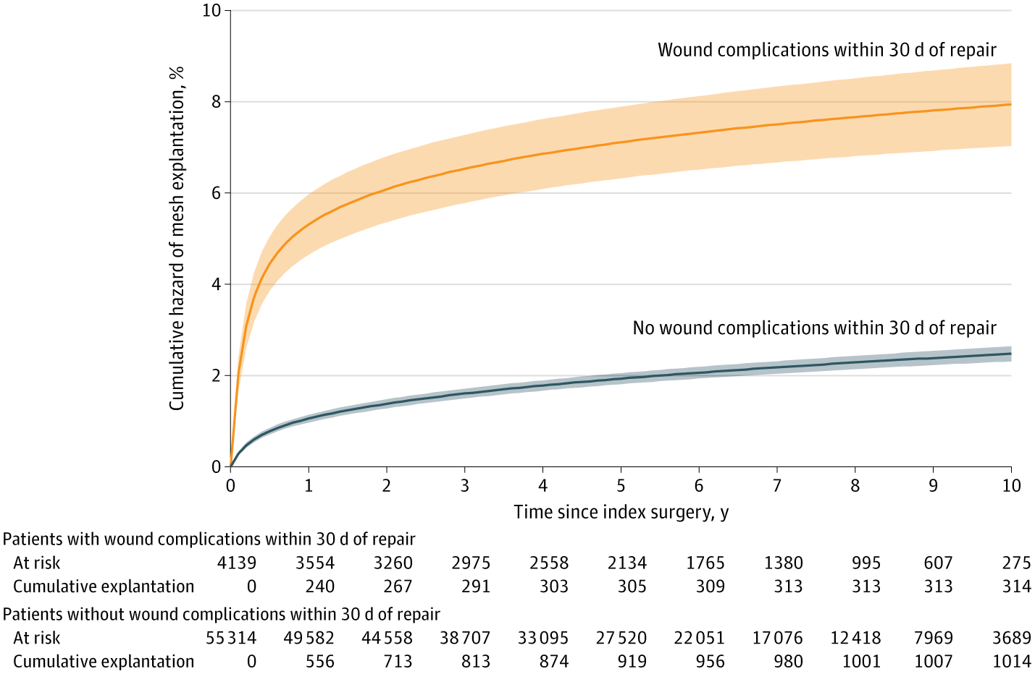
Procedural Factors
Approach
Obese patients MIS associated with lower complications, decreased mortality and shorter LOS [2]
Component separation and mesh placement
ACS increases wound risk (aOR1.8-3.2) and overall complication (aOR 1.98) [3,5]
Retrorectus mesh placement may be protective against mesh removal [6]
Operative time
Each additional minute increases risk (aOR 1.01) [3,4]
Prolonged operative times associated with both SSI and increased LOS
Notes:
1.
Costs Associated With Modifiable Risk Factors in Ventral and Incisional Hernia Repair.
JAMA Network Open. 2019. Howard R, Thompson M, Fan Z, et al.
2.
Postoperative Outcomes of Ventral Hernia Repair in Veterans.
Surgery. 2021. Shahait AD, Alghanem L, Cmorej P, et al.
3.
Open Preperitoneal Ventral Hernia Repair: Prospective Observational Study of Quality Improvement Outcomes Over 18 Years and 1,842 Patients.
Surgery. 2023. Katzen MM, Kercher KW, Sacco JM, et al.
4.
Risk Factors for Postoperative Wound Infections and Prolonged Hospitalization After Ventral/­Incisional Hernia Repair.
Hernia : The Journal of Hernias and Abdominal Wall Surgery. 2015. Kaoutzanis C, Leichtle SW, Mouawad NJ, et al.
5.
Variation in Surgical Approach and Postoperative Complication Among Older Adults Undergoing Ventral Hernia Repair.
Surgical Endoscopy. 2024. Reynolds CW, Hallway A, Sinamo JK, et al.
6.
Long-Term Risk of Mesh Infection Requiring Removal After Elective Ventral Hernia Repair.
JAMA Surgery. 2025. Ehlers AP, Sinamo JK, Howard R, et al.New
7.
Abdominal Wall Reconstruction in Ventral Hernia Repair: Do Current Models Predict Surgical Site Risk?.
Hernia : The Journal of Hernias and Abdominal Wall Surgery. 2025. Gala Z, Lemdani MS, Crystal D, et al.New
8.
The Association of Hernia-Specific and Procedural Risk Factors With Early Complications in Ventral Hernia Repair: ACHQC Analysis.
American Journal of Surgery. 2024. Al-Mansour MR, Ding DD, Yergin CG, Tamer R, Huang LC.

Slide 11
Risk Stratification: What Tools Do We Have?
Ventral hernia Working Group (VHWG)
Ventral hernia Risk Score (VHRS)
Hernia Wound Risk Assessment Tool (HW-RAT)
Carolinas Equation for Determining Associated Risks (CeDAR)
ACHQC ORACLE
Notes:
These 5 are the most established and studied risk models, each with its own strength and weaknesses.
In order to improve our risk models, it is important to important to understand where we came from

Slide 12
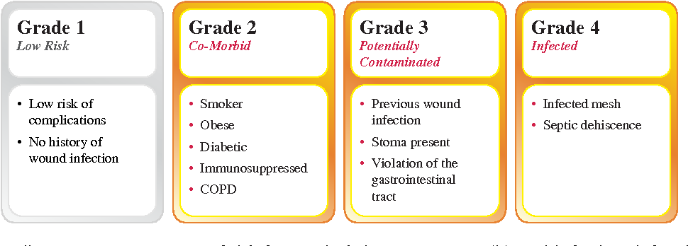
Ventral Hernia Working Group (VHWG)
Widely used, expert consensus 2010, modified 2013
Classify hernias by patient risk factors
No hernia or procedure factors.
Shows validity for predicting long-term recurrence with increasing hazard ratio across grades (Grade 2 HR 1.19, Grade 3 HR 1.79) [1-2]
Modest predictive ability with AUC of 0.614-0.616 for SSI and SSO
Notes:
1.
Abdominal Wall Reconstruction in Ventral Hernia Repair: Do Current Models Predict Surgical Site Risk?.
Hernia : The Journal of Hernias and Abdominal Wall Surgery. 2025. Gala Z, Lemdani MS, Crystal D, et al.New
2.
Evaluation of the Ventral Hernia Working Group Classification for Long-Term Outcome Using English Hospital Episode Statistics: A Population Study.
Hernia : The Journal of Hernias and Abdominal Wall Surgery. 2021. Hodgkinson JD, Worley G, Warusavitarne J, et al.

Slide 13
Ventral Hernia Risk Score (VHRS)
Parameters | Findings | Points
body mass index | < 40 kg per sq m | 0
 | >= 40 kg per sq m | 3
ASA score | 1 or 2 | 0
 | 3, 4 or 5 | 2
skin flap | no | 0
 | yes | 2
concomitant hernia repair | no | 0
 | yes | 2
surgical wound class | 1, 2 or 3 | 0
 | 4 (dirty, infected) | 7
Retrospective study of 888 VA patients 2013
Predict SSI and SSO after open ventral hernia repair
Patient, hernia, and procedure factors, although limited
External validation shows limited predictive accuracy AUC 0.588-0.609 for SSO and SSI
Notes:
1.
Abdominal Wall Reconstruction in Ventral Hernia Repair: Do Current Models Predict Surgical Site Risk?.
Hernia : The Journal of Hernias and Abdominal Wall Surgery. 2025. Gala Z, Lemdani MS, Crystal D, et al.New
2.
Evaluation of the Ventral Hernia Working Group Classification for Long-Term Outcome Using English Hospital Episode Statistics: A Population Study.
Hernia : The Journal of Hernias and Abdominal Wall Surgery. 2021. Hodgkinson JD, Worley G, Warusavitarne J, et al.

Slide 14
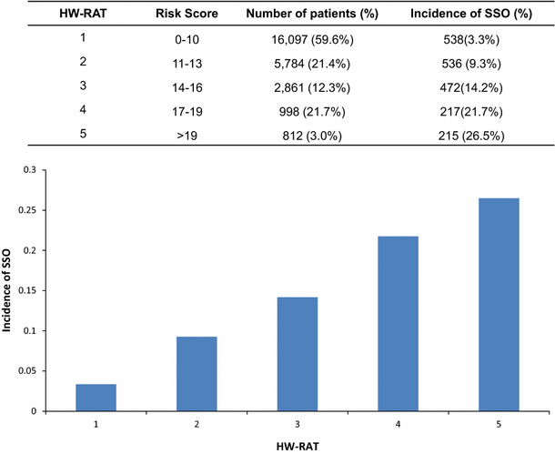
Hernia Wound Risk Assessment Tool (HW-RAT)
Developed from large ACS-NSQIP data
Considers both patient characteristics and surgical factors
No hernia
Stratifies into Groups 1-5
Showed good predictive ability (C-statistic 0.71)
Increasing rates of SSO
Notes:
.
Do Risk Calculators Accurately Predict Surgical Site occurrences?.
The Journal of Surgical Research. 2016. Mitchell TO, Holihan JL, Askenasy EP, et al.
4.
Wound Risk Assessment in Ventral Hernia Repair: Generation and Internal Validation Of a Risk Stratification System Using the ACS-NSQIP.
Hernia : The Journal of Hernias and Abdominal Wall Surgery. 2015. Fischer JP, Wink JD, Tuggle CT, Nelson JA, Kovach SJ.

Slide 15

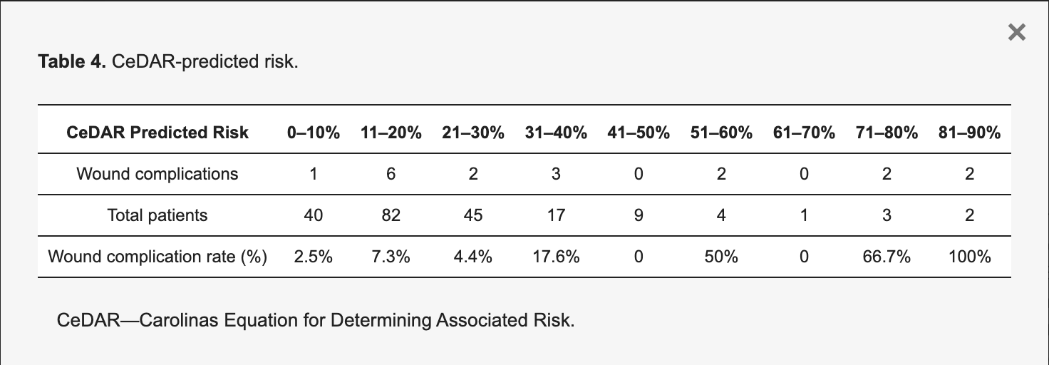
Carolinas Equation for Determining Associated Risks (CeDAR)
Derived from a prospective open VHR study 2009-2012 with average 1 year follow up [1]
DM, tobacco, previous hernia repair, stoma or enterotomy, active infection, advancement flaps, and BMI
Has patient, procedure, and hernia factors.
Estimates associated cost
Comparative study of 203 patients, CeDAR demonstrates significant relationship with SSOs, but was inaccurate across subgroups [2]
Notes:
1. Journal of the American College of Surgeons 221(4):p S65-S66, October 2015. | DOI: 10.1016/j.jamcollsurg.2015.07.145
2. J. Clin. Med.2024, 13(22), 6692;https://doi.org/10.3390/jcm13226692

Slide 16

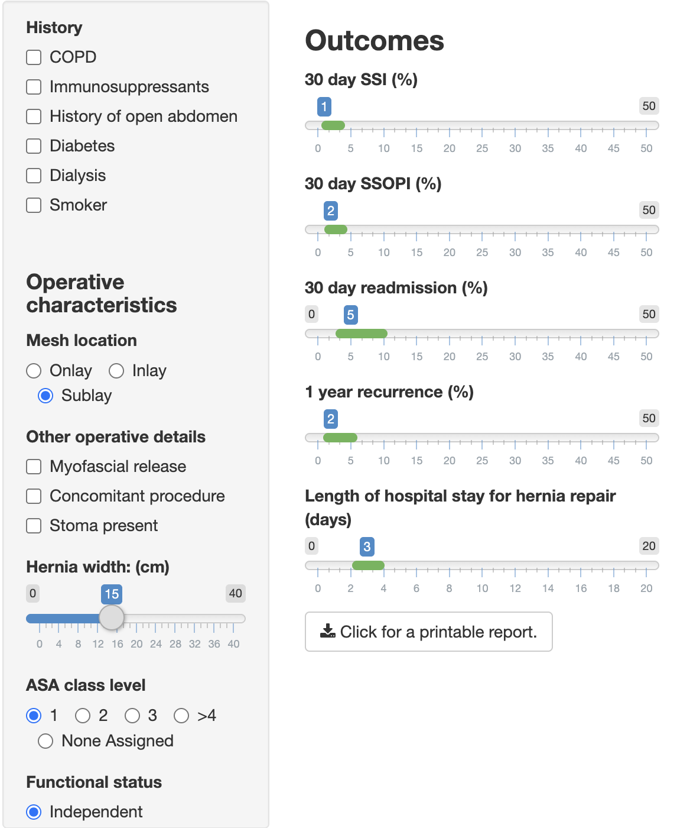
Large, hernia-specific national database (~10,690 patients)
Predicts 5 distinct outcomes
2023 study Blake et al. compared ORACLE prediction vs patient prediction
ORACLE correlated with actual SSI and 30-day readmissions while patient predictions did not [6]
Patient, hernia, and procedural factors
Does undergo continuous re-evaluation as new data is added to ACHQC [1]
Notes:
1.
Development and Validation of the Ventral Hernia Repair Outcomes Reporting App for Clinician and Patient Engagement (ORACLE).
Journal of the American College of Surgeons. 2019. Haskins IN, Olson MA, Stewart TG, Rosen MJ, Poulose BK.
2.
The Impact of Comorbidities on Postoperative Outcomes of Ventral Hernia Repair: The Patients' Perspective.
Hernia : The Journal of Hernias and Abdominal Wall Surgery. 2023. Blake KE, Perlmutter B, Saieed G, et al.
3.
Abdominal Wall Reconstruction in Ventral Hernia Repair: Do Current Models Predict Surgical Site Risk?.
Hernia : The Journal of Hernias and Abdominal Wall Surgery. 2025. Gala Z, Lemdani MS, Crystal D, et al.New
4.
Do Risk Calculators Accurately Predict Surgical Site occurrences?.
The Journal of Surgical Research. 2016. Mitchell TO, Holihan JL, Askenasy EP, et al.
5.
Wound Risk Assessment in Ventral Hernia Repair: Generation and Internal Validation Of a Risk Stratification System Using the ACS-NSQIP.
Hernia : The Journal of Hernias and Abdominal Wall Surgery. 2015. Fischer JP, Wink JD, Tuggle CT, Nelson JA, Kovach SJ.
6.
The Association of Hernia-Specific and Procedural Risk Factors With Early Complications in Ventral Hernia Repair: ACHQC Analysis.
American Journal of Surgery. 2024. Al-Mansour MR, Ding DD, Yergin CG, Tamer R, Huang LC.

Slide 17
What Factors We Know Matter
Patient-Specific Factors (from validated models):
BMI ≥30 (OR 1.01-1.66 for complications)[1]
ASA class ≥3 (significant predictor)[1-2]
Smoking (independent SSI risk factor)[2]
Diabetes/HbA1c ≥6.5% (1.9-fold increased wound complications)[3]
Low preoperative albumin (predictor of prolonged LOS)[2]
Age (increased risk with advancing age)[2][4]
Hernia-Specific Factors (often missing from traditional models):
Defect width (OR 1.01-1.66 per cm)[1]
Hernia size >300 cm² (proportional relationship with complications)[5]
Recurrent hernia (2.1-4.9-fold increased recurrence risk)[6]
Prior mesh or abdominal wall infection[1][7]
Presence of stoma[1]
Non-clean wound classification (CDC class 3-4: OR 2.1 for wound complications)[1][6]
Surgical/Procedural Factors:
Open approach (OR 1.01-1.66 vs. laparoscopic)[1]
Component separation (anterior: OR 1.8-3.2 for wound complications)[6]
Operative time (OR 1.004-1.01 per minute)[1][6]
Notes:
1.
The Association of Hernia-Specific and Procedural Risk Factors With Early Complications in Ventral Hernia Repair: ACHQC Analysis.
American Journal of Surgery. 2024. Al-Mansour MR, Ding DD, Yergin CG, Tamer R, Huang LC.
2.
Risk Factors for Postoperative Wound Infections and Prolonged Hospitalization After Ventral/­Incisional Hernia Repair.
Hernia : The Journal of Hernias and Abdominal Wall Surgery. 2015. Kaoutzanis C, Leichtle SW, Mouawad NJ, et al.
3.
Ventral Hernia Management: Expert Consensus Guided by Systematic Review.
Annals of Surgery. 2016. Liang MK, Holihan JL, Itani K, et al.
4.
Identification of Risk Factors for 30-Day Postoperative Complications in Patients Undergoing Primary Ventral Hernia Repair: A Prospective Cohort Study of 2,374 Patients.
Surgery. 2018. Kroese LF, Gillion JF, Jeekel J, Lange JF, Kleinrensink GJ.
5.
Risk Factors for Surgical Complications in Ventral Hernia Repair.
World Journal of Surgery. 2018. Lindmark M, Strigård K, Löwenmark T, Dahlstrand U, Gunnarsson U.
6.
Open Preperitoneal Ventral Hernia Repair: Prospective Observational Study of Quality Improvement Outcomes Over 18 Years and 1,842 Patients.
Surgery. 2023. Katzen MM, Kercher KW, Sacco JM, et al.
7.
Abdominal Wall Reconstruction in Ventral Hernia Repair: Do Current Models Predict Surgical Site Risk?.
Hernia : The Journal of Hernias and Abdominal Wall Surgery. 2025. Gala Z, Lemdani MS, Crystal D, et al.New

Slide 18
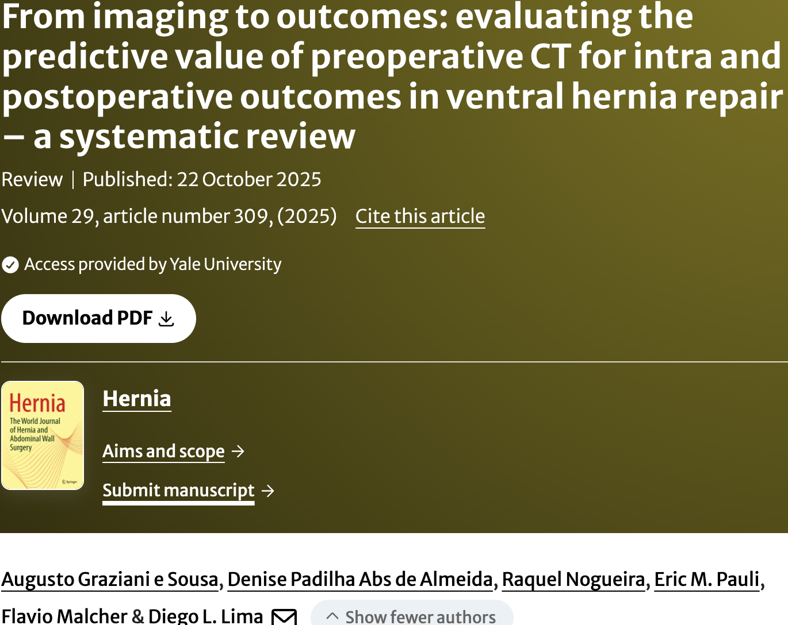
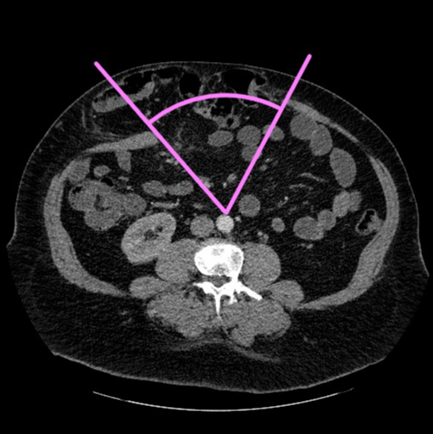
Additionally
CT-Based Radiologic Metrics [8] (emerging high-value predictors)
Component Separation Index (CSI) >0.068
Rectus : defect width ratio (1.22-3.85 predict need)
Sarcopenia (recurrence rates 2.56-56.25%, higher mortality)
Visceral fat volume and muscle attenuation (correlate with complications)
Hernia sac : abdominal cavity volume ratio (VR) – Tanaka Score [11]
Useful cutoff of 25% to predict fascial closure (<25% have 76% sensitivity and 88% PPV for complete fascial closure)
ICU admission [12]
Study | Main finding
Love 2021 | RDR reliably predicts fascial closure in open Rives–Stoppa repair without AMR.
Okorji 2024 | Prior hernia repair is a risk factor for robotic TAR; CT helps predict TAR need.
SantanaValenciano 2024 | Sarcopenia increases mortality risk but not recurrence or complications.
Frommer 2023 | AFT (CT) and smoking predict recurrence and infection in AWR.
Winters 2019 | CT-derived fat and hernia sac volumes predict reherniation and SSI in CST.
Franklin 2013 | Defect ratios and areas predict fascial closure in CST.
Wang 2025 | DTP is more accurate than DW for predicting CS need.
Du 2023 | Defect size, volume, and muscle attenuation predict CS.
Sharma 2024 | CSI is superior to 2D measures for predicting CS need in open/laparoscopic repair.
Blair 2015 | Hernia defect and AWT (CT) predict wound complications and need for complex AWR.
Al-Mansour 2021 | Radiologic features predict TFFC better than clinical characteristics.
Barnes 2018 | HUAC (sarcopenia) predicts complications in VHR with component separation.
Kumar 2022 | Pre-op CT hernia morphology does not predict recurrence; other factors matter more.
Smith 2023 | AP: TRSV ratio (CT) predicts TFFC, while BMI does not.
Notes:
8. emphasize the increasing importance of preoperative CT in evaluating ventral hernias
From Imaging to Outcomes: Evaluating the Predictive Value of Preoperative CT for Intra and Postoperative Outcomes in Ventral Hernia Repair - A Systematic Review.
Hernia : The Journal of Hernias and Abdominal Wall Surgery. 2025. Sousa AGE, de Almeida DPA, Nogueira R, Pauli, E, Malcher F and Lima DL
9.
Wound Risk Assessment in Ventral Hernia Repair: Generation and Internal Validation Of a Risk Stratification System Using the ACS-NSQIP.
Hernia : The Journal of Hernias and Abdominal Wall Surgery. 2015. Fischer JP, Wink JD, Tuggle CT, Nelson JA, Kovach SJ.
10.
A Comparison of Open Ventral Hernia Repair Risk Stratification Systems: A Call for Consensus.
Journal of Clinical Medicine. 2024. Talpai T, Râmboiu
11.Can Hernia Sac to Abdominal Cavity Volume Ratio Predict Fascial Closure Rate for Large Ventral Hernia? Reliability of the Tanaka Score.
Journal of the American College of Surgeons. 2021. Fafaj A, Thomas J, Zolin SJ, et al.
12. Said, S., Thomas, J., Montelione, K. et al. Tanaka score predicts surgical intensive care admission following abdominal wall reconstruction. Hernia 26, 873–880 (2022). https://doi.org/10.1007/s10029-022-02605-x

Slide 19

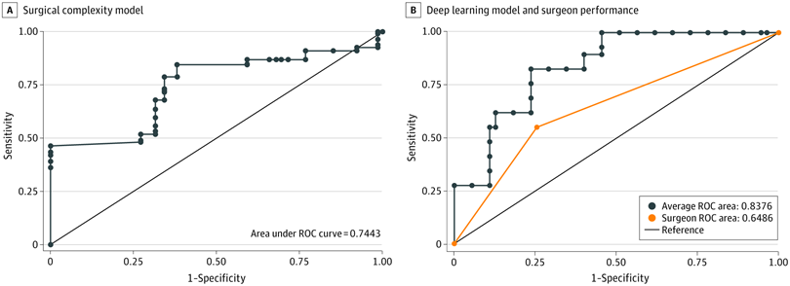
Machine Learning
369 patients AWR (4 surgeons, 75 years experience)
9303 CT images
80% images used to train, and 20% used for test.
Predict CS with superior accuracy, AUC 0.7-0.9
significantly better than 6 expert surgeon
Predict SSI with 85.2% accuracy
Notes:
With so many evolving data points and accumulation of data. How do we synthesize all this information?
ML is subfield of AI in which a computer learns from data, identify patterns, and makes predictions without being explicitly programmed for every scenario.
DLM of CT imaging have proven useful in trauma and oncologic settings, with mainfocus on diagnosis.
This study proves we can incorporate ML to improve predictor models for ventral hernias.
No large-scale, multi-center external validation studies of ML models currently exist.

Slide 20
Conclusions
Ventral hernia outcomes can and should be improved
Recognize multiple risk domains contribute to poor outcomes: patient, hernia, and procedural factors
Current risk models are improving but incomplete
Future goal: Comprehensive risk prediction tools incorporating all relevant factors, with integration of radiologic metrics and the aid of machine learning

Slide 21
Thank you!

