Slide 1

Incidence of inguinal hernia repair in the United States
Erika M. Schmidt, MD
Kimberly P. Woo, MD
Benjamin T. Miller, MD
Center for Abdominal Core Health, Cleveland Clinic Foundation Cleveland, OH

Slide 2
Disclosures
Dr. Miller is a consultant for Boston Scientific and has received speaking fees from BG Medical, a research grant from the American Hernia Society, and research funding from Integra.
The remaining authors have no disclosures.

Slide 3
How many inguinal hernia repairs are performed in the United States per year?

Slide 4





≤ 1,000,000
≤ 1,000,000
700,000 – 800,000
700,000 – 800,000
600,000
Notes:
https://www.fda.gov/medical-devices/implants-and-prosthetics/surgical-mesh-used-hernia-repair
https://www.sages.org/publications/patient-information/inguinal-hernia-repair-surgery-patient-information-from-sages/
Images:
https://encrypted-tbn0.gstatic.com/images?q=tbn:ANd9GcQxI7nbSbR5HfmkM9OV3hDAkpKH1kIlU3SSqQ&s
https://logos-world.net/wp-content/uploads/2022/02/FDA-Logo.png
https://www.edigitalagency.com.au/wp-content/uploads/new-ChatGPT-logo-black-png-large-size.png
https://www.openevidence.com/open-evidence-logo.jpg
https://i.ytimg.com/vi/YpKdPDHm1VY/maxresdefault.jpg

Slide 5

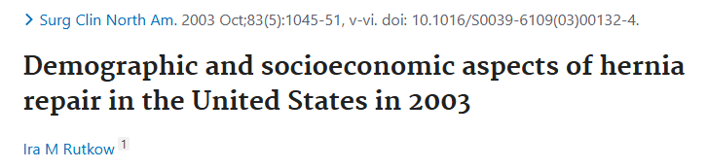
Notes:
Images:
https://www.google.com/search?sa=X&sca_esv=6cd0ff9fcc6c64b6&rlz=1C1GCCJ_enUS1169US1169&udm=2&q=down+a+rabbit+hole&stick=H4sIAAAAAAAAAFvEKpSSX56nkKhQlJiUlFmikJGfkwoAFV3E4BUAAAA&source=univ&ved=2ahUKEwilr8GvkomSAxUANNAFHc7bIHoQrNwCegQIbRAA&biw=1920&bih=911&dpr=1&aic=0#sv=CAMSVhoyKhBlLUYteHBqVUhVQTFFOTVNMg5GLXhwalVIVUExRTk1TToOMzNTTlJhVFlNVG5HME0gBCocCgZtb3NhaWMSEGUtRi14cGpVSFVBMUU5NU0YADABGAcg8Ny-1gcwAkoKCAEQAhgCIAIoAg

Slide 6
Notes:
Rutkow IM. Demographic and socioeconomic aspects of hernia repair in the United States in 2003. Surgical Clinics of North America. 2003;83(5):1045-1051. doi:10.1016/S0039-6109(03)00132-4
Images:
https://www.google.com/search?sa=X&sca_esv=6cd0ff9fcc6c64b6&rlz=1C1GCCJ_enUS1169US1169&udm=2&q=down+a+rabbit+hole&stick=H4sIAAAAAAAAAFvEKpSSX56nkKhQlJiUlFmikJGfkwoAFV3E4BUAAAA&source=univ&ved=2ahUKEwilr8GvkomSAxUANNAFHc7bIHoQrNwCegQIbRAA&biw=1920&bih=911&dpr=1&aic=0#sv=CAMSVhoyKhBlLUYteHBqVUhVQTFFOTVNMg5GLXhwalVIVUExRTk1TToOMzNTTlJhVFlNVG5HME0gBCocCgZtb3NhaWMSEGUtRi14cGpVSFVBMUU5NU0YADABGAcg8Ny-1gcwAkoKCAEQAhgCIAIoAg

Slide 7
Data extracted from two CDC surveys:
Inpatient: National Hospital Discharge Survey (NHDS)
Outpatient: National Survey of Ambulatory Surgery (NSAS)
Calculated using 1% growth rate from 1996 – 2003
Federal centers not included – 5% correction
Notes:
Rutkow IM. Demographic and socioeconomic aspects of hernia repair in the United States in 2003. Surgical Clinics of North America. 2003;83(5):1045-1051. doi:10.1016/S0039-6109(03)00132-4

Slide 8
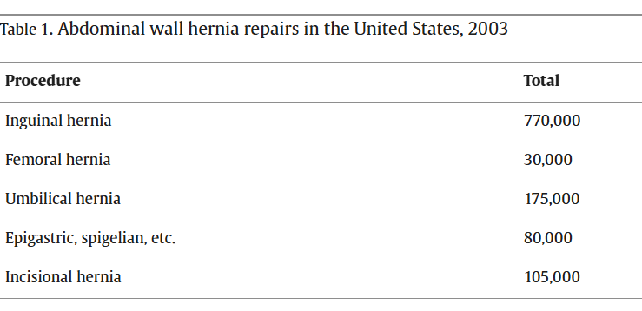
Notes:
Rutkow IM. Demographic and socioeconomic aspects of hernia repair in the United States in 2003. Surgical Clinics of North America. 2003;83(5):1045-1051. doi:10.1016/S0039-6109(03)00132-4

Slide 9
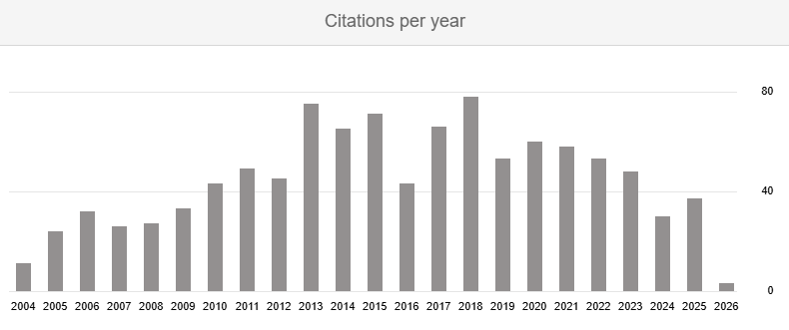
Estimated error rate: ~10%
>1,000 citations since publication (37 in 2025)
Notes:
Rutkow IM. Demographic and socioeconomic aspects of hernia repair in the United States in 2003. Surgical Clinics of North America. 2003;83(5):1045-1051. doi:10.1016/S0039-6109(03)00132-4
https://scholar.google.com/scholar?cites=8960325677359854239&as_sdt=5,36&sciodt=0,36&hl=en

Slide 10
Since 2003
Evolution of national databases for case tracking
Watchful waiting for asymptomatic cases
MIS utilization: 37.8% of repairs (2017 NSQIP)
Ambulatory surgery center (ASC) expansion:
~12,300 ASCs in the United States
$45.6 billion market
Notes:
Madion, M., Goldblatt, M.I., Gould, J.C. et al. Ten-year trends in minimally invasive hernia repair: a NSQIP database review. Surg Endosc 35, 7200–7208 (2021). https://doi.org/10.1007/s00464-020-08217-9
ASC Data. ASC Industry Overview - June 2023. https://ascdata.com/wp-content/uploads/2023/06/ASC-Data-Industry-Overview-June-2023.pdf. Accessed January 1, 2026.

Slide 11

And yet

Slide 12
Challenges to an updated estimate
Gaps in outpatient data collection
Variability in states included and data shared
Exclusion of freestanding and federal centers

Slide 13
Challenges to an updated estimate
Gaps in outpatient data collection
Variability in states included and data shared
Exclusion of freestanding and federal centers

Slide 14



Population-level trends
National Center for Health Statistics
(NCHS)
Encounter-level data
Healthcare Cost and Utilization Project
(HCUP)
Notes:
Images:
https://www.hhs.gov/sites/default/files/hhs-logo-2022.png
https://onemap.cdc.gov/Portal/sharing/rest/content/items/6b55227caecc4ad38dd67a0a447b52ca/data
https://upload.wikimedia.org/wikipedia/commons/b/ba/Agency_for_Healthcare_Research_and_Quality_Logo.png

Slide 15
CDC
= Inpatient
= Outpatient
NSAS
(1994 – 1996, 2006)
NHAMCS
(2009 – 2018)
NHDS
(1965 – 2010)
NHCS
(2011 – present)
1960
1970
1980
1990
2000
2010
2020
2030
Inpatient:
National Hospital Discharge Survey (NHDS)
National Hospital Care Survey (NHCS)
Inpatient admissions, emergency department visits
Notes:
U.S. Centers for Disease Control and Prevention. Surveys and Data Collection Systems. https://www.cdc.gov/nchs/surveys/index.html. Accessed January 1, 2026.

Slide 16
CDC
= Inpatient
= Outpatient
NSAS
(1994 – 1996, 2006)
NHAMCS
(2009 – 2018)
NHDS
(1965 – 2010)
NHCS
(2011 – present)
1960
1970
1980
1990
2000
2010
2020
2030
Outpatient:
National Survey of Ambulatory Surgery (NSAS)
National Hospital Ambulatory Medical Care Survey (NHAMCS)
Hospital-affiliated ASCs (2009-2018), freestanding ASCs (2010-2012)
Notes:
U.S. Centers for Disease Control and Prevention. Surveys and Data Collection Systems. https://www.cdc.gov/nchs/surveys/index.html. Accessed January 1, 2026.
U.S. Centers for Disease Control and Prevention. National Hospital Ambulatory Medical Care Survey. https://www.cdc.gov/nchs/nhamcs/about/index.html. Accessed December 20, 2025.

Slide 17
= Inpatient
= Outpatient
Inpatient:
HCUP National (Nationwide) Inpatient Survey (NIS)
Samples discharges from all participating hospitals
Identifies diagnoses and procedures using ICD-10 codes
1960
1970
1980
1990
2000
2010
2020
2030
NIS
(1992 – present)
NASS
(2016 – present)
AHRQ
Notes:
The Healthcare Cost and Utilization Project Fact Sheet. Healthcare Cost and Utilization Project (HCUP). March 2022. Agency for Healthcare Research and Quality, Rockville, MD. https://hcup-us.ahrq.gov/news/exhibit_booth/HCUPFactSheet.pdf. Accessed January 1, 2026.
Introduction to the HCUP National Inpatient Sample (NIS) 2022. Healthcare Cost and Utilization Project (HCUP). November 2024. Agency for Healthcare Research and Quality, Rockville, MD. https://hcup-us.ahrq.gov/db/nation/nis/NISIntroduction2022.pdf. Accessed December 18, 2025.

Slide 18
= Inpatient
= Outpatient
Outpatient:
HCUP Nationwide Ambulatory Surgery Sample (NASS)
Samples hospital-affiliated ASCs
Identifies cases using CPT codes
1960
1970
1980
1990
2000
2010
2020
2030
NIS
(1992 – present)
NASS
(2016 – present)
AHRQ
Notes:
The Healthcare Cost and Utilization Project Fact Sheet. Healthcare Cost and Utilization Project (HCUP). March 2022. Agency for Healthcare Research and Quality, Rockville, MD. https://hcup-us.ahrq.gov/news/exhibit_booth/HCUPFactSheet.pdf. Accessed January 1, 2026.
Introduction to the HCUP Nationwide Ambulatory Surgery Sample (NASS) 2022. Healthcare Cost and Utilization Project (HCUP). December 2024. Agency for Healthcare Research and Quality, Rockville, MD. https://hcup-us.ahrq.gov/db/nation/nass/NASSIntroduction2022.pdf. Accessed December 18, 2025.

Slide 19
CDC
= Inpatient
= Outpatient
NSAS
(1994 – 1996, 2006)
NHAMCS
(2009 – 2018)
NHDS
(1965 – 2010)
NHCS
(2011 – present)
1960
1970
1980
1990
2000
2010
2020
2030
NIS
(1992 – present)
1996-2026:
Number of years capturing inpatient, hospital-affiliated ASC, and freestanding ASC cases?
NASS
(2016 – present)
AHRQ

Slide 20
CDC
= Inpatient
= Outpatient
NSAS
(1994 – 1996, 2006)
NHAMCS
(2009 – 2018)
NHDS
(1965 – 2010)
NHCS
(2011 – present)
1960
1970
1980
1990
2000
2010
2020
2030
NIS
(1992 – present)
5
(1996, 2006, 2010, 2011, 2012)
NASS
(2016 – present)
AHRQ

Slide 21
Challenges to an updated estimate
Gaps in outpatient data collection
Variability in states included and data shared
Exclusion of freestanding and federal centers

Slide 22
2022 HCUP databases
HCUP National (Nationwide) Inpatient Survey (NIS)
47 participating states + Washington D.C. (~97% of population)
Approximated ~20% of discharges from US community hospitals
Included 6.5 million encounters (unweighted)
HCUP Nationwide Ambulatory Surgery Sample (NASS)
32 participating states + Washington D.C. (~80% of population)
Sampled 2,799 of 4,314 hospital-affiliated ASCs
Included 9.1 million encounters (unweighted)
Notes:
Introduction to the HCUP National Inpatient Sample (NIS) 2022. Healthcare Cost and Utilization Project (HCUP). November 2024. Agency for Healthcare Research and Quality, Rockville, MD. https://hcup-us.ahrq.gov/db/nation/nis/NISIntroduction2022.pdf. Accessed December 18, 2025.
Introduction to the HCUP Nationwide Ambulatory Surgery Sample (NASS) 2022. Healthcare Cost and Utilization Project (HCUP). December 2024. Agency for Healthcare Research and Quality, Rockville, MD. https://hcup-us.ahrq.gov/db/nation/nass/NASSIntroduction2022.pdf. Accessed December 18, 2025.

Slide 23
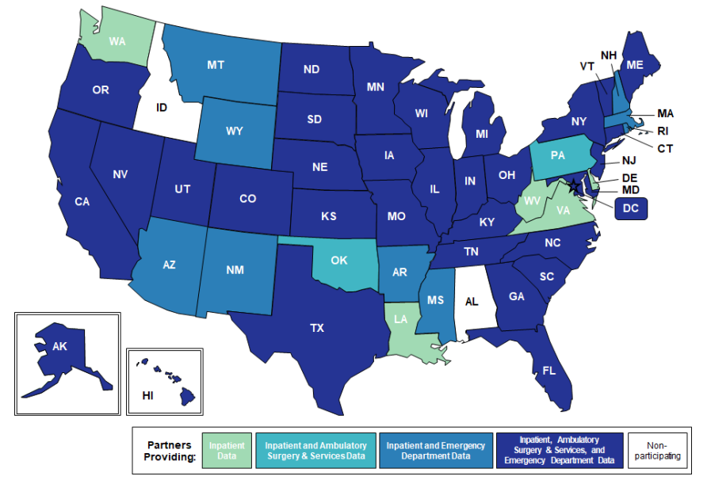
HCUP databases
HCUP partners participate voluntarily
Results in annual variation in:
Number of participating states
Consistency of data shared among states
Notes:
The Healthcare Cost and Utilization Project Fact Sheet. Healthcare Cost and Utilization Project (HCUP). March 2022. Agency for Healthcare Research and Quality, Rockville, MD. https://hcup-us.ahrq.gov/news/exhibit_booth/HCUPFactSheet.pdf. Accessed January 1, 2026.
Images:
https://hcup-us.ahrq.gov/news/exhibit_booth/HCUPFactSheet.pdf

Slide 24
Challenges to an updated estimate
Gaps in outpatient data collection
Variability in states included and data shared
Exclusion of freestanding and federal centers

Slide 25
2022 ASC estimates
Per ASC Data: 11,255 ASCs nationwide
6,223 Medicare-certified
5,168 Non-Medicare certified
NASS: 2,799 of 4,314 hospital-affiliated ASCs
11,255 – 4,314 = 6,941 ASCs not captured
Notes:
ASC Data. ASC Industry Overview - June 2023. https://ascdata.com/wp-content/uploads/2023/06/ASC-Data-Industry-Overview-June-2023.pdf. Accessed January 1, 2026.
Introduction to the HCUP Nationwide Ambulatory Surgery Sample (NASS) 2022. Healthcare Cost and Utilization Project (HCUP). December 2024. Agency for Healthcare Research and Quality, Rockville, MD. https://hcup-us.ahrq.gov/db/nation/nass/NASSIntroduction2022.pdf. Accessed December 18, 2025.

Slide 26
Veterans Affairs
170 VA medical centers, 1,100 outpatient centers
VA Surgical Quality Improvement Program
Allows designation of inpatient vs ambulatory
Includes ~11,000 inguinal hernia repairs per year
Represents a sample, not exact hospital volume
Notes:
U.S. Department of Veterans Affairs. Veterans Health Administration - About VHA. https://www.va.gov/health/aboutvha.asp#:~:text=The%20VHA%20provides%20care%20at:%20*%20170,*%20Prosthetics%20*%20Urology%20*%20Vision%20care. Accessed January 19, 2026.
Holleran TJ, Napolitano MA, Sparks AD, Duncan JE, Garrett M, Brody FJ. Trends and outcomes of open, laparoscopic, and robotic inguinal hernia repair in the veterans affairs system. Hernia. 2022;26(3):889-899. doi:10.1007/s10029-021-02419-3
Massarweh NN, Kaji AH, Itani KMF. Practical guide to surgical data sets: veterans affairs surgical quality improvement program(Vasqip). JAMA Surg. 2018;153(8):768. doi:10.1001/jamasurg.2018.0504
Sehat AJ, Oliver JB, Yu Y, Kunac A, Anjaria DJ. Increasing volume but declining resident autonomy in laparoscopic inguinal hernia repair: an inverse relationship. Surg Endosc. 2023;37(4):3119-3126. doi:10.1007/s00464-022-09476-4

Slide 27
How many inguinal hernia repairs are performed in the United States per year?

Slide 28
What we can account for
 | 2018 | 2019 | 2020 | 2021 | 2022
NIS, weighted N | 35,395 | 34,365 | 30,280 | 31,900 | 32,295
NASS, weighted N | 446,464 | 456,556 | 399,740 | 446,198 | 476,637
Total | 481,859 | 490,921 (+1.9%) | 430,020 (-12.4%) | 478,098 (+11.2%) | 508,932 (+6.5%)
Notes:
Frequencies by Diagnosis and Procedure Codes, NIS 2016-2023 with ICD-10-CM/PCS [Excel file]. Healthcare Cost and Utilization Project (HCUP). November 2024. Agency for Healthcare Research and Quality, Rockville, MD. Retrieved from https://hcup-us.ahrq.gov/db/nation/nis/nisdbdocumentation.jsp. Accessed December 31, 2025.
Frequencies by Diagnosis and Procedure Codes, NASS 2016-2022 [Excel file]. Healthcare Cost and Utilization Project (HCUP). December 2024. Agency for Healthcare Research and Quality, Rockville, MD. Retrieved from https://hcup-us.ahrq.gov/db/nation/nass/nassdbdocumentation.jsp. Accessed December 31, 2025.

Slide 29
What we cannot
Cases performed in non-participating states
Cases at federal centers (inpatient / outpatient)
Cases at freestanding ASCs
Ambulatory cases requiring admission
Total = ???

Slide 30
Does it really matter?

Slide 31
More than a number
Inguinal hernia repairs are one of the most common general surgery operations performed
Mesh-based repairs comprise the majority of cases
There remains a proportion of patients undergoing this operation which we cannot account for

Slide 32
More than a number
A system to comprehensively and longitudinally track cases is an opportunity to enhance the patient experience:
Preoperative counseling
Expectations regarding outcomes
Data collection across practice settings
Ongoing quality improvement

Slide 33
Conclusions
National databases are incomplete with regards to surgical case tracking
Redefining our national estimate reflects a commitment to our patients and to the quality of care we provide
The way out of the rabbit hole rests on investment and advocacy at the national, state, and provider levels

Slide 35
Finding the way out
Expand the use of encounter-level data
Create a device-based registry
Consider mandatory reporting

Slide 36
Encounter-level data
Expand the NIS and NASS:
Include freestanding ASCs
Increase the number of states captured
Improve consistency of data shared
Interface with federal centers
Identify options to link quality and cost data
Hernia-specific databases

Slide 37
Encounter-level data
Swedish Hernia Register
Voluntary national quality registry
Coverage rate of 95-99% per year
Data accuracy 98%
Average 16,000 registered operations per year
Danish Inguinal / Ventral Hernia Databases
Mandatory national registries
Utilize unique personal identification numbers to link with other quality and civil registries
Coverage rate of 80-90% per year
Average 12,000 registered operations per year
Notes:
Sweden: 16,000 per 10.6million -> USA 516,226
Danish: 12,000 per 6.02million -> USA 681,728
Axman E, Nordin P, Modin M, de la Croix H. Assessing the validity and cover rate of the national Swedish hernia register. Clin Epidemiol. 2021;13:1129-1134. doi:10.2147/CLEP.S335765
Friis-Andersen H, Bisgaard T. The Danish inguinal hernia database. Clin Epidemiol. 2016;8:521-524. doi:10.2147/CLEP.S99512
Helgstrand F, Jorgensen LN. The Danish ventral hernia database – A valuable tool for quality assessment and research. Clin Epidemiol. 2016;8:719-723. https://doi.org/10.2147/CLEP.S99501

Slide 38
Encounter-level data
Abdominal Core Health Quality Collaborative
Voluntary enrollment of institutions / surgeons
Infrastructure to capture exact operative census, patient-reported outcomes, and hernia-specific outcomes
Notes:
Abdominal Core Health Quality Collaborative. About Us. https://achqc.org/faqs. Accessed January 19, 2026.
Abdominal Core Health Quality Collaborative. Membership. https://achqc.org/faqs/membership. Accessed January 19, 2026.

Slide 39
Device-based registry
Mesh registry using unique device identifiers
Promotes post-market surveillance
Longitudinal evaluation of mesh performance
Patient identification for safety monitoring and recalls
May improve patient experience with implanted devices
Potential for ease of EMR integration at the cost of capturing patient-reported outcomes data
Notes:
Hider AM, Howard R. Improving transparency—FDA guidance on hernia mesh labeling. JAMA Surg. 2025;160(12):1297. doi:10.1001/jamasurg.2025.4192

