Slide 1

Evaluating the Relationship Between Abdominal Core Rehabilitation PT and Functional Tests and Hernia Defect Size
W. Taylor Head MD, Sidhant Kalsotra MD, Peter Edwards BA, Savannah M. Renshaw MPH MPA, Elanna K. Arhos PhD, Stephanie Di Stasi PT PhD, Ajit Chaudhari PhD, and Benjamin K. Poulose MD MPH FACS
ACHQC 8th Annual Quality Improvement Summit
Notes:
Good morning everyone. My name is Taylor Head, and I'm a fourth year general surgery resident at The Ohio State University. Today I'll be sharing work from our Center for Abdominal Core Health, titled "Evaluating the Relationship Between Abdominal Core Rehabilitation PT and Functional Tests and Hernia Defect Size." This represents a collaborative effort with my co-authors Dr. Sidhant Kalsotra, Peter Edwards, Savannah Renshaw, Dr. Elanna Arhos, Dr. Stephanie Di Stasi, Dr. Ajit Chaudhari, and Dr. Benjamin Poulose.

Slide 2

Disclosures
William Head: None
Divyaam Satija: None
Kiana Shannon: None
Peter Edwards: None
Savannah Renshaw: None
Elanna Arhos: None
Lai Wei: None
Stephanie Di Stasi: None
Ajit Chaudhari: None
Benjamin Poulose:
Abdominal Core Health Quality Collaborative (ACHQC) – salary support
BD Interventional – research support
Advanced Medical Devices – research support
Abbvie/Allergan – consulting
EndoEvolve – equity
Notes:
Here are our team’s relevant disclosures.

Slide 3
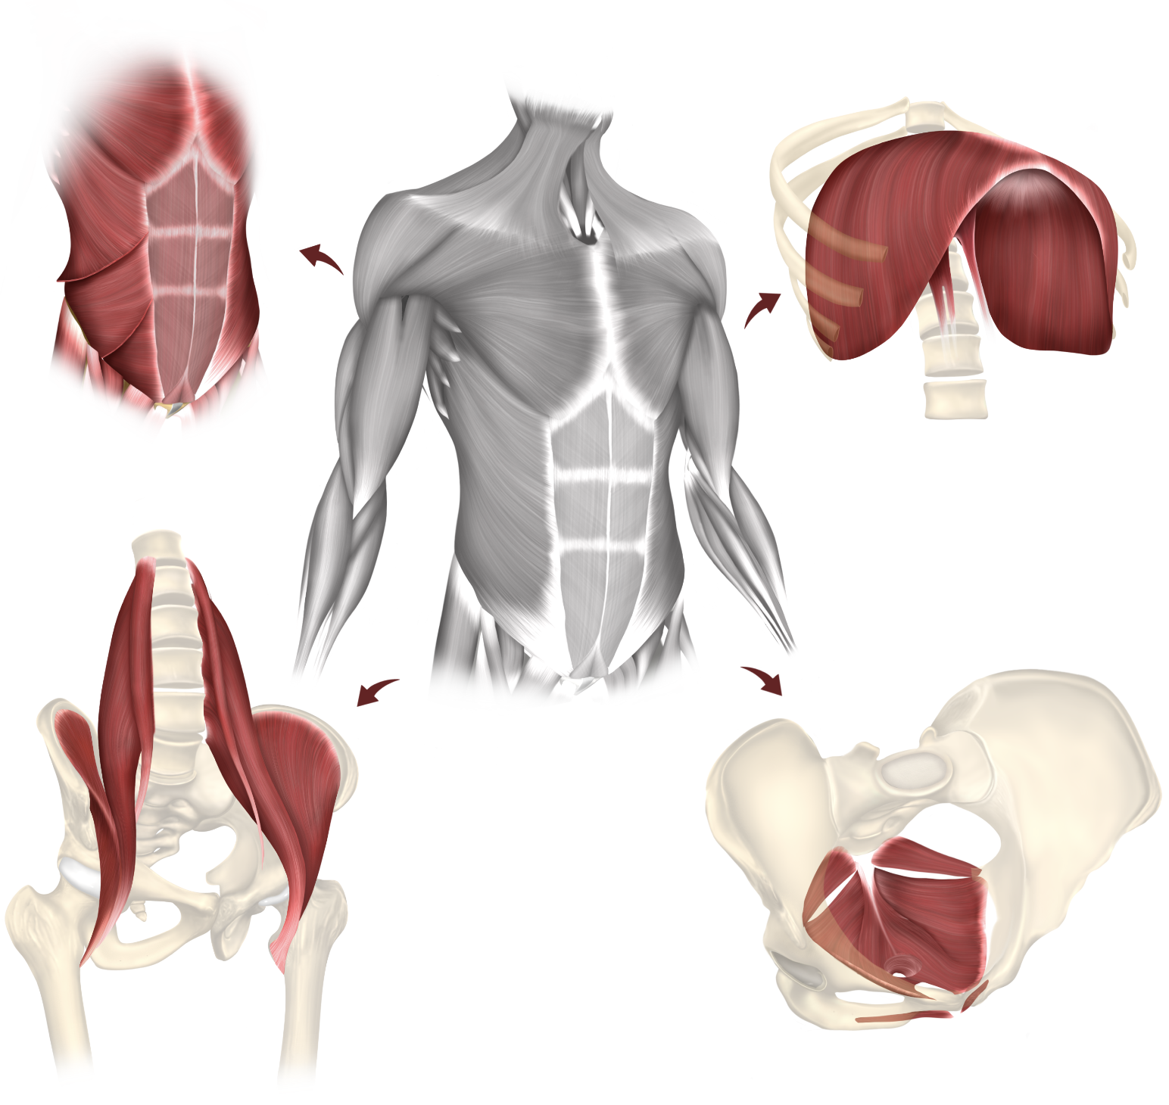
Background
Ventral Hernia
More than half-a-million repairs performed annually in US
Traditional Outcome Metrics
Success of repair has historically been measured with SSI, SSO, recurrence
Emergence of Abdominal Core Health
Stability and function of the coordinated system bounded by the diaphragm, pelvic floor, abdominal wall, and flanks
Notes:
Let me start with some background. Ventral hernias are among the most prevalent surgical conditions in the United States, with over half a million repairs performed annually.
Historically, the success of these repairs has been measured using traditional outcome metrics—things like surgical site infections, surgical site occurrences, and recurrence rates. While these remain important endpoints, there's growing attention toward a broader concept: abdominal core health. Abdominal core health reflects the stability and coordinated function of the system bounded by the diaphragm, pelvic floor, abdominal wall, and flanks. Ventral hernias fundamentally disrupt this system, often leading to pain, weakness, and functional limitations that extend beyond the anatomic defect itself. Surgical repair aims not only to restore anatomy but to reestablish integrated core function. Despite this, functional recovery after ventral hernia repair remains poorly characterized.

Slide 4




Background
The Role of Physical Function Testing
Objective measurement of a patient’s
+
+
=
mobility
strength
balance
functional status
Used commonly in orthopedics as a surrogate measure for postoperative recovery
No prior studies have applied these tests longitudinally in the ventral hernia population
Notes:
So this is where physical function testing comes into play. Physical function tests are objective measures that assess a patient's mobility, strength, balance, and overall functional status. These tests are used commonly in orthopedics as surrogate measures for surgical readiness and postoperative recovery. However, no prior studies have applied these tests longitudinally in the ventral hernia population. This represents a significant knowledge gap. We have objective ways to measure function in joint replacement patients throughout their recovery, but we lack similar tools to track functional recovery after hernia repair.

Slide 5
Background
Study Rationale
Growing recognition of abdominal core integrity in patient outcomes
Understanding the relationship between hernias and function can improve:
Preoperative risk assessment
Intraoperative decision-making
Postoperative recovery strategies
Notes:
The rationale for our study stems from a growing recognition that abdominal core integrity plays a crucial role in patient outcomes.
Understanding the relationship between hernias and physical function can improve several aspects of care: first, preoperative risk assessment—identifying which patients may be at higher risk for poor functional outcomes. Second, intraoperative decision-making— perhaps informing the extent of repair or mesh selection. And third, postoperative recovery strategies—guiding rehabilitation and setting realistic expectations for patients.

Slide 6
Objective
Question:
What is the recovery before/after ventral hernia repair as measured by physical function tests?
Hypothesis:
Larger hernia defects are associated with poorer functional test performance
Patients demonstrate linear improvements in physical function test performance over time
Notes:
Our central research question was: What is the trajectory of recovery after ventral hernia repair as measured by physical function tests? We had two specific hypotheses: First, that larger hernia defects would be associated with poorer functional test performance. And second, that patients would demonstrate linear improvements in physical function test performance over time following surgery.

Slide 7

Methods
Design: Review of prospectively collected data in Pilot Trial of Abdominal Core Rehabilitation To Improve Outcomes after Ventral Hernia Repair
Population: Elective ventral hernia repair patients 4/2022 - 8/2024
Data Analysis: Primary outcome: Two physical function tests
Inclusion | Exclusion
Ages 18-70 | Movement/balance disorder
Independent functional status | Ambulatory assist device (cane/walker)
Width ≥2cm | Current PT or skilled exercise program
baseline
4 weeks
10 weeks
6 months
1 year
Notes:
Let me walk you through our methodology. We analyzed prospectively collected data from our ongoing randomized controlled trial—the Pilot Trial of Abdominal Core Rehabilitation to Improve Outcomes after Ventral Hernia Repair, or ABVENTURE-P. We included elective, functionally independent adults aged 18 to 70 undergoing ventral hernia repair between April 2022 and August 2024. Hernias had to be at least 2 centimeters in width. We excluded patients with movement or balance disorders, those requiring ambulatory assist devices like canes or walkers, and anyone currently enrolled in physical therapy or a skilled exercise program. Our two primary outcomes were physical function tests: the Timed Up and Go, or TUG, and the Five Times Sit-to-Stand, or 5xSTS. These tests were performed preoperatively and then repeated at 4 weeks, 10 weeks, 6 months, and 1 year postoperatively, giving us a detailed longitudinal picture of functional recovery.

Slide 8
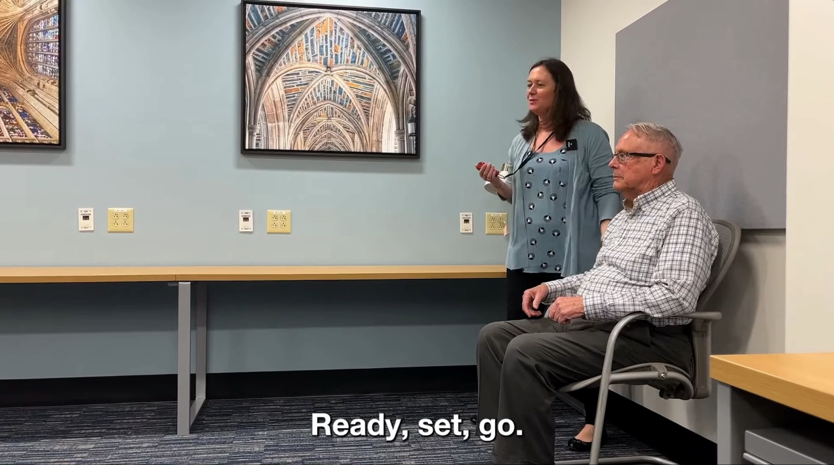
Methods
Timed Up & Go (TUG)
Notes:
Here is a short video depicting the Timed Up & Go test, which measures how long it takes a patient to stand, walk three meters, turn, return, and sit.
(This test primarily assesses mobility and balance.)

Slide 9
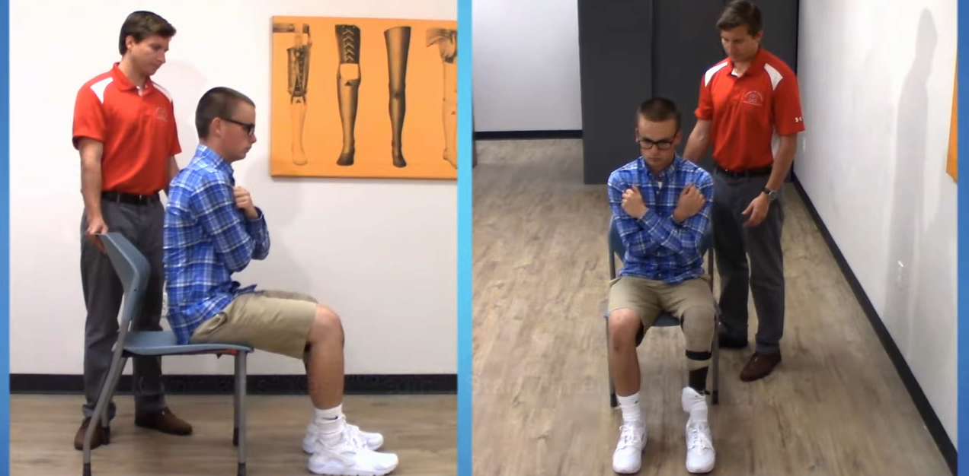
Methods
Five Times Sit-to-Stand (5xSTS)
Notes:
This second video shows the Five Times Sit-to-Stand test, which requires standing up and sitting down five times without using the arms for support. As you can see from these videos these tests are easily conducted in the clinical setting and only require a small area to move around in, a chair, and a timer.
(It’s a measure of lower-limb strength, endurance, and trunk stabilization)

Slide 10
Results
Study Population
 |  |  | Overall
Participants |  |  | 115
Age, years | Mean (SD) |  | 50.25 (10.22)
BMI, kg/m² | Mean (SD) |  | 33.25 (5.97)
Sex, male |  |  | 70 (60.9%)
Race | Asian/Pacific Islander |  | 1 (0.9%)
 | Black |  | 13 (11.3%)
 | White |  | 97 (84.4%)
 | Other/Unknown |  | 4 (3.5%)
Any comorbidity |  |  | 49 (42.6%)
Hernia width, cm | Mean (SD) |  | 6.96 (6.87)
Notes:
Now let's look at our results. A total of 115 patients were included in the analysis. The mean age was 50 years, mean BMI was 33 kilograms per meter squared, and 61% were male. The majority—84%—were white, with 11% Black patients. About 43% had at least one significant comorbidity. The average hernia width was 7 centimeters, but there was substantial variability, ranging from 2 centimeters all the way up to 38 centimeters. This heterogeneity in hernia size allowed us to examine the relationship between defect size and functional outcomes.

Slide 11
Results
Study Population – Width Subgroups
 |  |  | Overall | EHS 1 (<4 cm) | EHS 2 (4-10 cm) | EHS 3 (≥10 cm) | P-value
N |  |  | 115 | 54 | 34 | 27
Age, years | Mean (SD) |  | 50.25 (10.22) | 48.02 (11.13) | 51.71 (8.99) | 52.89 (9.10) | 0.079
BMI, kg/m² | Mean (SD) |  | 33.25 (5.97) | 32.80 (6.08) | 32.66 (6.11) | 34.87 (5.51) | 0.299
Sex, male |  |  | 70 (60.9%) | 38 (70.4%) | 17 (50.0%) | 15 (55.6%) | 0.132
Race | Asian/Pacific Islander |  | 1 (0.9%) | 0 (0%) | 1 (2.9%) | 0 (0%) | 0.642
 | Black |  | 13 (11.3%) | 6 (11.1%) | 4 (11.8%) | 3 (11.1%)
 | White |  | 97 (84.4%) | 45 (83.3%) | 29 (85.3%) | 23 (85.2%)
 | Other/Unknown |  | 4 (3.5%) | 3 (5.6%) | 0 (0%) | 1 (3.7%)
Any comorbidity |  |  | 49 (42.6%) | 22 (40.7%) | 16 (47.1%) | 11 (40.7%) | 0.823
Hernia width, cm | Mean (SD) |  | 6.96 (6.87) | 2.48 (0.57) | 6.35 (1.94) | 16.7 (7.78) | <0.001
Notes:
We were particularly interested in examining the impact of hernia size on functional outcomes. So we divided our population into subgroups based on the European Hernia Society width classification for incisional abdominal wall hernias. These categories include: EHS grade 1—hernias less than 4 centimeters; EHS grade 2—hernias 4 to 10 centimeters; and EHS grade 3—hernias 10 centimeters or greater. We had 54 patients in grade 1, 34 in grade 2, and 27 in grade 3. Importantly, there were no significant baseline differences between these groups in terms of age, BMI, sex, race, or comorbidity burden. This gave us relatively balanced groups for comparison.

Slide 12
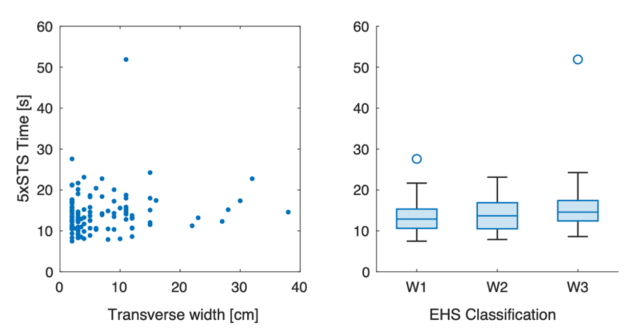
Results - Preoperative
Scatter and Box Plots of Five Times Sit-to-Stand and Hernia Width
Spearman’s rho = 0.13, p = 0.19
One-way ANOVA, p = 0.12
Notes:
A key question was whether hernia size predicts baseline functional impairment—that is, before surgery even occurs. These scatter plots and box plots show the relationship between hernia width and preoperative performance on both the Five Times Sit-to-Stand and Timed Up and Go tests. What we found was surprising: there was no significant correlation. For Five Times Sit-to-Stand, Spearman's rho was 0.13 with a p-value of 0.19.

Slide 13
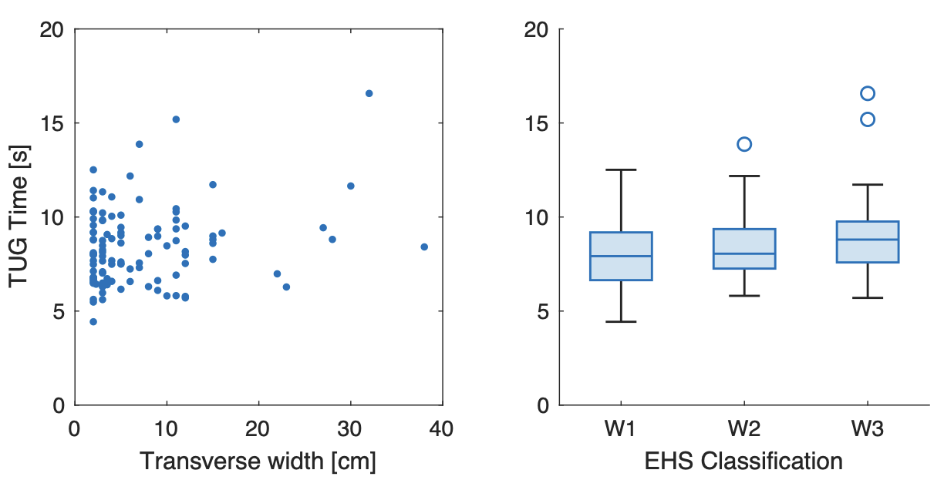
Results - Pretoperative
Scatter and Box Plots of Timed Up & Go and Hernia Width
Spearman’s rho = 0.13, p = 0.16
one-way ANOVA p = 0.08
Notes:
For Timed Up and Go, rho was also 0.13 with a p-value of 0.16. One-way ANOVA confirmed no significant differences across width categories. This means that hernia size alone does not predict how impaired a patient is functionally before surgery. Other factors—perhaps chronicity, patient physiology, or compensatory mechanisms—may be more important determinants of baseline function.

Slide 14
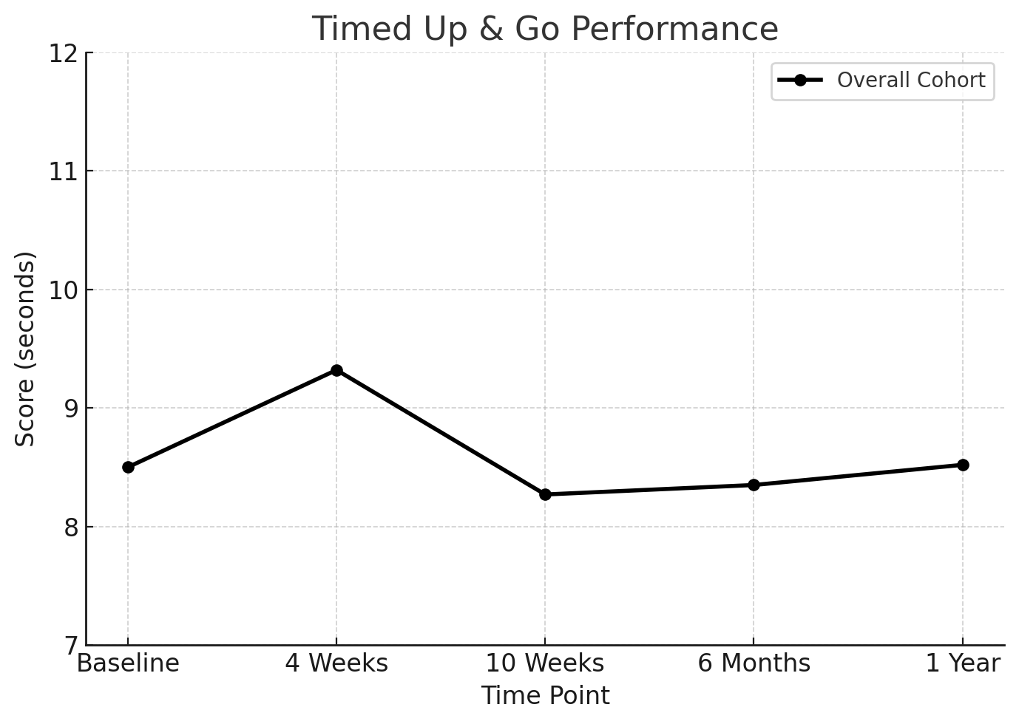
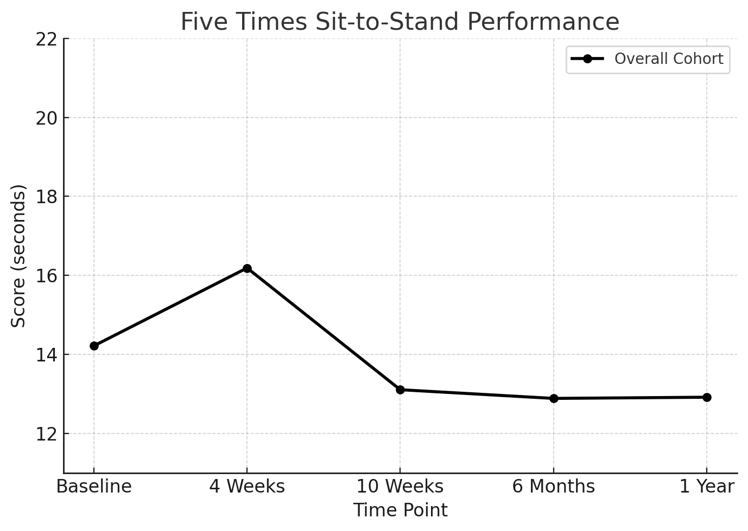
Results - Postoperative
Physical Function Test Performance
worse
better
Notes:
Now let's look at the overall trajectory of postoperative functional recovery. At baseline, the mean Timed Up and Go was 8.5 seconds, and the mean Five Times Sit-to-Stand was 14.2 seconds. What happened after surgery was quite interesting. At 4 weeks postoperatively, both tests showed significant worsening. Timed Up and Go slowed by approximately one second, and Five Times Sit-toStand slowed by nearly two seconds. This early decline likely reflects postoperative pain, healing, and limited core engagement as patients avoid using their abdominal muscles.
After 4 weeks, performance began to improve. For Timed Up and Go, patients recovered to baseline by 10 weeks and remained stable thereafter—essentially returning to their preoperative level with no further significant change at 6 months or 1 year. In contrast, Five Times Sit-to-Stand demonstrated a very different pattern. It showed progressive improvement at every single follow-up timepoint. By 10 weeks, patients were significantly faster than baseline. At 6 months, they were even better. And at 1 year, they had surpassed their baseline performance by about one and a half seconds. This suggests that Five Times Sit-to-Stand may be more sensitive to meaningful functional gains after ventral hernia repair.

Slide 15
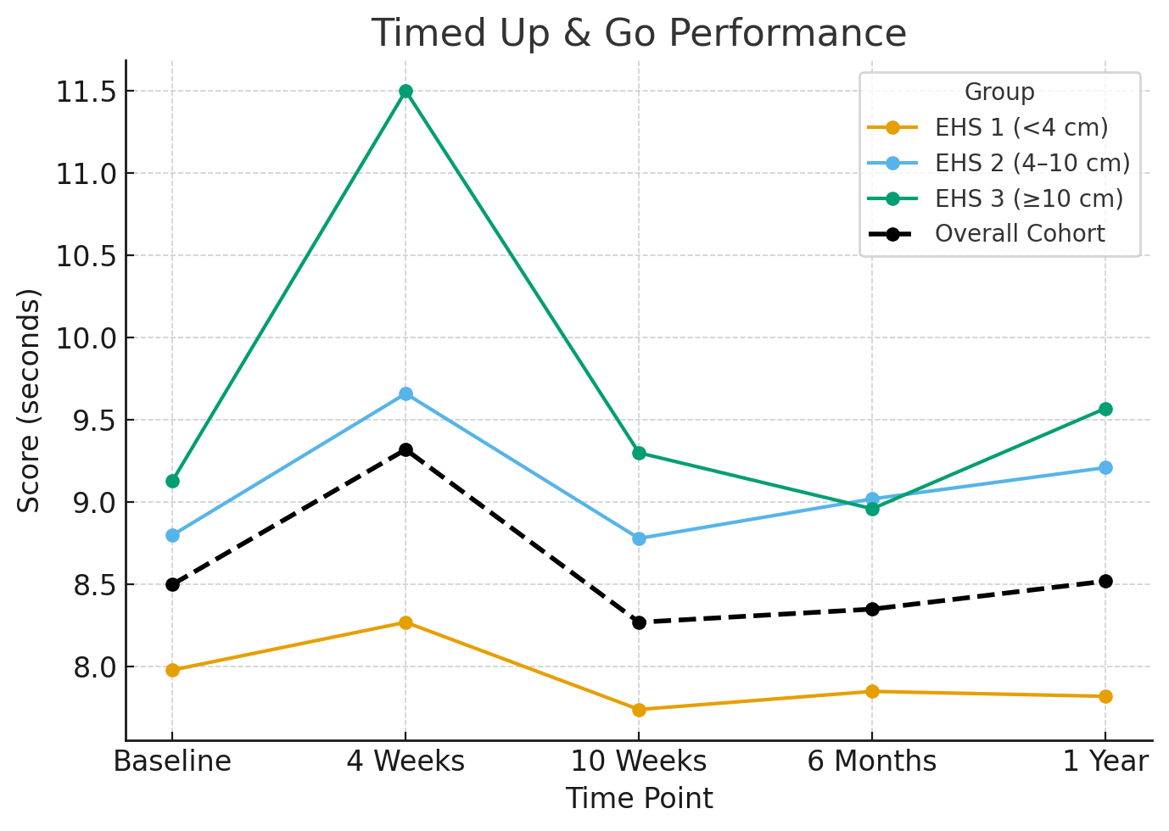
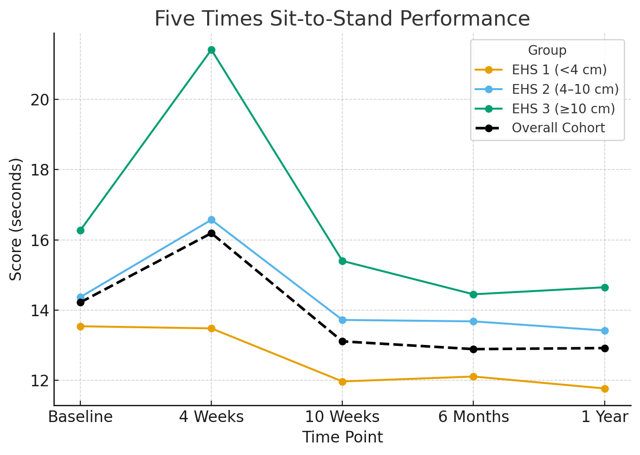
Results - Postoperative
Performance by Hernia Size
worse
better
Notes:
We then examined whether hernia size affected postoperative functional trajectories. These graphs show estimated functional scores—or least square means—across the three hernia width subgroups over time. What we found is striking: larger hernias consistently performed worse across all timepoints. This was true before surgery, and it persisted throughout the entire follow-up period. The gap actually widened early after surgery. At 4 weeks, patients with hernias greater than 10 centimeters averaged 21.4 seconds on the Five Times Sit-to-Stand, compared to only 13.5 seconds for those with hernias less than 4 centimeters. That's almost an 8-second difference—clinically very meaningful. While all width subgroups did improve over time, these rank-order differences persisted. Larger hernias maintained lower absolute function throughout the study period. However—and this is important—the recovery trajectories were grossly parallel. This suggests that larger hernias don't recover more slowly; they simply start from a worse baseline impairment level and maintain that deficit over time.

Slide 16
Results - Postoperative
Performance changes from baseline (GEE Model)
Time Point | Estimate | Standard Error | 95% Confidence Interval |  | P-value
Timed Up & Go
Baseline | Reference
4 Weeks | 0.94 | 0.35 | 0.25 | 1.63 | *0.007
10 Weeks | -0.08 | 0.15 | -0.37 | 0.22 | 0.616
6 Months | -0.04 | 0.17 | -0.36 | 0.29 | 0.825
1 Year | 0.16 | 0.19 | -0.20 | 0.53 | 0.382
Five Times Sit-to-Stand
Baseline | Reference
4 Weeks | 1.81 | 0.73 | 0.37 | 3.25 | *0.014
10 Weeks | -1.13 | 0.35 | -1.83 | -0.44 | *0.001
6 Months | -1.32 | 0.34 | -1.99 | -0.65 | *<.0001
1 Year | -1.50 | 0.31 | -2.10 | -0.89 | *<.0001
Notes:
This table summarizes the change in performance compared to baseline, modeled using Generalized Estimating Equations to account for repeated measures. For both tests, we observed a significant decline at 4 weeks, confirming what we saw graphically. For Timed Up and Go, patients recovered to near-baseline performance by 10 weeks and remained stable through 1 year. None of the later timepoints showed significant differences from baseline. In contrast, Five Times Sit-to-Stand showed a very different trajectory: early impairment at 4 weeks, then steady, significant improvement over time. By 1 year, patients completed the test about 1.5 seconds faster than their preoperative baseline, with a p-value less than 0.0001. This indicates that Five Times Sit-to-Stand may be more sensitive to meaningful postoperative change. Timed Up and Go seems to reflect transient surgical impact, whereas Five Times Sit-to-Stand better captures true functional gains after repair.

Slide 17
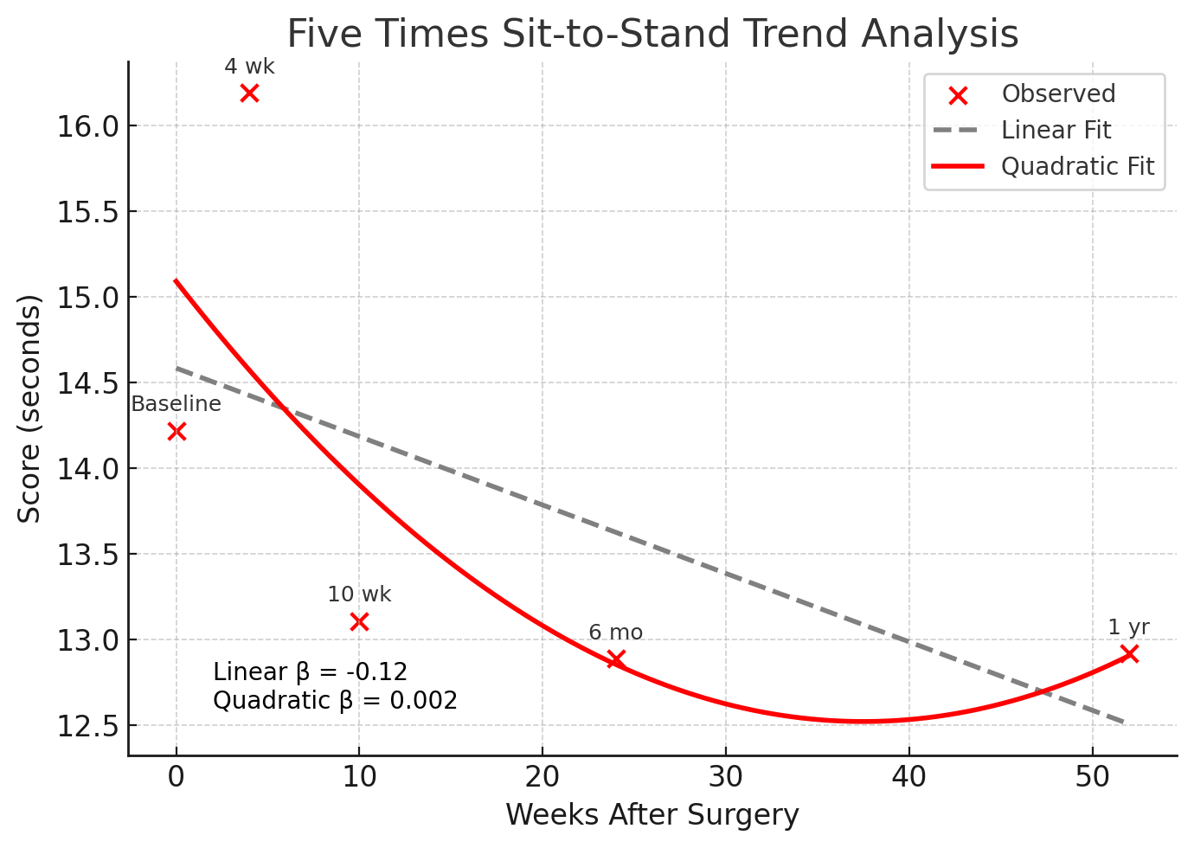
Results - Postoperative
Performance trends over time (Quadratic Estimate)
worse
better
Notes:
To further characterize the recovery pattern, we modeled performance trends using mixed-effects regression with both linear and quadratic terms. For Timed Up and Go, neither the linear nor quadratic term reached significance, confirming no consistent long-term trend beyond early recovery.
For Five Times Sit-to-Stand, both terms were highly significant. The negative linear slope indicates sustained improvement over time. The positive quadratic term indicates that these gains slow down—in other words, the rate of improvement decreases over time. This pattern demonstrates that recovery is nonlinear. Most improvement occurs in the first 6 months, then plateaus, suggesting a potential ceiling effect by 1 year. Patients may reach their maximal functional capacity by this point without additional structured intervention.

Slide 18
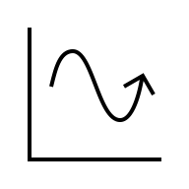



Conclusions
Hernia size does NOT
predict baseline
impairment
Recovery after
ventral hernia repair
is nonlinear
Larger hernias incur
greater impairment
post-operatively
Five Times Sit-to-Stand
captures meaningful
recovery patterns
Notes:
In conclusion, four key findings emerged from this study: First, hernia size does not predict baseline functional impairment. Large hernias aren't necessarily associated with worse function preoperatively. This challenges the assumption that bigger hernias automatically mean more disabled patients before surgery. Second, functional recovery after ventral hernia repair is nonlinear. Patients worsen early at 4 weeks, improve steadily through 6 months, then plateau by 1 year. Third, larger hernias incur greater overall functional impairment postoperatively. These patients have lower absolute function throughout the recovery period, though they follow similar improvement trajectories. And fourth, the Five Times Sit-to-Stand test best captured these recovery patterns, showing measurable decline and subsequent improvement. In contrast, Timed Up and Go remained largely unchanged, possibly reflecting limited sensitivity to abdominal corespecific recovery

Slide 19


Future Steps
Questions:
How do these tests align with patient-reported outcomes?
What factors drive variability in recovery besides hernia size?
Is there a physiologic ceiling to recovery after ventral hernia repair?
Areas of Focus:
Identify and assess other physical function tests
Correlate test performance with outcomes such as SSI, SSO, recurrence
RCT evaluation of physical therapy vs standard precautions
Notes:
These findings raise several important questions that warrant further investigation. First, how do these objective physical function tests align with patient-reported outcomes like HerQLes quality of life scores or PROMIS pain measures? Do improvements in function translate to what patients actually feel and experience? Second, what factors drive the variability in recovery besides hernia size? Are there modifiable factors—perhaps nutritional status, smoking, or preoperative conditioning—that we could target to improve outcomes? And third, is there a physiologic ceiling to recovery after ventral hernia repair? And if so, can we raise that ceiling through interventions like structured rehabilitation? Major areas of focus for our center moving forward include: identifying and assessing additional physical function tests in the ventral hernia population to build a comprehensive assessment toolkit; correlating test performance with traditionally important outcome metrics like SSI, SSO, and recurrence to see if function predicts complications; and most importantly, we are currently conducting a randomized controlled trial—ABVENTURE—to evaluate the role of postoperative physical therapy versus standard precautions and their impact on these functional recovery scores.

Slide 20

Email: William.Head@OSUMC.edu
Notes:
I’d like to acknowledge my co-authors, our study team, and the American College of Surgeons for the opportunity to present this work. I will now take any questions.
(In healthy, independent adults <60 years old, a time of less than 10 seconds (s) is generally considered normal for both 5xSTS and TUG.^{23–25} Times ≥ 10s for 5xSTS and ≥ 12s for TUG are associated with increased risk of disability and fall, respectively.
Several potential mechanisms may explain the nonlinear recovery trajectories identified in this study. The initial decline in performance at 4 weeks likely reflects postoperative pain and healing leading to limited core engagement and preferential use of accessory muscle groups. While the acute inflammatory phase generally resolves in the first few weeks, the abdominal fascia has been shown to regain only 50% of its original strength later at 2 months postoperatively.²⁶ Improvements at 10 weeks and 6 months coincide with this timeline and suggest a gradual return of core engagement and strengthening. Prior studies using dynamometry and computerized tomography have also shown a reversal of disuse atrophy and restored biomechanical integrity in this window.^{27,28} The plateau in 5xSTS performance at 1 year may represent a ceiling effect, perhaps driven by persistent biomechanical limitations or a lack of structured rehabilitation. Prior work from our Center for Abdominal Core Health found no correlation between hernia size and baseline performance; however, larger defects were associated with worse postoperative performance in this study. These patients may face compounded barriers due to longer preoperative decline, more invasive repairs, and perhaps inherently lower ceilings for recovery.
Altogether, these results suggest that recovery after VHR is multifactorial and reflects not just biologic healing but also various functional domains. The specific physical function tests used in this study - TUG and 5xSTS - are designed to assess the interaction of these domains. 5xSTS primarily focuses on lower limb strength but also involves trunk stabilization and abdominal bracing during repeated transitions, and TUG includes additional elements of ambulation and turning that involve mobility, balance, and coordination.^{29–32} The varying results between the two tests may be explained by these physiologic differences, with 5xSTS showing progressive improvement and eventual plateau, and TUG remaining largely unchanged. Overall, both tests engage not just the abdominal wall but the abdominal core and therefore may provide clinically relevant insight into practical recovery after VHR.² 5xSTS may better track changes after VHR while TUG may a screening tool for global limitations. Physical function tests that provide a more isolated evaluation of the abdominal wall have been developed, such as the partial curl-up, and the prone bridge (plank) tests.^{33,34} Future studies should compare abdominal wall-specific tests with holistic measures to determine which components of abdominal core function are most impacted after VHR.

