Slide 1


2023 Quality Improvement Summit Getting the Most Out of the QC in Community & Private Practice: Tips & Tricks on How to Incorporate the QC workflow for Data Entry and How I Market Myself Using the QC Winnie Henderson MD, PhD, FACS, CGRA ACHQC QI Committee March 4th , 2023

Slide 2
ACHQC Website
Abdominal Core Surgery Rehab
ACHQC Mobile App
Patient Informational Flyers
Marketing & Data Entry

Slide 3
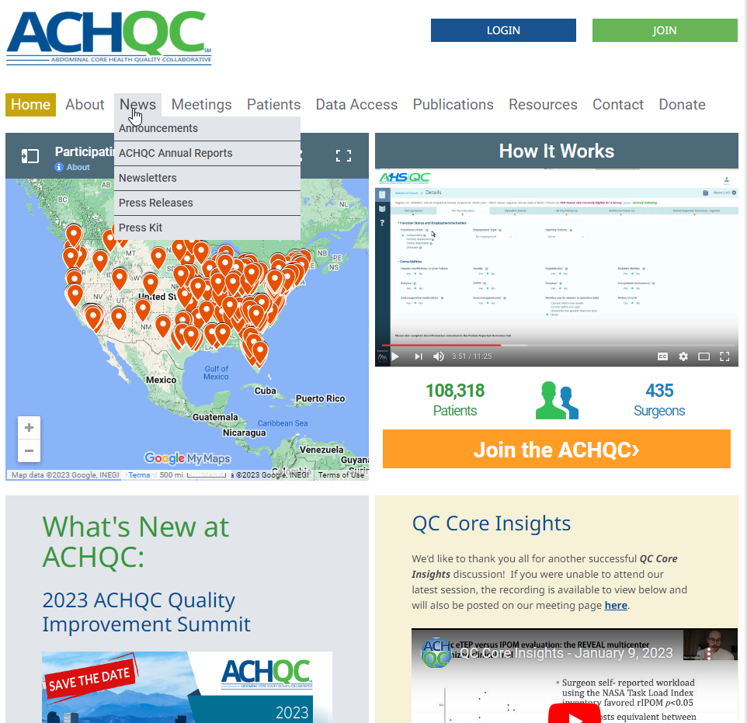
ACHQC Website

Slide 4

ACHQC Website

Slide 5
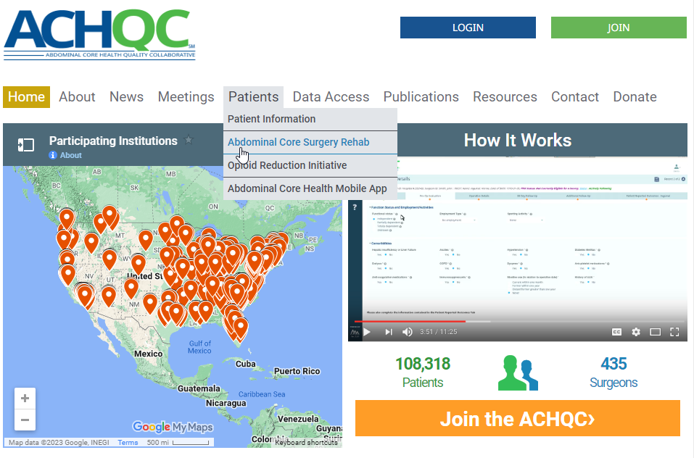
Abdominal Core Surgery Rehab

Slide 6


Slide 7
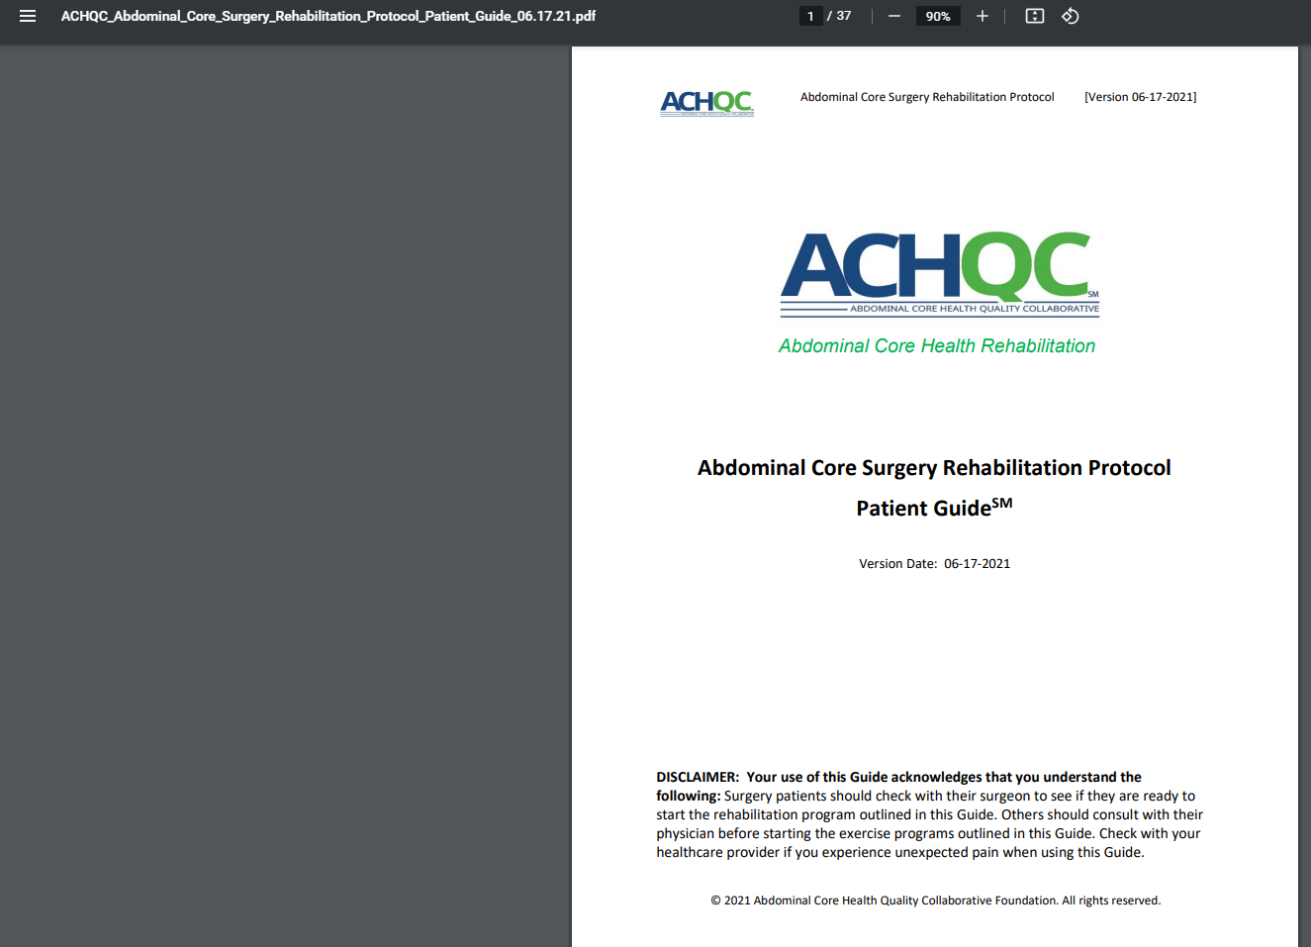

Slide 8
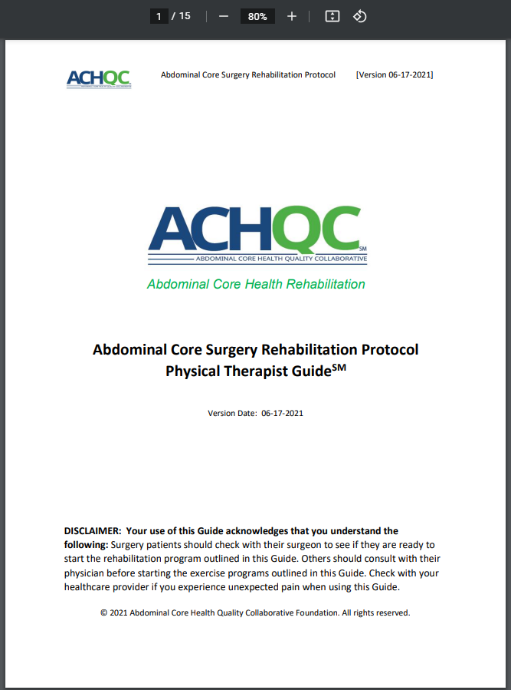

Slide 9
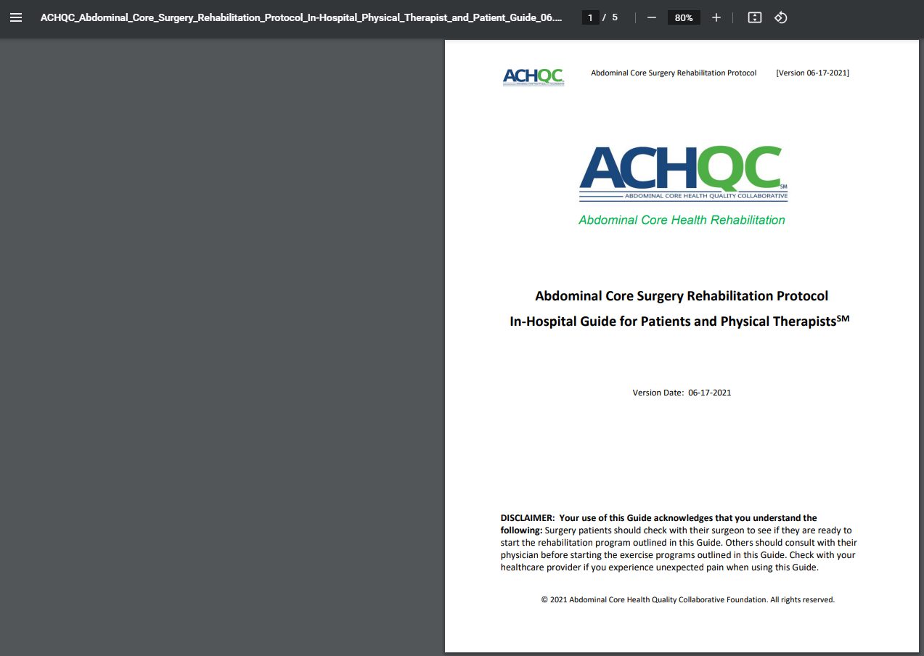
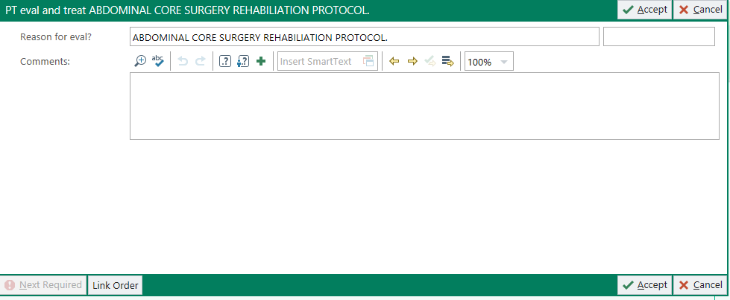

Slide 10
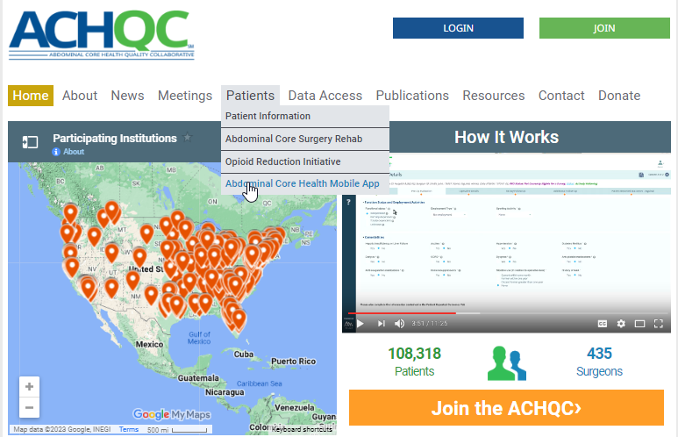
Abdominal Core Health Mobile App

Slide 11
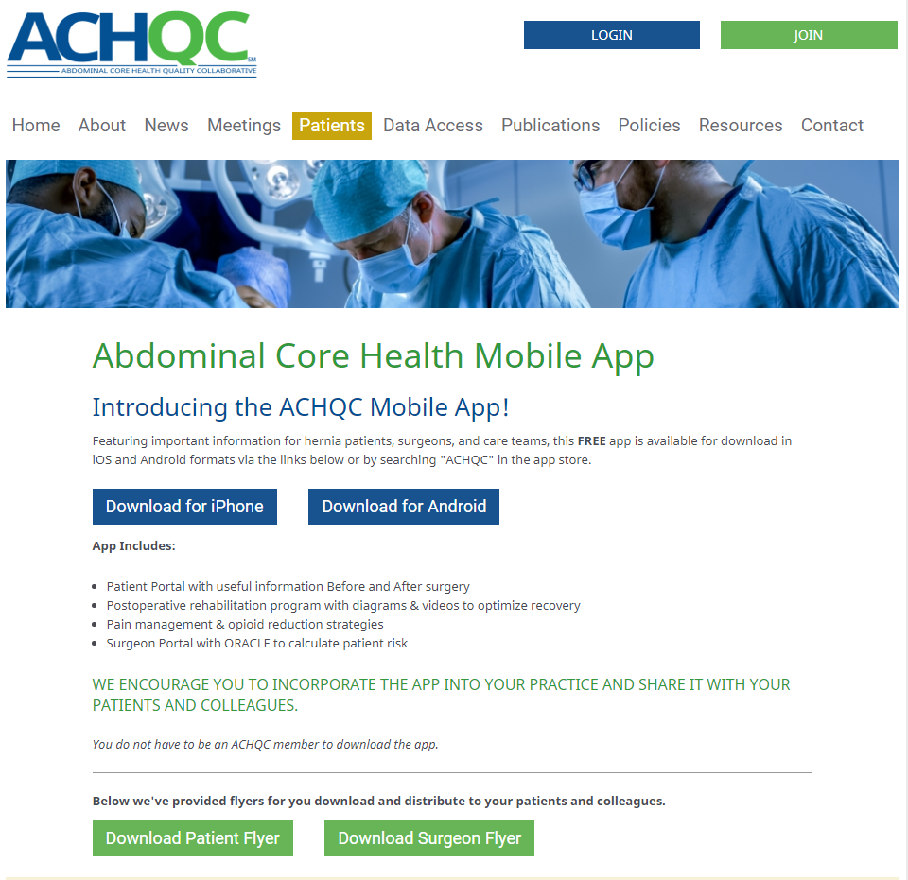

Slide 12
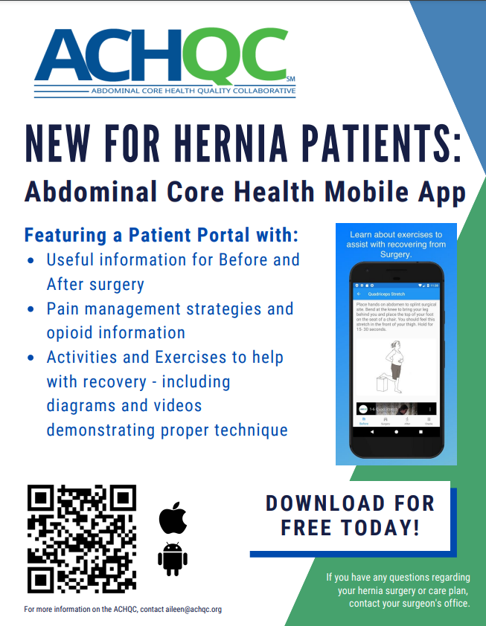
https://www.achqc.org/patients/achqc-mobile-app

Slide 13
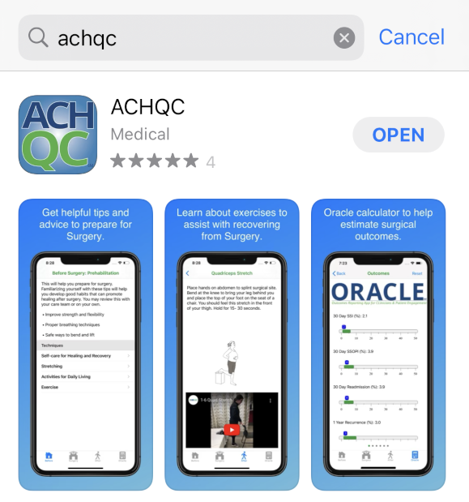

Slide 14
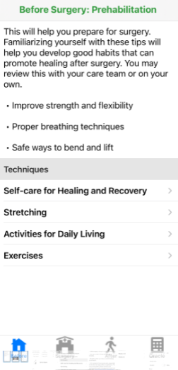
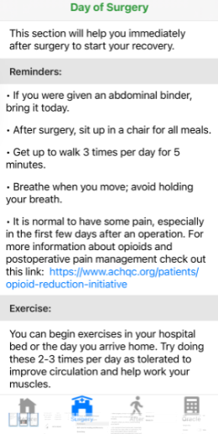

Slide 15
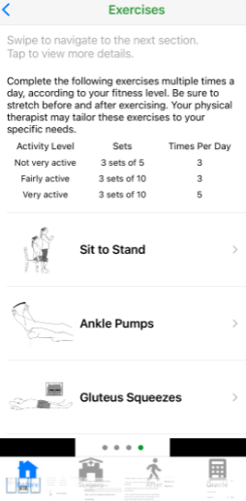
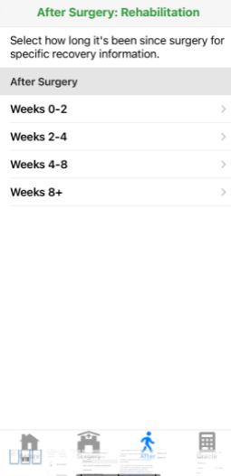
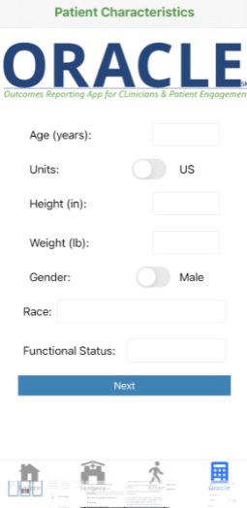

Slide 16
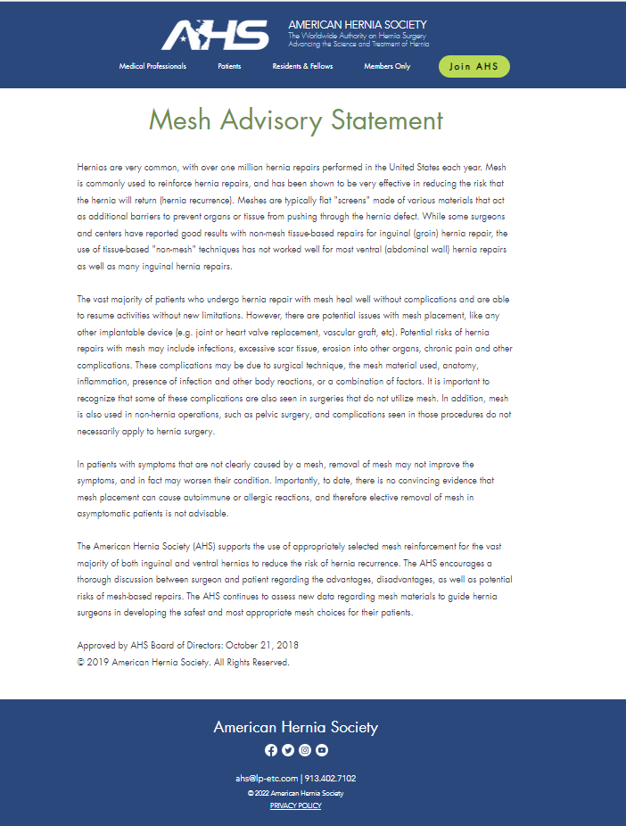
Mesh Advisory Statement | AmericanHernia (americanherniasociety.org)

Slide 17

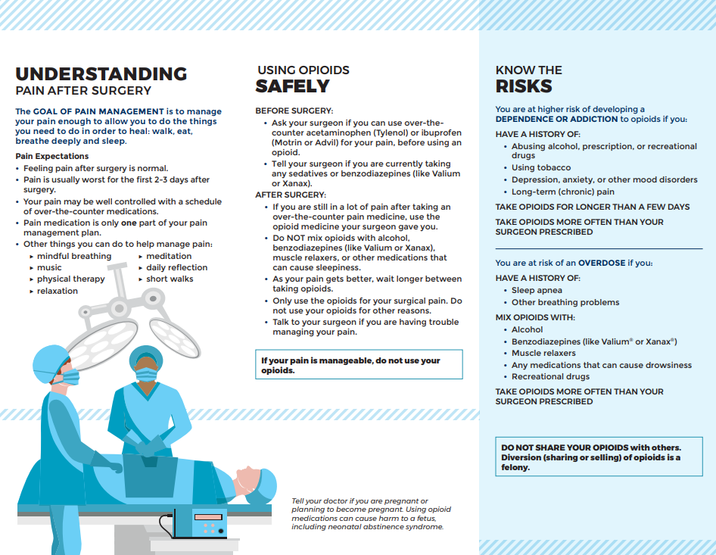
https://www.achqc.org/patients/opioid-reduction-initiative

Slide 18
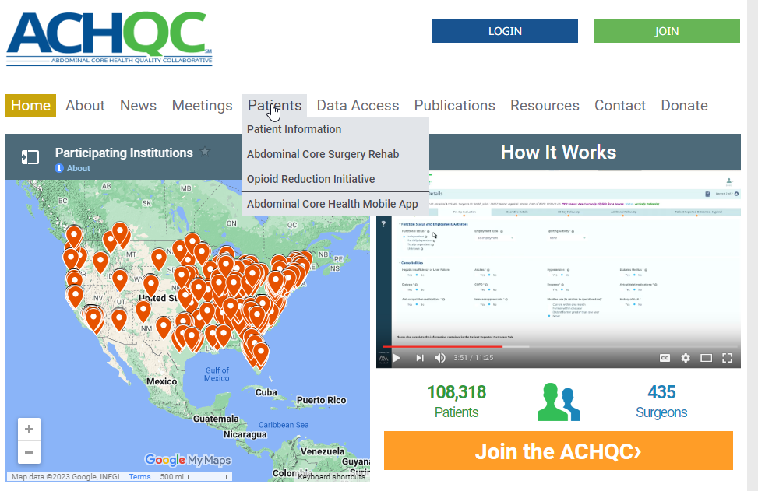
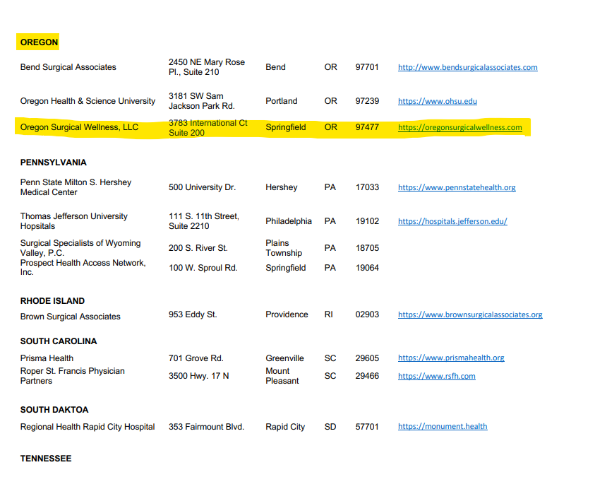
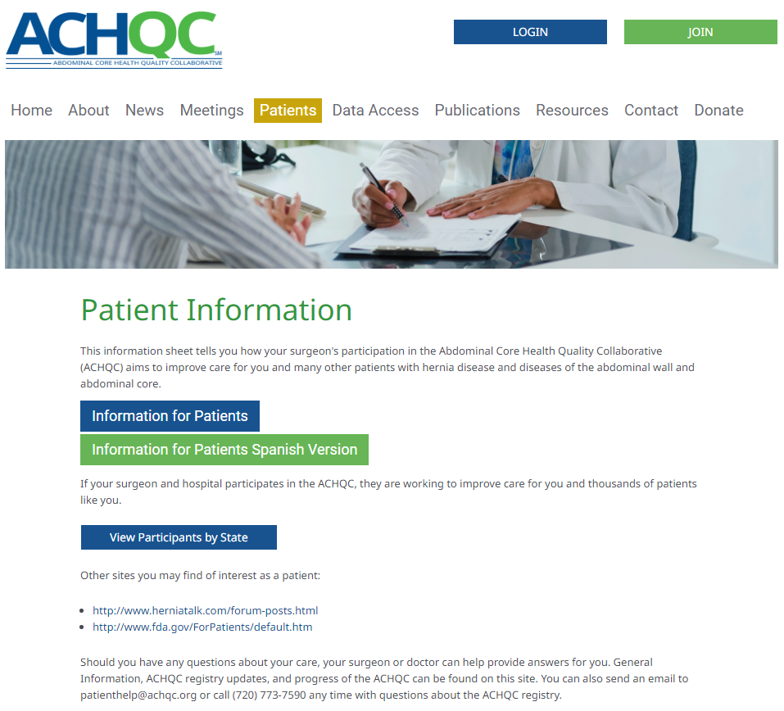
Marketing & Data Entry

Slide 19

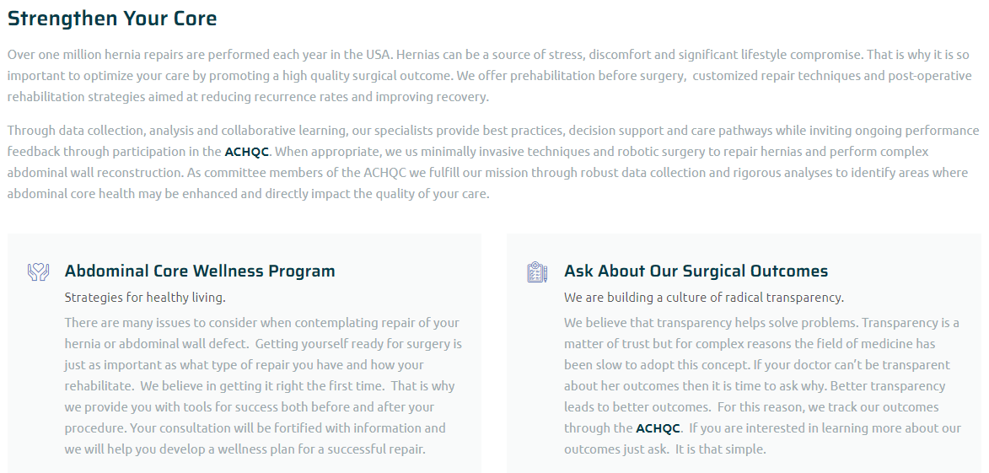

Slide 20

Lane County Medical Society Medical Matters
June 2021 & 2022 National Hernia Awareness Month

Slide 21
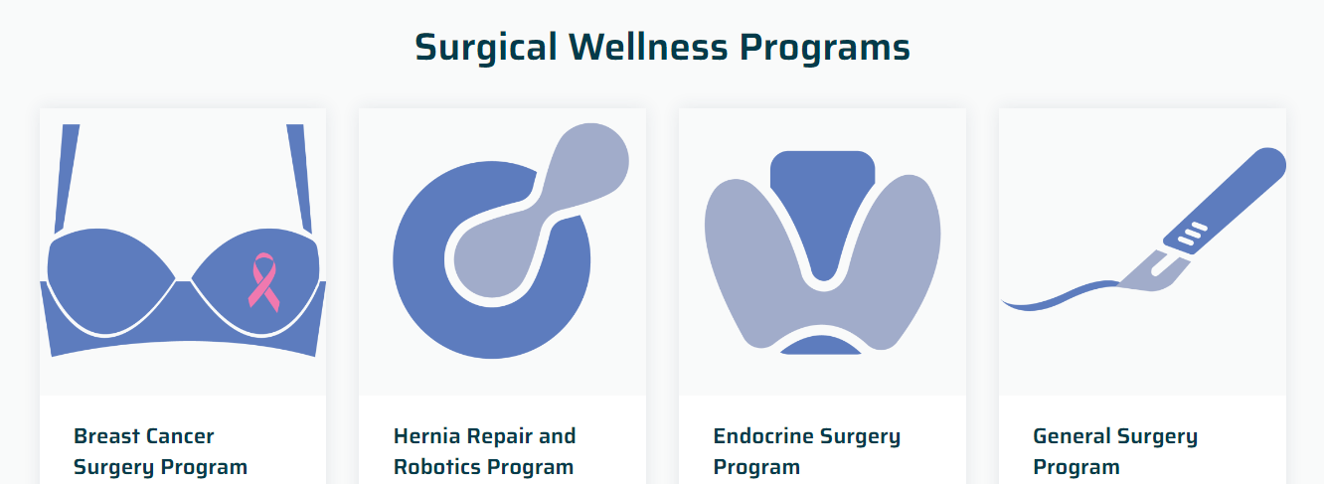




National Registry Data Management Team

Slide 22

Thank You

