Slide 1
Open versus Robotic REtrOmuscular Ventral Hernia Repair:
Preliminary outcomes of ORREO trial
Jeremy Warren, MD FACS
University of South Carolina School of Medicine Greenville
Prisma Health Upstate

Slide 2
Disclosure
Intuitive (JAW, AMC)
Study funded with SAGES grant

Slide 3
Background
Does minimally invasive abdominal wall reconstruction improve clinical outcomes?
Notes:
The advent of robotic hernia repair has enabled many of us to expand our armamentarium to include minimally invasive abdominal wall reconstruction. Intuitively this should provide significant patient benefits for wound complications and recovery, but data confirming this is lacking.

Slide 4

Background
222 open vs 111 roboticRM
4 vs 2% SSI (p=0.05)
LOS 3 vs 2 days (p<0.001)
Carbonell AM, Ann Surg 2018
Notes:
The first large study published comparing open and robotic AWR was from the ACHQC, comparing 222 open to 111 robotic repairs using a propensity score match. There was trend toward lower SSI rates, but a clear benefit in length of stay favoring robotic repair.

Slide 5
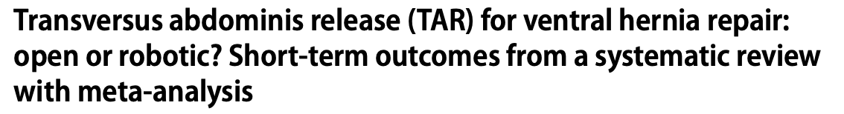
Background
237 rTAR vs 594 oTAR from 6 studies
No difference in SSI (3.6 vs 5.2%; p=0.44)
Lower SSO for rTAR (5.3 vs 11.5%; p=0.02). No diff in SSOPI
Lower systemic complications rTAR (6.3 vs 26.5%; p<0.001)
Shorter LOS with rTAR
Bracale U, Hernia 2021
Notes:
A recent review indicates a similar benefit for LOS reduction, but again no significant difference in SSI. There was a difference in SSO, but no difference SSOs requiring intervention. A lower risk of general complications was seen with robotic TAR in this study.

Slide 6

Background
350 robotic matched to 759 open; all patients >65y/o
LOS: 1 vs 4 days (p<0.001)
No difference in complications
Slight improvement in QOL at 1 year
Collins CE, Ann Surg 2021
Notes:
Another recent large study comparing open and robotic repair once again demonstrated the benefit of shorter LOS with no other differences in clinical outcomes. A slight improvement in quality of life was identified after robotic repair.

Slide 7
Methods
Prospective RCT
Inclusion:
Hernia 7-15cm
At least one: DM, COPD, BMI >30, current smoker
Exclusion:
Presence of stoma
Wound class 3 or 4
Notes:
This study is the first RCT comparing open and robotic retromuscular repair. Since we feel the greatest potential benefit in overall complications is in higher risk patients, we actually designed the trial include more complex patients with larger hernias and comorbidities commonly associated with infection risk.

Slide 8
Methods
Primary endpoint:
Composite outcome
SSO (excluding simple seroma)
SSOPI
SSI
Readmission
Recurrence
Notes:
Due to the overall low incidence of infection and a prohibitive number of patients needed to see a difference in SSI on our initial power analysis, we opted to use a composite outcome using the factors seen here as our primary endpoint. This may be unfamiliar to many here, but it is a methodology used in several other disciplines. It’s much like a central line “bundle” – is it the use of CHG, full drape, biopatch that reduces line infections? The difference can really only be seen when all measures are used. Here, the technique can result in a variety of potential negative outcomes, thus combining the outcomes may demonstrate a difference in negative outcome that may not be seen with any single outcome measure.

Slide 9
Methods
Power analysis:
Based on retrospective review of open / robotic cases
Composite outcome: Open - 52.2%, Robotic - 24.1%
Calculated 46pts in each arm to detect difference
Enrolled 100 total (50 each arm)
Intention to treat analysis: 5 patients converted to open included in robotic arm
Notes:
Our initial power analysis based on our institutional retrospective data demonstrated a composite outcome of 52% for open repair vs 24% for robotic, thus needing 46 patients in each arm to show this difference. Intention to treat analysis was performed, so the 5 patients converted to open repair were included in the robotic arm.

Slide 10
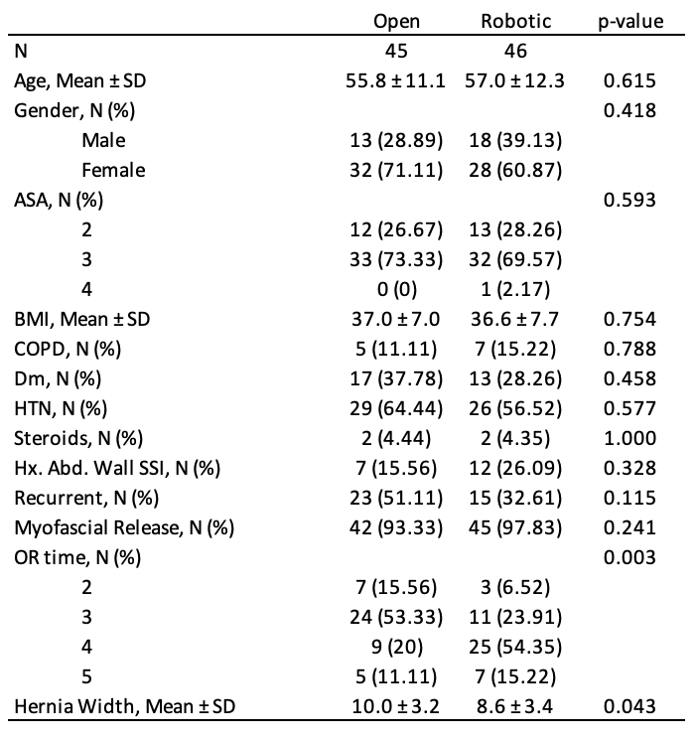
Results
Notes:
There was a significant difference between groups was a longer mean operative time with robotic repair, which was expected. There was also a 1.4cm mean difference in hernia width between the two groups, though the clinical significance of this difference is unclear.

Slide 11
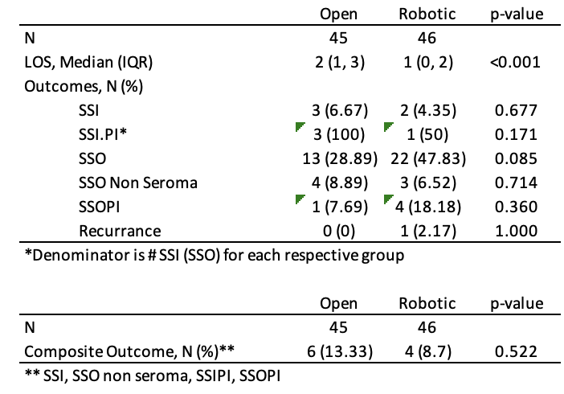
Results
R
No difference in primary outcome
Shorter LOS
SSIPI - wound opening, perc drain x2 (open); wound opening (robotic)
All SSOPI were perc drains
Notes:
Our primary outcome showed a composite outcome of 13.3% for open repair and 8.7% for robotic, which did not reach statistical significance. Analysis of individual outcomes also did not demonstrate statistical significance between groups. As see with other studies, though, we did still see a shorter LOS with robotic repair.

Slide 12
Results
5 patients required conversion to open
0 SSI
3 SSO (2 seroma, 1 cellulitis)
0 SSOPI
Notes:
There were 5 patients that were converted to open repair after beginning robotically, none of who developed an SSI or required intervention for their SSO.

Slide 13
Pending results
R
PROs
Recurrence at 2 years
Notes:
This is a 2 year study and we are still gathering data for complete follow-up. We have also not analyzed PRO or cost data yet.

Slide 14
Limitations
Small sample size
Recruitment and randomization
Follow-up
Evolution of technique (eTEP, fixation), ERAS (TAP blocks)
Notes:
There are some important limitations that deserve mention. First, our sample size was likely an underestimate of the n needed to demonstrate a difference. This is in part due to the use of the composite outcome, as we did not feel we could reach the number of patients needed based on power analysis for SSI alone. Also, the composite outcomes on our retrospective review likely had significant selection bias that skewed the power analysis toward a lower sample size. Second, this was a surpisingly difficult trial to recruit patients into, and interestingly it was NOT because all patients wanted to proceed robotically. There were many patients who declined randomization in favor of open repair as well for a variety of reasons. What was intended to take less than 2 years took nearly 4. Our follow-up has also been a challenge with 39 patients either withdrawing from the study after surgery, never scheduling surgery after randomization, or lost-to-follow-up. We are still in process of chart review and contacting all patients for follow-up. Finally, there has been some evolution of robotic technique during the study, as we transitioned from a robotic transabdominal RM repair with TAR to predominantly eTEP. Unclear if this transition had any effect on the outcomes as yet.

Slide 15
Summary
First RCT comparing open v robotic VHR.
Robotic repair appears to shorten LOS compared to open, as seen with other studies.
Future study with larger sample size needed to determine other differences.
Notes:
Despite these limitations this is the first RCT comparing open and robotic VHR and as important first step in gathering high-level data on this approach. As seen with most other published studies, there is a reduced LOS with robotic repair, which is certainly clinically relevant. While there was a modest reduction in negative outcomes overall with robotic repair, this was not a statistically significant finding. Further study is certainly warranted to better identify the optimal patient for robotic repair and to demonstrate what clinical benefit may exist for robotic vs open repair. Incorporation of PRO data, opioid use, and larger sample size will be key steps for future study design.

