Slide 1
ReducINg Surgical SitE Infections in Ventral Hernia Repair:
RINSE trial preliminary outcomes
Jeremy Warren, MD FACS
University of South Carolina School of Medicine Greenville
Prisma Health Upstate

Slide 2
Disclosure
Intuitive

Slide 3
Background
Can antibiotic irrigation reduce the rate of SSI in VHR?
What antibiotic(s) should be used?
What technique (pulse lavage, timing, duration, etc)?
Notes:
Wound complications continue to afflict a high percentage of patients after open ventral hernia repair and AWR. One fairly simple intervention is the used of antimicrobial irrigation at the time of repair. However there is very little hernia specific data and limited data overall to guide the choice of antibiotic or the optimal technique for delivery.

Slide 4
Background
56 patients evaluated prospectively
  22 pos cultures pre-lavage; 4 after lavage (81.8% reduction)
  19.6% SSI (n=11)
    2 of 4 pos-pos (50%)
    5 of 18 pos-neg (27.8%)
    4 of 34 neg-neg (11.8%)
Majumder A, Surg Techol Int 2015
Notes:
One study evaluated the impact of antibiotic pulse lavage during contaminated RM VHR, demonstrating a reduction in positive culture after lavage. Of patients who remained positive after lavage, 2 of the 4 (50%) developed an SSI vs only 27.8% of the patients who converted to negative culture after initial positive culture. It is difficult to draw conclusions from this due to the very small number of patients with positive cultures (22 out of 56) and SSI (11 out of 56).

Slide 5

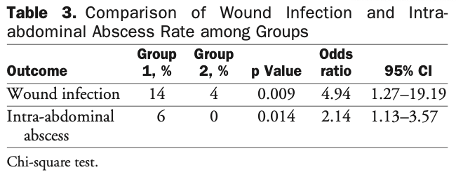
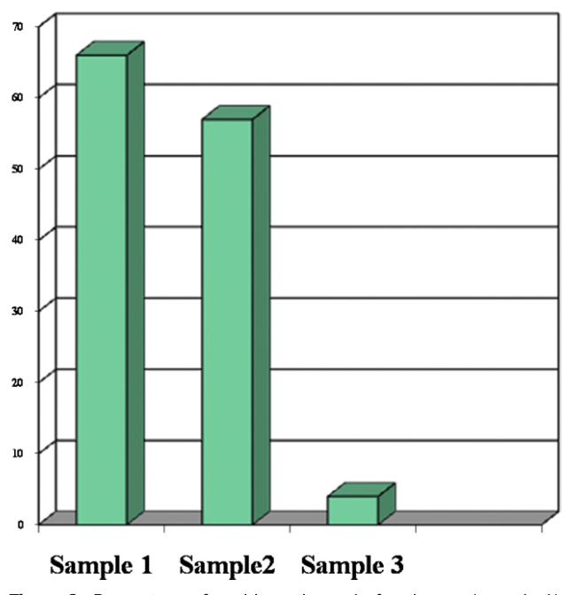
Background
RCT 103 pts
Saline vs abx irrigation
Peritoneal cultures
Ruiz-Tovar, JACS 2012
Notes:
A RCT from the colorectal literature showed more significant results and the basis for our use of antibiotic irrigation during VHR. In this study, 103 patients were randomized to saline vs antibiotic irrigation of the peritoneal cavity using a Gentamycin-Clindamycin solution. This intervention saw a significant reduction in SSI from 14 to 4%.

Slide 6

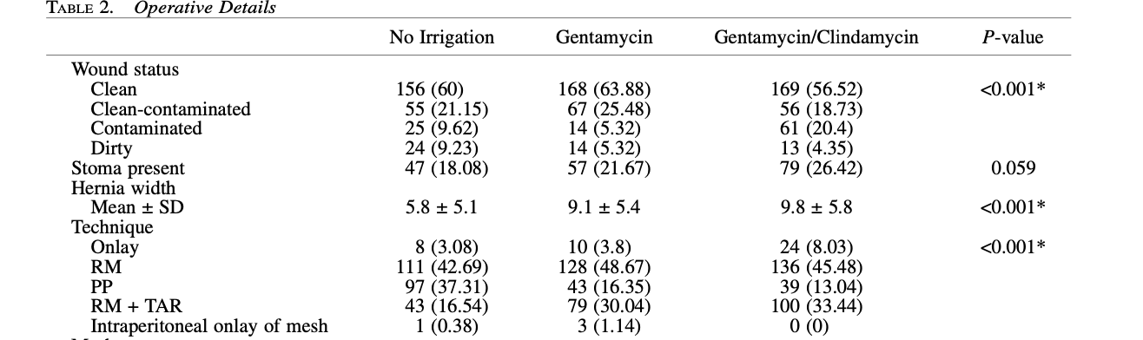
Background
Retrospective 852 patients
  no abx = 260; gent = 266; gent + clinda 299
Fatula, Am Surg 2018
Notes:
We retrospectively analyzed our use of antibiotic irrigation for VHR. We initially looked at 852 open repairs, comparing those who received no or saline only irrigation, gentamycin irrigation alone, or the gent-clinda irrigation. As this was a retrospective study, there were some important differences between these groups, though most would actual predict HIGHER SSI, such as large hernia width and greater percentage of more complex repair (TAR).

Slide 7
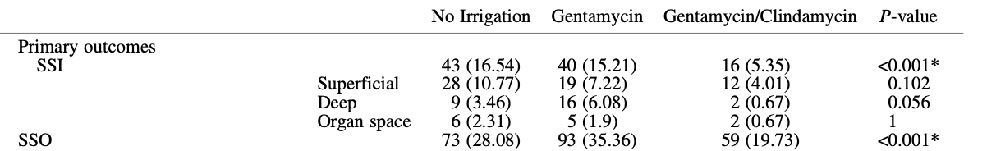
Background
Fatula, Am Surg 2018
Notes:
We found that the combination of clindamycin and gentamycin significantly reduced the risk of SSI, decreasing the overall rate from 16.5% for no irrigation and 15% with gentamycin alone to just 5.4% with combination solution.

Slide 8
Methods
Subgroup analysis: RM +/- TAR, permanent synthetic mesh, excluding dirty wounds, excluding gent alone
 | Abx (n=224) | Saline (n=111)
clean | 10% | 3.3%
clean cont | 16.7% | 4%
cont | 40% | 7.4%
total | 16.2% | 4.5%
Notes:
In designing this trial, we performed a subgroup analysis of only patients undergoing open RM hernia repair. Our initial retrospective study included many preperitoneal hernia repairs and a handful of other techniques. Using this criteria and comparing only gent+clinda vs saline, we found the differences in SSI as seen above, which was the basis for our power analysis for this study.

Slide 9
Methods
Power analysis: 210 total patients
Inclusion: elective open RM VHR +/- TAR with PP mesh; class 1-3
Exclusion: dirty wounds, alternate technique or mesh
Multicenter embedded QC trial
  Cleveland Clinic Oregon Health
  Prisma Health Penn State
Notes:
We determined that 210 patients, 105 in each arm, would detect the differences seen in the prior slide. We included any patients undergoing elective, open RM hernia repair with or without TAR using a polypropylene mesh. We excluded dirty / infected wounds or patients repaired with non-RM approach. Patients were randomized at the time of mesh placement in the operating room after confirming their wound status and that the operation was able to proceed with retromuscular repair and polypropylene mesh. Once the mesh was placed, solution was instilled in the retromuscular space to completely cover the mesh, letting this dwell for 3 minutes before evacuating. Use of drains was at the discretion of the surgeon.
Participating sites included Cleveland Clinic, Oregon Health, Penn State, and Prisma Health

Slide 10
Results
Demographics
 | Group 1: Control | Group 2: Antibiotic
n | 125 | 125
Age; median (IQR) | 62 (50.7-68) | 59 (51.7-67)
Female | 56.8% | 47.2%
ASA 3 | 83.2% | 81.6%
BMI; median (IQR) | 33.1 (29.2-36.2) | 33.0 (29.2-37.1)
HTN | 56.8% | 61.6%
DM | 21.6% | 26.45
COPD | 10.4% | 9.6%
Current smoker | 10.4% | 10.4%
Notes:
As expected, we saw no significant differences in our patient groups.

Slide 11
Results
Hernia Characteristics
 | Group 1: Control | Group 2: Antibiotic
Incisional hernias | 97.6% | 95.2%
Hernia width; median (IQR) | 14 (10-17) | 14 (10-16.3)
Hernia length; median (IQR) | 20 (15-24) | 20 (15-24)
ASA 3 | 83.2% | 81.6%
Modified VHWG grade
1 | 15.2%% | 15.2%
2 | 63.2% | 68%
3 | 21.6% | 16.8%
Recurrent hernia | 63.2% | 52.8%
Notes:
We also so no significant differences in hernia characteristics

Slide 12
Results
Operative Details
 | Group 1: Control | Group 2: Antibiotic
Wound class
1 | 78.4% | 83.2% | p=0.404
2 | 10.4% | 10.4%
3 | 11.2% | 6.4%
Mesh used | 99.2% | 100% | p=0.316
Mesh area; median (IQR) | 900cm² (900-1012.5) | 900cm² (900-1376.0) | p=0.398
Mesh type, permanent synth | 99.2% | 100% | p=.314
Mesh placement; RM | 99.2% | 100% | p=0.314
Myofascial release |  |  | p=0.472
TAR | 85.8% | 82.7%
Concomitant procedures | 19.2% | 16.8% | p=0.621
Notes:
Repair technique was also similar between groups, with 85 and 83% requiring TAR in the saline and antibiotic groups. About 80% of cases in this study were clean.

Slide 13
Results
Outcomes
 | Group 1: Control | Group 2: Antibiotic
Intraop complications
bowel injury | 6 (4.8%) | 3 (2.4%) | p=0.308
30-day SSI* | 11 (9.9%) | 10 (9.1%) | p=0.836
Superficial | 7 (63.6%) | 4 (40%)
Deep | 4 (36.4%) | 5 (50%)
Organ space | 1 (9.1%) | 1 (10%)
SSIPI | 8 | 8 | p=0.985
Wound opening | 5 | 5
Perc drainage | 2 | 2
Wound debridement | 0 | 3
* follow-up: Group 1 n=111, Group 2 n=110
Notes:
There was no difference seen in SSI or SSIPI with the use of antibiotic irrigation in this study

Slide 14
Results
Outcomes
 | Group 1: Control | Group 2: Antibiotic
30-day SSO* | 13 (11.7%) | 15 (13.6%) | p=0.667
Cellulitis | 3 (23.1%) | 2 (13.3%)
Seroma | 4 (30.8%) | 9 (60%)
Other | 6 | 4
SSOPI | 4 (3.6%) | 4 (3.6%) | p=0.990
Wound opening | 3 | 4
Perc drainage | 1 | 0
Wound debridement | 1 | 1
Partial mesh removal | 1 | 0
Readmission | 11 (9.9%) | 7 (6.4%) | p=0.335
Reoperation | 6 (5.4%) | 1 (0.9%) | p=0.056
Wound complication | 2 (33.3%) | 1 (100%)
* follow-up: Group 1 n=111, Group 2 n=110
Notes:
Similarly, no difference was seen with SSO or SSOPI, readmission, or reoperation.

Slide 15
Summary
Antibiotic irrigation did not reduce surgical site infection in open ventral hernia repair.
Future study focusing on higher risk population should be considered.
Notes:
So, based on this trial, antibiotic irrigation at the time of mesh placement during open RM VHR appears to have no impact on incidence of SSI. However, it is important to note that about 80% of these patients were clean. Our power analysis was based on a sample with only 60% of patients having a clean repair, a group with a much lower overall SSI rate (10%) vs clean contaminated (17%) and contaminated (40%) cases. This difference likely skews our results, as our infection rate for RINSE was 9%, almost identical to that seen in our retrospective analysis.

Slide 16
Future study
R
30-day SSI (n=21)
    clean: n=13/202 (6.4%)
    clean-contaminated: n=1/26 (3.8%)
    contaminated: n=7/22 (31.8%)
Is this the right antibiotic choice / method?
Notes:
Here, only 27 patients in the control group and 21 in the antibiotic group were non-clean cases. 8 of the 21 infections occurred in these 48 patients (16.7%), while SSI in clean cases was just 6.4% (13 / 202). So, while we were not powered appropriately to say that this is a significant difference, it does point to the possible benefit in these higher risk patients and serve as a basis for future study.

