Slide 1
Surgical Approaches for Core Abdominal Injuries: A Review of the Abdominal Core Health Quality Collaborative Database
March 5, 2023
ACHQC QI Summit
Denver, Colorado

Slide 2
Disclosures
None

Slide 3
What’s In a Name?
Sports Hernia
Athletic Pubalgia
Core Muscle Injury*
Gilmore’s Groin
Sportsman’s Hernia
Groin Pain Syndrome
Inguinal Disruption

Slide 4
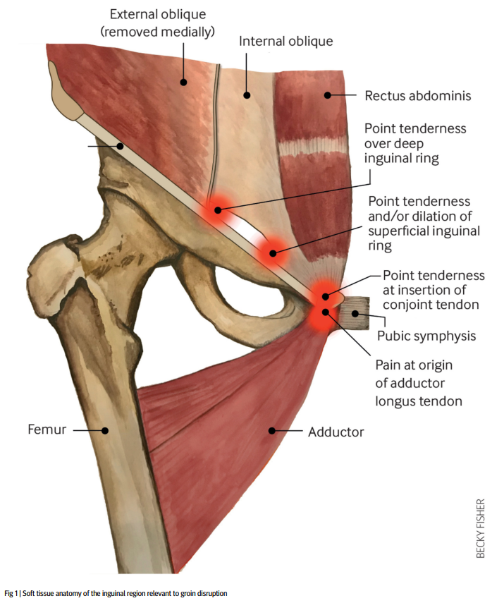
Who are we really talking about?
Overuse injury from repetitive loading of the pubis that leads to inflammation, tearing, rupture or destabilization of the core muscles from the pubic bone.

Slide 5
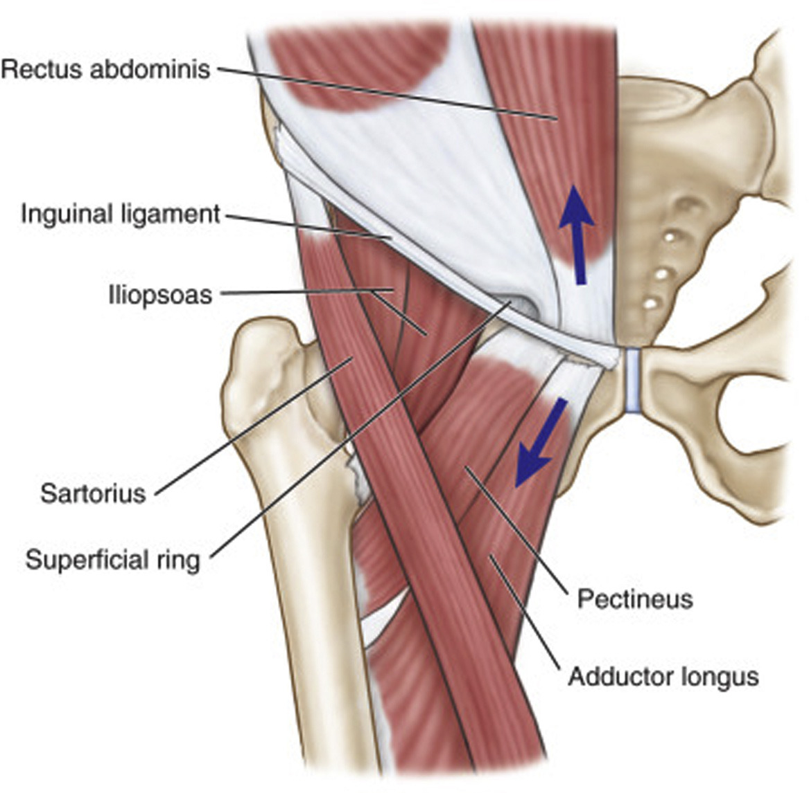
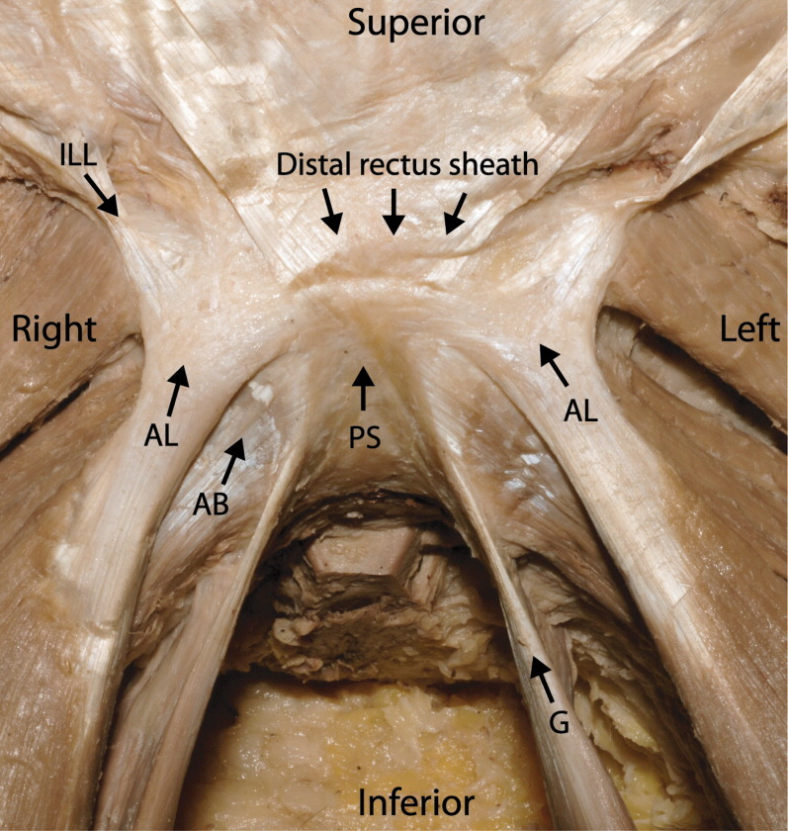
“Pubic Joint”

Slide 6

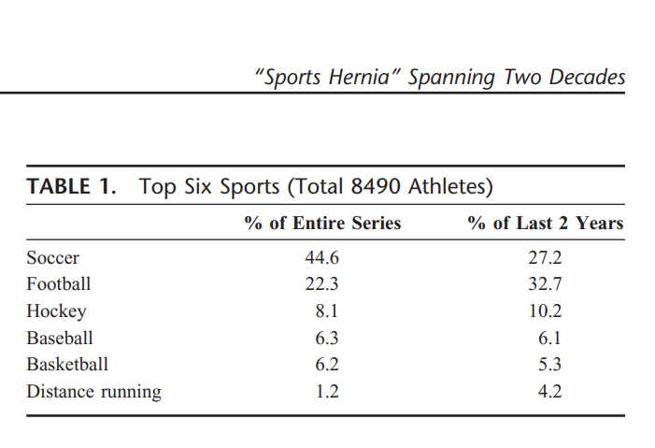
“Pubic Joint”
Meyers et al. Ann Surg 2008

Slide 7
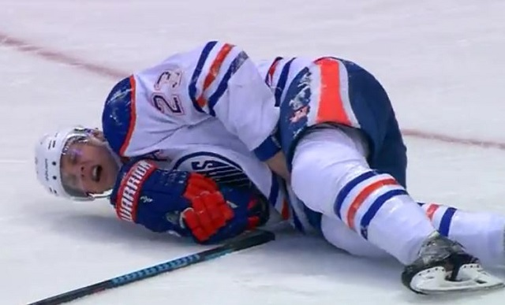
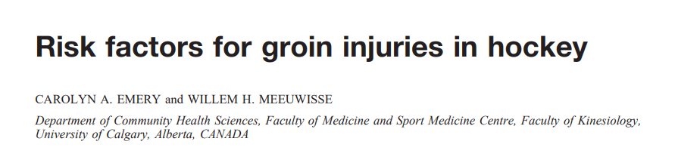
Risk factors
NHL Study
  Previous injury (2x)
  Limited off season training (3x)
  Veteran (5x)
  Peak isometric adductor torque (0x)
  Total abduction flexibility (0x)

Slide 8
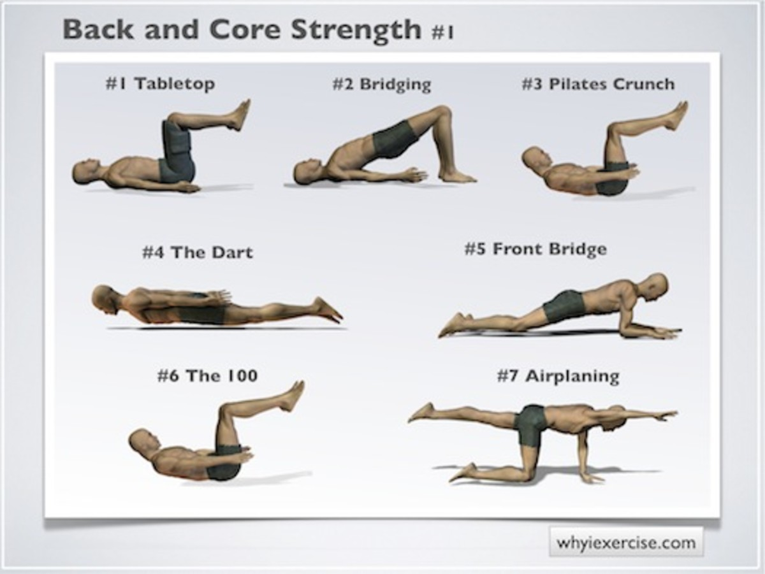
Non-operative Treatment
NSAIDs
Rest True rest for 4-6 weeks
Ice
Physical Therapy
  Minimum 3 months
  Strength and Flexibility
  Must participate at home

Slide 9
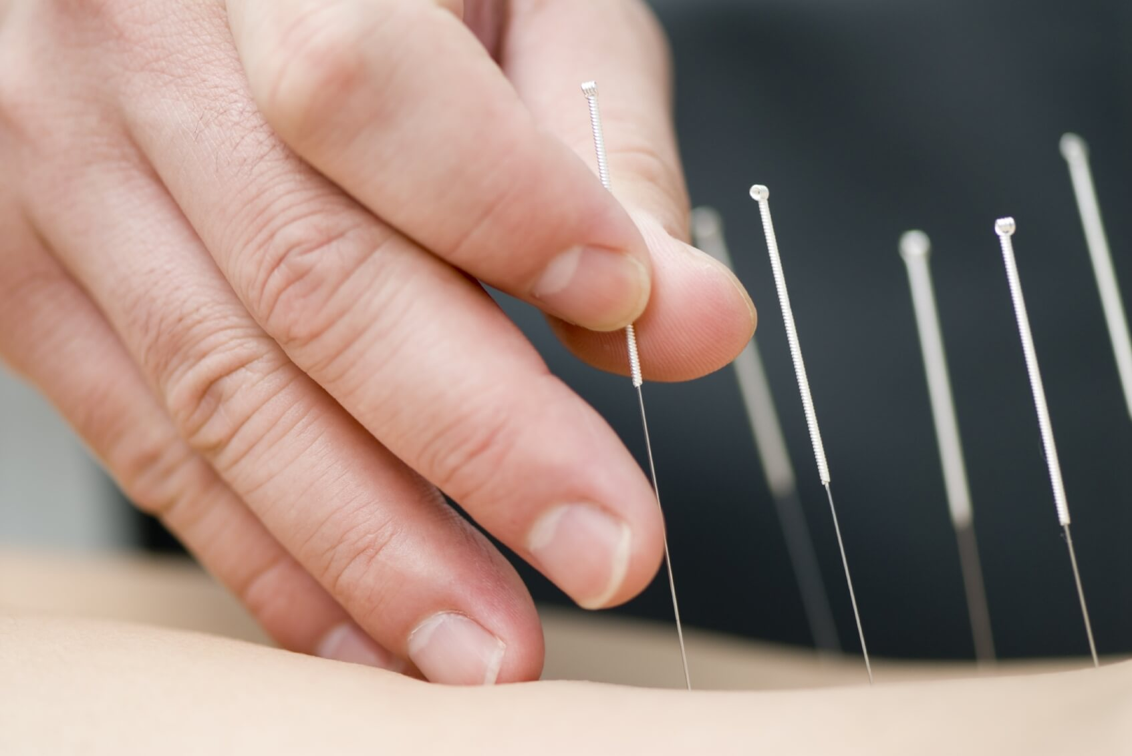
Physiotherapy & Alternative Medicine
Massage
Dry Needling
Acupuncture
PRP injections
Ultrasound Therapy

Slide 10
Surgical Repair Options
Primary or Non-mesh
  Meyer’s
  Muschawek
  Gilmore
Tension Free Mesh
  Lichtenstein
  Laparoscopic TEP/TAPP
Adductor Tenotomy

Slide 11
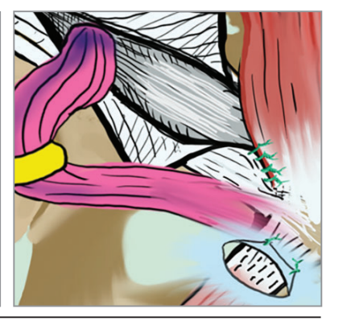
Meyer’s
Zuckerbraun. JAMA Surg 2020

Slide 12
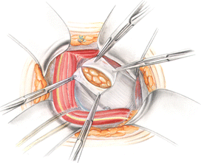
Muschaweck (Minimal Repair Technique)

Slide 13
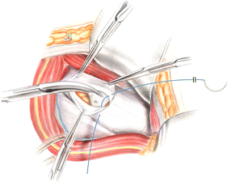
Muschaweck (Minimal Repair Technique)

Slide 14
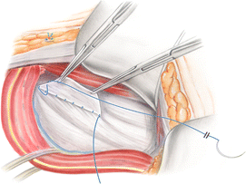
Muschaweck (Minimal Repair Technique)

Slide 15
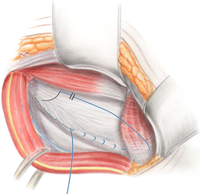
Muschaweck (Minimal Repair Technique)

Slide 16
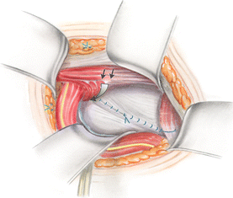
Muschaweck (Minimal Repair Technique)

Slide 17
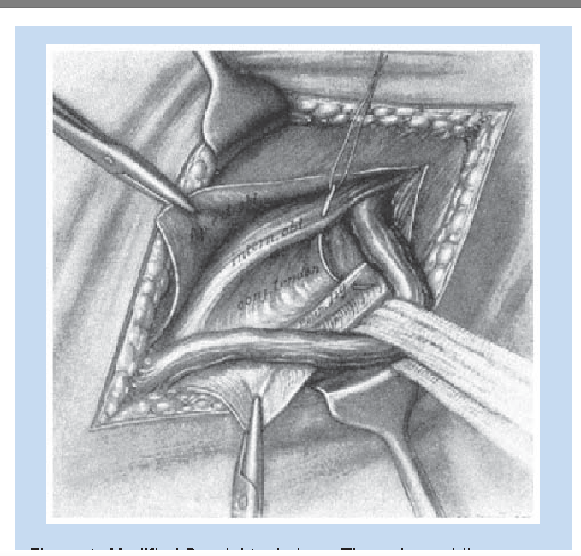
Gilmore’s Repair

Slide 18
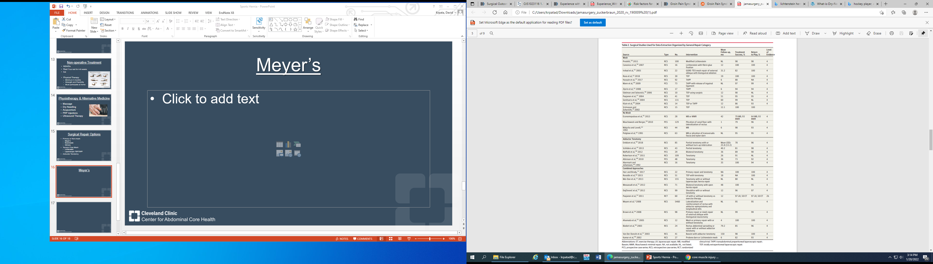
Outcomes: No Mesh

Slide 19
Outcomes: Mesh

Slide 20
Outcomes: Combined

Slide 21
ACHQC Database and Primary Goal
Core Abdominal Injury (CAI) is captured as a variable in the ACHQC.
We aimed to describe how high volume hernia surgeons within the QC address this problem surgically and the short term outcomes.

Slide 22
Methods
Registry query for:
  CAI
  Inguinal Hernias (IH)
  Both
Data abstracted:
  Operative approach
  Quality of life

Slide 23
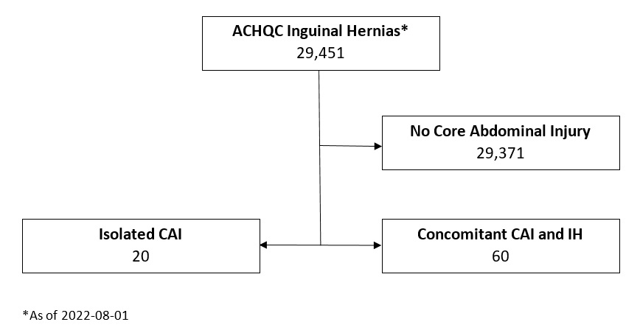

Slide 24
Isolated CAI - Baseline Characteristics
Baseline Characteristics
Age 31.25(10.6) mean(SD) Range: 18-49
Gender Male 90% (18) Female 10% (2)
Race Black 20% (4) Hispanic 10% (2) White 70% (14)
BMI 26.9 (25.47-29.25) median(IQR)
Surgeon Affiliation
Academic | 90% (18)
Private | 5% (1)
Private with academic affiliation | 5% (1)

Slide 25
Isolated CAI - Comorbidities
Comorbidities
Ascites | 0
Hypertension | 0
Diabetes Mellitus | 5% (1)
Dialysis | 0
COPD | 0
Anti-platelet medications | 0
Anti-coagulation mediations | 0
Immunosuppression | 0
Nicotine use within 1 year | 0
Smoker within 1 year | 0
History of AAA | 0
History of IBD | 0
History of MRSA infection | 0
Hepatic insufficiency/Liver failure | 0
Collagen vascular disorder | 0

Slide 26
Isolated CAI - Approach
Surgical Approach - Laterality
Unilateral | 75% (15)
Bilateral | 25% (5)
Mesh placement
Unilateral | 7/20
Bilateral | 4/20
No Mesh | 9/20

Slide 27
Isolated CAI - Technique
Tissue-based Repairs (n=9)
Closure of floor | 33.3% (4)
Bassini | 8.3% (1)
Femoral orifice exploration | 8.3% (1)
Laparoscopic-to-open conversion | 8.3% (1)
McVay | 8.3% (1)
Shouldice | 8.3% (1)
Mesh-based Repairs (n=11)
TAPP | 3
TEP | 4
Lichtenstein | 4

Slide 28
Isolated CAI – Postoperative Course
There were no postoperative complications, reoperations, or recurrences within 30 days.

Slide 29
Concomitant CAI and IH - Baseline Characteristics
Baseline Characteristics (n=60)
Age 36.97(18.39) mean(SD) Range: 18-87
Gender Male 96.67% (58) Female 3.33% (2)
Race Black 11.67% (7) Hispanic 1.67% (1) Middle Eastern 3.33% (2) White 83.33% (50)
BMI 26.20 (23.70-30.26) median(IQR)
Surgeon Affiliation
Academic | 68.33% (41)
Private | 15% (9)
Private with academic affiliation | 16.67% (10)

Slide 30
Concomitant CAI and IH - Comorbidities
Comorbidities
Ascites | 0
Hypertension | 6.67% (4)
Diabetes Mellitus | 1.67% (1)
Dialysis | 0
COPD | 0
Anti-platelet medications | 0
Anti-coagulation mediations | 3.33% (2)
Immunosuppression | 0
Nicotine use within 1 year | 6.67% (4)
Smoker within 1 year | 6.67% (4)
History of AAA | 0
History of IBD | 0
History of MRSA infection | 0
Hepatic insufficiency/Liver failure | 0
Collagen vascular disorder | 0

Slide 31
Concomitant CAI and IH - Approach
Mesh placement
Unilateral | 38/60
Bilateral | 20/60
Bilateral Repair/Unilateral Mesh | 2/60
No Mesh | 0/60
Surgical Approach - Laterality
Unilateral | 63% (38)
Bilateral | 37% (22)

Slide 32
Concomitant CAI and IH - Technique
Open Repairs (n=31)
Lichtenstein | 67.7% (21)
Closure of floor | 3.2% (1)
Plug-and-Patch | 3.2% (1)
TREPP | 22.6% (7)
Shouldice | 3.2% (1)
Laparoscopic Repairs (n=29)
TAPP | 79.3% (23)
TEP | 20.7% (6)

Slide 33
Concomitant CAI and IH– Postoperative Course
There was 1 seroma at 30 days, no reoperations, or recurrences within 30 days.

Slide 34
Combined EuraHS
EuraHS Scores
 | CAI only, n=12 Median (IQR) | CAI and IH, n=23 Median (IQR)
Baseline Overall Score | 42 (29.42-57.61) | 37.5 (26.44-46.58)
30-day Postoperative Overall Score | 29 (6.75-41.75) | 16 (5.17-27.33)
Baseline Pain Score | 14 (11.83-19.17) | 13.5 (9.42-16.58)
30-day Postoperative Pain Score | 4.5 (2.42-15.83) | 3 (2-7)
Baseline Esthetical Score | 2 (0-6.17) | 1.5 (0-7.75)
30-day Esthetical Score | 4.5 (0.42-9.17) | 4 (0.17-6.83)
Baseline Restriction Score | 24 (19.42-30.86) | 20.5 (15.69-28.08)
30-day Postoperative Restriction score | 11 (0-30.33) | 6 (0-18.17)

Slide 35
Summary
Core abdominal injuries make up a very small subset of ACHQC surgeons surgical practice.
ACHQC surgeons are more likely to perform a mesh based repair for core injuries with or without a concomitant hernia
Surgery did improve quality of life at 30 days, but long-term data is missing from the ACHQC.

Slide 36

Thank You

Slide 39
RCT: Lap TEP vs PT

Slide 40
RCT: Lap TEP vs PT

