Slide 1

Robotic Vs. Open Ventral Hernia Repair, The Contest Continues:
A Retrospective Analysis Of 33,488 Patients From ACHQC
Cristhian Valor MD, Nicole Lopez-Canizares MD, Xavier Pereira MD, Flavio Malcher MD, MSc, FACS
New York University Langone – Department of General Surgery

Slide 2
Disclosures
FM: BD, Allergan, Intuitive, Medtronic, Integra, Deep Blue
This Document Contains Confidential Quality Assurance Material, Privileged from Disclosure Pursuant to New York State Civil Practice Laws and Rules Article 31§3101(b); New York Education Law Title 8, Article 131 §6527; New York Public Health Law Article 28 §2805(m); and when applicable 42 U.S.C. 299b-22”

Slide 3
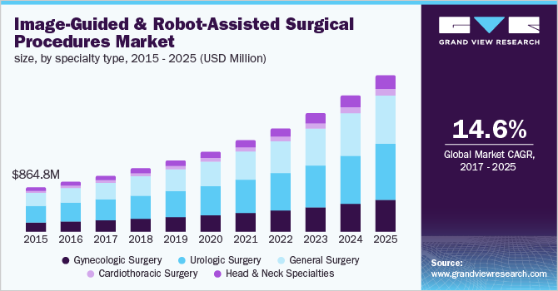
Background
Robotic Surgery applications continue to increase exponentially
Comparative outcomes between robotic and open ventral hernia repair (VHR) regarding gastrointestinal (GI) complications are not well established
Our study evaluates 16,000 ventral hernia repairs (VHR) and compares the rates of 30-day postoperative gastrointestinal complications in open vs robotic cases.
This Document Contains Confidential Quality Assurance Material, Privileged from Disclosure Pursuant to New York State Civil Practice Laws and Rules Article 31§3101(b); New York Education Law Title 8, Article 131 §6527; New York Public Health Law Article 28 §2805(m); and when applicable 42 U.S.C. 299b-22”
Notes:
Robotic surgery continues to increase exponentially, especially in general surgery
Comparative outcomes between robotic and open VHR are not well established and the data is not clear
We set out to perform a highly powered study to answer and compare rates of 30 day postoperative GI complications between robotic and open VHRs

Slide 4
Methods
Retrospective review of prospectively collected data from the ACHQC and identified patients ages 18 to 90 years old undergoing an open or robotic VHR with follow up after 30 days (N = 33488)
After propensity score matching 1:1 adjusting for demographic, clinical, and hernia related factors, our matched patient data was stratified equally into open vs. robotic VHR groups (N = 8148 each group)
Finally, logistic regression analysis was used to compare 30-day rate of GI related complications, readmission, and re-intervention
This Document Contains Confidential Quality Assurance Material, Privileged from Disclosure Pursuant to New York State Civil Practice Laws and Rules Article 31§3101(b); New York Education Law Title 8, Article 131 §6527; New York Public Health Law Article 28 §2805(m); and when applicable 42 U.S.C. 299b-22”
Notes:
So we queried the ACHQC hernia database for adults 18 to 90 years who had undergone either an open vs robotic VHR with a 30 day follow up
We identified 33,000 patients that met this criteria. We matched this group 1:1 adjusting for their demographic and clinical parameters and stratified patients into open vs robotic VHR. Each group had 8148 patients for a total analysis pool of 16296
We then performed logistic regression to determine the rate of GI related complications, readmission, and re-intervention

Slide 5
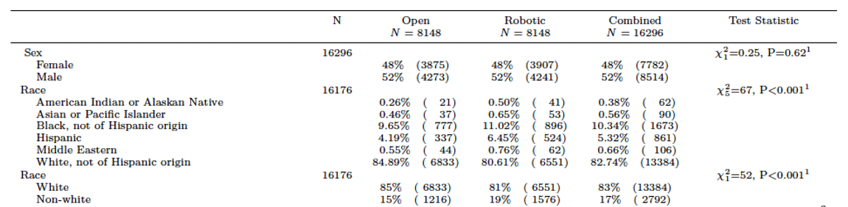
Patient related Demographics
Equal Gender Distribution
85% of patients were white, 15% non-white
Notes:
Lets go over some of the demographics. I am going to breeze through some of these slides.
Our cohort was equally distributed based on gender, and the vast majority were white

Slide 6
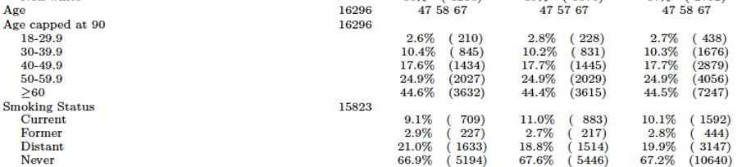
Patient Related Demographics
Average age in our cohort was 58 years
~45% of patients were > 60
Most patients were nonsmokers
Notes:
The average age was 58 years, but the majority of patients were above 60
Most patients were nonsmokers

Slide 7
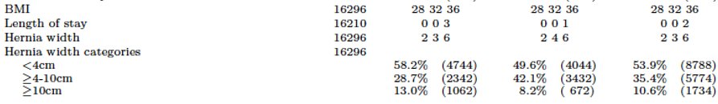
Hernia Related Demographics
Average BMI was 32 (obese)
Average length of stay was 0 days
Most hernias were < 4 cm wide
Notes:
Average BMI was 32
Average LOS was 0 days with a tendency to have higher LOS in the open group
Most hernias repaired were small

Slide 8
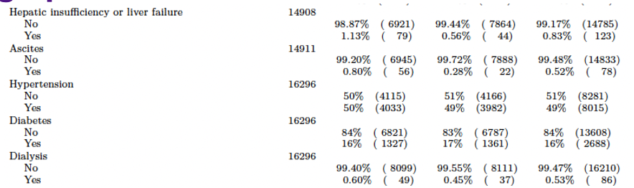
Clinical Demographics
49% had hypertension
18% were diabetics
0.8% had liver disease
0.5% had ESRD on Dialysis
Notes:
In terms of the patient comorbidities:
Most patients were hypertensive
About 20% of them were diabetics
Liver and Kidney disease were rare

Slide 9
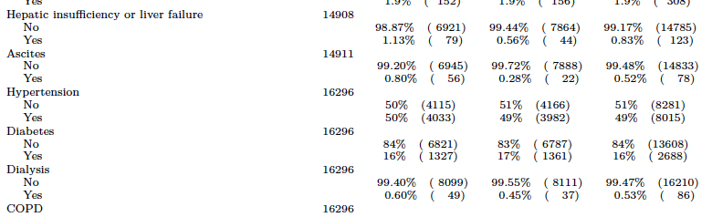
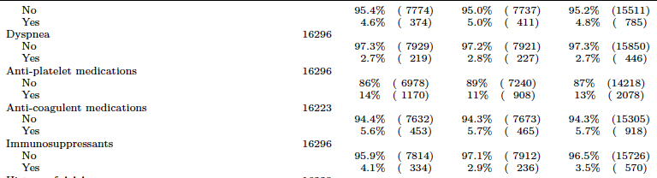
Clinical Demographics
4.5% of patients had COPD
13% were on antiplatelets medication, 5.7% on anticoagulation
3.5% were immunosuppressed
Notes:
4.5% had COPD
19% were on either AC or anti-platelets

Slide 10
Results
Outcome | N = | Open | Robotic | Combined | p-value
30-day readmission | 16,296 | 261/8148 (3.2%) | 234/8148 (2.9%) | 495/16296 (3.0%) | 0.22
Any Postop Complication | 16,296 | 1066/8148 (13%) | 845/8148 (10%) | 1911/16292 (12%) | 0.001
GI-Related Complications
Ileus | 1911 | 25% | 15% | 20% | 0.004
SBO | 1911 | 4.2% | 3.8% | 4% | 0.81
Re-intervention | 1911 | 1.44% | 0.99% | 1.22% | 0.01
Delayed Bowel Injury | 1911 | 0.15% | 0.26% | 0.20% | 0.2
Table 2. 30-day comparative outcomes after open and robotic ventral hernia repair
This Document Contains Confidential Quality Assurance Material, Privileged from Disclosure Pursuant to New York State Civil Practice Laws and Rules Article 31§3101(b); New York Education Law Title 8, Article 131 §6527; New York Public Health Law Article 28 §2805(m); and when applicable 42 U.S.C. 299b-22”
Notes:
30 day readmission rate was on average 3% for any VHR. This is commonly reported in the literature. There was no statistical difference between open and robotic
The rate of any postop complications (this encompasses skin, respiratory, abdominal, hernia related complications) was 12% overall for both procedures. The open VHR group had a statistically significant increased rate of complication of 13% vs 10% for the robotic group
When we filtered for GI-related complications we found that the most common GI related complication is ileus, and ileus is present more commonly after open VHR
We had no statistical difference for SBO
The rate of re-intervention was statistically significantly higher for open VHR, the most common causes for reintervention were wound disruptions
Delayed bowel injury although rare, and not statistically significant was more common after robotic VHR

Slide 11
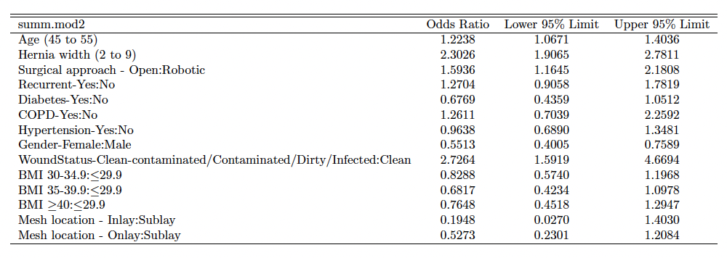
Results
Table 3. Odds Ratios for Gastrointestinal Complications for patient, clinical, and hernia related factors
This Document Contains Confidential Quality Assurance Material, Privileged from Disclosure Pursuant to New York State Civil Practice Laws and Rules Article 31§3101(b); New York Education Law Title 8, Article 131 §6527; New York Public Health Law Article 28 §2805(m); and when applicable 42 U.S.C. 299b-22”
Notes:
Open robotic has an odds ratio of 1.59 for GI related complications when compared to open

Slide 12
Results
Table 3. Odds Ratios for Gastrointestinal Complications for patient, clinical, and hernia related factors
This Document Contains Confidential Quality Assurance Material, Privileged from Disclosure Pursuant to New York State Civil Practice Laws and Rules Article 31§3101(b); New York Education Law Title 8, Article 131 §6527; New York Public Health Law Article 28 §2805(m); and when applicable 42 U.S.C. 299b-22”
Notes:
Other causes or risk factors for GI related complications that we identified were having an operation for a recurrent hernia
Or a contaminated/dirty case

Slide 13
Discussion
Data favors the use of robotic platforms regarding GI complications for the VHR
Of the GI related complications, Ileus is the most common in both groups, being prevalent in the open group: likely due to increased bowel manipulation, retraction, operative stress, and higher analgesia requirements
Need for reintervention was more common after open VHR, likely due to the increased operative trauma, leading to higher rate of complication
Although not statistically significant, delayed bowel injury was more common in the robotic VHR group, likely occurring during motion of the robotic instruments off screen, or second to the absence of haptic feedback
This Document Contains Confidential Quality Assurance Material, Privileged from Disclosure Pursuant to New York State Civil Practice Laws and Rules Article 31§3101(b); New York Education Law Title 8, Article 131 §6527; New York Public Health Law Article 28 §2805(m); and when applicable 42 U.S.C. 299b-22”
Notes:
From these results:

Slide 14
Conclusion
Robotic VHR represents a safer alternative regarding GI complications to open VHR, provided the necessary resources and expertise are available
Future research should investigate the long-term benefits and cost-effectiveness of the robotic approach
Notes:
With less rate of postoperative complications and GI-related complications such as ileus, and less rate for re-intervention in the first 30-days,

Slide 15
Strengths and Limitations
Strengths:
  Highly powered study encompassing an analysis of ~16,000 patients
  There is paucity of data evaluating robotic outcomes in comparison to open VHRs. The majority of the minimally invasive data stems from laparoscopic operations, and none evaluates the rate of GI-related complications
Limitations:
  Retrospective analysis of surgeon compiled and reported data
  Data acquired from ACHQC Database with possible variations in reporting methods

Slide 16


