Slide 1
Laparoscopic Paraesophageal Hernia Repair With Mesh Augmentation
Nir Messer, MD
Hernia Fellow
Cleveland Clinic Foundation

Slide 2
Disclosures
None

Slide 3
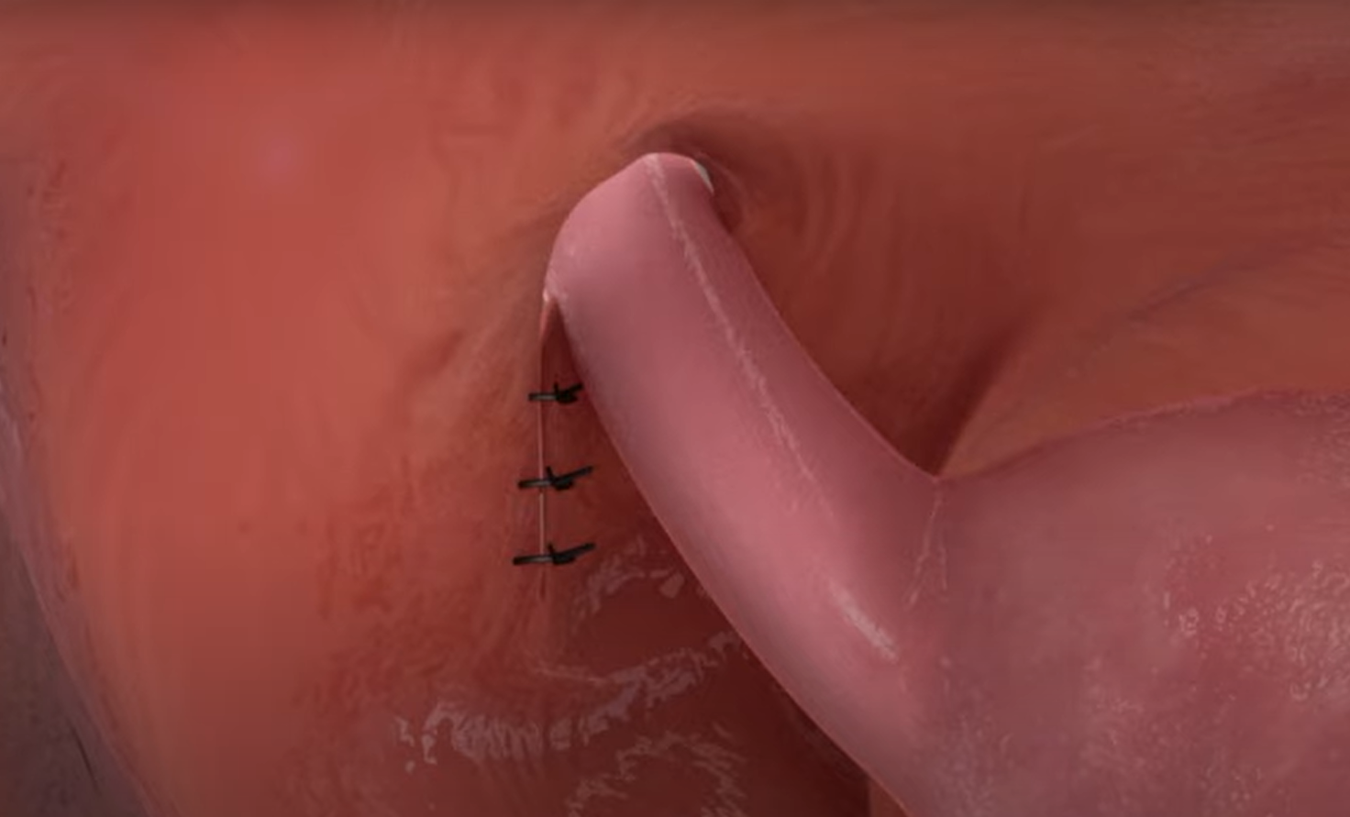
Classic Approach
Hernia sac reduction
Intra-thoracic esophageal mobilization
Primary posterior hiatal suturing
± Antireflux procedure
± Gastropexy
High Recurrence Rates

Slide 4
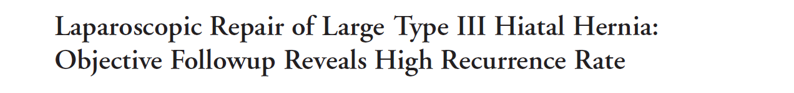
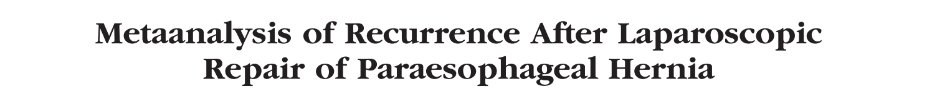
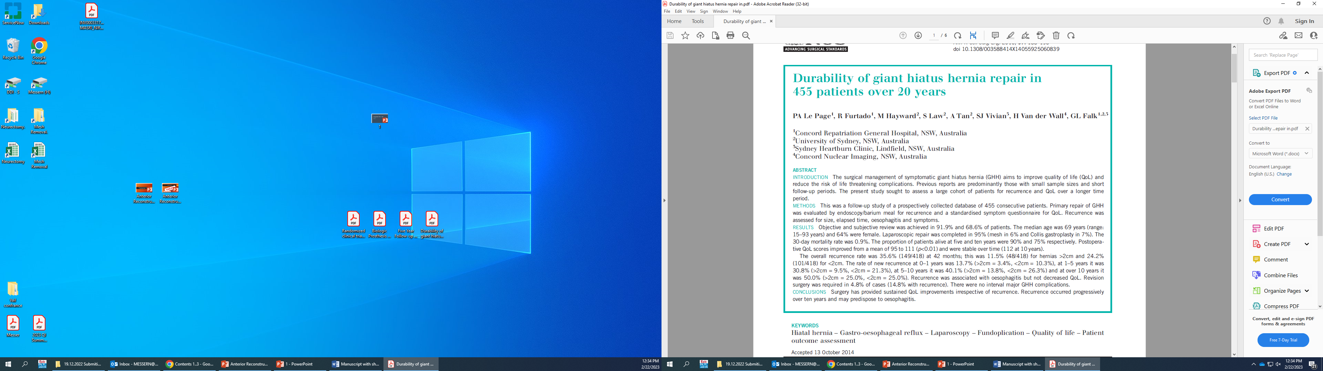
Recurrence rate
Time | Recurrence Rate
24 months | 42%
Time | Recurrence Rate
24 months | 25.5%
Time | Recurrence Rate
One year | 13.7%
1-5 years | 30.8%
5–10 years | 40.1%
over 10 years | 50.0%
Notes:
Journal of the American College of Surgeons

Slide 5
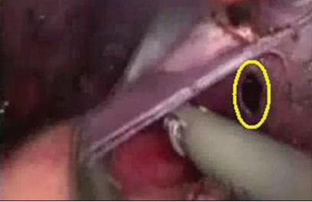
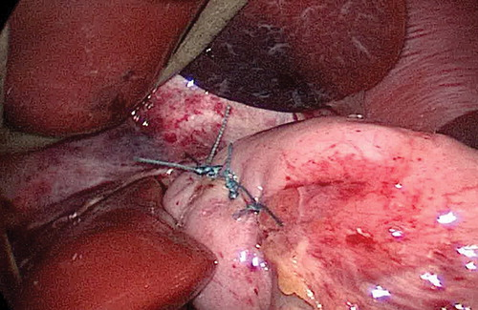
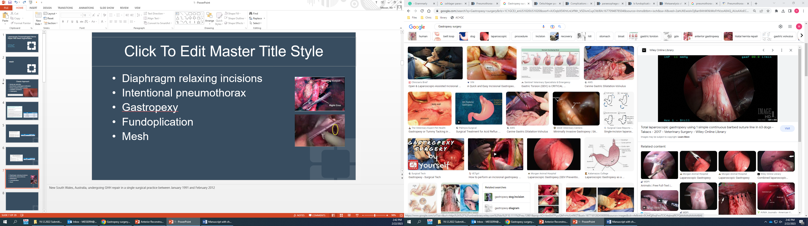
Overcoming the Obstacle
Diaphragm relaxing incisions
Intentional pneumothorax
Gastropexy
Fundoplication
Notes:
New South Wales, Australia, undergoing GHH repair in a single surgical practice between January 1991 and February 2012

Slide 6

Mesh

Slide 7
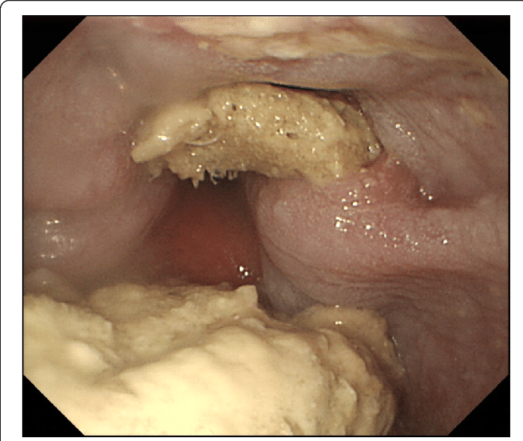
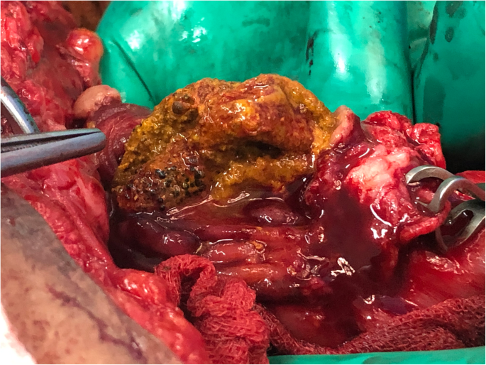
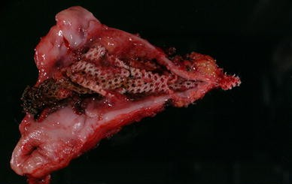
Notes:
Mesh erosion
Mesh migration
Esophageal stenosis

Slide 8
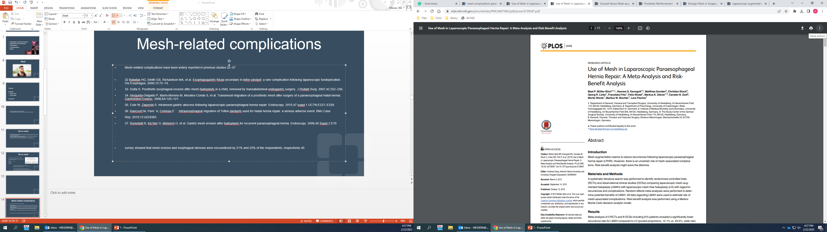
Mesh complications | N = 5499
Stenosis | 27 (0.4%)
Erosions | 49 (0.8%)
Fistula | 1 (0.01%)
Cardiac tamponade | 8 (0.1%)
Fibrosis | 5 (0.09%)
Aortic lesion | 2 (0.02%)
Total | 91 (1.6%)
124 studies
5499 patients with mesh
Mean follow-up - 34 months
Notes:
2015
Germany

Slide 9
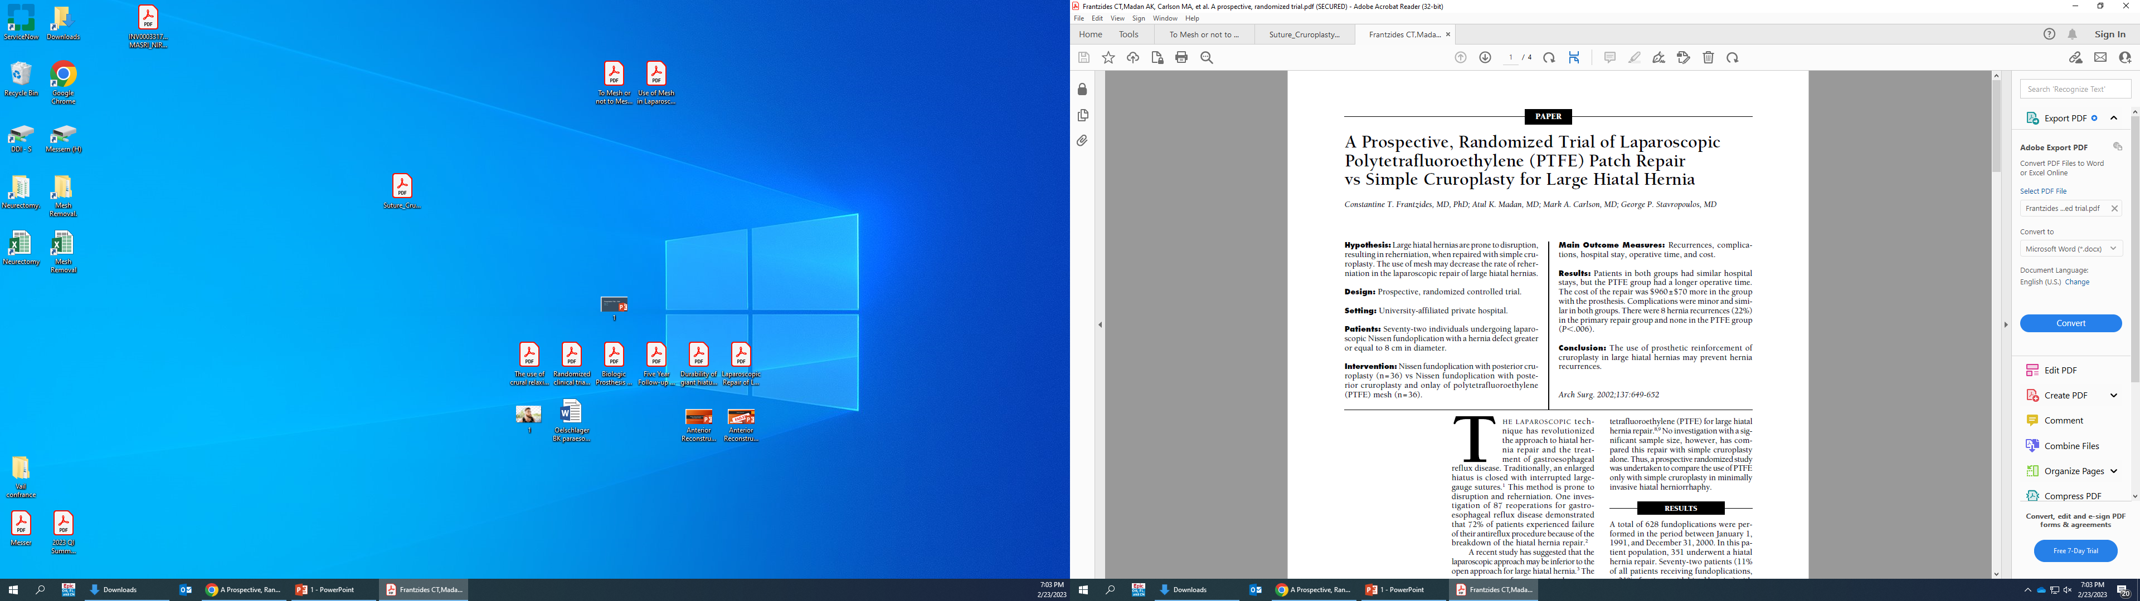
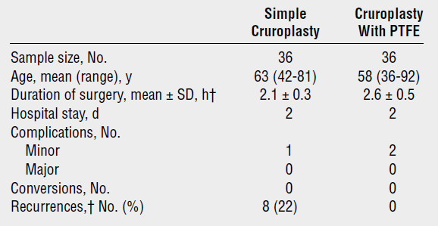
Yes! to mesh
36 cruroplasty
36 cruroplasty + PTFE mesh
Hernia size >8 cm
Mean follow-up 39 months
Notes:
2002
The Archives of Surgery
PTFE complications: Pneumonia & urinary retention.
Non mesh: pneumothorax.

Slide 10
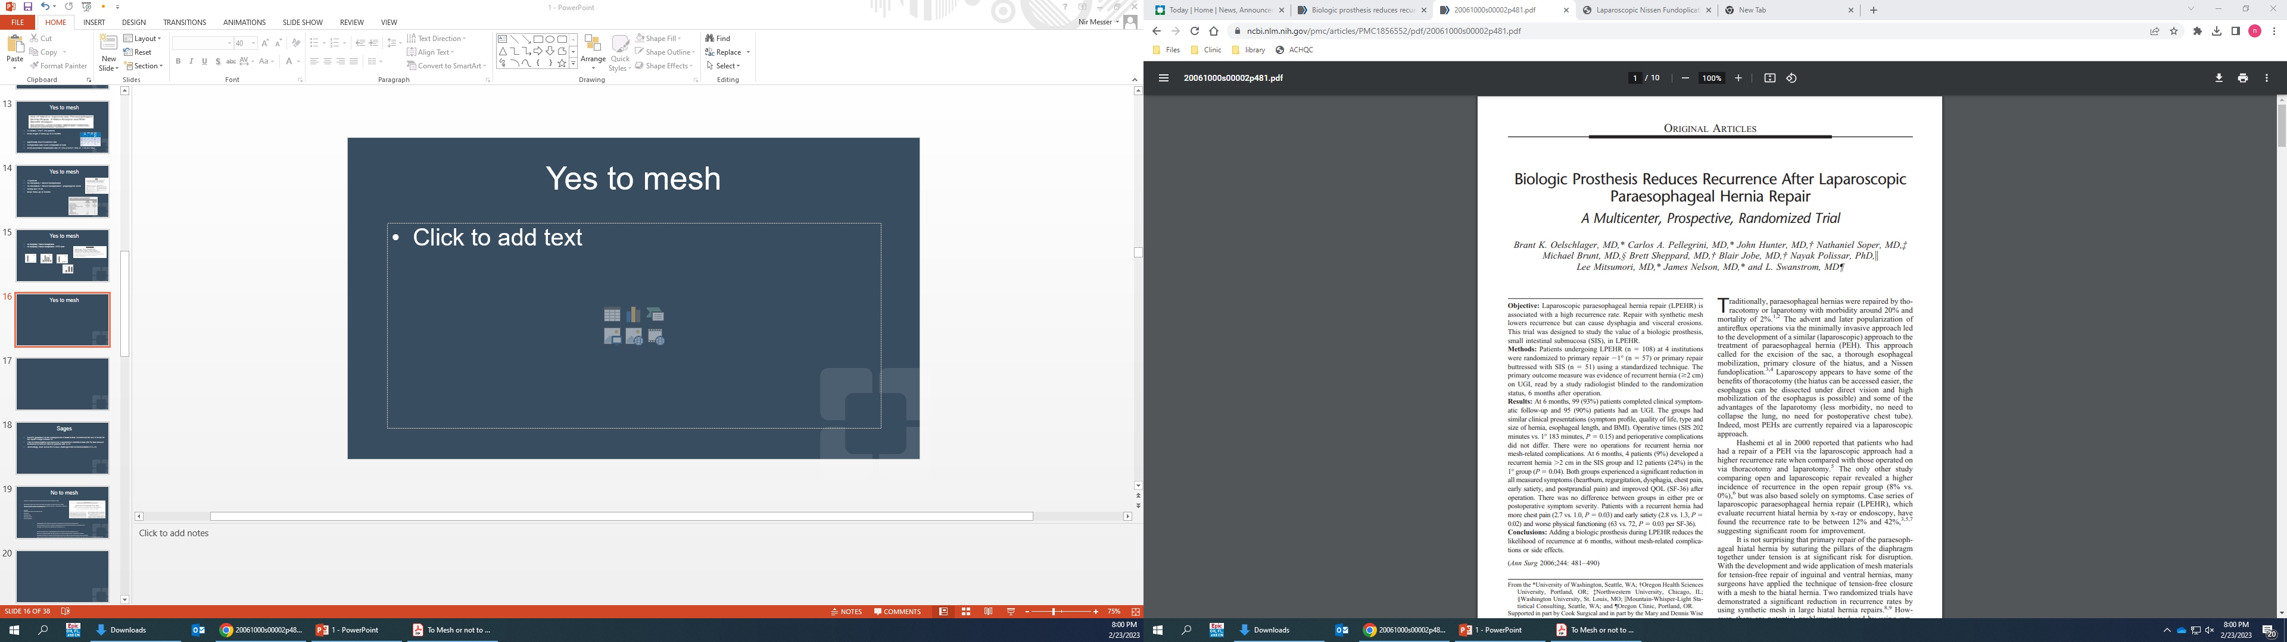
Yes! to mesh
57 cruroplasty
51 cruroplasty + Biologic mesh
6 months follow up
Hernia recurrence
Primary repair group 24%
Mesh group 9%
(P = 0.04)
Notes:
Ann Surg 2006
small intestinal submucosa (SIS)

Slide 11
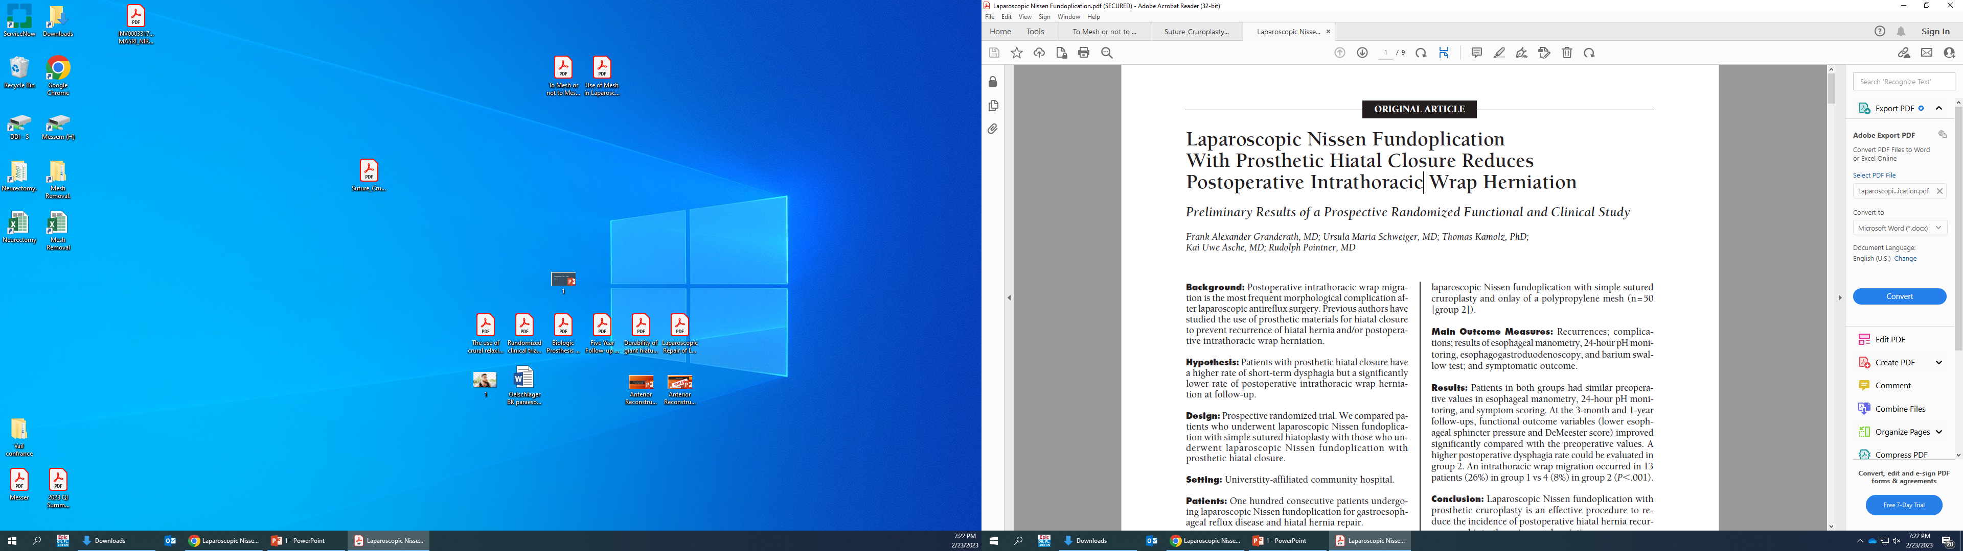
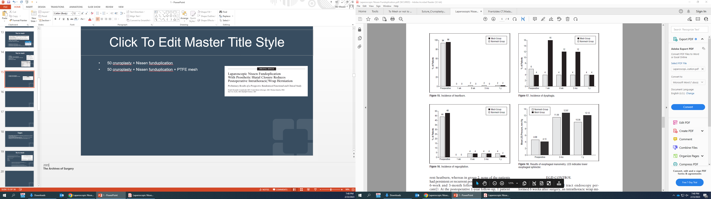
Yes! to mesh
50 cruroplasty
50 cruroplasty + polypropylene mesh
Notes:
2005
The Archives of Surgery

Slide 12
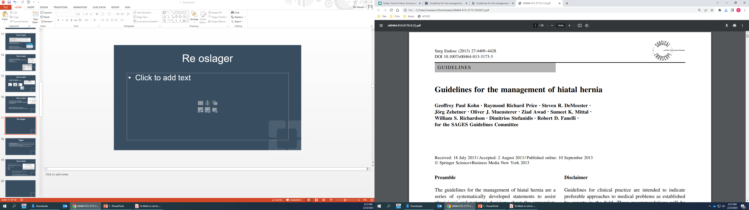
SAGES Guidelines
Guideline 11
The use of mesh for reinforcement of large hiatal hernia repairs leads to decreased short term recurrence rates (+++ strong)

Slide 13
Yes! to mesh
12 studies, 3 RCT
915 patients
Mean follow-up of 34 months
 | No mesh | Mesh | Odds ratio | confidence interval | p
Recurrence rate | 20.5% | 12.1% | 0.55 | 0.34 - 0.89 | 0.04
Complications rates | 14.2% | 15.3% | 1.02 | 0.63 - 1.65 | 0.94
Notes:
2015

Slide 14
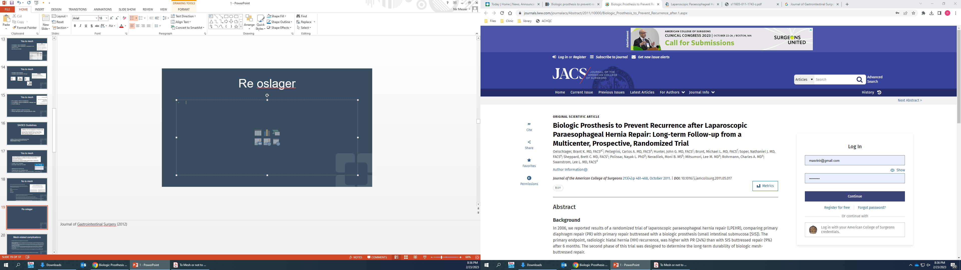
No! to mesh
5 years follow-up
Similar recurrence rates
Primary repair group 59%
Mesh group 54%
(P = 0.7)
Notes:
Journal of Gastrointestinal Surgery (2012)
Similar recurrence rates

Slide 15
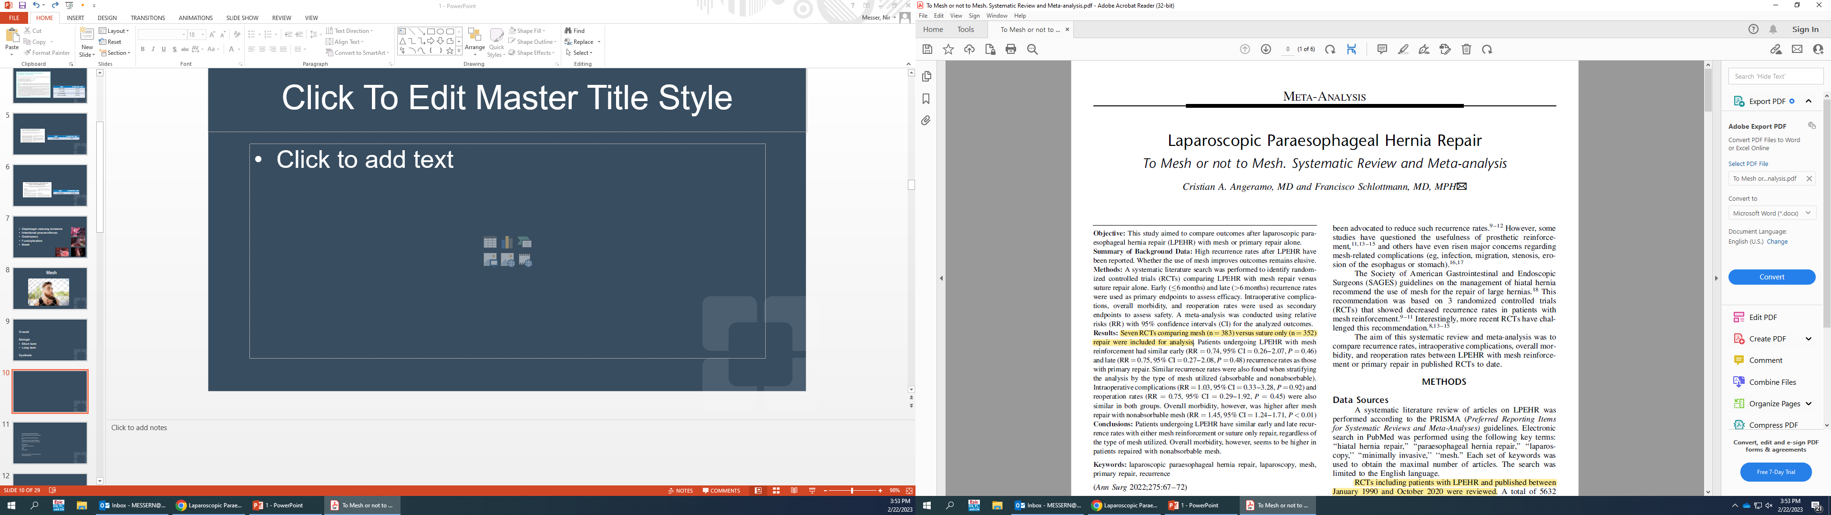
No! to mesh
 | Relative Risk | confidence interval | p
Early recurrence rates | 0.77 | 0.26 – 2.07 | 0. 46
Late recurrence rates | 0.75 | 0.27-2.08 | 0.48
Intraoperative complications | 1.03 | 0.33-3.28 | 0.92
Reoperation rates | 0.75 | 0.29-1.92 | 0.45
Overall morbidity | 1.45 | 1.24 - 1.71 | 0.01
7 RCTs
Mesh (n=383)
Primary repair (n=352)
Notes:
Annals of surg 2022
Mesh reinforcement did not reduce early or late recurrence rates regardless of the type of mesh used
Overall morbidity was higher after mesh repair, especially with the use of nonabsorbable mesh.
Study limits:
Published between January 1990 and October 2020
Heterogeneity
different thecniques
different types of mesh
Recurrency defenation

Slide 16
Pitfalls
Heterogeneous operative methods
Type of mesh, mesh position, fundoplication, gastropexy.
Inconsistent definitions of a recurrence
Clinical recurrence (mild vs. severe), radiographic recurrence (small vs. large)
Notes:
Young, old, obesity, diabetes
elective, urgent, clean, dirty, primary, incisional hernia cases

Slide 17
Conclusions
Risks are less severe as we perceive
Biological meshes are ineffective
Data is insufficient to determine whether a synthetic mesh is effective

Slide 18

Thank You

Slide 21
Anterior repair approach

Slide 22
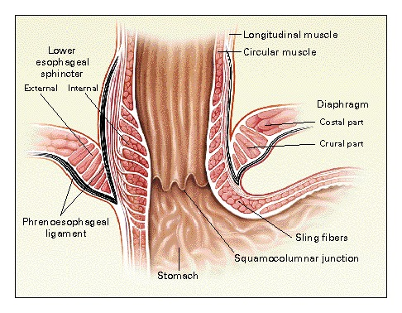
Physiology of the anti-reflux barrier
Muscular component:
The lower esophageal sphincter (LES)
Gastric cardia's sling fibers
Notes:
Gastric cardia's sling fibers are oriented diagonally from the cardia-fundus to the lower curve of the stomach.

Slide 23
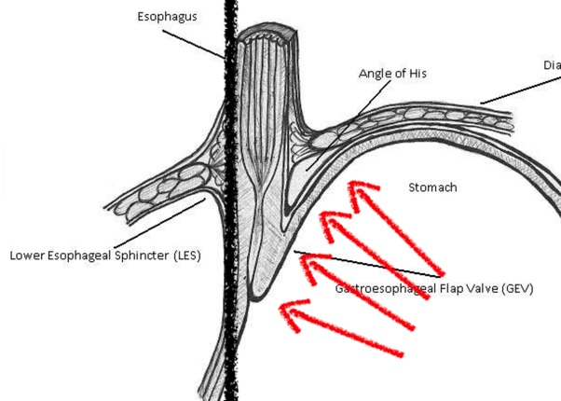
Physiology of the anti-reflux barrier
Mechanical component:
increased intra-abdominal pressure compress the GEJ against the spine
Notes:
The esophageal hiatus is anchored to the spine posteriorly.
During inspiration, intrathoracic pressure decreases, the anteroposterior diameter of the crural opening is decreased, compressing the esophagus.

Slide 24
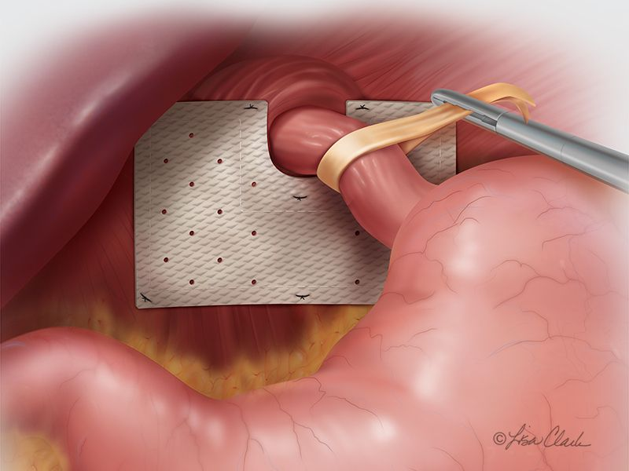

Slide 25
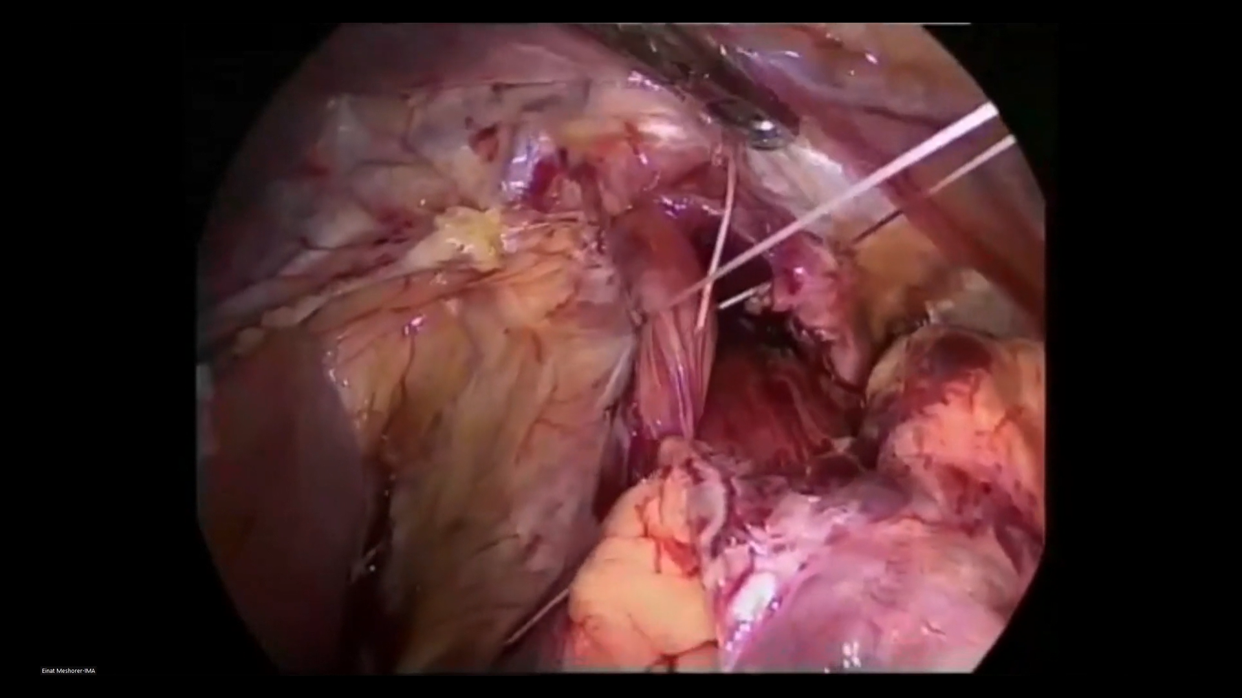
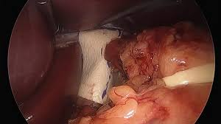

Slide 26
196
underwent laparoscopic repair
8
Combined motility disorder
Retrospective
178 patients
Mean follow-up - 65 months
4
Lack of follow up
6
Died of unrelated reasons
178
patients

Slide 27
 | N (%)
Clinical success | 156 (87.7%)
Recurrence of symptoms | 22 (12.3%)
Minor recurrence | 16 (8.9%)
Significant recurrence | 14 (7.8%)
Reoperation | 12 (6.7%)
Notes:
178

Slide 28
Thank You

