Slide 1


Can Surgeons Accurately Interpret Prior Ventral Hernia Repairs Using Postoperative CT Scans?
QI Summit: March 4-5, 2023, Denver, CO
Kaela E. Blake, MD
Assistant Professor of Surgery
MIS, Bariatrics & Abdominal Wall Reconstruction
University of Tennessee Graduate School of Medicine
University of Tennessee Medical Center, Knoxville, TN

Slide 2
Disclosures
No conflicts of interest to disclose

Slide 3

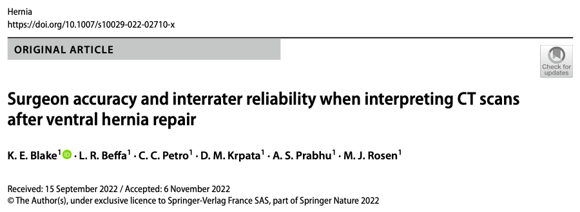
Can surgeons accurately identify the type of VHR performed based on CT?
Methods:
15 expert AWR surgeons from 10 institutions reviewed 21 CT scans (axials)

Slide 4
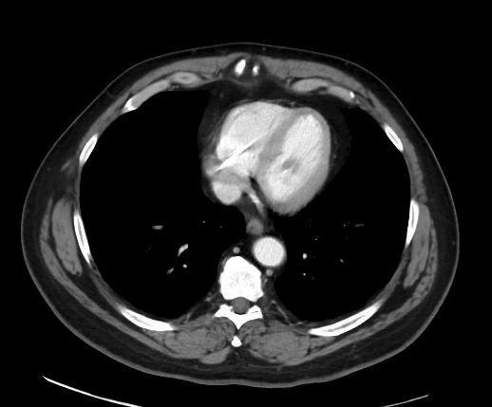
Multiple choices for each CT scan:
a) Robotic IPOM+
b) Robotic eTEP
c) Open Rives Stoppa
d) Open Anterior Component Separation
e) Open TAR
f) Positive Control (prior laparotomy without hernia repair)
g) Negative Control (no prior laparotomy or hernia repair)
Notes:
Robo eTEP

Slide 5
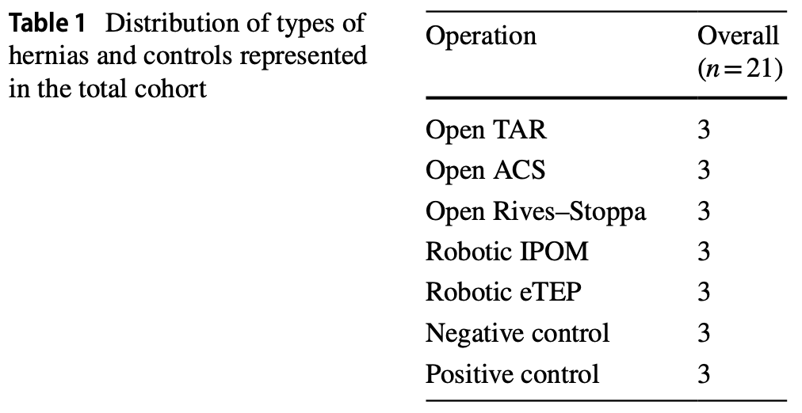

Slide 6
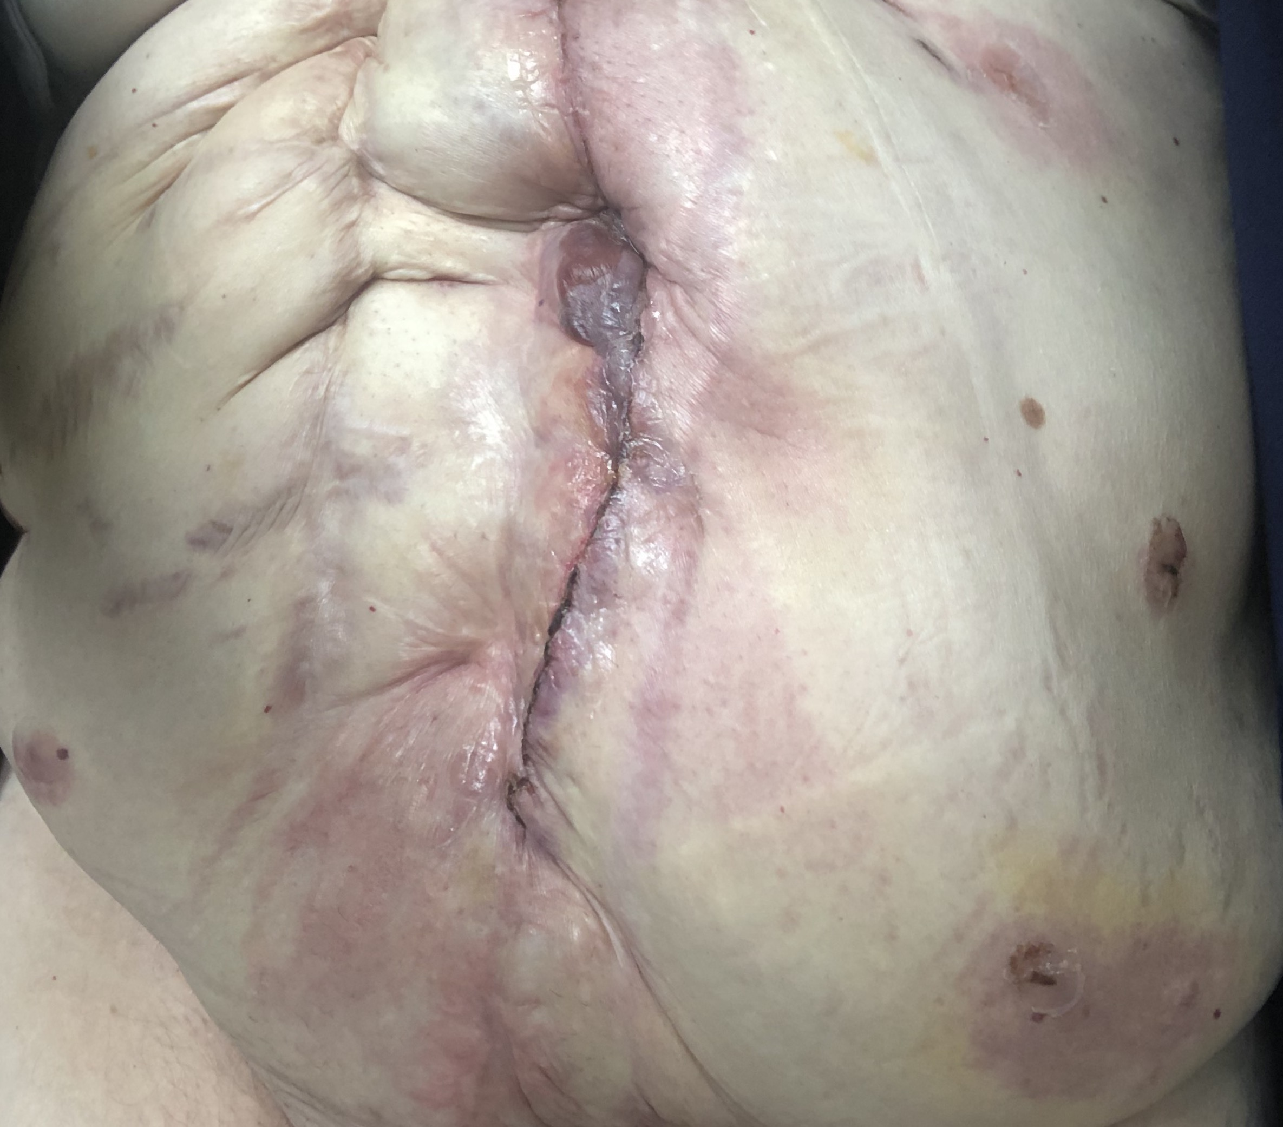
Exclusion Criteria:
Multiple prior incisional hernia repairs
Hernia recurrence or wound complications on imaging
Hernia repairs not listed in multiple choices
Main Outcomes:
Surgeon accuracy
Interrater reliability (agreement) among surgeons
Repeatability – if an individual surgeon could identify the same type of hernia repair in reproducible manner
→
→
→

Slide 7
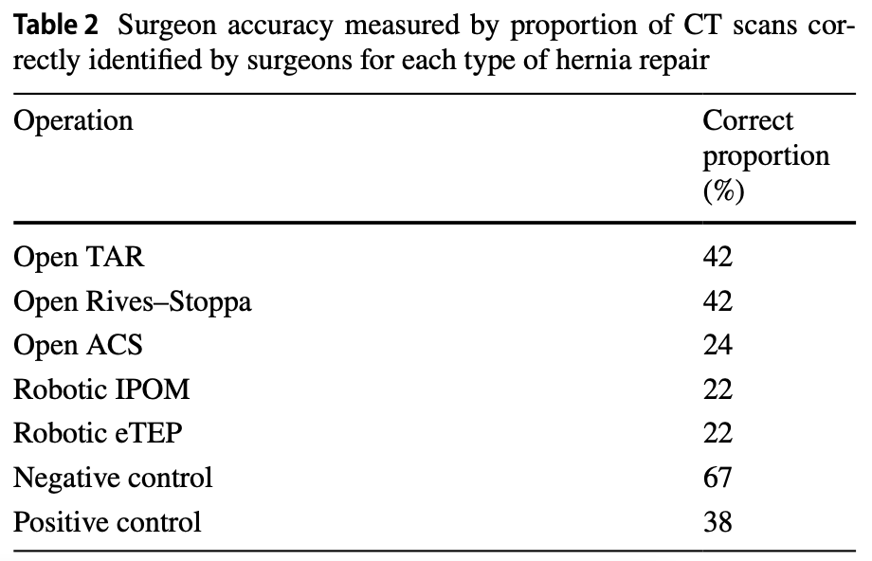
Results: Accuracy
Expert AWR surgeons unable to accurately determine the correct hernia repair over 50% of the time.

Slide 8
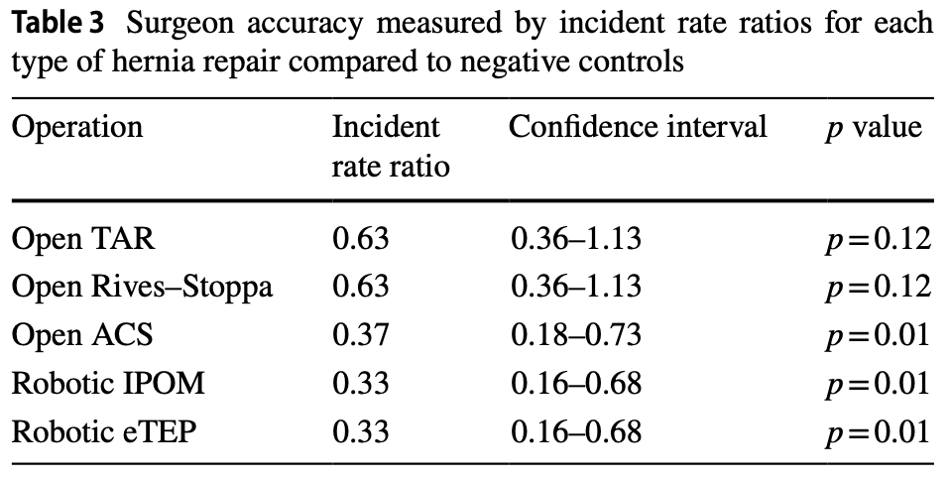
Results: Accuracy
Incident Rate Ratio –
Controls for variability among the same surgeon
Similar to odds ratios
(> 1 = easier, < 1 = harder to identify compared to identifying negative controls)
Surgeons significantly worse at identifying:
-Open ACS
-Robotic IPOM
-Robotic eTEP
(compared to negative controls)

Slide 9
Results:
Interrater reliability (agreement on answers)—whether correct or incorrect
Fair - agreement coefficient of 0.23 (95% CI 0.15–0.302, p = 0.01)]
Surgeons sometimes agreed, but often on the wrong answer.
Repeatability – if individual surgeon correctly answers the same type of hernia repair in a reproducible manner
Poor (R = 0.046, CI 0–0.14, p = 0.03)
Coefficient Ranges:
< 0.2 is poor
0.2–0.4 is fair
0.4–0.6 is moderate
0.6–0.8 is good
0.8–1 is very good
Repeatability (R):
R = 1 considered good
Results farther from 1 = considered poor

Slide 10
Conclusions:
Surgeons’ ability to accurately determine the type of previous ventral hernia repair using axial CT scans is poor
Hernia repairs correctly identified less than 50% of the time
Robotic approaches were the most difficult
Surgeon agreement was fair, but they were often incorrect when they did agree.

Slide 11
Main takeaways:
Understanding prior operative history important for recurrent hernia repair – surgical planning, OR booking, patient counseling
When prior operative reports are missing or incomplete, this information cannot accurately be gleaned from CT scans.
Highlights the importance of:
Accurate OR dictations
Using necessary resources to obtain prior OP notes

Slide 12

Thank you.

