Slide 1

Single-stage stoma reversal with AWR: Have we crossed the line?
ACHQC QI Summit
Megan Melland-Smith, MD
Notes:
Preventing incision hernia following stoma closure – To mesh or not to mesh?
10-12 minute presentation

Slide 2
Disclosures
Study Funding: none
Clayton Petro
BD Consultant
Surgimatix Consultant
Research Grants - AHS, CSA, SAGES
Ajita Prabhu
Speaking fees and research support paid to institution from Intuitive Surgical
Consulting fees and is on the Advisory Board for CMR Surgical
Consulting fees from Verb Surgical
Lucas Beffa
Honoraria from Intuitive Surgical
Michael Rosen
Medical director of ACHQC
Stock options with Ariste

Slide 3
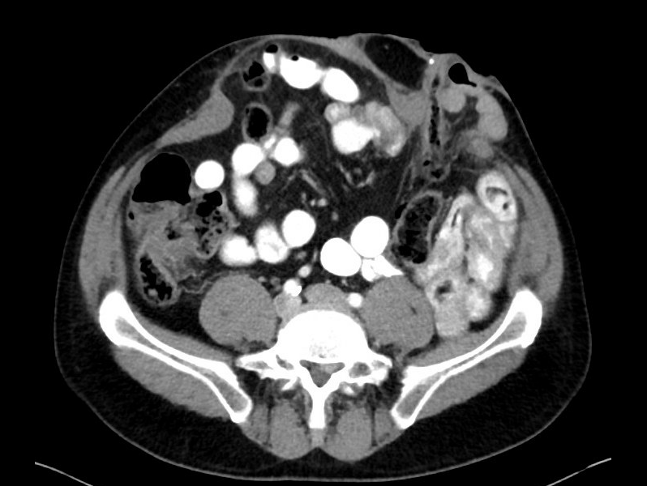
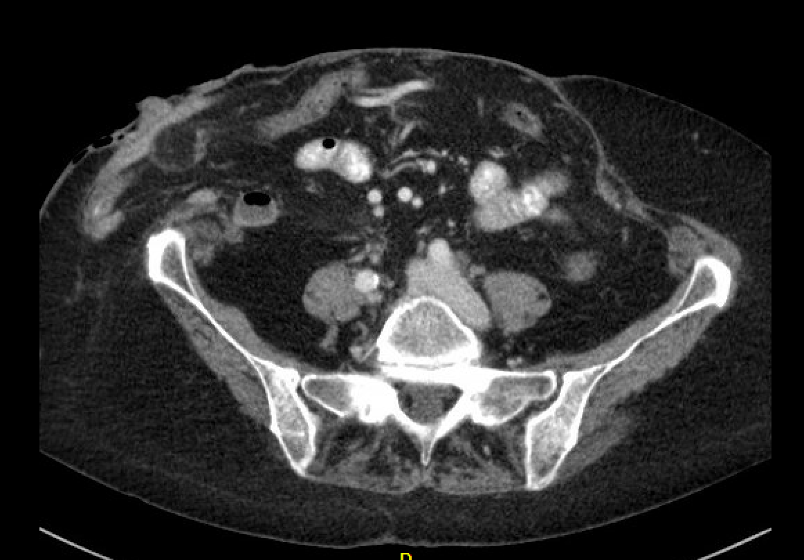
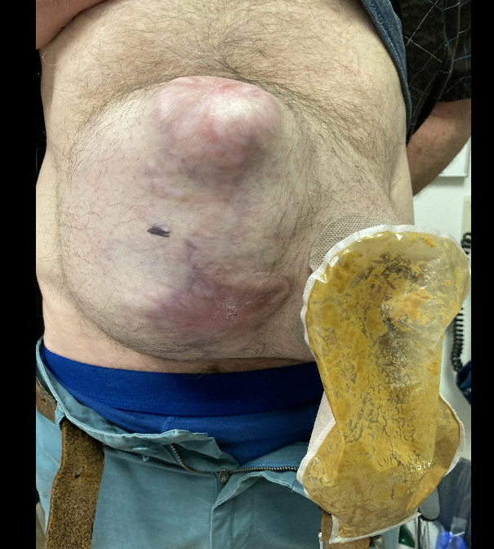
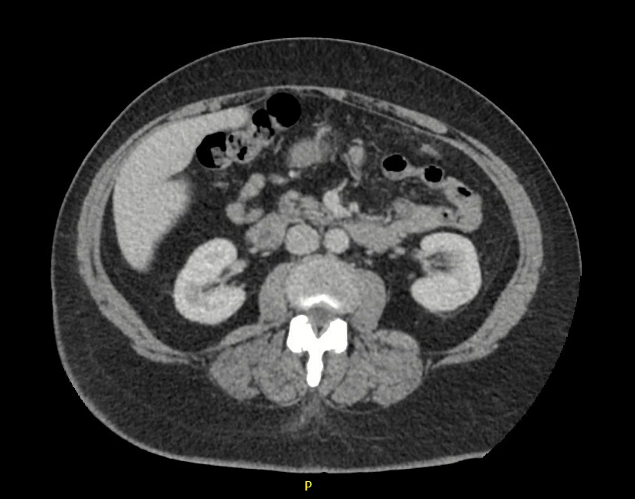
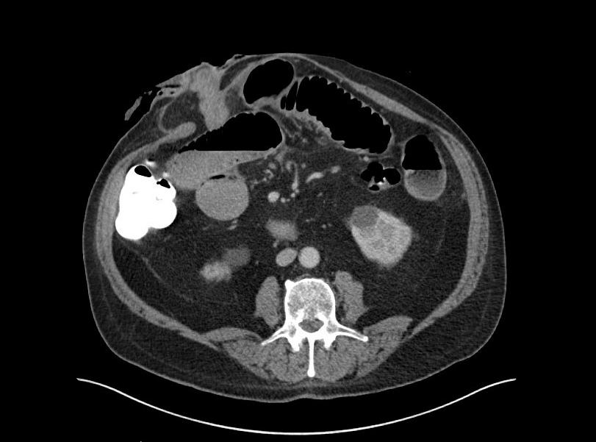
Temporary Stomas & Hernias
Notes:
Temporary stomas are interesting to hernia surgoens because they have usually these patients have gone through an abdominal catastrophy in order obtain this stoma
They frequently are left with large midline and parastomal defects.
Post perforated diverticulitits, s/p Hartmanns, with a midline wound infection.

Slide 4

Stoma Closure
Common referral from Colorectal surgery
Opportunity to consolidate surgeries
Risk vs benefit
Primary suture repair of ostomy site: 20-40% incisional hernias (Bhanghu et al. 2012)
To stage or not to stage?
Notes:
The colorectal surgeons don’t always dominate the day, instead they just refer these complex abdomens to us after they’ve told the patient that the whole thing can be fixed at the same time.
Consolidating surgeries really is an attractive option for patients, 1 admission, 1 GA
But what is often underestimated by CORS is the risk of putting mesh on top of a fresh anastomosis
There was a meta-analysis from 2012 which showed an incisional hernia repair of 20-40% following primary suture closure of ostomy sites, and this paper didn’t specifically identify patients with existing abdominal wall hernias
The ultimate decision is whether or not to stage these pateints.

Slide 5

Fight or Flight
Petro and Rosen, 2018
Notes:
A concept that was very nicely put into words by Dr. Petro and Dr. Rosen.
Consent for both. I think its important to go into these cases with the mindset that you might not go ahead with AWR.

Slide 6
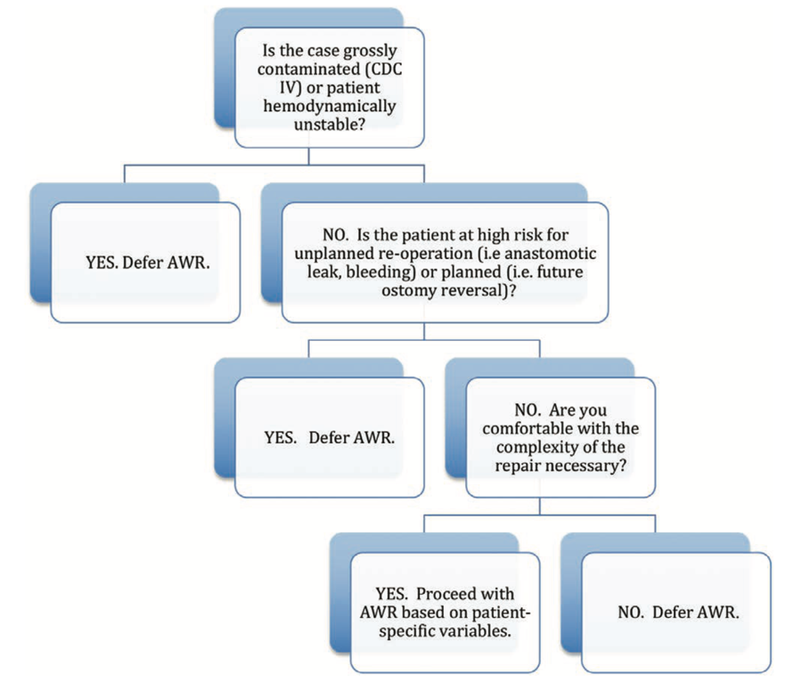
Time for flight
Staged approach
Prohibitive level of contamination
Risk of re-operation - i.e. anastomotic leak
Need for diverting loop ileostomy
Surgeon comfort
What’s going to be different next time?
Notes:
There’s times when you should get on that airplane and get out of the OR. And that should be explicit in the consent process.
There definitely are things that you can run into in the operating room that should push you away from reconstructing.
This is an algorithm from the paper that nicely outlines these scenarios
The first being gross contamination
Second is the risk of re-operation – anastomotic leak
And I think the most important question is….what’s going to be different next time? With temporary stomas next time there isn’t going to be a stoma and that’s a huge advantage

Slide 7

Let’s Fight!
Single stage approach
GI part of the case = Perfect
Optimized patient with adequate nutrition
**Obese, diabetic smoker with high output stoma**
Can tolerate another several hours of anesthesia
Notes:
There’s times when it is appropriate to bring the boxing mitts and go for everything at once.
These are cases where the GI part goes well. The anastomosis was tension free, well-perfused. The patients not an obese diabetic smoker with a HOPS and the colorectal surgeons havent taken 7 hourss
The case didn’t take a million hours.

Slide 8
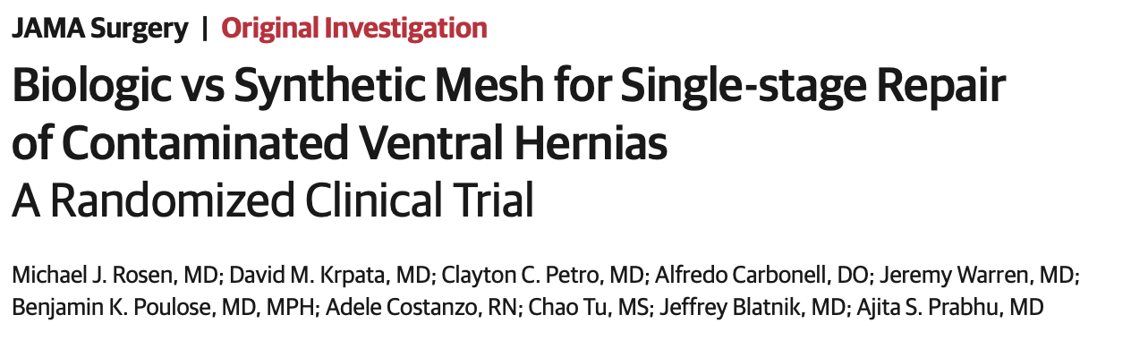

Mesh in Contaminated Fields
Phasix??
Biologic vs synthetic:
SSOPI - 27.6% vs 24.6%
SSI - 21.3% vs 15.1%
SSO - 7.1% vs 11.1%
1 biologic mesh excision
2 yr recurrence rate: 20.5% vs 5.6%
Short-term infectious complications do not translate into long term recurrence with synthetic mesh
Notes:
If you are going to fight then you have to be ok with mesh in contaminated fields
In the biologic vs synthetic randomized trial the use of synthetic mesh was proven to be safe in contaminated settings, with a slightly increased risk of post-operative wound morbidity. Its interesting that this wound morbidity didn’t translate into mesh excision or recurrence. Despite dealing with upfront wound morbidity, this doesn’t translate into

Slide 9
Single-stage stoma reversal with AWR: Have we crossed the line? An ACHQC Analysis Melland-Smith et al.
Notes:
So we decided to query the QC and look at all the stoma takedowns with concurrent AWR

Slide 10
Patient Characteristics
Variable | Permanent synthetic n= 279 | Biologic n= 46 | Resorbable synthetic n= 43 | p-value
Age, y, median (IQR) | 62 (51-69) | 59 (49-70) | 59 (53-68) | 0.7
BMI, kg/m², median (IQR) | 30.3 (26.2-35.4) | 29.0 (25.2-31.9) | 30.8 (27.6-32.9) | 0.1
Diabetes mellitus, n (%) | 57 (20.4) | 9 (19.2) | 8 (18.6) | 0.9
Smoking, n (%) | 50 (18.1) | 10 (21.7) | 10 (23.3) | 0.6
Immunosuppressants | 17 (6.1) | 3 (6.5) | 5 (11.6) | 0.4
Hx of abdominal wall infection | 69 (24.7) | 13 (28.3) | 18 (41.9) | 0.06
Mesh location, n (%)
Retromuscular/preperitoneal | 279 (100.0) | 46 (100.0) | 43 (100.0) | NA
Recurrent hernia, n (%) | 50 (17.9) | 8 (17.4) | 8 (18.6) | 0.9
Type of hernia, n (%)
Incisional | 214 (76.7) | 38 (82.6) | 33 (76.7) | 0.6
Parastomal | 210 (75.3) | 27 (58.7) | 22 (51.2) | 0.01
368 patients
Permanent synthetic (PS) vs Biologic vs Resorbable synthetic (RS)
Retromuscular mesh
89 ileostomies, 276 colostomies, 3 both

Slide 11
Hernia Characteristics
Variable | Permanent synthetic n = 279 | Biologic n = 46 | Resorbable synthetic n = 43 | p-value
Bowel preparation | 171 (61.3) | 23 (50.0) | 22 (51.2) | 0.9
Hernia width cm, median (IQR) | 11.0 (6.0-15.0) | 12.5 (8.0-16.1) | 10.0 (6.0-12.1) | 0.2
Mesh width cm, median (IQR) | 23.0 (16.7-30.0) | 22.0 (18.9-30.0) | 20.0 (12.4-25.0) | 0.02
Myofascial release, n (%) | 261 (93.6) | 40 (87.0) | 38 (88.4) | 0.2
External oblique | 4 (1.5) | 2 (5.0) | 4 (10.5) | 0.01*
Transversus abdominus | 186 (71.3) | 29 (72.5) | 25 (65.8) | 0.6
Fascial closure, n (%) | 271 (97.1) | 45 (97.8) | 42 (97.7) | 0.9
Operative time >240 min, n (%) | 193 (69.2) | 32 (69.6) | 27 (62.8) | 0.5
Approach |  |  |  | 0.2
Laparoscopic | 0 (0) | 1 (2.2) | 1 (2.3) | -
Open | 278 (99.6) | 45 (97.8) | 42 (97.7) | -
Robotic | 1 (0.4) | 0 | 0 (0) | -
Avg hernia width 11.2cm
>65% TARs
>97% fascial closure
>97% open repairs

Slide 12
30-day Outcomes
#
Mesh type | PS (n= 242) | Biologic (n= 42) | RS (n= 38) | p-value
SSI, n (%) | 32 (13.2) | 6 (14.3) | 5 (13.2) | 0.9
Superficial | 12 (37.5) | 4 (66.7) | 3 (60.0) | 0.3
Deep | 13 (40.6) | 2 (33.3) | 2 (13.2) | 0.9
Organ space | 11 (34.4) | 0 (0) | 1 (20.0) | 0.2
SSO, n (%) | 43 (17.8) | 5 (11.9) | 4 (10.5) | 0.4
SSOPI, n (%) | 34 (14.1) | 6 (14.3) | 3 (7.9) | 0.6
Length of stay, d, median (IQR) | 5 (4-7) | 7 (4-9) | 7 (5-10) | 0.04*
Reoperation, n (%) | 9 (3.7) | 2 (4.8) | 2 (5.3) | 0.9
Readmission, n (%) | 25 (10.3) | 6 (14.3) | 6 (15.8) | 0.5
No differences between mesh types
3 PS mesh infections
1 PS mesh excision
4 PS enterocutaneous fistulas
Only 1 mesh infection AND EC fistula
??? Anastomotic leak
#
Notes:
Anastomotic leak is not captured on the QC, we weren’t able to look at that. When is a limitation of this study.

Slide 13
1-Year Outcomes
Mesh type/location (number of patients with 1-yr follow-up) | Recurrence 1 year, n (%) | HerQLes baseline, Median (IQR) | HerQLes 1 year, Median (IQR)
PS (n=98) | 6 (6.1) | 41.7 (20.0-69.4) | 83.3 (59.6-95.1)
Biologic (n=31) | 1 (3.2) | 8.3 (6.1-39.4) | 95.0 (80.3-100.0)
RS (n=13) | 1 (7.7) | 47.5 (23.3-87.8) | 66.7 (51.4-95.8)
p-value | P=0.56 | P=0.05 | P=0.3
35% f/u
74% f/u
34% f/u
* 5 of 8 were colostomies
* BMI 30, hernia width 10.8 cm
* 3 parastomal hernias, 2 incisional hernias, 3 both

Slide 14
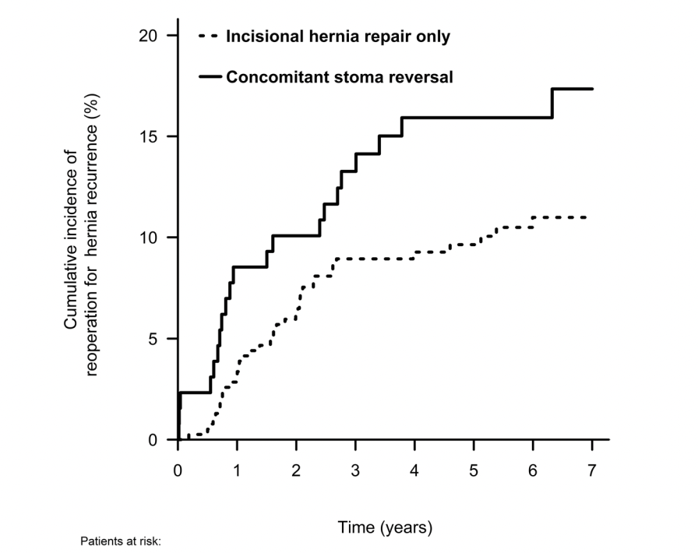
Discussion
No significant differences in wound morbidity between mesh types
Only PS mesh infection, excision, EC fistula
Risk of anastomotic leak cannot be underestimated
Danish Hernia Database 2021 – 5.4% leak rate
Obliterated retromuscular plane → Complicates future AWR
Oma et al. 2021, Hernia
Notes:
RM mesh is resilient
While we didn’t capture anastomotic leak in this study, the risk of anastomtic leak cannot be underestimated in these cases.
No comment on which type of mesh or in which location the mesh was placed

Slide 15
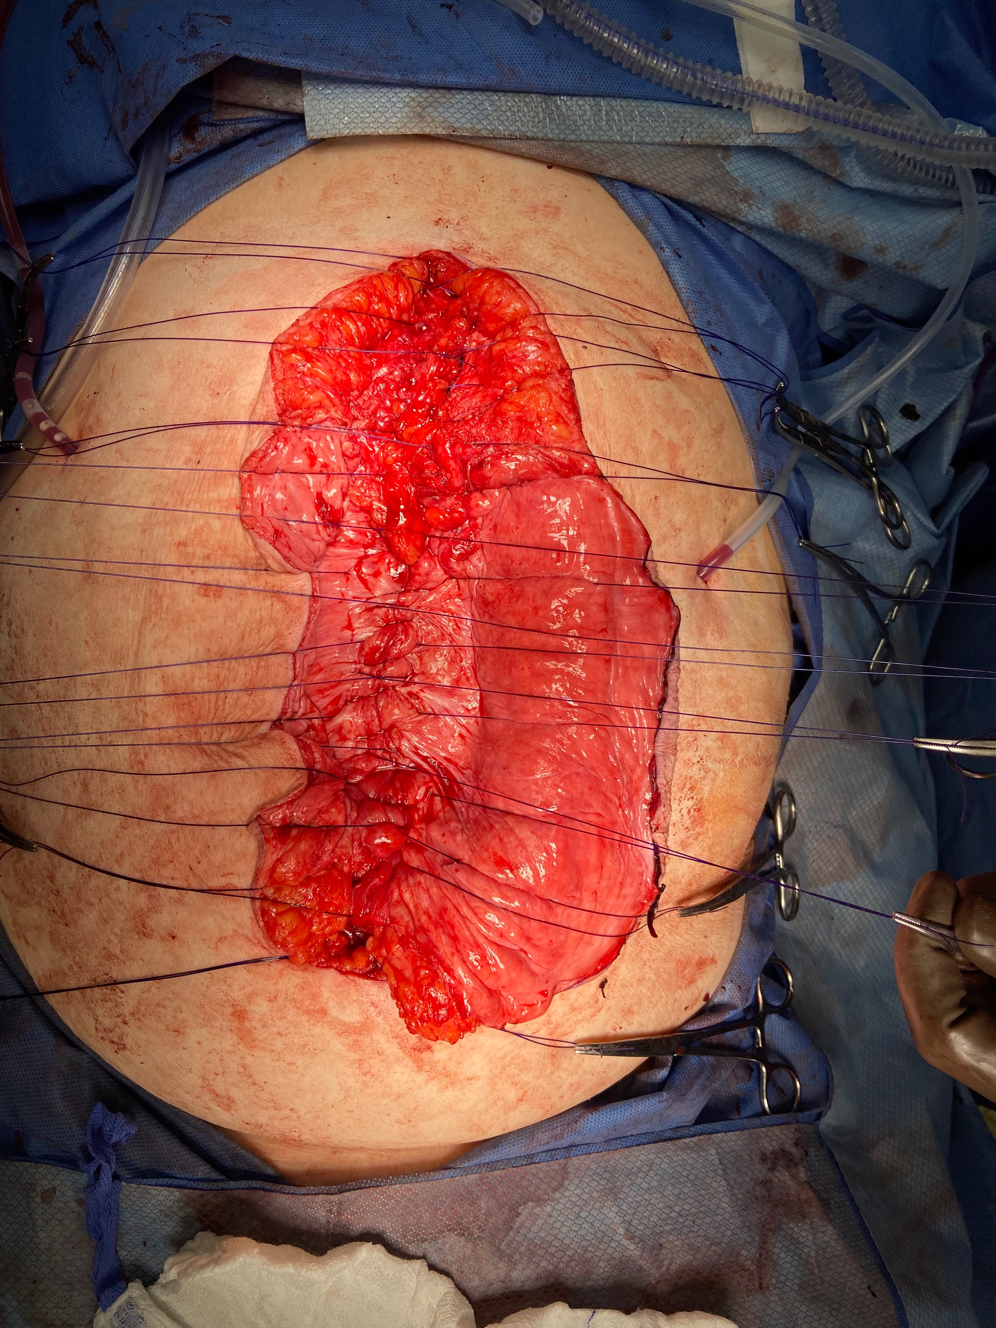
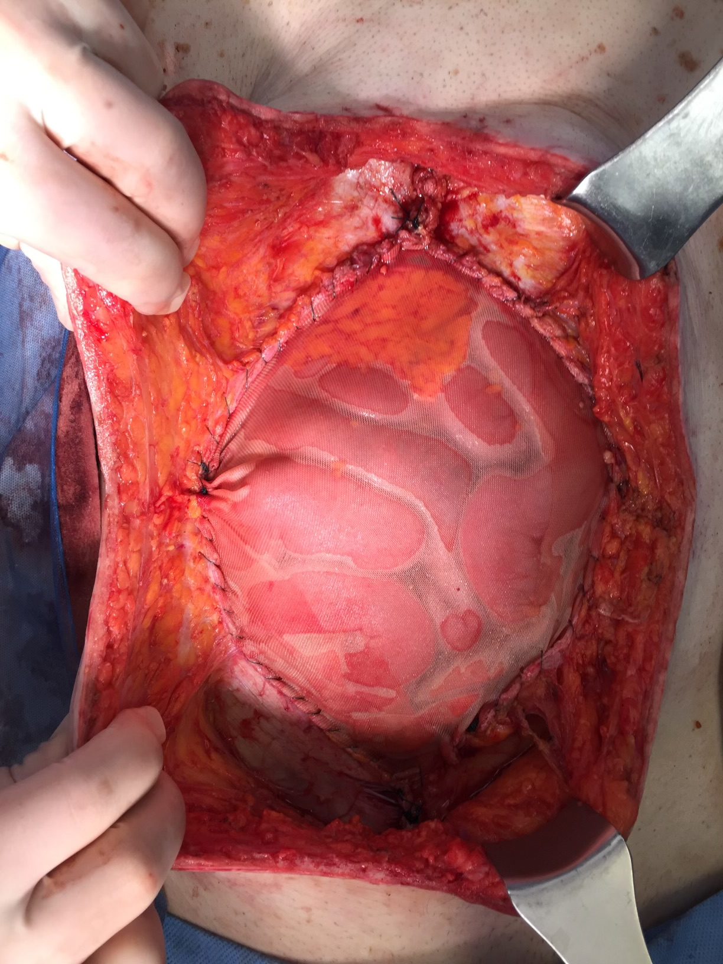
Bailout options
Primary closure – interrupted figure-of-eight PDS sutures
Inlay or bridging piece of Vicryl® mesh or biologic – expensive hernia sac
*Both have inevitably high recurrence rates
Are there other options?
Fascial release of tension – posterior rectus sheath

Slide 16
Key Takeaways
Remember, next time it’s a CLEAN case
Type of mesh doesn’t really matter…choosing the correct patient matters more
Consent for both!
Mesh is safe in contaminated fields…most of the time
Staged vs single stage prospective study is needed

Slide 17
Thank you!
Megan Melland-Smith
mellanm@ccf.org

Slide 19
Rough work
#
#
Notes:
ROCSS trial

Slide 20
ACHQC vs Danish Hernia Database
ACHQC
Danish Hernia Database
368 patients; 1yr f/u
89 ileostomies, 276 colostomies, 3 both
>50% had parastomal and incisional hernia
11cm hernia width
100% repaired with retromuscular permanent synthetic vs biologic vs resorbable synthetic mesh
516 patients; 6yr f/u
Incisional hernia repair vs concurrent stoma closure
64 ileostomies, 65 colostomies
9cm hernia width
75% repaired with mesh**
Notes:
Two retrospective studies
No comment on which type of mesh or in which location the mesh was placed

Slide 21
Outcomes
#
ACHQC
Danish Hernia Database
All mesh types:
SSOPI 12%
SSI 13%
SSO 13%
3 PS mesh infections, 1 mesh excision
4 enterocutaneous fistulas
Increased re-operation for recurrence (17.8% vs 10.6%, OR 1.69, p=0.04)
Subgroup analysis of mesh patients OR 1.54, p=0.12
5.4% anastomotic leak
Increased LOS (8 vs 3 days)
#

Slide 22
Conclusion
No significant differences in wound morbidity between mesh types
Only PS mesh infection, excision, EC fistula
Single stage approach is feasible
Bailout is ok too
Primary closure – interrupted figure-of-eight PDS sutures
Inlay or bridging piece of Vicryl® mesh
Next time it’s a clean case!
Notes:
RM mesh is resilient
While we didn’t capture anastomotic leak in this study, the risk of anastomtic leak cannot be underestimated in these cases.
No comment on which type of mesh or in which location the mesh was placed

