Slide 1
Robotic Vs. Open Ventral Hernia Repair: A Randomized Controlled Trial
Lucas Beffa, MD, FACS
Assistant Professor of Surgery
Lerner College of Medicine
Cleveland Clinic

Slide 2
Disclosures
Intuitive Surgical

Slide 3
Background
Robotic posterior component separations (TAR) as an option for complex abdominal wall reconstruction have become increasingly popular

Slide 4
Background
Despite its growth, there are few trials supporting any benefit
Almost all studies currently are retrospective and highly biased

Slide 5
Theoretical Benefits vs. Liabilities
Theoretical benefits
Shorter length of stay
Less acute pain
Lower post operative morbidity
Theoretical liabilities
Longer OR times
Higher direct cost
Cosmesis?
Value = Outcomes/Cost

Slide 6
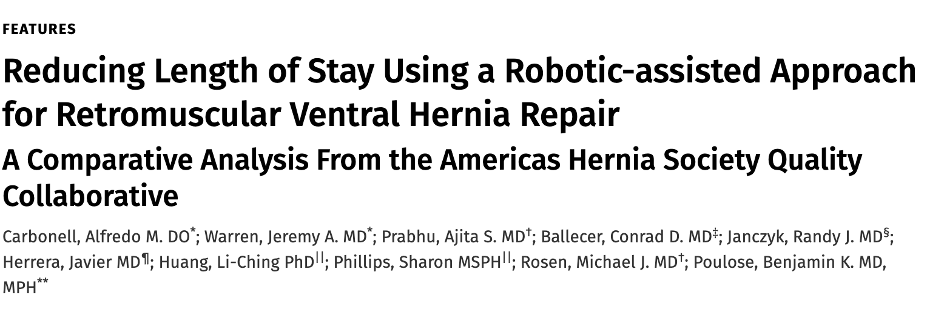
Current Evidence
111 rRVHR vs 222 oRVHR
Shorter LOS in Robotic group
Median 2 days vs 3 days
Higher SSO in Robotic group
But fewer drains used in rRVHR
No difference in readmissions, SSI, intra-operative complications, or other post operative complications

Slide 7
ORREO Trial
Open vs. Robotic REtrOmuscular Ventral Hernia Repair
7-15 cm hernias with at least one comorbidity
Primary End point: Composite outcome of complications (SSO, SSI, SSOPI, readmission, reoperation)
50 patients in each arm
No difference in primary outcome
Shorter LOS in robotic arm (2 vs 1 days)

Slide 8
Design
Robotic vs. Open
Retromuscular
Permanent synthetic mesh
Midline defects (between semilunar lines)
Size 7 – 15 cm in width (primary or incisional)
BMI less than or equal to 45
Must be a candidate for both open or robotic surgery

Slide 9
Primary Outcome
Length of stay
Reported in hours
Defined as surgery start time to when discharge order is placed
Hypothesis: Robotic will have a 24 hour shorter LOS compared to open

Slide 10
Secondary Outcomes
Pragmatic Hernia Recurrence
Hernia Specific Quality of Life (HerQLes)
30 day, one year
EuraHS
30 day, one year
Pain scores – NRS 11
POD 1 -5, 30 day, one year
PROMIS 3A SF
SSO/SSOPI/SSI
Direct Costs
Opioid consumption
Readmission
Conversion from Robotic to Open
Analyzed both ITT and PP

Slide 11
Power Calculation
Alpha 0.05, Power of 0.9
24 hour difference in LOS
86 in each arm, assuming 10% attrition rate
200 total patients
100 patients in each arm

Slide 12
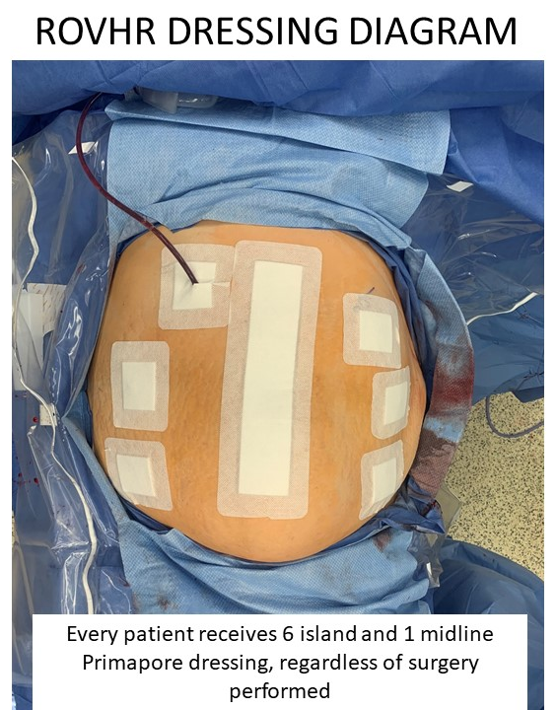
Patient Blinding
Randomized in clinic
Consented for both
Same bandages post-op
Parallel Groups - ERAS
Keep binder on for first two days
Patients guess which one they had

Slide 13
Surgeon Blinding
Operating surgeon un-blinded
Discharge surgeon blinded
Only determines when patient can discharge
Operating surgeon manages patient post op and monitors for complications, etc.

Slide 14

Surgeon Quality Assurance
Surgeons need to have at least 50 robotic retromuscular hernia repairs
Submit two unedited robotic TAR videos for review

Slide 15
Current Enrollment
Started Sept 2022
3 enrolling surgeons (fourth coming soon)
26 Consented
15 Operated

Slide 16
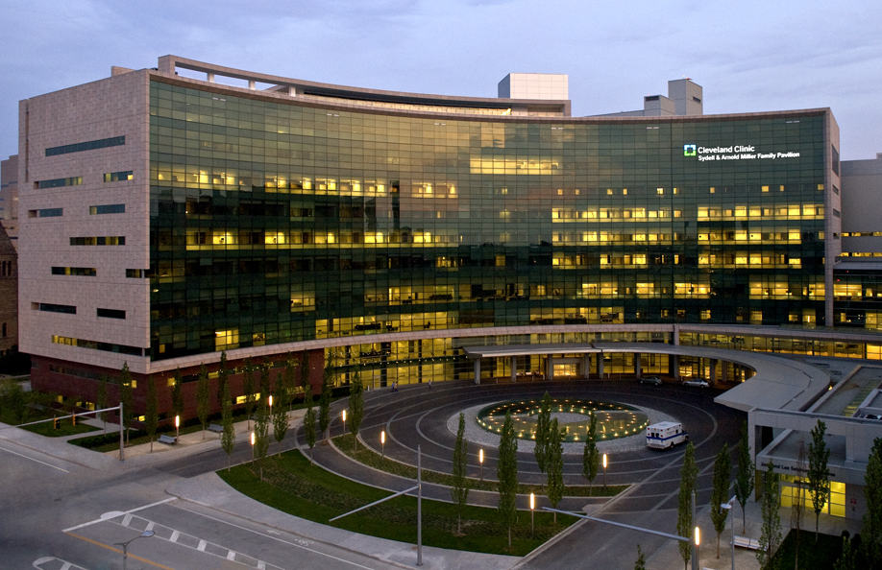
Future Directions
Currently recruiting other sites
If interested, speak to me or email me
BeffaL@ccf.org

