Slide 1

Comparison of Outcomes After Robotic Ventral Hernia Repair in Obese vs Non-obese Patients
Nicole López-Cañizares MD¹, Cristhian Valor MD², Flavio Malcher MD, MSc, FACS³ Department of Surgery, NYU Langone Hospital

Slide 2
DISCLOSURES
FM: Intuitive, BD, Medtronic, Integra, Allergan, Deep Blue

Slide 3
Background
Obesity is considered a major risk factor for the complications and recurrence after ventral hernia repair (VHR), being viewed as a contraindication to open ventral hernia repair. (Owei L., et al.)
There is a paucity of literature for obese individuals who undergo a minimally invasive VHR. There are a few publications that support robotic VHR in these patients (Kudsi et al, Malcher et al).
We hypothesize that the robotics repairs will have a similar outcomes regardless of patient’s BMI
Notes:
Owei L, Swendiman RA, Kelz RR, Dempsey DT, Dumon KR. Impact of body mass index on open ventral hernia repair: A retrospective review. Surgery. 2017 Dec;162(6):1320-1329. doi: 10.1016/j.surg.2017.07.025. Epub 2017 Sep 28. PMID: 28964507.
Kudsi OY, Bou-Ayash N, Gokcal F. Comparison of perioperative outcomes between non-obese and obese patients undergoing robotic inguinal hernia repair: a propensity score matching analysis. Hernia. 2022 Aug;26(4):1033-1039. doi: 10.1007/s10029-021-02433-5. Epub 2021 May 31. PMID: 34057626.

Slide 4
Methods
From the Abdominal Core Health Quality Collaborative (ACHQC) registry we extracted the data between the date range of January 2013 and December 2022
Inclusion criteria: >18 years old, robotic ventral hernia repair
Exclusion criteria: BMI < 18.5, < 18 years old, and open or laparoscopic repair
A total of 8140 patients were included
Patients were divided into four groups based on their BMI at the time of surgery: - non-obese (BMI < 29.99) - obesity class I (BMI > 30-34.9) - obesity class II (BMI > 35-39.9) - obesity class III (BMI > 40)

Slide 5
Methods
Univariate analysis and logistic regression analysis were performed to compare short term outcomes across the different BMI categories
Primary endpoints included: rate of complications, length of hospital stay (LOS), narcotic/analgesic usage, emergency readmission within 30 days after discharge, and pain scores
The hernia-related quality-of-life survey (HerQLes) was used to conduct pre- and postoperative hernia-specific quality-of-life assessments.
The PROMIS Pain 3A survey was also used to measure patients' pain over the first seven postoperative days

Slide 6
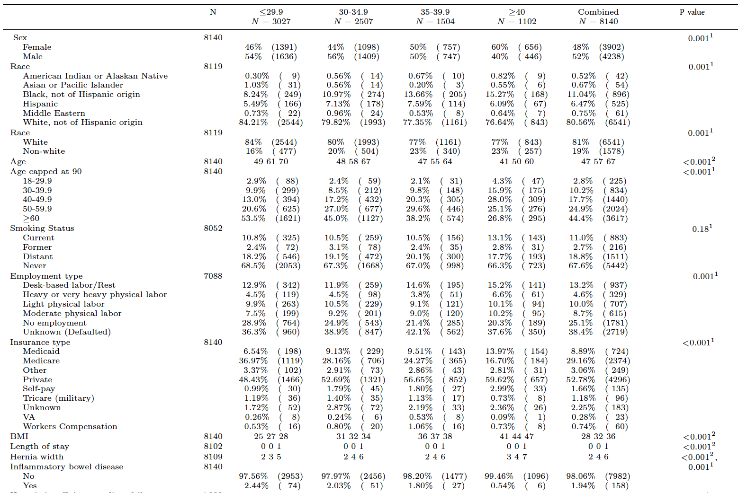
Table 1. Patient Demographics (BMI= body mass index, ASA= the American society of anesthesiologist, HT= hypertension, CAD=coronary artery disease, COPD= chronic obstructive pulmonary disease, DM= diabetes mellitus, SD= standard deviation, IQR= interquartile range p value= 0.001
Results n=8,140
(37%)
(31%)
(18%)
(14%)

Slide 7
Results
Complication | BMI < 29.99 | BMI > 30 | Combined | P value
Overall Complication | 251/3027 (8.3%) | 596/5140 (11.7%) | 847/8140 (10.4%) | 0.001
Seroma | 103/3027 (1.26%) | 354/5140 (4.34%) | 457/8140 (5.6%) | 0.001
SSI | 13/3027 (0.43%) | 42/5113 (0.82%) | 55/8140 (0.68%) | 0.03
SSO | 141/3027 (4.7%) | 430/5113 (8.4%) | 571/8140 (7%) | 0.001
SSI/SSO requiring intervention | 32/3027 (1.1%) | 81/5113 (1.6%) | 113/8140 (1.4%) | 0.05
30-day readmissions | 96/3027 (3.2%) | 140/5113 (2.7%) | 236/8140 (2.9%) | 0.26
Table 2. 30-day rate of most common complications in obese and non-obese patients undergoing robotic VHR N = 8140
Notes:
Not clinically significant

Slide 8
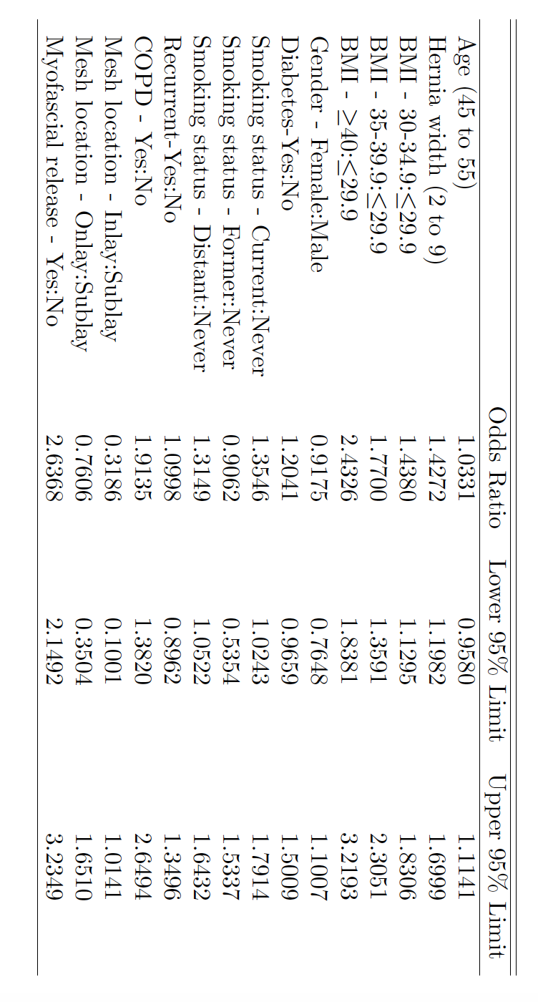
Results
Table 4. Calculated odds ratio for postoperative complications after undergoing RVHR based on patient comorbidities and known risk factors

Slide 9
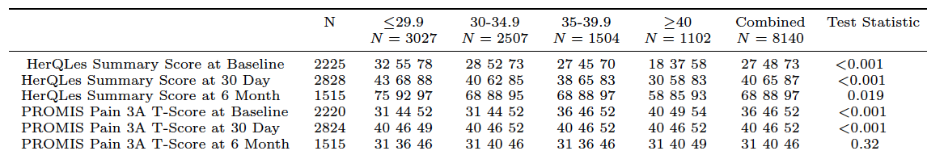
Results
Improvement: 67% 69% 95% 135%
Reduction: 22% 10% 27% 22%
No difference in QOL or pain score at 6 months
Table 3. HerQLes and PROMIS Pain 3A T-Scores at baseline, 30 days, and 6 months postoperatively

Slide 10
Discussion
Postoperative complications were observed in 10.4% of cases across all BMI groups with a statistically significant association with higher BMI (P<0.001)
Complications were minor and most were managed conservatively
RVHR has a similar safety profile (ex LOS, QOL, pain, SSI/SSO requiring intervention) for obese and non-obese patients as well as reassuring QoL and Pain scores with no difference at 6 months across all BMIs
Notes:
1/100 requiring intervention

Slide 11
Conclusion
Our study suggests that obese individuals can safely undergo this procedure with a significant improvement in pain and QOL, despite higher incidence of 30 day complications
We hope our research will encourage more patients and surgeons to consider this MI as a treatment option for VHR

Slide 12
Limitations
Retrospective study
Surgeon inputed data
Lenght of follow up
Not matched data

Slide 13


