Slide 1
A Cut Through the Mesh: Non-hernia Related Reoperations after Complex AWR
Ryan Ellis, MD
General Surgery Resident
Co-Authors:
Jenny Chang, MD
Sara Maskal, MD
Varisha Essani, BS
Sharon Phillips, MS
Benjamin Miller, MD
Ajita Prabhu, MD
Lucas Beffa, MD
David Krpata, MD
Clayton Petro, MD
Michael Rosen, MD
ACHQC QI Summit
Denver, Colorado
March 2023

Slide 2
Disclosures
Study Funding:​ none​
Clayton Petro ​
  BD Consultant​
  Surgimatix Consultant​
  Research Grants – AHS, CSA, SAGES​
Ajita Prabhu​
  Speaking fees and research support paid to institution from Intuitive Surgical​
  Consulting fees and is on the Advisory Board for CMR Surgical​
  Consulting fees from Verb Surgical​
Lucas Beffa​
  Honoraria from Intuitive Surgical​
Michael Rosen​
  Medical director of ACHQC​
  Stock options with Ariste​

Slide 3
Background
Notes:
I was speaking with a friend from medical school recently and he was asking me about my experience thus far in the hernia lab. One word kept coming to mind…

Slide 4
Background
  Big!

Slide 5
Background
  Big man
Notes:
Well, the team is led by a big man: at 6’5”, Dr. Rosen makes even me feel short

Slide 6
Background
  Big man
  Big hernias
Notes:
I think it goes without saying that the Cleveland Clinic sees big hernias

Slide 7
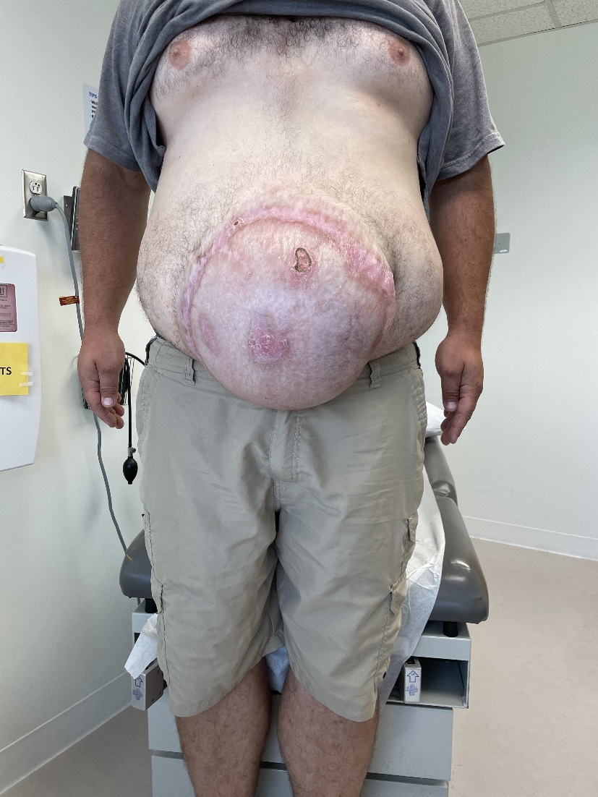
Notes:
Hernias like this are seen and fixed almost every day

Slide 8
Background
  Big man
  Big hernias
  Big repairs
Notes:
And big hernias mean big repairs

Slide 9
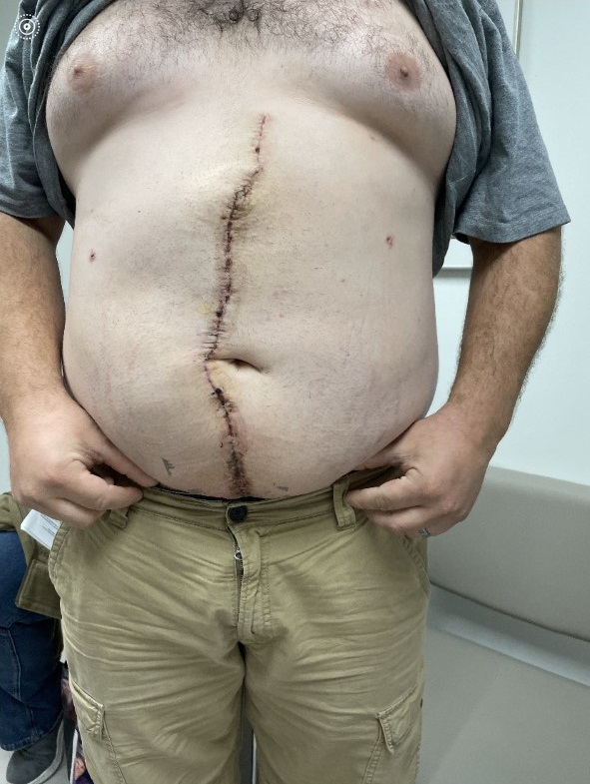
Notes:
Repairs like this

Slide 10
Background
  Big man
  Big hernias
  Big repairs
  Big mesh

Slide 11
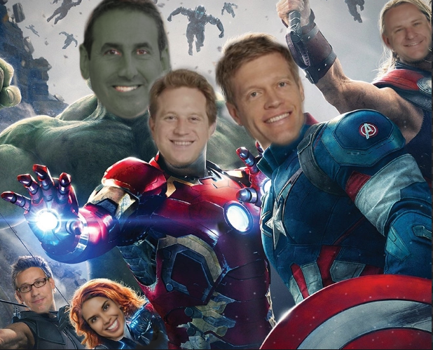

Slide 12
We Synthetic Mesh
    We study it a lot
    So have others:
      Kokotovic, Bisgaard, Helgstrand (2016)
        Cumulative incidence of mesh-related complication requiring surgery was 4.5% at 5 years
Notes:
Now I know that there is a time and a place for everything but is often the go to for large ventral hernia repairs. Our group has extensively studied repeatedly shown the safety and efficacy of using permanent mesh in AWR

Slide 13
What about non-hernia related reoperations?

Slide 14
Specific Aims
Identify the rate and indications for non-hernia related reoperations
Characterize the post-operative outcomes after cutting through mesh and different closure methods

Slide 15
Study Design
Registry-based study with supplemental chart review
Inclusion Criteria
  Adult patients who had previously undergone:
    Open, midline ventral hernia repair with TAR
    Placement of retromuscular permanent synthetic mesh
  Subsequent operation (open, MIS) in which the retromuscular mesh was cut or excised
Dates: 1/2014-9/2022

Slide 16
Variables: Index Operation/AWR
Comorbidities
Operative Details
Postoperative (30-day) Course

Slide 17
Variables: Operations after AWR
Date of reoperation
Indication for reoperation
Operative details
Postoperative course
Postoperative imaging

Slide 18
Results

Slide 19
1137
AWRs with Retromuscular Mesh
37 (41%)
Reoperations for index hernia-related indications
53 (59%)
Reoperations for other indications
90 (8%)
Reoperations for any indication

Slide 20
Non-Hernia Related Operations after AWR
Non-Hernia Operation Indications After AWR (N=53)
Small Bowel Obstruction | 13
Biliary Pathology | 9
Urologic Pathology | 5
Other Type of Hernia | 4
Gynecologic Pathology | 4
Sepsis | 3
Obesity | 3
Liver Pathology | 3
Pneumoperitoneum | 2
Pain | 2
Aneurysmal Disease | 2
Pancreatic Pathology | 2
Diverticulitis | 2
Appendicitis | 1
Abscess/Fluid Collection | 1
Large/Small Bowel Cancer | 1
53/1137 (4.7%)
Time to operation after AWR
  Median 774 days
  IQR [285, 1122]

Slide 21
Demographics and Comorbidities at Time of AWR
 | Total AWRs (N=1137) | Non-hernia Reoperations (N=53)
Sex, % Female (N) | 50% (569) | 49% (26)
Race, % White (N) | 92% (1044) | 86.8% (46)
Age, years, median [IQR] | 61 [52, 68] | 58 [50, 67]
BMI, kg/m², median [IQR] | 32 [28, 36] | 31 [27, 36]
Active Smoker, % (N) | 5.8% (66) | 3.8% (2)
Comorbidities, % (N) Hypertension Ascites Diabetes Dialysis COPD Anti-platelet use Immunosuppression History of AAA | 64% (730) 0.36% (4) 24% (275) 0.53% (6) 9.5% (108) 5.9% (67) 9.8% (112) 2.5% (29) | 70% (37) 2% (1) 23% (12) 3.8% (2) 7.5% (4) 7.5% (4) 15% (8) 3.8% (2)
History of MRSA infection, % (N) | 4% (45) | 0
Current active infection, % (N) | 1.1% (13) | 1.9% (1)
ASA Class, % (N) 3 | 82.8% (941) | 88.7% (47)
Wound class, % (N) Clean Clean-contaminated Contaminated | 85.7% (974) 9.5% (108) 4.66% (53) | 88.7% (47) 7.5% (4) 3.8% (2)

Slide 22
Operative Details for AWR
 | Total AWRs (N=1137) | Non-hernia Reoperations (N=53)
Elective case, % (N) | 99.56% (1132) | 100% (53)
Intraop complication, % (N) | 7.7% (88) | 7.5% (4)
Hernia length, median [IQR] | 23 [19, 26] | 24 [20, 26]
Hernia width, median [IQR] | 15 [ 12, 19] | 15 [11, 17]
Stoma present, % (N) | 1.3% (15) | 3.8% (2)
Mesh length, median [IQR] | 30 [30, 45] | 30 [30, 40]
Mesh width, median [IQR] | 30 [30, 50] | 30 [30, 40]
Fascial closure, % (N) | 92.6% (1053) | 94.3% (50)
Fascial closure suture Absorbable Permanent | 99.62% (1050) 0.38% (4) | 98% (49) 2% (1)
Fascial closure technique, % (N) Running Simple interrupted Figure of eight Mattress | 41% (432) 0.19% (2) 62% (651) 0 | 44% (22) 0 56% (28) 0

Slide 23
Reoperative Details

Slide 24
Details of Reoperations (N=53), % (N)
Approach Open MIS | 64% (34) 36% (19)
Enterotomies | 5.7% (3)
Cancer operations | 15% (8)
Emergency operations | 23% (12)
Wound class Clean Clean-contaminated Contaminated Dirty | 30% (16) 49% (26) 9% (5) 11% (6)
Partial mesh excision | 2% (1)
Complete mesh excision | 0
Fascial closure suture type Permanent Absorbable Not listed/None | 36% (19) 49% (26) 13% (7)
Fascial closure suture technique Running Interrupted Not listed | 34% (18) 45% (24) 21% (11)
New mesh placement | 2% (1)

Slide 25
Reoperation Outcomes (N=53), % (N)
SSO | 11.3% (6)
SSO types Cellulitis Non-healing wound Serous drainage Purulent drainage Seroma EC fistula Other | 0 1.9% (1) 3.8% (2) 1.9% (1) 3.8% (2) 1.9% (1) 1.9% (1)
SSI | 9.4% (5)
SSI types Superficial infection Deep incisional infection Organ space infection | 1.9% (1) 1.9% (1) 5.7% (3)
SSOPI types Wound opening Wound debridement Suture excision Percutaneous drainage | 7.5% (4) 1.9% (1) 0 0
Imaging Recurrence (N=33) | 24.2% (8)

Slide 26
Fascial Closure Technique and Recurrence
  Suture Type (p=1)
  Suture Technique (p=0.66)
  Mesh Excision (p=1)
  New mesh placement (p=1)

Slide 27
Conclusion
  Rate of reoperation for non-hernia related indications was low
  Most common suture technique
    Absorbable and interrupted
  Hard to identify who will need reoperations
    Points to consider: being proactive about screenings, presence of gallstones, severe obesity, etc.
Notes:
We already know

Slide 28
Future Work
Continue collecting data
  More complete recurrence evaluation on patients (pragmatic method)
Identify any preoperative screening and imaging that may have prevented an operation after abdominal wall reconstruction.

Slide 29

Thank You

