Slide 1
Utilization of Transversus Abdominus Release During Open vs. Robotic Ventral Hernia Repair
Courtney Collins MD MS FACS, Savannah Renshaw MPH MPA, Molly Olsen MS, Ben Poulose MD MS FACS
Ohio State University
ACHQC QI Summit 2023

Slide 2
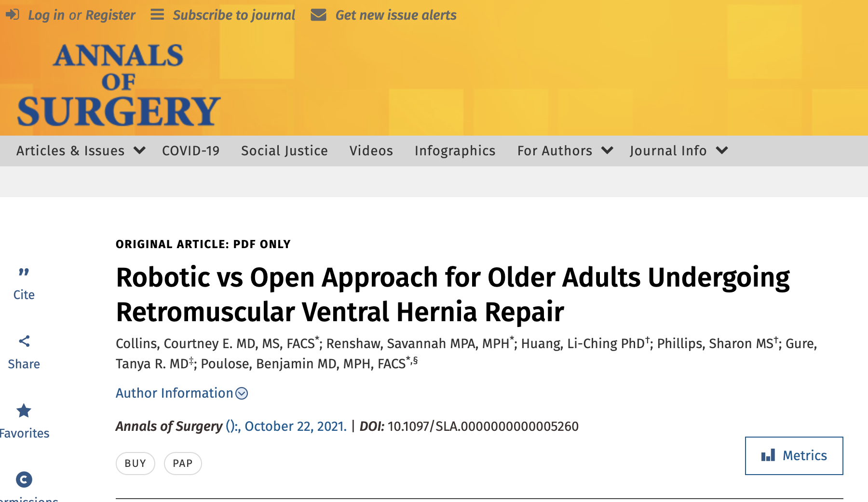

How We Got Here
We wrote a paper about open vs. robotic retromuscular hernia repairs in older adults
Reviewer 2 hated it
BUT they had one good point
Our robotic group had significantly narrower hernias (7 vs 11 cm) than our robot group. . . but had a similar number of TARs
We told them we’d look into it. . So we did

Slide 3
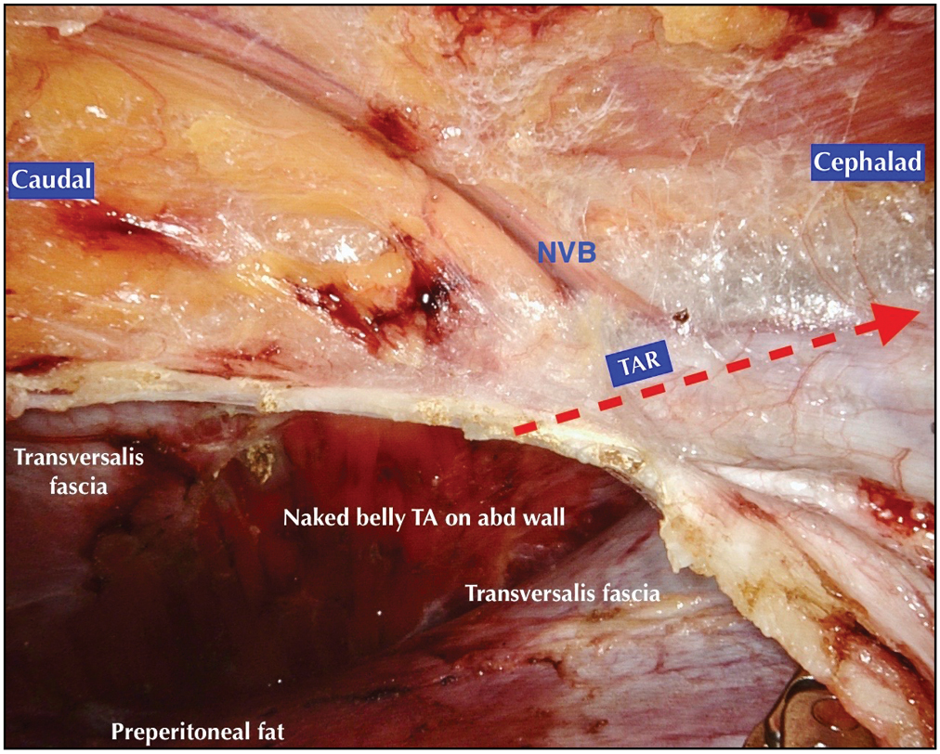
Transversus Abdominus Release
My favorite operation!!
Good overall outcomes, low recurrence
BUT it has risks
  Mesh complications
  Posterior sheath breakdown
  Linea semilunaris injuries
  Permanent alteration of the abdominal wall
  Limits future reconstruction options

Slide 4
Study Question
Does the robotic platform increase the chances that a surgeon will utilize a transversus abdominus release?

Slide 5
Study Design
Population
  Elective ventral hernia repair
  Hernias > 5 cm with mesh placement
  Excluded parastomal hernias, laparoscopic repairs
Exposure
  Robotic platform vs open
Statistical Approach: Propensity Score Match
Outcome of Interest
  Utilization of transversus abdominus release during repair

Slide 6
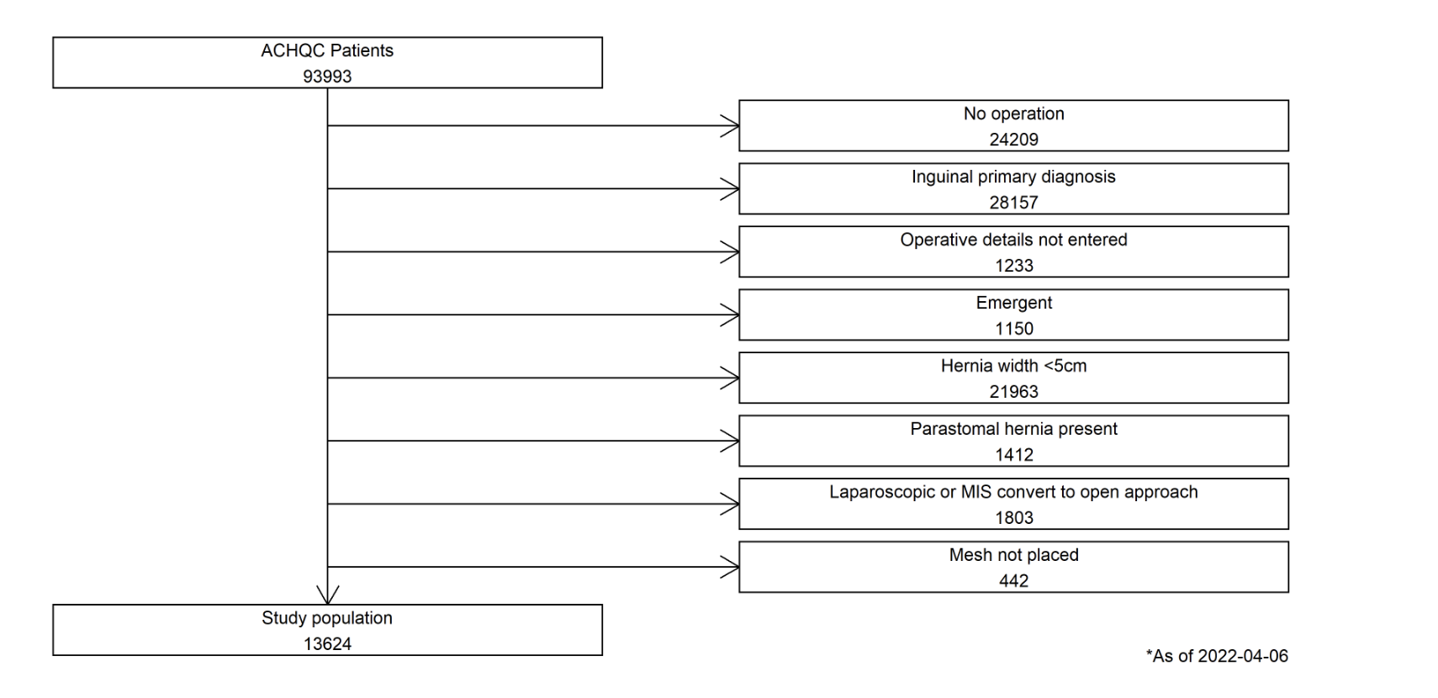

Slide 7
Demographic/Clinical Information
 | Open N=10177 | Robotic N=3447 | P value
Mean Age | 58.5 | 58.8 | 0.24
% Male | 46 | 44 | 0.03
% White | 88 | 82 | <0.01
Median BMI | 32 | 33 | <0.01
% Private Insurance | 43 | 49 | <0.02
Diabetes | 23 | 21 | 0.01
COPD | 8.0 | 6.0 | <0.01
Recent Smoker | 12 | 15 | <0.01

Slide 8
Hernia/Operative Details
 | Open | Robotic | P value
Median Width (cm) | 11 | 7 | <0.01
Median Length (cm) | 17 | 12 | <0.01
% Incisional | 95 | 90 | <0.01
% Recurrent | 48 | 37 | <0.01
% TAR utilization | 51 | 41 | <0.01

Slide 9
1: 1 Propensity Score Match
Age/Gender/Race
Insurance Status
BMI
ASA class
Hernia width/length
Hernia type
Recurrent vs non recurrent
Surgical indication
History of open abdomen
History of AAA, IBD, MRSA
Diabetes
Functional Status
Dialysis
Hypertension
Smoking within 1 year

Slide 10
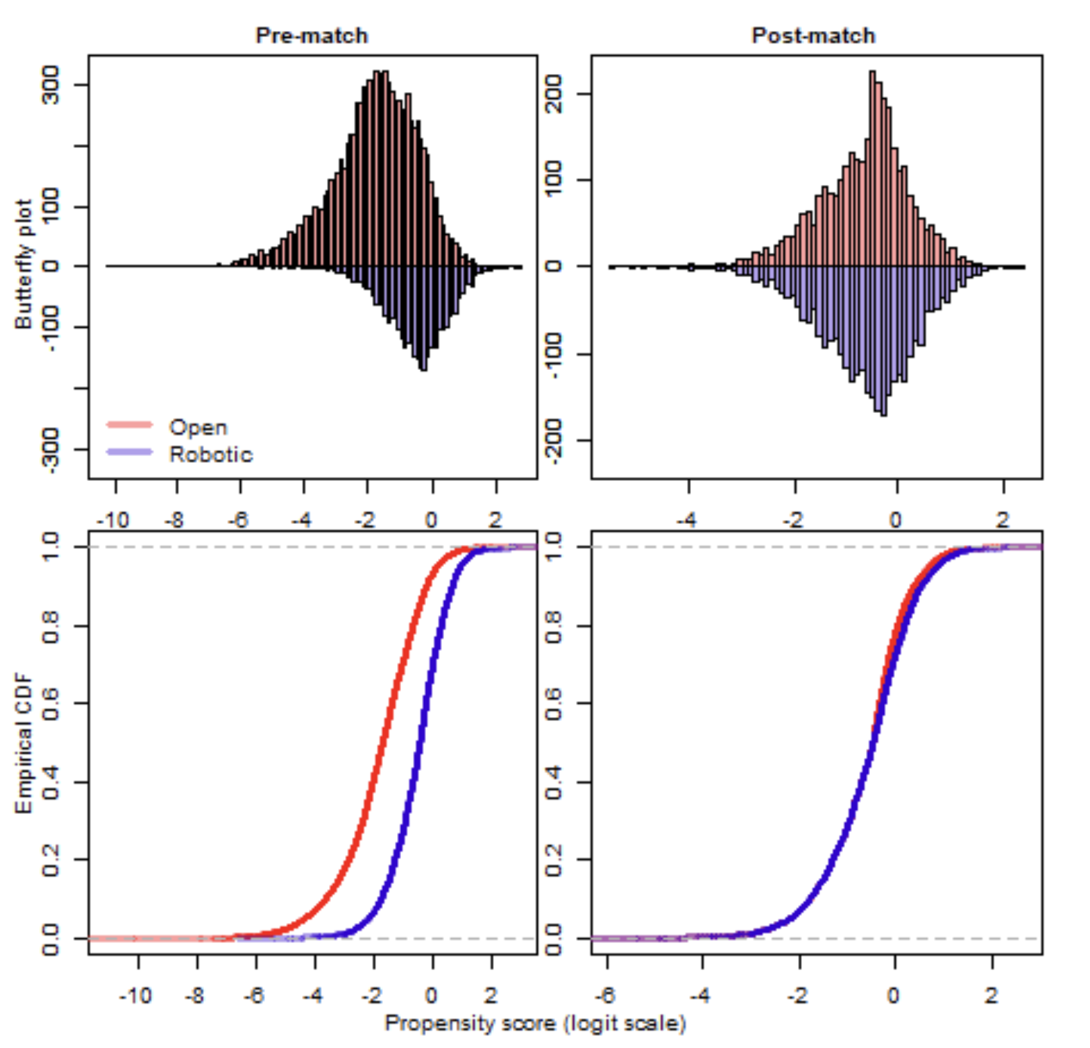
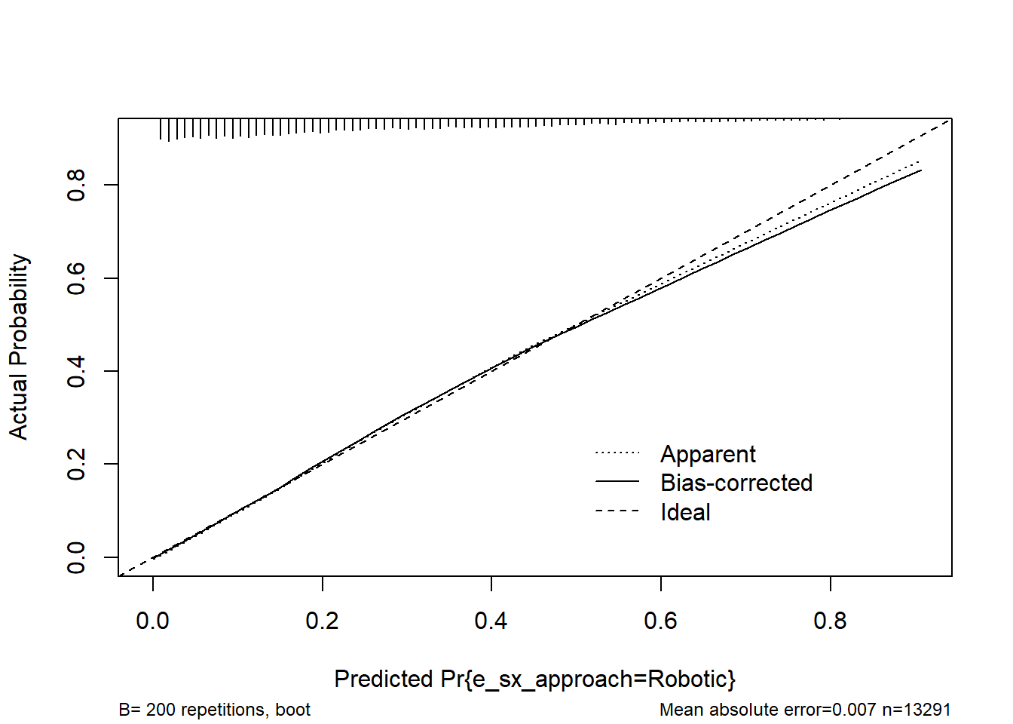
Propensity Results

Slide 11
Propensity Match Results
 | Open N=3188 | Robotic N=3188 | SMD
Age | 58 | 58 | 0.002
% Male | 45 | 44.5 | 0.01
% White | 84 | 83 | 0.05
BMI | 33 | 33 | 0.02
% Academic | 64 | 61 | 0.07
% Private insurance | 48 | 48 | 0.01
Hernia Width | 8.3 | 8.3 | 0.008
Hernia Length | 12.8 | 13.0 | 0.02
Recurrent | 36.4 | 35.8 | 0.01
Incisional | 92 | 91 | 0.03

Slide 12
Drumroll please. . .

Slide 13


42.5%
32.4%
P value < 0.01

Slide 14
Overall conclusions
Prior to matching, open hernia repairs have a higher TAR utilization (but are also larger and more complicated)
Hernia width after matching for pertinent factors was around 8 cm.
Over 1/3 of patients with hernias of this width had a TAR
Significantly more TARs in the robotic group (almost half)

Slide 15
Y’all Are Doing Too Many TARs
Ok I am too

Slide 16
Possible explanations
Intra operative factors we may not be able to account for
Pneumoperitoneum can hinder posterior sheath closure.
The robotic platform gives improved visualization of the TAR plane which may make them seem “easy” to do.
Something else?

Slide 17
Implications/Future Questions
Surgeons may need to be more selective with the robotic approach, especially if they are not facile with eTEPP
What is happening outside of the QC community?
What are the long term implications of widespread TAR utilization?
Does this matter?

Slide 18

Thank You!
Courtney.collins@osumc.edu
DrCoCoMD

