Slide 1
Effect of Urban vs. Rural Distress on Post Operative Outcomes After Ventral Hernia Repair
Courtney Collins MD MS FACS, Savannah Renshaw MPH MPA, Li-Ching Huang PhD, Ben Poulose MD MS FACS
Ohio State University
ACHQC QI Summit 2023

Slide 2

Disclosures
Nothing financial
But. . . this is an equity talk
It’s important to understand our own biases

Slide 3


As You All Know. . .

Slide 4



Increased mortality in patients with public insurance (Novitsky et al., 2013)
Increased disability in patients with low education (Soulsby et al., 2022)
Increased ED visits in patients with heavy labor jobs (Renshaw et al., 2022)

Slide 5
It’s Not Just About Income
Lack of access to healthcare
Logistical Barriers (transportation, job concerns, etc)
Low health literacy
Physician bias
Different resource allocation

Slide 6
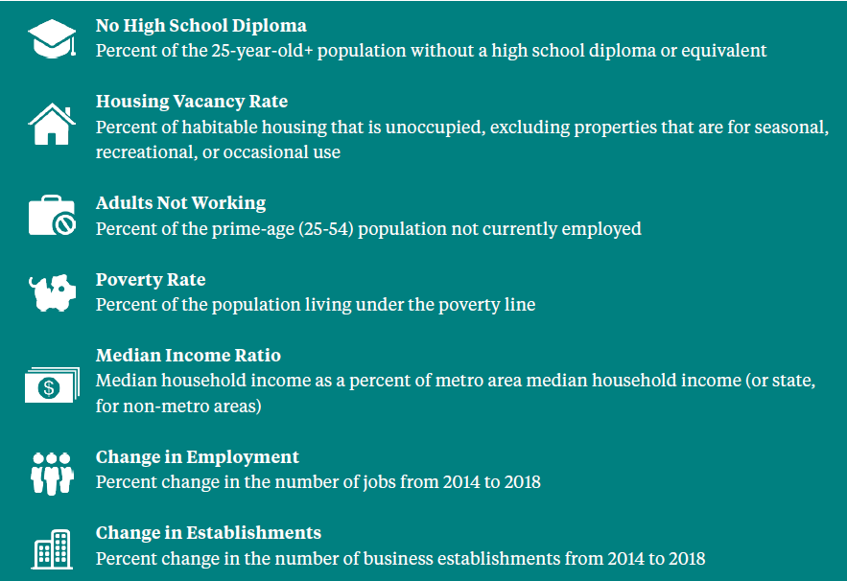
The Distressed Communities Index
Established by the Economic Innovation Group in 2015
Investigate the spatial distribution of economic well being
Updated biannually (4th iteration)
7 Metrics, 5 categories

Slide 7

Go Ahead- Find Yours!
https://eig.org/distressed-communities/2022-dci-interactive-map/

Slide 8

50.5 million people live in a distressed community
The most economic gains, including 62% of new jobs were seen in prosperous communities
Urban communities are actually becoming slightly less distressed
70% of distressed communities are majority Black
At every prosperity level, Whites make significantly more than Blacks
Rural communities saw an increase of 25% of people living in distressed communities

Slide 9

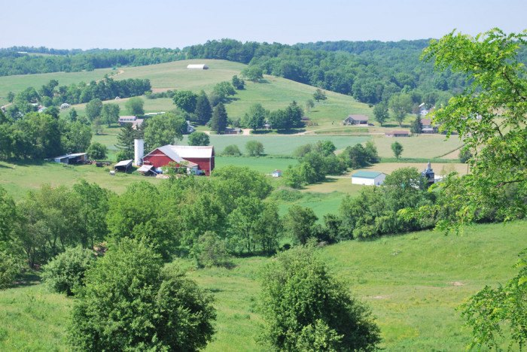
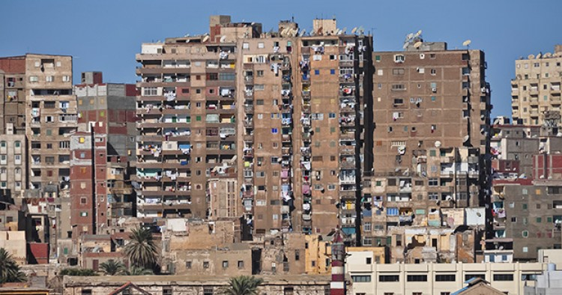
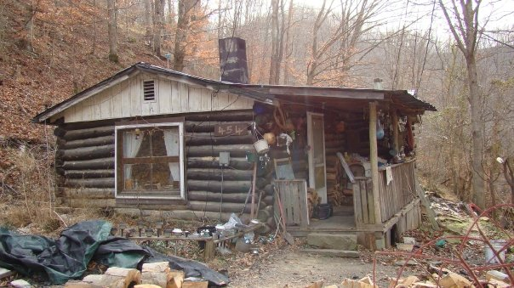
“Distress” Can Look Different

Slide 10
Our Question
How does urban vs rural status affect post operative outcomes after elective ventral hernia repair at each DCI quintile?

Slide 11
Study Design
Population
Elective ventral hernia repair
18 years or older
Able to calculate DCI and urban/rural status
30 day follow up
Outcomes
Post operative complications
Exposure of interest
Urban/rural status (county level)
Interaction of DCI and Urban/rural status

Slide 12
Statistical Analysis
Propensity Score Match
Multivariate Logistic Regression
2:1 matching ratio
Age/gender/race
Smoking status/BMI
Co morbidities
Hernia factors (recurrent, width)
Operative approach
DCI quintile
Interaction term for DCI and urban/suburban classification

Slide 13
Demographic/Clinical Variables
 | Rural N= 4395 | Urban/Suburban N= 23938 | P value
Median Age | 58 | 57 | <0.01*
% Female | 51 | 47 | <0;01*
% Non White | 8 | 19 | <0.01*
% Private Insurance | 47 | 52 | <0.01*
Diabetes | 21 | 16 | <0.01*
Hypertension | 53 | 45 | <0.01*
COPD | 8 | 5 | <0.01*
Current smoker | 10 | 9 | 0.13
Median BMI | 32 | 31 | <0.01*

Slide 14
Distressed Community Index
 | Rural N= 4395 | Urban/Suburban N= 23938
% Prosperous | 17 | 50
% Comfortable | 22 | 22
% Mid Tier | 22 | 13
% At Risk | 26 | 15
% Distressed | 17 | 1

Slide 15
Hernia/Operative Details
 | Rural N= 4395 | Urban/Suburban N= 23938 | P value
Median Hernia Width (cm) | 6 | 4 | <0.01
Median Hernia Length (cm) | 9 | 4 | <0.01
% Recurrent | 35 | 24 | <0.01
% Incisional | 76 | 59 | <0.01
% Robotic | 24 | 21 | <0.01
% Mesh Used | 90 | 83 | <0.01

Slide 16
Outcomes
 | Rural | Urban/Suburban | P value
% Any Complication | 21 | 15 | <0.01
% SSI | 5 | 2 | <0.01
% SSO | 14 | 10 | <0.01
% Readmission | 5 | 4 | <0.01

Slide 17
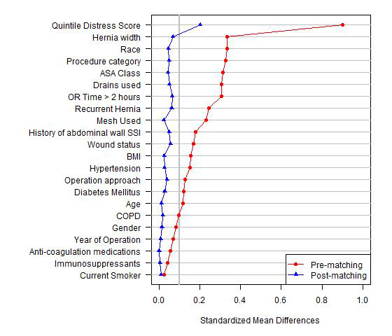
Propensity Score Matching
Generally well matched
Persistent differences in:
Race
Hernia width
DCI Quintile
Recurrence

Slide 18
Demographic/Clinical Factors After PSM
 | Rural | Urban/Suburban | P value
Median Age | 58 | 58 | 0.8
% Female | 51 | 50 | 0.5
% Non White | 7 | 9 | 0.02*
Median BMI | 32 | 32 | 0.07
Diabetes | 21 | 20 | 0.2
Hypertension | 53 | 51 | 0.2
COPD | 7 | 7 | 0.34
Current smoker | 10 | 9 | 0.1
Median Hernia Width (cm) | 6 | 5 | <0.01*
% Recurrent Hernia | 35 | 32 | <0.01*
% Robotic | 26 | 24 | 0.4

Slide 19
DCI Quintile After PSM
 | Rural | Urban/Suburban
Prosperous | 19 | 24
Comfortable | 25 | 28
Mid Tier | 24 | 22
At Risk | 30 | 25
Distressed | 2 | 1

Slide 20
Multivariable Model Results

Slide 21
Any Complication- Rural vs. Suburban/Urban
 | Odds Ratio | 95 % CI | P value
Distressed | 0.78 | 0.38-1.6 | 0.5
At Risk | 1.3 | 1.1-1.5 | <0.01
Mid Tier | 1.2 | 1.1-1.5 | 0.04
Comfortable | 1 | 0.8-1.1 | 0.9
Prosperous | 1.1 | 0.9-1.4 | 0.3

Slide 22
SSI-Rural vs. Suburban/Urban
 | Odds Ratio | 95 % CI | P value
Distressed | 0.7 | 0.2-2.2 | 0.5
At Risk | 1.6 | 1.2-2.3 | <0.01
Mid Tier | 1.6 | 1.0-2.4 | 0.04
Comfortable | 1.0 | 0.7-1.4 | 0.8
Prosperous | 1.5 | 1-2.3 | 0.06

Slide 23
Readmission-Rural vs. Urban/Suburban
 | Odds Ratio | 95 % CI | P value
Distressed | 2.0 | 0.5-8.3 | 0.3
At Risk | 1.3 | 1.0-1.8 | 0.09
Mid Tier | 1.1 | 0.8-1.6 | 0.6
Comfortable | 1.0 | 0.7-1.3 | 0.8
Prosperous | 1.0 | 0.7-1.5 | 0.9

Slide 24
In Conclusion
We don’t treat a lot of rural patients!!
Rural patients are more medically and surgically complex
Rural patients have higher rates of complications after elective ventral hernia repair
In more distressed communities, rural patients demonstrate a slightly elevated risk of post operative complications compared to urban patients with the same vulnerability

Slide 25
Future Thoughts
Quality of Life outcomes-analysis pending
Does this point to an access to care issue?
Are these even the right outcomes to be measuring?
What can we do to improve care for rural patients?

Slide 26

Thank You!
Courtney.collins@osumc.edu
DrCoCoMD

