Slide 1
Zooming towards net zero: leveraging virtual visits to decrease carbon emissions and costs from General Surgery
March 5, 2023
ACHQC QI Summit
Denver, Colorado
Jenny H. Chang, MD
Sara M. Maskal MD
Ryan C. Ellis MD
Ajita Prabhu, MD
Clayton Petro, MD
Lucas Beffa, MD
Robert Simon, MD
Daniel Joyce, MD
Samer Naffouje, MD
R. Matthew Walsh, MD
Michael Rosen, MD
Benjamin Miller, MD
Notes:
Thank you for the opportunity to present today and demonstrate how hernia surgeons can ACTUALLY change the world.
My title is: Zooming towards net zero: leveraging virtual visits to decrease carbon emissions and costs from General Surgery.

Slide 2
Disclosures
Study Funding: none
Clayton Petro, MD
BD Consultant
Surgimatix Consultant
Research Grants – AHS, CSA, SAGES
Ajita Prabhu, MD
Speaking fees and research support paid to institution from Intuitive Surgical
Consulting fees and is on the Advisory Board for CMR Surgical
Consulting fees from Verb Surgical
Lucas Beffa, MD
Honoraria from Intuitive Surgical
Michael Rosen,MD
Medical director of ACHQC
Stock options with Ariste
Notes:
We have the following disclosures to report.
No funding was obtained for this study

Slide 3

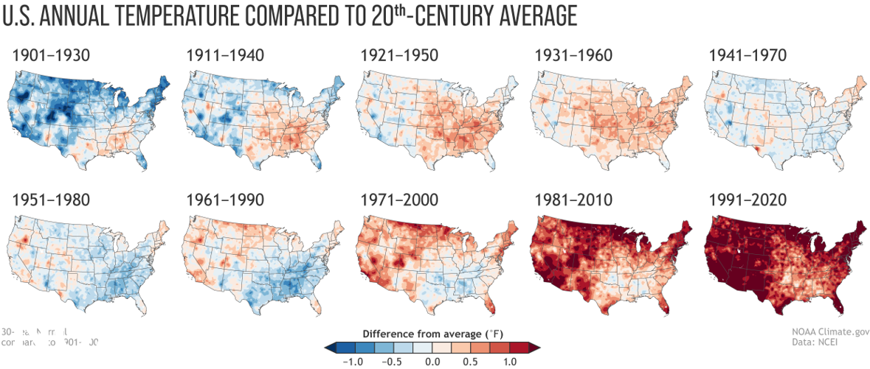
Climate Change is Real
Image Credit: NOAA, US Department of Commerce
Notes:
Climate change and global warming is real.

Slide 4
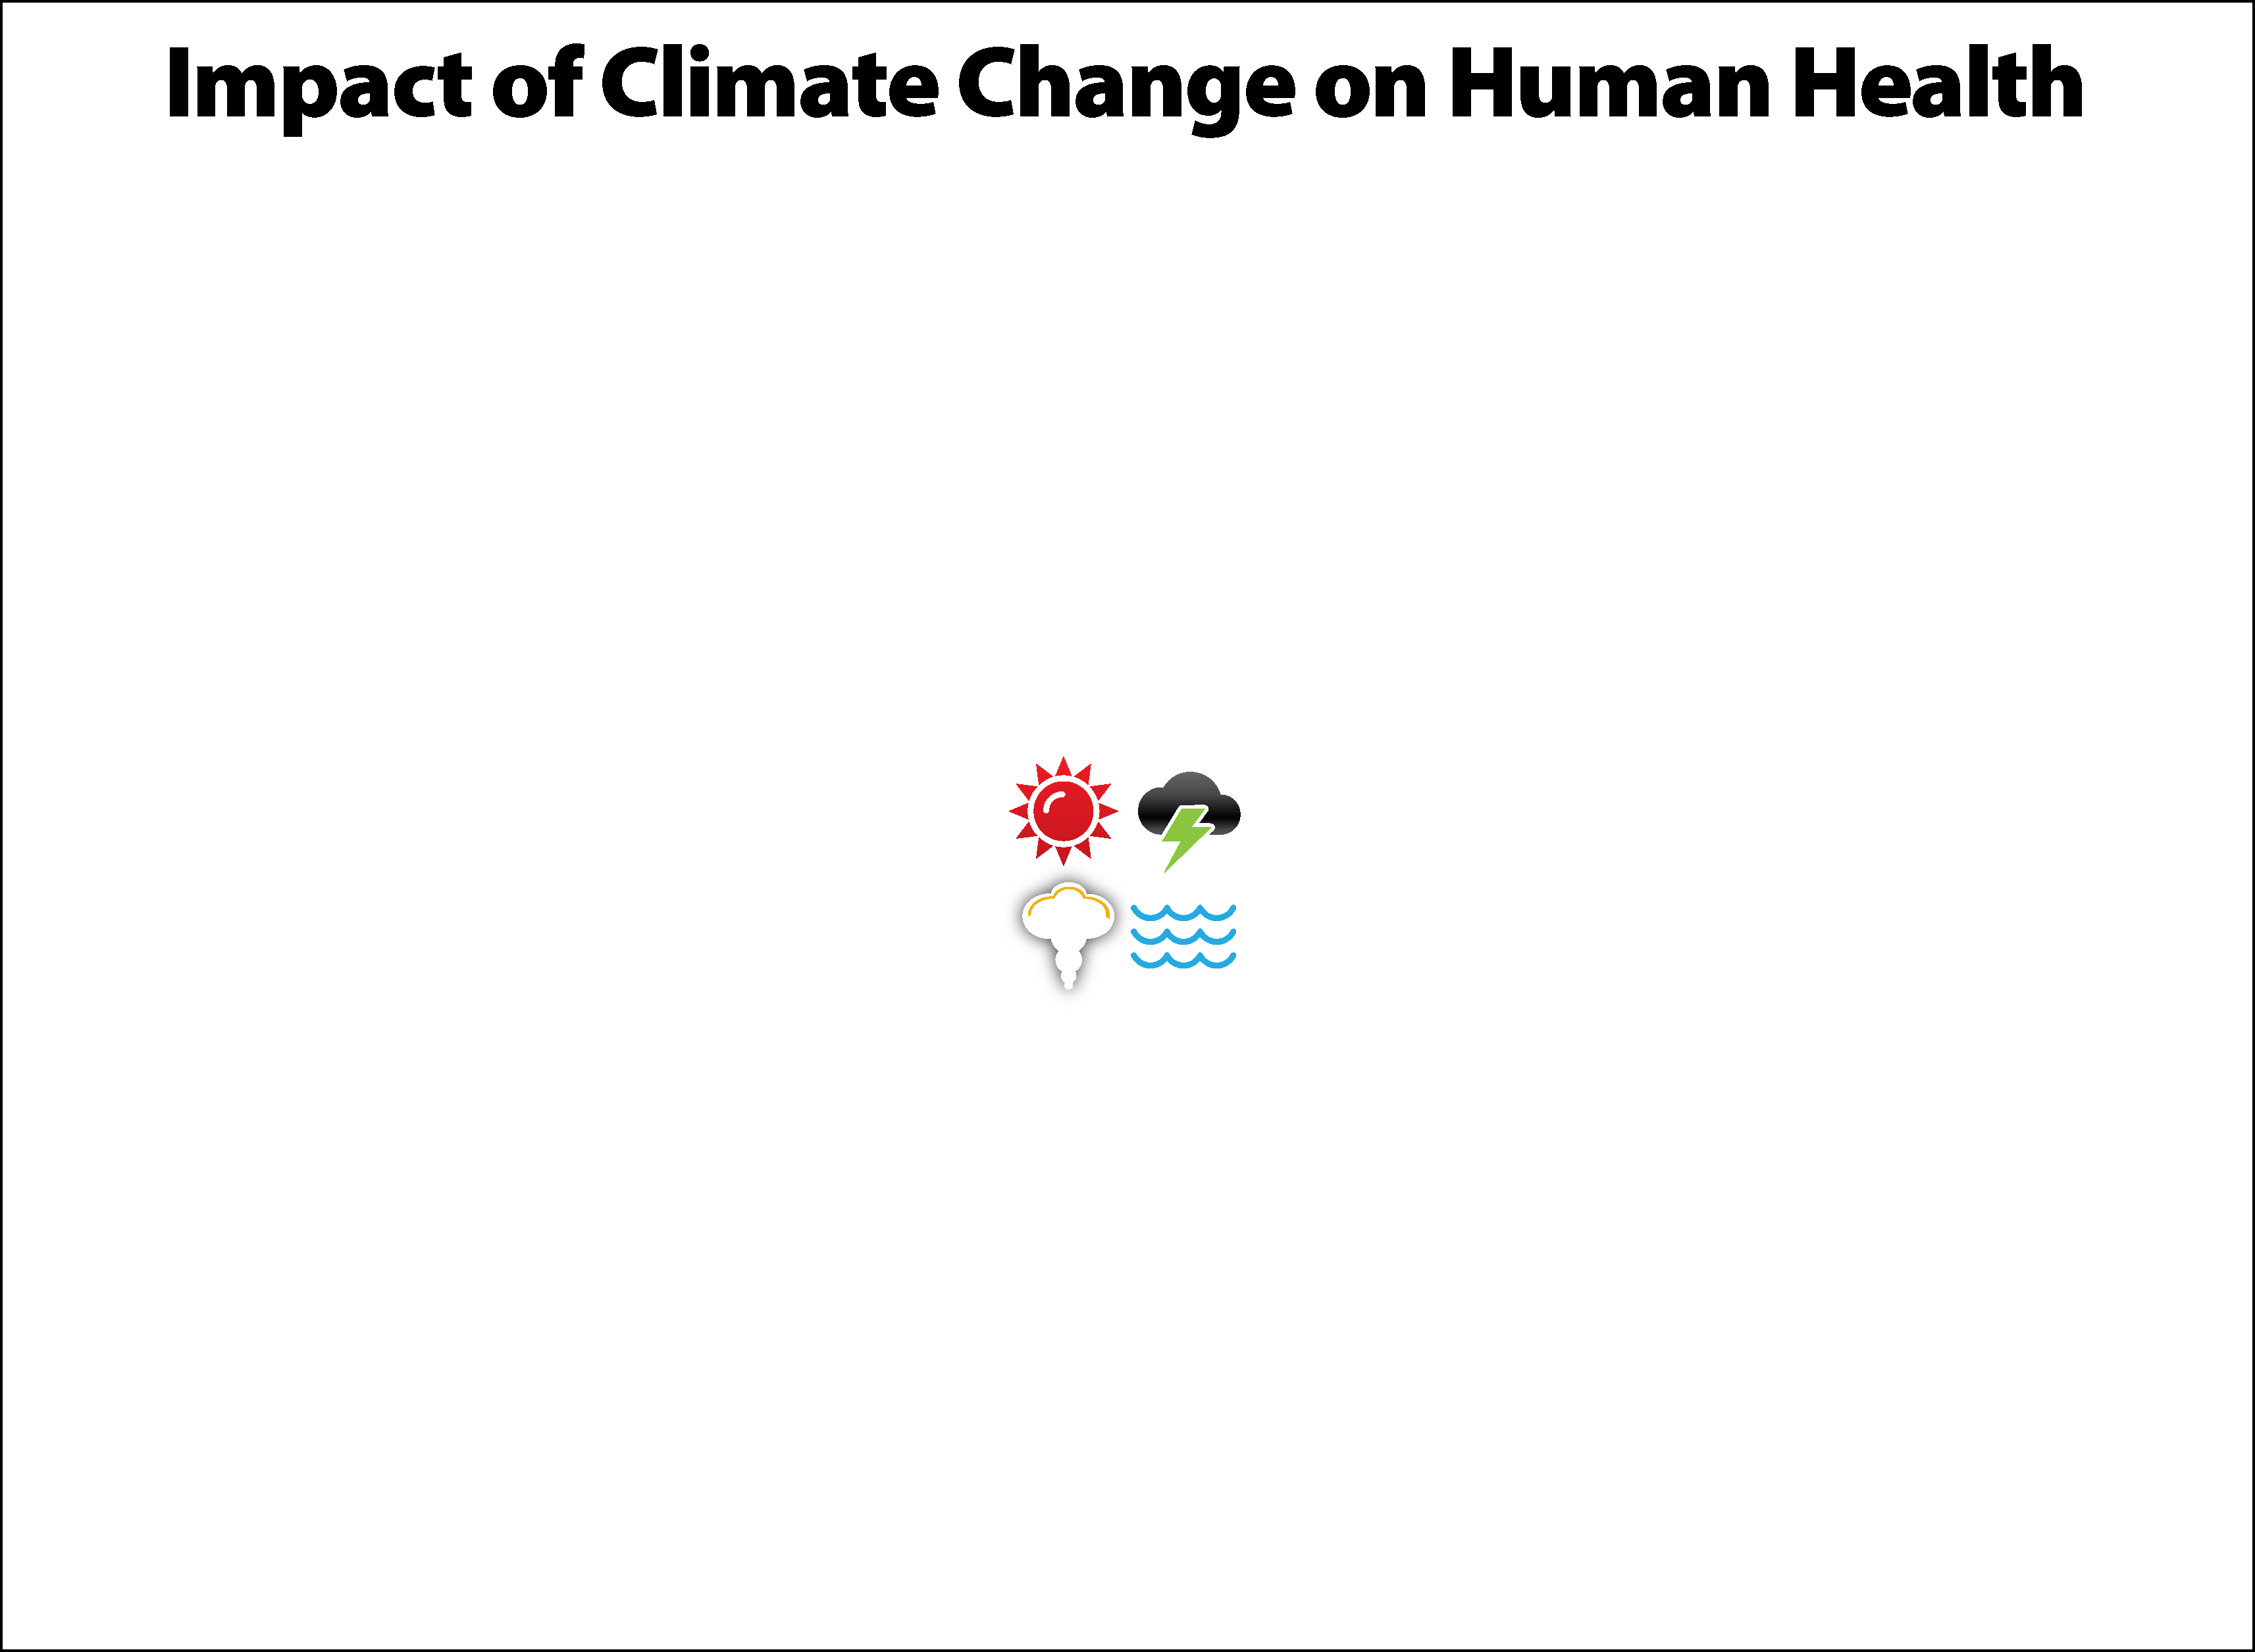
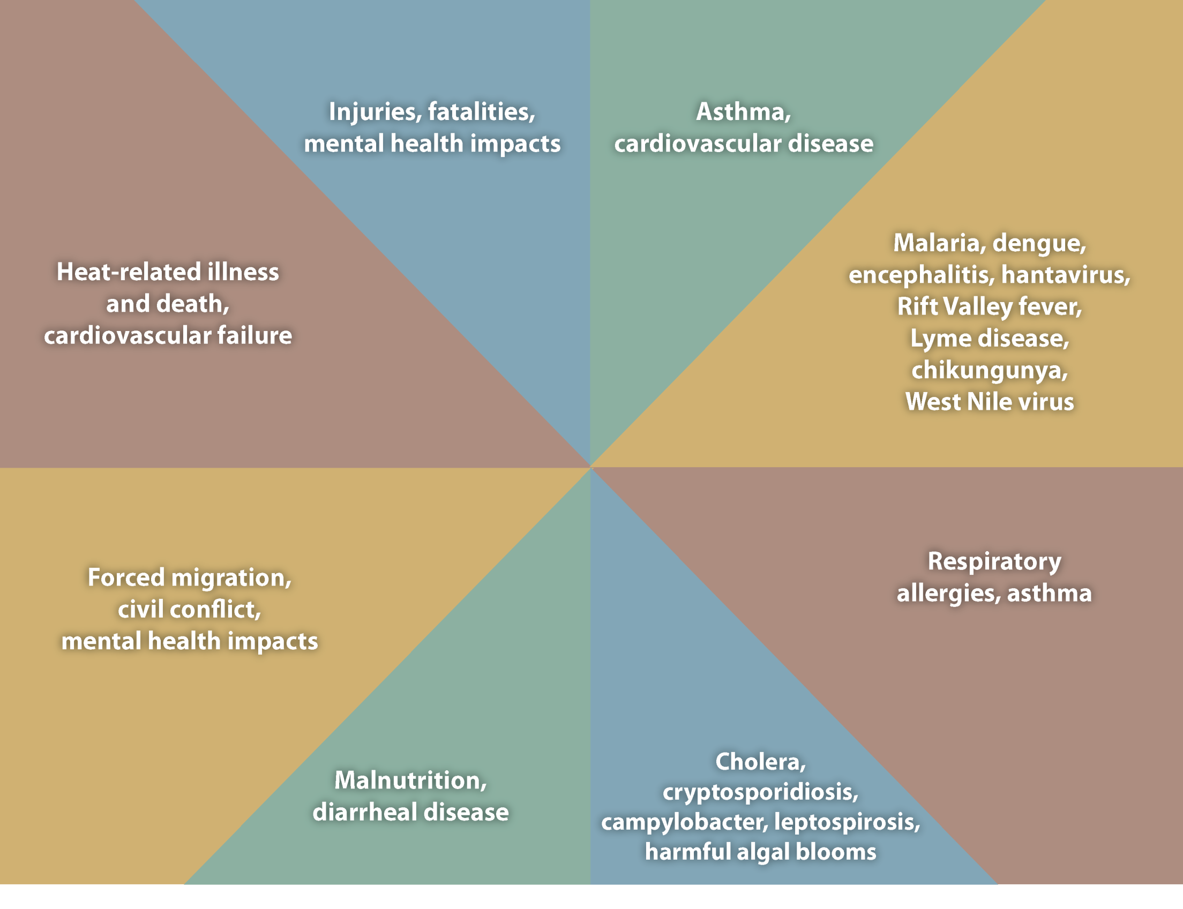
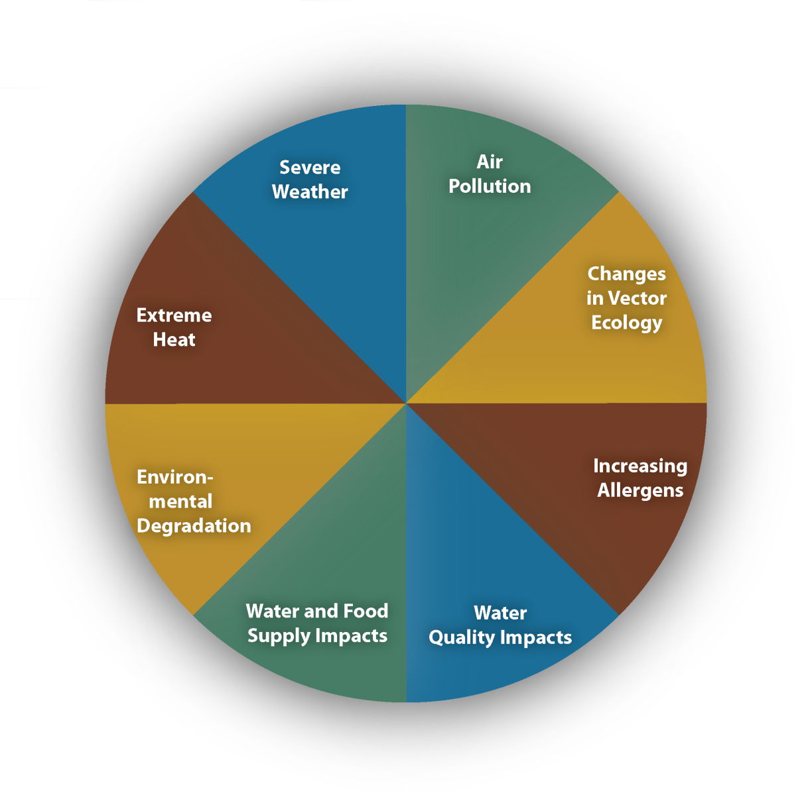
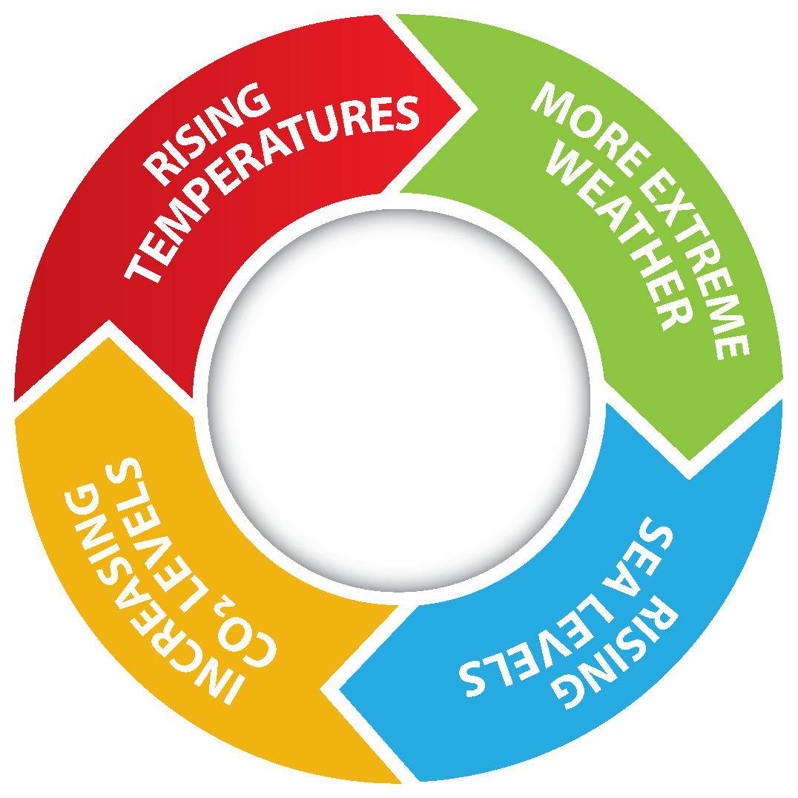
Source: CDC
Notes:
With profound impact on our patients and communities. Climate change impacts a wide-range of health outcomes. This slide illustrates the most significant climate change impacts (rising temperatures, more extreme weather, rising sea levels, and increasing carbon dioxide levels), their effect on exposures, and the subsequent health outcomes that can result from these changes in exposures.

Slide 5
Introduction
U.S. health sector is responsible for an estimated 8.5% of national carbon emissions
Minimizing healthcare-associated travel may reduce the healthcare sector's greenhouse gas emissions as well as patient travel costs
COVID-19 pandemic was a sudden catalyst for telemedicine
Notes:
U.S. health sector is responsible for an estimated 8.5% of national carbon emissions
Minimizing healthcare-associated travel may reduce the healthcare sector's greenhouse gas emissions as well as patient travel costs
COVID-19 pandemic was a sudden catalyst for telemedicine as the healthcare industry was required to rethink the delivery of clinical care in the context of social distancing.

Slide 6
Aim
Determine the cost burden of travel for patients and examine the environmental impact associated with travel versus telehealth prior to and during the COVID-19 pandemic
Notes:
The purpose of our study was to determine the cost burden of travel for patients and examine the environmental impact associated with travel versus telehealth prior to and during the COVID-19 pandemic.

Slide 7
Methods
Outpatient clinical encounters with staff surgeon
General Surgery Division Included: HPB, acute care surgery, hernia and breast surgery
June 2017-December 2019
Prior to COVID-19 pandemic
January 2020 – July 2022
During COVID-19 pandemic
Notes:
We retrospectively identified outpatient Clinical encounters from general surgery staff surgeons of the hepato-pancreatico-biliary, acute care surgery, hernia and breast surgery divisions from one quaternary referral hospital from June 2017 to July 2022.
(CLICK) The 19-month period of June 2017 to December 2019 prior to the COVID-19 pandemic and the 19-month period of January 2020-July 2022 during the COVID-19 pandemic were compared

Slide 8

Virtual Visit Definition
Virtual visits were defined as synchronous surgeon-to-patient interaction through a video conferencing platform facilitated by a secure electronic medical record system (Epic,Verona, WI) or institution device.
Notes:
Virtual visits were defined as synchronous surgeon-to-patient interaction through a video conferencing platform facilitated by a secure electronic medical record system (Epic,Verona, WI) or institution device.
Telephone only encounters were excluded

Slide 9

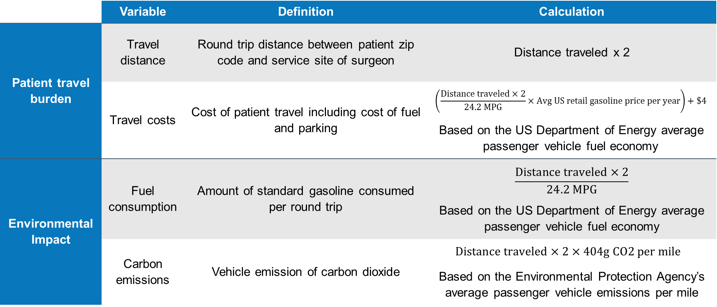
Methods
 | Variable | Definition | Calculation
Patient travel burden | Travel distance | Round trip distance between patient zip code and service site of surgeon | Distance traveled x 2
 | Travel costs | Cost of patient travel including cost of fuel and parking | $$\left(\frac{Distance traveled×2}{24.2 MPG}×Avg US retail gasoline price per year\right)+\$4$$ Based on the US Department of Energy average passenger vehicle fuel economy
Environmental Impact | Fuel consumption | Amount of standard gasoline consumed per round trip | $$\frac{Distance traveled×2}{24.2 MPG}$$ Based on the US Department of Energy average passenger vehicle fuel economy
 | Carbon emissions | Vehicle emission of carbon dioxide | $Distance traveled×2×404g CO2 per mile$ Based on the Environmental Protection Agency’s average passenger vehicle emissions per mile
Notes:
(CLICK) Patient travel burden was defined as travel distance and travel costs for patients. Distance traveled was estimated based on the zip code of the patients’ home and the service site of the staff surgeon.
(CLICK) Cost of travel was estimated using the round trip distance, average fuel economy of a passenger vehicle, parking fee of $4 at our institution, and average US retail gasoline prices by year based on the US Energy Information Administration.¹³
(CLICK) To estimate the environmental impact, fuel consumption and carbon emissions were calculated based on distance traveled.
(CLICK) The following assumptions were made: 1) all patients were transported from their home to their visit using an average passenger vehicle
(CLICK) (not a truck, transit car, motorcycle, transit bus, or plane) that requires gasoline rather than diesel. 2) The average fuel economy for a passenger vehicle is 24.2 miles per gasoline gallon 3) On average, CO₂ emissions are 95-99% of the total greenhouse gas emissions from a passenger vehicle, and the average passenger vehicle emits approximately 404 grams of CO₂ per mile .
The environmental impact of computers was considered negligible due to their utilization during both office and virtual visits.

Slide 10
Results
Number of virtual visits
Prior to COVID-19 | During COVID-19
1% (307/26,515) | 11% (3,256/29,733)
Notes:
Telemedicine was successfully utilized to maintain clinical volume during COVID-19, with a 1000% increase in utilization of virtual visits

Slide 11
Who is using virtual visits?
Age
Median income (based on zip code)
 | 2017 – 2019 (Prior to COVID-19) | 2020-2022 ( During COVID-19)
Office Visits | 59 years (SD 15) | 59 years (SD 15)
Virtual Visits | 56 years (SD 16) | 57 years (SD 15)
p Value | 0.009 | 0.000
 | 2017 – 2019 (Prior to COVID-19) | 2020-2022 ( During COVID-19)
Office Visits | $60,628 (SD $21,917) | $59,908 (SD $22,326)
Virtual Visits | $63,596 (SD $21,119) | $62,677 (SD $ 22,548)
p Value | 0.017 | 0.001
Notes:
It is perceived that older and poorer patients may have barriers to telehealth.
Due to our large sample size, there were statistically significant differences in age and median income, but one that is practically irrelevant.

Slide 12
Driving Distance
 | Virtual Visits before COVID-19 | Virtual Visits during COVID-19
Per Patient Visit | 378 miles | 182 miles
Total Saved | 201,956 miles | 1,191,449 miles

Slide 13

Carbon emissions
 | Virtual Visits before COVID-19 | Virtual Visits during COVID-19
Per Patient Visit | 153 kg CO2 | 74 kg CO2
Total | 81,590 kg CO2 | 481,341 kg CO2

Slide 14

Gas
 | Virtual Visits before COVID-19 | Virtual Visits during COVID-19
Per Patient Visit | 16 gallons | 8 gallons
Total | 8,345 gallons | 49,233 gallons

Slide 15

Travel Cost
 | Virtual Visits before COVID-19 | Virtual Visits during COVID-19
Per Patient Visit | $48 | $23
Total Save | $23,942 | $147,438

Slide 16
There is a difference of an aggregate 40,888 gallons of gasoline and 399,751 kilograms of CO2 saved through utilization of telemedicine between the pre-COVID-19 and COVID-19 periods.
Notes:
There is a difference of an aggregate 40,888 gallons of gasoline and 399,751 kilograms of CO2 saved through utilization of telemedicine between the pre-COVID-19 and COVID-19 periods.

Slide 17

Source: EPA.gov
Notes:
These savings were equivalent to CO2 emissions from 77 homes’ electricity use for one year.

Slide 18

Notes:
Or Dr Rosen driving his Ford truck around the WORLD 39 times.
This is only representative of a portion of the General Surgery department at one quaternary institution which sees 10 million patients a year.

Slide 19
Discussion
As the healthcare sector is a major contributor to climate change, patient travel should be a target for strategic planning for sustainability
Patients using virtual visits are statistically younger and wealthier?
Notes:
As the healthcare sector is a major contributor to climate change, patient travel should be a target for strategic planning for sustainability
Patients using virtual visits are statistically younger and wealthier, altought not clinically significant.
However. Regardless of patient zip code median income, virtual visit utilization demonstrated travel cost savings for patients. Virtual visits at our institution and at a national level should be better targeted at providing care to economically disadvantaged communities which have been disproportionately affected by climate change in prior studies¹ for patient cost and environmental savings.

Slide 20
Opportunities for Improving Telehealth
Workflow
Technology
Example: Technology literacy challenges for patients and clinicians
Billing and reimbursement restraints
Notes:
Further work is needed to measure quality of care and satisfaction of surgeons and patients to continue integration of virtual visits for select general surgery patients.
Barriers to increased integration of telemedicine in General Surgery clinical care include concerns with technology, Billing and reimbursement restraints
Although these barriers are not insurmountable.
Other barriers: disruption of workflow, security and privacy concerns, technology infrastructure and technology literacy challenges for patients and clinicians, limited ability to examine patients leading to clinical uncertainty, perceived lack of personal connection, as well as regulatory and reimbursement restraints.

Slide 21
Conclusion
The impact of virtual visits extends beyond the cost of care not only in dollars, but on the environment.
This is one way surgeons can make a positive impact on the environment.

Slide 22
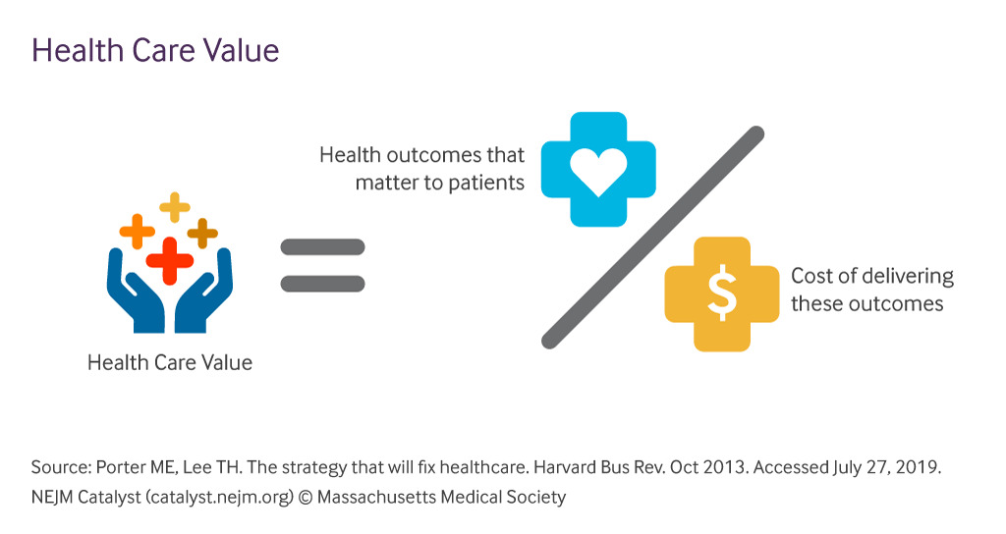

A Call to Action
Value in healthcare is defined as:
Notes:
The value in health care is traditionally defined as quality divided by cost.
(CLICK) But perhaps, the cost of the planet, as it affects our patients, should be considered too.

Slide 23

Thank You
Notes:
Dr Miller hugging a tree

