Slide 1
What Happens if We Start Operating on Smokers?
Nir Messer, MD
Hernia Fellow
Cleveland Clinic Foundation

Slide 2
Disclosures
None

Slide 3
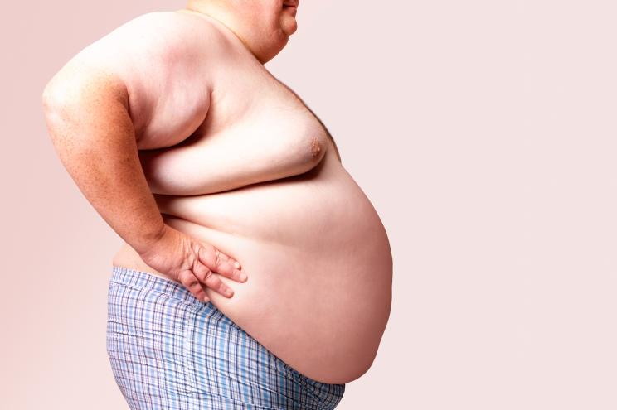
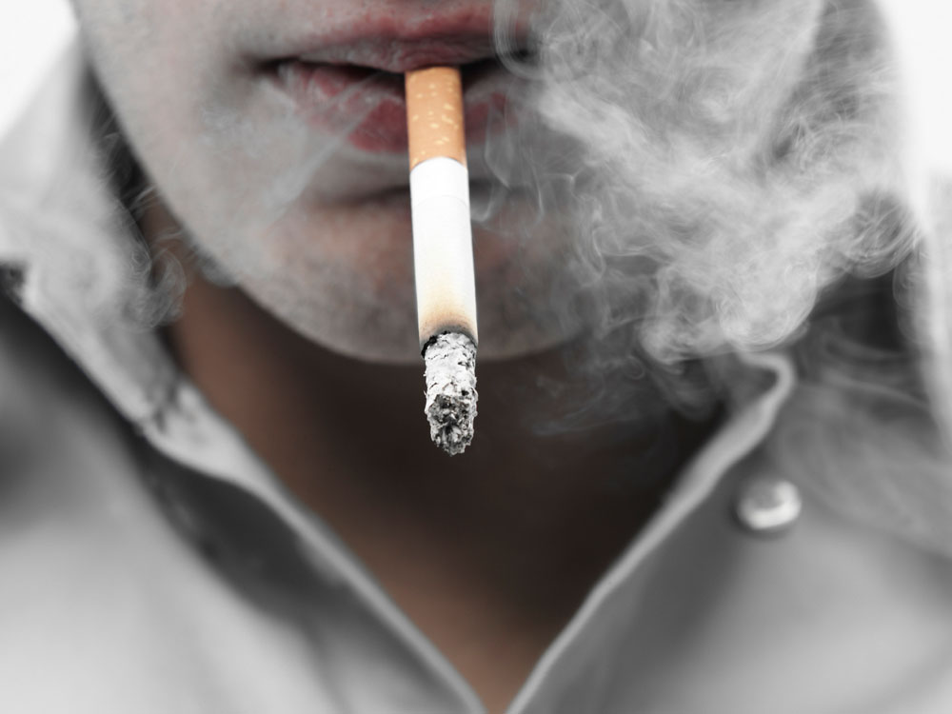

Preoperative Optimization

Slide 4
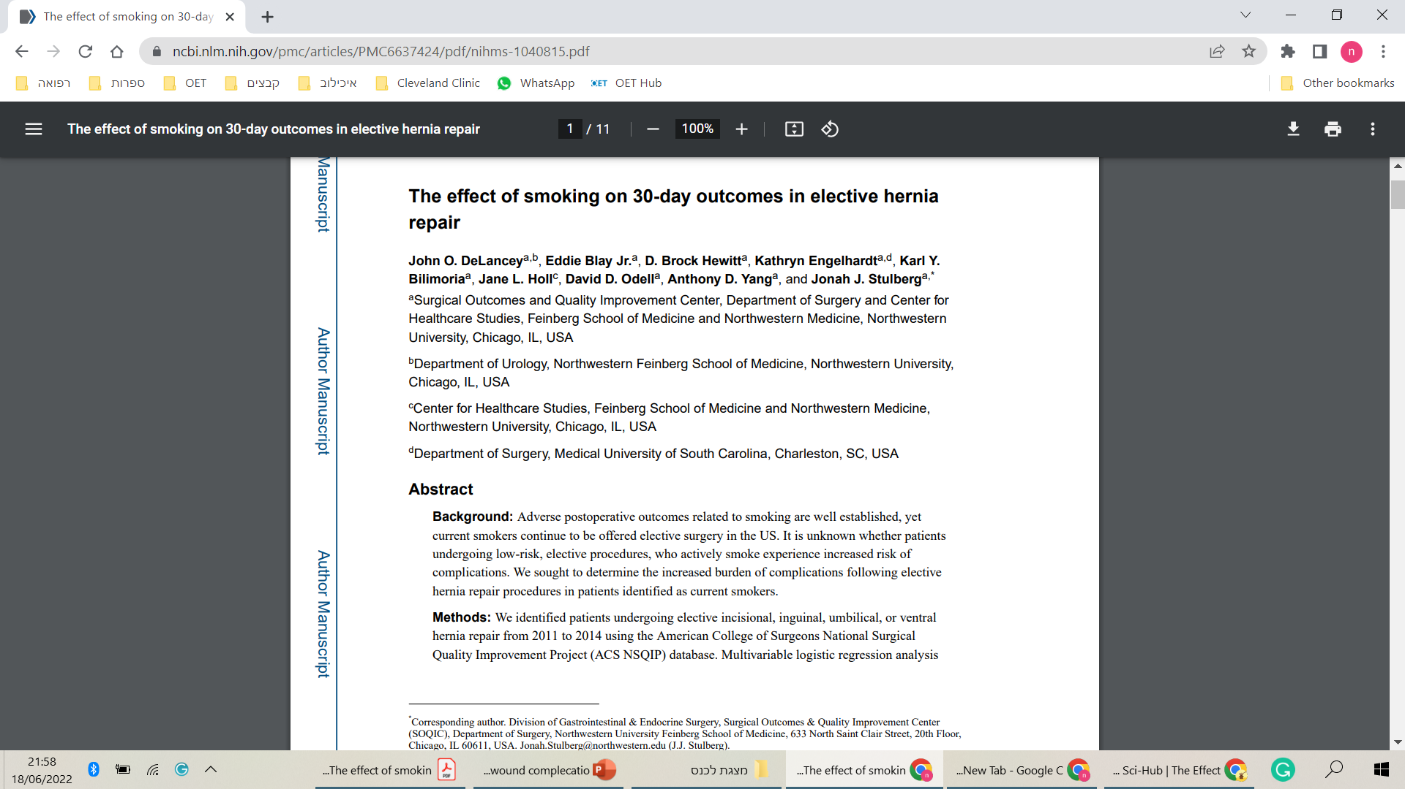
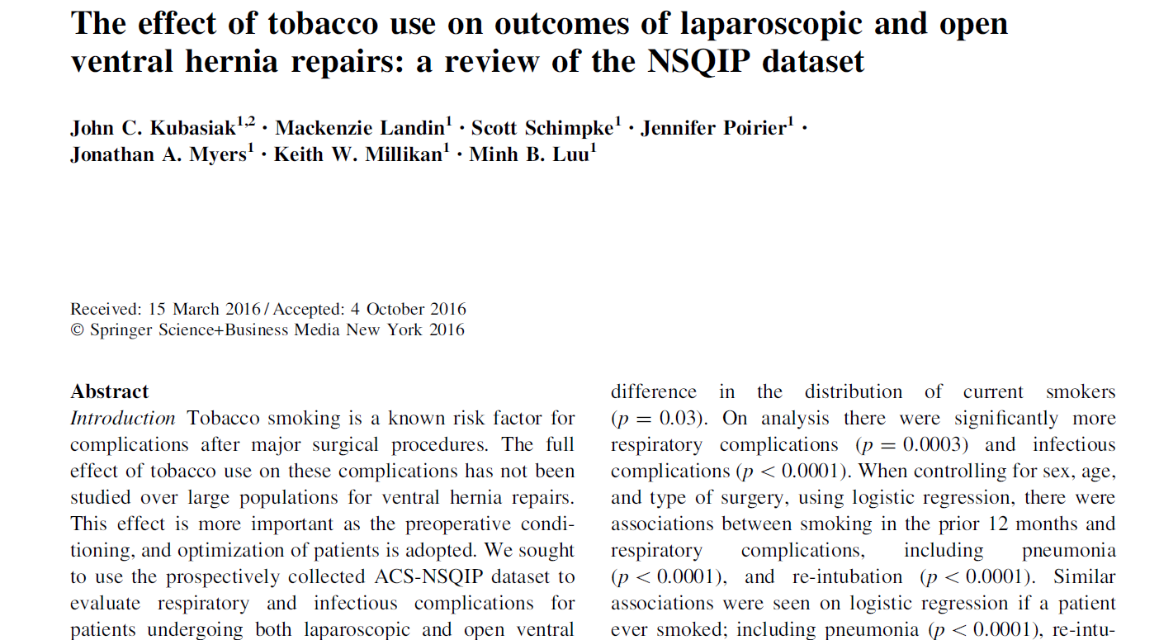
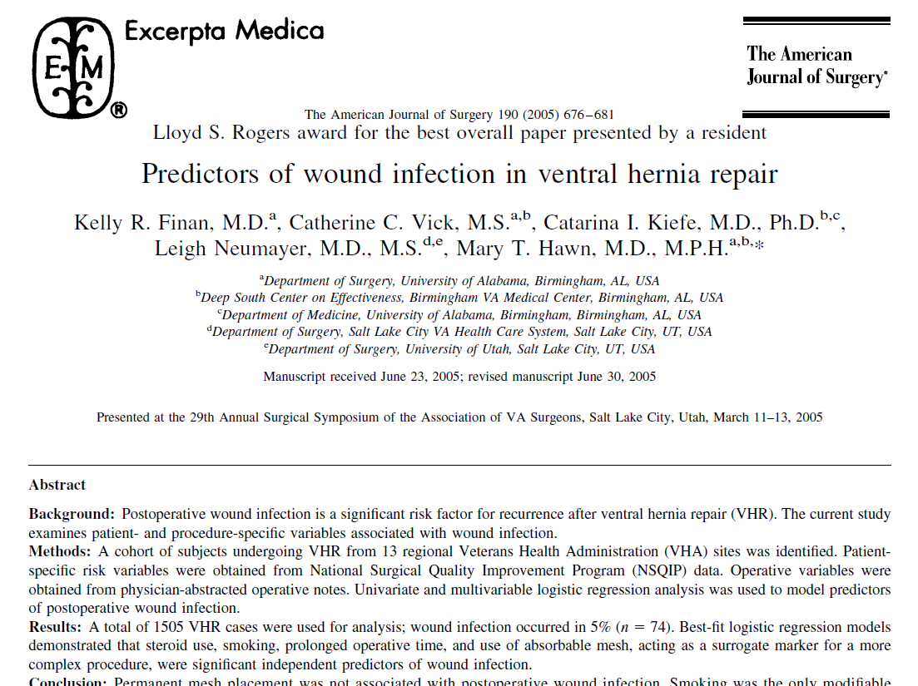

Slide 5
Analyses pitfalls
Heterogeneous populations
  Elective, urgent, clean, contaminated
Heterogeneous surgical methods
  Open, MIS, primary repair, mesh repair, mesh plane, type of mesh
Inconsistent definitions of smokers
Notes:
Young, old, obesity, diabetes
elective, urgent, clean, dirty, primary, incisional hernia cases

Slide 6
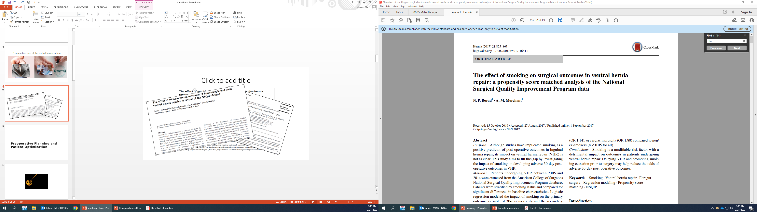
Hernia journal, 2017
30,529 active smokers
30,529 previous or never smokers
Notes:
hernia

Slide 7
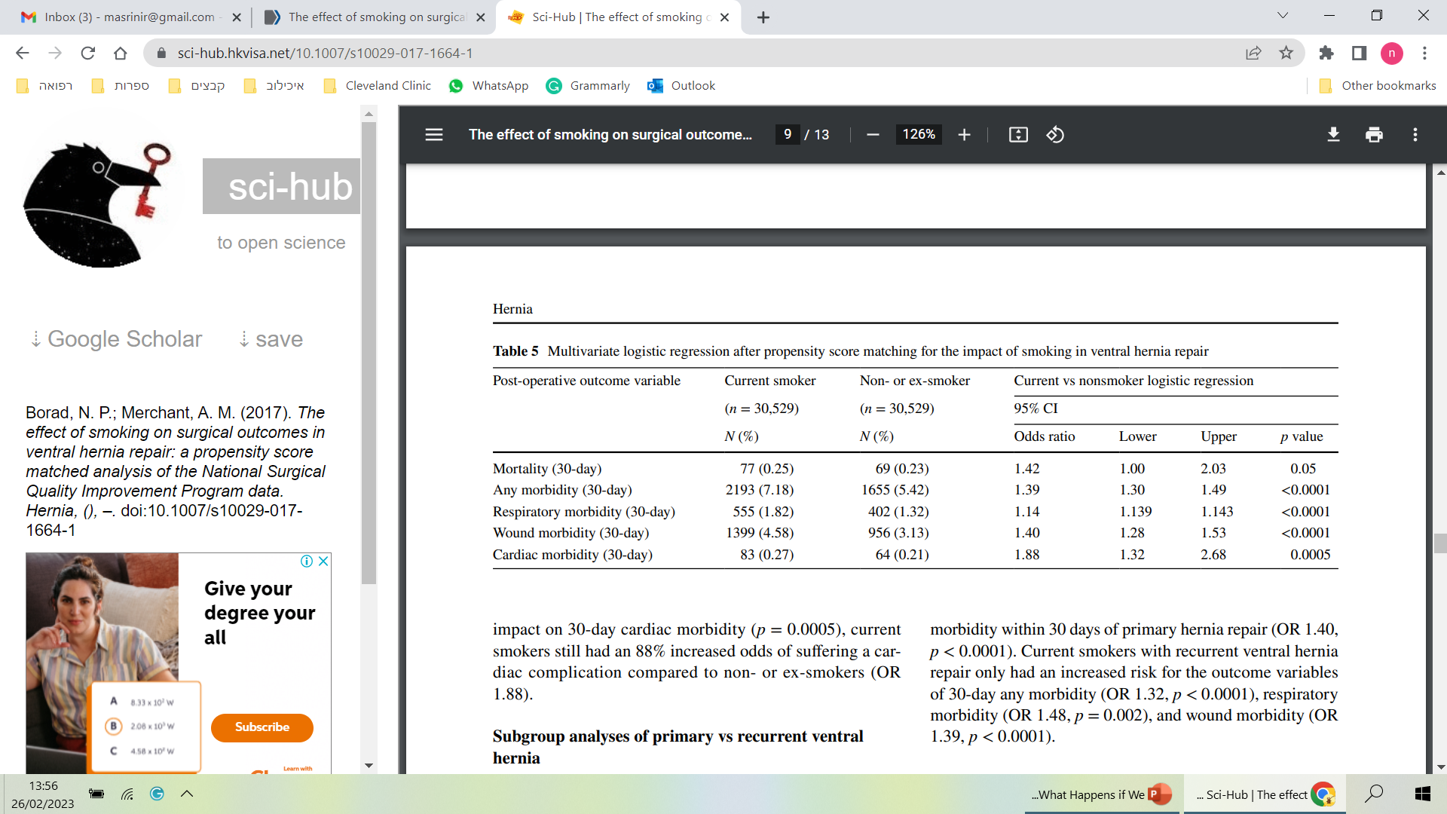

Slide 8
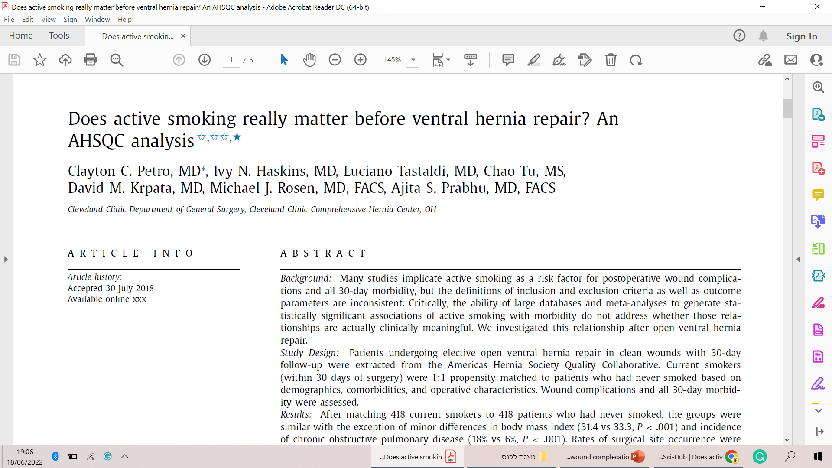
Surgery, 2018
ACHQC database
418 Current smokers
418 Never smokers
Clean, open ventral hernia repair
Mean hernia width - 7.7 cm
Mean hernia length - 12 cm
Transversus abdominis release – 60%
Notes:
surgery

Slide 9
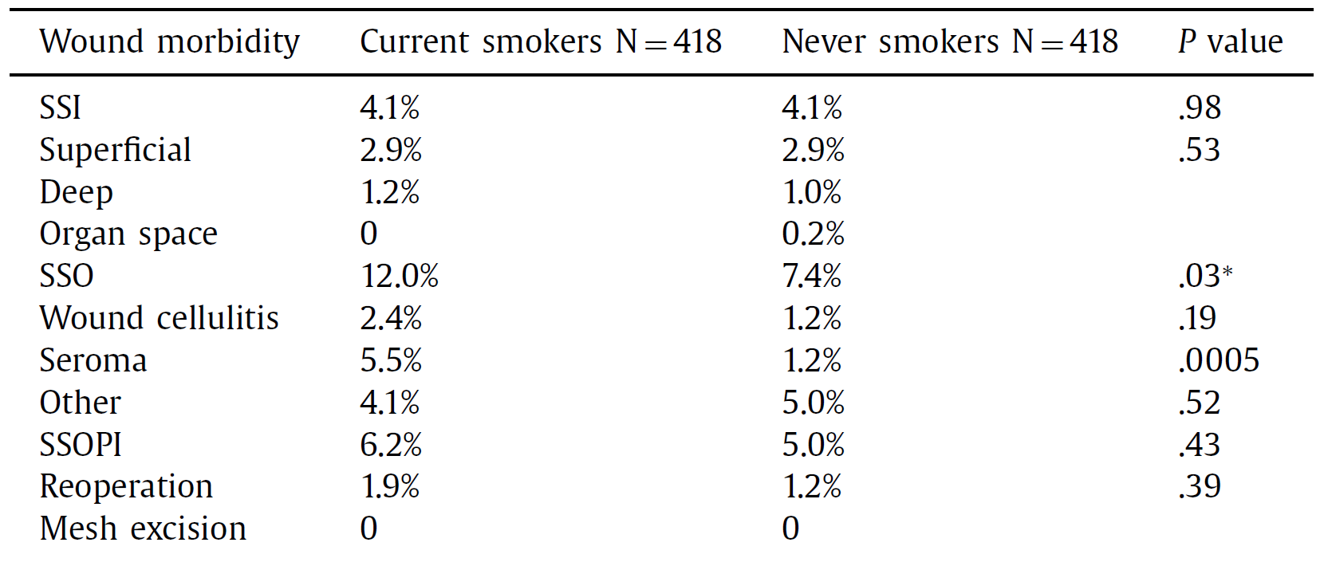
Results

Slide 10
Is preoperative optimization being used as an excuse to deny hernia patient care?

Slide 11

Policy Change
2022 | 2021 | 2020* | 2019 | 2018 | 2017
31 | 33 | 22* | 24 | 16 | 11

Slide 12

ACHQC database, Cleveland Clinic patients
Clean, open ventral hernia repair
106 Current smokers
304 Never smokers

Slide 13
Operative characteristics
Operative characteristics | Petro et al. | New study
 | N = 836 | N = 410
Hernia length | 12cm | 22cm
Hernia width | 7.7cm | 15cm
Transversus abdominis release | 60% | 100%

Slide 14
Wound Morbidity
1:3 propensity matching
Wound morbidity | Never | Current smokers | P-value
 | (N=304) | (N=106)
SSI | (7%) 21 | (12%) 13 | 0.129
Superficial | (52%) 11 | (85%)11 | 0.075
Deep | (38%) 8 | (15%) 2 | 0.251
Organ space | (10%) 2 | (0%) 0 | 0.513
SSI intervention
Oral antibiotics | (76%) 16 | (61%) 8 | 0.451
IV antibiotics | (61%) 13 | (15%) 2 | 0.021
Wound opening | (33%) 7 | (69%) 9 | 0.092
Percutaneous drainage | (28%) 6 | (0%) 0 | 0.062
Partial or complete mesh removal | (0%) 0 | (0%) 0 | NA

Slide 15
Wound Morbidity
1:3 propensity matching
Wound morbidity | Never | Current smokers | P-value
 | (N=304) | (N=106)
SSO | (8%) 25 | (12%) 13 | 0.298
Seroma | (20%) 5 | (61%) 8 | 0.028
Infected seroma | (8%) 2 | (0%) 0 | 0.532
Hematoma | (4%) 1 | (8%) 1 | 1
Infected hematoma | (0%) 0 | (0%) 0 | NA
Wound cellulitis | (33%) 8 | (15%) 2 | 0.44
Enterocutaneous fistula | (0%) 0 | (0%) 0 | NA
SSOPI
Oral antibiotics | (45%) 11 | (15%) 2 | 0.083
IV antibiotics | (20%) 5 | (8%) 1 | 0.394
Wound opening | (16%) 4 | (38%) 5 | 0.229
Percutaneous drainage | (20%) 5 | (0%) 0 | 0.14
Partial or complete mesh removal | (0%) 0 | (0%) 0 | NA

Slide 16
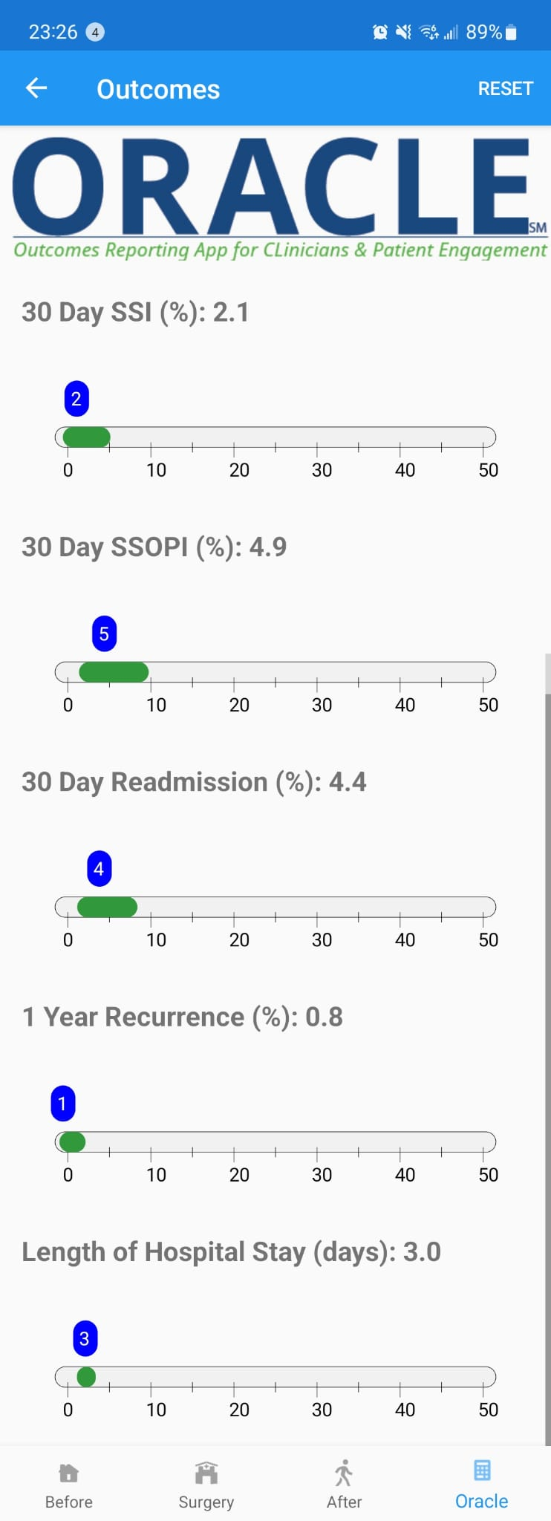
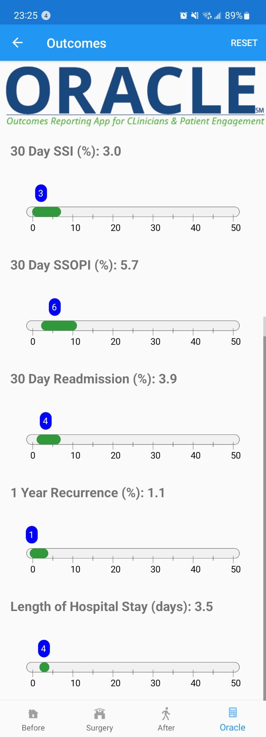


ORACLE
Outcomes Reporting App for Clinicians Patients Engagement
Non-Smoker
Smoker
Notes:
A.I artificial intelligence

Slide 17
Conclusions
Smoking cessation is clearly good!
Deny patients' care due to a potential risk of wound morbidity is overestimated.

Slide 18
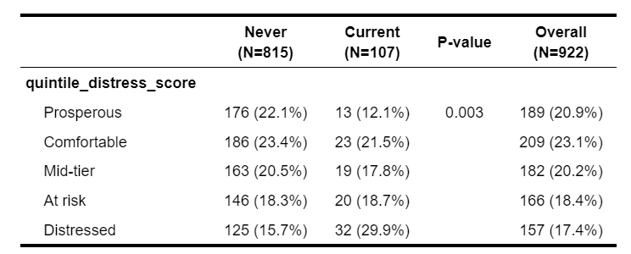
Conclusions
The unintended consequences of disparities and care should be considered.

Slide 19

Thank You

