Slide 1



Robotic IPOM vs eTEP for Ventral Hernia Repair - an ACHQC-embedded multicenter randomized controlled trial
Research Team:
Katie Montelione, MD MS
Sam Zolin, MD
Kayla Diaz, MCR CCRP
Kristen McKenzie, BSN RN
Lelanie Wilber, LPN
Tamela Fonseca, MSN, RN, CCRC, NE-BC
Chao Tu, MS
Molly Olson LaBelle, MS
Clayton Petro, MD
Assistant Professor of Surgery
Lerner College of Medicine
Cleveland Clinic
Enrolling Surgeons:
Clayton Petro, MD
Ajita Prabhu, MD
David Renton, MD
Michael Meara, MD
Jonathan Yunis, MD
Design/Implementation/Analysis:
David Krpata, MD
Lucas Beffa, MD
Ben Poulose, MD
Michael Rosen, MD

Slide 2
Disclosures
Study Funding:
AHS Research Grant
SAGES Robotic Research Grant
Cleveland Clinic Digestive Disease and Surgery Institute Internal Research Grant
Clayton Petro – Additional grant from Cent Surg Assoc.
David Renton – None
Michael Meara – Intuitive Surgical
Ajita Prabhu –
Intuitive Surgical - speaking fees and research grant paid to institution
CMR Surgical - consulting
Verb Surgical – consulting

Slide 3
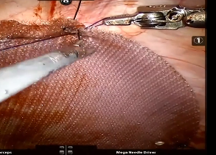
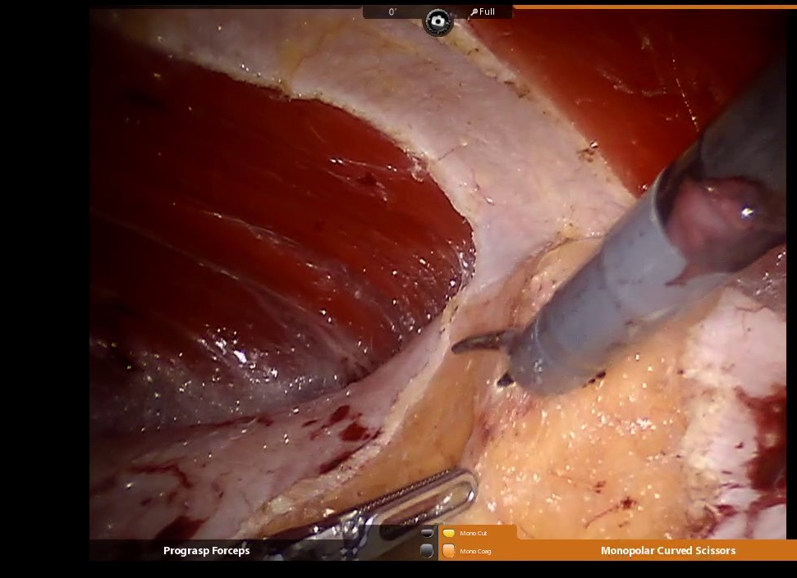
Small/Medium
Ventral Hernias
Robotic IPOM
Less technically challenging
Intraperitoneal mesh
>$
Notoriously painful
Robotic eTEP
More technically challenging
Extraperitoneal mesh
<$
Theoretically less painful
Notes:
The important thing to remember when designing these types of trials is that when you talk about value – things like time, money, and learning curve are all things that are reasonable to overcome IF there’s a clear benefit to the patient. And of course I think there’s definitely a sect of hernia surgeons who just believe that mesh should be in the retromuscular plane due to the long-term complications associated with intraperitoneal mesh. But those are ultimately rare long-term effects that aren’t really realistic primary endpoints for an RCT so we decided that we should investigate the early benefit of postoperative pain

Slide 4
Hypothesis
Ventral hernia repair utilizing robotic eTEP offers less early postoperative pain than robotic IPOM.

Slide 5
Specific Aims
Evaluate the relationship of robotic IPOM and eTEP to:
Early postoperative pain
Length of stay/Same Day Discharge
Opioid consumption
30-day outcomes/PROs
Surgeon perceived workload
Cost

Slide 6
METHODS

Slide 7
Inclusion/Exclusion Criteria
Inclusion
>18yo
Midline ventral hernia <7cm wide
Non-emergent
Either technique technically feasible
Exclusion
Previous retromuscular mesh repair
>7cm wide

Slide 8
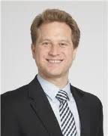



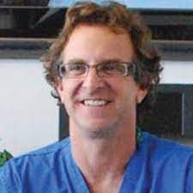
Technique
Robotic IPOM
Fascial closure - #1 Stratafix Symmetric
>4cm mesh overlap
Barrier coated PP
Mesh secured –3-0 self-locking absorbable suture
Robotic eTEP
Optical RM entry
Docking orientation and dissection - surgeon discretion
Fascial closure - #1 Stratafix Symmetric
Posterior sheath closure with 2-0 or 3-0 absorbable suture
MW polypropylene, no fixation
Notes:
Enrolling surgeons had been trained in both techniques and had incorporated each into their practice.
Patients randomized to robotic IPOM or eTEP using a computer-generated allocation table with a 1:1 concealment

Slide 9
Outcome Variables
 | Baseline | POD#0 | POD#1 | POD#7 | POD#30 | 1-year
NRS-11 | x | x | x | x | x | x
Promis 3a SF | x |  |  |  | x | x
HerQLes | x |  |  |  | x | x
Opioid Consumption | x |  |  |  | x | x
Hernia Recurrence Inv |  |  |  |  |  | x
Primary Outcome – 30% difference (4.8 – 3.3) in NRS-11 on POD#1
α=0.05, β=80%, 64 Patient (32/arm)
+36 to account for conversions and lost follow-up = 100
30-Day Outcomes
LOS, SSO, SSI, SSOPI, Readmission, Reoperation
Surgeon Workload – NASA-TLX
Cost – Total 30-day cost, Disposable/Reusables, OR Time

Slide 10
RESULTS

Slide 11
NOV 2019-NOV 2021
Notes:
Things to point out – Eligible patients were offered robotic repairs but patients didn’t meet inclusion/exclusion criteria or the surgeon didn’t feel either technique could be done. The study did close before 19 consented patients were randomized. 2 patients in each arm were converted to either laparoscopy, robotic-assisted, or open procedures and were treated in an intent to treat fashion. 30-day follow-up was achieved on 100% of patients and all patient data was available for analysis.

Slide 12
Patient Demographics, Comorbidities, Hernia Dimensions
 | Robotic IPOM | Robotic eTEP
N | 49 | 51
Age (median, IQR) | 56.0 (47.7—68.0) | 51.0 (41.7—63.0)
Female % | 45% (25/51) | 49% (22/49)
BMI (median, IQR) | 31.80 (25.57—35.20) | 33.10 (30.72—37.47)
HTN % | 47% (23/49) | 45% (23/51)
DM % | 8% (4/49) | 23% (12/51)
COPD % | 4% (2/49) | 4% (2/41)
Active Smoker % | 12% (6/49) | 4% (2/51)
ASA % I | 2% (1/49) | 4% (2/51)
II | 47% (23/49) | 29% (15/51)
III | 51% (25/49) | 67% (34/51)
Chronic Opioid Use | 6% (1/31) | 6% (2/34)
Other Chronic Substance Abuse | 6% (2/31) | 6% (2/34)
Hernia Width, cm (median, IQR) | 3.50 (2.00—5.00) | 4.00 (3.00—5.00)
Hernia Length, cm (median, IQR) | 4.00 (2.00—8.33) | 5.00 (3.00—10.00)
Notes:
Patient Demographics,Co-morbidities, Hernia Characteristics

Slide 13
Operative Details
 | Robotic IPOM | Robotic eTEP | p
Mesh Width, cm (median, IQR) | 15.0 (12.0—15.0) | 15.0 (15.0—18.8) | <0.001
Mesh Length, cm (median, IQR) | 15.0 (15.0—15.0) | 23.0 (18.0—27.5) | <0.001
Mesh Area, cm² (median, IQR) | 225 (150—225) | 340 (291—450) | <0.001
OR Time (minutes, median, IQR) | 107 [86.0;139] | 165 [129;212] | <0.001
Drains Used | 2% (1/49)* | 16% (8/51) | 0.02
Approach |  |  | 0.26
Per randomization | 47/49 | 49/51
Convert to Laparoscopy | 1 | 0
Convert to Robotic-assisted | 0 | 2
Convert to Open | 1* | 0
TAR | 1* | 3 | 0.33
Bowel Serosal Injury | 1 | 0 | 0.30
Length of Stay, hours (median, IQR) | 11.0 [7.00;25.8] | 11.0 [8.00;27.0] | 0.62
Same Day Discharge % | 59% (29/49) | 71% (36/51) | 0.23
# Opioid Tablets Prescribed (median, IQR) | 18 (10-20) | 20 (15-20) | 0.06
Notes:
IPOM – convert to lap for table drifting, robot convert to open with severe sub-q emphysema with elevated PCO2, 1 open case?
eTEP – 2 convert to robotic-assisted for bleeding and inadequate visualization
1 intra-op bowel injury – only intra-op complication

Slide 14
Patient-Reported Outcomes
 | Robotic IPOM | Robotic eTEP | p
NRS-11
Baseline (median, IQR) | 1.00 [0.00-4.00] | 1.00 [0.00-4.00] | 0.79
POD#0 (median, IQR) | 5.00 [4.00-7.00] | 5.00 [4.00-6.50] | 0.86
POD#1 (median, IQR) | 5.00 [4.00-6.50] | 5.00 [3.50-7.00] | 0.66
 | MV analysis: difference 0.28 [95% CI -0.63 - 1.19] |  | 0.56
POD#7 (median, IQR) | 3.00 [2.50-5.00] | 3.00 [2.00-5.00] | 0.46
POD#30 (median, IQR) | 1.00 [0.00-3.00] | 2.00 [0.00-3.25] | 0.45
PROMIS 3a
Baseline (median, IQR) | 43.5 (30.7—52.1) | 44.9 (30.7—52.3) | 0.97
30-day (median, IQR) | 46.3 (43.5—52.1) | 43.5 (40.2—49.4) | 0.049
HerQLes
Baseline (median, IQR) | 56.7 (34.2—76.1) | 49.2 (31.5—80.3) | 0.80
30-day (median, IQR) | 61.7 (38.1—73.6) | 55.8 (33.3—81.7) | 0.68
Notes:
MV regression adjusted for surgeon, operative time, baseline pain, and patient co-morbidities

Slide 15
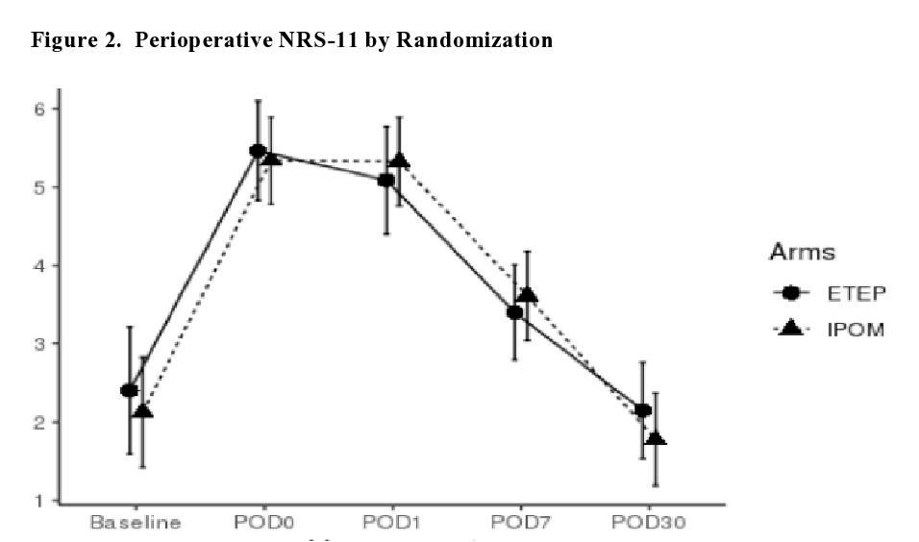

Slide 16
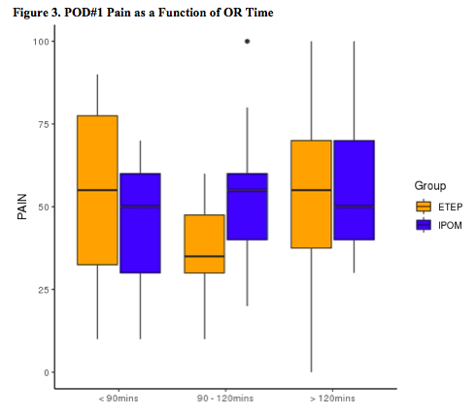

Slide 17
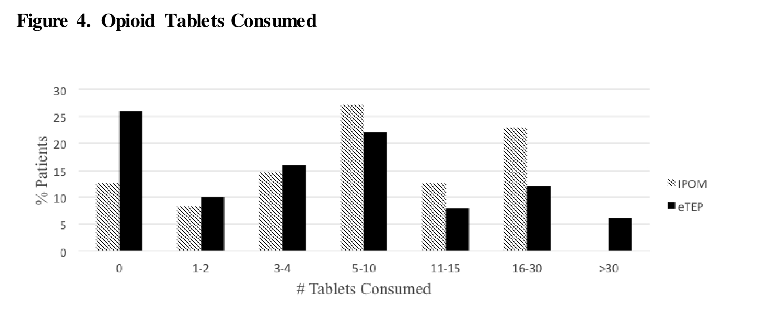
 | Robotic IPOM | Robotic eTEP | p
Chronic Opioid Use | 6% (1/31) | 6% (2/34) | 0.95
Other Chronic Substance Abuse | 6% (2/31) | 6% (2/34) | 0.94
# Opioid Tablets Prescribed (median, IQR) | 18 (10-20) | 20 (15-20) | 0.06
p = 0.27

Slide 18
Complications
 | Robotic IPOM | Robotic eTEP | p
SSO | 0 | 8 | 0.004
Seroma | 0 | 7
Wound Cellulitis | 0 | 1
SSI | 0 | 0 | NA
SSOPI | 0 | 0
Readmission | 2 | 1 | 0.53
Due to pain | 2 | 0
GI Complication | 0 | 1
Reoperation | 0 | 1 | 0.32
Mesh excision | 0 | 1
Notes:
Patient Demographics and Co-morbidities

Slide 19
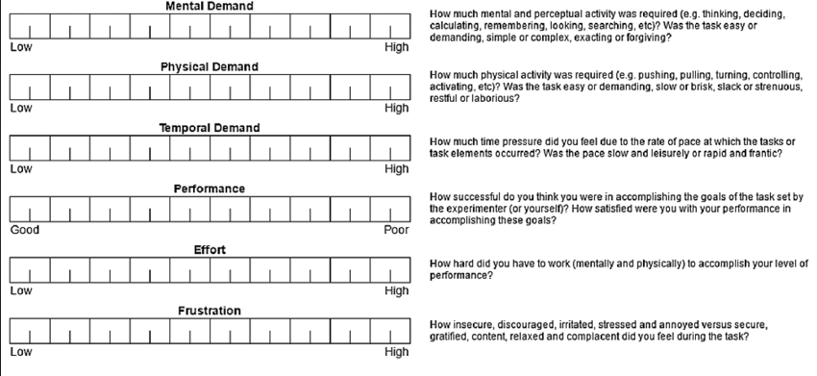
Surgeon Workload – NASA-TLX

Slide 20
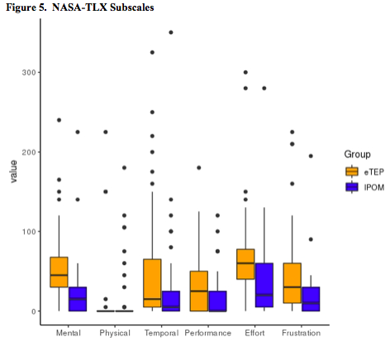
p = | <0.001 | 0.087 | <0.001 | 0.019 | 0.009 | <0.001
Notes:
Mental DemandHow much mental and perceptual activity was required? Was the task easy or demanding, simple or complex?
Physical DemandHow much physical activity was required? Was the task easy or demanding, slack or strenuous?
Temporal DemandHow much time pressure did you feel due to the pace at which the tasks or task elements occurred? Was the pace slow or rapid?
Overall PerformanceHow successful were you in performing the task? How satisfied were you with your performance?
EffortHow hard did you have to work (mentally and physically) to accomplish your level of performance?
Frustration LevelHow irritated, stressed, and annoyed versus content, relaxed, and complacent did you feel during the task?

Slide 21
Cost
 | Robotic IPOM | Robotic eTEP | p
Total Direct Cost – 30-Day (median, IQR) | $8282 [6979-11835] | $8680 [7550-10282] | 0.52
Mesh | $442 [434-485] | $69 [62-76] | <0.0001
OR Time | $669 [579-861] | $1075 [787-1367] | <0.0001
Disposable/Reusables | $3105 [2345-3692] | $3067 [2301-4018] | 0.89
Robotic Equipment | $760 [615-933] | $946 [798-1203] | 0.001

Slide 22
Summary
Robotic IPOM and eTEP have similar postoperative pain profiles.
LOS, same day discharge, opioid consumption, cost and 30-day outcomes appear comparable.
eTEP appears to take longer and increase surgeons’ workload

Slide 23
IPOM
Not sacrificing extraperitoneal planes
Rare complications of intraperitoneal mesh
eTEP
Burning retrorectus plane
Rare complications of achieving extraperitoneal mesh

Slide 24
Selective Use of eTEP
Particularly Useful:
Recurrences after IPOM
Suprapubic and sub-xyphoid defects
Crohn’s patients
Multiple spaced-out small midline hernias
Concomitant inguinal/ventral

Slide 25
Conclusion
Robotic eTEP utilization should be selective and not performed solely for a benefit in postoperative pain.

Slide 26
OR Time vs. Pain

Slide 27
Surgeon Workload

