Slide 1


The Effect Of Tobacco Use On Inguinal Hernia Repair Outcomes
Mazen R. Al-Mansour, MBBS, FACS
Assistant Professor
University of Florida

Slide 2





Disclosures

Slide 3
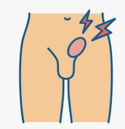


Background
Is tobacco a risk factor?
Does tobacco cessation improve risk?

Slide 4
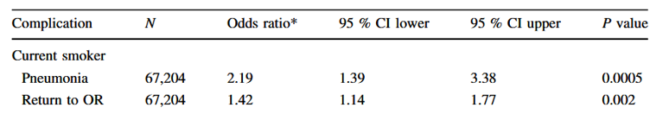

Literature 1/2
versus
Smoking is a modifiable risk factor
Failure to quit smoking is associated with complications
Landin. Surg Enodsc. 2015

Slide 5
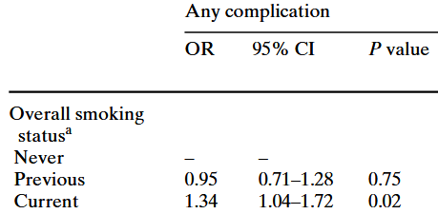
Literature 2/2
versus
Complication rate 3%
Smoking might be a modifiable risk factor
Is this clinically important?
Lindström . Hernia. 2007

Slide 6

Introduction
Association
OBJECTIVE
versus

Slide 7

Methods
Current smoker
(n = 2,239)
Total
(n = 93,851)
Elective inguinals
(n = 19,866)
Former smoker
(n = 4,064)
Excluded
Ventral
No operation
No 30-day follow up
Concomitant procedure
Never smoker
(n = 13,563)

Slide 8

Methods
Overall 30-day complications
Primary Outcome
Wound
Respiratory
Cardiovascular
Mortality
Reoperation
Readmission

Slide 9

Results Patient Characteristics
 |  | Total N=19866 | Current Smokers N=2239 | Former Smokers N=4064 | Never Smokers N=13563
Age, years |  | 62 | 56 | 68 | 61
Male (%) |  | 92 | 94 | 92 | 91
BMI, Kg/m2 |  | 26 | 26 | 26 | 26
ASA (%)
 | 1 | 18 | 10 | 8 | 22
 | 2 | 57 | 59 | 55 | 57
 | 3+ | 25 | 31 | 37 | 21
Comorbidities
 | Diabetes | 7 | 6 | 11 | 6
 | COPD | 3 | 9 | 6 | 1

Slide 10
Results Hernia / Op Character
 |  | Total N=19866 | Current Smokers N=2239 | Former Smokers N=4064 | Never Smokers N=13563
Recurrent (%) |  | 10 | 10 | 10 | 9
Bilateral (%) |  | 23 | 23 | 22 | 23
Approach (%)
 | Open | 35 | 31 | 38 | 35
 | Lap | 35 | 34 | 36 | 34
 | Robo | 30 | 34 | 25 | 30
General anesthesia (%) |  | 87 | 93 | 89 | 86

Slide 11
Results 30-day Outcomes (unadjusted)
% | Total N=19866 | Current Smokers N=2239 | Former Smokers N=4064 | Never Smokers N=13563
Overall complications * | 8 | 9 | 9 | 7
SSI | 0 | 0 | 0 | 0
SSO* | 5 | 6 | 6 | 4
SSOPI | 0 | 0 | 0 | 0
Resp complications | 0 | 0 | 0 | 0
Card complications | 0 | 0 | 0 | 0
*P < 0.05

Slide 12
Results 30-day Outcomes (unadjusted)
 | Total N=19866 | Current Smokers N=2239 | Former Smokers N=4064 | Never Smokers N=13563
Readmission (%) | 1 | 1 | 1 | 1
Reoperation (%) | 0 | 1 | 0 | 0
Mortality (%) | 0 | 0 | 0 | 0
Δ Eura-HS | -10 | -15 | -11 | -10
*P < 0.05

Slide 13
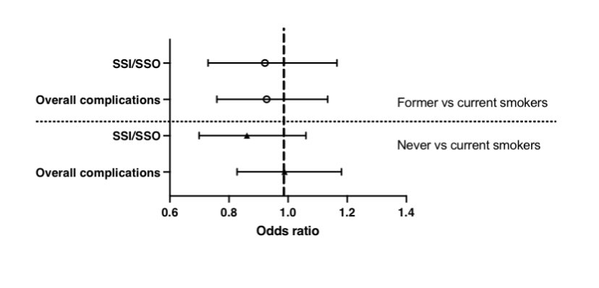
Results 30-day Outcomes (adjusted)

Slide 14

Conclusions
No association smoking & 30-day outcomes in inguinals
Long-term outcomes ?

Slide 15


Why is this important?
ACCESS TO HERNIA CARE

Slide 16

Thank You

