Slide 1
“To Wrap or Not to Wrap”
(Wrap vs. No Wrap: I Can’t Wrap My Head Around It)
Nicole Brie White M.D. FACS
Clinical Associate Professor University of Washington School of Medicine Department of Surgery
3/4/23

Slide 2
No Disclosures

Slide 3
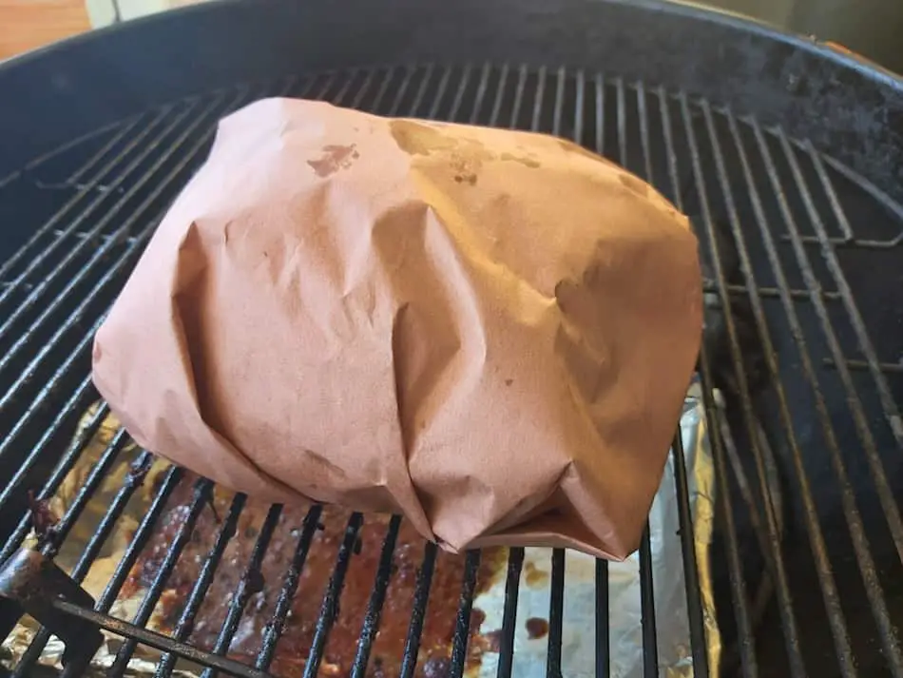
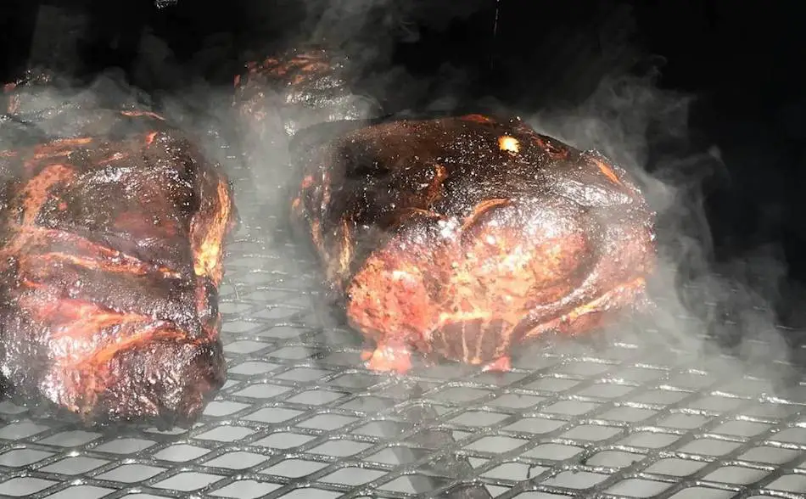

Slide 4
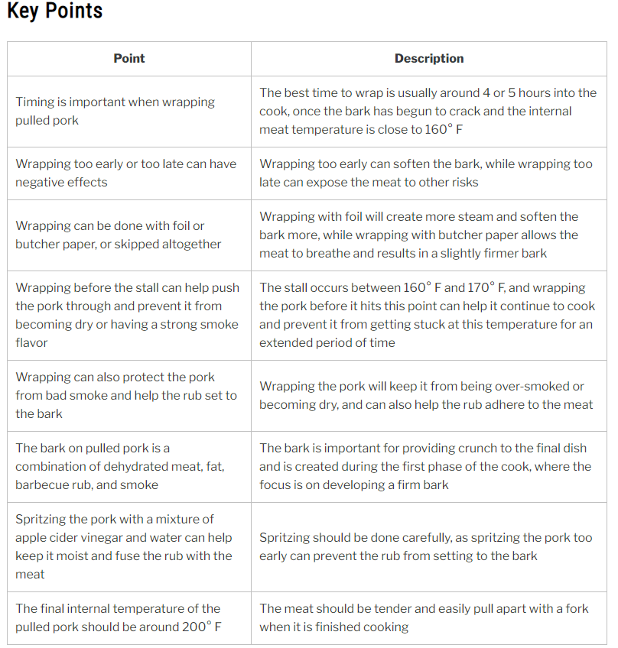
Point | Description
Timing is important when wrapping | The best time to wrap is in a non emergent case. I the patient is stable consideration of wrap is accepted.
Wrapping too “early (tight)” can have negative effects. | Can cause increased Dysphagia and Gas bloat
Wrapping too “late no wrap” can have negative effects. | Exposure to refluxate and end organ damage.
Wrapping can be done with Full Partial or None | Surgeons Choice
Wrapping before can prevent | “Strong reflux symptoms”
Wrapping can protect | “Bad reflux esophagitis”

Slide 5
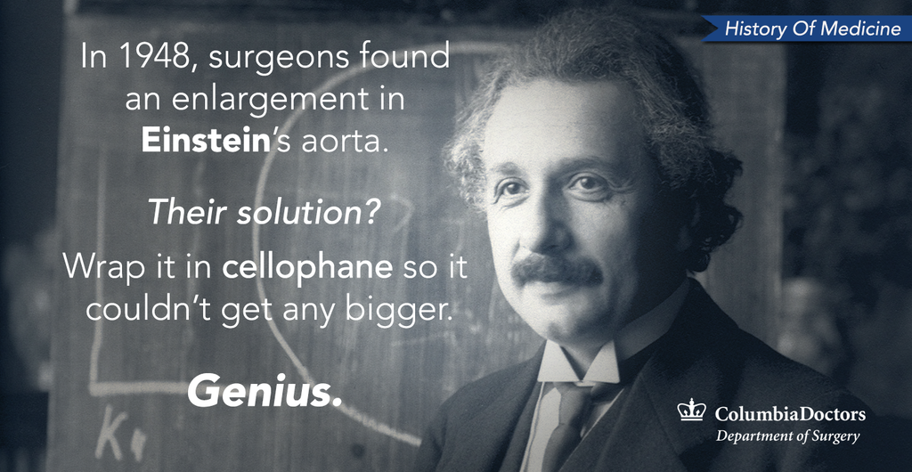

Slide 6
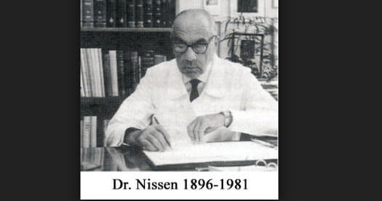

Slide 7
Evolution of Hiatal Hernia Repair
1950’s-60’s
Allison and Barrett- Reduce EGJ intraabdominal
20 years 50 % failed
Nissen- Cardio-Phrenic Angle
Collis- Length
Hill- Gastroesophageal Valve (Phrenoesophageal Ligaments)
Notes:
Who is the highest profile patient Nissen had and what type of wrap did he do?

Slide 8

Reflux Barrier
GEJ Position
Phrenoesophageal Ligaments
LES/HPZ
Gastroesophageal Valve- GEV

Slide 9
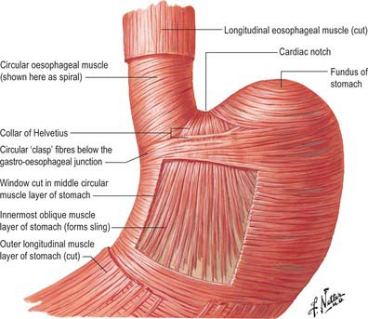
The Gastroesophageal Flap Valve Journal of Clinical Gastroenterology28(3):194-197, April 1999.

Slide 10
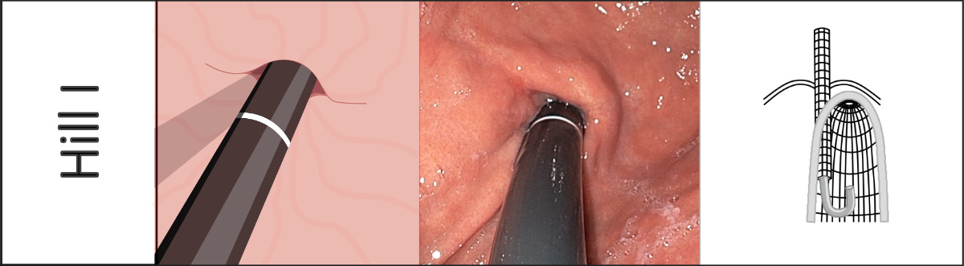
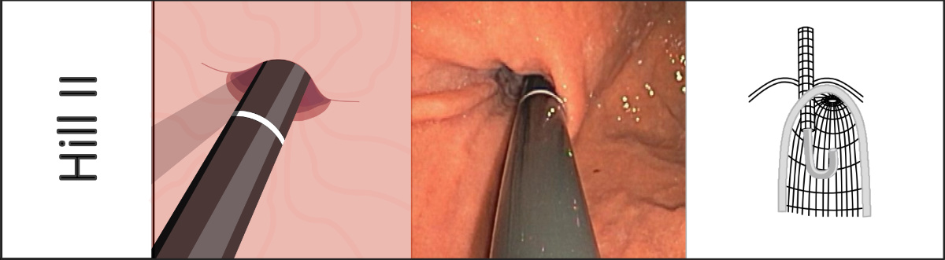
Widder, Anna Widder_A@ukw.de

Slide 11
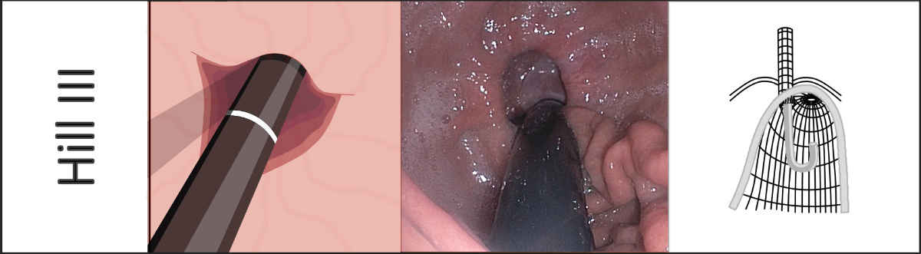
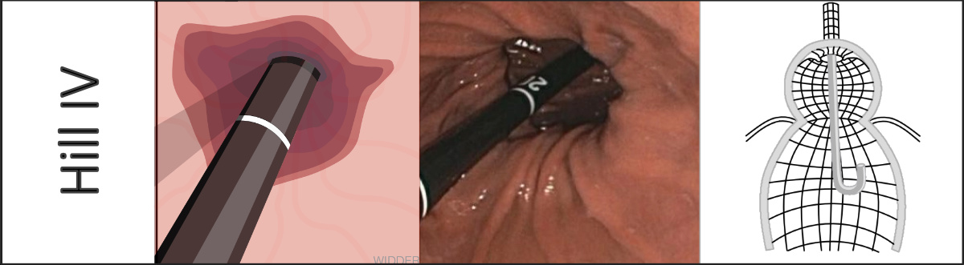

Slide 12
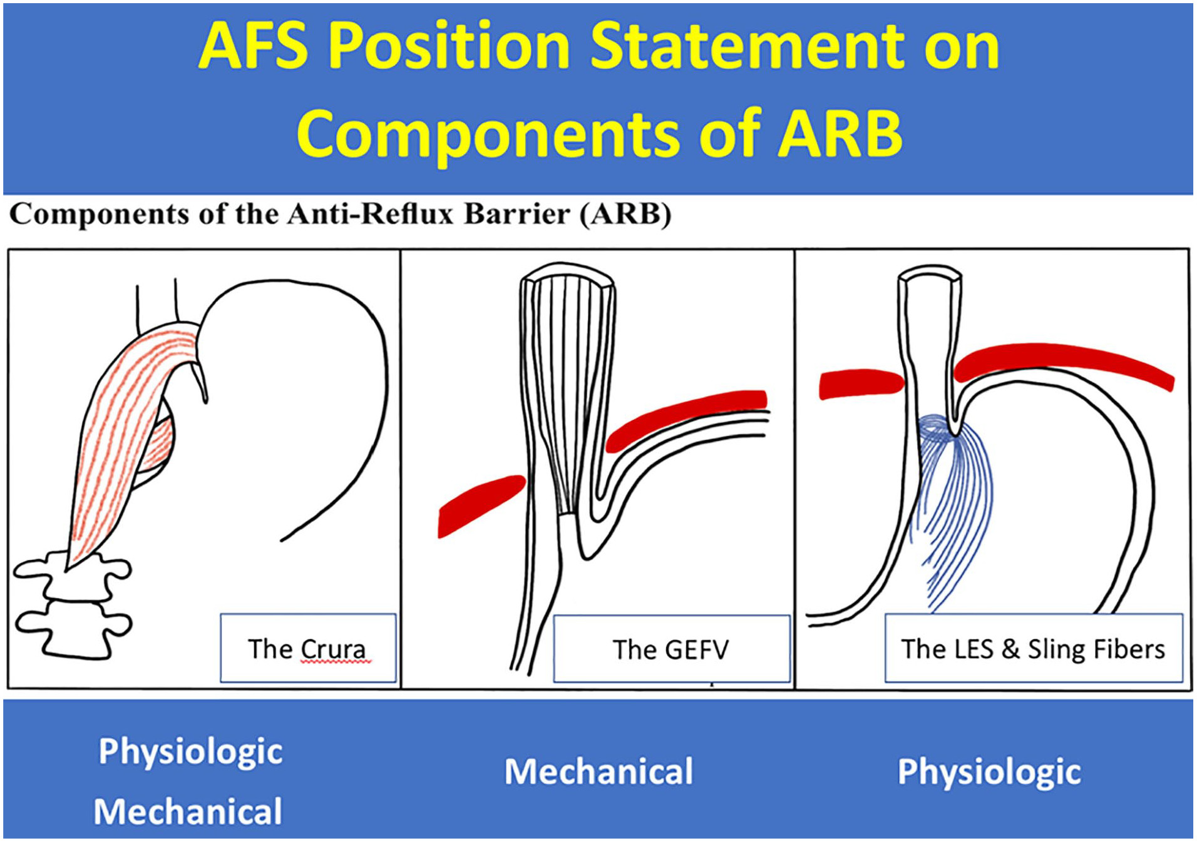
The American Foregut Society White Paper on the Endoscopic Classification of Esophagogastric Junction Integrity
Volume 2, Issue 4 https://doi.org/10.1177/26345161221126961

Slide 13
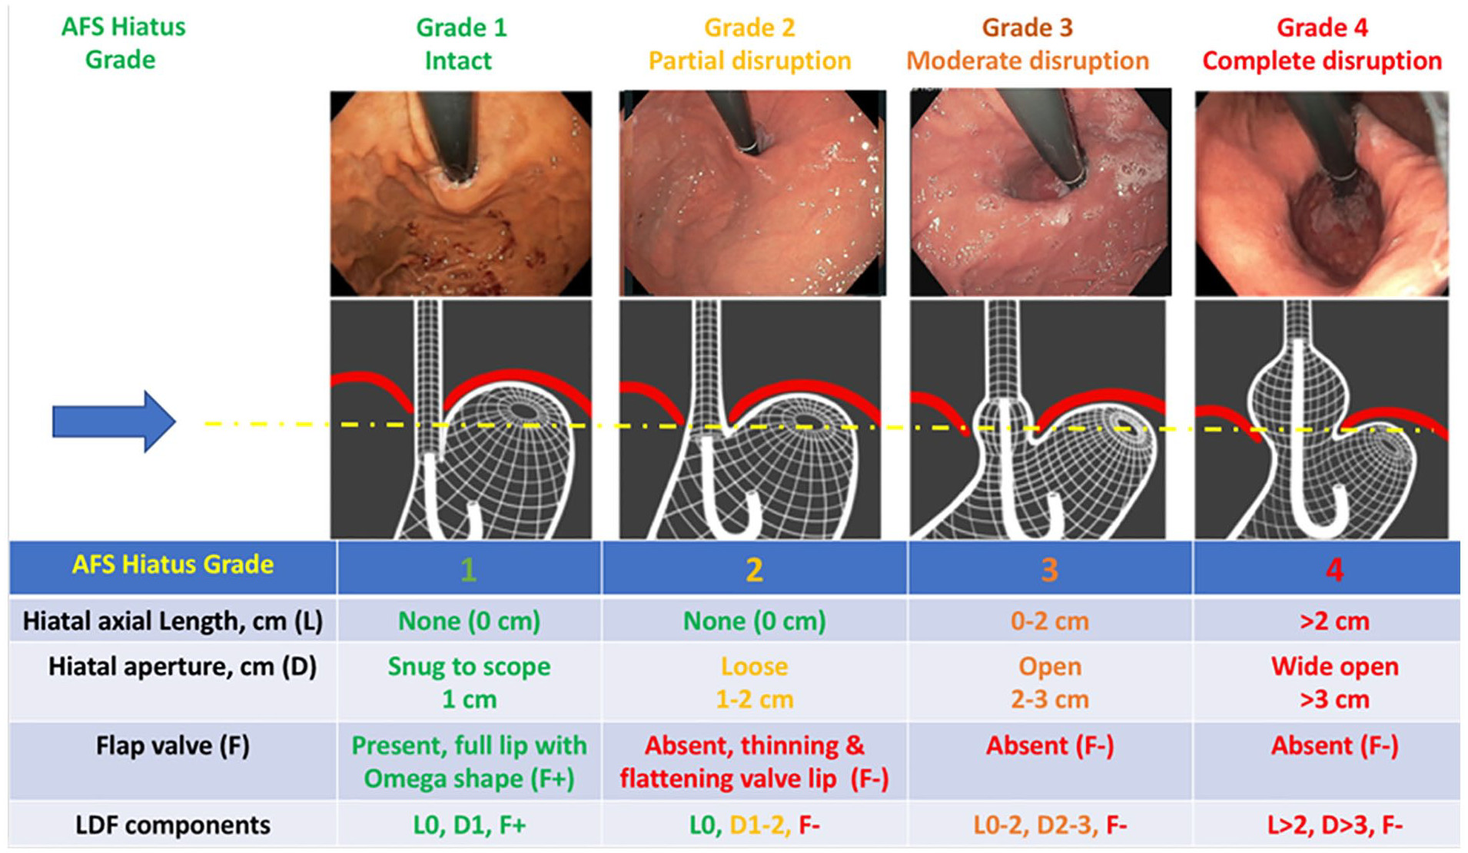
Ninh T. Nguyen, Nirav C. Thosani, Marcia Irene Canto, Kenneth Chang, John Lipham, Barham Abu Dayyeh, Erik B. Wilson, V. Raman Muthusamy, John Clarke, Reginald Bell, Peter Janu, Lee Swanstrom, Ava Runge, Peter J. Kahrilas
Notes:
Length diameter and flap

Slide 14
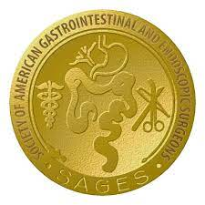
SAGES GUIDELINES- Management of Hiatal Hernias- April 2013
Fundoplication with PEH Repair
++ Weak Evidence

Slide 15
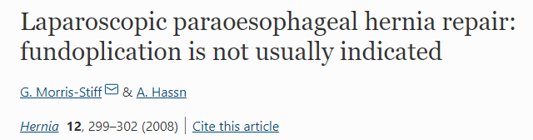
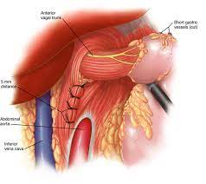
Recommendation
No WRAP
Prospective 23 patients
First 11 PEH-Cruroplasty+Nissen
12 PEH- Cruroplasty only
Dysphagia > with Wrap
No difference in Reflux
Recommendation
NO WRAP

Slide 16
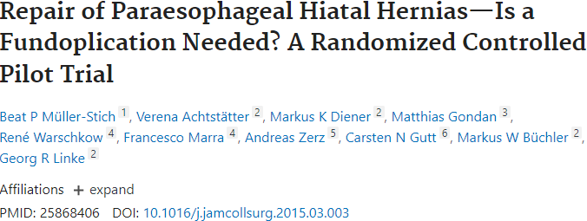
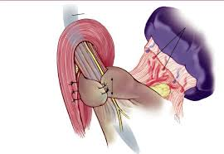
RECOMMENDATION
YES WRAP
RCT
40 patients
Laparoscopic PEH repair-Mesh
Gastropexy vs Floppy Nissen
Gastropexy
3 month > DeMeester score
12 month> Reflux score
Gastropexy 12 month >Esophagitis
Gastropexy =Nissen
Dysphagia, gas bloat and QOL

Slide 17

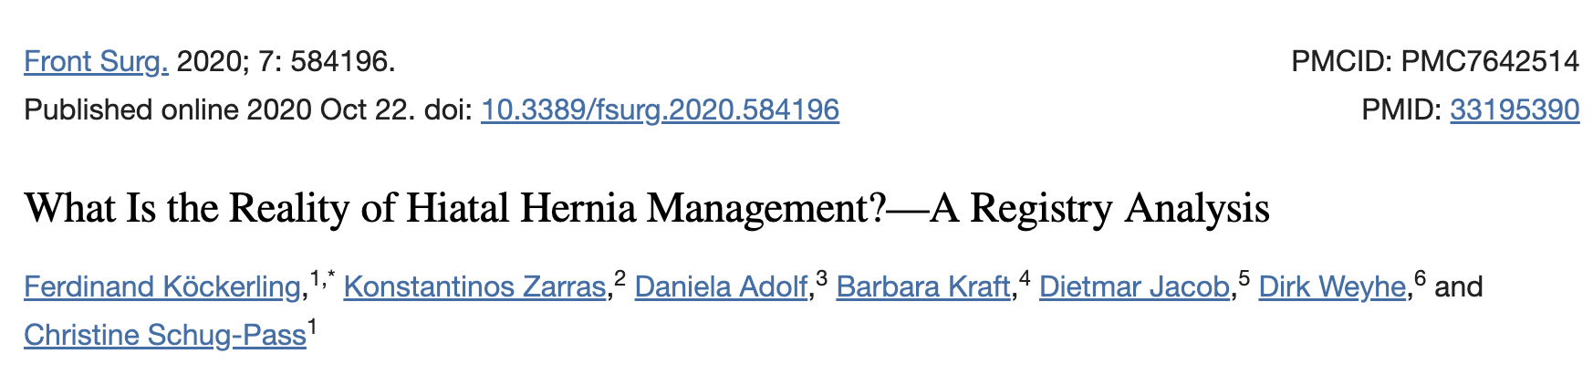
-10-year study in the European Herniamed registry
-17,328 patients elective Hiatal Hernia repair
-Fundoplications decreased from 90% to 74%
Other techniques 20.9%

Slide 18
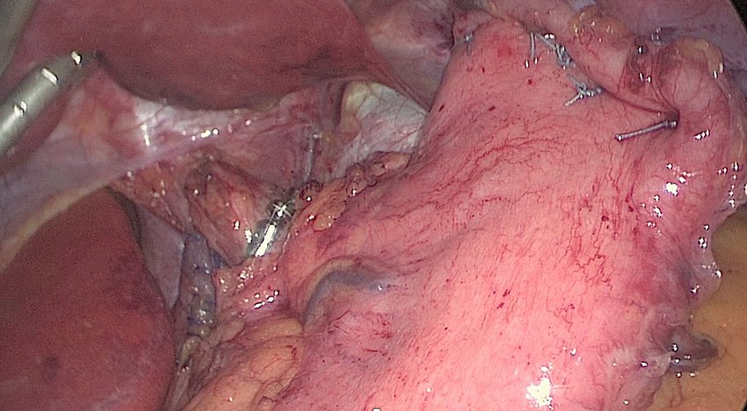
Fundic gastropexy for high risk of recurrence laparoscopic hiatal hernia repair and esophageal sphincter augmentation
(LINX) improves outcomes without altering perioperative course
July 2021
Surgical Endoscopy 35(7)
DOI:10.1007/s00464-020-07789-w

Slide 19
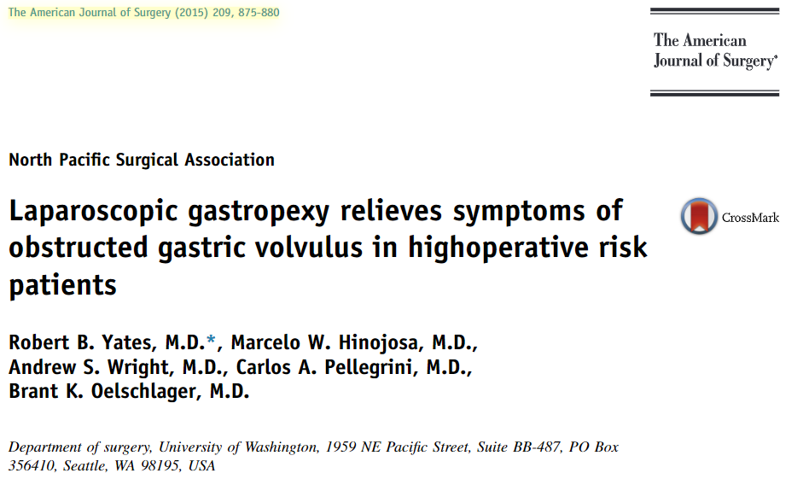
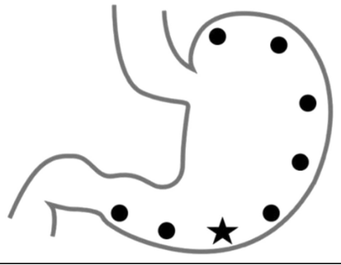
No Cruroplasty
7 Gastropexy sutures
+ or – G- tube
Safe and feasible in select patients
G tube not recommended

Slide 20
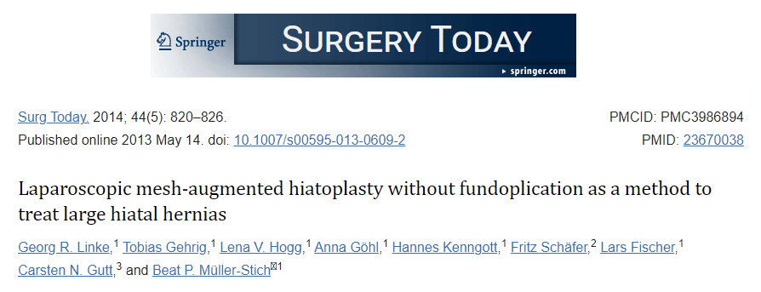
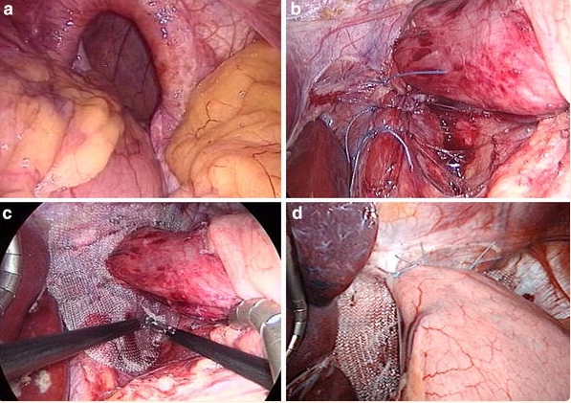
Retrospective
55 pt’s
6-year f/u
Safe and Feasible
4 % Reoperation with Wrap for GERD
2 % Mesh related stenosis

Slide 21
Prevention of Gastroesophageal Reflux Disease is a trade-off
Risk vs benefits
What is the goal

Slide 22
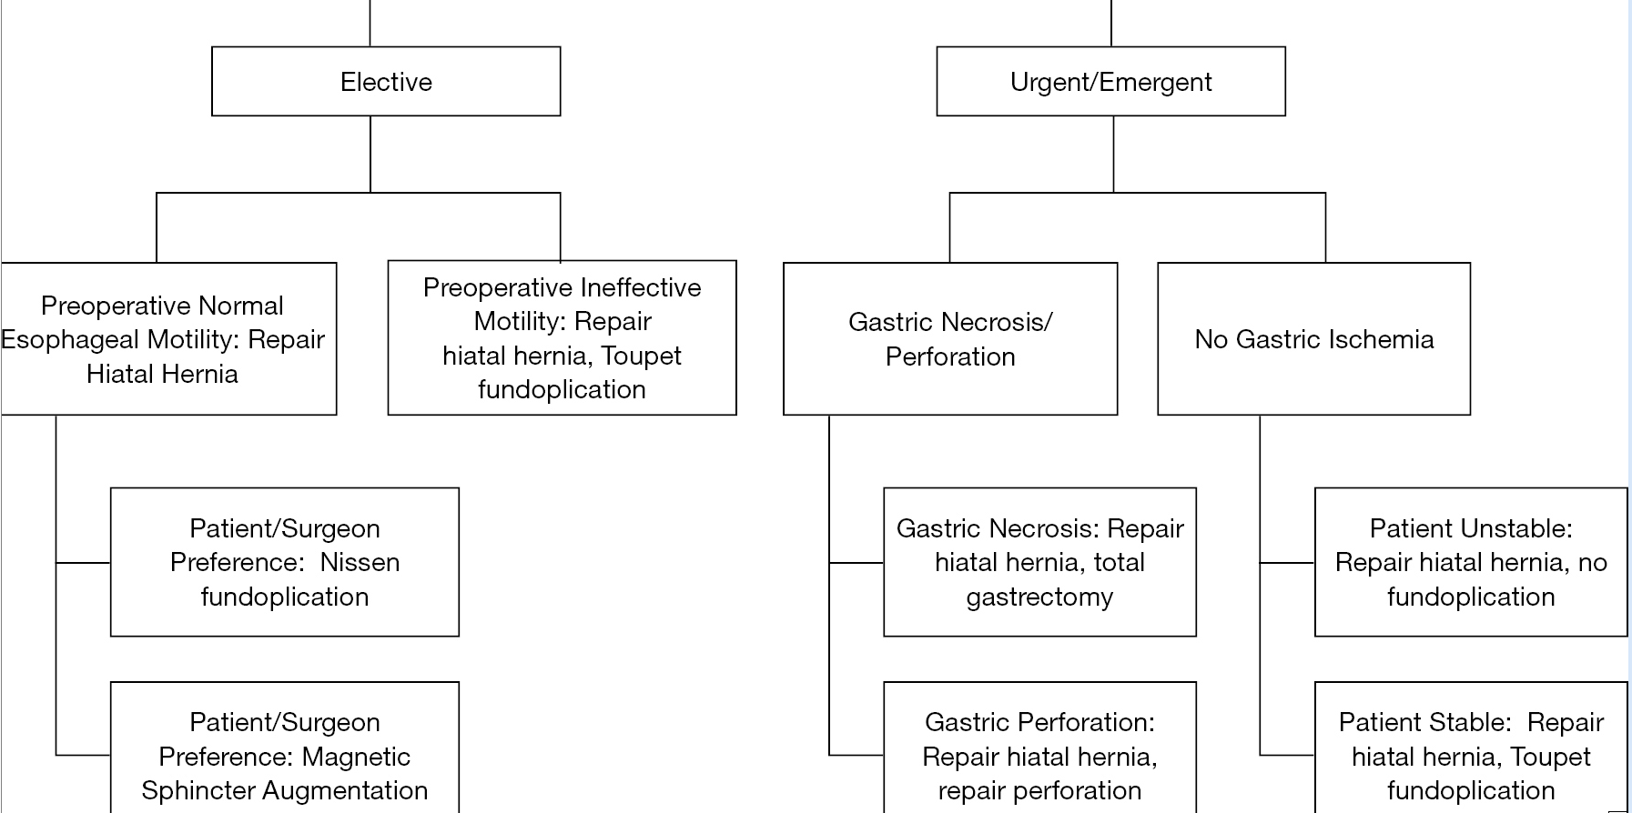

Slide 23
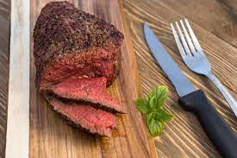
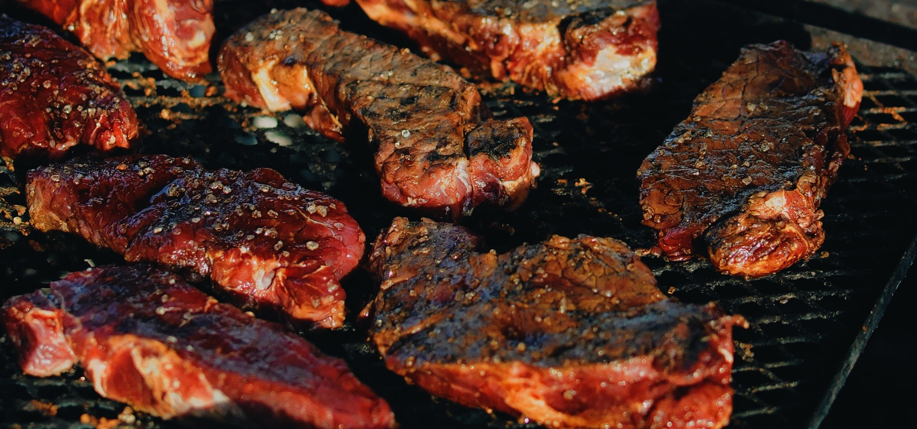
Ultimately, the decision to wrap or not wrap the pork is up to the individual pitmaster “SURGEON” and their preference.
Wrapping Prevents against Over-Smoking and Bad Smoke
“Burned out esophagus”

Slide 24
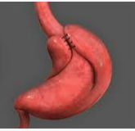
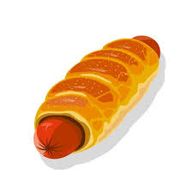
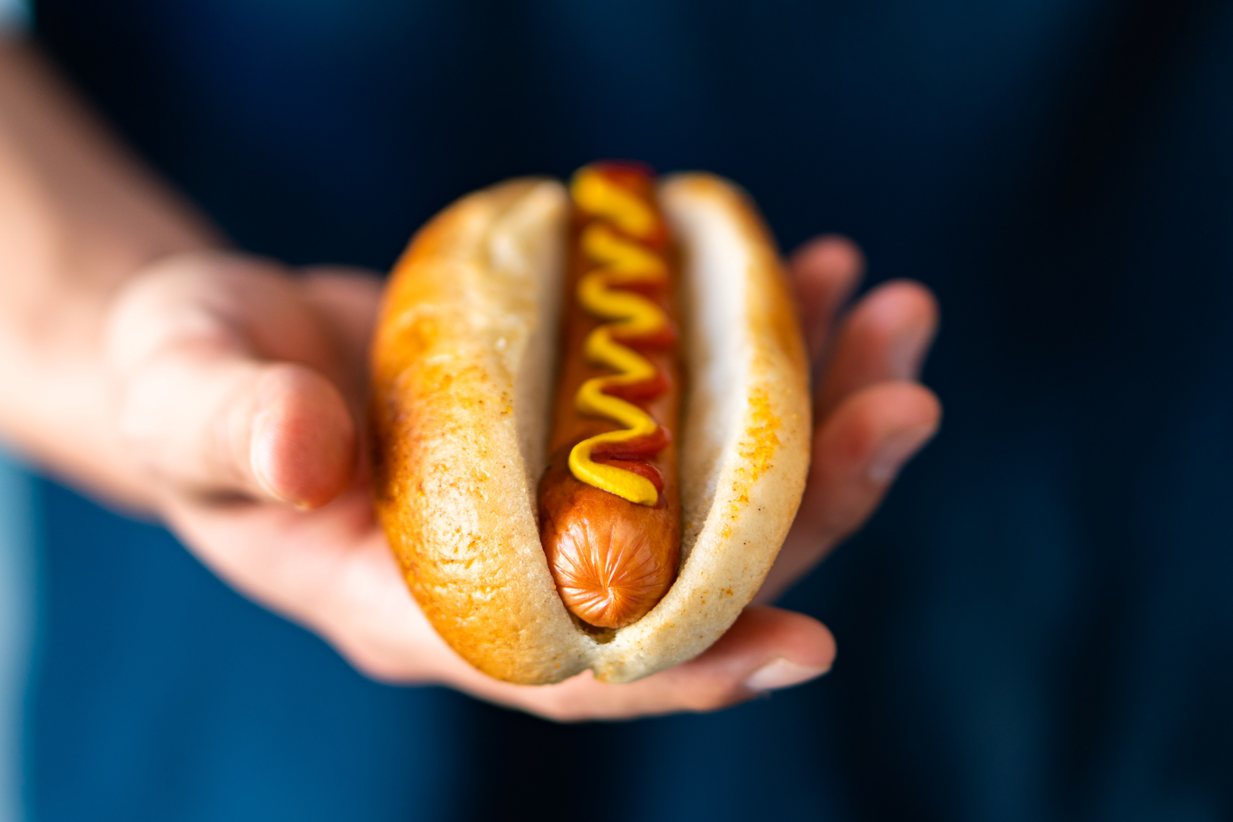
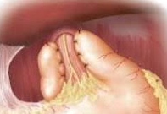
How do you like yours?

